Slide 1
Airbnb Dynamic Pricing Analysis
Minor Project
Submitted By: C Nagadeekshika

Slide 2
The Business Problem
Why This Project?
Imagine you are an Airbnb host.
Questions:
❓ What price should I set?
❓ Which room type earns more?
❓ Which neighborhood generates higher revenue?
❓ How does availability affect bookings?
This project answers these questions using data analytics.

Slide 3
Project Objectives
What We Wanted to Discover?
🎯 Analyze Airbnb pricing patterns
🎯 Compare room types
🎯 Study neighborhood performance
🎯 Understand review behavior
🎯 Build an interactive dashboard

Slide 4
Dataset Overview
About the Dataset
📊 Total Records: 48,895
📊 Total Features: 16
Key Variables:
🏠 Room Type
💰 Price
📍 Neighborhood
⭐ Reviews
📅 Availability

Slide 5
Data Cleaning Journey
RAW DATASET
────────────
Records: 48,895
Missing Values Present
Inconsistent Data
Unclean Structure
↓
DATA CLEANING USING PYTHON
↓
CLEAN DATASET
────────────
Missing Values Checked
Data Types Verified
Ready for Analysis
Power BI Compatible

Slide 6
Key Exploratory Findings
What the Data Revealed?
🏠 Entire homes dominate Airbnb listings
💰 Entire homes have the highest prices
🏡 Shared rooms have the lowest prices
📍 Manhattan listings are generally expensive
⭐ Reviews vary significantly among listings

Slide 7
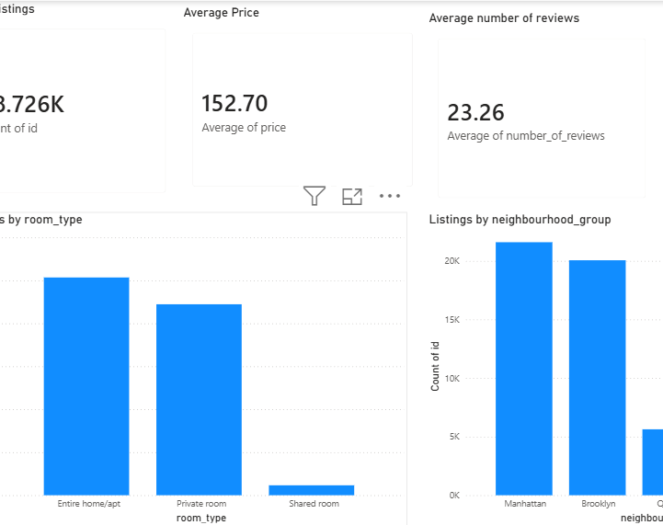
Dashboard 1 – Overview
Airbnb Overview Dashboard
Insights:
Distribution of listings
Price overview
Room type comparison
Neighborhood analysis

Slide 8
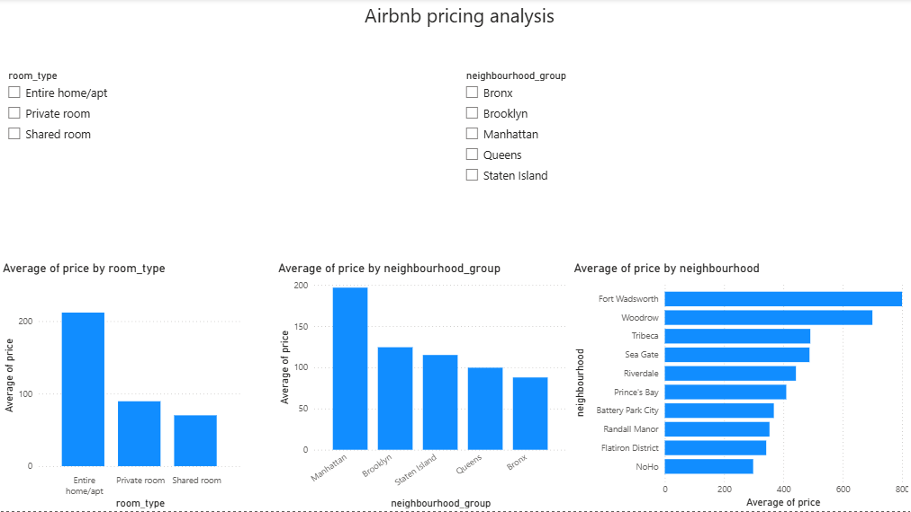
Dashboard 2 – Pricing Analysis
Where Is the Money?
Major Findings:
💰 Manhattan has highest average prices
💰 Entire homes generate premium pricing
💰 Luxury neighborhoods command exceptional prices
💰 Room type strongly influences price

Slide 9
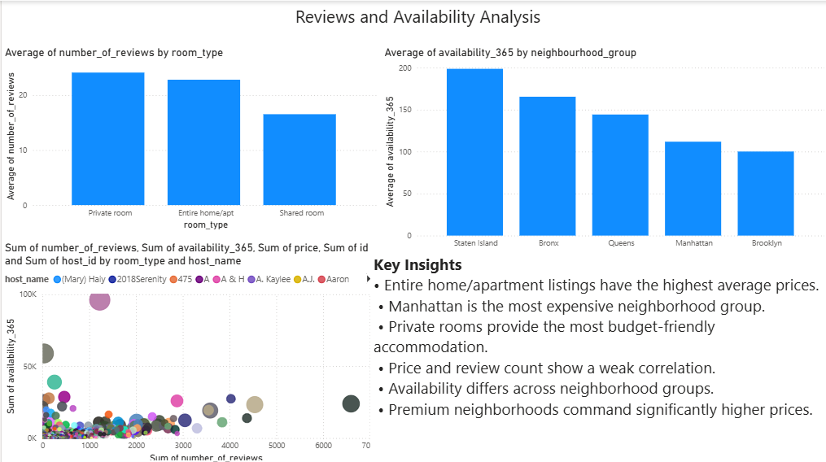
Dashboard 3 – Reviews & Availability
Customer Behavior Insights
Key Observations:
⭐ Review counts vary widely
📅 Availability differs across neighborhoods
🏠 Room type impacts booking patterns
📊 Weak correlation between reviews and price

Slide 10
Final Insights & Conclusion
Top Business Insights
🏆 Entire home/apartment listings earn the highest prices
🏆 Manhattan is the most premium neighborhood group
🏆 Private rooms offer budget-friendly options
🏆 Price is influenced more by location than reviews
🏆 Room type is a major pricing factor
Conclusion
Data analytics helps Airbnb hosts make smarter pricing decisions and understand market trends more effectively.

