Slide 1
DAA Macro Project
Unit IV – Backtracking
N-Queens Problem
State Space Tree using Backtracking (N = 4)
Project 10

Slide 2
Problem Statement
Place N queens on an N × N chessboard so that no two queens attack each other.
No two queens may be in the same row, column, or diagonal.
For this project, N = 4.
Backtracking systematically explores possible placements and abandons invalid branches.
The state-space tree shows the recursive search visually.

Slide 3
Backtracking Algorithm
Start with row 1 and try each column.
Use isSafe() to check column and diagonal conflicts.
If a position is safe, place the queen and move to the next row.
If no position works, return to the previous row and change the previous placement.
When all four rows are filled, the solution is complete.

Slide 4
Pseudocode
NQueens(row)
if row == N:
print solution
return true
for col = 0 to N-1:
if isSafe(row, col):
place queen
if NQueens(row + 1):
return true
remove queen // backtrack
return false

Slide 5
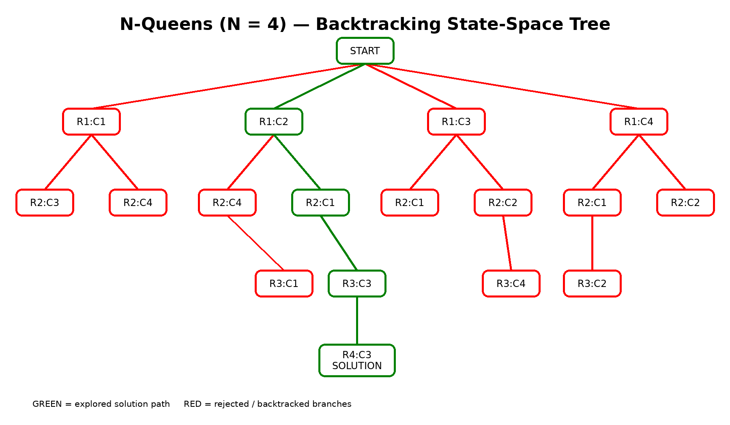
State-Space Tree Visualization

Slide 6
How Backtracking is Shown
Each node represents a queen placement decision.
The tree expands one row at a time.
Red branches represent rejected or dead-end choices.
The algorithm returns to an earlier row when a branch cannot lead to a solution.
The green path highlights a complete solution.

Slide 7
Sample Solution for N = 4
One solution is [1, 3, 0, 2] using zero-based column indexes.
Chessboard representation:
. Q . .
. . . Q
Q . . .
. . Q .
No two queens share a column or diagonal.

Slide 8
Prompt Used for AI Visualization
Visualize the state space tree for the N-Queens problem with N=4 using backtracking.
Show the root and row-by-row queen placements. Mark invalid/rejected branches in red,
show the explored solution path in green, and clearly indicate where backtracking occurs.
Label nodes using row and column positions such as R1:C2. Highlight one complete solution.
Create a clean academic DAA visualization suitable for a project report and presentation.

Slide 9
Complexity and Learning Outcome
Worst-case search is commonly expressed as O(N!) for straightforward backtracking.
The safety check in this implementation takes O(N) per attempted placement.
Backtracking reduces unnecessary exploration by pruning invalid choices.
Learned recursive problem solving and state-space representation.
Learned how AI-generated visualizations can explain algorithm behavior.

Slide 10
Conclusion
The N-Queens problem demonstrates the core idea of backtracking.
A solution is built incrementally while invalid choices are rejected early.
The state-space tree makes recursive exploration and backtracking easy to understand.
This project combines algorithm implementation, visualization, and GitHub documentation.

