Slide 1
Project 13: 0/1 Knapsack using Branch and Bound
DAA Macro Project – Unit V
Java implementation with bounding and pruning

Slide 2
Problem Statement
Capacity = 10
Items: (2,3), (3,4), (4,5), (5,6)
Goal: maximize profit without exceeding capacity

Slide 3
Branch and Bound
Create include/exclude branches.
Calculate an optimistic upper bound at each node.
Prune nodes that cannot improve the current best solution.

Slide 4
Bound Calculation
Use remaining items in decreasing profit/weight ratio.
Take complete items while possible.
Use a fractional part only for the upper bound.

Slide 5
Visualization
The tree displays weight, current profit and bound.
Pruned branches are identified.
The optimal node gives profit 13 with weight 10.

Slide 6
Result and Learning Outcome
Maximum Profit: 13
Selected Items: 1, 2, 4
Learned bounding, pruning and state-space tree exploration.

Slide 7
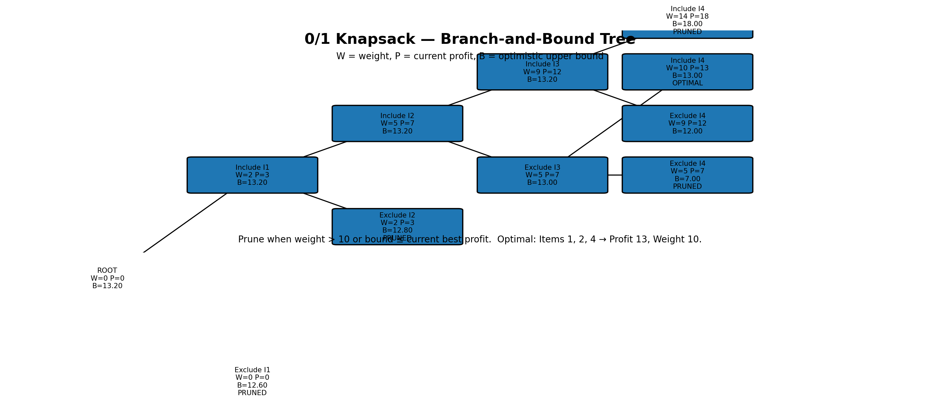
Branch-and-Bound Tree Visualization

