Slide 1
0/1 Knapsack using Dynamic Programming
DAA Macro Project – Unit III, Project 9

Slide 2
Problem Statement
Select a subset of items to maximize total profit.
Each item can be selected at most once.
Knapsack capacity = 10.
The project uses 4 items with given weights and profits.

Slide 3
Input and Objective
Item 1: weight 2, profit 3
Item 2: weight 3, profit 4
Item 3: weight 4, profit 5
Item 4: weight 5, profit 6
Find the maximum profit without exceeding capacity 10.

Slide 4
Dynamic Programming Approach
Create dp[i][w] for the first i items and capacity w.
For each item, choose between including and excluding it.
Store the better result in the DP table.
Trace the final table to identify selected items.

Slide 5
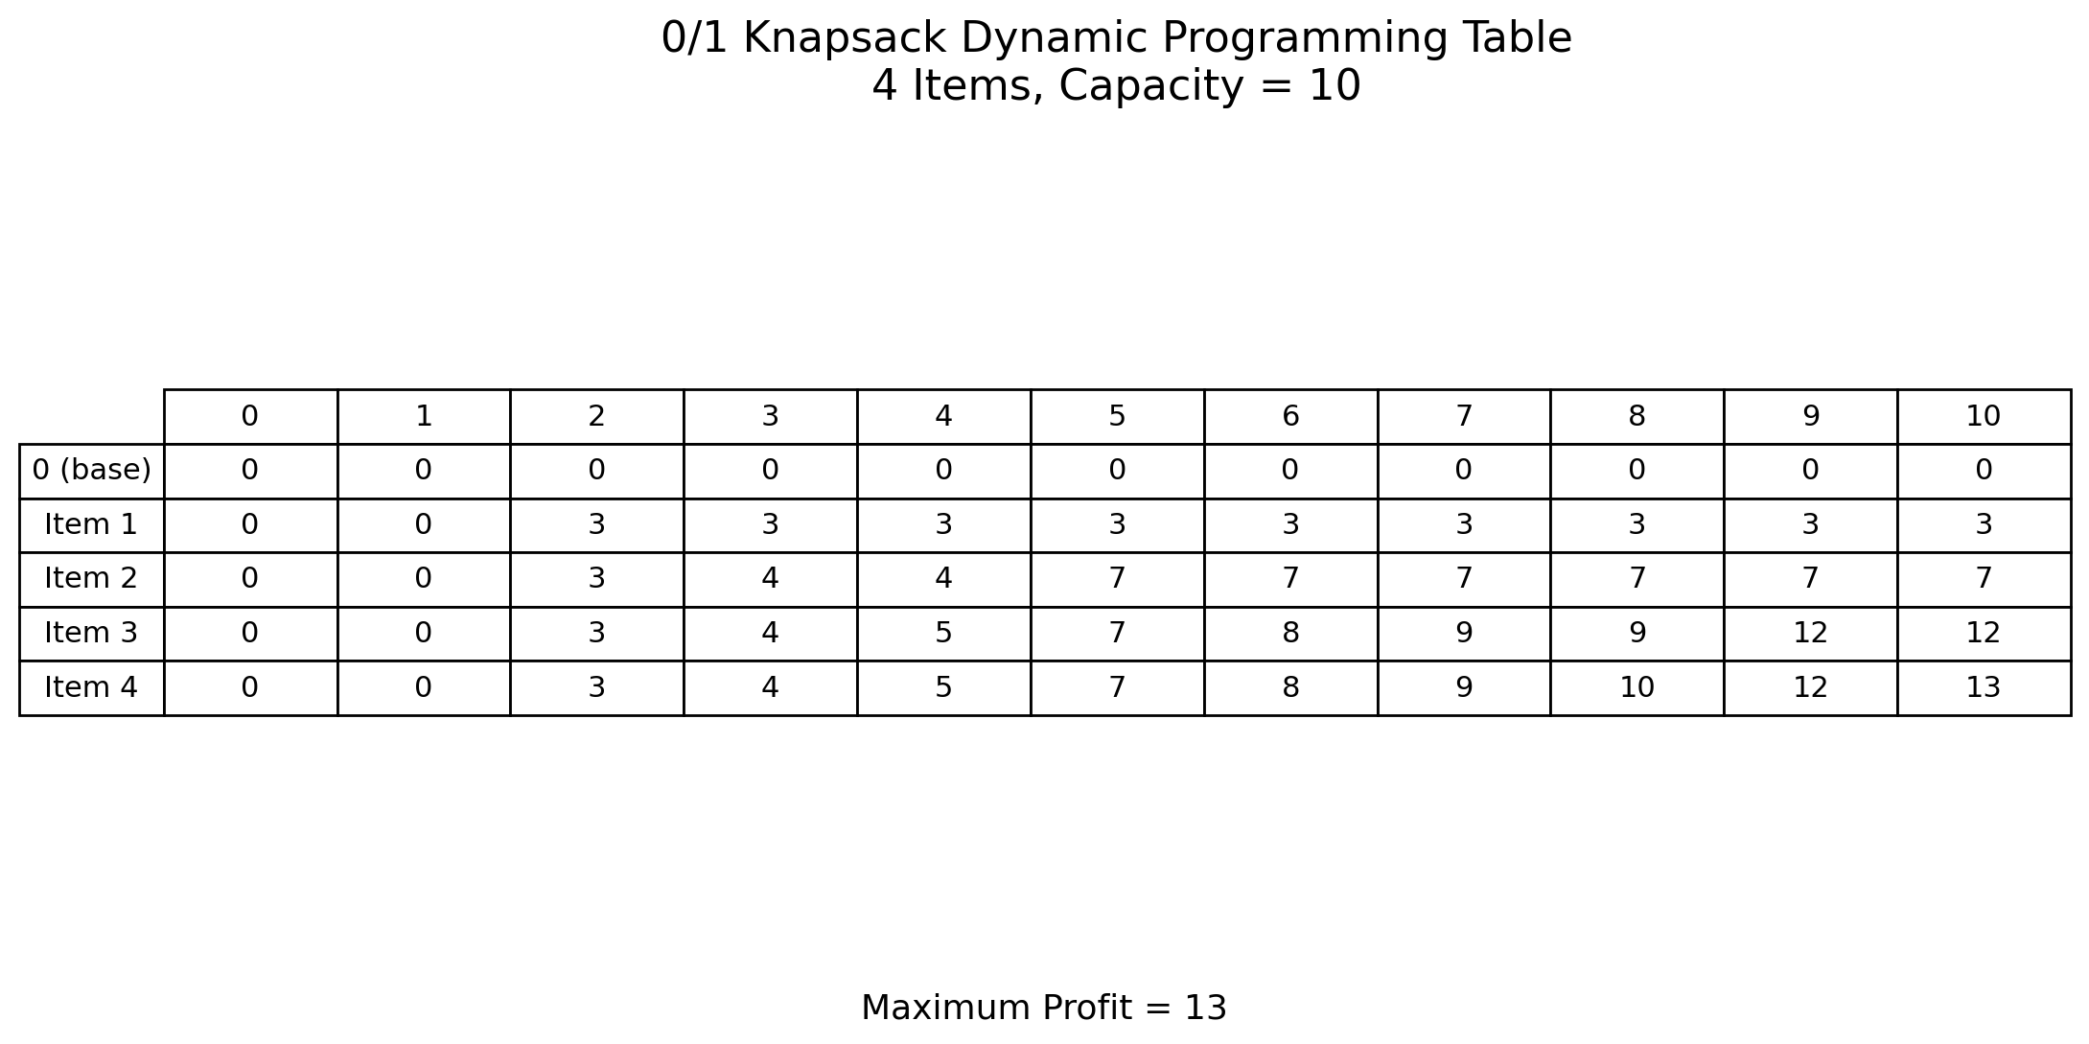
DP Table Visualization

Slide 6
Result and Complexity
Maximum Profit = 13
Selected Items = 1, 2, 4
Total Weight = 10
Time Complexity: O(n × W)
Space Complexity: O(n × W)

Slide 7
Learning Outcome
Understood the 0/1 Knapsack Dynamic Programming technique.
Learned how a DP table represents smaller subproblems.
Understood inclusion/exclusion decisions.
Practiced algorithm documentation and visualization.

