Slide 1
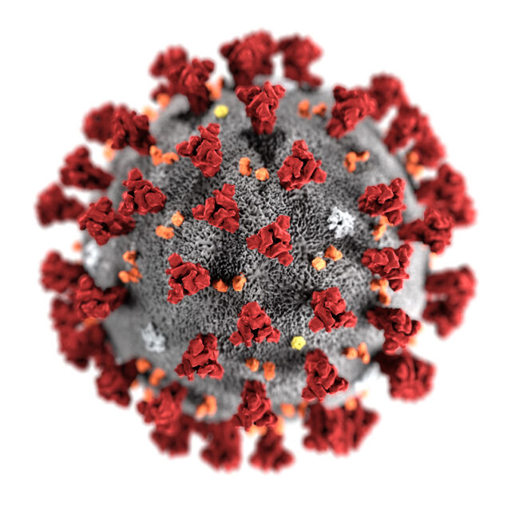
Team Quaranteam
Meet the team members :
Deekshita Verma ( Team Lead & AR/ Unity Developer)
Cheshtha Agarwal ( Web Developer)
Shivangi Goel ( Web Developer)
Aastha Jain (Web Developer)
Shrankhla Srivastava ( ML Developer)

Slide 2


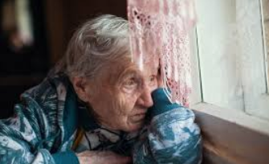
Problem Statement
A common platform to COVID fighters, NGOs and social organizations to collaborate and address the challenges encountered. An entertainment section for the depressed and isolated people to uplift the mood. Additionally, community building is promoted through fun activities and events posted on the platform.

Slide 3
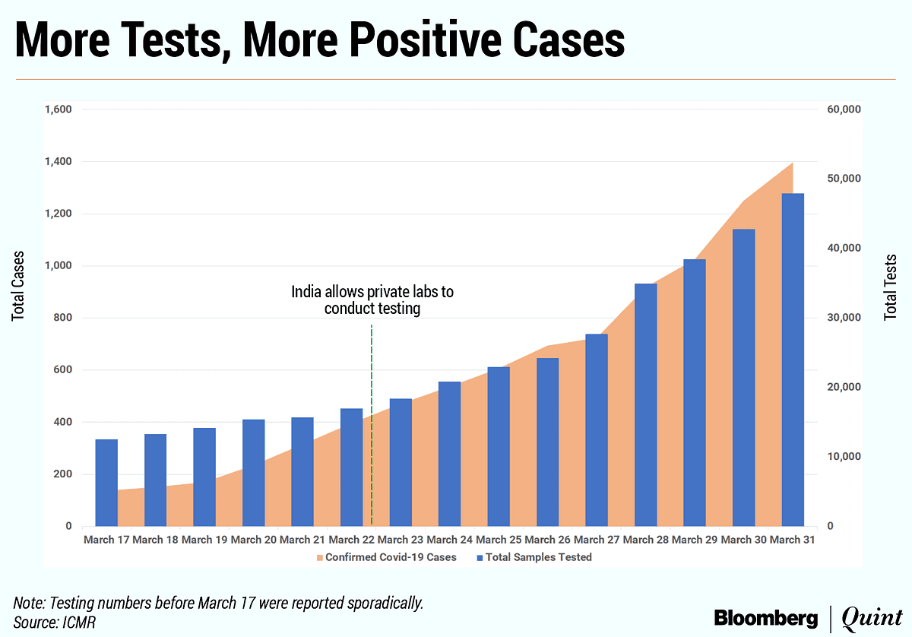
Why this idea?
Covid-19 has had various impacts on our lives in different ways.
Our country has been the first one to report 90,000 cases in a day and Corona Virus has entered into several homes unexpectedly.
With this we decided to come up with a project that provides a one stop destination to real time statistics , helping you manage isolation in your homes, providing you the best resources and volunteers during this time and a place where you could vent out through your blogs.

Slide 4
Key features
Real time COVID-19 Statistics.
Our Heroes : Honouring and Appreciating COVID-19 Warriors and heroes who’ve helped the community to stay strong and fight the situation( one can register as a hero too)
Managing Isolation : Being in isolation in your home can be difficult so we provide you with some games designed in unity , some movies to binge on and book recommendation too. You can write or read blogs of people who currently are in isolation or have been through all of this to help you stay aware and take precautions . It can also be considered as a place where you can vent out anonymously and people can support them through writing a comment under their blog.
Events : Any NGO or organization hosting webinars for social good and fun activities can put up their respective meeting details which will encourage community building and engagement.
Problem Faced and Solutions : Any need or requirements can be posted here and any person or organization willing to help can contact the concerned person to provide their services.
You need to login/register to access all these features.

Slide 5





How did we co-ordinate everything?

Slide 6





Tech stack used..

Slide 7
Problems faced
We were initially focusing on building on AR games but they can’t be used on website and hence, we made 3D games using Unity.
In READMORE function used in blog section , our page was loading before the JavaScript was executed. We tackled it by using Local Storage.
We were also having problem with Read Now ! Button in books recommendation but we were finally able to solve the problem.

Slide 8
Future scope …
No project can be perfect there is always scope of improvement with time ;)
Movie recommendations is currently a third party engine. In future we would like to have our own book and movie recommendation engine.
We could also add a personal chat feature for people to communicate better.
Last but not the least, during this time mental health is something we need to emphasize on and we would want to dedicate a whole section of this website to mental health where people can check their mental health score through a questionnaire and if it doesn’t come out to be that good we could recommend them a psychologist or a counsellor for the same.

