Slide 1
DATA ANALYSIS & VISUALIZATION
Laptop Market Trends
Pricing, Specifications & Performance — An Analysis of 991 Laptop Listings
Deekshith Kumar | B.Tech (CSE) | Aspiring Data Analyst
GitHub: github.com/Deekshith-17 | September 2026

Slide 2
Objective
What this project sets out to answer
1
Price Drivers
2
Brand Value
Which specifications (processor, RAM, storage, GPU) most influence laptop price?
Which brands offer the best rating-to-price ratio for buyers?
3
Rating Factors
4
Visual Insight
How do hardware choices relate to customer satisfaction?
Present findings through clear, data-driven charts.
2

Slide 3
The Dataset
laptops.csv — real-world laptop listings
991
22
920
10
Laptop Listings
Attributes per Laptop
Records After Cleaning
Brands Represented
Key attributes analyzed:
Brand & Model
Price & Rating
Processor (brand, tier, cores, threads)
RAM & Storage (type, capacity)
GPU (brand, type)
Display (size, resolution, touch)
OS & Warranty
3

Slide 4
Methodology
From raw data to visual insight
Data
Collection
Cleaning &
Preprocessing
Exploratory
Analysis
Visualization
Insight
Generation
991 laptop
records loaded
Nulls filled, duplicates
removed, outliers cut (IQR)
Stats, grouping,
correlation matrix
Bar, box, violin,
heatmap, pie, pairplot
Business takeaways
& recommendations
Tools Used
Python
Pandas
NumPy
Matplotlib
Seaborn
4

Slide 5
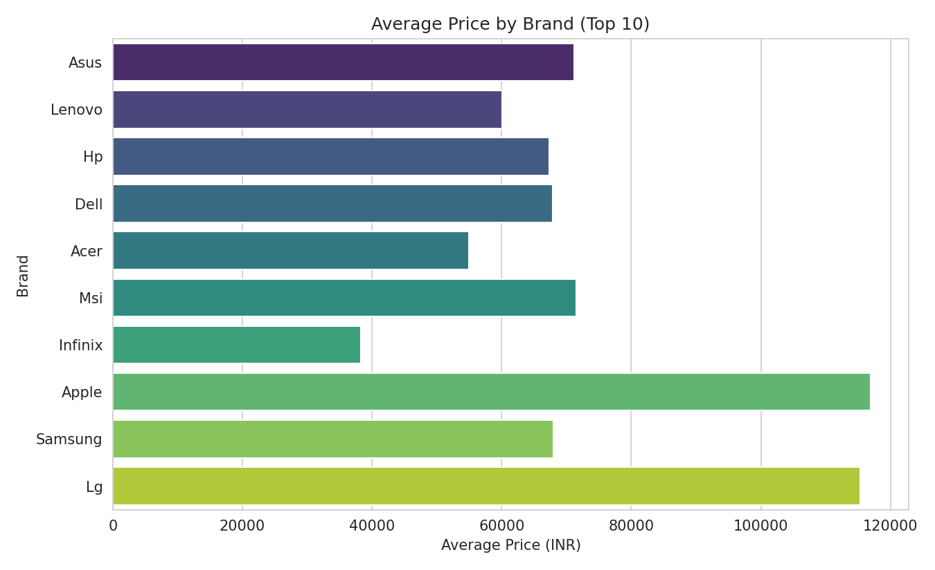
Which Brands Cost the Most?
₹1,16,990
Apple — highest average price
₹9,800
Iball — lowest average price
Why it happens
Premium brands use higher-tier processors, more RAM, and dedicated GPUs — all of which raise manufacturing cost. Budget brands optimize for entry-level specs to hit lower price points.
5

Slide 6
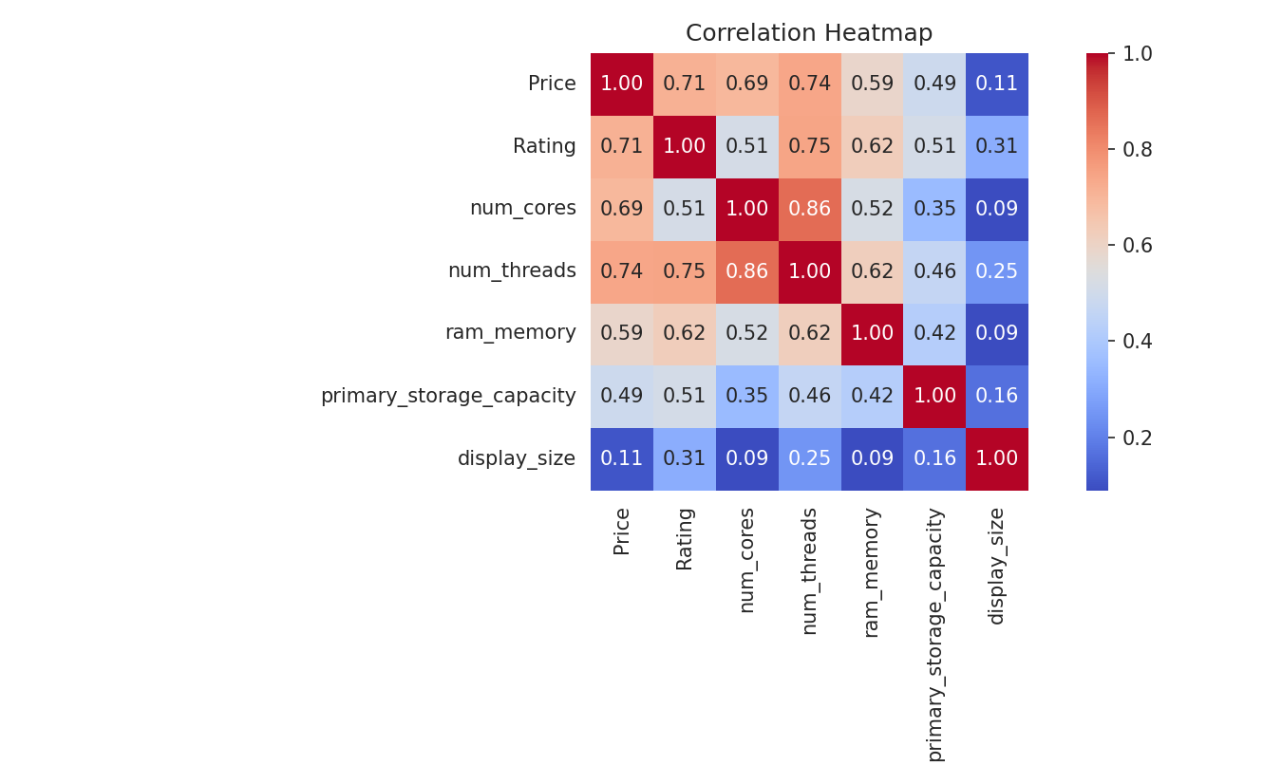
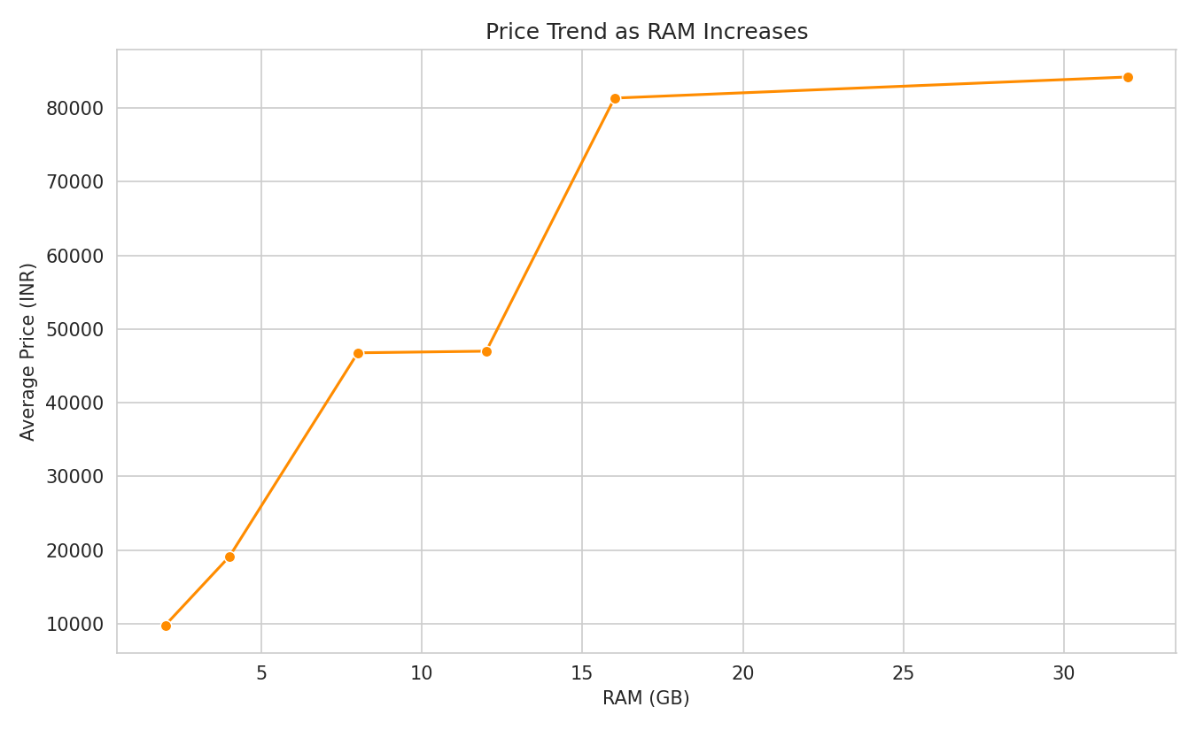
What Actually Drives Price?
Strongest driver: Thread count (r = 0.74) & Rating (r = 0.71) Weakest driver: Display size (r = 0.11)
RAM shows a clear step-up pattern — price roughly triples between 8GB and 16GB configurations, then rises steadily beyond that.
6

Slide 7
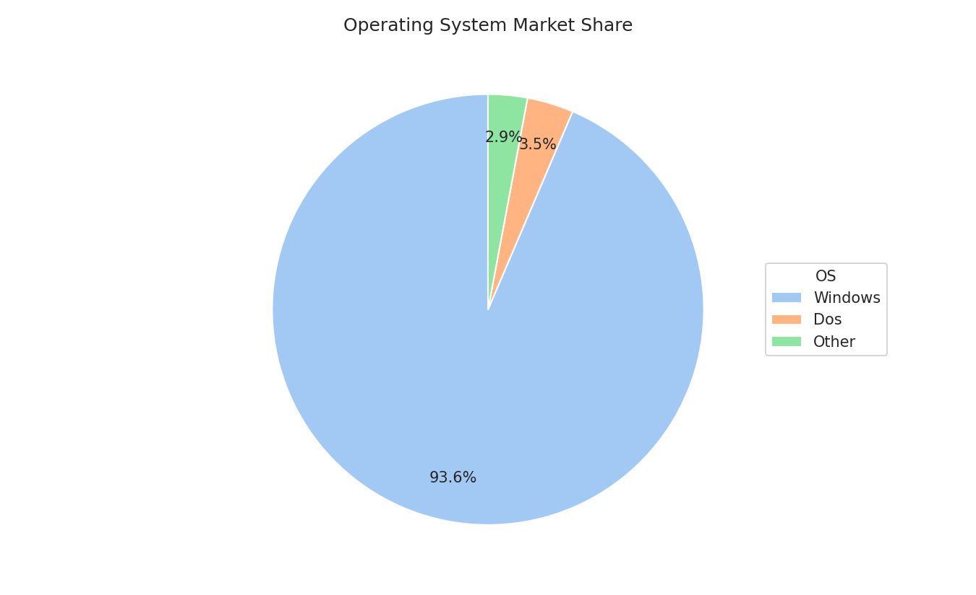
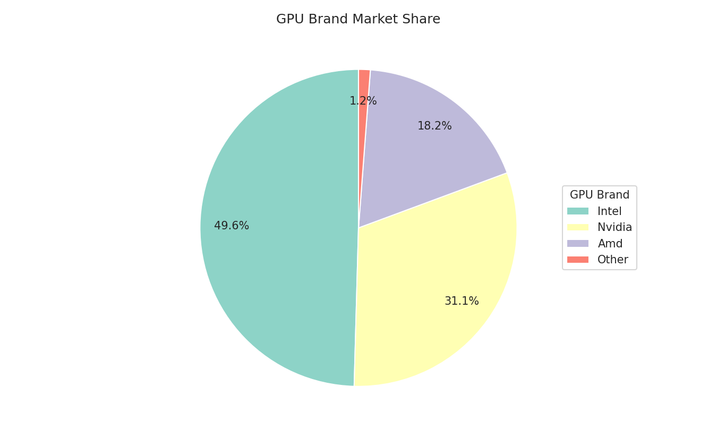
Market Composition
Operating system and GPU brand share across all listings
7

Slide 8
Recommendations
Turning insight into action
For Buyers
For Retailers
For Manufacturers
Best value sits in the Mid-range segment: SSD storage, 16GB RAM, and an i5/Ryzen 5-class processor balance performance and price.
Lead marketing with processor tier and thread count — the strongest, most persuasive price justifiers for customers.
Dedicated GPU and SSD storage both show a clear price-and-rating lift — worth prioritizing in new product lines.
8

Slide 9
Conclusion
This project shows how systematic cleaning, exploration, and visualization of real laptop data turns raw specifications into clear, actionable insight — for buyers choosing a laptop and for businesses shaping price strategy.
Thank You
github.com/Deekshith-17/laptop-market-analysis

