Slide 1
UNIT-4
Regression analysis, Regression: linear regression simple linear regression, multiple & Polynomial regression, Sparse model. Unsupervised learning, clustering, similarity and distances, quality measures of clustering, case study.

Slide 2
Regression Analysis
Regression analysis is a statistical technique of measuring the relationship between variables.
It provides the values of the dependent variable from the value of an independent variable.
The main use of regression analysis is to determine the strength of predictors, forecast an effect, a trend, etc.
For example, a gym supplement company can use regression analysis techniques to determine how prices and advertisements can affect the sales of its supplements.

Slide 3
Types of regression techniques
There are several types of regression analysis, each with their own strengths and weaknesses. Here are the most common.
1. Linear regression
2. Polynomial regression
3. Logistic regression
4. Ridge regression
5. Lasso regression

Slide 4
Linear regression
The name says it all: linear regression can be used only when there is a linear relationship among the variables.
It is a statistical model used to understand the association between independent variables (X) and dependent variables (Y).
The variables that are taken as input are called independent variables. In the example of the gym supplement above, the prices and advertisement effect are the independent variables, whereas the one that is being predicted is called the dependent variable (in this case, ‘sales’).

Slide 5
Simple Linear Regression
Simple linear regression is an approach for predicting a response using a single feature.
It is one of the most basic machine learning models that a machine learning enthusiast gets to know about. In linear regression, we assume that the two variables i.e. dependent and independent variables are linearly related.
Hence, we try to find a linear function that predicts the response value(y) as accurately as possible as a function of the feature or independent variable(x). Let us consider a dataset where we have a value of response y for every feature x:

Slide 6
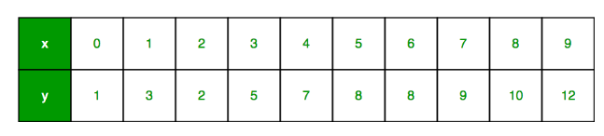
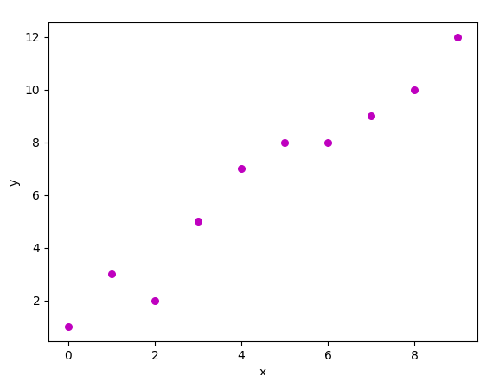
x as feature vector, i.e x = [x_1, x_2, …., x_n],
y as response vector, i.e y = [y_1, y_2, …., y_n]
for n observations (in the above example, n=10). A scatter plot of the above dataset looks like this:-

Slide 7


Now, the task is to find a line that fits best in the above scatter plot so that we can predict the response for any new feature values. (i.e a value of x not present in a dataset) This line is called a regression line. The equation of the regression line is represented as:
The simple linear regression model is essentially a linear equation of the form
If there is more than one independent variable, it is called multiple linear regression and is expressed as follows:
where x denotes the explanatory variable. β1 β2…. Βn are the slope of the particular regression line. β0 is the Y-intercept of the regression line.

Slide 8
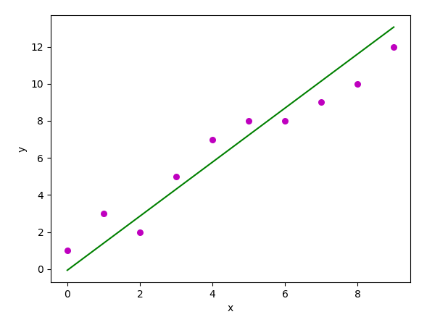

Slide 9
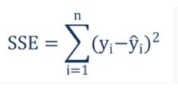
How is the best fit line achieved?
The best way to fit a line is by minimizing the sum of squared errors, i.e., the distance between the predicted value and the actual value.
The least square method is the process of fitting the best curve for a set of data points.
The formula to minimize the sum of squared errors is as below:
where yi is the actual value and yi_cap is the predicted value.

Slide 10
Assumptions of linear regression
The dependent/target variable is continuous.
There isn’t any relationship between the independent variables.
There should be a linear relationship between the dependent and explanatory variables.
Residuals should follow a normal distribution.
Residuals should have constant variance.
Residuals should be independently distributed/no autocorrelation.

Slide 11
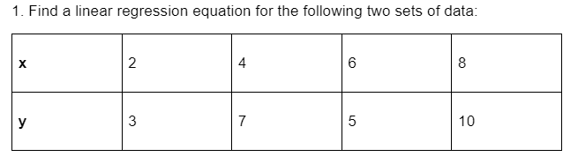
Example
To find the linear regression equation we need to find the value of Σx, Σy, Σxand Σxy

Slide 12
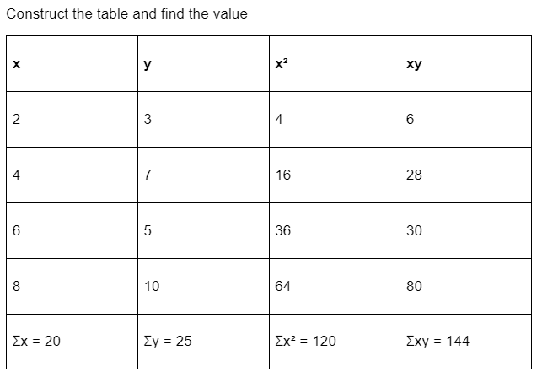

Slide 13
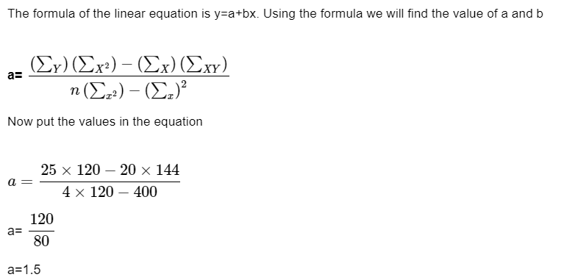

Slide 14
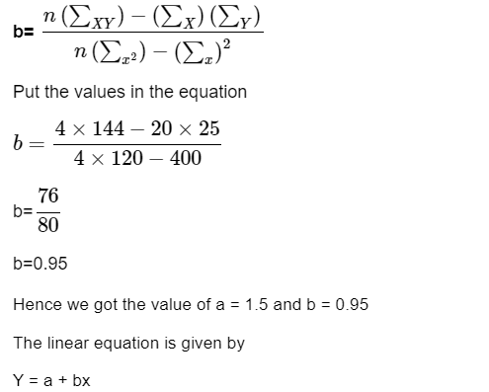

Slide 15
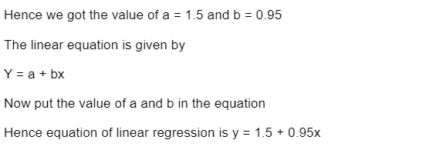

Slide 16
Multiple Linear Regression
Multiple Linear Regression is one of the important regression algorithms which models the linear relationship between a single dependent continuous variable and more than one independent variable.
In Simple Linear Regression, where a single Independent/Predictor(X) variable is used to model the response variable (Y).
But there may be various cases in which the response variable is affected by more than one predictor variable; for such cases, the Multiple Linear Regression algorithm is used.

Slide 17
Some key points about MLR:
For MLR, the dependent or target variable(Y) must be the continuous/real, but the predictor or independent variable may be of continuous or categorical form.
Each feature variable must model the linear relationship with the dependent variable.
MLR tries to fit a regression line through a multidimensional space of data-points.

Slide 18
Assumptions for Multiple Linear Regression:
A linear relationship should exist between the Target and predictor variables.
The regression residuals must be normally distributed.
MLR assumes little or no multicollinearity (correlation between the independent variable) in data.

Slide 19
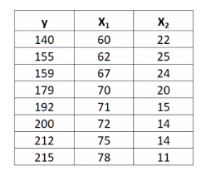
Example:Multiple linear regression
Suppose we have the following dataset with one response variable y and two predictor variables X₁ and X₂:

Slide 20



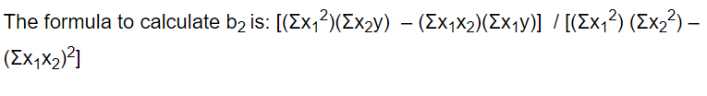
Use the following steps to fit a multiple linear regression model to this dataset.

Slide 21
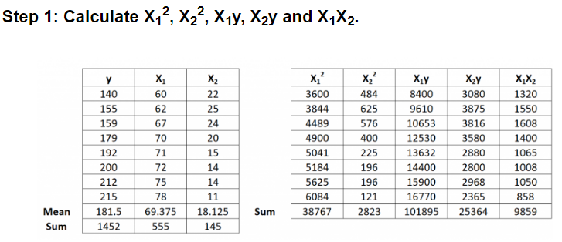

Slide 22
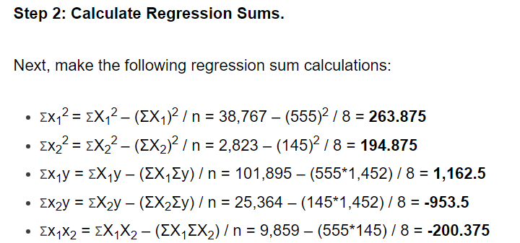

Slide 23
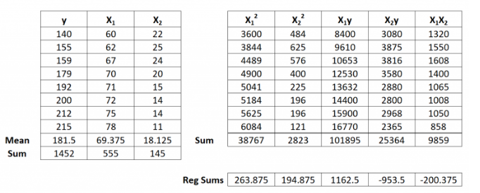

Slide 24
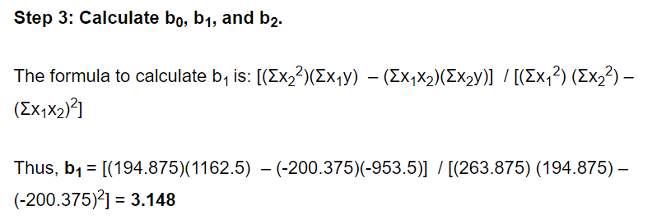

Slide 25
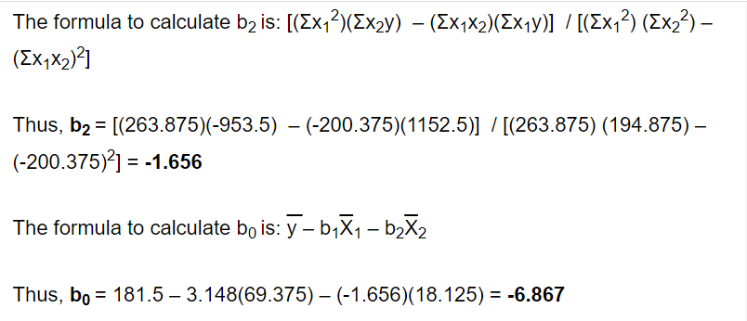

Slide 26
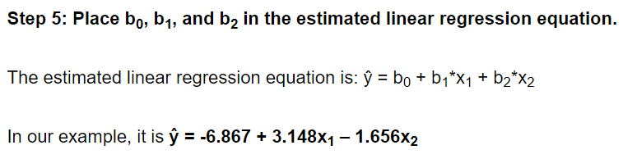

Slide 27
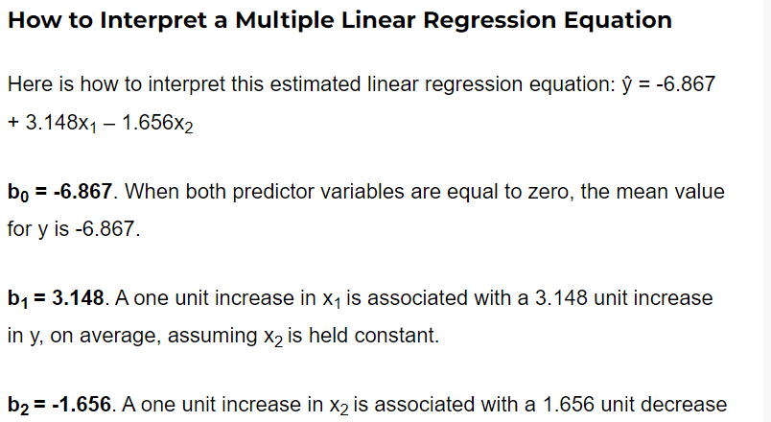


Slide 28
Polynomial regression
Polynomial Regression is a regression algorithm that models the relationship between a dependent(y) and independent variable(x) as nth degree polynomial.
Polynomial regression is a form of Linear regression where only due to the Non-linear relationship between dependent and independent variables, we add some polynomial terms to linear regression to convert it into Polynomial regression.
The Polynomial Regression equation is given below:
y= b₀+b₁x₁+ b₂x₁²+ b₂x₁³+...... b_{n}x₁^{n}

Slide 29
It makes use of a linear regression model to fit the complicated and non-linear functions and datasets.
Hence, "In Polynomial regression, the original features are converted into Polynomial features of required degree (2,3,..,n) and then modeled using a linear model."
Need for Polynomial Regression:
The need of Polynomial Regression in ML can be understood in the below points:
If we apply a linear model on a linear dataset, then it provides us a good result as we have seen in Simple Linear Regression, but if we apply the same model without any modification on a non-linear dataset, then it will produce a drastic output.
Due to which loss function will increase, the error rate will be high, and accuracy will be decreased.

Slide 30
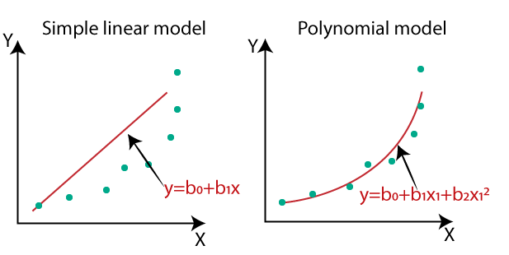
So for such cases, where data points are arranged in a non-linear fashion, we need the Polynomial Regression model.
We can understand it in a better way using the below comparison diagram of the linear dataset and non-linear dataset.

Slide 31
In the above image, we have taken a dataset which is arranged non-linearly. So if we try to cover it with a linear model, then we can clearly see that it hardly covers any data point. On the other hand, a curve is suitable to cover most of the data points, which is of the Polynomial model.
Hence, if the datasets are arranged in a non-linear fashion, then we should use the Polynomial Regression model instead of Simple Linear Regression.

Slide 32
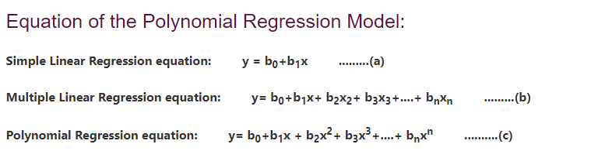

Slide 33
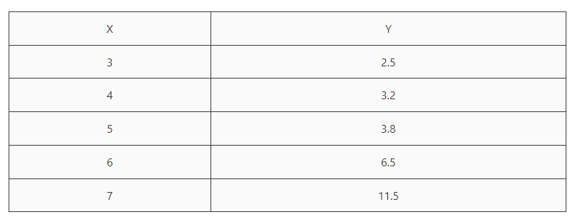
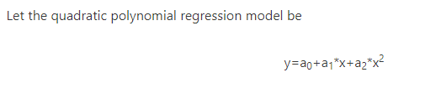
Example
Example:
Predicting the height of a person given the age of the person.

Slide 34
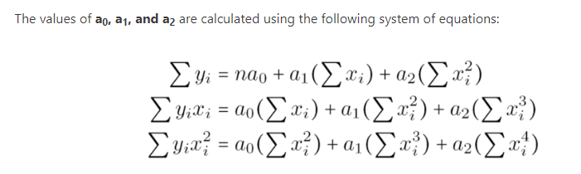

Slide 35
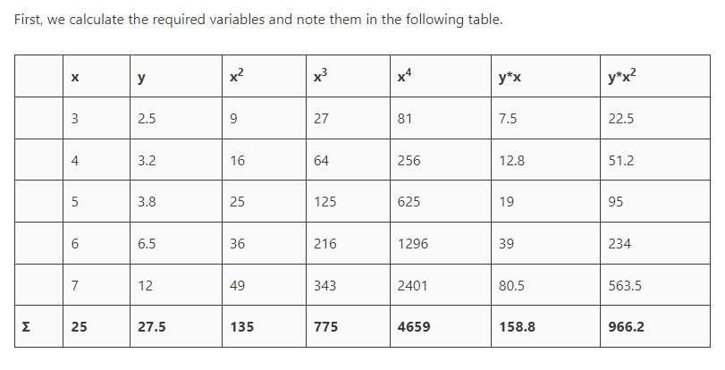

Slide 36
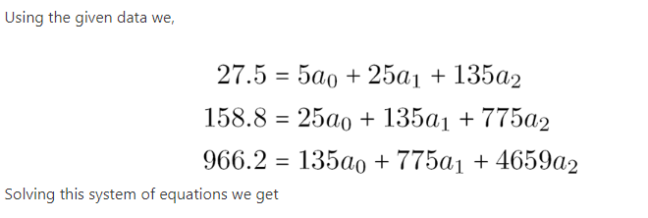
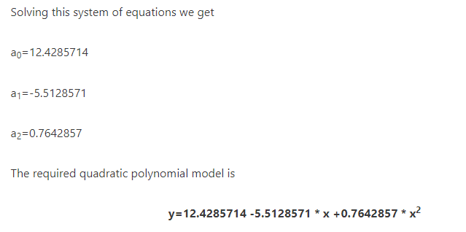
Now, given the value of x (independent variable), we can calculate the value of y (dependent or output variable).

Slide 37

Sparse model
The definition of sparse is come from the distribution. Sparse means something that is small number or amount and spread out over an area(or distribution).
Sparse modeling has advantages from training model. For example, consider about simple linear regression.
When creating a polynomial regression model(meaning that have many terms of coefficients), the model can be expressed as a vector of polynomial coefficients.
If the model is overtrained, in other words, all coefficient(or weight) vector have non-zero value, model will be overfitted.

Slide 38
On the other hands, if the coefficient vector has most of zeroes, then the regression model cannot represent the actual data (underfitted).
That is, if the coefficient vector tends to be sparsed with non-zero values, the model is considered as a good fitting model.
As a result, Sparsity helps to model for regularization and it prevents model from overfitting.
Another advantage from sparsity is variable selection. If we define a model as sparse, it means that some dependent variables represented by 0 are not used to predict.
So we can analyze the performance of model from selected variable. That is called model interpretability.

Slide 39
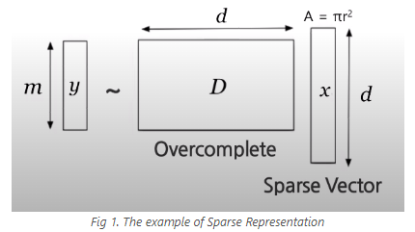
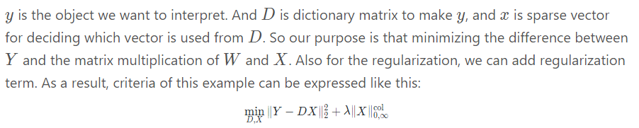

Slide 40
Above formula, first term is the square of L2-norm(also known as Euclidean distance).
second term is L0-norm(cardinality ie The L0 norm counts the total number of nonzero elements of a vector. For example, the distance between the origin (0, 0) and vector (0, 5) is 1, because there's only one nonzero element) of X.
If the the number of zeros in the sparse vector is large, the regularization term has small value. That is, sparse vector becomes more sparse.
Let’s look at more precisely about the definition of norm. Actually, norm is the length of vector in terms of p. The mathematical expression of vector norm is like this:

Slide 41

Let’s look at more precisely about the definition of norm. Actually, norm is the length of vector in terms of p. The mathematical expression of vector norm is like this:
Consider about this simple case. If we have x=(0,−2,0,1,0,3), we can define the norm in terms of p:

Slide 42
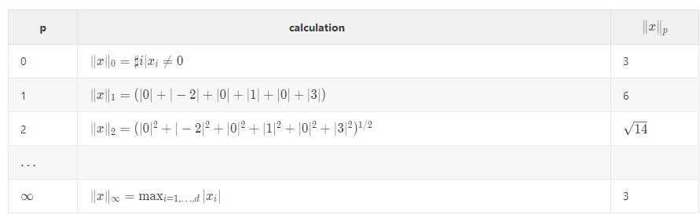

Slide 43

Problem of Sparse Modeling
We already expressed the criteria of specific sparse modeling, but we can generalize its form,
The first term is loss function for quantifying the goodness of approximation. So it tries to minimize the error between Y and DX. And second term is regularization term as explained, it evaluates sparseness of coefficients(or dictionary). If this value is small, we can say that the model is more sparse and explainable.

Slide 44
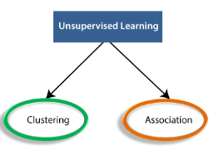
Unsupervised Learning
Unsupervised learning is a type of machine learning in which models are trained using unlabeled dataset and are allowed to act on that data without any supervision.
The goal of unsupervised learning is to find the underlying structure of dataset, group that data according to similarities, and represent that dataset in a compressed format.
Types of Unsupervised Learning Algorithm:
The unsupervised learning algorithm can be further categorized into two types of problems:

Slide 45
Clustering
Clustering or cluster analysis is a machine learning technique, which groups the unlabelled dataset.
It can be defined as "A way of grouping the data points into different clusters, consisting of similar data points. The objects with the possible similarities remain in a group that has less or no similarities with another group.“
It does it by finding some similar patterns in the unlabelled dataset such as shape, size, color, behavior, etc., and divides them as per the presence and absence of those similar patterns.
It is an unsupervised learning method, hence no supervision is provided to the algorithm, and it deals with the unlabeled dataset.
After applying this clustering technique, each cluster or group is provided with a cluster-ID. ML system can use this id to simplify the processing of large and complex datasets.

Slide 46
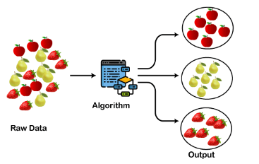
The below diagram explains the working of the clustering algorithm. We can see the different fruits are divided into several groups with similar properties

Slide 47
Clustering is an unsupervised machine learning task. You might also hear this referred to as cluster analysis because of the way this method works.
Using a clustering algorithm means you're going to give the algorithm a lot of input data with no labels and let it find any groupings in the data it can.
Those groupings are called clusters. A cluster is a group of data points that are similar to each other based on their relation to surrounding data points. Clustering is used for things like feature engineering or pattern discovery.

Slide 48
Types of Clustering Methods
Types of clustering algorithms
There are different types of clustering algorithms that handle all kinds of unique data.
Density-based
Distribution-based
Centroid-based
Hierarchical-based

Slide 49
Density-based
In density-based clustering, data is grouped by areas of high concentrations of data points surrounded by areas of low concentrations of data points.
Basically the algorithm finds the places that are dense with data points and calls those clusters.
Distribution-based
With a distribution-based clustering approach, all of the data points are considered parts of a cluster based on the probability that they belong to a given cluster.
It works like this: there is a center-point, and as the distance of a data point from the center increases, the probability of it being a part of that cluster decreases.

Slide 50
Centroid-based
Centroid-based clustering is the one you probably hear about the most.
It's a little sensitive to the initial parameters you give it, but it's fast and efficient.
These types of algorithms separate data points based on multiple centroids in the data.
Each data point is assigned to a cluster based on its squared distance from the centroid.
This is the most commonly used type of clustering.

Slide 51
Hierarchical-based
Hierarchical-based clustering is typically used on hierarchical data, like you would get from a company database or taxonomies.
It builds a tree of clusters so everything is organized from the top-down.
This is more restrictive than the other clustering types, but it's perfect for specific kinds of data sets.

Slide 52
Clustering Algorithms
K-means clustering algorithm
K-means clustering is the most commonly used clustering algorithm. It's a centroid-based algorithm and the simplest unsupervised learning algorithm.
This algorithm tries to minimize the variance of data points within a cluster. It's also how most people are introduced to unsupervised machine learning.
K-means is best used on smaller data sets because it iterates over all of the data points. That means it'll take more time to classify data points if there are a large amount of them in the data set.

Slide 53
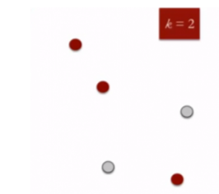
K means is an iterative clustering algorithm that aims to find local maxima in each iteration. This algorithm works in these 5 steps:
1. Specify the desired number of clusters K: Let us choose k=2 for these 5 data points in 2-D space.

Slide 54
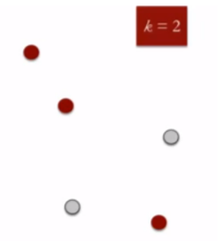
2. Randomly assign each data point to a cluster: Let’s assign three points in cluster 1, shown using red color, and two points in cluster 2, shown using grey color.

Slide 55
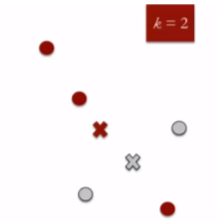
3. Compute cluster centroids: The centroid of data points in the red cluster is shown using the red cross, and those in the grey cluster using a grey cross.

Slide 56
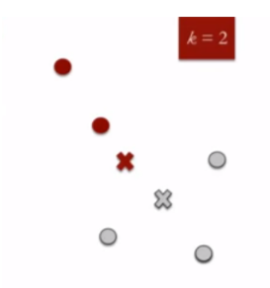
4. Re-assign each point to the closest cluster centroid: Note that only the data point at the bottom is assigned to the red cluster, even though it’s closer to the centroid of the grey cluster. Thus, we assign that data point to the grey cluster.

Slide 57
5. Re-compute cluster centroids: Now, re-computing the centroids for both clusters.
Repeat steps 4 and 5 until no improvements are possible: Similarly, we’ll repeat the 4th and 5th steps until we’ll reach global optima, i.e., when there is no further switching of data points between two clusters for two successive repeats. It will mark the termination of the algorithm if not explicitly mentioned.

Slide 58
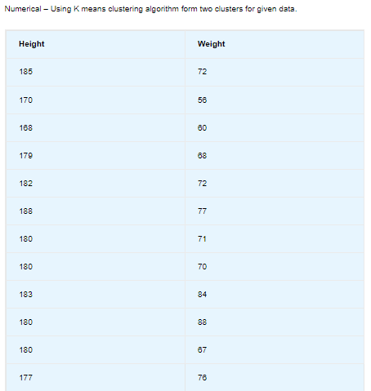

Slide 59
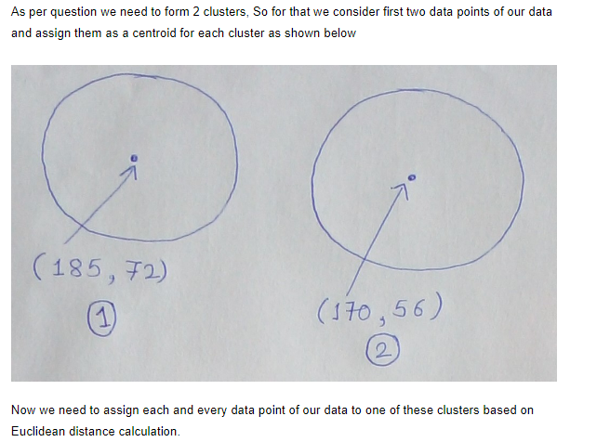

Slide 60
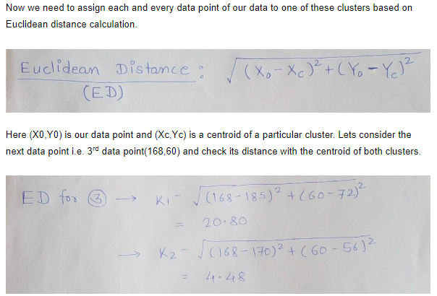

Slide 61
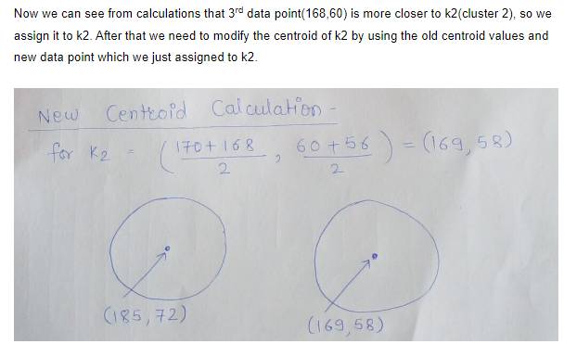

Slide 62
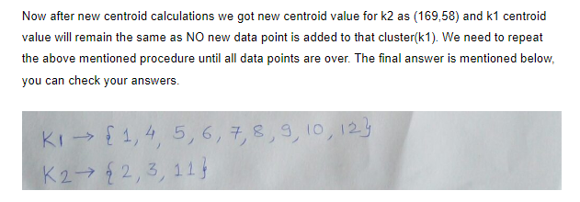

Slide 63
Hierarchical Clustering
Hierarchical clustering, as the name suggests, is an algorithm that builds a hierarchy of clusters.
This algorithm starts with all the data points assigned to a cluster of their own.
Then two nearest clusters are merged into the same cluster. In the end, this algorithm terminates when there is only a single cluster left.
The results of hierarchical clustering can be shown using a dendrogram.

Slide 64
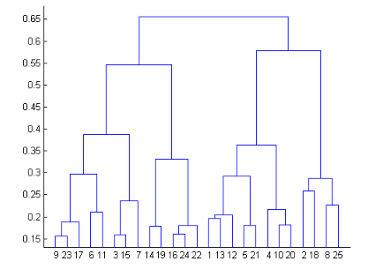
The dendrogram can be interpreted as:

Slide 65
At the bottom, we start with 25 data points, each assigned to separate clusters.
The two closest clusters are then merged till we have just one cluster at the top.
The height in the dendrogram at which two clusters are merged represents the distance between two clusters in the data space.
The decision of the no. of clusters that can best depict different groups can be chosen by observing the dendrogram.
The best choice of the no. of clusters is the no. of vertical lines in the dendrogram cut by a horizontal line that can transverse the maximum distance vertically without intersecting a cluster.

Slide 66
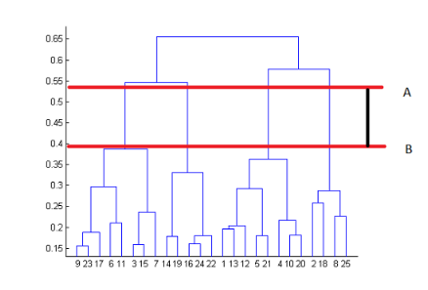

Slide 67
Two important things that you should know about hierarchical clustering are:
This algorithm has been implemented above using a bottom-up approach. It is also possible to follow a top-down approach starting with all data points assigned in the same cluster and recursively performing splits till each data point is assigned a separate cluster.
The decision to merge two clusters is taken on the basis of the closeness of these clusters. There are multiple metrics for deciding the closeness of two clusters:

Slide 68
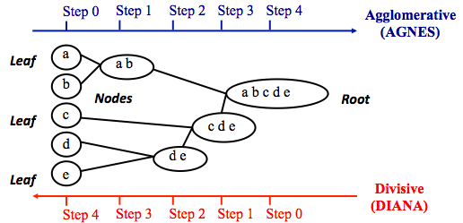
Agglomerative clustering
Agglomerative clustering works in a “bottom-up” manner. That is, each object is initially considered as a single-element cluster (leaf). At each step of the algorithm, the two clusters that are the most similar are combined into a new bigger cluster (nodes). This procedure is iterated until all points are member of just one single big cluster

Slide 69
Steps to agglomerative hierarchical clustering
We’ll follow the steps below to perform agglomerative hierarchical clustering:
Preparing the data
Computing (dis)similarity information between every pair of objects in the data set.
Using linkage function to group objects into hierarchical cluster tree, based on the distance information generated at step 1. Objects/clusters that are in close proximity are linked together using the linkage function.
Determining where to cut the hierarchical tree into clusters. This creates a partition of the data.

Slide 70
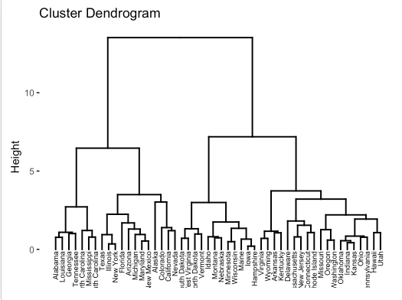

Slide 71
Difference Between K Means and Hierarchical Clustering
Hierarchical clustering can’t handle big data well, but K Means can. This is because the time complexity of K Means is linear, i.e., O(n), while that of hierarchical is quadratic, i.e., O(n2).
Since we start with a random choice of clusters, the results produced by running the algorithm multiple times might differ in K Means clustering. While in Hierarchical clustering, the results are reproducible.
K Means is found to work well when the shape of the clusters is hyperspherical (like a circle in 2D or a sphere in 3D).
K Means clustering requires prior knowledge of K, i.e., no. of clusters you want to divide your data into. But, you can stop at whatever number of clusters you find appropriate in hierarchical clustering by interpreting the dendrogram.

Slide 72
Density-Based Spatial Clustering Of Applications With Noise (DBSCAN)
Clusters are dense regions in the data space, separated by regions of the lower density of points.
The DBSCAN algorithm is based on this intuitive notion of “clusters” and “noise”.
The key idea is that for each point of a cluster, the neighborhood of a given radius has to contain at least a minimum number of points.
Why DBSCAN?
Partitioning methods (K-means, PAM clustering) and hierarchical clustering work for finding spherical-shaped clusters or convex clusters.
In other words, they are suitable only for compact and well-separated clusters. Moreover, they are also severely affected by the presence of noise and outliers in the data.

Slide 73
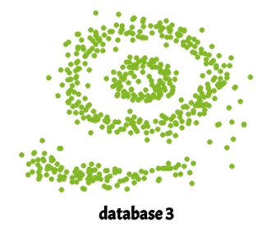
Real-life data may contain irregularities, like:
Clusters can be of arbitrary shape such as those shown in the figure below.
Data may contain noise.
The figure above shows a data set containing non-convex shape clusters and outliers.
Given such data, the k-means algorithm has difficulties in identifying these clusters with arbitrary shapes.

Slide 74
Parameters Required For DBSCAN Algorithm
1.eps: It defines the neighborhood around a data point i.e. if the distance between two points is lower or equal to ‘eps’ then they are considered neighbors.
If the eps value is chosen too small then a large part of the data will be considered as an outlier.
If it is chosen very large then the clusters will merge and the majority of the data points will be in the same clusters. One way to find the eps value is based on the k-distance graph.
2. MinPts: Minimum number of neighbors (data points) within eps radius.
The larger the dataset, the larger value of MinPts must be chosen. As a general rule, the minimum MinPts can be derived from the number of dimensions D in the dataset as, MinPts >= D+1.
The minimum value of MinPts must be chosen at least 3.

Slide 75
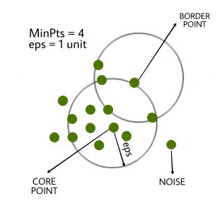

Slide 76
Steps Used In DBSCAN Algorithm
Find all the neighbor points within eps and identify the core points or visited with more than MinPts neighbors.
For each core point if it is not already assigned to a cluster, create a new cluster.
Find recursively all its density-connected points and assign them to the same cluster as the core point. A point a and b are said to be density connected if there exists a point c which has a sufficient number of points in its neighbors and both points a and b are within the eps distance. This is a chaining process. So, if b is a neighbor of c, c is a neighbor of d, and d is a neighbor of e, which in turn is neighbor of a implying that b is a neighbor of a.
Iterate through the remaining unvisited points in the dataset. Those points that do not belong to any cluster are noise.

Slide 77
Gaussian Mixture Model algorithm
One of the problems with k-means is that the data needs to follow a circular format. The way k-means calculates the distance between data points has to do with a circular path, so non-circular data isn't clustered correctly.
This is an issue that Gaussian mixture models fix. You don’t need circular shaped data for it to work well.
The Gaussian mixture model uses multiple Gaussian distributions to fit arbitrarily shaped data.
There are several single Gaussian models that act as hidden layers in this hybrid model. So the model calculates the probability that a data point belongs to a specific Gaussian distribution and that's the cluster it will fall under.

Slide 78
Similarity and Distances
Clustering algorithms are constructed using similarity and distance (dissimilarity).
Regarding the characteristics of quantitative data, distance is preferred to identify the relationship between the data.
And when working with qualitative data aspects, the similarity is preferred. The distance metric is essential to clustering techniques.
A difficult task is choosing the appropriate distance metric for a particular dataset.
Distance-based clustering algorithms primarily utilize similarity or distance metrics to group comparable data points into the same clusters while putting dissimilar or far-away data points into different clusters.

Slide 79
Distance Measures
Distance measures are used to determine the dissimilarity between two data points.
There are several distance measures commonly used in clustering.
Euclidean Distance
Manhattan Distance
Cosine Similarity
Mahalanobis Distance

Slide 80
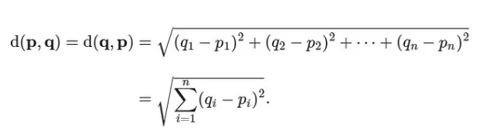
1.Euclidean Distance
This is the most common distance measure used in clustering.
It works on the principle of the Pythagoras theorem and signifies the shortest distance between two points

Slide 81
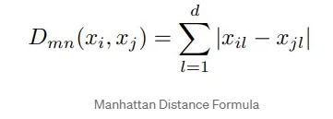
2. Manhattan Distance
This distance measure is also known as city block distance or taxicab distance.
Manhattan distance can be used for data with discrete variables, such as the number of bedrooms in a house.
It is perhaps more useful to vectors that describe objects on a uniform grid, like a chessboard or city blocks.

Slide 82
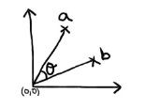

3. Cosine Similarity
This similarity measure is commonly used for text-based data or other high-dimensional data.
It measures the cosine of the angle between two vectors in a multidimensional space.
The cosine similarity ranges from -1 to 1, with 1 indicating that the vectors are identical a value of 0 indicating that they are orthogonal (perpendicular) to each other.

Slide 83
4. Mahalanobis Distance:
It measures the distance between a point and a distribution.
It takes into account the covariance of the data, and is useful when the data is non-spherical or has correlated dimensions.
Similarity Measures
Similarity measures are used to determine the similarity between two data points.
There are several similarity measures commonly used in clustering, including:

Slide 84
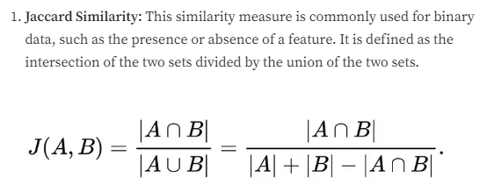

Slide 85


Slide 86

2. Pearson Correlation
This similarity measure is commonly used for continuous variables.
It measures the linear correlation between two variables.
The Pearson correlation ranges from -1 to 1, A Pearson correlation of 1 indicates a perfect positive linear relationship, meaning that as one variable increases, the other variable also increases at a constant rate

Slide 87
3. Hamming Distance
This similarity measure is commonly used for data with categorical variables.
It measures the number of positions at which two strings differ.

Slide 88


Slide 89
Quality measures of clustering
If all the data objects in the cluster are highly similar then the cluster has high quality.
We can measure the quality of Clustering by using the Dissimilarity/Similarity metric in most situations.
But there are some other methods to measure the Qualities of Good Clustering if the clusters are alike.
1. Dissimilarity/Similarity metric
2. Cluster completeness
3. Ragbag
4. Small cluster preservation

Slide 90
1. Dissimilarity/Similarity metric
The similarity between the clusters can be expressed in terms of a distance function, which is represented by d(i, j).
Distance functions are different for various data types and data variables.
Distance function measure is different for continuous-valued variables, categorical variables, and vector variables.
Distance function can be expressed as Euclidean distance, Mahalanobis distance, and Cosine distance for different types of data.

Slide 91
2. Cluster completeness
Cluster completeness is the essential parameter for good clustering, if any two data objects are having similar characteristics then they are assigned to the same category of the cluster according to ground truth.
Cluster completeness is high if the objects are of the same category.
Let us consider the clustering C1, which contains the sub-clusters s1 and s2, where the members of the s1 and s2 cluster belong to the same category according to ground truth. Let us consider another clustering C2 which is identical to C1 but now s1 and s2 are merged into one cluster. Then, we define the clustering quality measure, Q, and according to cluster completeness C2, will have more cluster quality compared to the C1 that is, Q(C2, Cg ) > Q(C1, Cg ).

Slide 92
3. Ragbag
In some situations, there can be a few categories in which the objects of those categories cannot be merged with other objects.
Then the quality of those cluster categories is measured by the Rag Bag method.
According to the rag bag method, we should put the heterogeneous object into a rag bag category.
Let us consider a clustering C1 and a cluster C ∈ C1 so that all objects in C belong to the same category of cluster C1 except the object o according to ground truth. Consider a clustering C2 which is identical to C1 except that o is assigned to a cluster D which holds the objects of different categories. According to the ground truth, this situation is noisy and the quality of clustering is measured using the rag bag criteria. we define the clustering quality measure, Q, and according to rag bag method criteria C2, will have more cluster quality compared to the C1 that is, Q(C2, Cg )>Q(C1, Cg).

Slide 93
4. Small cluster preservation
If a small category of clustering is further split into small pieces, then those small pieces of cluster become noise to the entire clustering and thus it becomes difficult to identify that small category from the clustering.
The small cluster preservation criterion states that are splitting a small category into pieces is not advisable and it further decreases the quality of clusters as the pieces of clusters are distinctive.
Suppose clustering C1 has split into three clusters, C11 = {d1, . . . , dn}, C12 = {dn+1}, and C13 = {dn+2}.
Let clustering C2 also split into three clusters, namely C1 = {d1, . . . , dn−1}, C2 = {dn}, and C3 = {dn+1,dn+2}. As C1 splits the small category of objects and C2 splits the big category which is preferred according to the rule mentioned above the clustering quality measure Q should give a higher score to C2, that is, Q(C2, Cg ) > Q(C1, Cg ).

