Slide 1

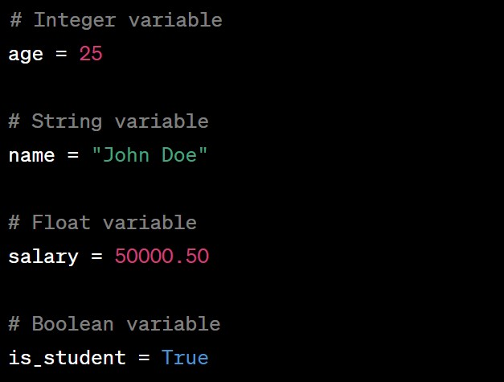
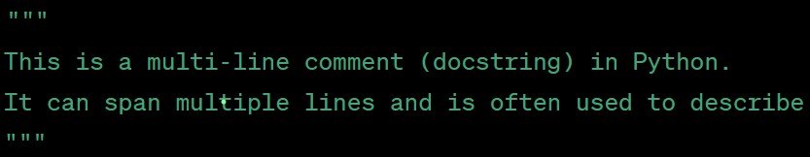
PYTHON
# Why Python?
# 1. Easy to Learn and Read: # Python has a simple and elegant syntax, making it easy for beginners to grasp and write code. It emphasizes readability, reducing the cost of program maintenance.
# 2. Versatile and Powerful: # Python can be used for a wide range of applications, including web development, data analysis, machine learning, artificial intelligence, scripting, automation, and more.
# 3. Large Community and Libraries: # Python has a massive and active community of developers. This means a vast collection of libraries and frameworks are available, enabling you to accomplish tasks quickly and efficiently.
# 4. High Demand in the Job Market: # Python is one of the most popular programming languages, and it's in high demand across various industries. Learning Python can open up numerous career opportunities.
# 5. Cross-Platform Support: # Python is a cross-platform language, meaning code written on one platform can run on multiple operating systems without modification.
# 6. Ideal for Prototyping and Rapid Development: # Python's simplicity and extensive libraries make it perfect for rapid prototyping and development. It allows you to quickly test ideas and build applications faster.
# 7. Great for Data Science and AI: # Python's data manipulation and analysis libraries (such as Pandas, NumPy, and SciPy) make it an excellent choice for data science and AI projects, enabling researchers to gain insights from large datasets. # Overall, Python is a versatile, beginner-friendly, and powerful language that's used extensively in various domains, making it a valuable skill for any programmer to learn.
NUMERIC TYPES:
int: Integer type (e.g., 5, -10, 100)
float: Floating-point type (e.g., 3.14, -2.5, 1e-5)
complex: Complex numbers (e.g., 2 + 3j)
STRING: A sequence of characters enclosed in single ('') or double ("") quotes. (e.g., "Hello", 'Python')
BOOLEAN: Represents a binary value, either True or False. Useful in conditional statements.
LIST: An ordered collection that allows duplicates and is mutable. It is denoted by square brackets []. (e.g., [1, 2, 3], ['apple', 'banana'])
TUPLE: Similar to lists, but immutable (cannot be changed after creation). Denoted by parentheses (). (e.g., (1, 2, 3), ('red', 'blue'))
SET: An unordered collection that doesn't allow duplicates. Denoted by curly braces {}. (e.g., {1, 2, 3}, {'cat', 'dog'})
DICTIONARY: A collection of key-value pairs enclosed in curly braces {}. (e.g., {'name': 'John', 'age': 25})
FIRST PROGRAM
VARIABLE DECLARATION
We can create a variable by assigning a value to it using the equals (=) sign
IDENTIFYING THE TYPE OF A VARIABLE
The ‘Type()’ function in python is a built-in function that allows you to determine the data type of a given object or variable. It returns a type object, representing the specific data type of the object.
Age = 25
Print(type(Age)) #output : <class ‘int’>
Name = ‘John Doe’
Print(type(Name)) #output : <class ‘str’>
Is_student = True
Print(type(Is_student )) #output : <class ‘bool’>
COMMENTS
Single-line comments: #
Multi-line comments: ’’’WORLD
HELLO’’’
ASSIGNING A VARIABLE

Slide 2
PYTHON
RULES FOR DEFINING A VARIABLE NAME
Variable names can contain letters (both uppercase and lowercase), digits, and underscores.The first character of a variable name cannot be a digit. It must be a letter (a-z, A-Z) or an underscore (_).
Python is case-sensitive so ‘myVariable’, ‘myvariable’, ‘MYVARIABLE’, are considered three different variables.
You cannot use python’s reserved keywords(e.g., if, else, for, while, def, class, etc.) as variable names since they have special meanings in the language.
Using underscores in variable names is common and encouraged for readability.
Variables with names like my_variable or user_name are examples of using underscores.
Variable names cannot contain spaces. If you need to represent multiple words, use underscores or CamelCase notation (e.g., my_variable, user_name, firstName, lastName).
Avoid using special characters like @, $, %, etc., in variable names. Stick to letters, digits, and underscores.
Choose variable names that are descriptive and meaningful. This improves code readability and makes your code easier to understand.
ASSIGNED OPERATORS
OPERATOR | DESCRIPTION | EXAMPLE | EQUIVALENT TO
= | ASSIGNMENT | x = 10 | x = 10
+= | ADD AND ASSIGN | x += 5 | x = x + 5
-= | SUBTRACT AND ASSIGN | x -= 3 | x = x - 3
*= | MULTIPLY AND ASSIGN | x *= 2 | x = x * 2
/= | DIVIDE AND ASSIGN | x /= 4 | x = x / 4
//= | FLOOR DIVIDE AND ASSIGN | x //= 3 | x = x // 3
%= | MODULO AND ASSIGN | x %= 7 | x = x % 7
**= | EXPONENTIATION AND ASSIGN | x **= 2 | x = x ** 2
&= | BITWISE AND AND ASSIGN | x &= 3 | x = x & 3
|= | BITWISE OR AND ASSIGN | x |= 5 | x = x | 5
^= | BITWISE XOR AND ASSIGN | x ^= 6 | x = x ^ 6
<<= | LEFT SHIFT AND ASSIGN | x <<= 2 | x = x << 2
>>= | RIGHT SHIFT AND ASSIGN | x >>= 3 | x = x >> 3
ARITHMETIC OPERATORS
OPERATOR | DESCRIPTION | EXAMPLE | RESULT
+ | ADDITION | 5 + 3 | 8
- | SUBTRACTION | 7 - 2 | 5
* | MULTIPLICATION | 4 * 6 | 24
/ | DIVISION | 10 / 2 | 5.0
// | FLOOR DIVISION (INTEGER DIVISION) | 10 // 3 | 3
% | MODULUS (REMAINDER) | 10 % 3 | 1
** | EXPONENTIATION (POWER) | 2 ** 3 | 8

Slide 3

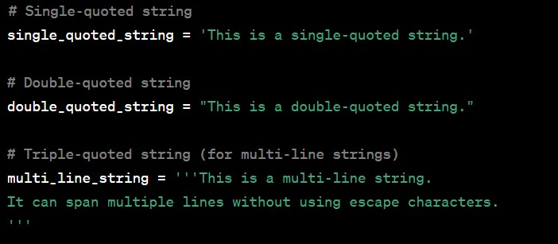
PYTHON
COMPARISION OPERATORS
INPUT() FUNCTION
In python, the ‘input()’ function is used to take user input from the console or command line. It allows the program to pause and wait for the user to enter some data, which is then returned as a string.
-the ‘input()’ function always returns a string
-by using appropriate typecasting functions like ‘int()’, ‘float()’ the input can be converted
to specific data types
OPERATOR | DESCRIPTION | EXAMPLE | RESULT
== | EQUAL | 5 == 5 | TRUE
!= | NOT EQUAL | 5 != 3 | TRUE
> | GREATER THAN | 10 > 5 | TRUE
< | LESS THAN | 3 < 7 | TRUE
>= | GREATER THAN OR EQUAL TO | 8 >= 8 | TRUE
<= | LESS THAN OR EQUAL TO | 4 <= 2 | FALSE
STRINGS
#string creation
Strings in python are sequences of characters and are one of the fundamental data types in the language. They are used to represent text and are enclosed in either single quotes(‘’) or double quotes(“”).
LOGICAL OPERATORS
OPERATOR | DESCRIPTION | EXAMPLE
AND | Logical AND. Returns True if both operands are True, otherwise False. | True and False returns False
OR | Logical OR. Returns True if at least one operand is True, otherwise False. | True or False returns True
NOT | Logical NOT. Returns True if the operand is False, and vice versa. | not True returns False
LEN FUNCTION
my_string = "Hello, World!"
length = len(my_string)
print(length) # Output: 13

Slide 4
PYTHON
# Escaping single and double quotes
escaped_string = 'He said, "Don\'t do that.“’
print(escaped_string)
# output:
He said, "Don't do that."
# Using triple quotes to include both single and double quotes without escaping
mixed_quotes = """She said, "It's okay.""""
print(mixed_quotes)
# output:
She said, "It's okay."
# Raw string (ignores escape characters)
A raw string is a string that ignores escape charaters. It is created by prefixing the string with ‘r’ or ‘R’.
raw_string = r'C:\Users\John\Documents’
print(raw_string)
# output:
C:\Users\John\Documents
# Concatenating strings
first_name = "John"
last_name = "Doe"
full_name = first_name + " " + last_name
print(full_name)
# output:
John Doe
# String formatting using f-strings
-In this code, an f-string(formatted string literal) to format the string is used. The variables ‘first name’,’last_name’, and ‘age’ are embedded with curly braces ‘{}’ in the string.
-The f-string evaluates these expressions and replaces them with their corresponding values.
age = 30
formatted_string = f"My name is {first_name} {last_name} and I am {age} years old."
print(formatted_string)
# string formatting using the format() method in Python.
name = "Alice"
age = 30
# Using format()
formatted_string = "My name is {}, and I am {} years old.".format(name, age) #"My name is Alice, and I am 30 years old."
# output:
My name is John Doe and I am 30 years old.
# String indexing and slicing
- Indexing allows to access individual characters in a string by their position in the sequence.
- string indexing starts from 0 for the first character and counts up incrementally.
- Negative indices count from the end of the string, where -1 represents the last character, -2 represents the second-to-last character, and so on.
my_string = "Hello, World!"
print(my_string[0]) # Output: 'H' (First character)
print(my_string[4]) # Output: 'o' (Fifth character))
print(my_string[-1]) # Output: '!' (Last character)
print(my_string[-3]) # Output: 'r' (Third-to-last character)

Slide 5
PYTHON
Slicing allows you to extract a portion of the original string. It is done by specifying a range of indices using the syntax [start:end]. The result includes characters from the start index (inclusive) to the end index (exclusive).
my_string = "Hello, World!"
print(my_string[0:5]) # Output: 'Hello' (Characters from index 0 to 4)
print(my_string[7:]) # Output: 'World!' (Characters from index 7 to the end) print(my_string[:5]) # Output: 'Hello' (Characters from the beginning to index 4) print(my_string[-6:]) # Output: 'World!' (Last 6 characters)
- slicing returns a new string and does not modify the original string.
- If the start index is not specified, it defaults to 0, and if the end index is not specified, it defaults to the end of the string.
- Additionally, slicing allows for the use of a step value, but when omitted, the step defaults to 1.
my_string = "Hello, World!"
print(my_string[::2]) # Output: 'Hlo ol!' (Characters with a step of 2)
print(my_string[::-1]) # Output: '!dlroW ,olleH' (Reverse the string)
# String methods in Python
# 1. capitalize(): Converts the first character of the string to uppercase. string1 = "hello, world!"
result1 = string1.capitalize()
print(result1) # Output: "Hello, world!"
# 2. upper(): Converts all characters in the string to uppercase.
string2 = "hello, world!"
result2 = string2.upper()
print(result2) # Output: "HELLO, WORLD!"
# 3. lower(): Converts all characters in the string to lowercase.
string3 = "Hello, World!"
result3 = string3.lower()
print(result3) # Output: "hello, world!"
# 4. title(): Converts the first character of each word to uppercase.
string4 = "hello, world!"
result4 = string4.title()
print(result4) # Output: "Hello, World!"
# 5. swapcase(): Swaps the case of all characters in the string.
string5 = "Hello, World!"
result5 = string5.swapcase()
print(result5) # Output: "hELLO, wORLD!"
# 6. strip(): Removes leading and trailing whitespace characters from the string.
string6 = " Hello, World! "
result6 = string6.strip()
print(result6) # Output: "Hello, World!"
# 7. replace(): Replaces occurrences of a substring with another substring.
string7 = "Hello, World!"
result7 = string7.replace("Hello", "Hi")
print(result7) # Output: "Hi, World!"
# 8. split(): Splits the string into a list of substrings using a specified separator.
string8 = "apple,banana,orange"
result8 = string8.split(",")
print(result8) # Output: ['apple', 'banana', 'orange’]
# 9. join(): Joins elements of a list into a single string using a specified separator.
list9 = ["apple", "banana", "orange"]
result9 = ",".join(list9)
print(result9) # Output: "apple,banana,orange"
# 10. isalpha(): Returns True if all characters in the string are alphabetic.
string10 = "Hello"
result10 = string10.isalpha()
print(result10) # Output: True

Slide 6
PYTHON
# 11. isdigit(): Returns True if all characters in the string are digits.
string11 = "123"
result11 = string11.isdigit()
print(result11) # Output: True
# 12. startswith(): Returns True if the string starts with a specified substring.
string12 = "Hello, World!"
result12 = string12.startswith("Hello")
print(result12) # Output: True
# 13. endswith(): Returns True if the string ends with a specified substring.
string13 = "Hello, World!"
result13 = string13.endswith("World!")
print(result13) # Output: True
# 14. count(): returns the number of non-overlapping occurrences of substring within a string.
my_string = "Hello, Hello, Hello, World!"
substring = "Hello"
count_result = my_string.count(substring)
print(count_result) ##output: 3
# 15. find(): returns the lowest index of the first occurrence of a substring within the string. If the substring is not found, it returns -1.
my_string = "Hello, World!"
substring = "World"
find_result = my_string.find(substring)
print(find_result) # Output: 7
my_string = "Hello, World!"
substring = "Universe"
find_result = my_string.find(substring)
print(find_result) # Output: -1
# Escape Sequences in Python
# Newline
print("Hello\nWorld!")
# Output:
# Hello
# World!
# Tab
print("Name:\tAlice")
# Output: Name: Alice
# Backslash
print("This is a backslash: \\")
# Output: This is a backslash: \
# Single Quote
print('I\'m learning Python.’)
# Output: I'm learning Python.
# Double Quote
print("She said, \"Hello!\"")
# Output: She said, "Hello!"
# Carriage Return
print("Hello\rWorld!")
# Output: World!ollo
# Vertical Tab
print("Hello\vWorld!")
# Output: HelloxWorld!
# Backspace
print("Hello\bWorld!")
# Output: HellWorld!
# Alert/Bell
print("Hello\aWorld!")
# Output: Hello World! (Depending on the system, this may create an audible alert sound)
# Unicode Escape (using \u)
print("\u03A9") # Greek capital letter Omega
# Output: Ω
# Unicode Escape (using \U)
print("\U0001F604") # Smiling Face with Open Mouth and Smiling Eyes emoji
# Output: 😄

