Slide 1
Introduction :
Welcome to this presentation on data analysis and visualization. Data analysis plays a crucial role in understanding trends, patterns, and relationships in datasets. This presentation explores various techniques used to analyze a dataset, including handling missing values, understanding distributions, identifying correlations, and visualizing data using different chart types. The dataset under consideration includes year-wise data on land extent across four divisions: Kumta, Kundapur, Puttur, and Moodabidri. Through the following slides, we will discuss how to process, analyze, and interpret this data to derive meaningful insights. The key visualizations include histograms, scatter plots, line charts, box plots, and pie charts. Each type of visualization serves a different purpose in understanding the dataset. By the end of this presentation, you will gain a strong understanding of how to explore and interpret data using various analysis techniques and visual tools.

Slide 2
Handling Missing Values :
Missing data is a common issue in datasets that needs to be addressed before performing meaningful analysis. In our dataset, some values were missing in the columns representing land extent across different divisions. There are multiple ways to handle missing data, including:
Removing rows: If the missing values are few, we can drop those rows.
Filling with mean/median: Using the mean or median of the column helps retain the overall distribution.
Interpolation: If the data follows a trend, interpolation can estimate the missing values. In our case, we used the median to fill in missing values since the data had some skewness. This approach ensures minimal distortion while maintaining the data's integrity. After handling missing values, the dataset became complete, allowing us to proceed with further analysis confidently.

Slide 3
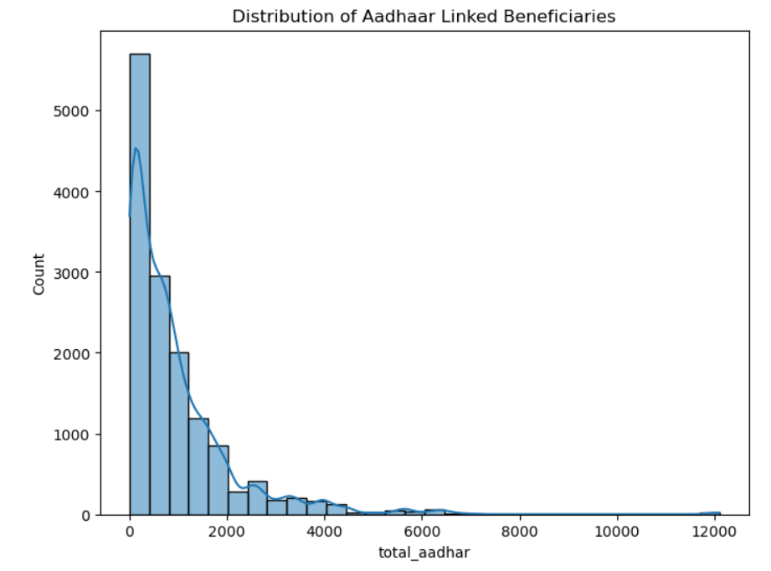
Identifies leading states in beneficiary numbers.

Slide 4
Data Visualization:
Understanding data distributions and trends over time is crucial. Histograms help visualize the frequency distribution of data values, highlighting patterns such as skewness or uniformity. In our dataset, histograms were used to examine the land extent distribution across the four divisions. Line charts are another powerful visualization that helps identify trends over time. By plotting the year on the x-axis and land extent on the y-axis, we observed changes in land extent across different years and divisions. This trend analysis allows us to detect fluctuations, increases, or decreases over time, which can be useful in decision-making and forecasting. Through these visualizations, we gained deeper insights into how land extent has evolved in each division over the years.

Slide 5
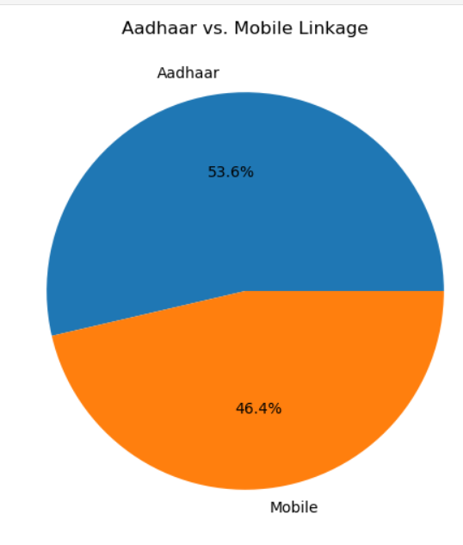
Highlights variations among states in Aadhaar linkage.

Slide 6
Correlation and Comparisons :
Scatter plots are useful for identifying relationships between two variables. In our dataset, scatter plots helped us analyze the correlation between different divisions' land extents. A strong positive correlation suggests that when land extent increases in one division, it tends to increase in another. Additionally, box plots were used to examine data distributions, outliers, and variability. Box plots show the median, quartiles, and outliers, allowing us to compare distributions across divisions effectively. These visualizations are critical in understanding relationships and variations within the dataset, enabling more informed interpretations and decisions.

Slide 7
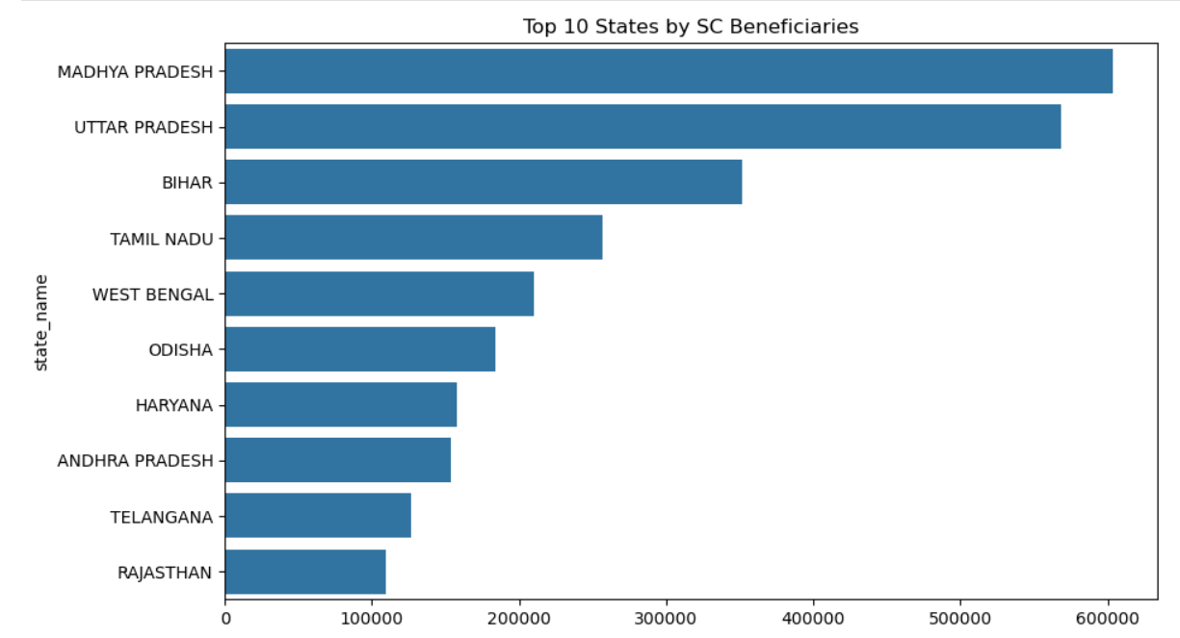
proportion compared to other categories.

Slide 8
Summary and Conclusion:
In summary, this presentation covered key aspects of data analysis and visualization. We started with handling missing values to ensure data completeness. We then explored different visualization techniques, including histograms for distribution analysis, line charts for trend identification, scatter plots for correlation analysis, and box plots for comparing distributions. These techniques provide valuable insights into the dataset, allowing us to understand patterns, relationships, and variations effectively. The ability to interpret and visualize data is essential for making informed decisions based on data-driven evidence. By leveraging these techniques, we can extract meaningful conclusions and enhance our understanding of datasets for various applications.

