Slide 1

Docker Commands

Slide 2
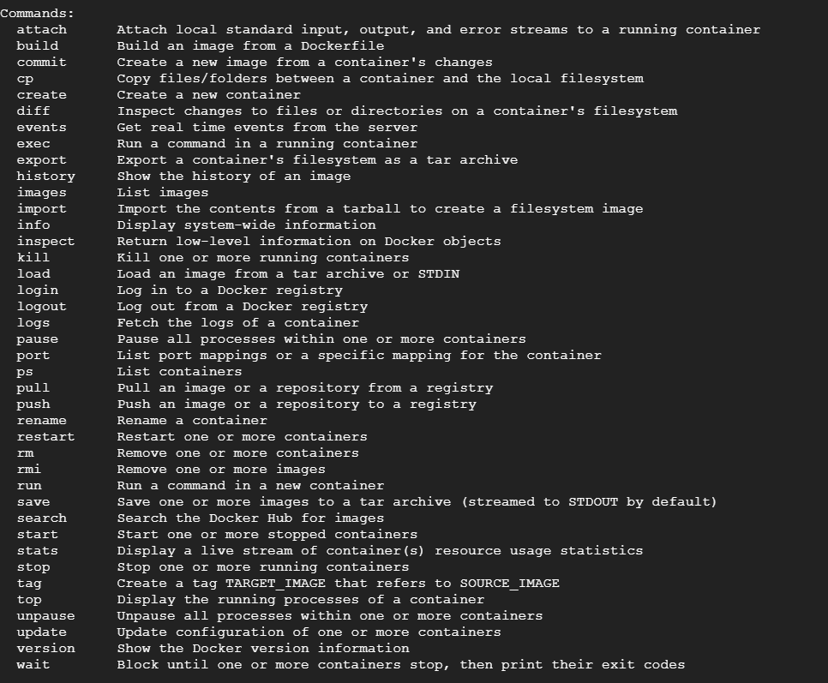

Slide 42
THANK YOU !!

