Slide 1



Slide 2
What is Linux?
Architecture of Linux
File system in Linux

Slide 3
What is Linux ?
The computer programs that allocate the system resources and coordinate all the details of the computer's internals is called the operating system or the kernel.
The Linux is also one of the operating system is a set of programs that act as a link between the computer and the user.
Users communicate with the kernel through a program known as the shell. The shell is a command line interpreter; it translates commands entered by the user and converts them into a language that is understood by the kernel.
Several people can use a Linux computer at the same time; hence Linux is called a multiuser system.
A user can also run multiple programs at the same time; hence Linux is a multitasking environment.

Slide 4
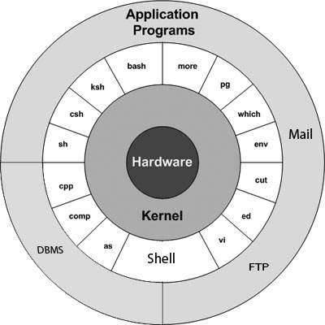
Linux Architecture
Kernel − The kernel is the heart of the operating system.
Shell − The shell is the utility that processes your requests.
Commands and Utilities − There are various commands and utilities which you can make use of in your day to day activities.
Files and Directories − All the data of Linux is organized into files. All files are then organized into directories.

Slide 5
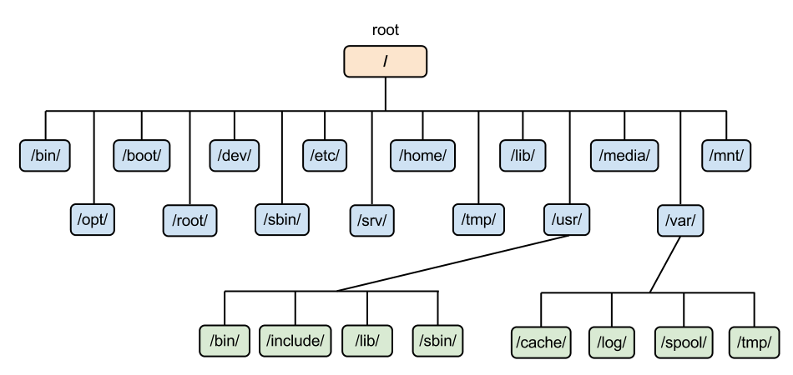
File system in Linux

Slide 6
man
the on line help provider command, gives the brief description, options and examples.
cal
the cal command is used to display calendar from 1 to 9999
date
the date command is used to see current date and time and also can be used for displaying date in different form
who
to list all users who are currently logged in
history
very useful command to show you all of the last commands that have been recently used

Slide 7
pwd
the pwd command check current directory.
basename
basename is a standard computer program on Linux and Linux-like operating systems. When basename is given a pathname, it will delete any prefix up to the last slash ( '/' ) character and return the result
cd
cd command changes directories to specified directory
directory name can be specified by using absolute path or relative path
ls
to list content of particular directory
options -l , -a, -R, -1

Slide 8
cat
cat command is used for displaying and creating files.
touch
used to create a single file or multiple empty files.
cp
cp command used to copy a file or group of files
rm
Remove file or directory
echo
echo command in linux is used to display line of text/string that are passed as an argument .

Slide 9
mv
mv stands for move. mv is used to move one or more files or directories from one place to another in file system like UNIX. It has two distinct functions: (i) It rename a file or folder. (ii) It moves group of files to different directory.
wc
On Linux and Unix-like operating systems, the wc command allows you to count the number of lines, words, characters, and bytes of each given file or standard input and print the result.
rev
rev command in Linux is used to reverse the lines characterwise. This utility basically reverses the order of the characters in each line by copying the specified files to the standard output. If no files are specified, then the standard input will read.
Pipe symbol ( | )

Slide 10
> : output redirection
>> : append redirection
< : input redirection
2> : error redirection

Slide 11
head
The head command, as the name implies, print the top N number of data of the given input.
tail
The tail command, as the name implies, print the last N number of data of the given input.
cut
The cut command in UNIX is a command for cutting out the sections from each line of files and writing the result to standard output. It can be used to cut parts of a line by byte position, character and field
sort
SORT command is used to sort a file, arranging the records in a particular order. By default, the sort command sorts file assuming the contents are ASCII. Options : -n -u -r
uniq
The uniq command in Linux is a command line utility that reports or filters out the repeated lines in a file. Options: -c -d

Slide 12
chmod
this command used to change file or directory permissions
chown
To change the owner ship of a file
mkdir
To create a directory we use this command
rmdir
rmdir command is used remove empty directories from the filesystem in Linux.

Slide 13
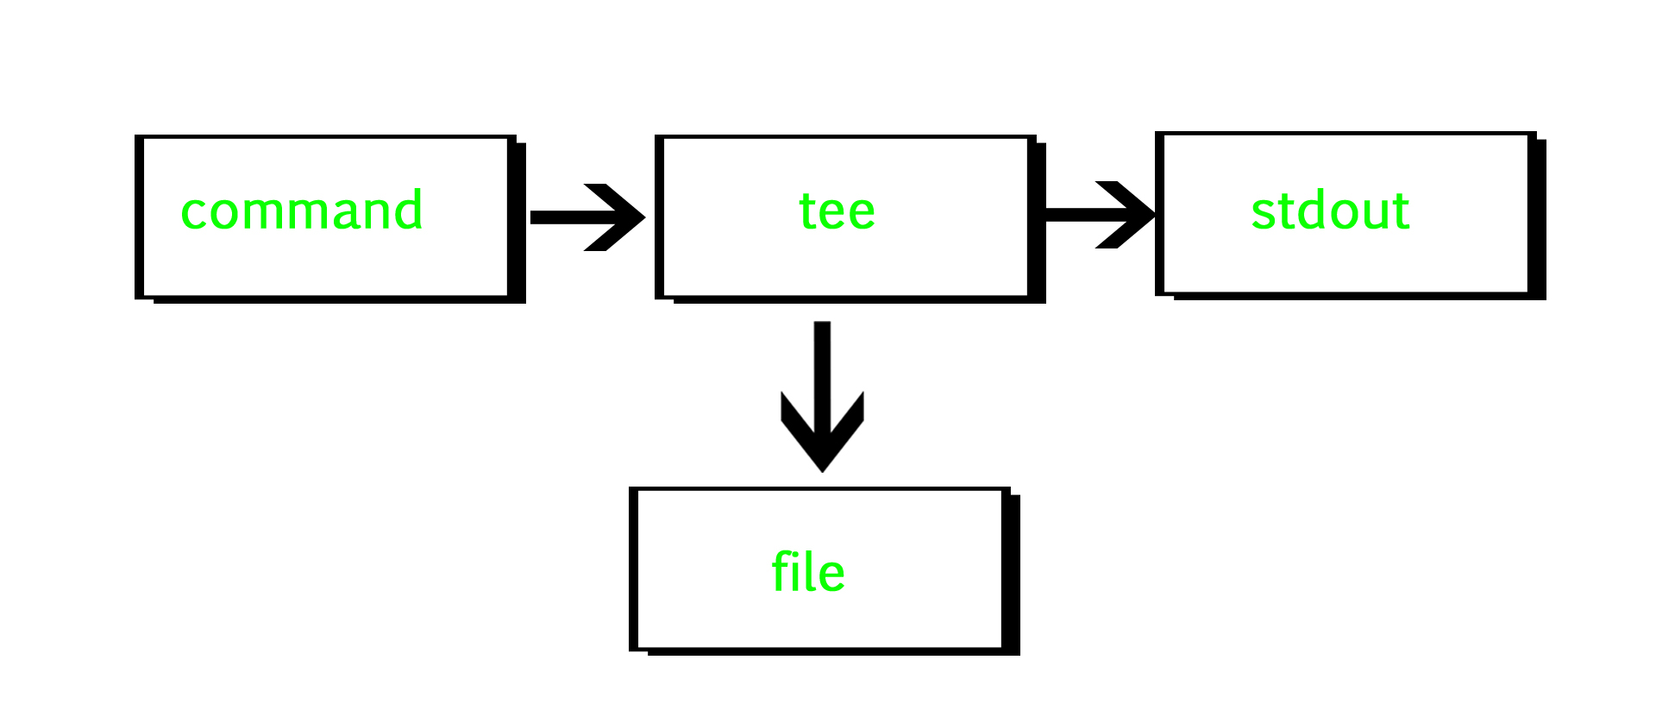
tee
tee command reads the standard input and writes it to both the standard output and one or more files
Examples:
df -h | tee disk_usage.txt
command | tee file1.out file2.out file3.out
command | tee -a file.out
find
The find command in UNIX is a command line utility for walking a file hierarchy. It can be used to find files and directories and perform subsequent operations on them. It supports searching by file, folder, name, creation date, modification date, owner and permissions.
Examples:
find folder_name - name sample.txt ( file_name )
find folder_name -name *.txt
find ./GFG -name sample.txt -exec rm -i {} \;
find ./GFG –empty
find ./GFG -perm 664
find ./ -type f -name "*.txt" -exec grep 'Geek' {} \;

Slide 14
grep
The grep filter searches a file for a particular pattern of characters and displays all lines that contain that pattern.
-c , -n, -v , -o
Wild card characters - *, ^, $
ps
ps command is used to list the currently running processes and their PIDs along with some other information depends on different options.
Options : -e, -a , -f , --sort=-%mem
nohup
command in Linux systems that keep processes running even after exiting the shell or terminal.
& → even if user logs out the process should be running
top
top command is used to show the Linux processes. It provides a dynamic real-time view of the running system
Kill – to kill a specific process we will use this command

Slide 15
netstat
netstat is one of the most basic network service debugging tools, telling you what ports are open and whether any programs are listening on ports.
Options :- -a, -t , -u , -l , -p
nslookup
Nslookup (stands for “Name Server Lookup”) is a useful command for getting information from DNS server.
ifconfig
The “ifconfig” command is used for displaying current network configuration information, setting up an ip address, netmask or broadcast address to an network interface, creating an alias for network interface, setting up hardware address and enable or disable network interfaces.

Slide 16
export
Export is a built-in command of the Bash shell. It is used to mark variables and functions to be passed to child processes.
sleep
sleep command is used to create a dummy job. A dummy job helps in delaying the execution.
du
du command, short for disk usage, is used to estimate file space usage. The du command can be used to track the files and directories which are consuming excessive amount of space on hard disk drive.
-h, -s, -d
df
df command that displays the amount of disk space available on the file system containing each file name argument.
Ex: df file_name
-h

Slide 17
xargs
The xargs command is used in a UNIX shell to convert input from standard input into arguments to a command.
Example: ls -1 | xarg rm
wget
Wget is the non-interactive network downloader which is used to download files from the server even when the user has not logged on to the system and it can work in the background without hindering the current process.
ping
The Linux ping command is a simple utility used to check whether a network is available and if a host is reachable.
tar
The Linux “tar” stands for tape archive, which is used by large number of Linux/Unix system administrators to deal with tape drives backup. The tar command used to rip a collection of files and directories into highly compressed archive file commonly called tarball or tar, gzip and bzip in Linux.
curl
curl is a command line tool to transfer data to or from a server, using any of the supported protocols (HTTP, FTP, IMAP, POP3, SCP, SFTP, SMTP, TFTP, TELNET, LDAP or FILE). curl is powered by Libcurl. This tool is preferred for automation, since it is designed to work without user interaction.
Example - curl https://www.geeksforgeeks.org

Slide 18
logname
he logname command prints the login name of the current user
useradd
useradd command to create new user accounts.
passwd
used to change the user account passwords
userdel
userdel command in Linux system is used to delete a user account and related files. getent passwd
To list all the user in linux or unix machine

Slide 19
groupadd
groupadd command is used to create a new user group.
Examples - groupadd developers and tail /etc/group
groupmod
groupmod command in Linux is used to modify or change the existing group on Linux system.
Example - groupmod -n group_new developers
groupdel
groupdel command is used to delete a existing group. Example – groupdel group_name
usermod
The most typical use case of the usermod is adding a user to a group.
sudo usermod -a -G games linuxize

Slide 20
sed
SED command in UNIX is stands for stream editor and it can perform lot’s of function on file like, searching, find and replace, insertion or deletion
Examples –
sed -n 's/unix/linux/p' geekfile.txt : it will print only matched lines after replacing specific word
sed '1,3 s/unix/linux/' geekfile.txt : You can specify a range of line numbers to the sed command for replacing a string.
sed '2,$ s/unix/linux/' geekfile.txt : Here $ indicates the last line in the file. So the sed command replaces the text from second line to last line in the file.
sed '5d' filename.txt
sed '$d' filename.txt
sed '3,6d' filename.txt
sed '12,$d' filename.txt
sed '/pattern/d' filename.txt

Slide 21
awk
Awk is a scripting language used for manipulating data and generating reports. The awk command programming language requires no compiling, and allows the user to use variables, numeric functions, string functions, and logical operators.
NR( current number of records), NF( number of fields), FS( field separator), OFS ( output field separator )
Syntax - awk options 'selection _criteria {action }' input-file > output-file
Examples:-
awk '{print}' employee.txt
awk '/manager/ {print}' employee.txt
awk '{print $1,$4}' employee.txt
awk '{print NR,$0}' employee.txt
awk '{print $1,$NF}' employee.txt
awk 'NR==3, NR==6 {print NR,$0}' employee.txt
awk '{ if($NF == "25000")print $1,$4,$NF}' employee.txt
awk 'length($0) > 10' employee.txt
echo "1: " | awk -F ":" '/1/ {print $1}'

Slide 22
cmp
cmp command in Linux/UNIX is used to compare the two files byte by byte and helps you to find out whether the two files are identical or not.
comm
comm compare two sorted files line by line and write to standard output; the lines that are common and the lines that are unique.
diff
diff is a command-line utility that allows you to compare two files line by line. It can also compare the contents of directories.
The diff command is most commonly used to create a patch containing the differences between one or more files that can be applied using the patch command
tr ( translate )
The tr command in UNIX is a command line utility for translating or deleting characters. It supports a range of transformations including uppercase to lowercase, squeezing repeating characters, deleting specific characters and basic find and replace
more

Slide 23
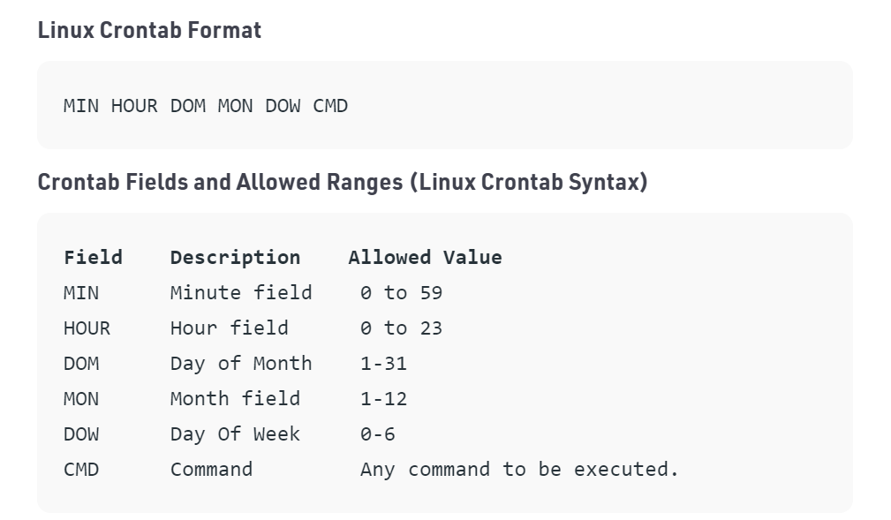

crontab
The crontab is a list of commands that you want to run on a regular schedule, and also the name of the command used to manage that list.

Slide 24
Shell Scripting

Slide 25
Vi editor
Nano
Visual studio code
Sublime
yum repository and apt-get

Slide 26
1 | $0 The filename of the current script.
2 | $n These variables correspond to the arguments with which a script was invoked. Here n is a positive decimal number corresponding to the position of an argument (the first argument is $1, the second argument is $2, and so on).
3 | $# The number of arguments supplied to a script.
4 | $* All the arguments are double quoted. If a script receives two arguments, $* is equivalent to $1 $2.
5 | $@ All the arguments are individually double quoted. If a script receives two arguments, $@ is equivalent to $1 $2.
6 | $? The exit status of the last command executed.
7 | $$ The process number of the current shell. For shell scripts, this is the process ID under which they are executing.
8 | $! The process number of the last background command.
While we creating shell scripts, we need keep few things in mind
Extension
Permissions
Shebang
Shell Variables
read

Slide 27
Operator | Description | Example
+ (Addition) | Adds values on either side of the operator | `expr $a + $b` will give 30
- (Subtraction) | Subtracts right hand operand from left hand operand | `expr $a - $b` will give -10
* (Multiplication) | Multiplies values on either side of the operator | `expr $a \* $b` will give 200
/ (Division) | Divides left hand operand by right hand operand | `expr $b / $a` will give 2
% (Modulus) | Divides left hand operand by right hand operand and returns remainder | `expr $b % $a` will give 0
= (Assignment) | Assigns right operand in left operand | a = $b would assign value of b into a
== (Equality) | Compares two numbers, if both are same then returns true. | [ $a == $b ] would return false.
!= (Not Equality) | Compares two numbers, if both are different then returns true. | [ $a != $b ] would return true.
Arithmetic Operators
Relational Operators
Boolean Operators
String Operators
File Test Operators

Slide 28
Operator | Description | Example
-eq | Checks if the value of two operands are equal or not; if yes, then the condition becomes true. | [ $a -eq $b ] is not true.
-ne | Checks if the value of two operands are equal or not; if values are not equal, then the condition becomes true. | [ $a -ne $b ] is true.
-gt | Checks if the value of left operand is greater than the value of right operand; if yes, then the condition becomes true. | [ $a -gt $b ] is not true.
-lt | Checks if the value of left operand is less than the value of right operand; if yes, then the condition becomes true. | [ $a -lt $b ] is true.
-ge | Checks if the value of left operand is greater than or equal to the value of right operand; if yes, then the condition becomes true. | [ $a -ge $b ] is not true.
-le | Checks if the value of left operand is less than or equal to the value of right operand; if yes, then the condition becomes true. | [ $a -le $b ] is true.
Arithmetic Operators
Relational Operators
Boolean Operators
String Operators
File Test Operators

Slide 29
Operator | Description | Example
! | This is logical negation. This inverts a true condition into false and vice versa. | [ ! false ] is true.
-o | This is logical OR. If one of the operands is true, then the condition becomes true. | [ $a -lt 20 -o $b -gt 100 ] is true.
-a | This is logical AND. If both the operands are true, then the condition becomes true otherwise false. | [ $a -lt 20 -a $b -gt 100 ] is false.
Arithmetic Operators
Relational Operators
Boolean Operators
String Operators
File Test Operators

Slide 30
Operator | Description | Example
= | Checks if the value of two operands are equal or not; if yes, then the condition becomes true. | [ $a = $b ] is not true.
!= | Checks if the value of two operands are equal or not; if values are not equal then the condition becomes true. | [ $a != $b ] is true.
-z | Checks if the given string operand size is zero; if it is zero length, then it returns true. | [ -z $a ] is not true.
-n | Checks if the given string operand size is non-zero; if it is nonzero length, then it returns true. | [ -n $a ] is not false.
str | Checks if str is not the empty string; if it is empty, then it returns false. | [ $a ] is not false.
Arithmetic Operators
Relational Operators
Boolean Operators
String Operators
File Test Operators

Slide 31
Operator | Description | Example
-b file | Checks if file is a block special file; if yes, then the condition becomes true. | [ -b $file ] is false.
-c file | Checks if file is a character special file; if yes, then the condition becomes true. | [ -c $file ] is false.
-d file | Checks if file is a directory; if yes, then the condition becomes true. | [ -d $file ] is not true.
-f file | Checks if file is an ordinary file as opposed to a directory or special file; if yes, then the condition becomes true. | [ -f $file ] is true.
-g file | Checks if file has its set group ID (SGID) bit set; if yes, then the condition becomes true. | [ -g $file ] is false.
-k file | Checks if file has its sticky bit set; if yes, then the condition becomes true. | [ -k $file ] is false.
-p file | Checks if file is a named pipe; if yes, then the condition becomes true. | [ -p $file ] is false.
-t file | Checks if file descriptor is open and associated with a terminal; if yes, then the condition becomes true. | [ -t $file ] is false.
-u file | Checks if file has its Set User ID (SUID) bit set; if yes, then the condition becomes true. | [ -u $file ] is false.
-r file | Checks if file is readable; if yes, then the condition becomes true. | [ -r $file ] is true.
-w file | Checks if file is writable; if yes, then the condition becomes true. | [ -w $file ] is true.
-x file | Checks if file is executable; if yes, then the condition becomes true. | [ -x $file ] is true.
-s file | Checks if file has size greater than 0; if yes, then condition becomes true. | [ -s $file ] is true.
-e file | Checks if file exists; is true even if file is a directory but exists. | [ -e $file ] is true.
Arithmetic Operators
Relational Operators
Boolean Operators
String Operators
File Test Operators

Slide 32
if...fi statement
if...else...fi statement
if...elif...else...fi statement
case...esac
while loop
for loop
break
continue

