Slide 1


SMART INDIA HACKATHON 2025
TITLE PAGE
Problem Statement ID –SIH1534
Problem Statement Title –Student innovation-DYNAMIC PAKRKING
Theme-Transportation and logistics
PS Category- Software and Hardware
Team ID- 44
Team Name (Registered on portal)-Acro Wizards

Slide 2
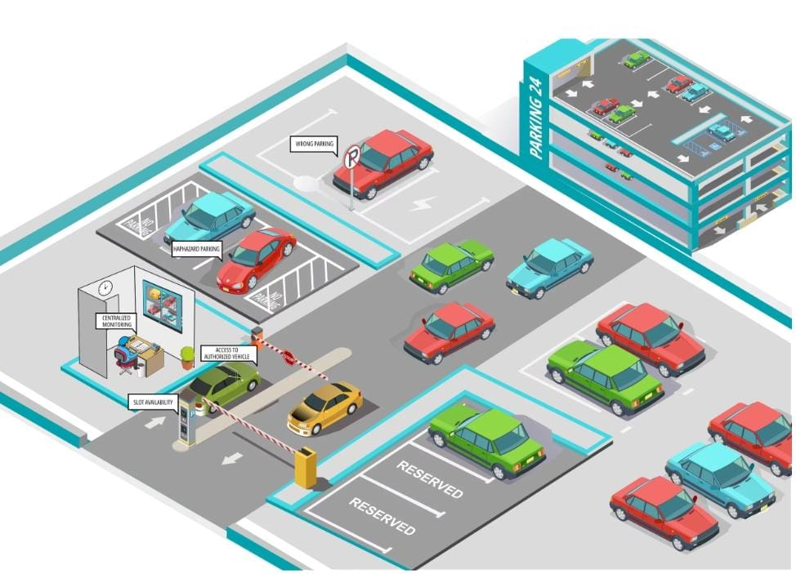
PROBLEM STATEMENT
ACRO WIZARDS
Ideas to address the growing pressure on the cities resources ,student innovation, transport network and logistic infrastructure
With rapid increase in the number of vehicles ,cities are facing several parking challenges like fuel wastage .Dynamic parking system is required to optimise slot allocation and improve user convince
HOW?
A dynamic parking management system is required to optimize slot allocation and improve user convince.
The system can implement dynamic pricing strategies, adjusting rates based on demand, and allow for pre-booking of parking slots to optimize space allocation.

Slide 3
SOLUTION
ACRO WIZARDS
PROJECT OBJECTIVES:
Design an efficient parking system to provide statistical information and enhance the security of utility.
Saving people‘s time in finding parking lots.
SOLUTION:
By implementing a dynamic parking management system provides real time availability, monitoring and seamless parking
WHY WE USE THIS SOLUTION:
Traditional parking system Rails because the lack of real time monitoring, long search times, and user inconvience. A dynamic parking system enables and smart management efficient space utilization through real-time monitoring
SOFTWARE APPROACH:
1) Vehicle entry and slot allocation
2) Real time monitoring and Guidance
3) Payment processing
4) Exit and automated Billing
5) Data collection and Reporting.

Slide 4
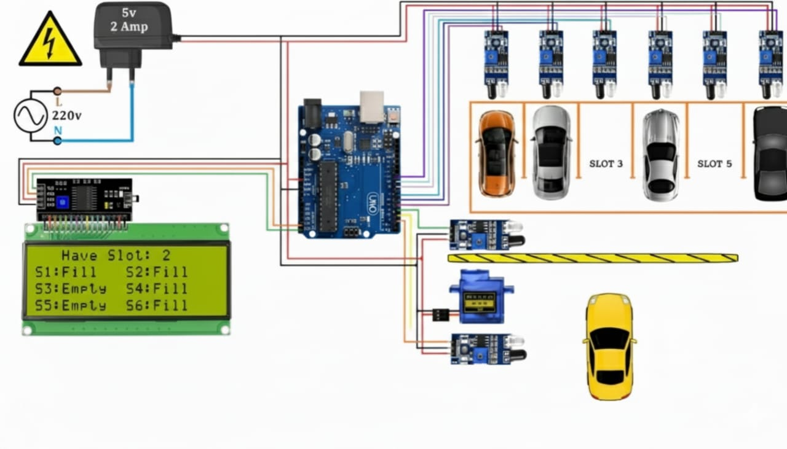
TECHNICAL APPROACH
ACRO WIZARDS
The Dynamic Parking Management System is an innovative solution designed to optimize parking space utilization. This system, as depicted in the circuit diagram, leverages an Arduino board to manage and monitor six parking slots. Sensors detect whether each slot is filled or empty, displaying the status on an LCD screen. A 5V 2A power supply ensures stable operation, converting 220V AC input for the system's needs. With real-time updates on slot availability, this system aims to streamline parking operations, reduce congestion, and enhance user experience in parking facilities.
DYNAMIC PARKING MANAGEMENT SYSTEM

Slide 5
IMPACT AND BENEFITS
ACRO WIZARDS
Potential impact on the target audience:
Providing clear instructions and support to help users understand and able adopt the new system
Designed the system to be accessible and user-friendly for all users.
Benefits of the solution :
Reduced traffic congestion due to parking searches
Increased parking revenue through optimized pricing
Better user experience with easy parking spot location
FUTURE SCOPE:
Smart parking systems will communicate directly with self-driving cars ,guiding them to available spots and park
Real-time monitoring and management of parking spaces will become more prevalent, optimizing space usage and
reducing congestion.
Will enable online pre-payment and streamline the parking process.

Slide 6
CONCLUSION AND FUTURE WORK
ACRO WIZARDS
The idea was to solve current parking problems using a secured wireless network, sensor communication, and IOT.
This system includes features like Parking Guidance System, Parking Reservation System, Parking Booking and Payment System, and Automatic Driverless Vehicle Parking Facility to provide the best possible parking solution to the customer.
It offers appropriate vacant parking space information along with booking and recommendation options to facilitate vehicles in a practical, real-time, and precise manner.
The designed system prototype incorporates a smart driverless vehicle parking facility based on line tracking technology.

