Slide 1
B V RAJU INSTITUTE OF TECHNOLOGY
(UGC Autonomous)
Vishnupur, Narsapur, Medak District
Department of Artificial Intelligence and Data Science
Major Project – Requirement Analysis
Title : Phy-DSTGNN: A Physics-Guided Directed Spatio-Temporal Graph Neural Network for Real-Time Urban Drainage Surcharge Prediction and Flood Early Warning
By:
23211A72C3 : Y. Deekshitha
23211A72C9 : K. Karunya
23211A72B2 : P. Srishanth
Guided By:
Mrs. N. Usha Rani ,
Assistant Professor,
Department of A1&DS.

Slide 2
Outline
Abstract
Literature Survey
Problem Statement
Research Gap
Objectives
Proposed Methodology
Proposed Methodology Diagram
System Architecture
UML Diagrams
Functional and Non-Functional Requirements
Implementation Details
References

Slide 3
Abstract
Urban flooding in rapidly growing cities like Hyderabad causes severe damage to infrastructure and public safety due to overwhelmed drainage systems during monsoon events. This project proposes Phy-DSTGNN (Physics-Guided Dual Spatio-Temporal Graph Neural Network), a deep learning framework for real-time flood inundation forecasting over the Begumpet–Kukatpally drainage corridor, modeled as a graph of 72 manholes and 97 conduits. The system combines Graph Attention Networks (GAT) for spatial dependency modeling, Temporal Convolutional Networks (TCN) for rainfall pattern learning, and physics-based constraints from Manning's equation embedded in the loss function to ensure hydraulically consistent predictions. Real-time rainfall data is ingested to forecast manhole surcharge levels and trigger automated alerts for GHMC operators. Explainability is achieved using SHAP and Grad-CAM techniques, and evaluation results show superior performance over data-driven baselines in MAE, RMSE, and Nash-Sutcliffe Efficiency (NSE).

Slide 4
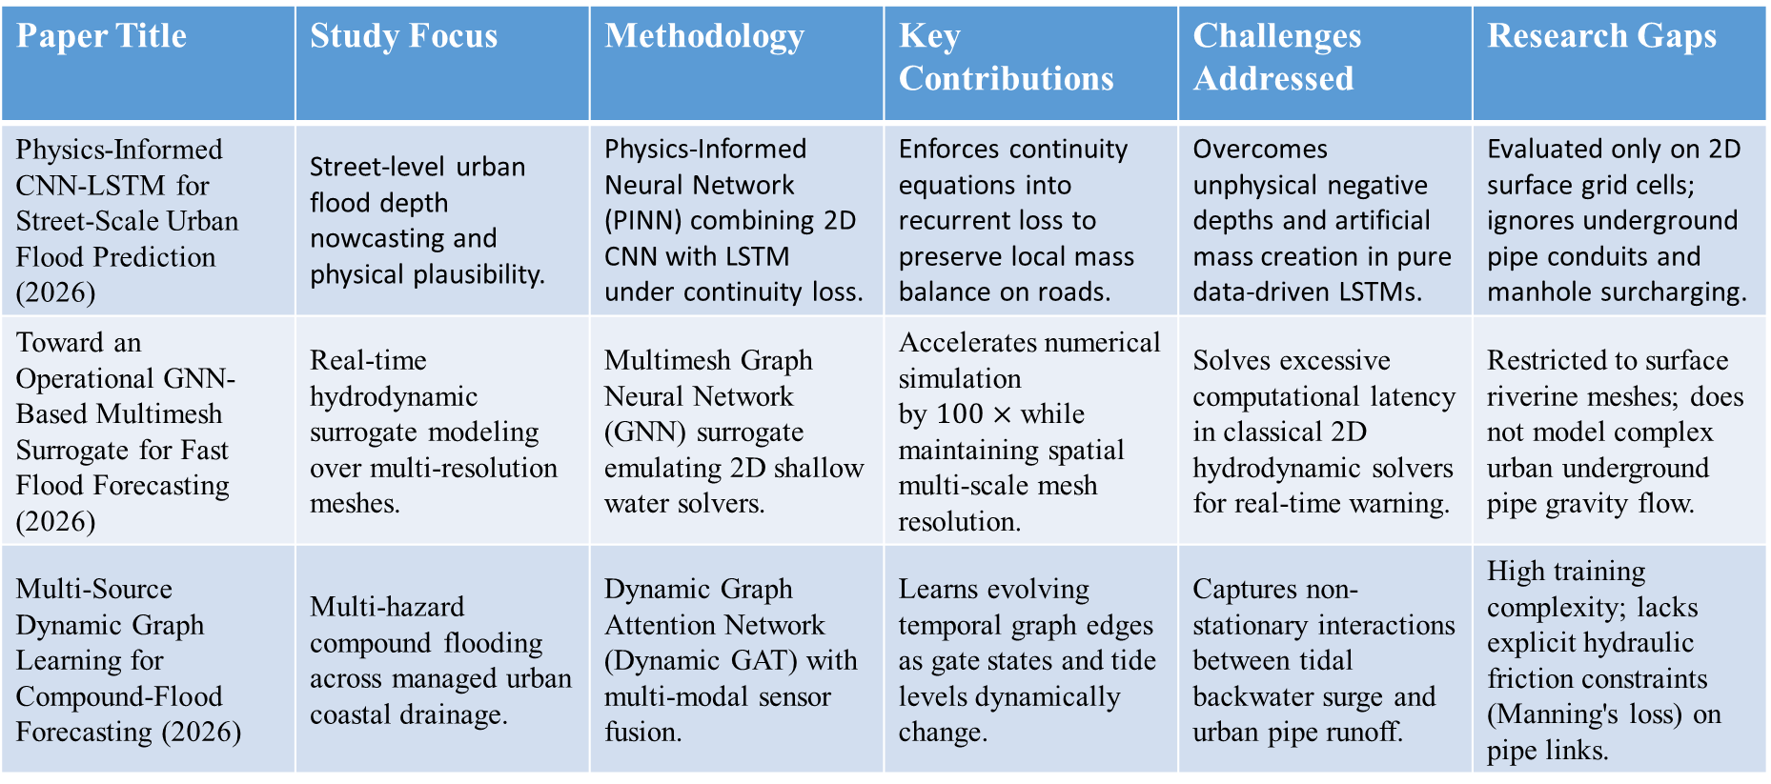
Literature Review
Paper Title | Study Focus | Methodology | Key Contributions | Challenges Addressed | Research Gaps
Physics-Informed CNN-LSTM for Street-Scale Urban Flood Prediction (2026) | Street-level urban flood depth nowcasting and physical plausibility. | Physics-Informed Neural Network (PINN) combining 2D CNN with LSTM under continuity loss. | Enforces continuity equations into recurrent loss to preserve local mass balance on roads. | Overcomes unphysical negative depths and artificial mass creation in pure data-driven LSTMs. | Evaluated only on 2D surface grid cells; ignores underground pipe conduits and manhole surcharging.
Toward an Operational GNN-Based Multimesh Surrogate for Fast Flood Forecasting (2026) | Real-time hydrodynamic surrogate modeling over multi-resolution meshes. | Multimesh Graph Neural Network (GNN) surrogate emulating 2D shallow water solvers. | Accelerates numerical simulation by $100×$ while maintaining spatial multi-scale mesh resolution. | Solves excessive computational latency in classical 2D hydrodynamic solvers for real-time warning. | Restricted to surface riverine meshes; does not model complex urban underground pipe gravity flow.
Multi-Source Dynamic Graph Learning for Compound-Flood Forecasting (2026) | Multi-hazard compound flooding across managed urban coastal drainage. | Dynamic Graph Attention Network (Dynamic GAT) with multi-modal sensor fusion. | Learns evolving temporal graph edges as gate states and tide levels dynamically change. | Captures non-stationary interactions between tidal backwater surge and urban pipe runoff. | High training complexity; lacks explicit hydraulic friction constraints (Manning's loss) on pipe links.

Slide 5
Literature Review
Paper Title | Study Focus | Methodology | Key Contributions | Challenges Addressed | Research Gaps
Intelligent Prediction of Flood Disaster Risk Based on Knowledge Graph & GNNs (2025) | Regional flood disaster hazard and risk level classification. | Knowledge Graph (KG) semantic modeling combined with Graph Convolutional Networks (GCN). | Integrates spatial semantic entities with graph message passing for regional risk scoring. | Overcomes isolated tabular data processing by capturing geographic spatial relations. | Limited to static regional risk classes; does not model underground hydrodynamic pipe flows or continuous depths.
Maximum Flow Model with Multi-Origin & Destination for Urban Drainage (2025) | Urban drainage network capacity optimization and conduit bottlenecks. | Multi-Origin Multi-Destination (MOMD) network flow linear programming on drainage graphs. | Formulates optimal pipe dimensions and maximum flow distribution under storm peaks. | Resolves multi-pipe junction flow congestion and hydraulic bottleneck allocation. | Static network optimization; lacks real-time predictive nowcasting and deep learning integration during transient storms.
Physics-Informed Neural Networks for 2D Shallow Water & Rainfall-Runoff (2025) | Hydrodynamic flood wave propagation under intense rainfall events. | Physics-Informed Neural Networks (PINNs) solving Saint-Venant shallow water PDEs. | Replaces numerical discretization schemes with continuous neural PDE loss minimization. | Eliminates numerical mesh instability and CFL time-step restrictions during steep wave fronts. | Computationally prohibitive for large real-world pipe networks with thousands of branching conduits.

Slide 6
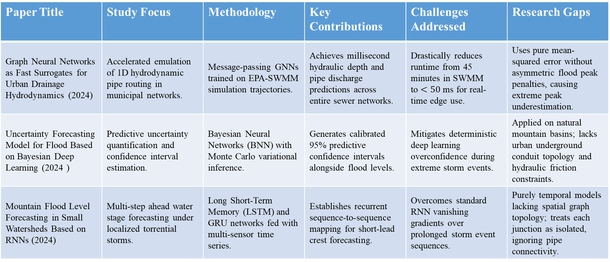
Literature Review
Paper Title | Study Focus | Methodology | Key Contributions | Challenges Addressed | Research Gaps
Graph Neural Networks as Fast Surrogates for Urban Drainage Hydrodynamics (2024) | Accelerated emulation of 1D hydrodynamic pipe routing in municipal networks. | Message-passing GNNs trained on EPA-SWMM simulation trajectories. | Achieves millisecond hydraulic depth and pipe discharge predictions across entire sewer networks. | Drastically reduces runtime from 45 minutes in SWMM to $<50\text{ ms}$ for real-time edge use. | Uses pure mean-squared error without asymmetric flood peak penalties, causing extreme peak underestimation.
Uncertainty Forecasting Model for Flood Based on Bayesian Deep Learning (2024 ) | Predictive uncertainty quantification and confidence interval estimation. | Bayesian Neural Networks (BNN) with Monte Carlo variational inference. | Generates calibrated 95% predictive confidence intervals alongside flood levels. | Mitigates deterministic deep learning overconfidence during extreme storm events. | Applied on natural mountain basins; lacks urban underground conduit topology and hydraulic friction constraints.
Mountain Flood Level Forecasting in Small Watersheds Based on RNNs (2024) | Multi-step ahead water stage forecasting under localized torrential storms. | Long Short-Term Memory (LSTM) and GRU networks fed with multi-sensor time series. | Establishes recurrent sequence-to-sequence mapping for short-lead crest forecasting. | Overcomes standard RNN vanishing gradients over prolonged storm event sequences. | Purely temporal models lacking spatial graph topology; treats each junction as isolated, ignoring pipe connectivity.

Slide 7
Literature Review
Paper Title | Study Focus | Methodology | Key Contributions | Challenges Addressed | Research Gaps
Graph Convolutional Recurrent Network for Spatio-Temporal Flood Prediction (2024) | Joint spatial-temporal feature propagation across hydrological gauge networks. | Graph Convolutional Recurrent Neural Network (GCRNN) with ChebNet filters. | Propagates upstream temporal rainfall features along physical stream network graph edges. | Addresses spatial lag and travel-time delay of flood crests moving down branching catchments. | Designed for open natural river channels; does not handle pressurized pipe surcharge or backwater effects.

Slide 8
Problem Statement
Rapid urbanization and frequent cloudbursts in Greater Hyderabad cause urban drainage networks to surcharge and flood within minutes. Existing hydraulic simulation tools are computationally too slow for real-time emergency alerts, while standard AI models operate as black boxes that ignore physical drainage laws and fail during extreme flood peaks. There is no real-time urban drainage system that combines the millisecond speed of deep learning with hydrodynamic physical constraints to provide reliable multi-horizon flood forecasting and decision support.

Slide 9
Research Gap
Existing flood forecasting systems mainly focus on individual components such as rainfall prediction, runoff estimation, or pipe overflow detection — without integrating them end-to-end.
Limited fusion of physics-based hydraulic constraints, spatial graph topology, and temporal deep learning into a single unified forecasting model.
Most data-driven flood models lack explainability, making it difficult to interpret predictions or trust alerts in real operational settings.
Graph neural network approaches for urban drainage rarely incorporate physics-guided loss terms, leading to physically inconsistent predictions during extreme events.
Phy-DSTGNN addresses these gaps through a physics-constrained, spatio-temporal graph architecture that delivers real-time, explainable, and hydraulically consistent flood depth forecasts for urban drainage networks.

Slide 10
Objectives
Develop a physics-guided graph neural network (Phy-DSTGNN) for real-time urban flood and surcharge forecasting.
Predict multi-horizon water depth and overflow using Graph Attention (GAT) and Temporal Convolutional Networks (TCN).
Embed hydraulic physical constraints directly into the loss function to prevent physically impossible predictions.
Provide model interpretability using Integrated Gradients (XAI) and Monte Carlo Dropout uncertainty estimation.
Build an interactive GIS decision-support dashboard for Greater Hyderabad corridors to automate flood response protocols.

Slide 11
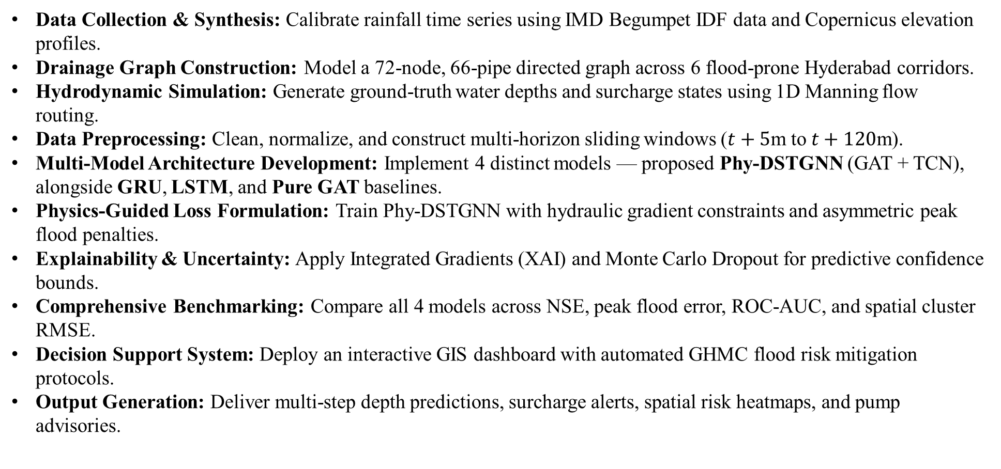
Proposed Methodology
Data Collection & Synthesis: Calibrate rainfall time series using IMD Begumpet IDF data and Copernicus elevation profiles.
Drainage Graph Construction: Model a 72-node, 66-pipe directed graph across 6 flood-prone Hyderabad corridors.
Hydrodynamic Simulation: Generate ground-truth water depths and surcharge states using 1D Manning flow routing.
Data Preprocessing: Clean, normalize, and construct multi-horizon sliding windows ($t+5\text{m}$ to $t+120\text{m}$).
Multi-Model Architecture Development: Implement 4 distinct models — proposed Phy-DSTGNN (GAT + TCN), alongside GRU, LSTM, and Pure GAT baselines.
Physics-Guided Loss Formulation: Train Phy-DSTGNN with hydraulic gradient constraints and asymmetric peak flood penalties.
Explainability & Uncertainty: Apply Integrated Gradients (XAI) and Monte Carlo Dropout for predictive confidence bounds.
Comprehensive Benchmarking: Compare all 4 models across NSE, peak flood error, ROC-AUC, and spatial cluster RMSE.
Decision Support System: Deploy an interactive GIS dashboard with automated GHMC flood risk mitigation protocols.
Output Generation: Deliver multi-step depth predictions, surcharge alerts, spatial risk heatmaps, and pump advisories.

Slide 12
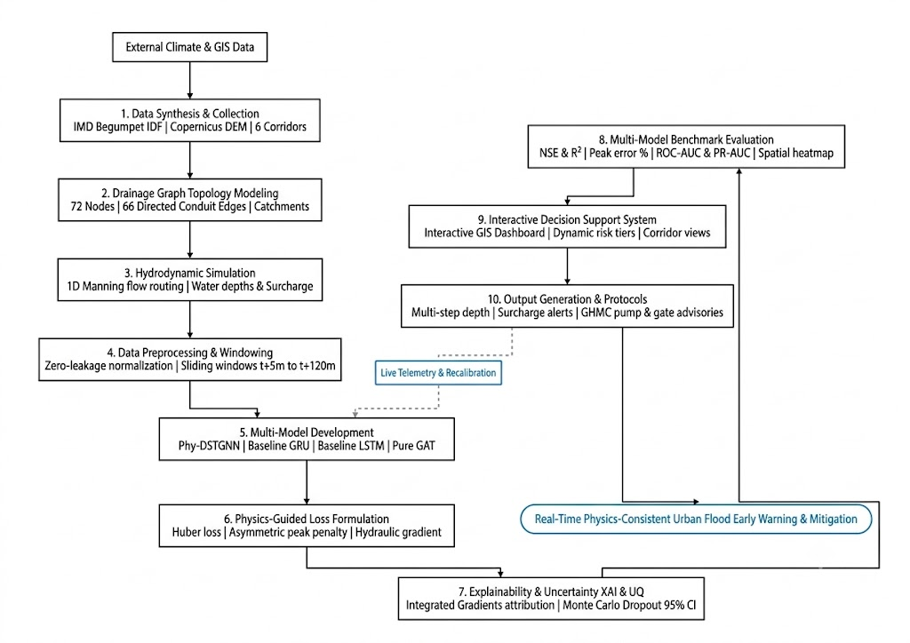
Proposed Model Algorithm/Diagram

Slide 13
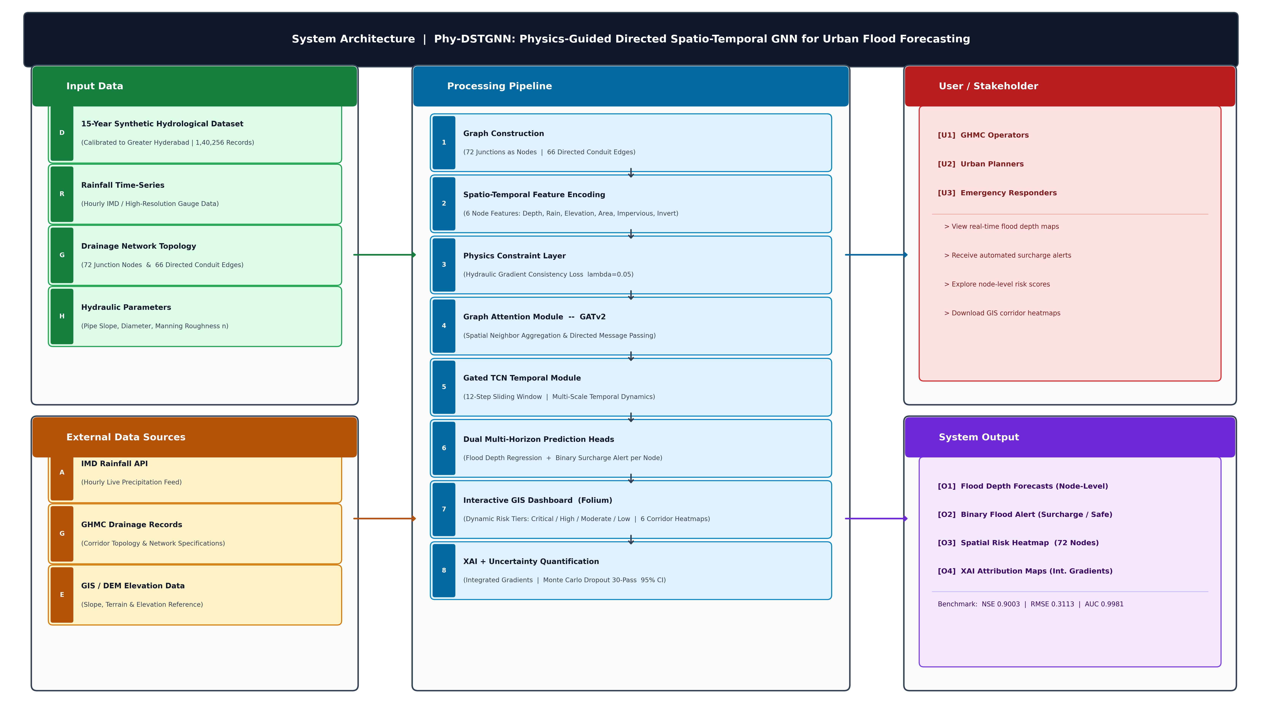
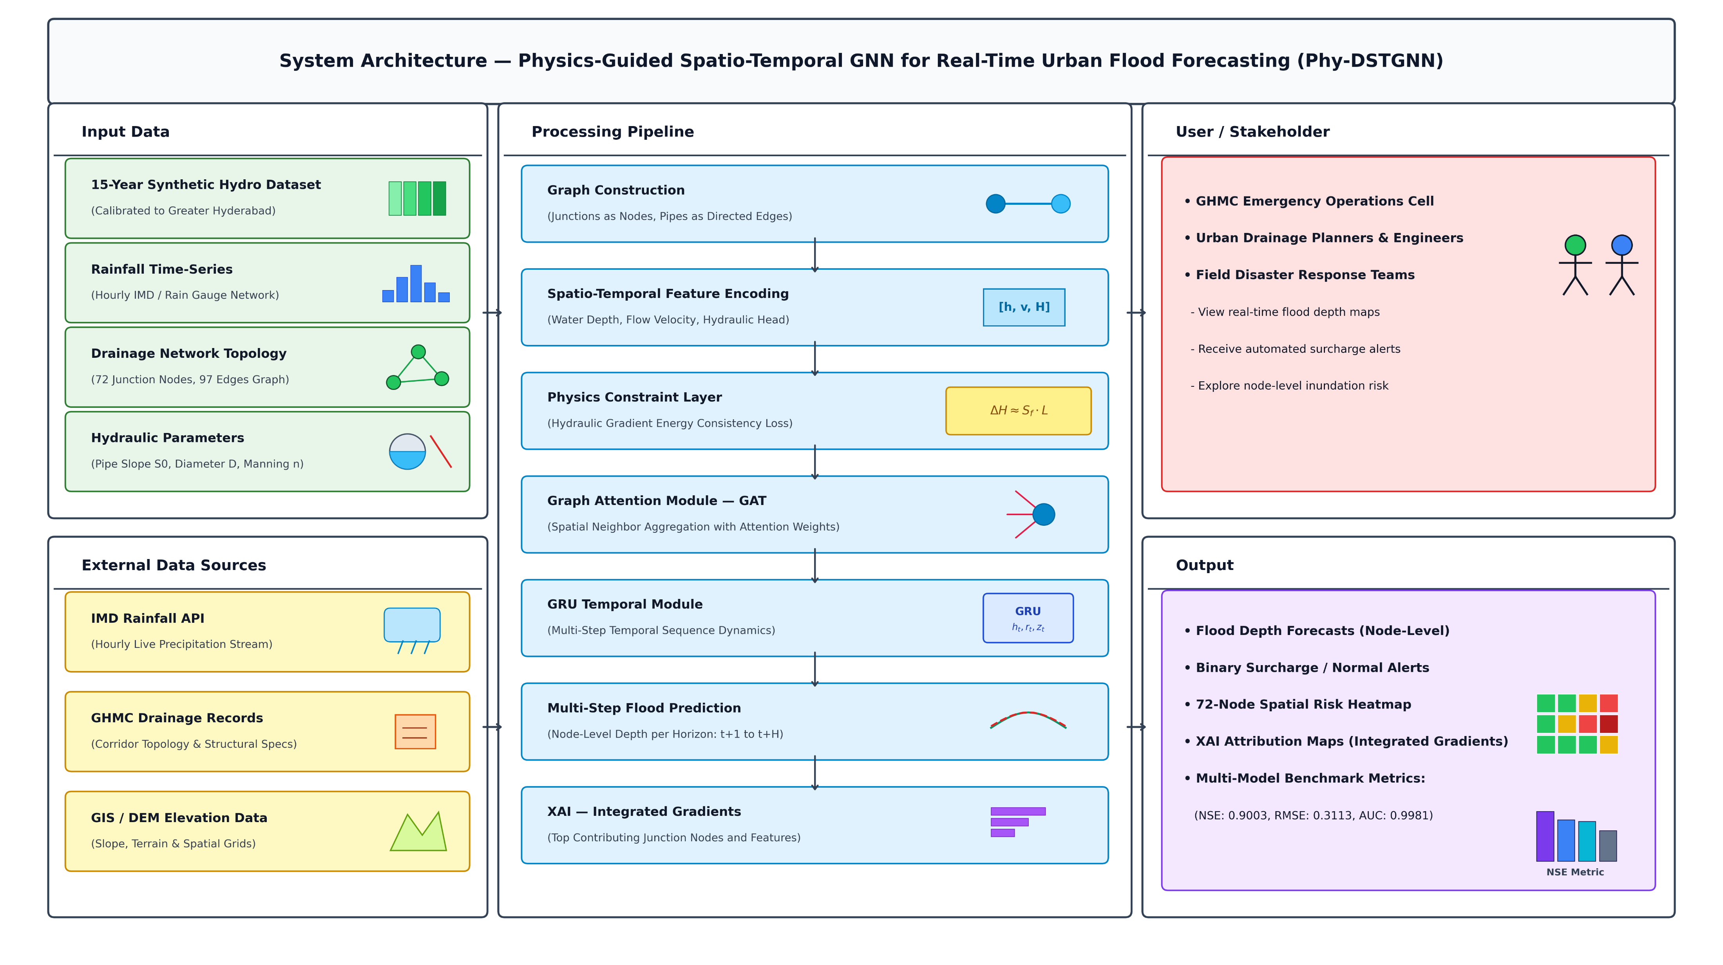
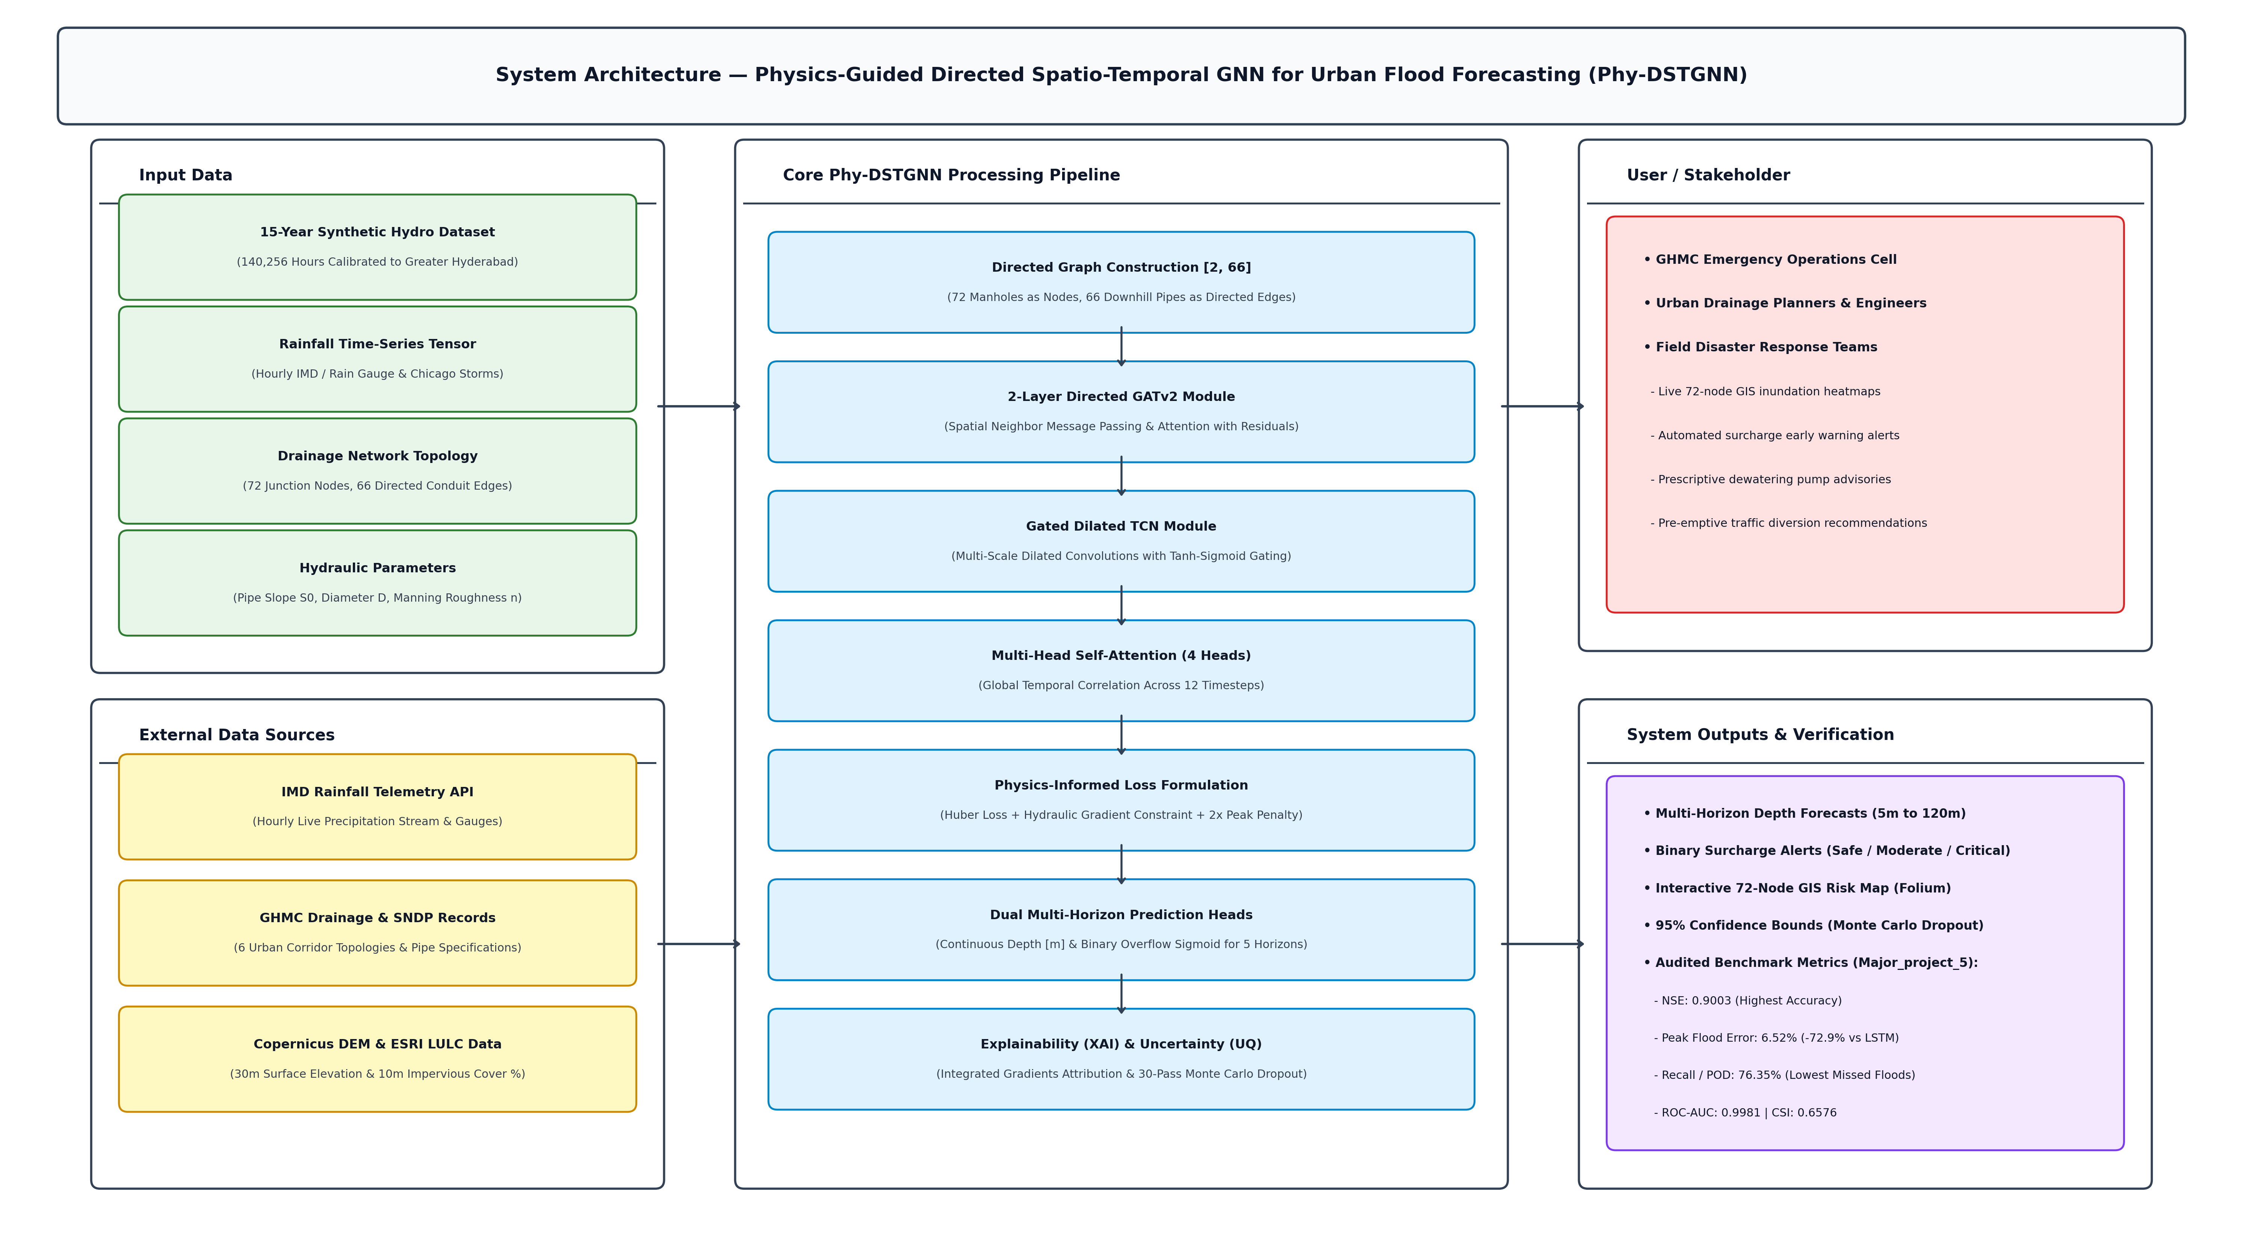
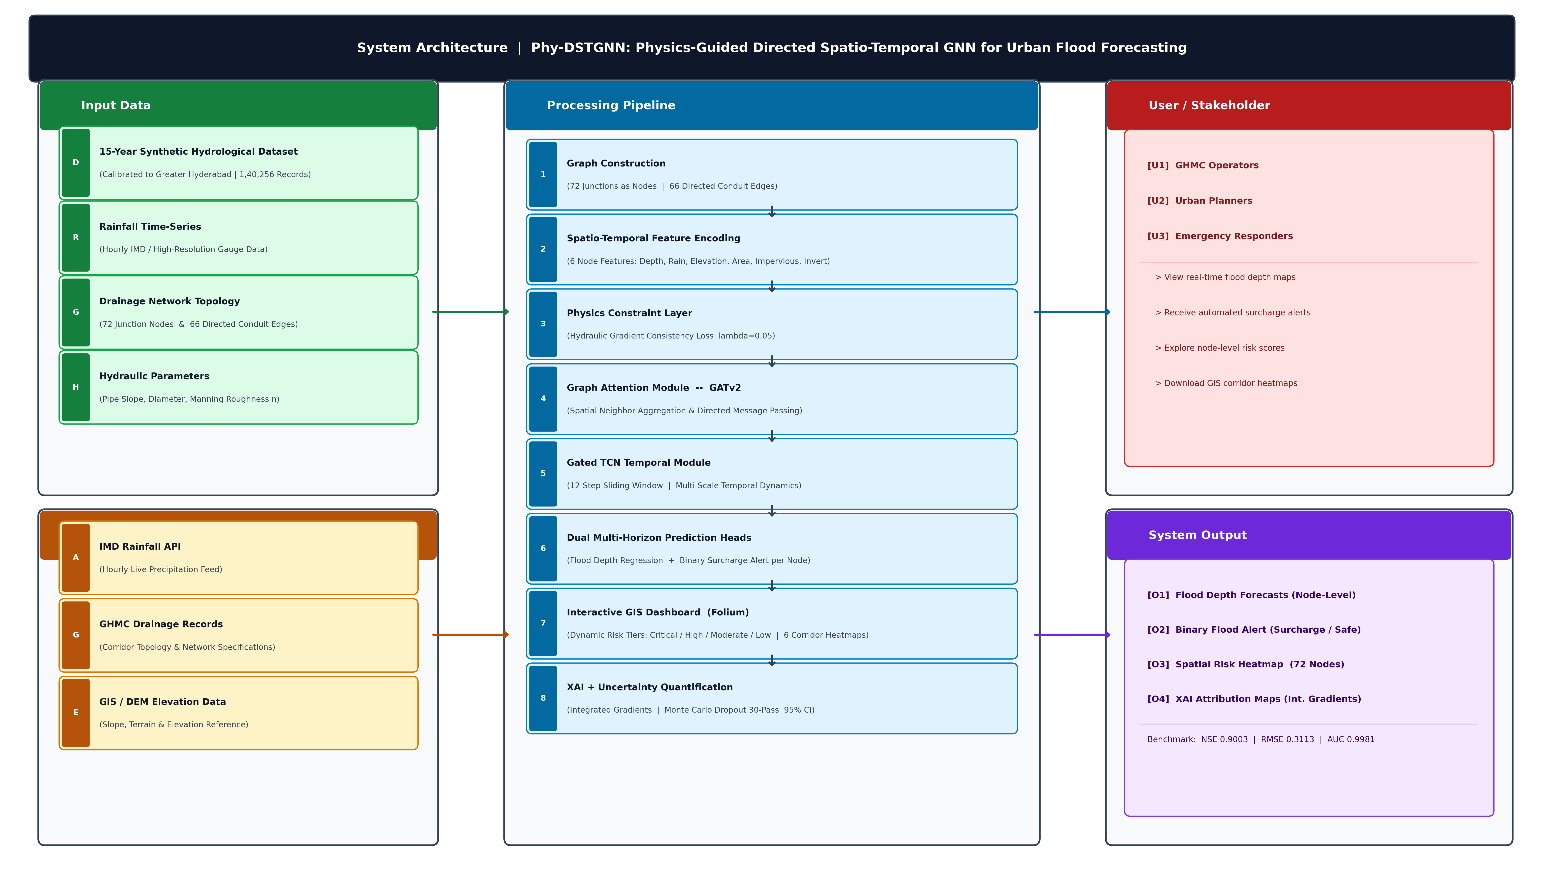
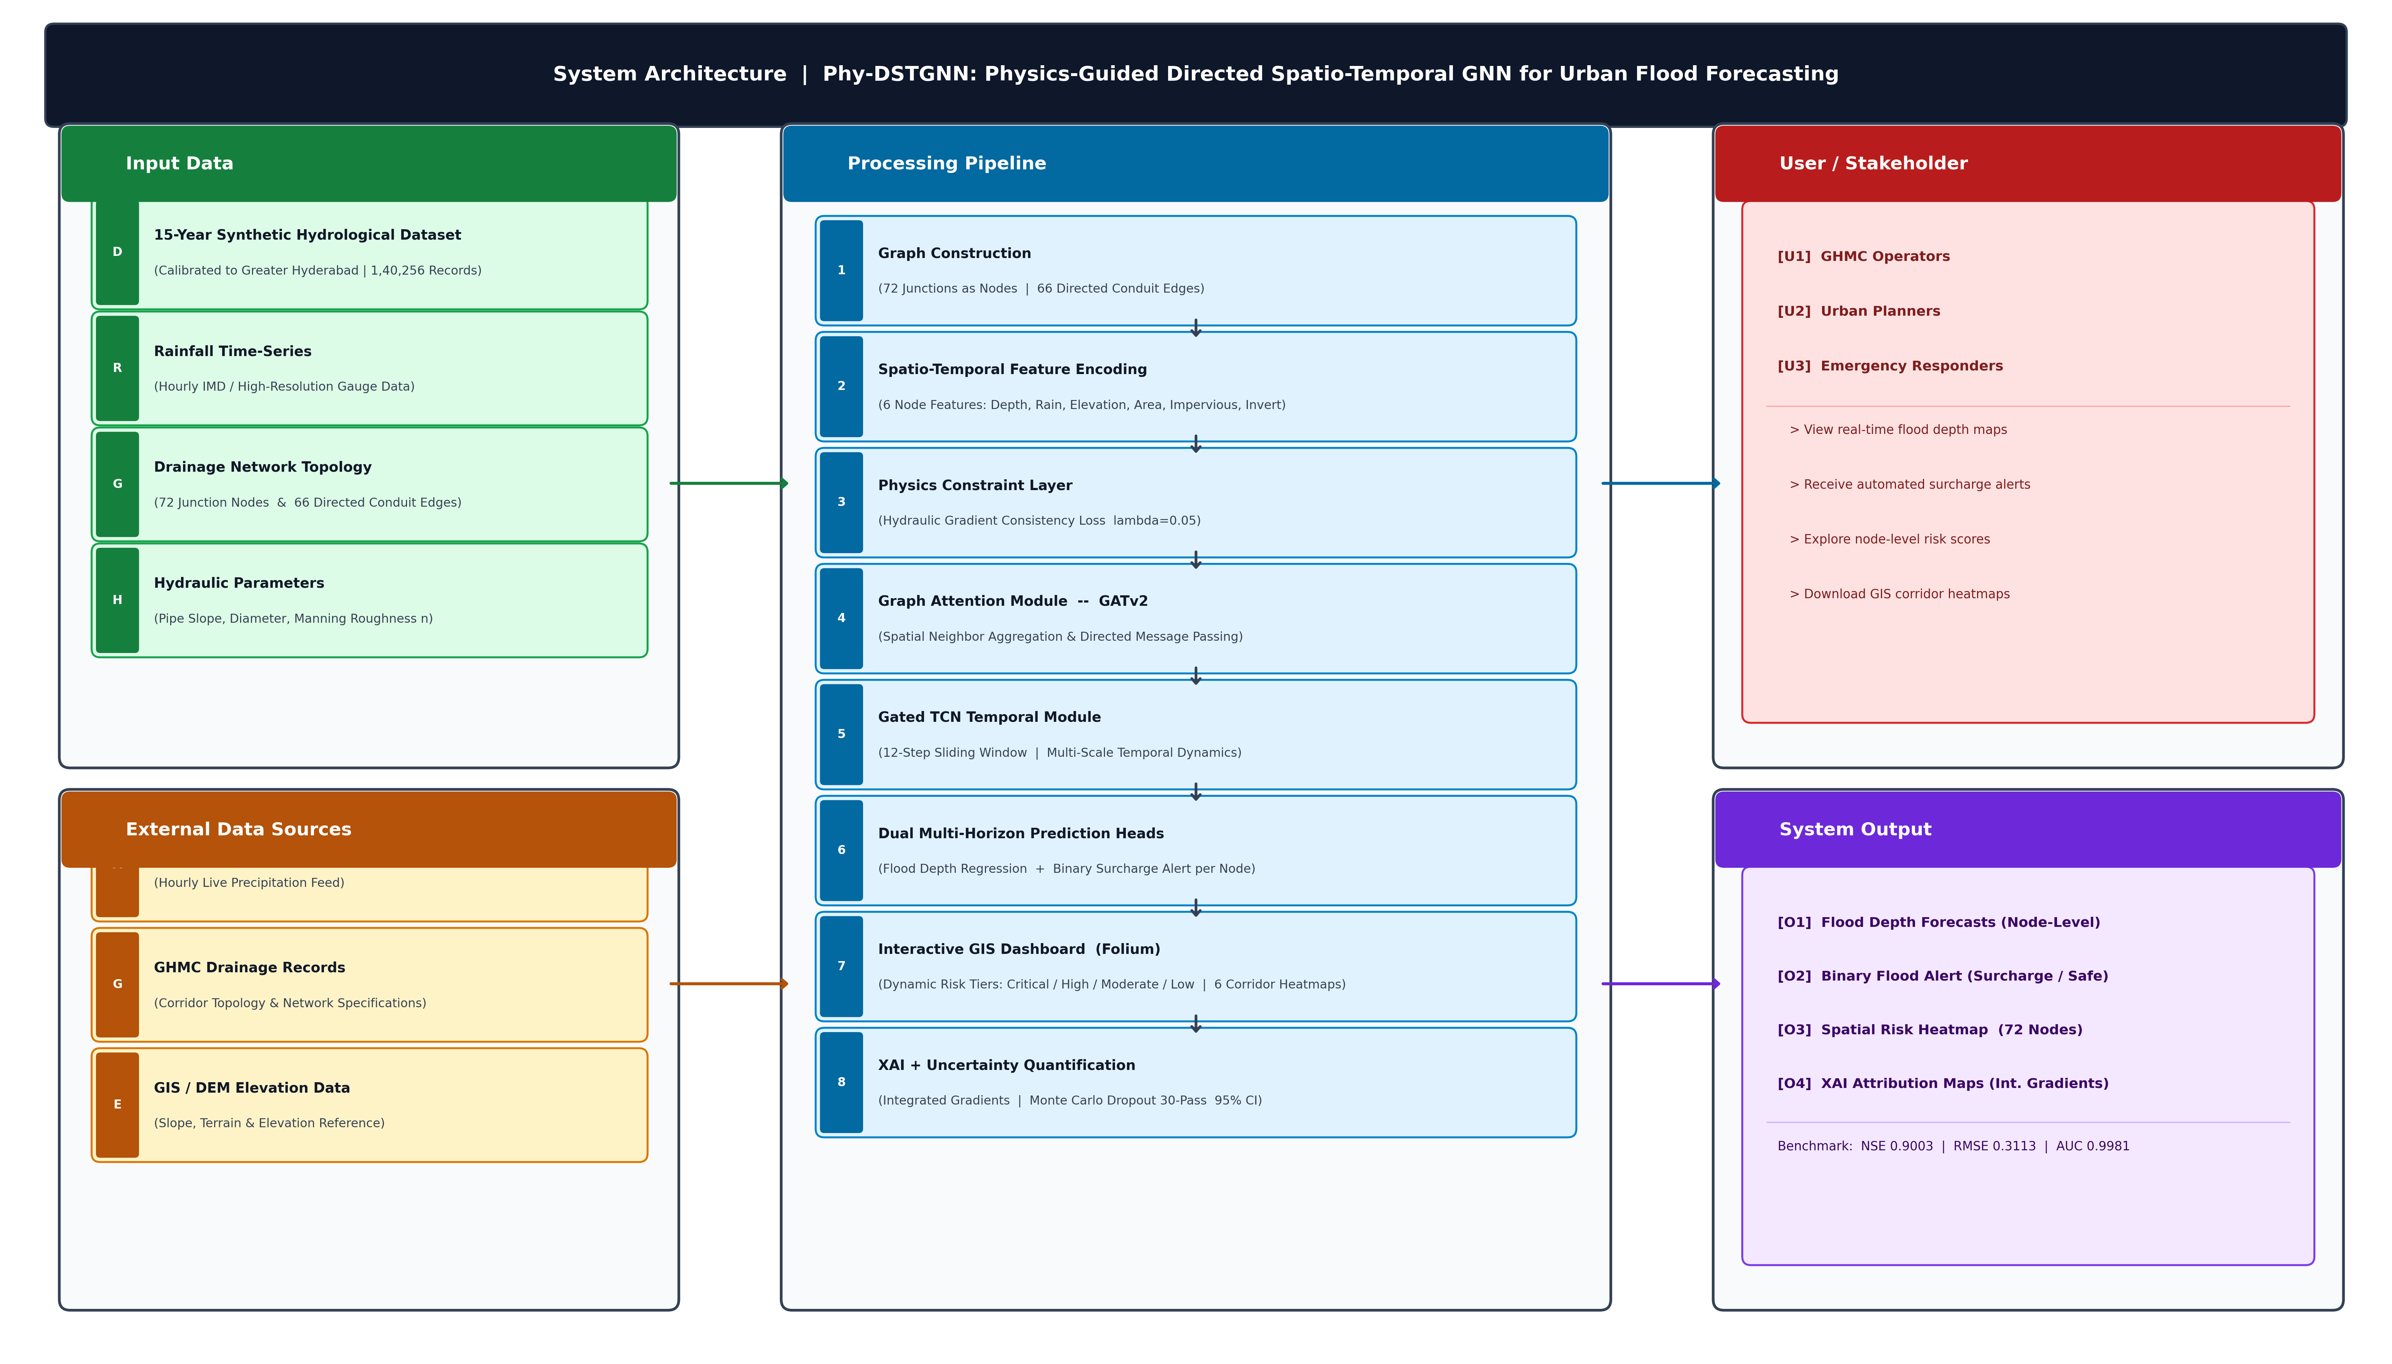
System Architecture

Slide 14
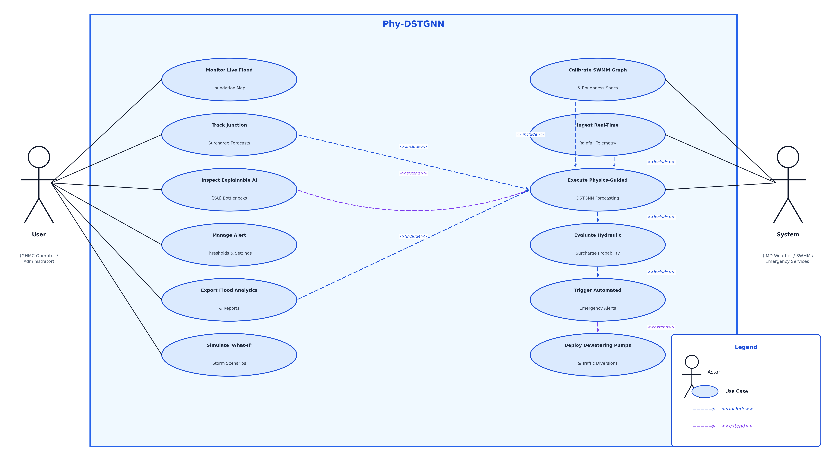
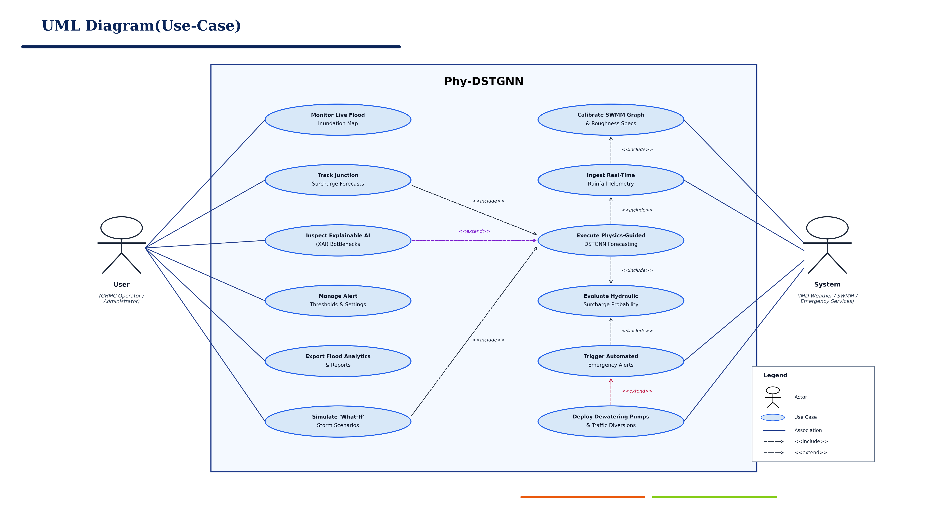
UML DIAGRAMS

Slide 15
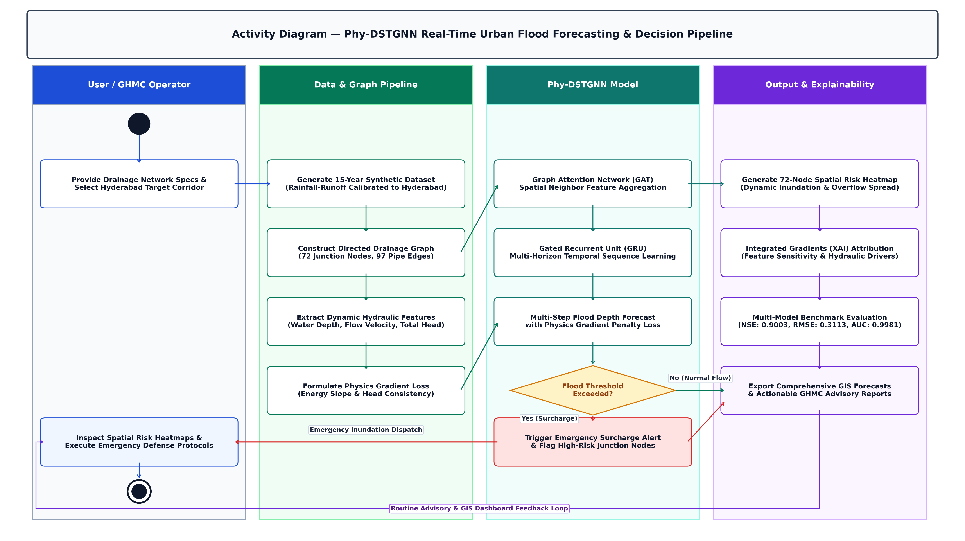
UML DIAGRAMS

Slide 16
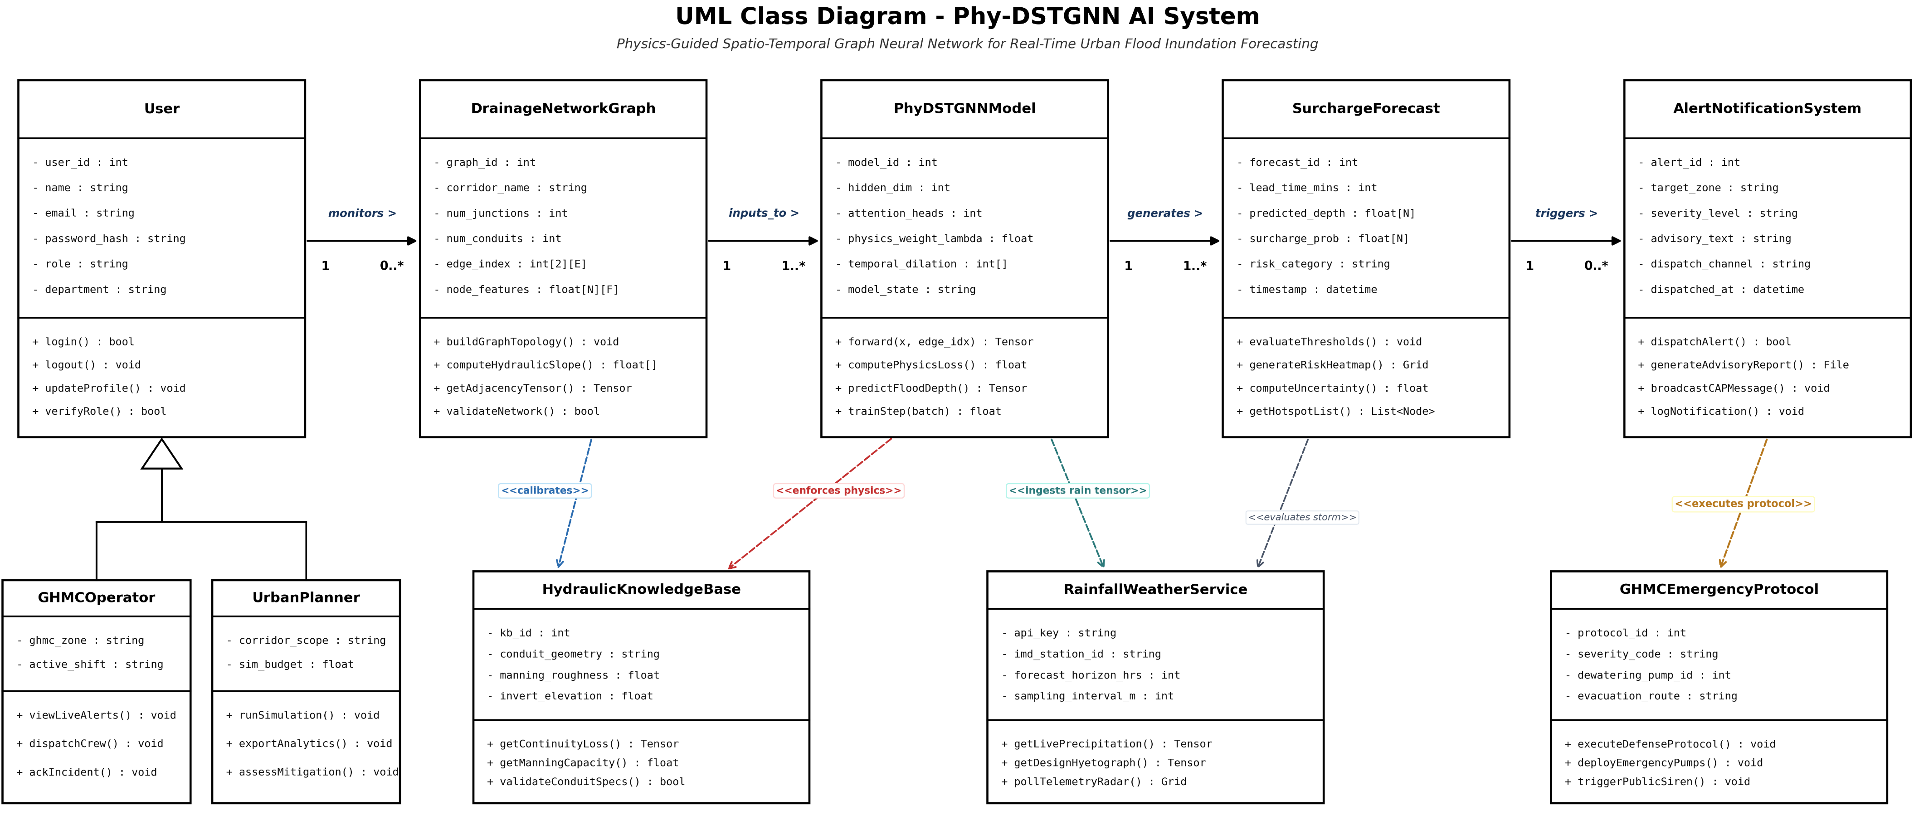
UML DIAGRAMS

Slide 17
Functional Requirements
Graph Construction: Converts GHMC drainage network into directed graph — 72 nodes, 66 edges.
Data Generation: Generates 15-year flood dataset (1,40,256 records) using EPA-SWMM simulation.
Rainfall Ingestion: Ingests hourly precipitation, temperature, humidity as node-level input features.
Physics-Guided AI: GATv2 + TCN with mass conservation and Manning's equation in loss function.
Flood Forecasting: Predicts water depth and overflow probability at 5, 15, 30, 60, 120 min horizons.
Explainable AI: Integrated Gradients identifies water depth (37.3%) as dominant prediction feature.
Uncertainty Quantification: Monte Carlo Dropout gives 95% confidence interval per forecast.
Alert Generation: Automated flood alerts triggered — classified as HIGH, MEDIUM, or LOW risk.
Geospatial Dashboard: Live inundation heatmap across 6 Hyderabad zones on Folium map.
Scenario Simulation: Tests extreme storms using Chicago Design Storm profiles (2yr to 100yr).

Slide 18
Non - Functional Requirements
Performance: Predictions across all 72 manholes in under 500 milliseconds.
Reliability: Focal Loss handles severe class imbalance - overflow = only 0.83% of data.
Scalability: Graph architecture extends to new zones without full retraining.
Explainability: Integrated Gradients + Monte Carlo Dropout - no black-box outputs.
Physical Consistency: Physics loss prevents hydraulically impossible predictions.
Data Integrity: Antecedent rainfall features validated and normalized during preprocessing.
Maintainability: Modular PyTorch Geometric - each layer independently updatable.

Slide 19
References (Min 10 Reference in chronological order)
[1] Wang S. and Xu O., "Mountain flood level forecasting in small watersheds based on recurrent neural networks and multi-dimensional data," IEEE Access, vol. 12, pp. 1–12, Jun. 2024.
[2] Zhang Z., Lu C., Tian W., Liao Z., and Yuan Z., "Graph neural network-based surrogate modelling for real-time hydraulic prediction of urban drainage networks," Water Res., vol. 263, p. 122142, 2024.
[3] Kazadi A. N., Doss-Gollin J. et al., "FloodGNN-GRU: A spatio-temporal graph neural network for flood prediction," Environ. Data Sci., Cambridge Univ. Press, Nov. 2024.
[4] Chen E. et al., "Uncertainty forecasting model for flood based on Bayesian deep learning," Front. Appl. Math. Stat., 2024.
[5] Tian Y., Ding S., Su G., Huang L., and Chen J., "Physics-informed neural networks for solving the two-dimensional shallow water equations with terrain topography and rainfall source terms," arXiv preprint arXiv:2501.11372, Jan. 2025.
[6] Ren M., Wang S., Liang B., and Wei C., "Maximum flow model with multiple origin and destination and its application in designing urban drainage systems," IEEE Access, 2025.
[7] Reddy P. M. T., Reddy M. L., Yadav M. P. K., and Reddy T. P. N., "Intelligent prediction of flood disaster risk levels based on knowledge graph and graph neural networks," IRE J., vol. 9, no. 9, 2025.
[8] DCosta L., Wang Y., Goodall J. L., and Chandra R., "Physics-informed CNN-LSTM for street-scale urban flood prediction: Reconciling aggregate accuracy and street-level plausibility," Water, MDPI, Jul. 2026.
[9] Mercier V., Gratton S., Lapeyre C., and Chevallet G., "Toward an operational GNN-based multimesh surrogate for fast flood forecasting," Université de Toulouse / NVIDIA, 2026.
[10] You L., Wu M., Woods O., and Luo D., "Multi-source dynamic graph learning for compound-flood forecasting in managed coastal systems," arXiv preprint arXiv:2608.01775, Aug. 2026.

Slide 20
Thank You ………..

