Slide 1
CUSTOMER LIFETIME VALUE PREDICTION Using -Decision Tree Regression
~ SAI DEEKSHITHA

Slide 2
Machine Learning Life Cycle:
Problem Understanding
Data Collection.
Data Preparation.
Choose a Model.
Train the Model
Evaluate the Model
Make Predictions

Slide 3
Problem Statement
The objective of this project is the prediction of Customer Life-time Value (CLV). CLV is the lifetime value of a customer, or in other words it represents the total amount of money a customer is expected to spend in business, or on products, during their lifetime. CLV is an important metric because it provides the business groups with a customer-centric perspective to guide some critical marketing and sales strategies, thereby enhancing important business decisions.

Slide 4
Features of the Dataset
Rows:
* We have 9807 rows in our dataset
Features:
* We have 22 columns in that
- 16 numerical features
- 2 categorical features
Target Variable:Customer.Lifetime.Value
Problem Type- Regression type

Slide 5
Data Cleaning and Pre-processing

Slide 6
Missing value Treatment
Null values are present in the Dataset, for filling the null vlaues in the categorical variables used Mode imputation method and for Numerical variables used Median imputation.
Since there are outliers in time_taken column we should replace null with median

Slide 7
Changing data types
There were 2categorical features in dataset
By using encoding categorical features are converted to numeric values

Slide 8
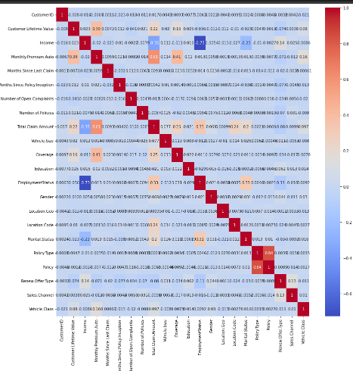
Correlation

Slide 9
Models and Approaches

Slide 10
Standardization
I used StandardScaler for Standardization
By using this it makes mean =0 and scales the data to unit variance

Slide 11
Models Used
Predictive Model used is Ridge Regression.

