Slide 1
BIG MART SALES –using ridge Regression
~ SAI DEEKSHITHA

Slide 2
Machine Learning Life Cycle:
Problem Understanding
Data Collection.
Data Preparation.
Choose a Model.
Train the Model
Evaluate the Model
Make Predictions

Slide 3
Problem Statement
The Big Mart Sales problem is a common business problem in the retail industry. The problem statement is to analyze the sales data of a Big Mart chain of stores and develop a predictive model that can help the management to understand the properties of products and stores that play a key role in increasing sales.

Slide 4
The dataset contains various attributes of products and stores, such as product weight, visibility, type, and store size, location, and establishment year. Using this data, the objective is to identify the key factors that influence the sales of a product and develop a model that can predict the sales of a product at a particular store.
The goal of this analysis is to help the management team to make data-driven decisions to increase the sales of the Big Mart stores

Slide 5
Features of the Dataset
Rows:
* We have 8523 rows in our dataset
Features:
* We have 12 columns in that
- 4 numerical features
- 8 categorical features
Target Variable: Item_Outlet_Sales
Problem Type- Regression type

Slide 6
Data Cleaning and Pre-processing

Slide 7
Missing value Treatment
Null values are present in the Dataset, for filling the null vlaues in the categorical variables used Mode imputation method and for Numerical variables used Mean imputation.

Slide 8
Changing data types
By using get dummies categorical features are converted to numeric values

Slide 9
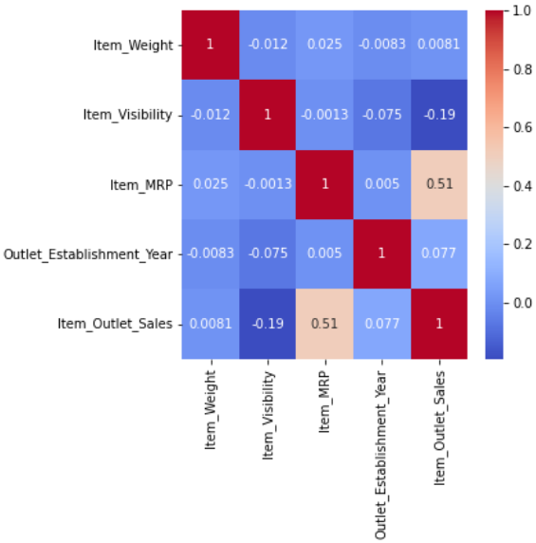
Correlation

Slide 10
Models and Approaches

Slide 11
Models Used
Predictive Model used is Ridge Regression.

