Slide 1

AUTONOMOUS NAVIGATION
By Deekshitha Desu

Slide 2
TOPICS
Introduction
Problem Statement
Objective
System Architecture
Work Done
Methodology
Challenges Faced
References
Future Scope
Conclusion

Slide 3
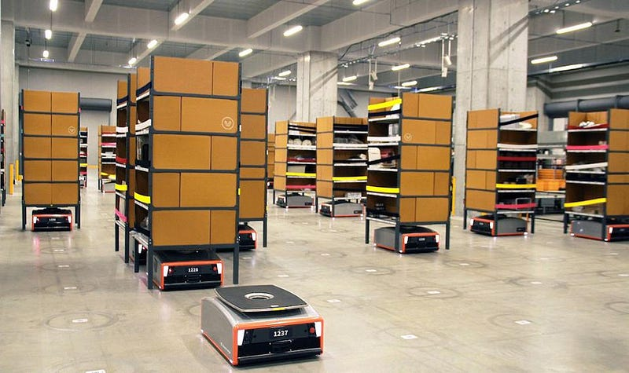
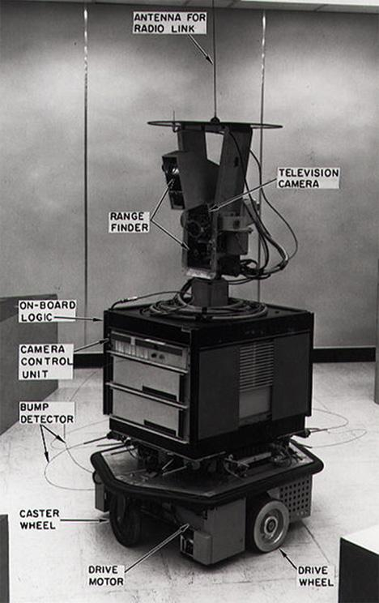
INTRODUCTION
Autonomous navigation enables a robot to move without human control and navigate to a target location automatically.
Shakey, developed in 1966 the world’s first autonomous mobile robot capable of navigation and decision-making.

Slide 4
Problem Statement
Developing an autonomous robot capable of accurate localization and navigation in real-time sensor data from LiDAR and wheel encoders.
Mapping
Creating a map of the surronding environment using LIDAR
Localization
Determining the robot’s current position and orientation
Navigation
Moving the robot safely from one point to the target destination.
The objective of this project is to achieve autonomous robot navigation through accurate mapping, localization, and real-time movement.

Slide 5
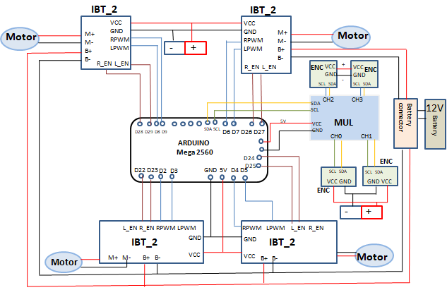
Hardware architecture

Slide 6
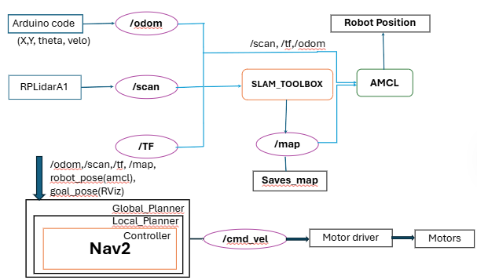
software architecture

Slide 7

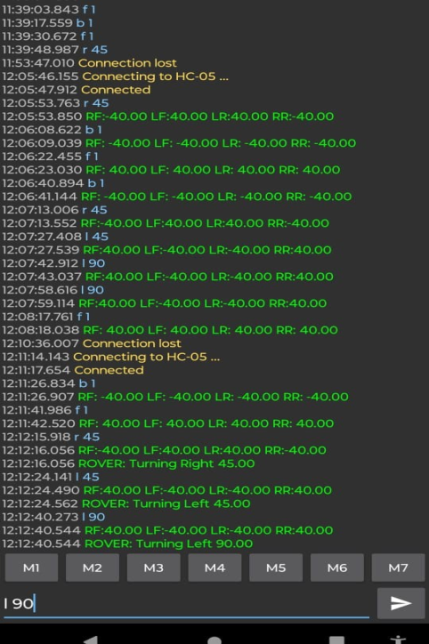
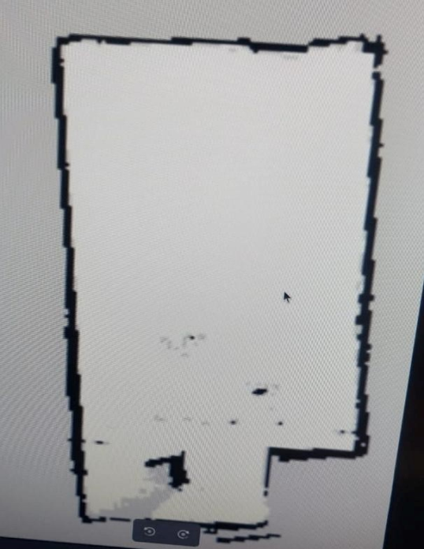
WORK dONE
Hardware Setup
Initial Motor Control: Developed an Arduino motor control code to control individual wheel speeds. m 30 30 30 30, m -60 60 60 -60
Closed Loop Encoder Feedback
Present Motor control: Updated the control code to support distance and angle based movement commands.
Bluetooth-Based Robot Control
Mapping: configured the Cartographer SLAM package in ROS2

Slide 8
methodology
The Arduino receives movement commands such as: front, backward, left and right.
Arduino generates PWM control signals.
Arduino commands
PWM signals
Wheel encoder feedback
IBT-2 Motor driver
Motor Rotates
These PWM signals are sent to the IBT-2 motor drivers.
The motor driver controls:
Motor direction
Motor speed
5.The motors rotate according to the PWM
values.
6.Wheel encoders continuously measure rotation and calculates wheel speed, distance, and direction.
CLOSED LOOP CONTROL
Arduino continuously compares: Desired wheel
speed and actual wheel speed from encoders
If error occurs: PWM is adjusted automatically and
motor speed is corrected.

Slide 9
challEnges
Mechanical alignment issues between motors and wheels.
Voltage and power supply issues for the ardunio.
Bluetooth module communication issues.
SSH connectivity over Wi-Fi regarding the ip-address.
Encoder noise and detection issues.
Network instability while performing mapping using ROS2.
references
https://www.youtube.com/watch?v=ZaiA3hWaRzE
https://www.youtube.com/watch?v=rZOxPGCn4QM&t=376
https://www.youtube.com/watch?v=T3if0aPj0Eo
https://github.com/SteveMacenski/slam_toolbox
https://github.com/Slamtec/rplidar_ros
https://github.com/rigbetellabs/tortoisebot/blob/ros2-humble/tortoisebot_slam/launch/cartographer.launch.py

Slide 10
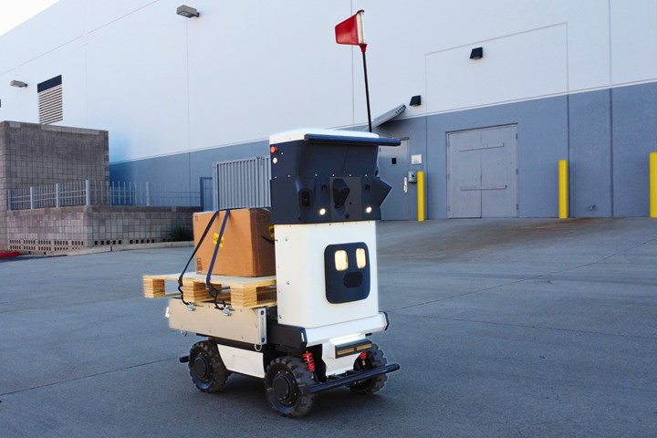
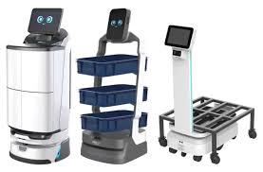
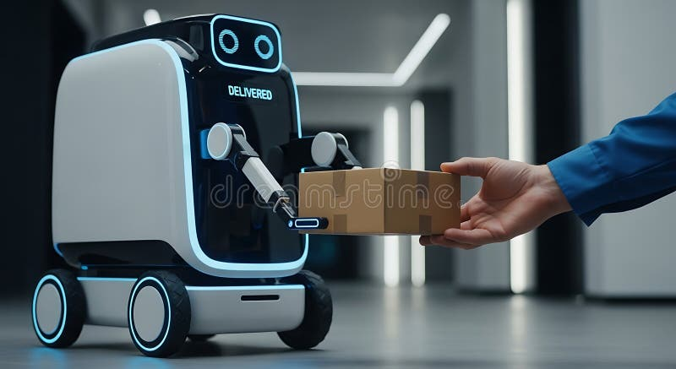
Future scope
Implement fully autonomous point-to-point navigation.
Integrate obstacle avoidance for safe indoor navigation.
Autonomous indoor delivery robot.
In conclusion, the project has been completed up to the mapping stage using Cartographer SLAM, and the next phase focuses on AMCL-based localization for autonomous navigation.

