Slide 1
💍 Marriage Data Analysis (India)
A Comprehensive PySpark & Visualization Project
2211CS010423

Slide 2
Introduction
This presentation analyzes Indian marriage data using PySpark, Matplotlib, and Seaborn.
It highlights trends in marriage type, age, income, gender, religion, and family structure.
The goal is to uncover sociological patterns and actionable insights.

Slide 3
Dataset Description
Marriage_Type – Love or Arranged
Age_at_Marriage – Age when married
Gender – Male or Female
Education_Level – Qualification level
Religion – Hindu, Muslim, Christian, etc.
Income_Level – Low, Middle, High
Children_Count – Number of children
Years_Since_Marriage – Duration of marriage

Slide 4
Data Operations
Data cleaning and preprocessing in PySpark
Descriptive statistics and summary analysis
Visualization using Matplotlib and Seaborn
Exploration of relationships between demographic and economic variables

Slide 5
Key Insights (1/2)
Love marriages: 45%, Arranged marriages: 55%
Gender ratio is balanced with a slight female majority
Most marriages occur between ages 25–35
Hindu marriages are predominant; others include Muslim & Christian

Slide 6
Key Insights (2/2)
Middle-income couples dominate the dataset
Average Children Count: 1–2 per couple
Age at marriage negatively correlates with years since marriage
Education and income positively influence marriage independence

Slide 7
Visual Analysis Overview
Bar Chart – Marriage Type Distribution
Pie Chart – Religion Share
Histogram – Age at Marriage
Scatter Plot – Age vs Years Since Marriage
Boxplot – Children Count vs Income Level
Heatmap – Numeric Correlation

Slide 8
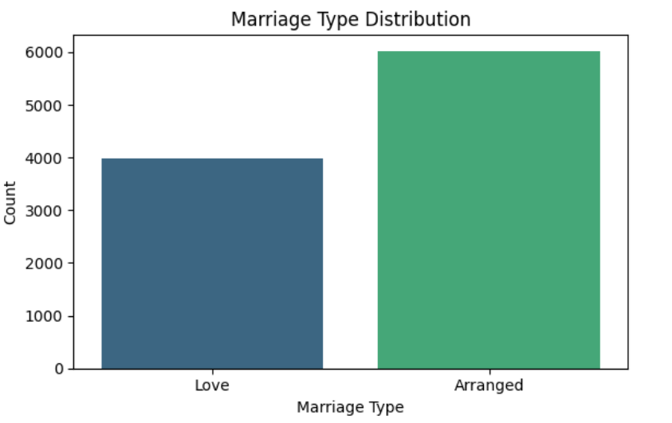

Slide 9
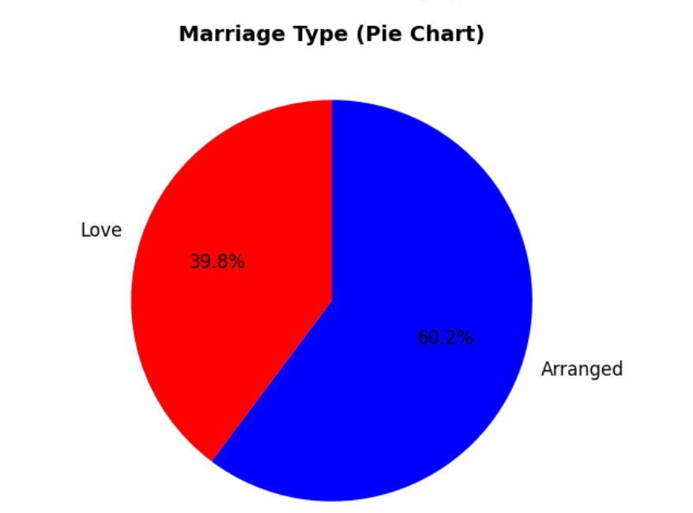

Slide 10
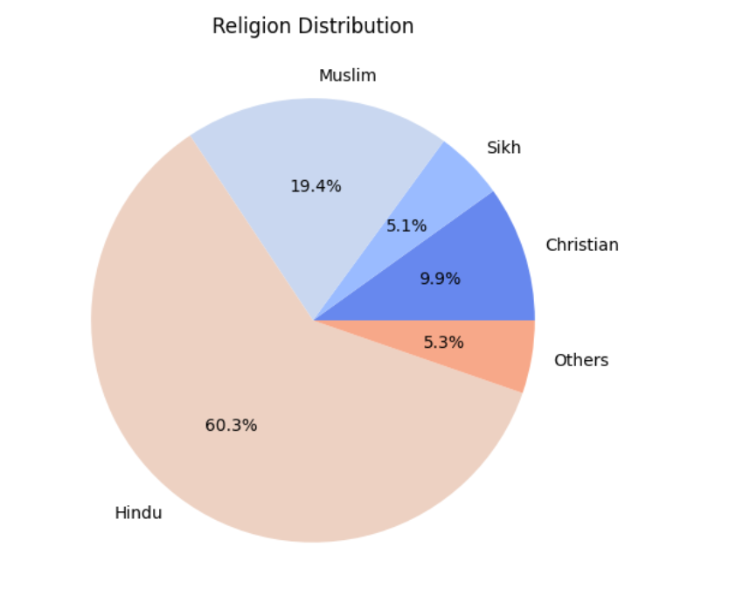

Slide 11
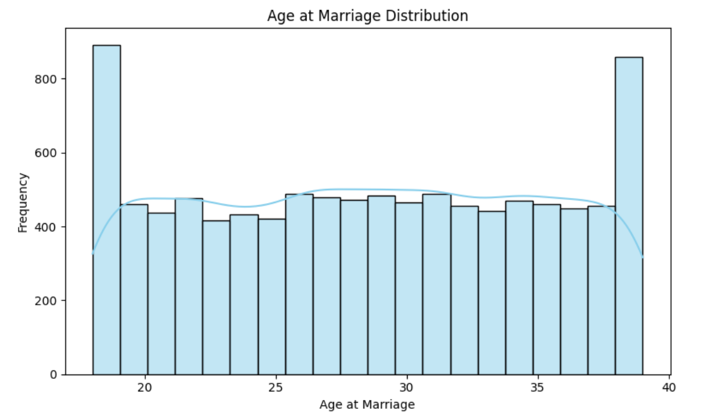

Slide 12
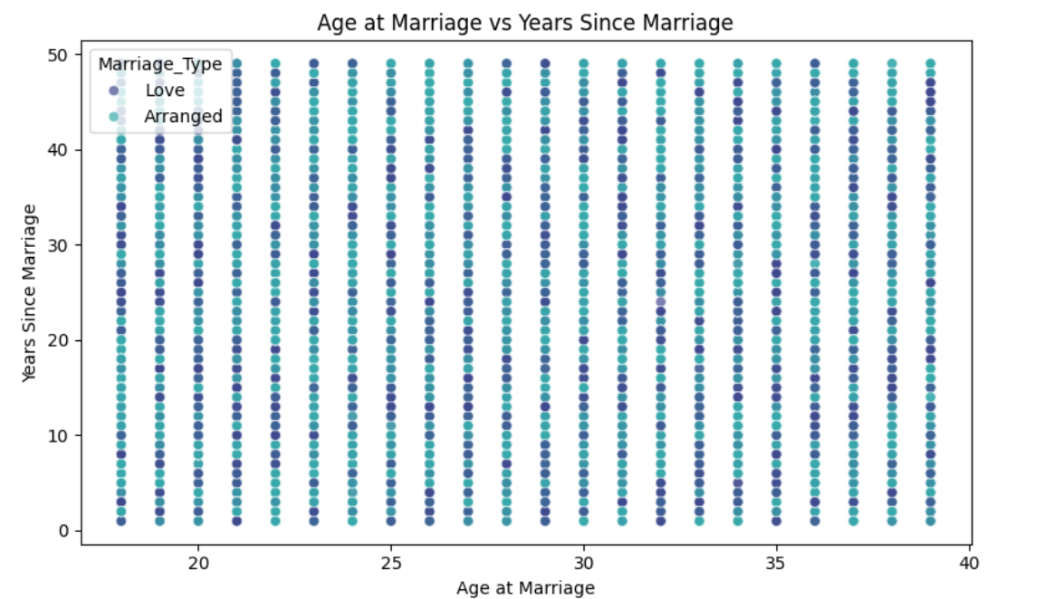

Slide 13
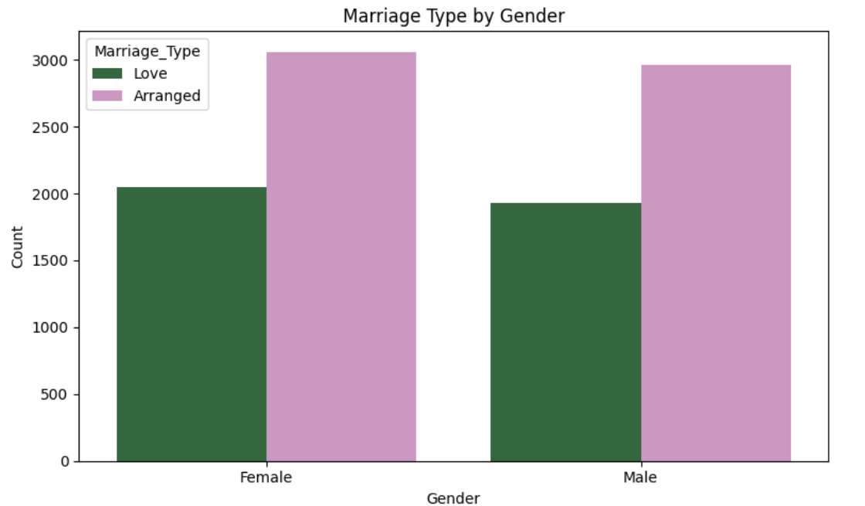

Slide 14
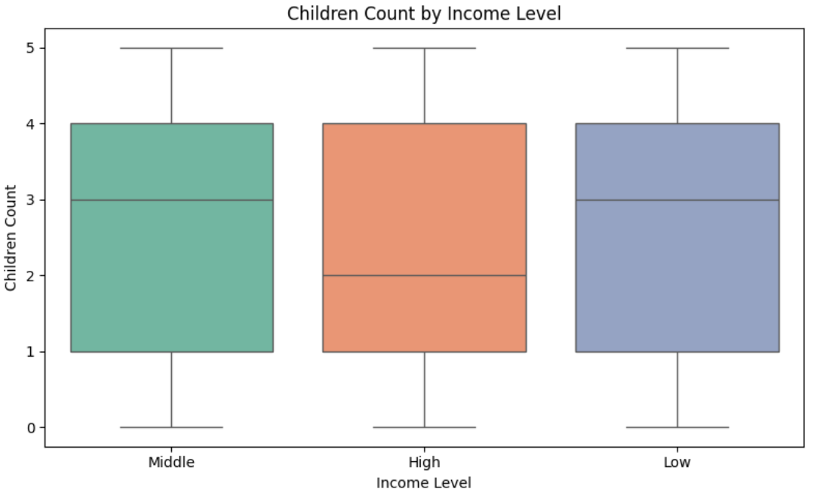

Slide 15
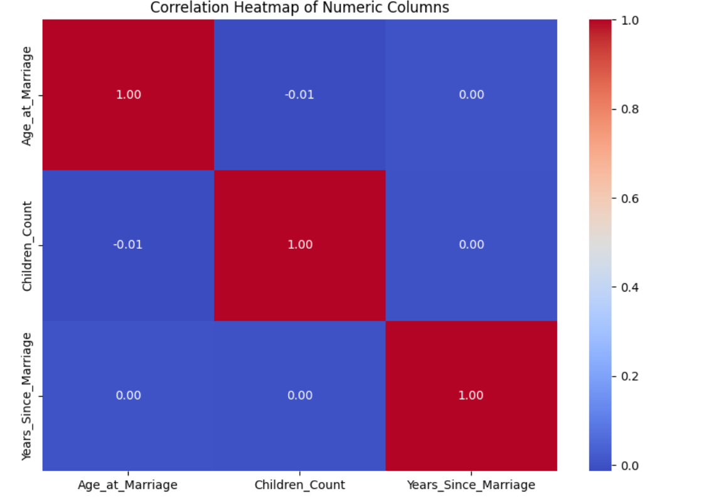

Slide 16
Recommendations
Promote awareness on balanced marital decision-making
Encourage informed marriage ages for stability
Support financial empowerment for young couples
Ensure gender equality and educational opportunity
Promote inter-caste and inter-religion harmony

Slide 17
Conclusion
The analysis highlights a society balancing tradition and modernity.
Arranged marriages remain dominant, but love marriages are rising steadily.
Education, income, and urbanization are key factors shaping marital patterns.
This study provides valuable insights for sociologists, policymakers, and educators.

