Slide 1
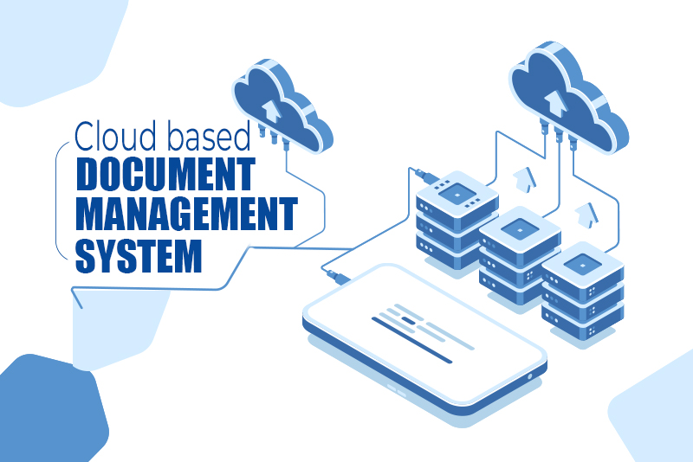

Cloud-Based Document Management System with AWS Elasticsearch
Deekshitha Bethireddy (2210030070)
Under the esteemed guidance of
Ms. P. Sree Lakshmi
Assistant Professor,
Department of Computer Science and Engineering

Slide 2
Project Overview
Brief Description of the Problem or Opportunity
Traditional document management systems struggle with scalability, search performance, and infrastructure maintenance.
There's a growing need for a scalable, automated, and efficient solution for document storage, indexing, and retrieval in organizations.
Objective of the Project
To build a serverless, cloud-based document management system using AWS.
Enable uploading, indexing, and keyword-based searching of documents using AWS S3, Lambda, OpenSearch, and API Gateway.
Real-World Relevance
Useful in educational institutions, healthcare, and corporate sectors.
Enhances document accessibility, automation, and decision-making efficiency.
Supports digital libraries, enterprise content management, and archival systems.

Slide 3





Services Used
Amazon S3 – Document Storage:
Used to store documents like PDFs and text files.
Triggers events upon uploads to initiate automated processing.
Amazon OpenSearch Service – Search & Analytics:
Provides full-text search capability.
Stores indexed content for fast retrieval via keyword queries.
AWS Lambda – Serverless Compute:
Automates text extraction and indexing of uploaded documents.
Runs code in response to S3 events or API requests.
AWS IAM – Access Control:
Manages permissions and roles for all services.
Ensures secure and authorized access across AWS resources.
Amazon CloudWatch – Monitoring & Logging:
Tracks Lambda executions, API performance, and system logs.
Alerts on errors like failed uploads or access issues.

Slide 4
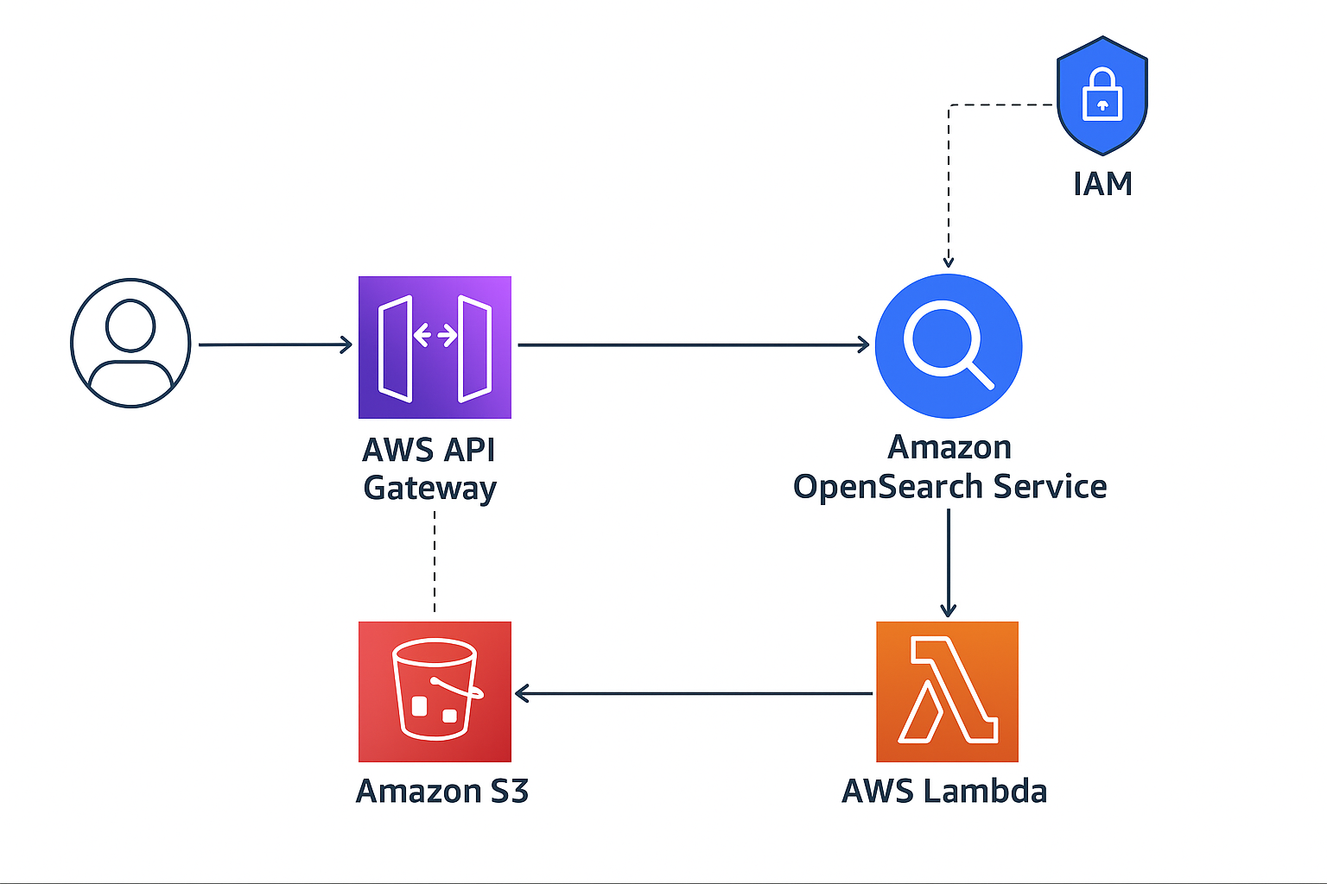
Flow Diagram

Slide 5
Implementation Process
Create and Configure AWS Resources
Develop and Deploy Lambda Function
Integrate Services Using API Gateway
Test the Workflow and Validate Results

Slide 6
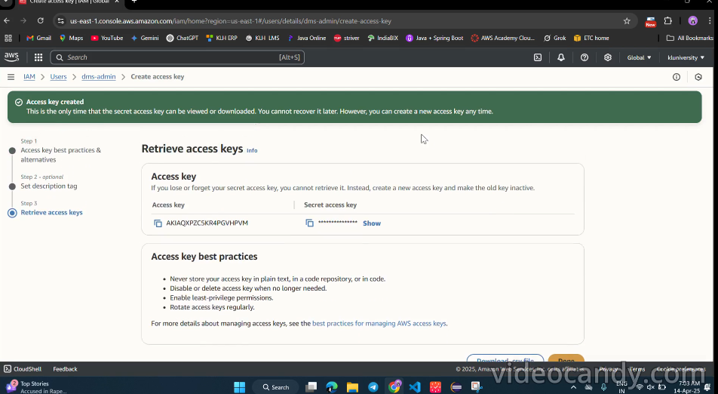
Creating the IAM user dms-admin and access key.

Slide 7
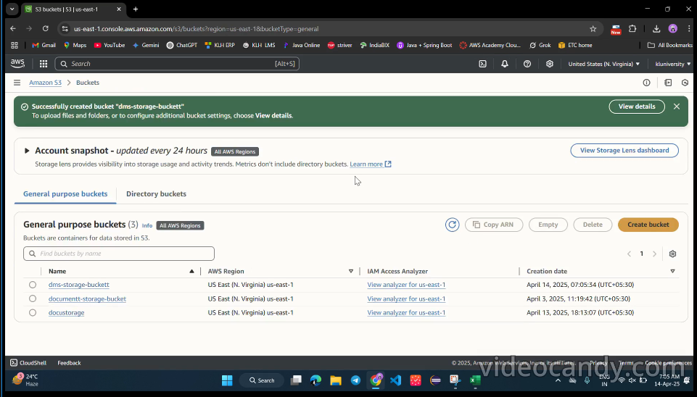
Successfully created S3 bucket.

Slide 8
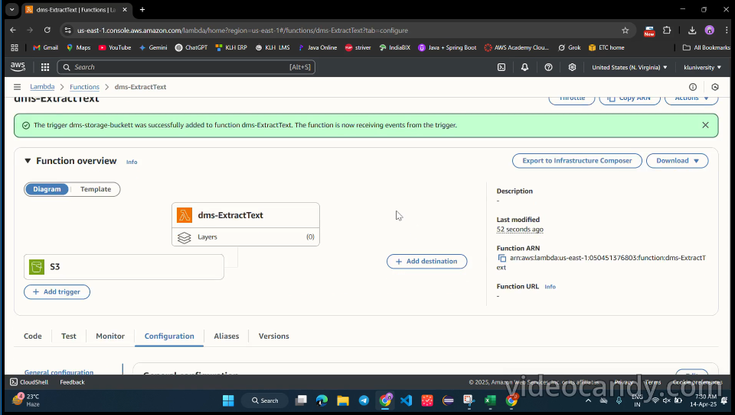
Creating Lambda function

Slide 9
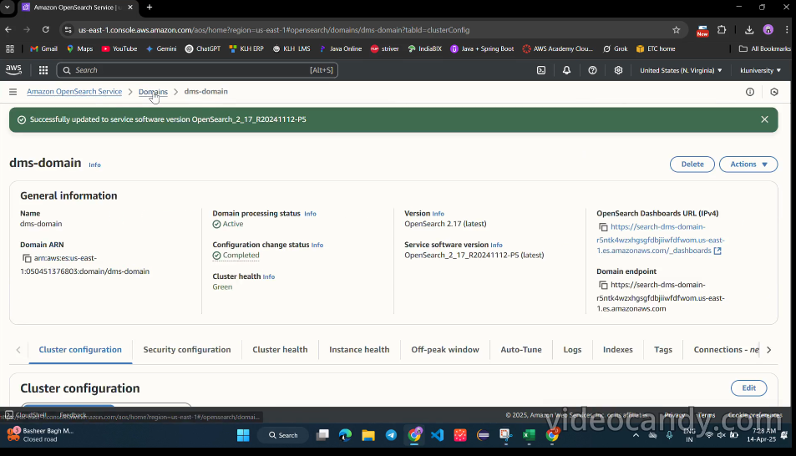
Creating OpenSearch Domain

Slide 10
Key Features and Functionality
Major Functionalities Implemented
Upload documents to S3
Automatic text extraction and indexing using Lambda
Full-text search using Amazon OpenSearch Service
RESTful API access via API Gateway
Integration of Multiple AWS Services
Amazon S3 – File storage and event triggering
AWS Lambda – Text extraction and indexing logic
Amazon OpenSearch Service – Search backend
API Gateway – Search endpoint for user interaction
IAM & CloudWatch – Security and monitoring

Slide 11
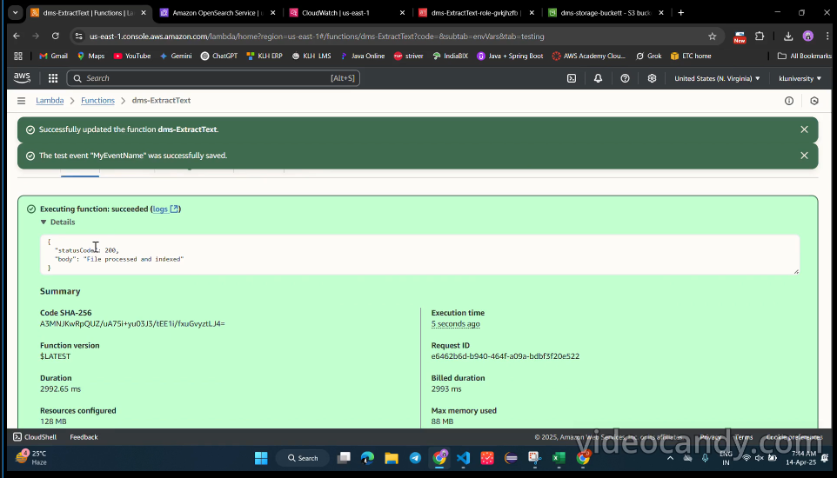
Results and Outputs

Slide 12
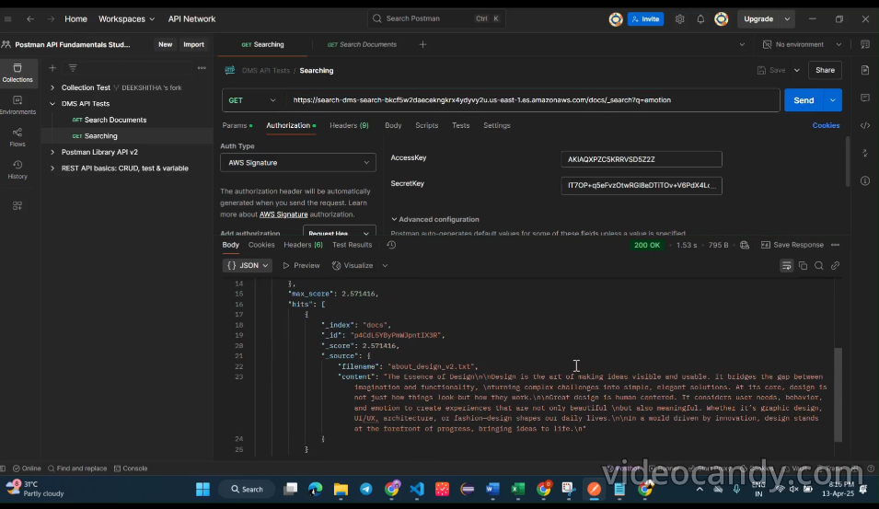
Postman response with search results.

Slide 13
Challenges and Solutions
Technical Difficulty: Encountered 403 error due to insufficient IAM permissions for dms-admin on OpenSearch.
Resolution: Updated dms-ExtractText-role-gvkjhfb with proper policies and adjusted OpenSearch domain policy.
Technical Difficulty: Lambda trigger failed to process S3 uploads (e.g., “design_principles").
Resolution: Configured S3 event notification and tested with sample upload.
Technical Difficulty: OpenSearch indexing failed due to pymupdf import issue.
Resolution: Moved fitz import inside lambda_handler and removed conflicting pymupdf.py file.

Slide 14
Learnings & Takeaways
AWS IAM – Role-based access control and policy configuration
Amazon S3 – Scalable object storage and event configuration
AWS Lambda – Serverless compute, automation, and function deployment
Amazon OpenSearch Service – Search engine setup and query execution
API Gateway – Creating and securing RESTful APIs
CloudWatch – Logging, monitoring, and debugging

Slide 15
Future Scope
Possible Extensions or Improvements:
Add a frontend UI for easier document upload and search.
Support for additional file formats (e.g., DOCX, images using OCR).
Implement user authentication using Amazon Cognito.
Real-Time Deployment Considerations:
Use API rate limiting and throttling to handle large user traffic.
Ensure OpenSearch indexing performance remains optimal.
Enable real-time notifications for document processing status (e.g., using SNS).

Slide 16
References
[1] Amazon OpenSearch Service Documentation: https://docs.aws.amazon.com/opensearch-service/latest/developerguide/what-is.html
[2] AWS S3 Documentation: https://docs.aws.amazon.com/AmazonS3/latest/userguide/Welcome.html
[3] AWS Lambda Documentation:
https://docs.aws.amazon.com/lambda/latest/dg/welcome.html
[4] AWS API Gateway Documentation:
https://docs.aws.amazon.com/apigateway/latest/developerguide/welcome.html
[5] AWS CloudWatch Documentation:
https://docs.aws.amazon.com/AmazonCloudWatch/latest/monitoring/WhatIsCloudWatch.html
[6] AWS IAM Documentation:
https://docs.aws.amazon.com/IAM/latest/UserGuide/introduction.html
[7] PyMuPDF Documentation:
https://pymupdf.readthedocs.io/en/latest/
[8] Troubleshooting Amazon OpenSearch Service:
https://docs.aws.amazon.com/opensearch-service/latest/developerguide/troubleshooting.html
[9] Building a Serverless Document Management System with AWS:
https://aws.amazon.com/blogs/compute/building-a-serverless-document-management-system/

Slide 17
THANK YOU

