Slide 1
بسم الله الرحمن الرحيم
Programming 1
( Object Oriented Programming )
*** Dr . Mohammed Musalam ***
Answers of Assigment 1
Eng. Deema Mohammed AL-Maqadma

Slide 2
*Multiple Choice*
1. This is a collection of programming that specify the fields and methods that a particular type of object may have. - a. class
2. A class is analogous to a(n) __________. - b. blueprint
3. An object is a(n) __________. - d. instance of a class
4. This is a class member that holds data. - c.field

Slide 3
5. This key word causes an object to be created in memory. - *b. new*
6. This is a method that gets a value from a class’s field, but does not change it. - *a. accessor*
7. This is a method that stores a value in a field or in some other way changes the value of a field. - *d. mutator*
8. When the value of an item is dependent on other data, and that item is not updated when the other data is changed, what has the value become? - *b. stale*
9. This is a method that is automatically called when an instance of a class is created. - *b. constructor*
10. When a local variable has the same name as a field, the local variable’s name does this to the field’s name. - *a. shadows*

Slide 4
10. When a local variable has the same name as a field, the local variable’s name does this to the field’s name. - *a. shadows*
11. This is automatically provided for a class if you do not write one yourself. - *c. default constructor*
12. Two or more methods in a class may have the same name, as long as this is different. - *c. their parameter lists*
13. The process of matching a method call with the correct method is known as __________. - *b. binding*
14. A class’s responsibilities are __________. - *d. both b and c*

Slide 5
*True or False*
15. The new operator creates an instance of a class. - *True
16. Each instance of a class has its own set of instance fields. - *True*
17. When you write a constructor for a class, it still has the default constructor that Java automatically provides. - *False*
18. A class may not have more than one constructor. - *False*
19. To find the classes needed for an object-oriented application, you identify all of the verbs in a description of the problem domain. - *False*

Slide 6
Find the Error
1. Find the error in the following class:
public class MyClass
{
private int x;
private double y;
public void MyClass(int a, double b)
{
x = a;
y = b;
}
}
[ The constructor doesn't have a return type]

Slide 7
2. Assume that the following method is a member of a class. Find the error.
public void total(int value1, value2, value3)
{
return value1 + value2 + value3;
}
[ Every variable should declare separately & The function returns the value of int so returntypr must
be int ,not Void ]
3. The following statement attempts to create a Rectangle object. Find the error.
Rectangle box = new Rectangle;
[ The parentheses of object's constructor]

Slide 8
4. Find the error in the following class:
public class TwoValues
{
private int x, y;
public TwoValues()
{
x = 0;
}
public TwoValues()
{
x = 0;
y = 0;
}
}
[ The overload constructor should differ in parameter list ( either in data type or number of variables) ]

Slide 9
5. Find the error in the following class:
public class FindTheError
{
public int square(int number)
{
return number * number;
}
public double square(int number)
{
return number * number;
}
}
[ The second method return a double value, so the data type of it's parameter variable should be double ]

Slide 10
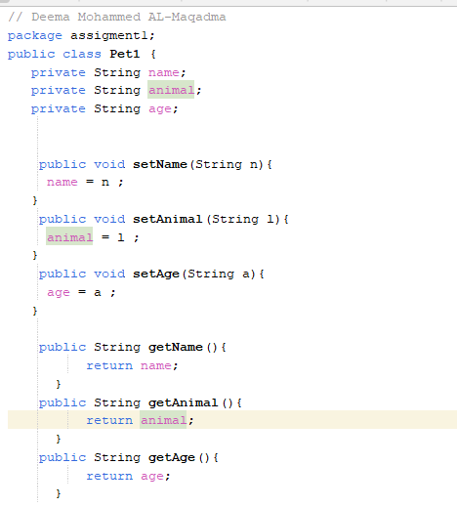
Algorithm Workbeanch
Q/1
Pet
-----------------------------
Name : String-
Animal : String
Age :String
-----------------------------
+ setName(n:String):void

Slide 11
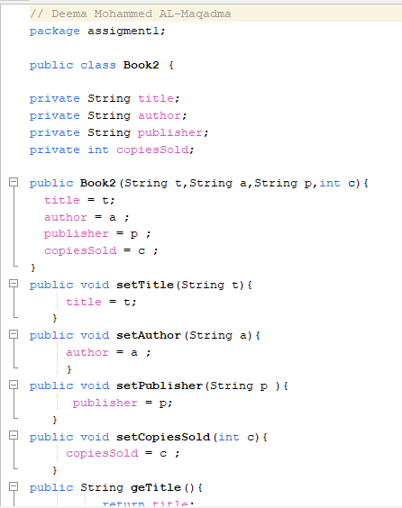
Q/2
Book2
-------------------title : String-
------------------
+Book2:(title : String,auther:String,…)

Slide 12
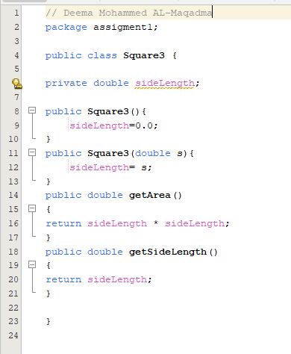
Q/3

Slide 13
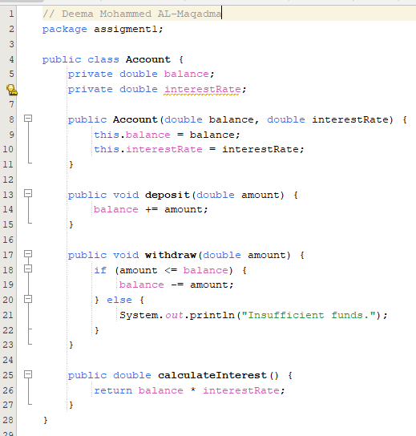
Q/4

Slide 14
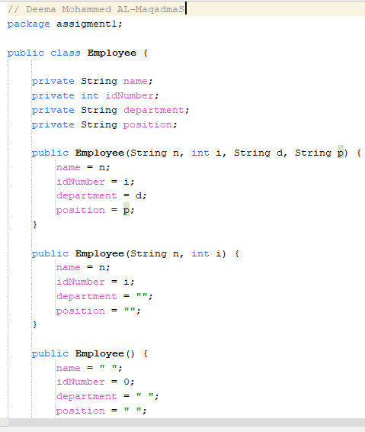
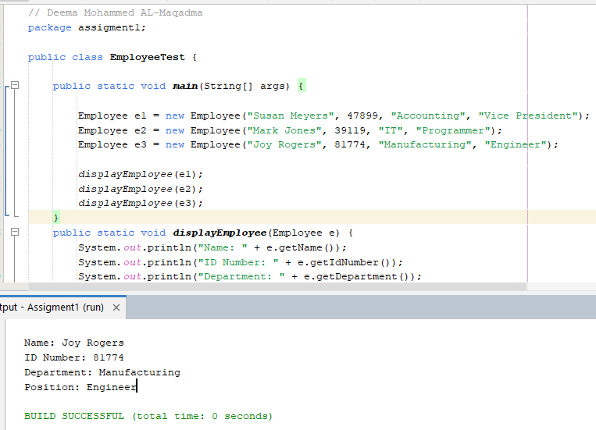

Slide 15
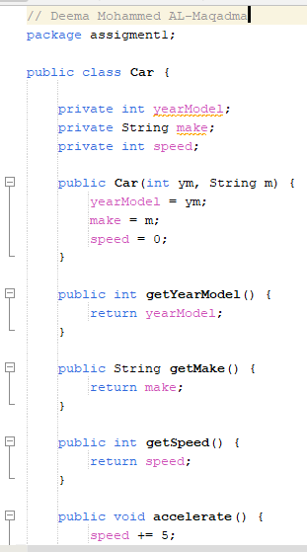
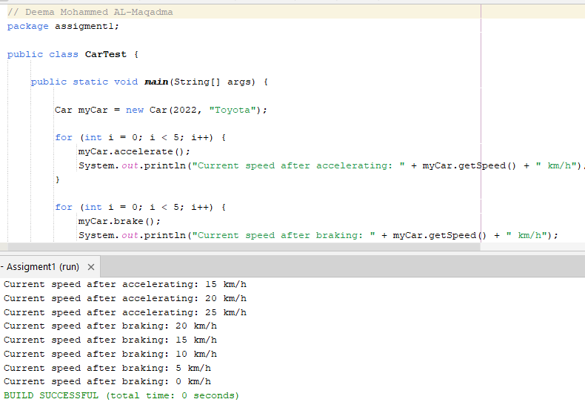

Slide 16
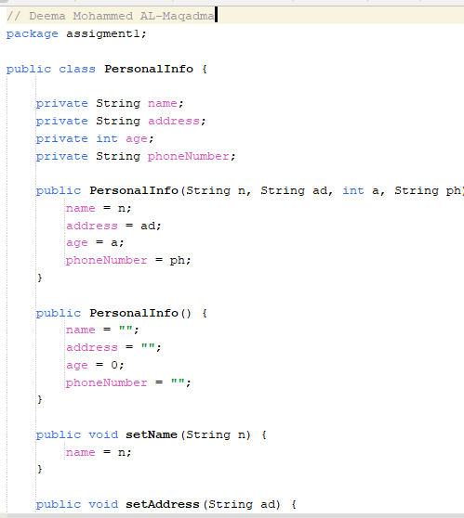
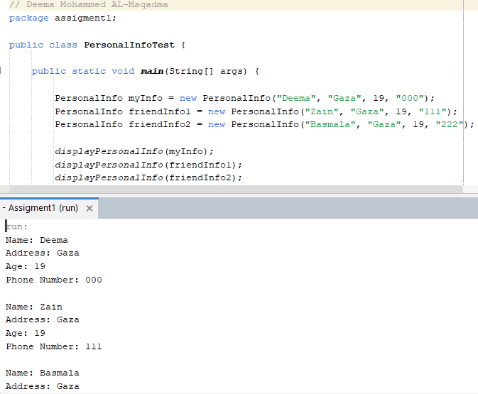

Slide 17
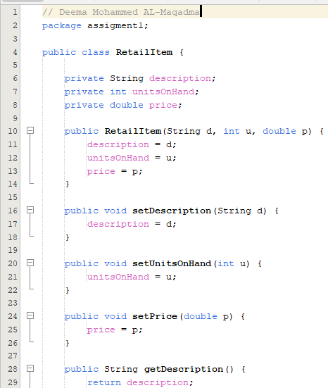
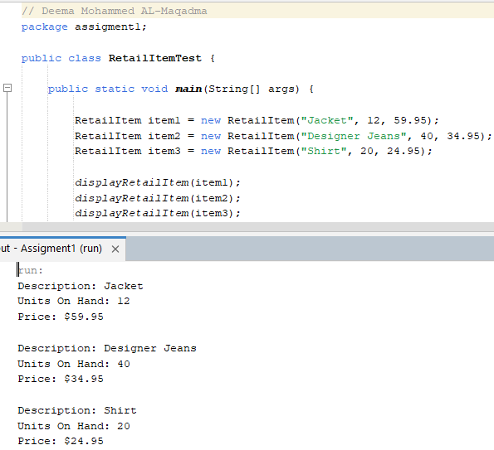

Slide 18
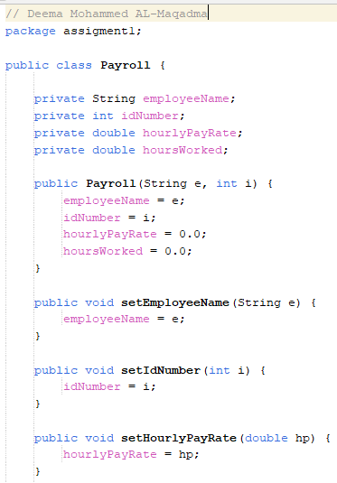
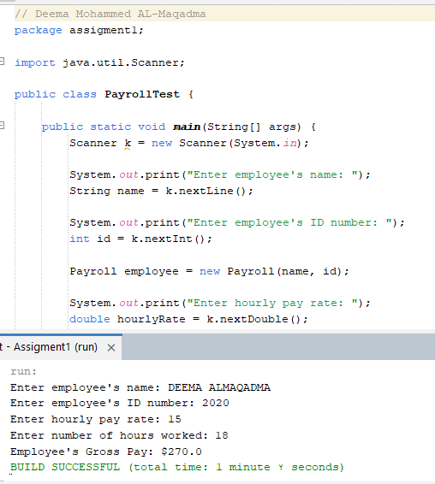

Slide 19
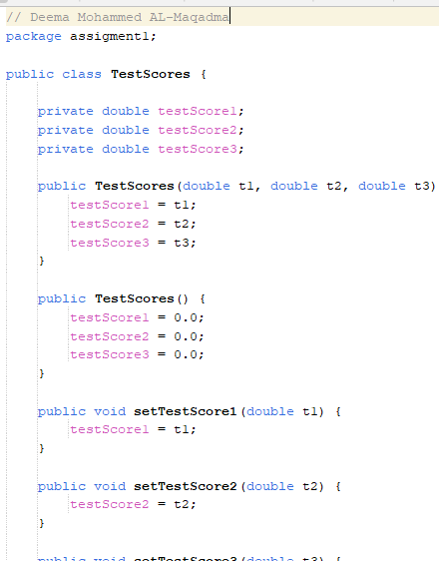
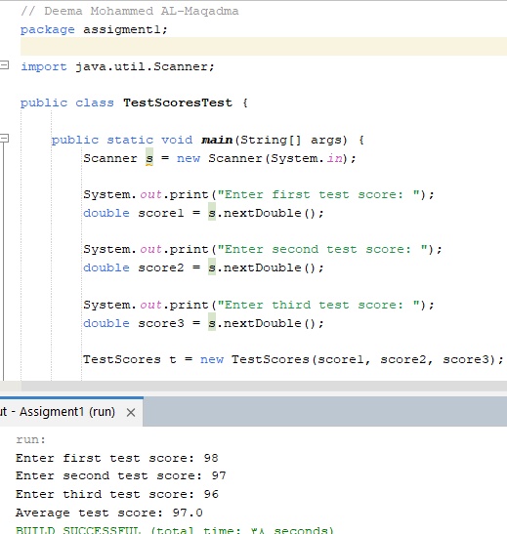

Slide 20
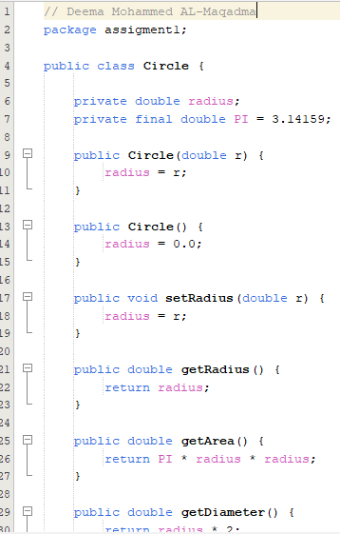
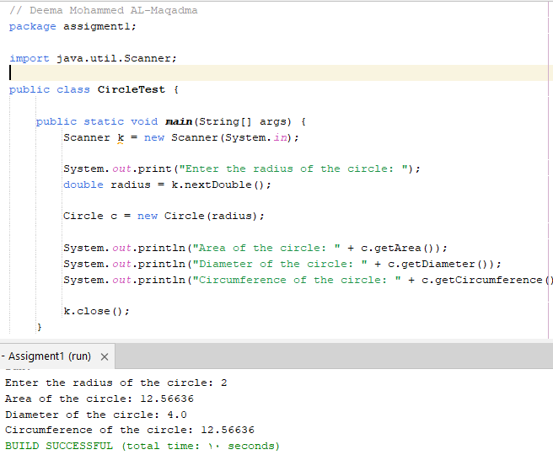

Slide 21
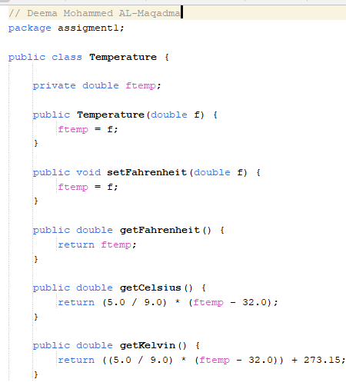
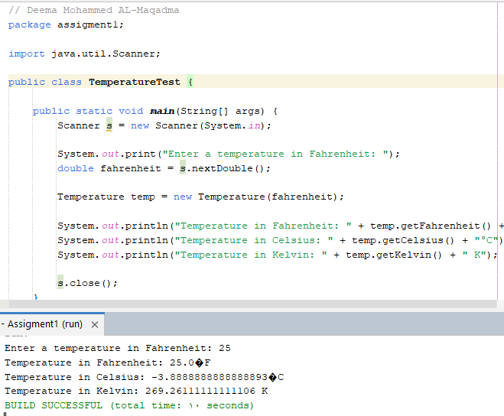

Slide 22
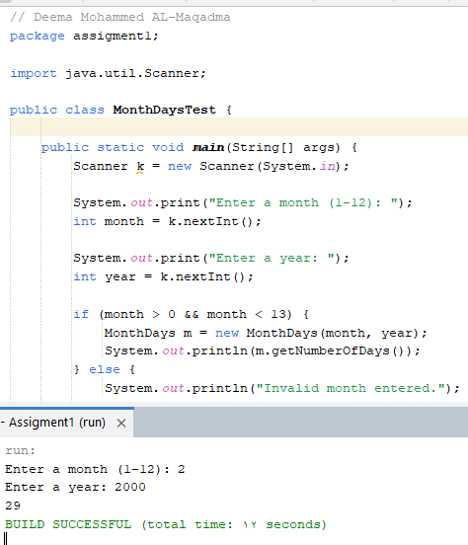
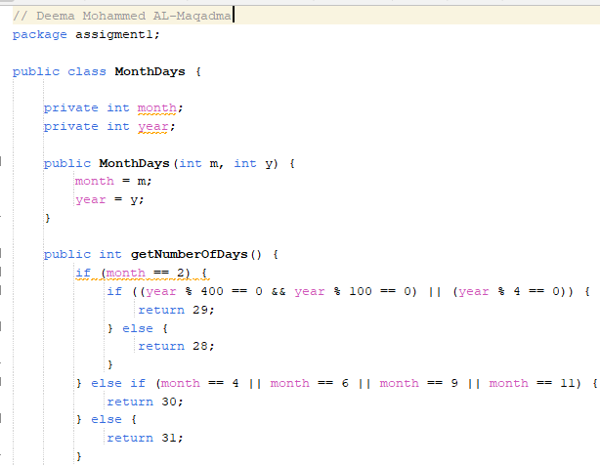

Slide 23
« واخر دعواهم أن الحمد لله رب العالمين «

