Slide 1
بسم الله الرحمن الرحيم
Programming 1
( Object Oriented Programming )
*** Dr . Mohammed Musalam *** Answers of Assigment 2
Eng. Deema Mohammed AL-Maqadma

Slide 2
Multiple Choice and True/False
1. This type of method cannot access any non-static member variables in its own class.
c. Static
2. When an object is passed as an argument to a method, this is actually passed. c. a reference to the object
3. If you write this method for a class, Java will automatically call it any time you concatenate an object of the class with a string. a. toString

Slide 3
4. Making an instance of one class a field in another class is called c. aggregation
5. This is the name of a reference variable that is always available to an instance method
and refers to the object that is calling the method. b. this
9. The Java Virtual Machine periodically performs this process, which automatically
removes unreferenced objects from memory. c. garbage collection

Slide 4
True or False: A static member method may refer to non-static member variables of
the same class, but only after an instance of the class has been defined.
13. True or False: All static member variables are initialized to –1 by default.
14. True or False: When an object is passed as an argument to a method, the method can
access the argument.
15. True or False: A method cannot return a reference to an object.

Slide 5
Find the Error
The following class definition has an error. What is it?
1. public class MyClass
{
private int x;
private double y;
public static void setValues(int a, double b)
{x = a;
y = b;
}
}
< [ The Static method can only access Static data >

Slide 6
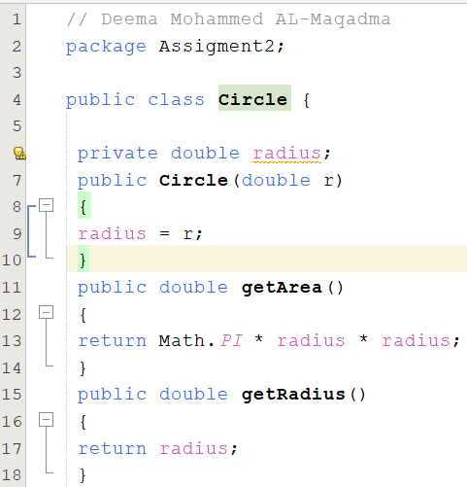
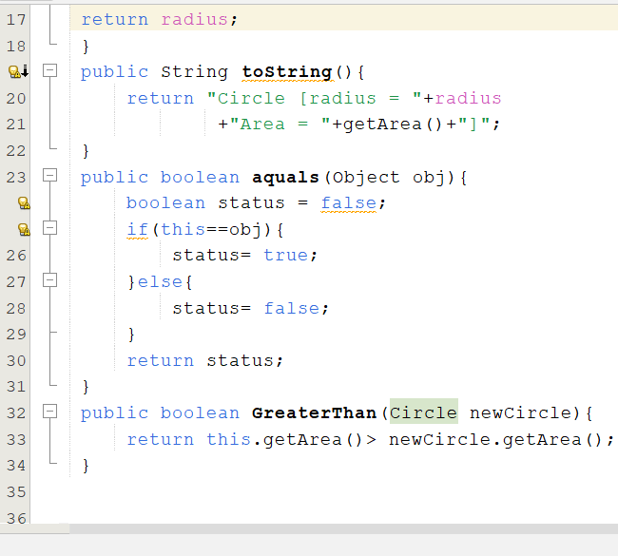
Algorithm Workbench
Q/1

Slide 7
2. Consider the following class declaration:
public class Thing
{
private int x;
private int y;
private static int z = 0;
public Thing()
{
x = z;
y = z;
}
static void putThing(int a)
{
z = a;
}
}
Assume a program containing the class declaration defines three Thing objects with
the following statements:
Thing one = new Thing();
Thing two = new Thing();
Thing three = new Thing();

Slide 8
How many separate instances of the x member exist? 3
b. How many separate instances of the y 3 member exist?
c. How many separate instances of the z member exist? 1
d. What value will be stored in the x and y members of each object? 0
e. Write a statement that will call the putThing method.
Thing.putThing(3);

Slide 9
« واخر دعواهم أن الحمد لله رب العالمين «

