Slide 1
بسم الله الرحمن الرحيم
Programming 1
( Object Oriented Programming )
*** Dr . Mohammed Musalam ***
Answers of Assigment 3
Eng. Deema Mohammed AL-Maqadma

Slide 2
Multiple Choice and True/False
1. In an inheritance relationship, this is the general class b. superclass
2. In an inheritance relationship, this is the specialized class c. subclass
3. This key word indicates that a class inherits from another class d. Extends
4. A subclass does not have access to these superclass members b. private
5. This key word refers to an object superclass a. super

Slide 3
6. In a subclass constructor, a call to the superclass constructor must a. appear as the very first statement
7. The following is an explicit call to the superclass default constructor c. super();
8. A method in a subclass that has the same signature as a method in the superclass is an example of b. overriding
9. A method in a subclass having the same name as a method in the superclass but a different signature is an example of a. overloading
10. These superclass members are accessible to subclasses and classes in the same package c. protected

Slide 4
11. All classes directly or indirectly inherit from this class a. Object
14. When a class implements an interface, it must b. provide all of the non default methods that are listed in the interface, with the exact signatures and return types specified
15. Fields in an interface are c. both final and static
16. Abstract methods must be a. overridden
17. Abstract classes cannot c. be instantiated
18. You use the _____ operator to define an anonymous inner class c. new
19. An anonymous inner class must ______ b. implement an interfacec. c.extend a superclassd. either b or c.

Slide 5
22. True : Constructors are not inherited.
23. False : In a subclass, a call to the superclass constructor can only be written in the subclass constructor.
24. False : If a subclass constructor does not explicitly call a superclass constructor, Java will not call any of the superclass constructors.
25. True : An object of a superclass can access members declared in a subclass.
26. True : The superclass constructor always
executes before the subclass constructor.
27. False : When a method is declared with the final modifier,it must be overridden in a subclass.

Slide 6
28. False : A superclass has a member with package access. A class that is outside the superclass package but inherits from the superclass can access the member
29. True : A superclass reference variable can reference an object of a subclass that extends the superclass.
30. False : A subclass reference variable can reference an object of the superclass.
31. True : When a class contains an abstract method, the class cannot be instantiated.
32. False : A class may only implement one interface.
33. True : By default all members of an interface are public.

Slide 7
Find the Error
1. // Superclass
public class Vehicle{
(Member declarations . . .)
}
// Subclass
public class Car expands Vehicle{
(Member declarations . . .)
}
[ The correct keyword is extends in Java for inheritance ]

Slide 8
2. // Superclass
public class Vehicle{
private double cost;
(Other methods . . .)
}
// Subclass
public class Car extends Vehicle{
public Car(double c) {
cost = c;
}
[ The field cost is declared private in the superclass. Private fields cannot be accessed directly in a subclass. This will result in a compile-time error. ]

Slide 9
3. // Superclass
public class Vehicle{
private double cost;
public Vehicle(double c) {
cost = c;
}(Other methods . . .)
}
// Subclass
public class Car extends Vehicle{
private int passengers;
public Car(int p) {
passengers = c;
} (Other methods . . .)
}
[ In the subclass constructor, the super constructor is not explicitly called, and since the Vehicle class does not have a default (no-arg) constructor, this results in a compile-time error. & The variable c in the subclass constructor is undefined it should be passed from the superclass constructor or set manually. ]

Slide 10
4. // Superclass
public class Vehicle{
public abstract double getMilesPerGallon(); (Other methods . . .)
}
// Subclasspublic class Car extends Vehicle{
private int mpg;
public int getMilesPerGallon(); {
return mpg;
}
(Other methods . . .)
}
[ The class Vehicle should has an abstract keyword because it has an abstract method & There’s a semi colon between the method header and body ]

Slide 11
Algorithm Workbeanch
1. Write the first line of the definition for a Poodle class. The class should extend the Dog class. public class Poodle extends Dog {…}
2. Look at the following code, which is the first line of a class definition/public class Tiger extends Felis In what order will the class constructors execute? When a subclass (Tiger) is created, the constructor of its superclass (Felis) is called first, then the Constructor of the subclass (Tiger) will execute.

Slide 12
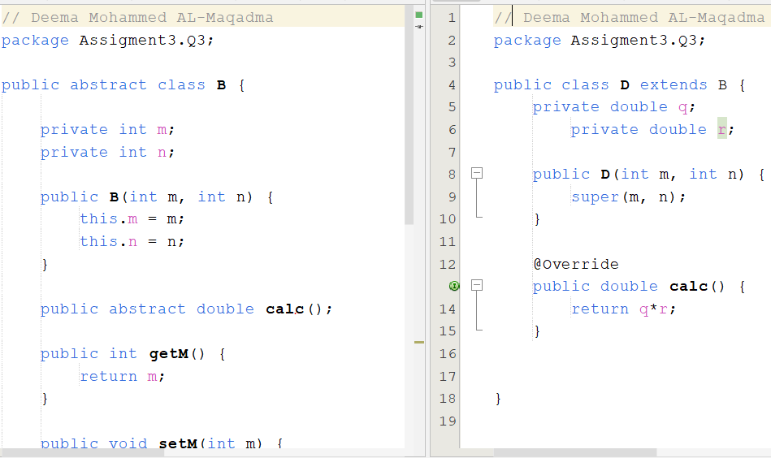

Slide 13
4. Write the statement that calls a superclass constructor and passes the arguments x, y, and z.
super ( x , y , z ) ;
5. A superclass has the following method: public void setValue(int v){
value = v;
}
Write a statement that may appear in a subclass that calls this method, passing 10 as an argument.
setValue ( 10 ) ;

Slide 14
6. A superclass has the following abstract method:
public abstract int getValue();
Write an example of a getValue method that
can appear in a subclass.
@Override
public int getValue() {
return this.value ; // OR return 10 ;
}

Slide 15
7. Write the first line of the definition for a Stereo class.
The class should extend the SoundSystem class, and it should implement the CDplayable, TunerPlayable, and
CassettePlayable interfaces.
public class Stereo extends SoundSystem implements CDplayable, TunerPlayable, CassettePlayable {
}

Slide 16
8. Write an interface named Nameable that specifies the following methods :
public void setName(String n)
public String getName()
public interface Nameable {
void setName(String n);
String getName();
}

Slide 17
« واخر دعواهم أن الحمد لله رب العالمين «

