Slide 1
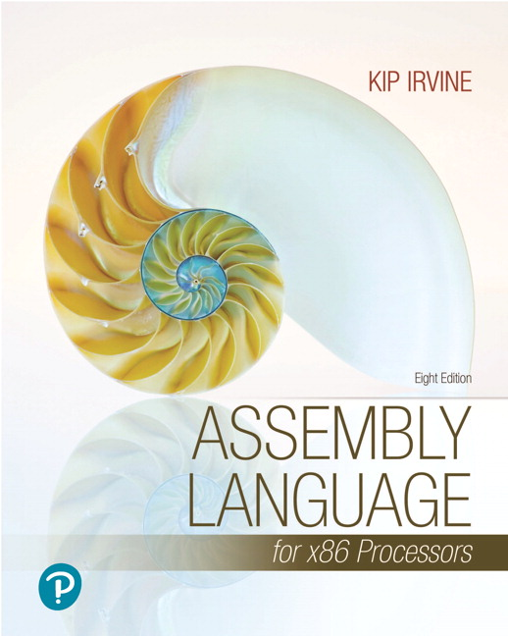
Assembly Language for x86 Processors
Eighth Edition
Chapter 6
Conditional Processing
Modified by :
Marwan Alakhras
Copyright © 2020, 2015, 2011 Pearson Education, Inc. All Rights Reserved

Slide 2
Chapter Overview
Boolean and Comparison Instructions
Conditional Jumps
Conditional Loop Instructions
Conditional Structures
Application: Finite-State Machines
Conditional Control Flow Directives

Slide 3
Boolean and Comparison Instructions
CPU Status Flags
AND Instruction
OR Instruction
XOR Instruction
NOT Instruction
Applications
TEST Instruction
CMP Instruction

Slide 4
Status Flags - Review
The Zero flag is set when the result of an operation equals zero.
The Carry flag is set when an instruction generates a result that is too large (or too small) for the destination operand.
The Sign flag is set if the destination operand is negative, and it is clear if the destination operand is positive.
The Overflow flag is set when an instruction generates an invalid signed result (bit 7 carry is XORed with bit 6 Carry).
The Parity flag is set when an instruction generates an even number of 1 bits in the low byte of the destination operand.
The Auxiliary Carry flag is set when an operation produces a carry out from bit 3 to bit 4

Slide 5
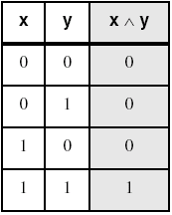
AND Instruction
Performs a Boolean AND operation between each pair of matching bits in two operands
Syntax:
AND destination, source
(same operand types as MOV)
AND
Always clears the OF, CF, the rest are modified

Slide 6
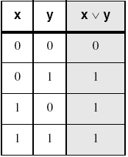
OR Instruction
Performs a Boolean OR operation between each pair of matching bits in two operands
Syntax:
OR destination, source
OR
Always clears the OF, CF, the rest are modified
Always clears the OF, CF

Slide 7
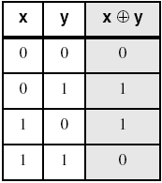
XOR Instruction
Performs a Boolean exclusive-OR operation between each pair of matching bits in two operands
Syntax:
XOR destination, source
XOR
XOR is a useful way to toggle (invert) the bits in an operand.
Always clears the OF, CF, the rest are modified

Slide 8
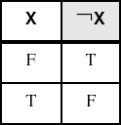
NOT Instruction
Performs a Boolean NOT operation on a single destination operand
Syntax:
NOT destination
NOT
No flags affect

Slide 9
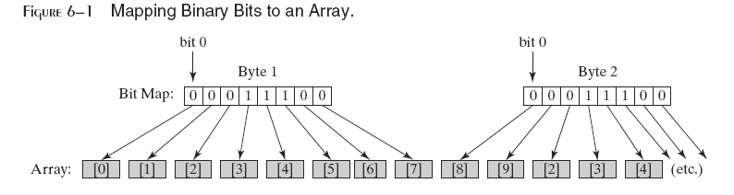
Bit-Mapped Sets
Binary bits indicate set membership
Efficient use of storage
Also known as bit vectors

Slide 10
Bit-Mapped Set Operations
Set Complement
mov eax,SetX
not eax
Set Intersection
mov eax,setX
and eax,setY
Set Union
mov eax,setX
or eax,setY

Slide 11
Applications (1 of 5)
Task: Convert the character in AL to upper case.
Solution: Use the AND instruction to clear bit 5.
mov al,'a' ; AL = 01100001b
and al,11011111b ; AL = 01000001b
Example: array is converted to upper case
.data
array BYTE 50 DUP(?)
.code
mov ecx,LENGTHOF array
mov esi,OFFSET array
L1: and BYTE PTR [esi],11011111b ; clear bit 5
inc esi
loop L1

Slide 12
Applications (2 of 5)
Task: Convert a binary decimal byte into its equivalent ASCII decimal digit.
Solution: Use the OR instruction to set bits 4 and 5.
mov al,6 ; AL = 00000110b
or al,00110000b ; AL = 00110110b
The ASCII digit '6' = 00110110b

Slide 13
Applications (3 of 5)
Task: Turn on the keyboard CapsLock key
Solution: Use the OR instruction to set bit 6 in the keyboard flag byte at 0040:0017h in the BIOS data area.
mov ax,40h ; BIOS segment
mov ds,ax
mov bx,17h ; keyboard flag byte
or BYTE PTR [bx],01000000b ; CapsLock on
This code only runs in Real-address mode, and it does not work under Windows NT, 2000, or XP.

Slide 14
Applications (4 of 5)
Task: Jump to a label if an integer is even.
Solution: AND the lowest bit with a 1. If the result is Zero, the number was even.
mov ax,wordVal
and ax,1 ; low bit set?
jz EvenValue ; jump if Zero flag set
JZ (jump if Zero) is covered in Section 6.3.
Your turn: Write code that jumps to a label if an integer is negative.

Slide 15
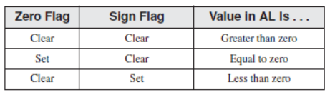
Applications (5 of 5)
Task: Jump to a label if the value in AL is not zero.
Solution: OR the byte with itself, then use the JNZ (jump if not zero) instruction.
or al,al
jnz IsNotZero ; jump if not zero
ORing any number with itself does not change its value.
The values of the Zero and Sign flags indicate the following about the contents of AL:

Slide 16
TEST Instruction
Performs a nondestructive AND operation between each pair of matching bits in two operands
No operands are modified, but the flags are affected.
Example: jump to a label if either bit 0 or bit 1 in AL is set.
test al,00000011b
jnz ValueFound
Example: jump to a label if neither bit 0 nor bit 1 in AL is set.
test al,00000011b
jz ValueNotFound
Always clears the OF, CF, the rest are modified

Slide 17
CMP Instruction
Compares the destination operand to the source operand
Nondestructive subtraction of source from destination (destination operand is not changed)
Syntax: CMP destination, source
Example: destination == source
mov al,5
cmp al,5 ; Zero flag set
Example: destination < source
mov al,4
cmp al,5 ; Carry flag set
Always modifies the all flags

Slide 18
CMP Instruction
Example: destination > source
mov al,6
cmp al,5 ; ZF = 0, CF = 0
(both the Zero and Carry flags are clear)
CMP used to create conditional logic structures
When following CMP with a conditional jump instruction, the result is the assembly language equivalent of an IF statement

Slide 19
What's Next
Boolean and Comparison Instructions
Conditional Jumps
Conditional Structure
Conditional Loop Instructions
Conditional Structures

Slide 20
Conditional Structures
Block-Structured IF Statements
Compound Expressions with AND
Compound Expressions with OR

Slide 21
Conditional Jumps Instructions
No high-level control structures in assembly language.
The most common way to transfer control in assembly language is to use a conditional jump.
This is a two-step process:
First test (create) the condition.
Then jump if the condition is true or continue if it is false.

Slide 22
Cont
Conditional jump instructions can be divided into four groups:
Jumps based on the value of a single arithmetic flag
Jumps based on the value of CX or ECX
Jumps based on comparisons of signed operands
Jumps based on comparisons of unsigned operands
Syntax:
J_{cond} destination ; cond is the jump condition

Slide 23
Jcond Ranges
Prior to the 386:
jump must be within –128 to +127 bytes from the current location counter
x86 processors:
32-bit offset permits jump anywhere in memory

Slide 24
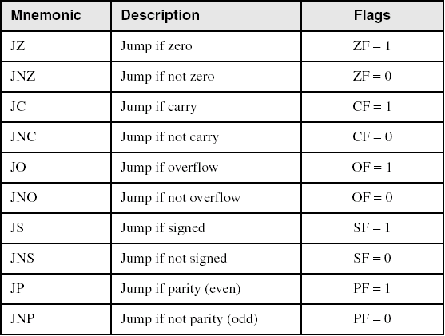
Jumps Based on Specific Flags

Slide 25
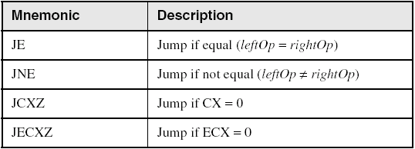
Jumps Based on Equality

Slide 26
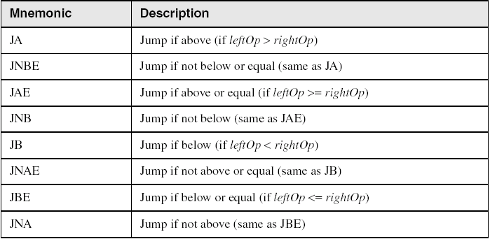
Jumps Based on Unsigned Comparisons

Slide 27
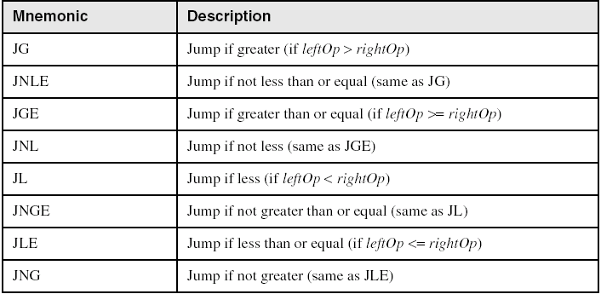
Jumps Based on Signed Comparisons

Slide 28
Applications (1 of 5)
Task: Jump to a label if unsigned EAX is greater than EBX
Solution: Use CMP, followed by JA
cmp eax,ebx
ja Larger
Task: Jump to a label if signed EAX is greater than EBX
Solution: Use CMP, followed by JG
cmp eax,ebx
jg Greater

Slide 29
Applications (2 of 5)
Jump to label L1 if unsigned EAX is less than or equal to Val1
cmp eax,Val1
jbe L1 ; below or equal
Jump to label L1 if signed EAX is less than or equal to Val1
cmp eax,Val1
jle L1

Slide 30
Applications (3 of 5)
Compare unsigned AX to BX, and copy the larger of the two into a variable named Large
mov Large,bx
cmp ax,bx
jna Next
mov Large,ax
Next:
Compare signed AX to BX, and copy the smaller of the two into a variable named Small
mov Small,ax
cmp bx,ax
jnl Next
mov Small,bx
Next:

Slide 31
Applications (4 of 5)
Jump to label L1 if the memory word pointed to by ESI equals Zero
cmp WORD PTR [esi],0
je L1
Jump to label L2 if the doubleword in memory pointed to by EDI is even
test DWORD PTR [edi],1
jz L2

Slide 32
Applications (5 of 5)
Task: Jump to label L1 if bits 0, 1, and 3 in AL are all set.
Solution: Clear all bits except bits 0, 1,and 3. Then compare the result with 00001011 binary.
and al,00001011b ; clear unwanted bits
cmp al,00001011b ; check remaining bits
je L1 ; all set? jump to L1

Slide 33
What's Next
Boolean and Comparison Instructions
Conditional Jumps
Conditional Loop Instructions
Conditional Structures

Slide 34
Block-Structured IF Statements
Assembly language programmers can easily translate logical statements written in C++/Java into assembly language. For example:
if( op1 == op2 )
X = 1;
else
X = 2;
mov eax,op1
cmp eax,op2
jne L1; Not equal
mov X,1
jmp L2
L1: mov X,2
L2:

Slide 35
Your turn . . .
Implement the following pseudocode in assembly language. All values are unsigned:
if( ebx <= ecx )
{
eax = 5;
edx = 6;
}
cmp ebx,ecx
ja next ; >
mov eax,5
mov edx,6
next:
(There are multiple correct solutions to this problem.)

Slide 36
Your turn . . .
Implement the following pseudocode in assembly language. All values are 32-bit unsigned integers:
if( var1 <= var2 )
var3 = 10;
else
{
var3 = 6;
var4 = 7;
}
mov eax,var1
cmp eax,var2
jbe L1; <=
mov var3,6
mov var4,7
jmp L2
L1: mov var3,10
L2:
(There are multiple correct solutions to this problem.)

Slide 37
Compound Expression with AND (1 of 3)
When implementing the logical AND operator, consider that HLLs use short-circuit evaluation
In the following example, if the first expression is false, the second expression is skipped:
if (al > bl) AND (bl > cl)
X = 1;

Slide 38
Compound Expression with AND (2 of 3)
if (al > bl) AND (bl > cl)
X = 1;
This is one possible implementation . . .
cmp al,bl ; first expression...
ja L1
jmp next
L1:
cmp bl,cl ; second expression...
ja L2
jmp next
L2: ; both are true
mov X,1 ; set X to 1
next:

Slide 39
Compound Expression with AND (3 of 3)
if (al > bl) AND (bl > cl)
X = 1;
But the following implementation uses 29% less code by reversing the first relational operator. We allow the program to "fall through" to the second expression:
cmp al,bl ; first expression...
jbe next ; quit if false
cmp bl,cl ; second expression...
jbe next ; quit if false
mov X,1 ; both are true
next:

Slide 40
Your turn . . .
Implement the following pseudocode in assembly language. All values are unsigned:
if( ebx <= ecx
&& ecx > edx )
{
eax = 5;
edx = 6;
}
cmp ebx,ecx
ja next
cmp ecx,edx
jbe next
mov eax,5
mov edx,6
next:
(There are multiple correct solutions to this problem.)

Slide 41
Compound Expression with OR (1 of 2)
When implementing the logical OR operator, consider that HLLs use short-circuit evaluation
In the following example, if the first expression is true, the second expression is skipped:
if (al > bl) OR (bl > cl)
X = 1;

Slide 42
Compound Expression with OR (2 of 2)
if (al > bl) OR (bl > cl)
X = 1;
We can use "fall-through" logic to keep the code as short as possible:
cmp al,bl ; is AL > BL?
ja L1 ; yes
cmp bl,cl ; no: is BL > CL?
jbe next ; no: skip next statement
L1: mov X,1 ; set X to 1
next:

Slide 43
Example 2: Find the largest between 2 numbers
.data
output2 BYTE "The largest number is: ",0
.code
main PROC
;… same as example 1 read 2 integer numbers
; print the largest number
mov edx, OFFSET output2
call WriteString
cmp eax, ebx
jae L1
mov eax, ebx
L1: call WriteDec

Slide 44
What's Next
Boolean and Comparison Instructions
Conditional Jumps
Conditional Loop Instructions
Conditional Structures

Slide 45
Conditional Loop Instructions
LOOP: decrements ecx and checks if ecx is not zero, if that condition is met it jumps at specified label, otherwise falls through.
mov ecx, 3
myloop:
; Your loop content
loop myloop

Slide 46
INCLUDE Irvine32.inc ; count the number of zero in an array
.data
array DWORD 5, 0, 3, 0, 0, 7, 0, 9 ;
.code
main PROC
mov ecx, lengthof array
xor eax, eax ; Clear EAX (used for counting)
xor esi, esi
scan_array:
cmp array[esi], 0 ; Compare it with 0
jne skip_increment ; If not zero, skip incrementing the count
inc eax ; Increment zero count in EAX
skip_increment:
add esi, 4 ; Move to the next DWORD element (4 bytes)
loop scan_array ; Loop while ECX != 0
call WriteDec ; Print the zero count
call Crlf ; Print a newline
exit ; Exit the program
main ENDP
END main

Slide 47
INCLUDE Irvine32.inc ; sum odd numbers
.data
array DWORD 1, 2, 3, 5, 8, 4, 7, 9
.code
main PROC
mov ecx, lengthof array
xor eax, eax ; Clear EAX (used for counting)
xor esi, esi
scan_array:
test array[esi], 1 ; destructive and with 000000001H
jz skip_addition ; If zero set, skip the value is even
add eax, array[esi] ; add the odd elements to the sum
skip_addition:
add esi, 4 ; Move to the next DWORD element (4 bytes)
loop scan_array ; Loop while ECX != 0
call WriteDec ; Print the sum of odd numbers
call Crlf ; Print a newline
exit ; Exit the program
main ENDP
END main

Slide 48
Conditional Loop Instructions
LOOPZ and LOOPE: decrements ecx and checks that ecx is not zero and ZF is set - if these conditions are met, it jumps at specified label, otherwise falls through.
LOOPNZ and LOOPNE: are same as LOOPZ/E except that it requires ZF to be not set (i.e be zero) to do the jump.

Slide 49
LOOPZ and LOOPE
Syntax:
LOOPE destination
LOOPZ destination
Logic:
ECX ← ECX – 1
if ECX > 0 and ZF=1, jump to destination
Useful when scanning an array for the first element that does not match a given value.
In 32-bit mode, ECX is the loop counter register. In 16-bit real-address mode, CX is the counter, and in 64-bit mode, RCX is the counter.

Slide 50
LOOPNZ and LOOPNE
LOOPNZ (LOOPNE) is a conditional loop instruction
Syntax:
LOOPNZ destination
LOOPNE destination
Logic:
ECX ← ECX – 1;
if ECX > 0 and ZF=0, jump to destination
Useful when scanning an array for the first element that matches a given value.

Slide 51
LOOPNZ Example
The following code finds the first positive value in an array:
.data
array SWORD -3, -6, -1, -10, 10, 30, 40, 4
.code
mov esi , offset array ; lea esi, array
mov ecx, LENGTHOF array
again:
mov ax, [esi]
add esi, TYPE array
test ax, 8000
loopnz again
jnz quit
; code found her
quit:

Slide 52
Your turn . . .
Locate the first nonzero value in the array.
.data
array SWORD 50 DUP(?)
.code
mov esi,OFFSET array
mov ecx,LENGTHOF array
again:mov bx, [esi]
found: ; do what ever you need
quit:

Slide 53
. . . (solution)
.data
array SWORD 50 DUP(?)
sentinel SWORD 0FFFFh
.code
lea esi, array
mov ecx, LENGTHOF array
again: mov bx, [esi]
add esi, TYPE array
cmp bx, 0
loopz again ; can we use loope?
jz quit
found: ; do what ever you need
quit:

Slide 54
WHILE Loops
A WHILE loop is really an IF statement followed by the body of the loop, followed by an unconditional jump to the top of the loop. Consider the following example:
while( eax < ebx)
eax = eax + 1;
This is a possible implementation:
top: cmp eax,ebx ; check loop condition
jae next ; false? exit loop
inc eax ; body of loop
jmp top ; repeat the loop
next:

Slide 55
Your turn . . .
Implement the following loop, using unsigned 32-bit integers:
while( ebx <= val1)
{
ebx = ebx + 5;
val1 = val1 - 1
}
top: cmp ebx,val1 ; check loop condition
ja next ; false? exit loop
add ebx,5 ; body of loop
dec val1
jmp top ; repeat the loop
next:

