Slide 1
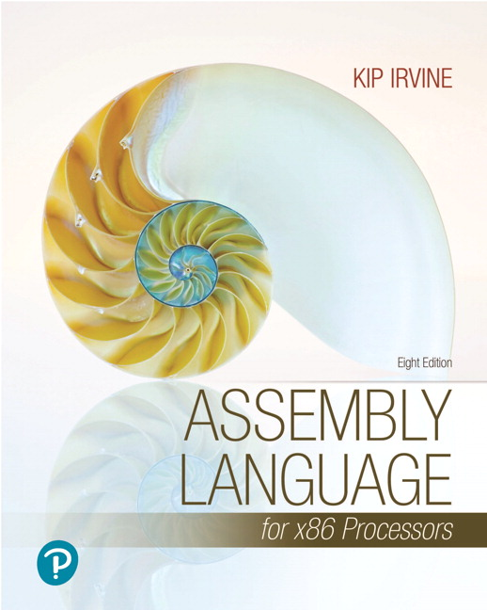
Assembly Language for x86 Processors
Eighth Edition
Chapter 7
Integer Arithmetic
Modified by :
Marwan Alakhras
Copyright © 2020, 2015, 2011 Pearson Education, Inc. All Rights Reserved

Slide 2
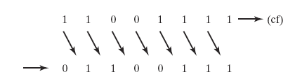
Logical Shift
A logical shift fills the newly created bit position with zero:

Slide 3
Arithmetic Shift
An arithmetic shift fills the newly created bit position with a copy of the number’s sign bit:

Slide 4
SHL Instruction
The SHL (shift left) instruction performs a logical left shift on the destination operand, filling the lowest bit with 0.
SHL destination, count
Operand types for SHL:
SHL reg, imm8
SHL mem, imm8
SHL reg, CL
SHL mem, CL
(Same for all shift and rotate instructions)

Slide 5
Fast Multiplication
Shifting left 1 bit multiplies a number by 2
mov dl,5
shl dl,1
Shifting left n bits multiplies the operand by 2^{n}
For example, 5 * 2² = 20
mov dl,5
shl dl,2 ; DL = 20

Slide 6
SHR Instruction
The SHR (shift right) instruction performs a logical right shift on the destination operand. The highest bit position is filled with a zero.
Shifting right n bits divides the operand by 2^{n}
mov dl,80
shr dl,1 ; DL = 40
shr dl,2 ; DL = 10

Slide 7
SAL and SAR Instructions
SAL (shift arithmetic left) is identical to SHL.
SAR (shift arithmetic right) performs a right arithmetic shift on the destination operand.
An arithmetic shift preserves the number's sign.
mov dl,-80
SAR dl,1 ; DL = -40
SAR dl,2 ; DL = -10

Slide 8
Your turn . . .
Indicate the hexadecimal value of AL after each shift:
mov al,6Bh ;6B = 01101011
shr al,1 a.
shl al,3 b.
mov al,8Ch ;8C =
sar al,1 c.
sar al,3 d.
35h = 0011 0101
A8h = 1010 1000
1000 1100
C6h = 1100 0110
F8h = 1111 1000

Slide 9
The MUL/IMUL Instruction
There are two instructions for multiplying binary data.
The MUL (Multiply) instruction handles unsigned data and the IMUL (Integer Multiply) handles signed data.
SYNTAX:
MUL/IMUL multiplier
The generated product is stored in two registers depending upon the size of the operands.

Slide 10
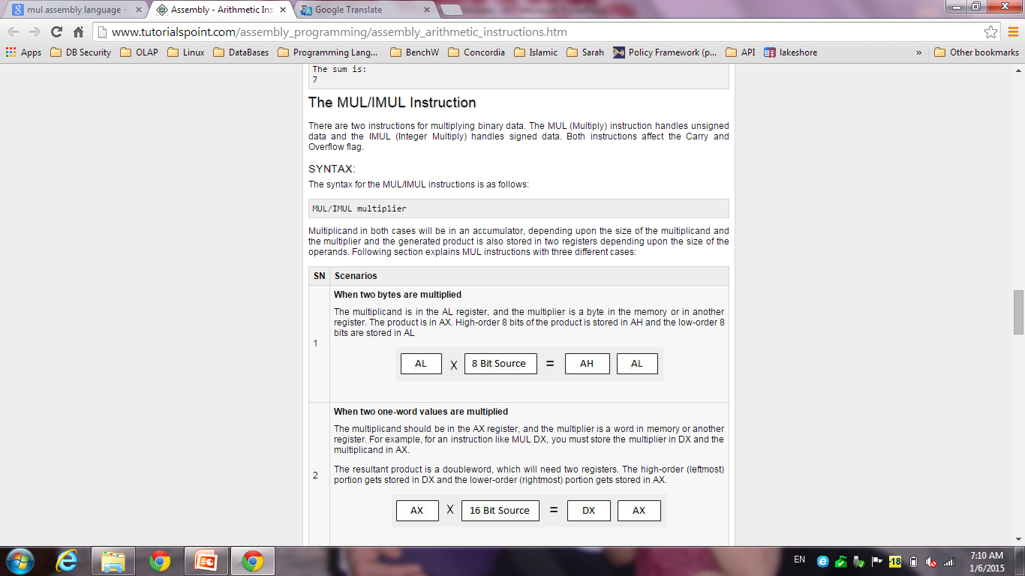
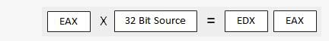
MUL Instruction
The MUL (unsigned multiply) instruction multiplies an 8-, 16-, or 32-bit operand by either AL, AX, or EAX.
The instruction formats are:
MUL r/m8
MUL r/m16
MUL r/m32

Slide 11
MUL Examples
100h * 2000h, using 16-bit operands:
.data
val1 WORD 2000h
val2 WORD 100h
.code
mov ax,val1
mul val2 ; DX:AX = 0020 0000h, CF=1
The Carry flag indicates whether or not the upper half of the product contains significant digits.
12345h * 1000h, using 32-bit operands:
mov eax,12345h
mov ebx,1000h
mul ebx ; EDX:EAX = 00000000 12345000h, CF=0

Slide 12
Your turn . . .
What will be the hexadecimal values of DX, AX, and the Carry flag after the following instructions execute?
mov ax,1234h
mov bx,100h
mul bx
DX = 0012h, AX = 3400h, CF = 1

Slide 13
Your turn . . .
What will be the hexadecimal values of EDX, EAX, and the Carry flag after the following instructions execute?
mov eax,00128765h
mov ecx,10000h
mul ecx
EDX = 00000012h, EAX = 87650000h, CF = 1

Slide 14
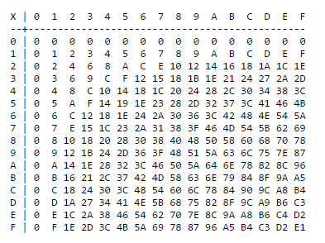
Cont.

Slide 15
DIV Instruction
The DIV (unsigned divide) instruction performs 8-bit, 16-bit, and 32-bit division on unsigned integers
A single operand is supplied (register or memory operand), which is assumed to be the divisor
Instruction formats:
DIV reg/mem8
DIV reg/mem16
DIV reg/mem32

Slide 16
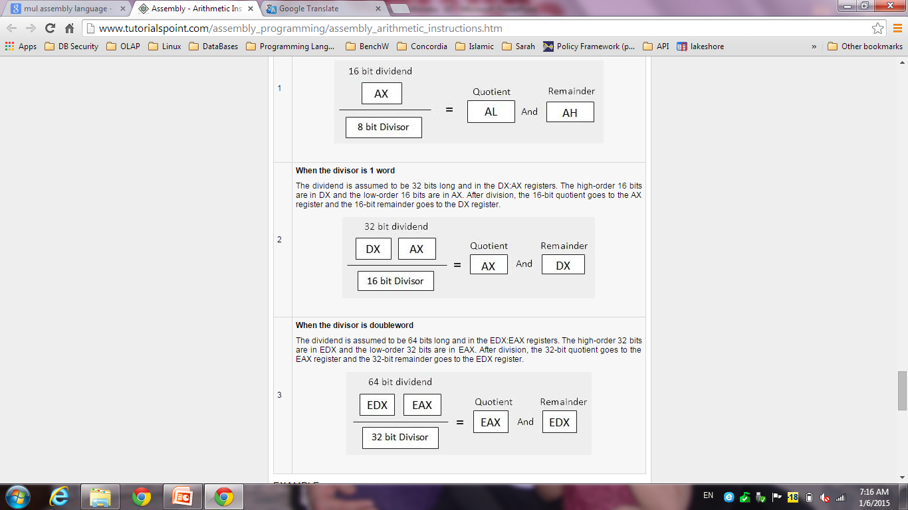
Cont.

Slide 17
DIV Examples
Divide 8003h by 100h, using 16-bit operands:
mov dx,0 ; clear dividend, high
mov ax,8003h ; dividend, low
mov cx,100h ; divisor
div cx ; AX = 0080h, DX = 3
Same division, using 32-bit operands:
mov edx,0 ; clear dividend, high
mov eax,8003h ; dividend, low
mov ecx,100h ; divisor
div ecx ; EAX = 00000080h, DX = 3

Slide 18
Your turn . . .
What will be the hexadecimal values of DX and AX after the following instructions execute? Or, if divide overflow occurs, you can indicate that as your answer:
mov dx,0087h
mov ax,6000h
mov bx,100h
div bx
DX = 0000h, AX = 8760h

Slide 19
Your turn . . .
What will be the hexadecimal values of DX and AX after the following instructions execute? Or, if divide overflow occurs, you can indicate that as your answer:
mov dx,0087h
mov ax,6000h
mov bx,10h
div bx
Divide Overflow

Slide 20
Your turn . . .
Implement the following expression using unsigned 32-bit integers:
eax = (ebx * 20) / ecx
mov eax,20
mul ebx
div ecx

