Slide 1

SQL Injection and Cross Site Scripting Prevention Using OWASP Web Application Firewall
Student Morozov Alexandr
Student Chentsov Dmitry
Samara 14.05.2024

Slide 2
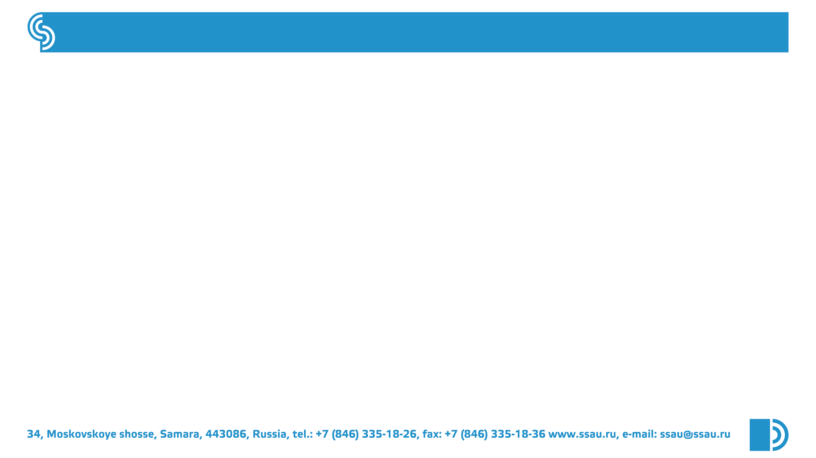
TABLE OF CONTENTS
1.INTRODUCTING
2.METHOD
3.METHOD
4.RESULT
5.RESULT
6.DISCUSSION
7.CONCLUSION
2

Slide 3

INTRODUCTION
Web application or website are widely used to provide functionality that allows companies to build and maintain relationships with their customers.
There are a lot of technique that commonly use by the attackers such as SQL Injection, Cross Site Scripting, Brute Force, Worm, deface, etc to intrude web application.
3

Slide 4
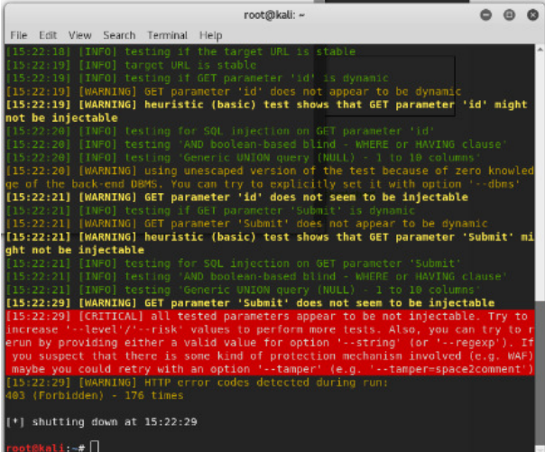
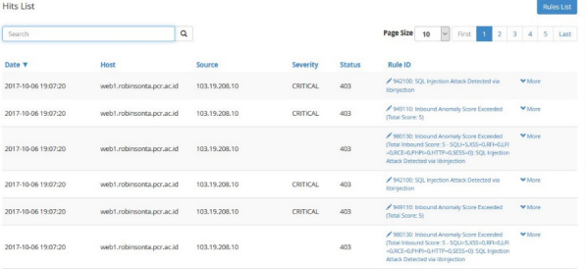
METHOD
OWASP ModSecurity
The method show that OWASP successfully secure web server from all SQLmap exploitations and detect the attack on the Hit List as show in the Figures.
ModSecurity Hit List
SQLmap detect WAF
4

Slide 5
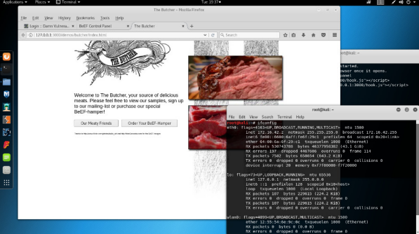
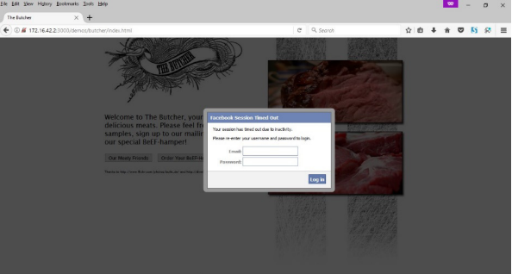
METHOD
BeEF
BeEF is an application for testing cross site scripting stored type which will hook a target PC that will cause the attacker can control the target PC.
BeEF Hook Page
BeEF fake form login into target PC
5

Slide 6
RESULT
RESULT OF USE OWASP ModSecurity
The result show that OWASP successfully secure web server from all SQLmap exploitations and detect the attack on the Hit List
Attack | Result
 | OWASP | NOOWASP
Tautology | Failed | Success
Logically | Success | Success
Union Queries | Failed | Success
Piggy-backed | Failed | MySQL countered
Stored Procedure | Failed | MySQL countered
Blind Injection | Failed | MySQL countered
Timing Attacks | Failed | MySQL countered
Attack | Result
Kali Linux | Success | Success
Back Box | Success | Success
Parrot | Success | Success
SQLMAP EXPLOITATION RESULT
SQL INJECTION RESULT
6

Slide 7
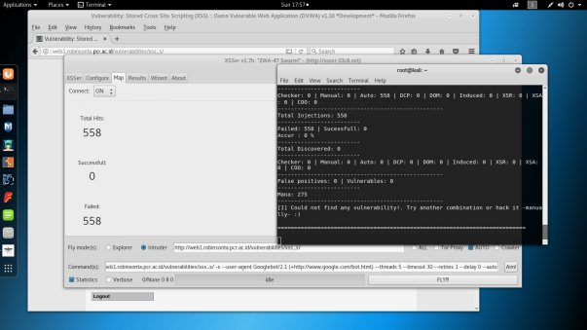
RESULT
RESULT OF USE OWASP ModSecurity
The result show that OWASP failed to secure the web server from XSS ( Stored ) which cause both of the web server redirecting page into Hook Page that prepared by the Attacker ( BeEF ) as show on the Figure.
XSSer failed to inject 558 CSS Query into web server
7

Slide 8

DISCUSSION
After the research, we see that today's methods of protection against SQL injections provide 100% security, and we hope that further research in this area will help improve this parameter.
8

Slide 9

CONCLUSION
After testing 7 kinds of SQL Injection on web servers, the result was some attack type already counter or covered by the MySQL patching itself. ( based on the results reference to SQL Injection Attack Testing )
SQLmap Exploitation sometimes even already detected there was a WAF/IDS/IPS its still force to inject dozens of query that can cause OWASP Hit List flooding. ( based on the results reference to SQL Injection using SQLmap Tool )
9

Slide 10
THANK YOU

