Slide 1
Big Integer Implementation of AES Encryption in C++
CPE-593 Final Project
Group 14

Slide 2
What is AES Encryption?
DES (older method) became obsolete
RSA vs AES (asymmetric vs symmetric)
AES 256 is the standard encryption algorithm for government purposes
128, 192 or 256 bit key

Slide 3
Generating a Private Key
Diffie Hellman Key exchange
Created class to simulate public vs private
Big Integer Implementation

Slide 4
Example of Diffie-Hellman
Value | Calculated By | Known By:
 |  | Alice | Bob | Eve
Public Prime Base (g) | rand() + MillerRabin() | Yes | Yes | Yes
Public Prime Modulus (p) | rand() + MillerRabin() | Yes | Yes | Yes
Alice Private Key (a) | rand() | Yes | No | No
Bob Private Key (b) | rand() | No | Yes | No
Alice Public Key (A) | gª mod p | Yes | Yes | Yes
Bob Public Key (B) | g^{b} mod p | Yes | Yes | Yes
Shared Private Key(s) | Bª mod p OR A^{b} mod p | Yes | Yes | No
Diffie-Hellman Information Table

Slide 5
The AES Algorithm Functions
*Borrowed from M. Mkhitaryan GitHub page^{[3]}*
AES Algorithm based on the logic of 5 total functions:
Encryption
Expand_Keys()
Add_Round_Key()
Sub_Bytes()
Shift_Rows()
Mix_Columns()
Decryption
Expand_Keys()
Add_Round_Key()
Inv_Sub_Bytes()
Inv_Shift_Rows()
Inv_Mix_Columns()
Inverted

Slide 6
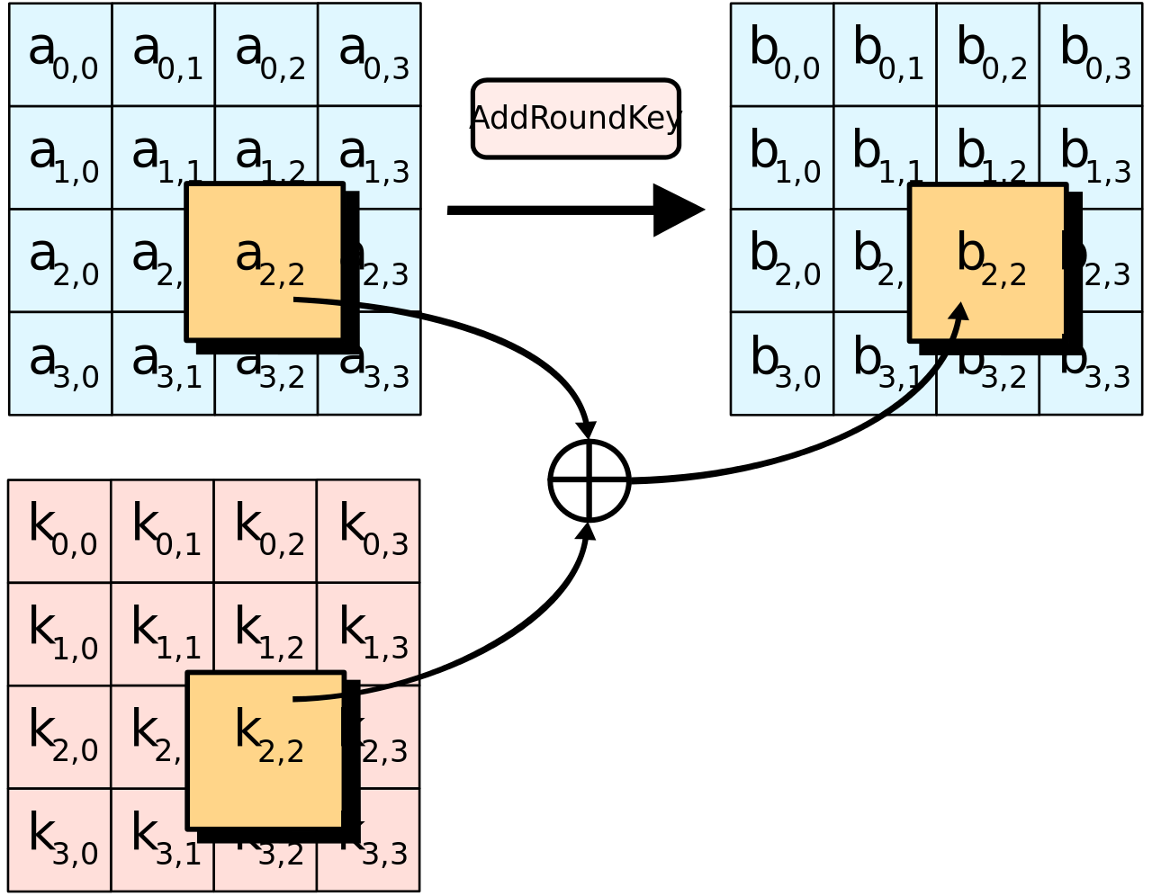
AES Functions Continued
Expand_Keys()
Encryption Key = [ 06 a7 82 9f … e5 ]
Add_Round_Key()
0
1
2
3
13

Slide 7
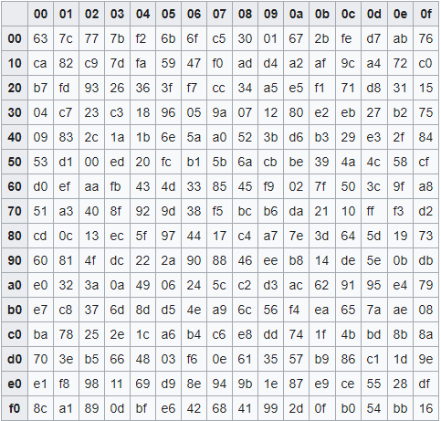
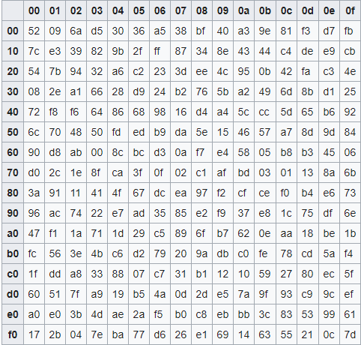
AES Functions Continued
Sub_Bytes()
Inv_Sub_Bytes()
Standard Rijndael sBox
Standard Rijndael Inverse sBox

Slide 8
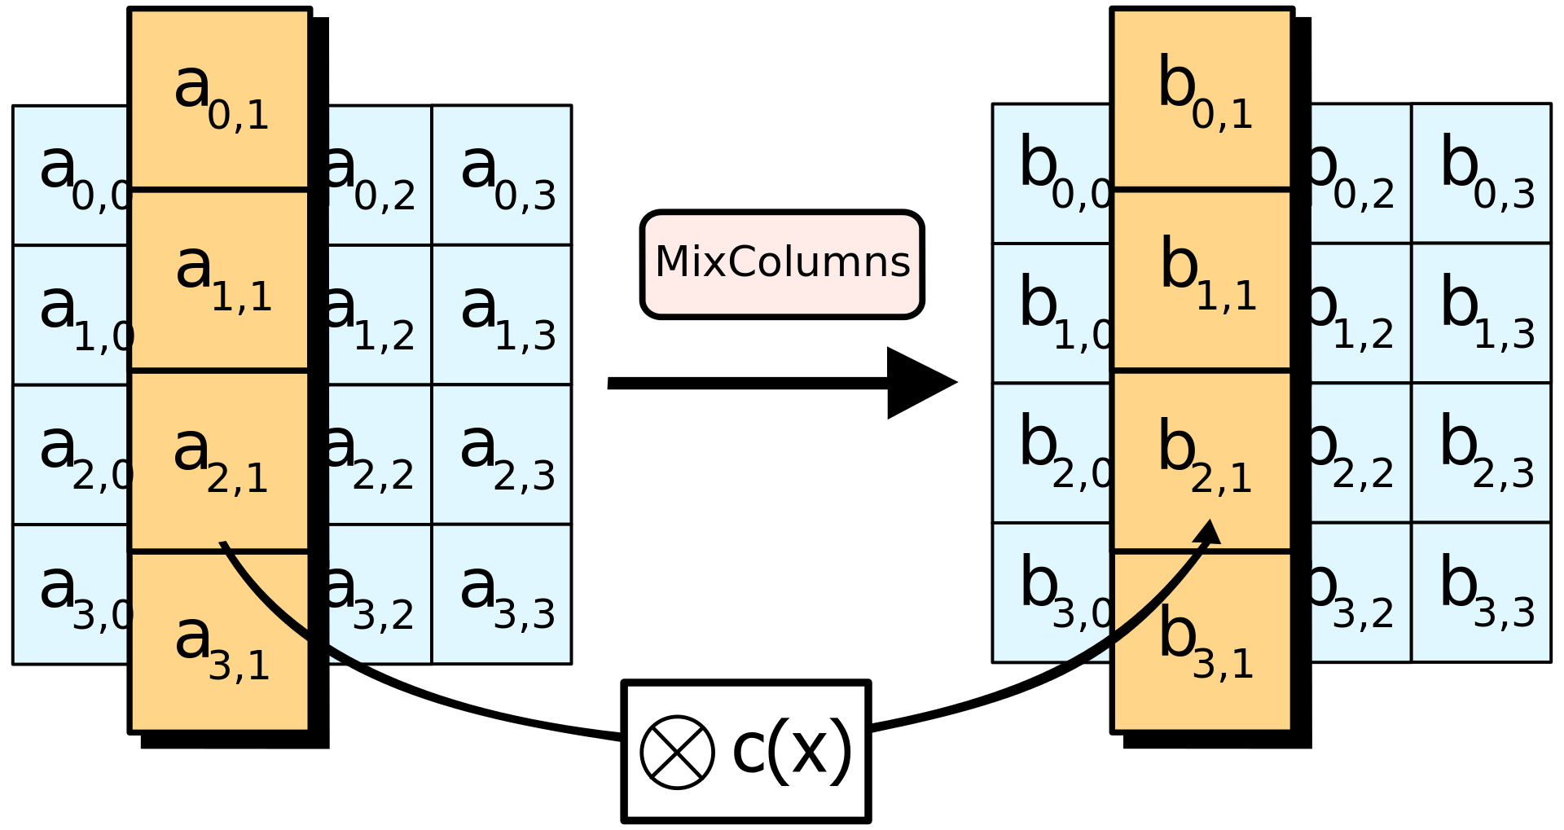
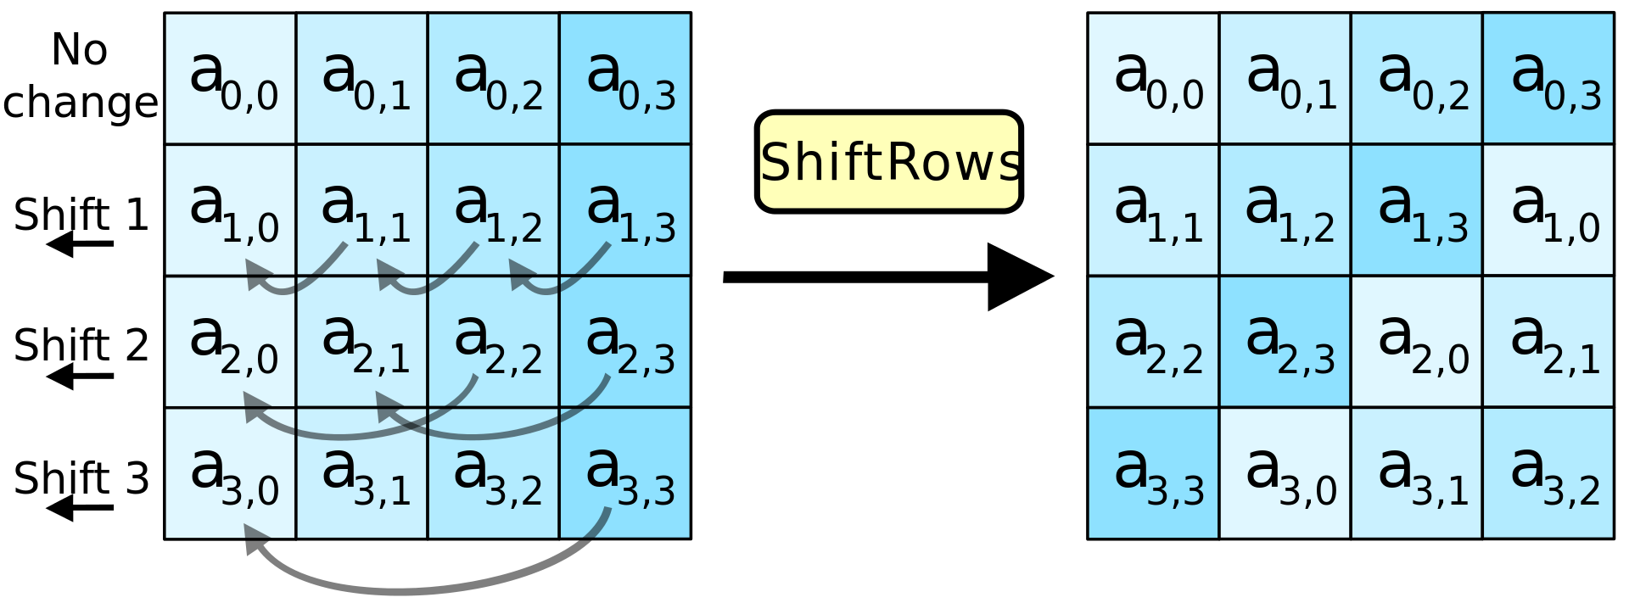
AES Functions Continued
Shift_Rows()
Mix_Columns()

Slide 9

AES Encryption Algorithm
Rijndael Encryption Algorithm
“Zipping Process”
Step 0 | Exapnd_Keys()
Step 1 | Add_Round_Key()
Step 2 (Repeated 13 times for 256 bit key) | Sub_Bytes() Shift_Rows() Mix_Columns() Add_Round_Key()
Step 3 | Sub_Bytes() Shift_Rows() Add_Round_Key()

Slide 10

AES Decryption Algorithm
Rijndael Decryption Algorithm
“Un-zipping Process”
Step 0 | Exapnd_Keys()
Step 1 | Add_Round_Key(reverse)
Step 2 (Repeated 13 times for 256 bit key) | Inv_Shift_Rows() Inv_Sub_Bytes() Add_Round_Key(reverse) Inv_Mix_Columns()
Step 3 | Inv_Shift_Rows() Inv_Sub_Bytes() Add_Round_Key(0)

Slide 11
Our Challenges
AES algorithm limited to reading files by 128 bit blocks
Needed a loop for encrypting/decrypting process of larger files
Cases where input file is not an exact multiple of 128 bits
Final iteration of loop writes a repeat last iteration’s ending result
Need to reinitialize encrypted array back to 0 each time
Created our own hash table as “ASCII table” and assign “space” as 0
The cursed value of “0x1a” (ASCII EOF character)
Needed to create a valid array and modify read values

Slide 12
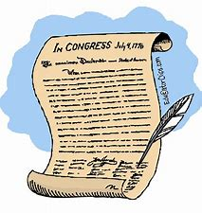
Having a Little Fun
Demonstration with encryption of the Declaration of Independence

Slide 13
Conclusion
Overall success
Skills/Knowledge over the course was essential
Encryption is definitely applicable & relevant
More can be done
Saving keys
Option to input your own keys
Option to adjust key size (128/192/256)

Slide 14
Resources
[1] “Advanced Encryption Standard”. Wikipedia. https://en.wikipedia.org/wiki/Advanced_Encryption_Standard
[2] Dr. M. Pound. “AES Explained (Advanced Encryption Standard)”. youtube/Computerphile. Nov 22, 2019. https://youtu.be/O4xNJsjtN6E
[3] M. Mkhitaryan. “AES-Rijndael-Encryption”. GitHub. April 23, 2017.
https://github.com/manvelmk/AES-Rijndael-Encryption/blob/master/AES.cpp
[4] S.Kallam. “Diffie-Hellman:Key Exchange and Public Key Cryptosystems,” Indiana State University, Sept 30, 2015. http://cs.indstate.edu/~skallam/doc.pdf

