Slide 1
SALES ANALYSIS PROJECT
By Deena T

Slide 2
1. Aim
2. Objectives
3. Research Questions
4. Tools and Datasets used
5. Methodology
6. Conclusion

Slide 3
Abstract
Aim
The primary aim of the project is to collect and analyze the data to create a dashboard which helps to understand the Sales Analyst Salary, Sales Methods,Sales Research.

Slide 4
Research Questions
Q-1: Share the successful salary package of sales analysts in top 5 companies using the data
Q-2: How Hospitality Sales and Travel sales representatives gather the customers and what is the retention percentage?
Q-3: Share 3 main types of sales research?
Q-4: Share data appropriately using 9 types of sales methods and techniques?
Q-5: Use the online date to do empirical research on sales analysis metrics and KPIs?

Slide 5
    Tools and Datasets used
    Tableau
    MS excel
    For Datasets - Google.com and kaggle.com

Slide 6
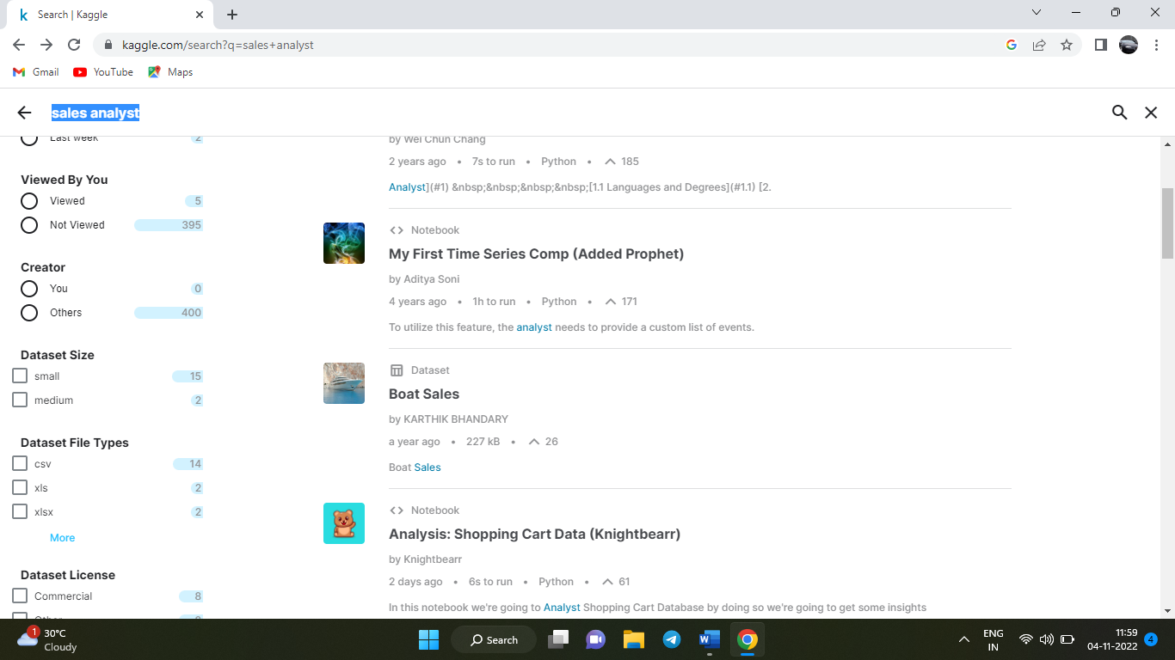
Methodology
Step 1:
Searched for the sales analyst dataset and dataset that is relevant to it in Kaggle and Google

Slide 7
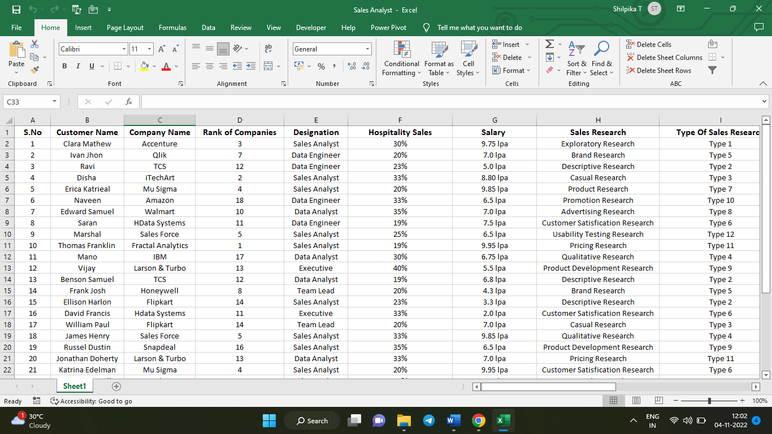
Step 2:
I finalized the data that is to be used for the project, organized the data, and performed data cleaning to make the data perfect for my project.

Slide 8
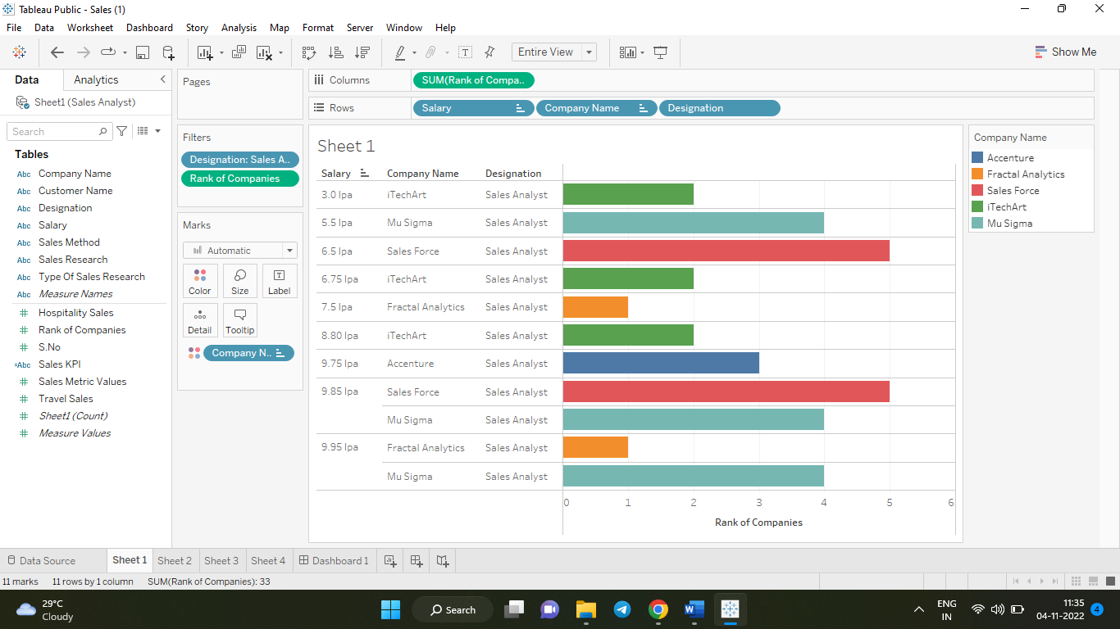
Step 3:
The questions which were given for my project was done in each sheet with different visualizations
Q-1: Share the successful salary package of sales analysts in top5
companies using the data

Slide 9
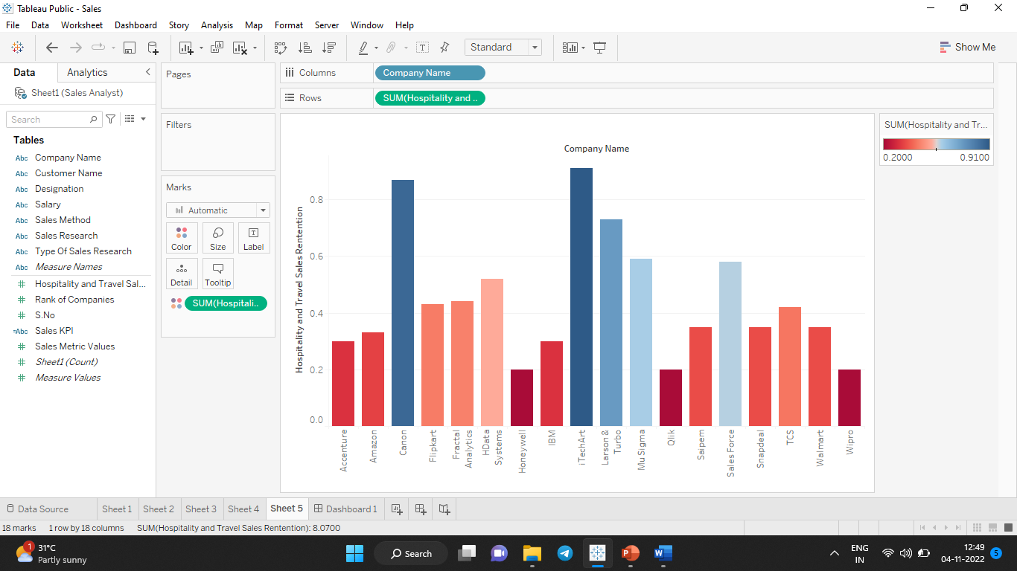
Q-2: How Hospitality Sales and Travel sales representatives gather the customers and what is the retention percentage?

Slide 10
Q-3: Share 3 main types of sales research?
The 3 main types of sales research are
Casual Research,
Descriptive Research,
Exploratory Research

Slide 11
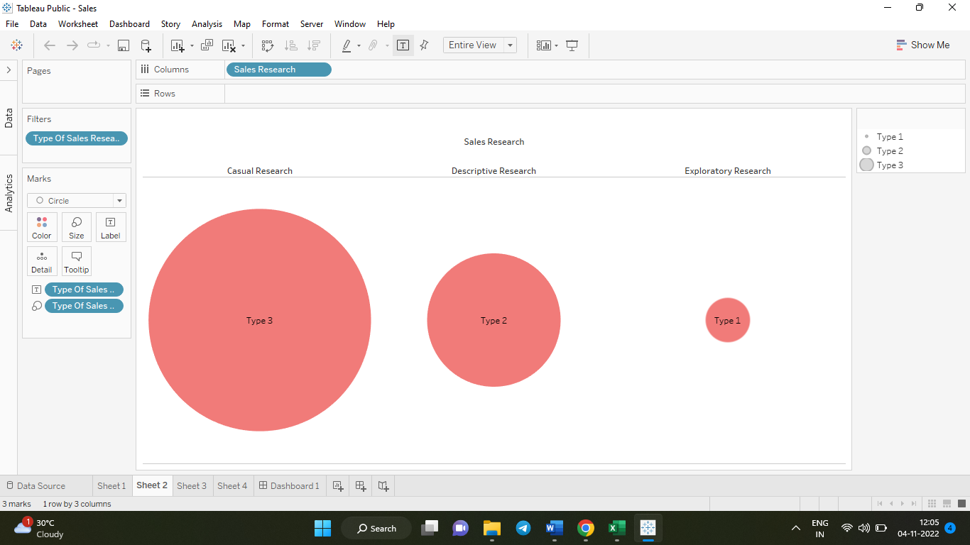
The 3 main types of sales research are shown below;

Slide 12
Q-4: Share data appropriately using 9 types of sales methods and techniques?
The 9 types of sales method are:
    Sales Trend Analysis
    Sales Performance Analysis
    Predictive Sales Analysis
    Sales Pipeline Analysis
    Product Sales Analysis
    Sales Effectiveness Analysis
    Prescriptive Analysis
    Diagnostic Analysis
    Marketing Analysis
    Sales Trend Analysis

Slide 13
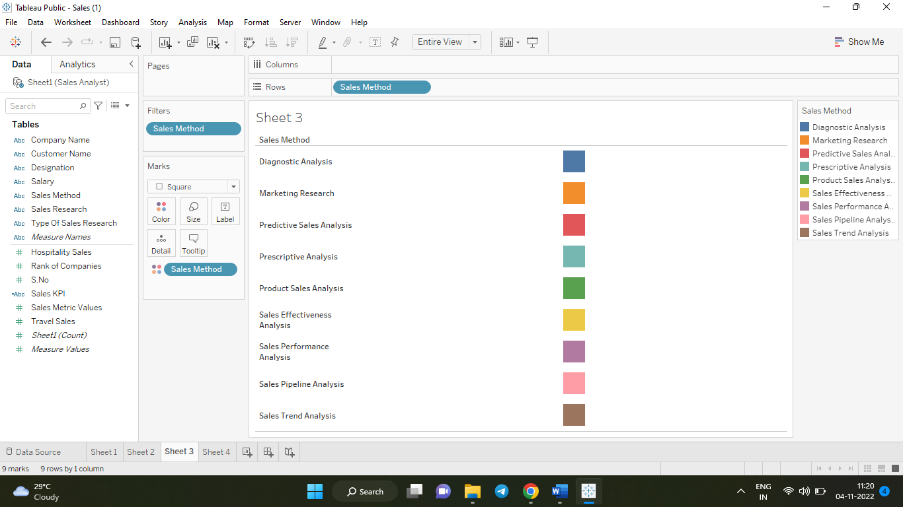
The 9 types of sales method are shown below;

Slide 14
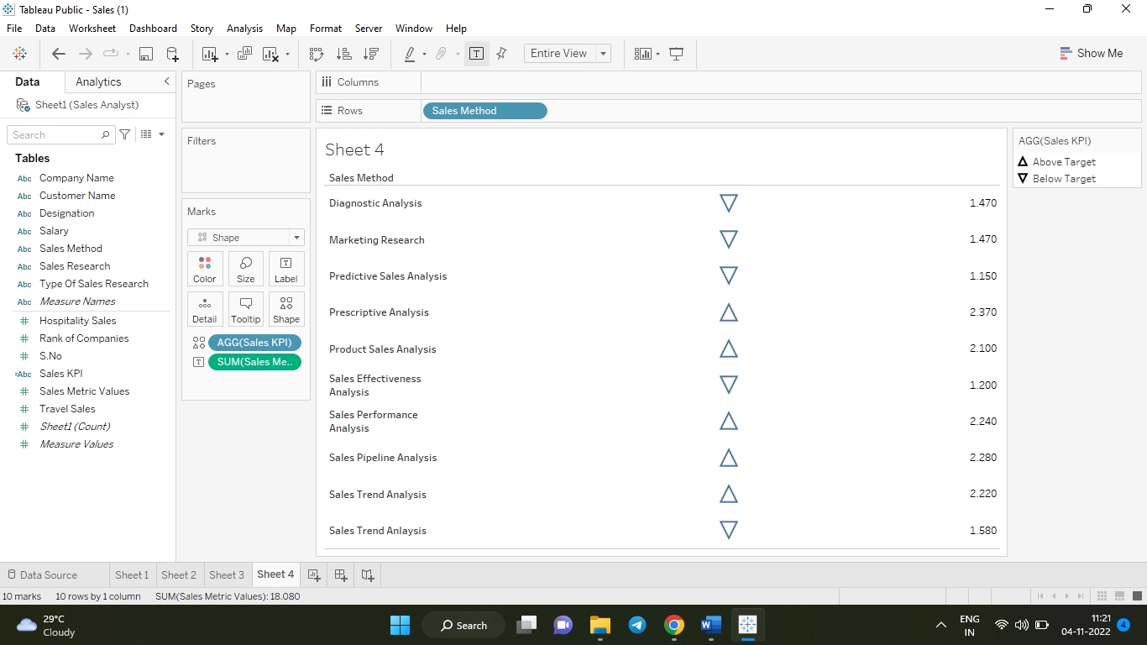
Q-5: Use the online date to do empirical research on sales analysis metrics and KPIs?

Slide 15
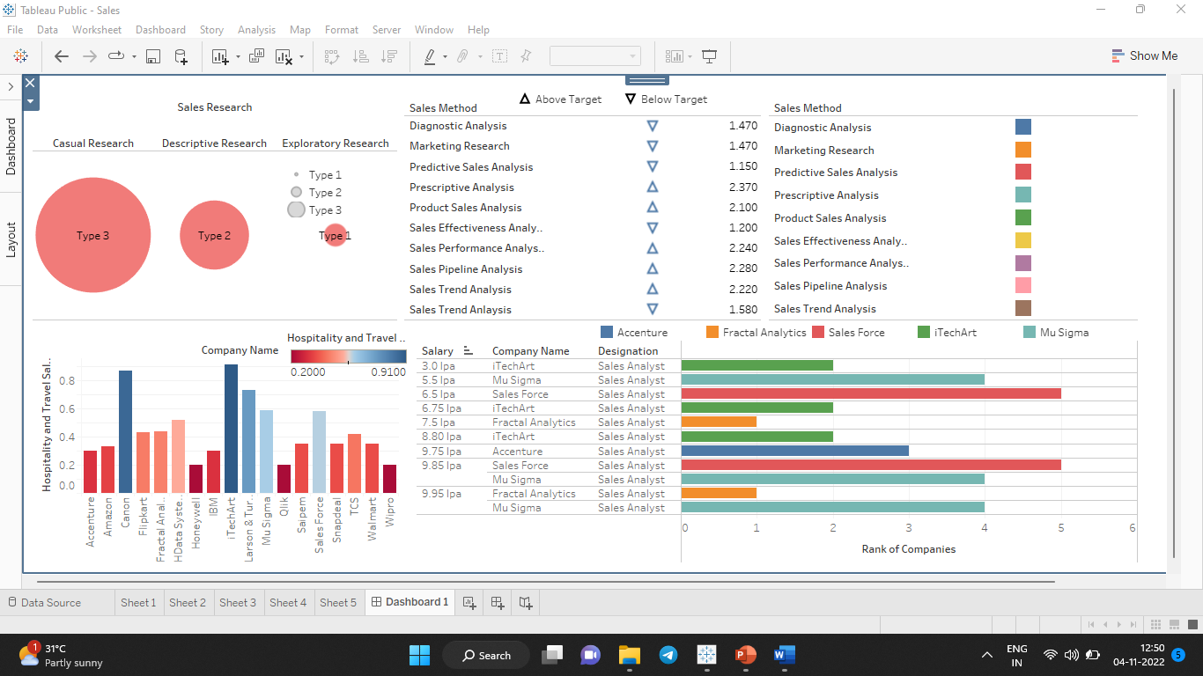
Step 4:
In the final step, all the sheets that were made before are put up in the dashboard, used Bar Graph, KPI for my Dashboard to look attractive.

Slide 16
Conclusion
This is the analysis of the given data set and I came to know that this visualization differs based on the values of the customer. I have given my sales organization insights which they can use, helping everyone to make critical decisions based on data’s.

Slide 17
Thank You

