Slide 1
EMPLOYEE PERFORMANCE ANALYSIS USING EXCEL
STUDENT NAME : DEENADHAYALAN P
REGISTER NO : 312204018, FFOBC98D8E0F8BD833049361085492EB
DEPARTMENT : B.COM GENERAL, COMMERCE
COLLEGE : SRIRAM COLLEGE OF ARTS & SCIENCE

Slide 2
PROJECT TITLE
Salary and compensation
Through Excel Data
Modelling

Slide 3


AGENDA
Problem Statement
Project Overview
End Users
Our Solution and Proposition
Dataset Description
Modelling Approach
Results and Discussion
Conclusion
3/21/2024 Annual Review

Slide 4

PROBLEM STATEMENT
To analyse the salary and compensation data and employees In order to identify patterns disparties and areas for improvement This analysis help in making data _driven decision regarding salary adjustable , budget allocation ,and employees satisfaction, Key questions Salary distribution Compensation companies

Slide 5

PROJECT OVERVIEW
.
Data collection Advanced data modelling Reporting and presentation Advanced data analysis Implementation band follow-up

Slide 6

WHO ARE THE END USERS?
HR manager Department heads Team leaders Board members Financial analysis Individual employees Executive leadership Finance department

Slide 7

OUR SOLUTION AND ITS VALUE PROPOSITION
Using Excel for salary and compensation analysis offers several key advantages. First, it allows for detailed and comprehensive analysis of compensation data through advanced functions, pivot tables, and charts, providing deep insights into salary distributions and trends. Second, Excel’s flexibility enables the customization of models and dashboards to suit specific organizational needs, tracking various metrics such as base salaries and bonuses. Additionally, Excel supports scenario forecasting, allowing users to model different compensation scenarios and assess their impacts using tools like data tables and solver.

Slide 8
Dataset Description
To analyze salary and compensation using Excel: 1. **Organize Data: Clean and structure data with columns for salaries, bonuses, job titles, etc. 2. **Descriptive Stats**: Use functions like AVERAGE, MEDIAN, and STDEV. 3. **Pivot Tables**: Summarize data by department or job title. 4. **Visualizations**: Create charts to visualize distributions and trends. 5. **Advanced Analysis**: Perform regression and correlation analysis to explore relationships. 6. **Reporting**: Build dashboards and document key findings.

Slide 9

THE "WOW" IN OUR SOLUTION
1. Collect Data: Gather salary, bonus, and benefit information. 2. Organize Data: Arrange data in Excel with relevant columns. 3. Analyze: Use formulas (e.g., AVERAGE) and pivot tables to understand compensation trends. 4. Model: Perform scenario analysis and what-if scenarios. 5. Report: Create charts and dashboards to present insights.
3/21/2024 Annual Review
9

Slide 10
MODELLING
To analyze salary and compensation using Excel, start by gathering and cleaning data on salaries, job titles, and other relevant factors. Organize the data in a table and perform exploratory analysis with pivot tables and charts. Use statistical functions to calculate averages and standard deviations. Apply regression analysis to understand how factors impact salary and use visualizations to present trends. Conduct scenario analysis to explore the effects of variable changes and summarize your findings in a clear report, validating results with external benchmarks.
10

Slide 11
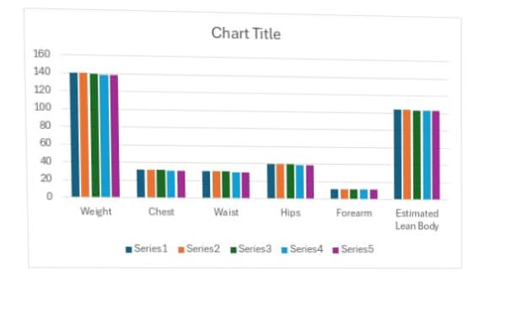
RESULTS
11

Slide 12
conclusion
In conclusion, the Excel-based salary analysis revealed key insights: a skewed salary distribution suggests issues with progression, a gender pay gap is evident in senior roles, and some positions are undercompensated compared to industry standards. Additionally, while bonuses are fairly distributed, inconsistencies in non-monetary benefits may impact employee satisfaction. Addressing these areas can enhance fairness, competitiveness, and retention.

