Slide 1
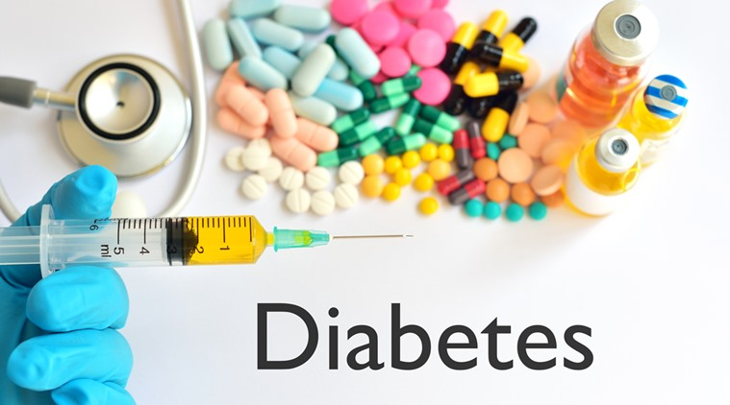
Deena Aljarallah

Slide 2
Diabetes
Diabetes is a disease that occurs when your blood glucose, also called blood sugar, is too high. Blood glucose is your main source of energy and comes from the food you eat. Insulin, a hormone made by the pancreas, helps glucose from food get into your cells to be used for energy.

Slide 3



Research suggests that 1 out of 3 adults has prediabetes.
Of this group, 9 out of 10 don't know they have it.

Slide 4
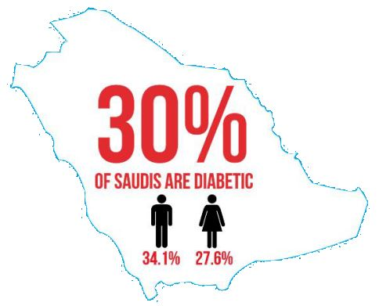

Slide 5
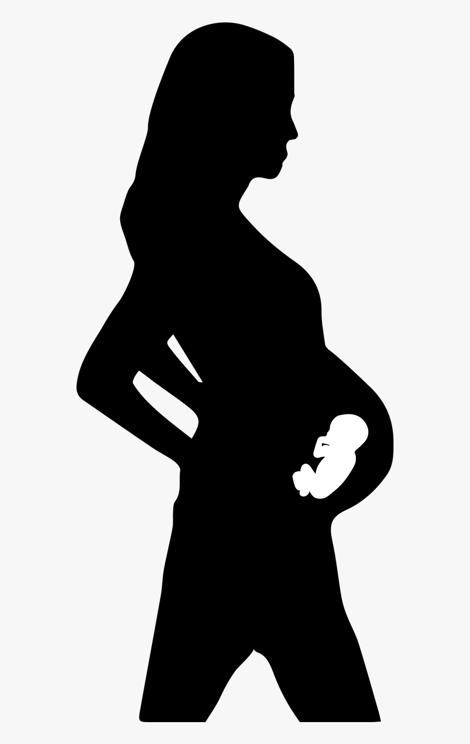
Diabetes during pregnancy has increased in recent years. From 2000 to 2010, the percentage of pregnant women with gestational diabetes increased 56%

Slide 6
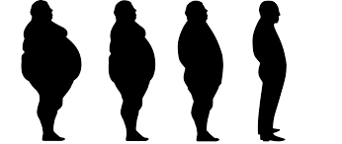
Any increase in BMI above normal weight levels is associated with an increased risk of being diagnosed as having complications of diabetes mellitus.

Slide 7
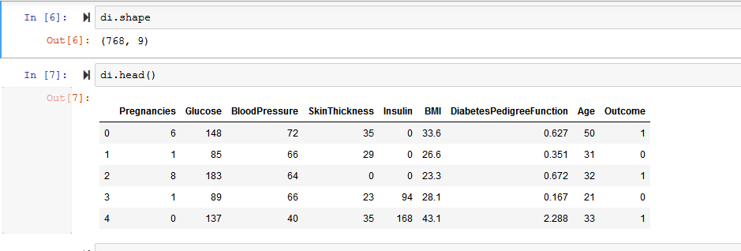
Diabetes Dataset

Slide 8
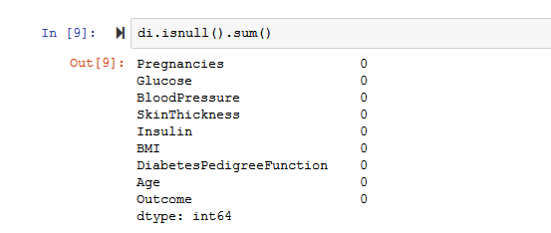
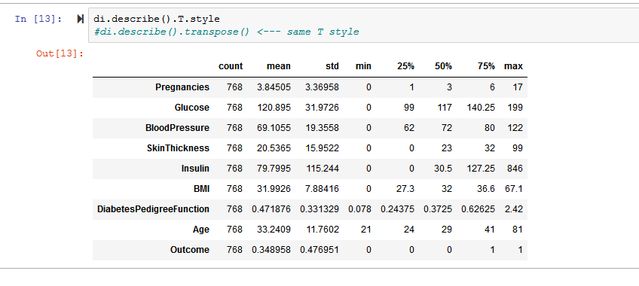
Exploratory Data Analysis (EDA)

Slide 9
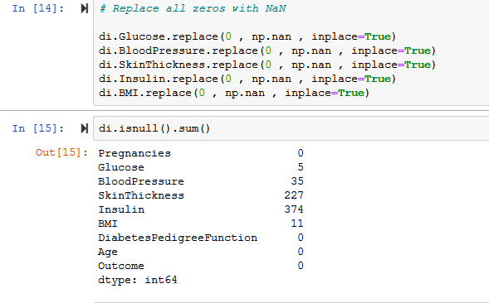
Data Cleaning

Slide 10
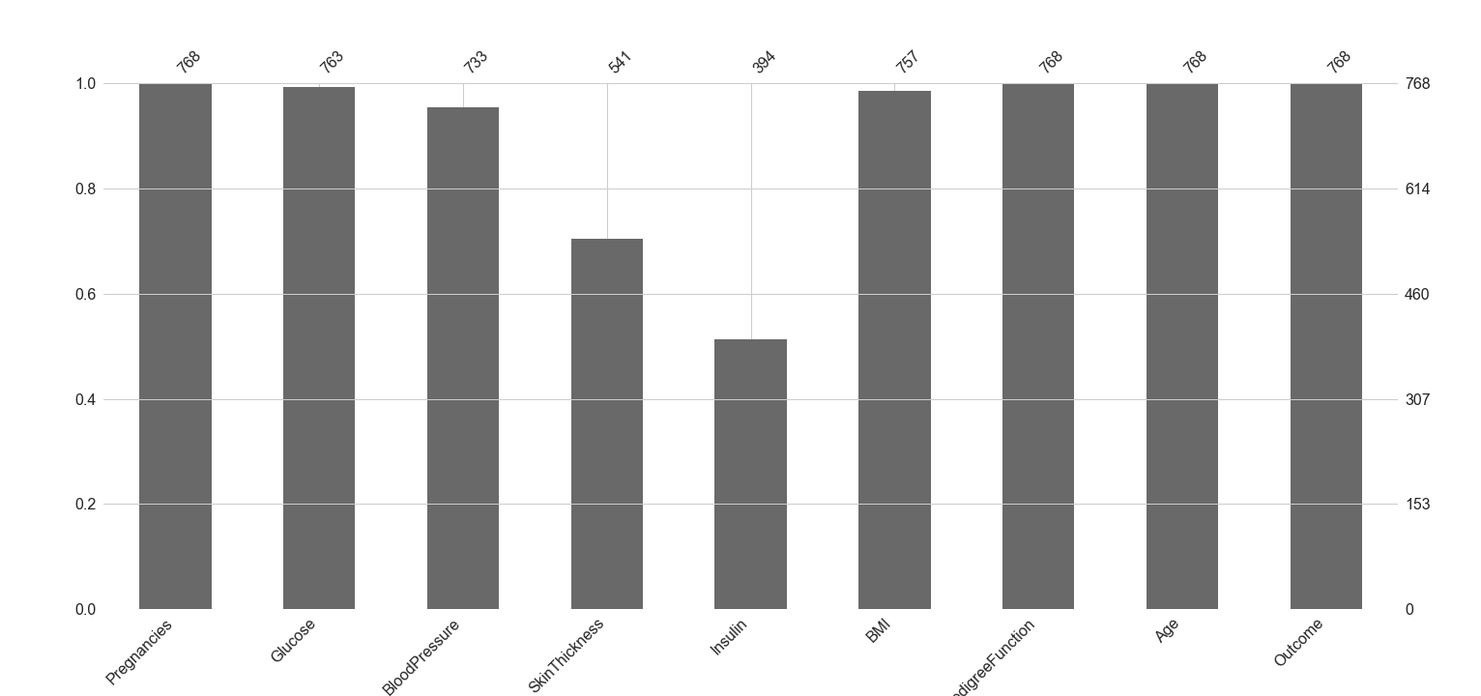
Visualizing missing values

Slide 11
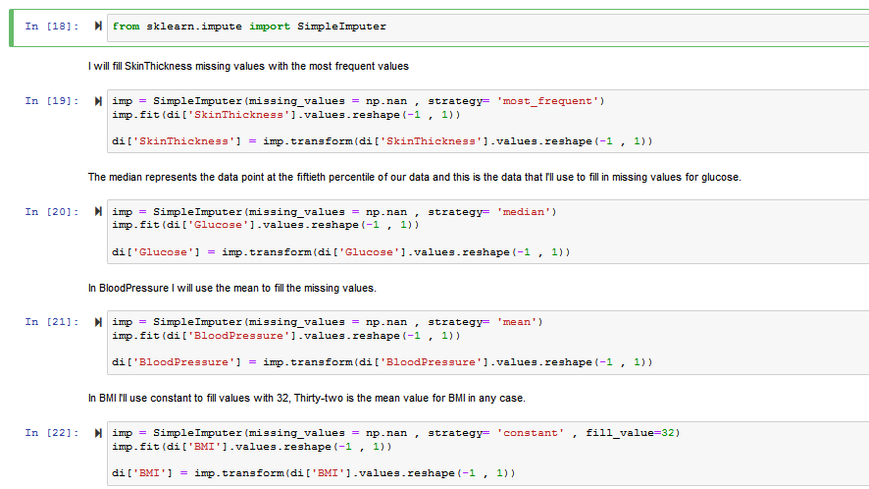
Fill In Missing Values Simple Imputer

Slide 12
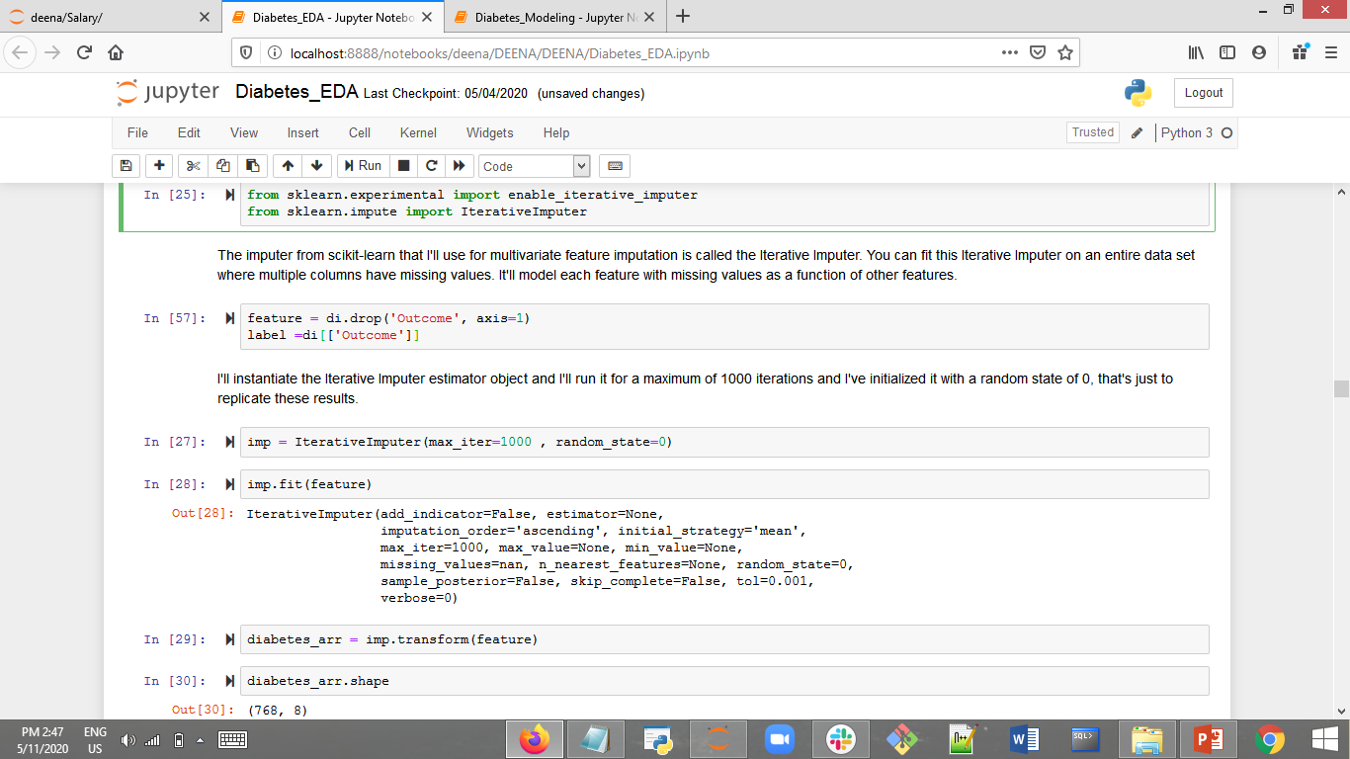
Iterative Imputer

Slide 13
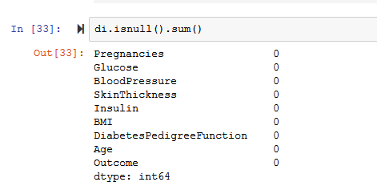
Now the dataset is clean and ready for modeling

Slide 14
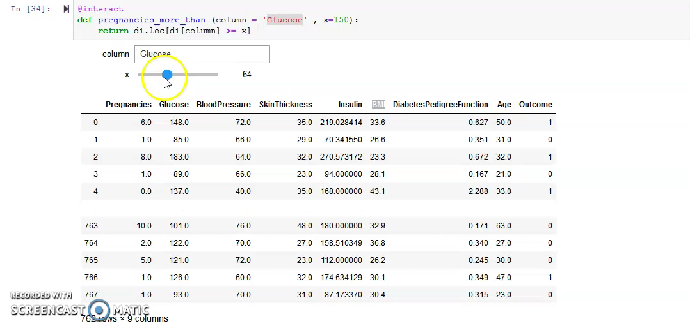

Slide 15
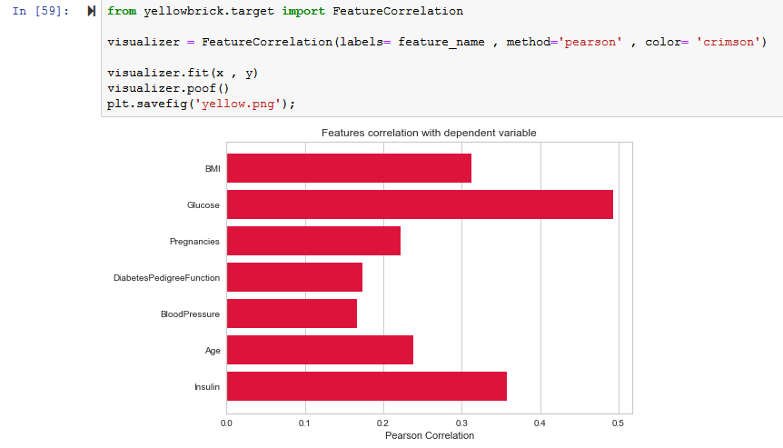
Data Visualization

Slide 16
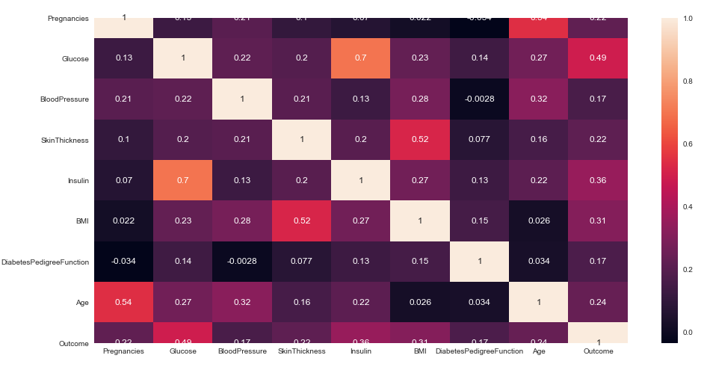
Heat map

Slide 17
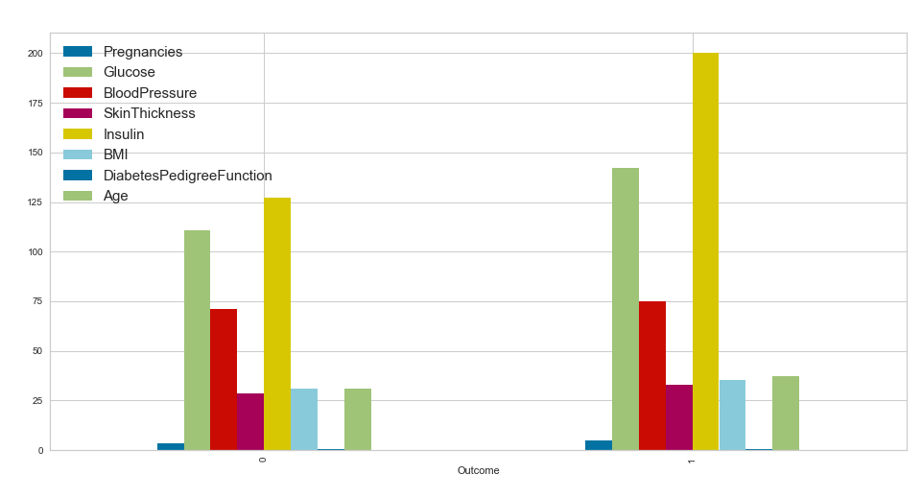

Slide 18
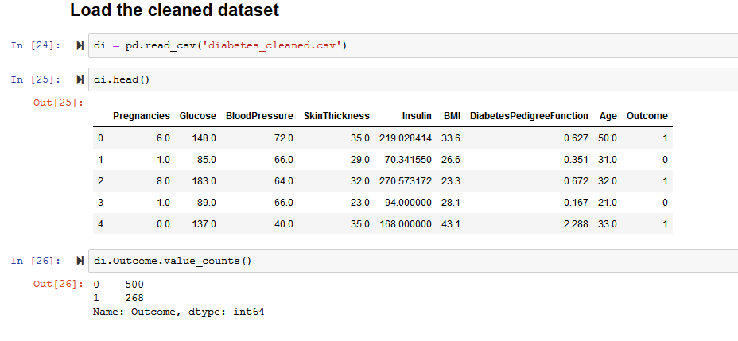
Modeling

Slide 19
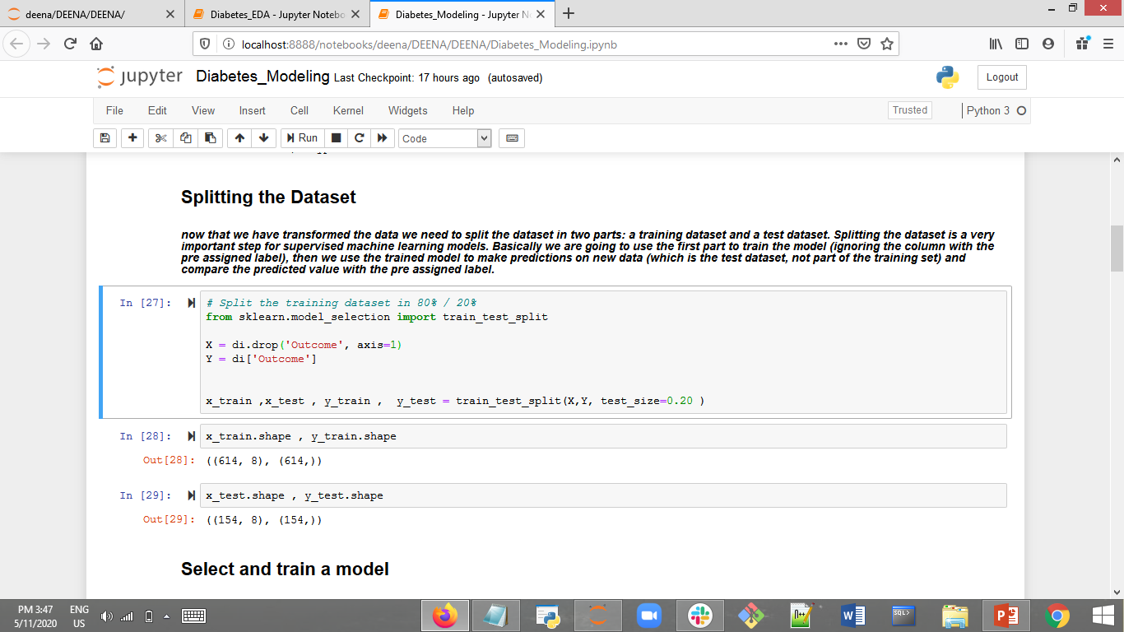
Splitting the Dataset

Slide 20
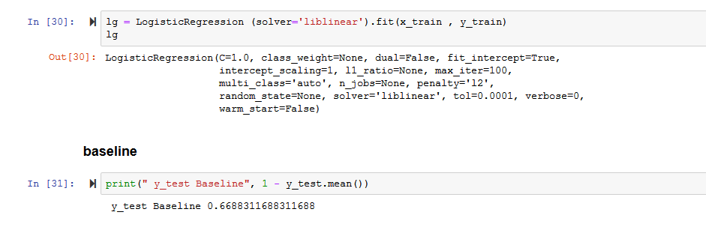
Select and Train Model

Slide 21
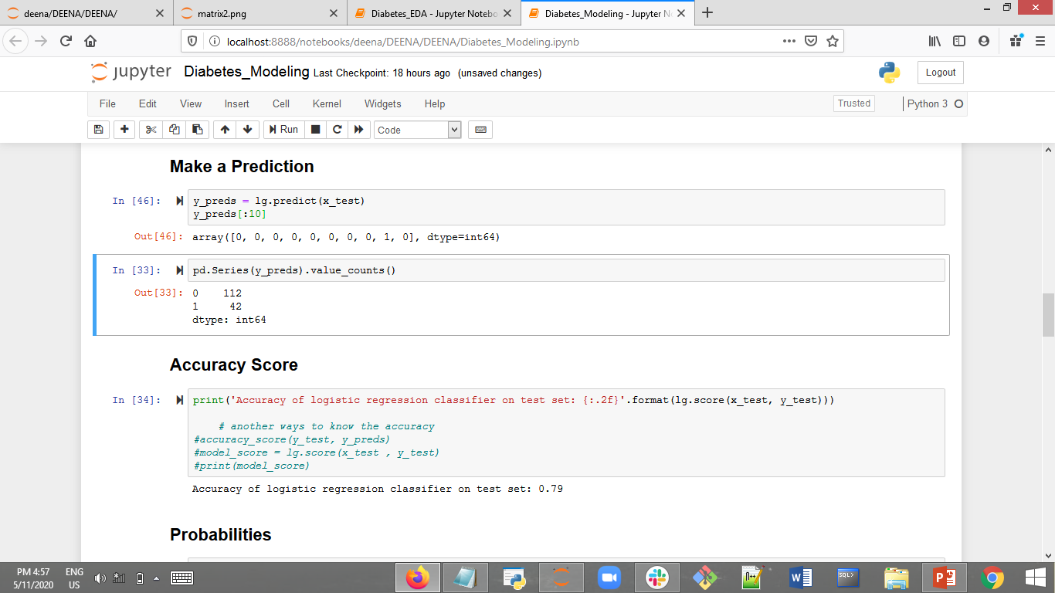
Predictions

Slide 22
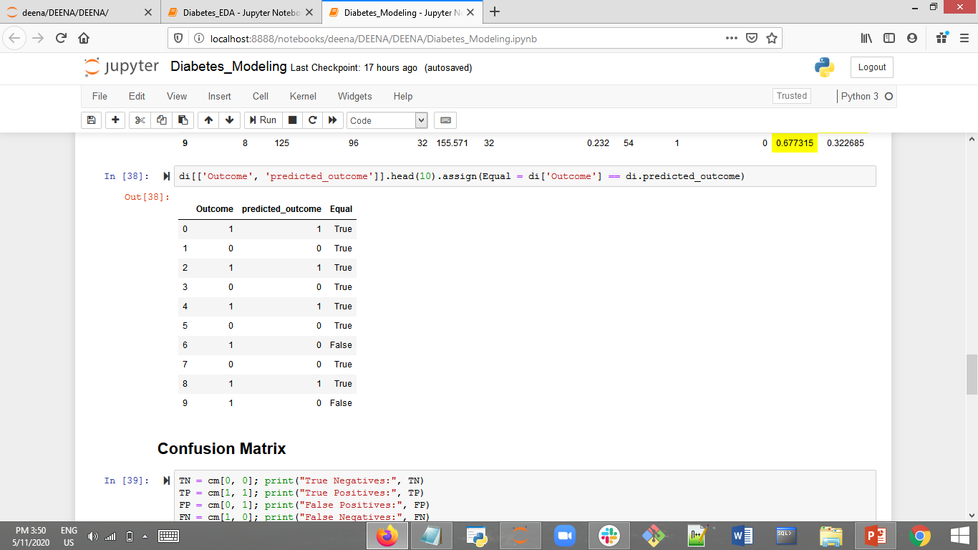
Predictions

Slide 23
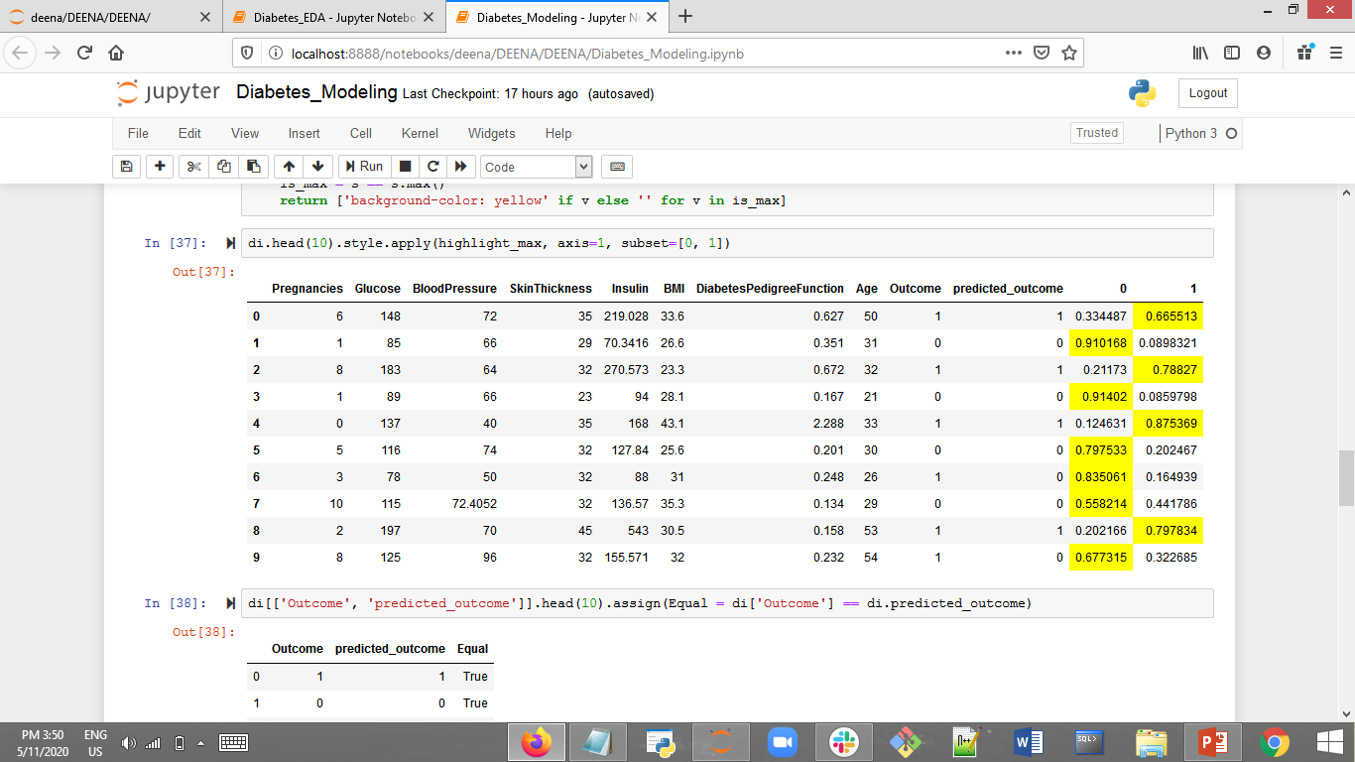
Probabilities

Slide 24
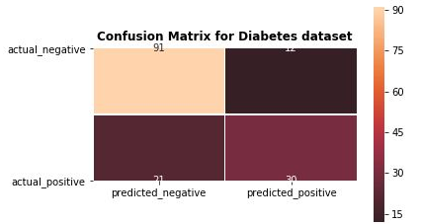

Confusion Matrix

Slide 25
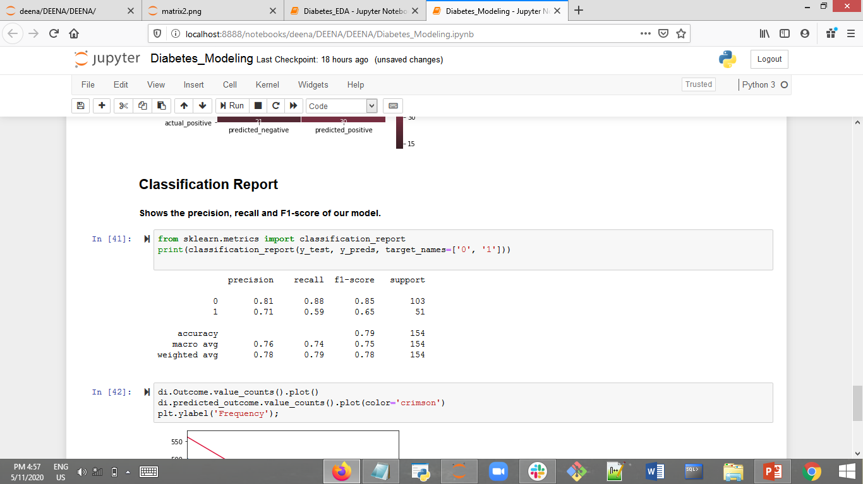
Classification Report

Slide 26

Thank you for listening

