Slide 1
Data Center Outage
Presented by:
Deena Al-Busaidi
Quds Al-Jabri
Nouf Al-Rashdi
Khadija Al-Zadjali

Slide 2
Table of contents
01
Introduction
02
Data Exploration
03
Bayesian Network
04
Estimating Conditional Probabilities
05
Dependency

Slide 3
Introduction
Why Do Servers Crash? This project explores real data from a data center to find out what causes servers to crash. We looked at CPU load, power supply, disk usage, network traffic, and malware.
High CPU load led to 17 crashes.
Unstable power caused nearly 89% of crashes.
High network traffic raised the chance of critical disk usage to 41.7%.
We built a Bayesian model to understand how these factors are connected and to help prevent future crashes.

Slide 4
Data Exploration

Slide 5
The Structure of the Data
Variable | Values (Categories) | Type
CPU Load | Low, Medium, High | Categorical
Power Supply | Stable, Fluctuating, Failed Stable | Categorical
Network Traffic | Low, Medium, High | Categorical
Disk Usage | Normal, High, Critical | Categorical
Malware Detected | True, False | Binary
Server Crash | True, False | Binary

Slide 6
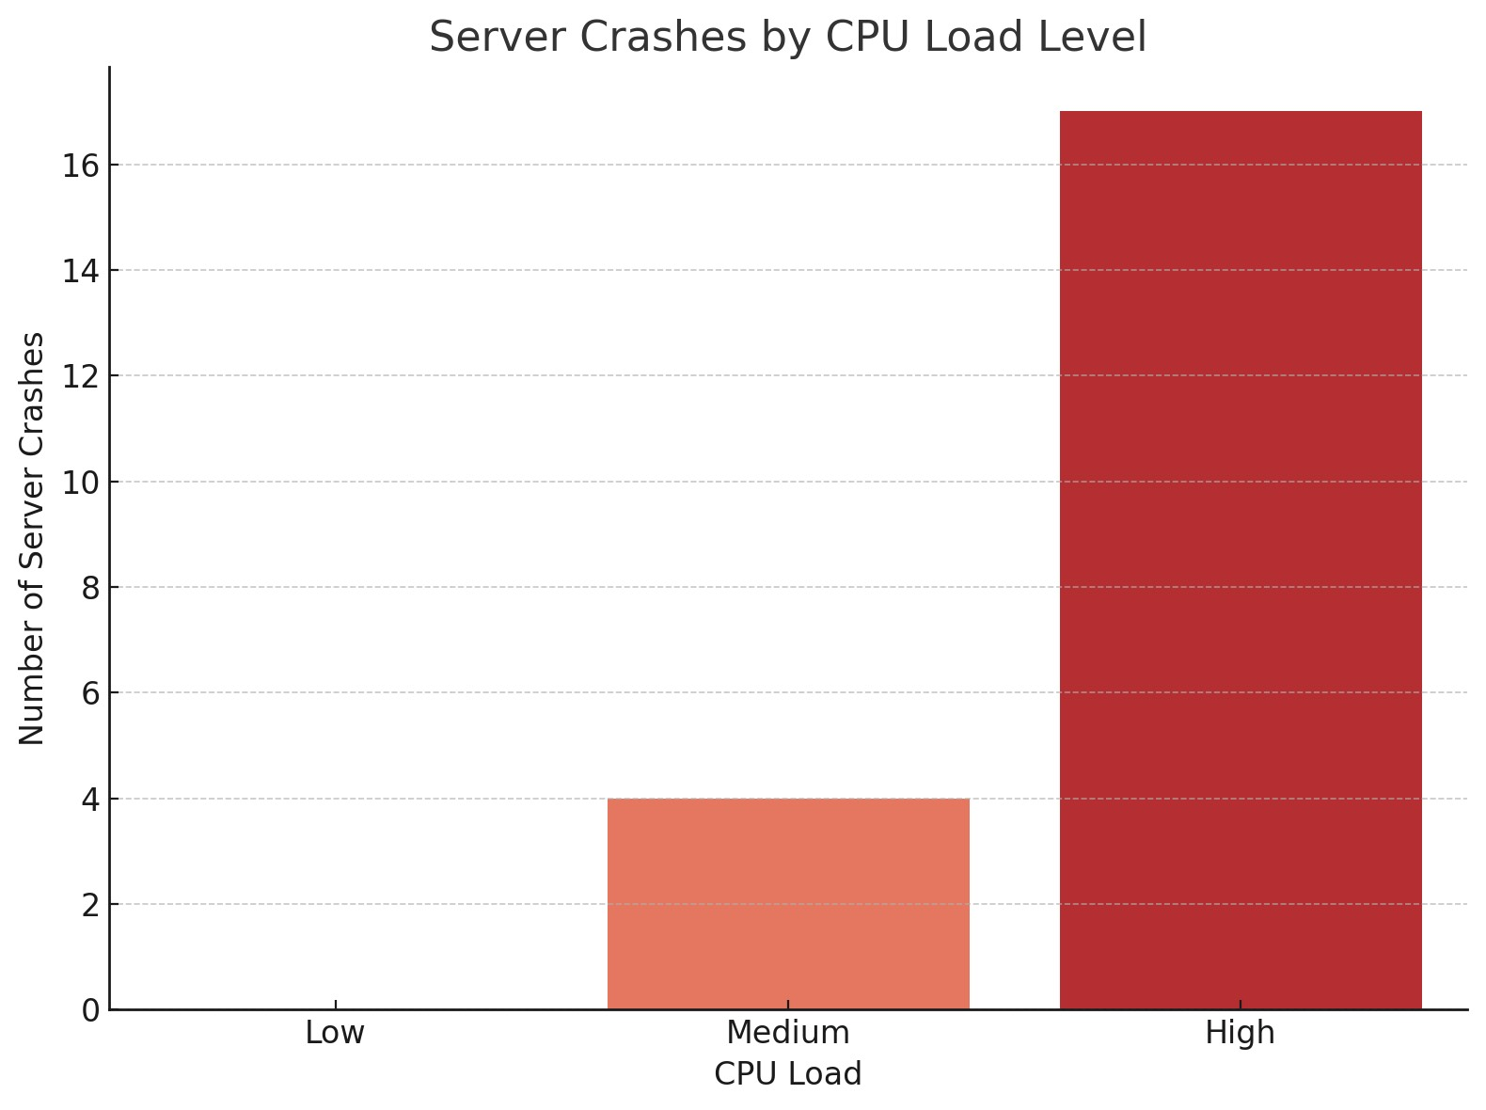
Impact of CPU Load on Server Stability

Slide 7
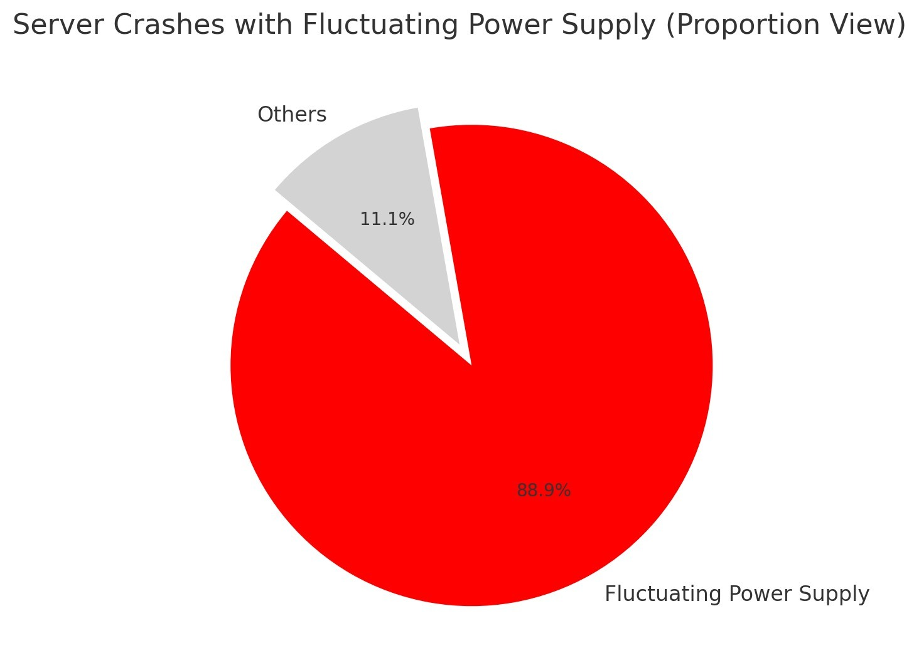
Impact of Power supply on Server Stability

Slide 8
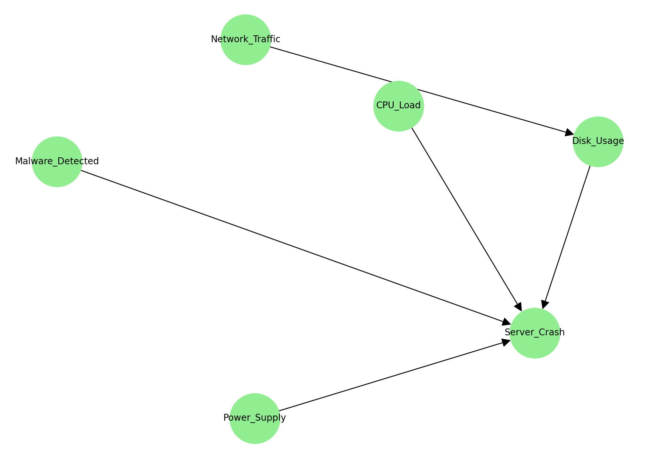
Bayesian Network

Slide 9
Conditional Probability Tables (CPTs)
CPU_Load | Power_Supply | Disk_Usage | Malware_Detected | FALSE | TRUE
High | Failed | Critical | 0 | 0 | 1
High | Fluctuating | Critical | 1 | 0 | 1
High | Fluctuating | High | 0 | 0 | 1
High | Fluctuating | High | 1 | 0 | 1
High | Stable | Critical | 0 | 0 | 1
High | Stable | Critical | 1 | 0 | 1
High | Stable | High | 0 | 0.25 | 0.75
High | Stable | High | 1 | 0 | 1
Low | Stable | Normal | 0 | 1 | 0
Medium | Failed | High | 0 | 0 | 1
Medium | Fluctuating | High | 0 | 0 | 1
Medium | Stable | High | 0 | 1 | 0
Medium | Stable | Normal | 0 | 1 | 0
Network_Traffic | Critical | High | Normal
High | 0.416666667 | 0.583333333 | 0
Low | 0.052631579 | 0.052631579 | 0.894736842
Medium | 0.052631579 | 0.631578947 | 0.315789474

Slide 10
Estimating Conditional Probabilities
CPU_ Load (High) & Power_Supply (Fluctuating) | 4
CPU_ Load (High) & Power_Supply (Fluctuating) & Server_Crash | 4
P(Server_Crash = TRUE | CPU_Load = High & Power_Supply = Fluctuating) | 1

Slide 11
Estimating Conditional Probabilities
Server_Crash = TRUE | 21
Malware_Detected = TRUE | 7
Malware_Detected = FALSE (for completeness) | 14
Malware = True | 0.33 | 33.33
Malware= False | 0.67 | 66.67
If a Server_Crash occurred, the most likely state of Malware_Detected is FALSE, with a probability of approximately 66.6%

Slide 12
Estimating Conditional Probabilities
Disk_Usage = Critical | 7
Disk_Usage = Critical / Total | 0.14 | 14
Unconditional Probability = 14%
Network_Traffic = High | 12
Network_Traffic = High AND Disk_Usage = Critical | 5
Given Network_Traffic=High | 0.417 | 41.67
Network_Traffic = High increases the likelihood of Disk_Usage being Critical from 14% to 41.67%.

Slide 13
How Network Traffic Overloads Disks?
Marginal Probabilities
P (Disk_Usage = High) | P (Network_Traffic = High)
P (20/50) = 0.40 | P (12/50) = 0.24
Joint Probability
P (Disk_Usage = High ∧ Network_Traffic = High)
P (8/50) = 0.16
Conditional Probability
P (Disk_Usage = High ∣ Network_Traffic = High)
P (Disk_Usage = High ∧ Network_Traffic = High) / P (Network_Traffic = High)
P (0.16/0.24) = 0.6667
Product Probability
P (Disk_Usage = High) * P (Network_Traffic = High)
P (0.40 * 0.24) = 0.096
Comparison for Independence Check
P (Disk_Usage ∣ Network_Traffic) = P (Disk_Usage) * P(Network_Traffic)
0.6667 ≠ 0.096
Since 0.6667 ≠ 0.096, the variables are not independent

Slide 14
Power Instability = Guaranteed Crash
Marginal Probabilities
Variables | Value | Count | Probability
Power_Supply | Stable | 38 | P (38/50) = 0.76
 | Fluctuating | 7 | P (7/50) = 0.14
 | Failed | 5 | P (5/50) = 0.10
Server_Crash | True | 21 | P (21/50) = 0.42
 | False | 29 | P (29/50) = 0.58
Conditional Probability
P (Server_Crash = True ∣ Power_Supply)
Power_Supply | Server_Crash = True Count | Probability
Stable | 6 | P (6/38) = 0.158
Fluctuating | 7 | P (7/7) = 1.0
Failed | 5 | P (5/5) = 1.0
A key insight from the analysis is that non-stable power—whether fluctuating or failed—consistently leads to system crashes, with a probability of 1.0.

Slide 15
Power Instability = Guaranteed Crash
Joint Probability
P (Server_Crash ∧ Fluctuating) | P (Server_Crash ∧ Failed)
P (7/50) = 0.14 | P (5/50) = 0.10
Product Probability
P (Server_Crash) * P (Fluctuating) | P (Server_Crash) * P (Failed)
P (0.42 * 0.14) = 0.0588 | P (0.42 * 0.10) = 0.042
Comparison for Independence Check
P (Server_Crash ∧ Fluctuating) = P (Server_Crash) * P (Fluctuating) | P (Server_Crash ∧ Failed) = P (Server_Crash) * P (Failed)
0.14 ≠ 0.0588 | 0.10 ≠ 0.042
Since 0.14 ≠ 0.0588, the variables are not independent | Since 0.10 ≠ 0.042, the variables are not independent

Slide 16
Malware’s Surprising Role in Crashes
Marginal Probabilities
P (Malware_Detected = True) | P (Server_Crash = True)
P (7/50) = 0.14 | P (21/50) = 0.42
Joint Probability
P (Malware ∧ Crash)
P (7/50) = 0.14
Conditional Probability
P (Malware_Detected = True ∣ Server_Crash = True)
P (Malware ∧ Crash) / P (Malware_Detected = True)
P (0.14/0.14) = 1.0
Product Probability
P (Malware) * P (Crash)
P (0.14 * 0.42) = 0.0588
Comparison for Independence Check
P (Malware ∧ Crash) = P (Malware) * P (Crash)
0.14 ≠ 0.0588
Since 0.14 ≠ 0.0588, the variables are not independent

Slide 17
Why High CPU Load is a Ticking Bomb
Marginal Probabilities
P (CPU_Load = High) | P (Server_Crash = True)
P (19/50) = 0.38 | P (21/50) = 0.42
Joint Probability
P (High CPU ∧ Crash)
P (14/50) = 0.28
Conditional Probability
P (CPU_Load = High ∣ Server_Crash = True)
P (High CPU ∧ Crash) / P (High CPU_Load)
P (0.28/0.38) = 0.737
Product Probability
P (Malware) * P (Crash)
P (0.38 * 0.42) = 0.1596
Comparison for Independence Check
P (Malware ∧ Crash) = P (Malware) * P (Crash)
0.737 ≠ 0.1596
Since 0.737 ≠ 0.1596, the variables are not independent

Slide 18
Conclusion
High CPU load, unstable power, and high network traffic are major causes of server crashes.
Bayesian analysis showed these factors are closely linked and can help predict risks.
Most crashes were not due to malware.
Monitoring these system metrics can help avoid downtime.

