Slide 1
SMART GLASS
VISUALLY CHALLENGED PEOPLE

Slide 2
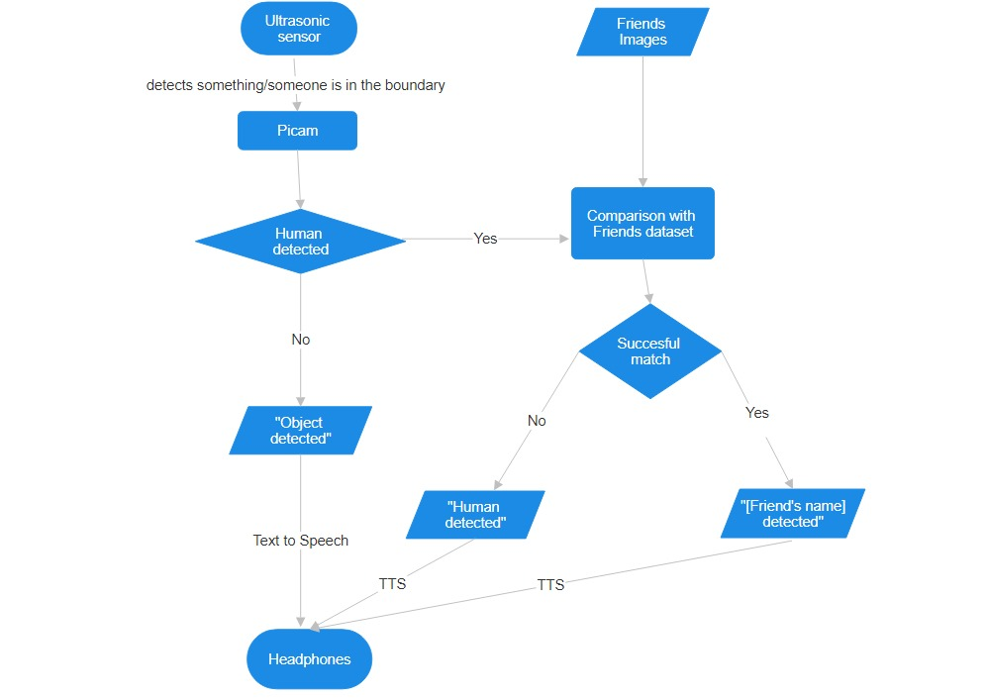
BLOCK DIAGRAM

Slide 3
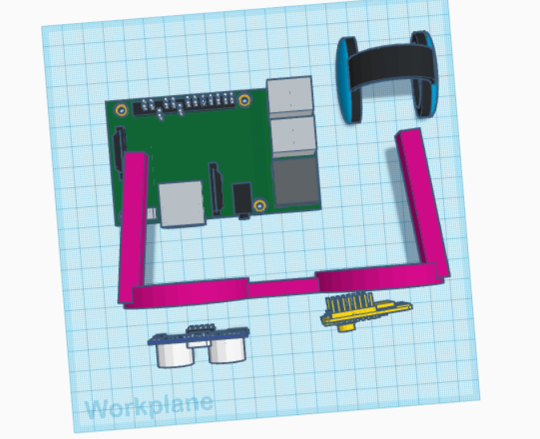
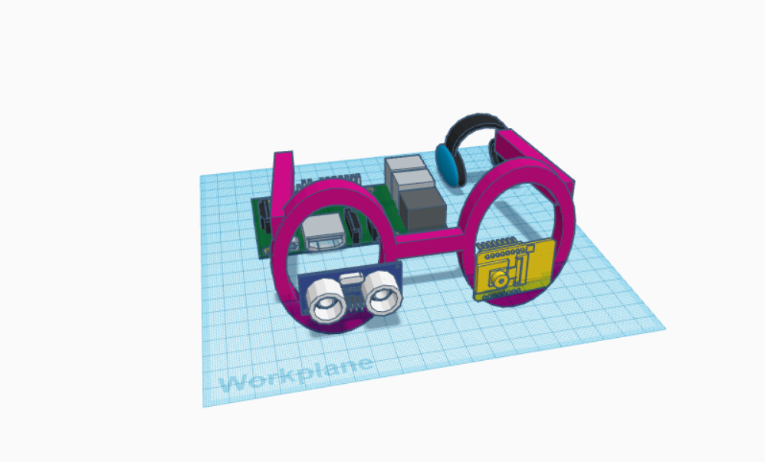
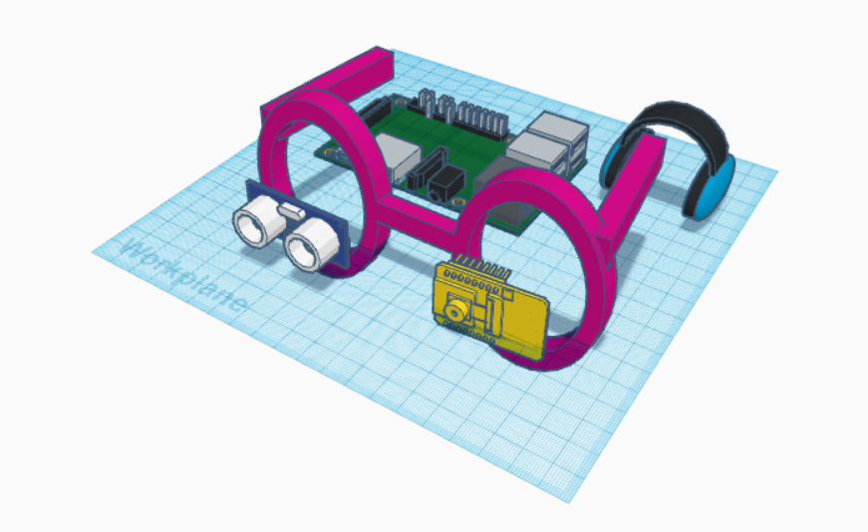
3D Model

Slide 4
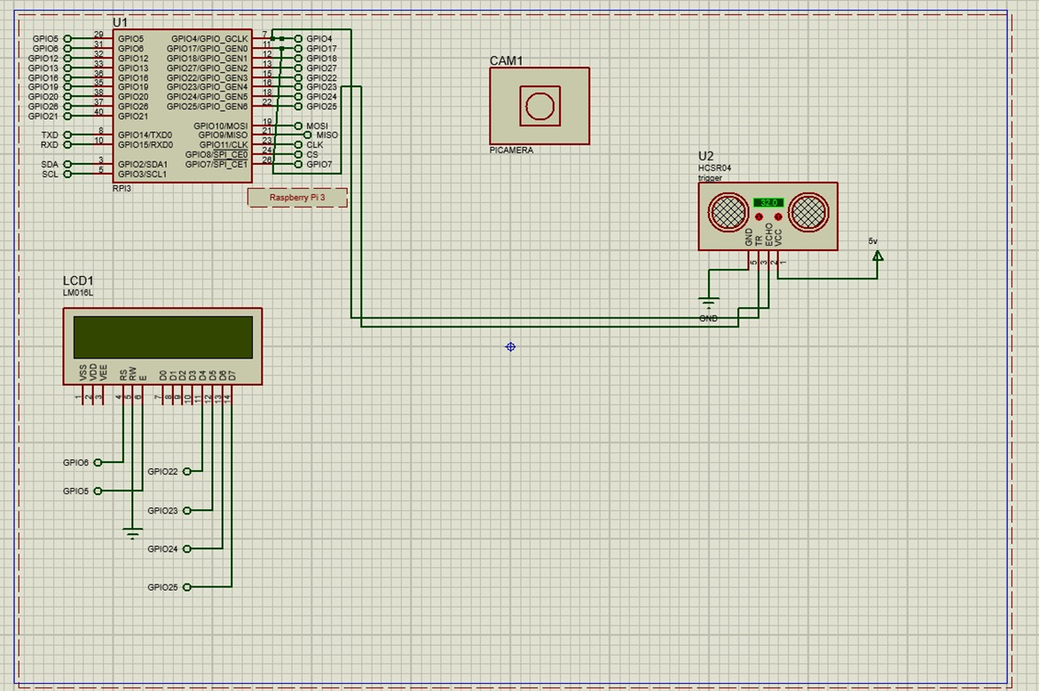
SIMULATION PROGRESS & RESULTS

Slide 5
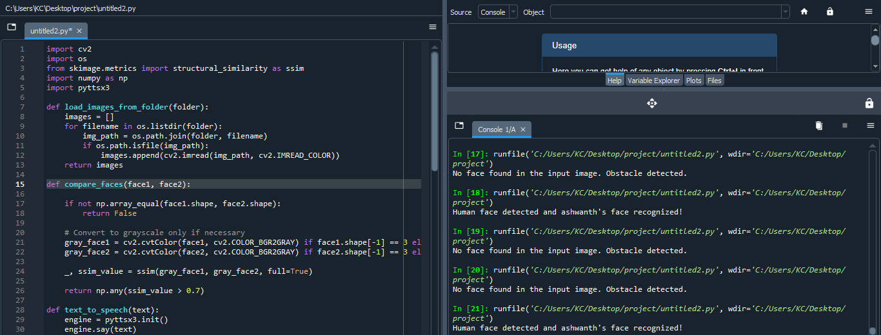
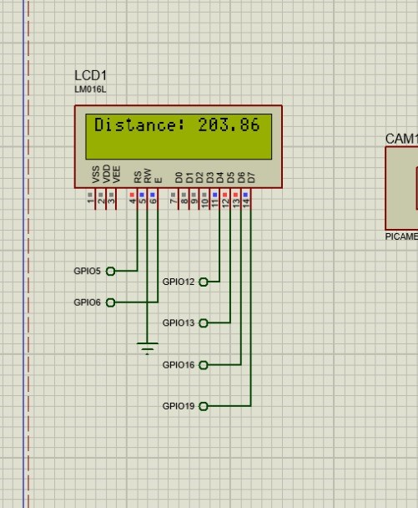

SIMULATION PROGRESS & RESULTS

