Slide 1



Two-Level Independent Ensemble Strategy for Multiclass Gastrointestinal Classification:
Leveraging Differential Fine-Tuning and Stacking Meta-Learner
BY -
Raman Kumar Singh
Deepanshu Sharma
Under Guidance of -
Dr. Nitesh Pradhan

Slide 2
Problem statement
The Burden: Digestive disorders cost $111.8 billion (2021) with 14.5 million emergency visits annually.
The Challenge:
Wireless Capsule Endoscopy (WCE) generates tens of thousands of images per patient.
Manual review is tedious, time-consuming, and prone to human error.
Current Limitations:
Single DCNN architectures suffer from performance variance.
Existing models often focus only on binary classification (e.g., Normal vs. Abnormal) rather than specific multiclass diseases.
Goal: Develop a robust, automated Deep Learning framework for multiclass GI disease classification.

Slide 3


Key Contributions
01
Dataset Optimization: Merged similar classes in the HyperKvasir dataset to create robust high-level classifications (handling class imbalance).
02
Two-Phase Differential Fine-Tuning: A novel training protocol for Base Learners to minimize catastrophic forgetting and maximize feature adaptation.
Bi-Level Ensemble Strategy:
Level 1: Independent Base Learners (ResNet, DenseNet, etc.).
Level 2: Stacking Ensemble using a Meta-Learner (Logistic Regression) to fuse predictions.
03
04
Dual Stream Experiment: Validated on two distinct class distributions (12 classes and 14 classes).

Slide 4


Data Description & Preprocessing
Source: HyperKvasir Dataset (110,079 images total).
Preprocessing Steps:
Resizing: Standardized to 224 x 224 pixels.
Class Merging: Combined severity grades (e.g., Ulcerative Colitis Grades 0-3 merged into one class; BBPS scores merged).
Filtering: Removed low-sample classes (e.g., hemorrhoids, ileum) to reduce noise.
Experimental Streams:
Stream 1: 12 Classes (Highly filtered).
Stream 2: 14 Classes (Broader diagnostic scope).

Slide 5


Meathodology : Level 1 : BASE Learner Training
Architectures Selected:
ResNet50, VGG16, MobileNetV2, DenseNet121, EfficientNet-B6, ResNet101, DenseNet169.
Solution: Algorithm 1 (Two-phase Diffrential Fine-Tuning)
Warmup Phase: Freeze backbone, train only the classification head.
Fine-Tuning Phase: Unfreeze backbone. Apply Stratified Learning Rates:
Backbone (Features): Low rate (eta_{backbone} = 10^{-5}).
Head (Classifier): Higher rate (eta_{head} = 10^{-4}).
The Challenge:
Standard transfer learning can destroy pre-trained features ("Catastrophic Forgetting").

Slide 6
Meathodology : Level 2 : Ensemble Strategies
1.Strategy 1: Soft Voting (Baseline): Arithmetic mean of predicted probabilities.
2.Strategy 2: Weighted Ensemble:
Weights ( w_i) assigned based on accuracy (a_i).
Formula: w_i = a_i / sum A
3.Strategy 3: Stacking Ensemble (The Proposed Solution):
Meta-Feature Generation: Concatenation of probability vectors from all Base Learners.
Meta-Learner: A Logistic Regression model trained to learn the optimal non-linear combination of base
predictions.
Goal: Correct systematic errors and visual ambiguities defined by base models.

Slide 7
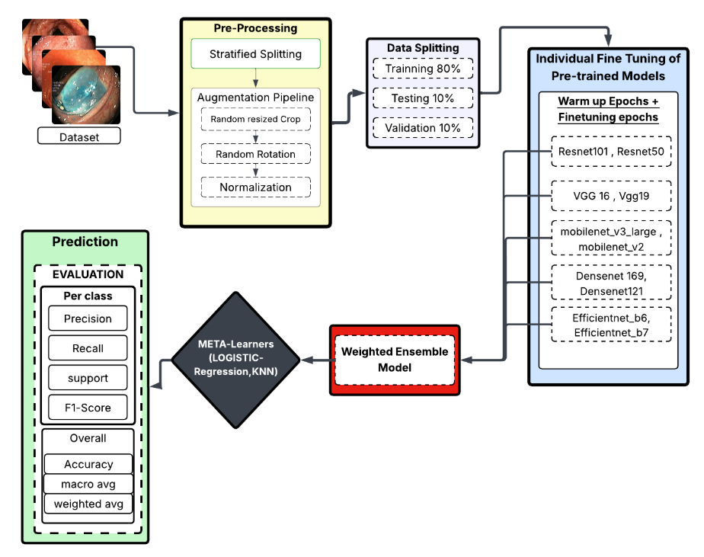
Proposed Archietecture

Slide 8

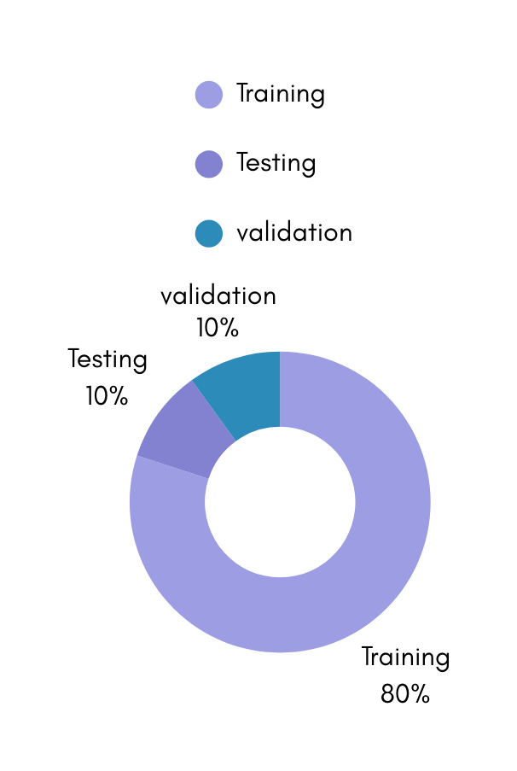
Experimental Setup
Data Split: Stratified Split to maintain class distribution.
80% Training
10% Validation
10% Testing
Input Configuration:
Batch Size: 32
Normalization: ImageNet mean and standard deviation.
Loss Function: Categorical Cross-Entropy.
Hardware: T4 GPU (Google Colab).

Slide 9


Results
Stream 1 (12 classes) | Stream 2 (14 classes)
Base Learner Performance Best: ResNet50 (94% Accuracy). Worst: EfficientNet-B6 (83% Accuracy). | Base Learner Performance Best: DenseNet169 (95.08% Accuracy). Worst: Mobilenet_v3_large (93.84% Accuracy).
Ensemble Performance: Stacking Ensemble Accuracy: 97% Absolute Gain: +3% over the best individual model. | Ensemble Performance: Stacking Ensemble Accuracy: 95.93% weighted F2-Score : 95.88%
Significance: The Meta-Learner successfully leveraged architectural diversity to push past the ceiling of individual ResNet performance. | Observation: Even with high-performing base models, Stacking provided an additional stability buffer (+0.85).

Slide 10

Conclusion & Future Scope
Conclusion:
Established a new standard for GI diagnosis reliability (97% accuracy).
Proven that "Stacking > Weighted Averaging > Single Models" for medical imaging.
Successfully handled class imbalance through merging and stratified sampling.
Future Scope:
Hierarchical Classification: First detect "Disease vs Normal," then "Specific Disease."
Video Analysis: Applying this frame-based ensemble to temporal video data (3D-CNNs).
Real-time Deployment: Optimizing the pipeline for live clinical use.

Slide 11

Thank You

