Slide 1
HACKATHON
MAKING APPLICATION
(For tracking of food waste for productive uses)
By
International Council for Circular Economy(ICCE)
Under
Clean and Green Technology
By- FOOD HACKERS
{ Parth Bansal
Deepanshu
Aditya Kumar Yadav
Aditya Rajput
Nibir Maram Deka
Neha Goyal }

Slide 2
Introduction
A big portion of the waste material binned is still in edible condition.
Basic tech used in app-
> Google Maps
> Android Studio
> Sockets
> Multithreading
> DBMS

Slide 3
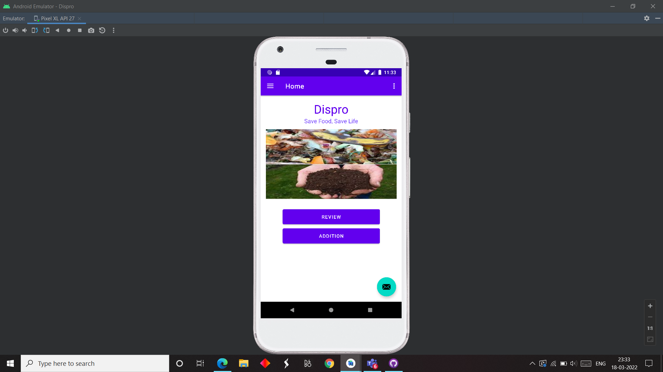
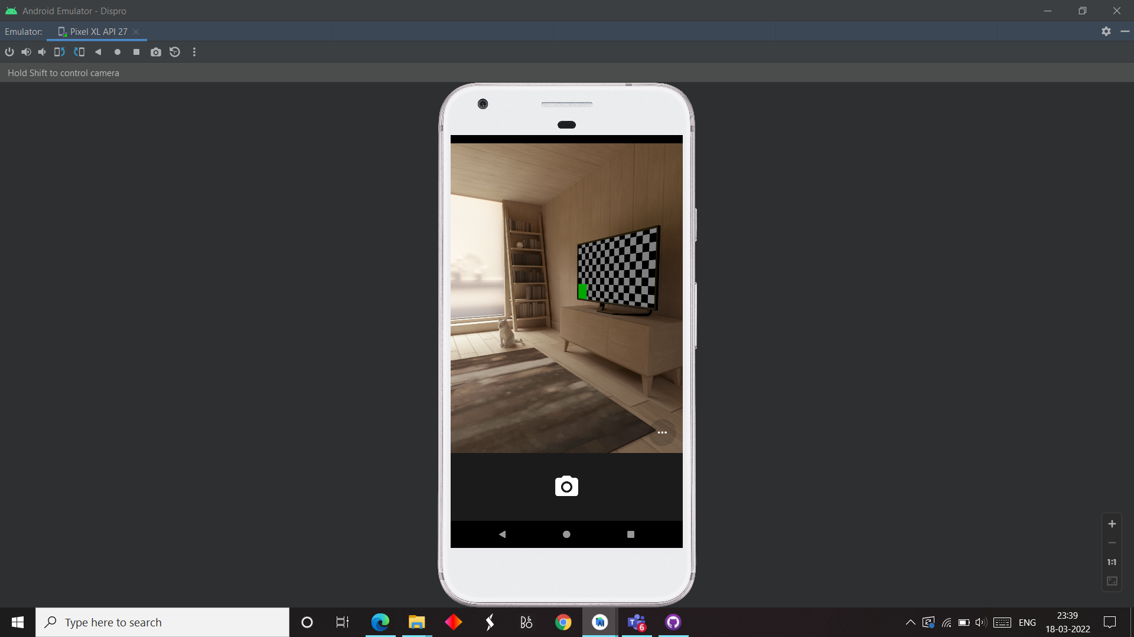
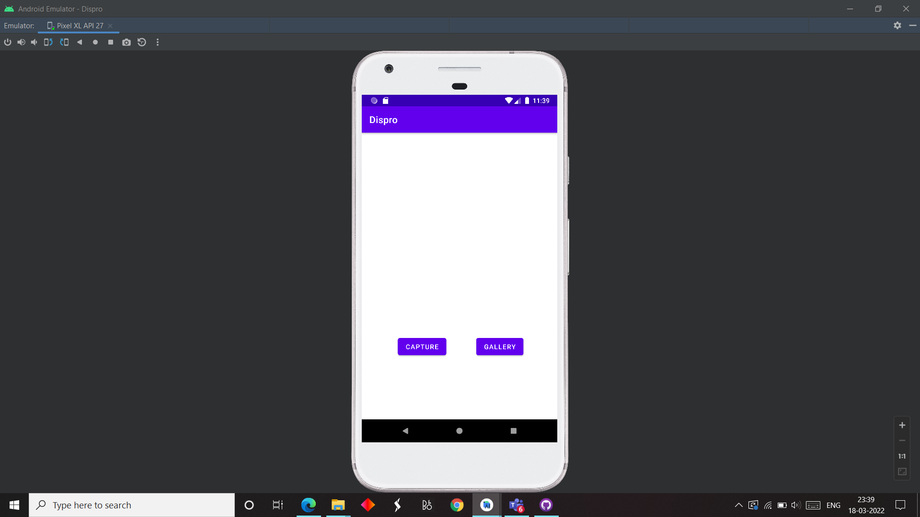
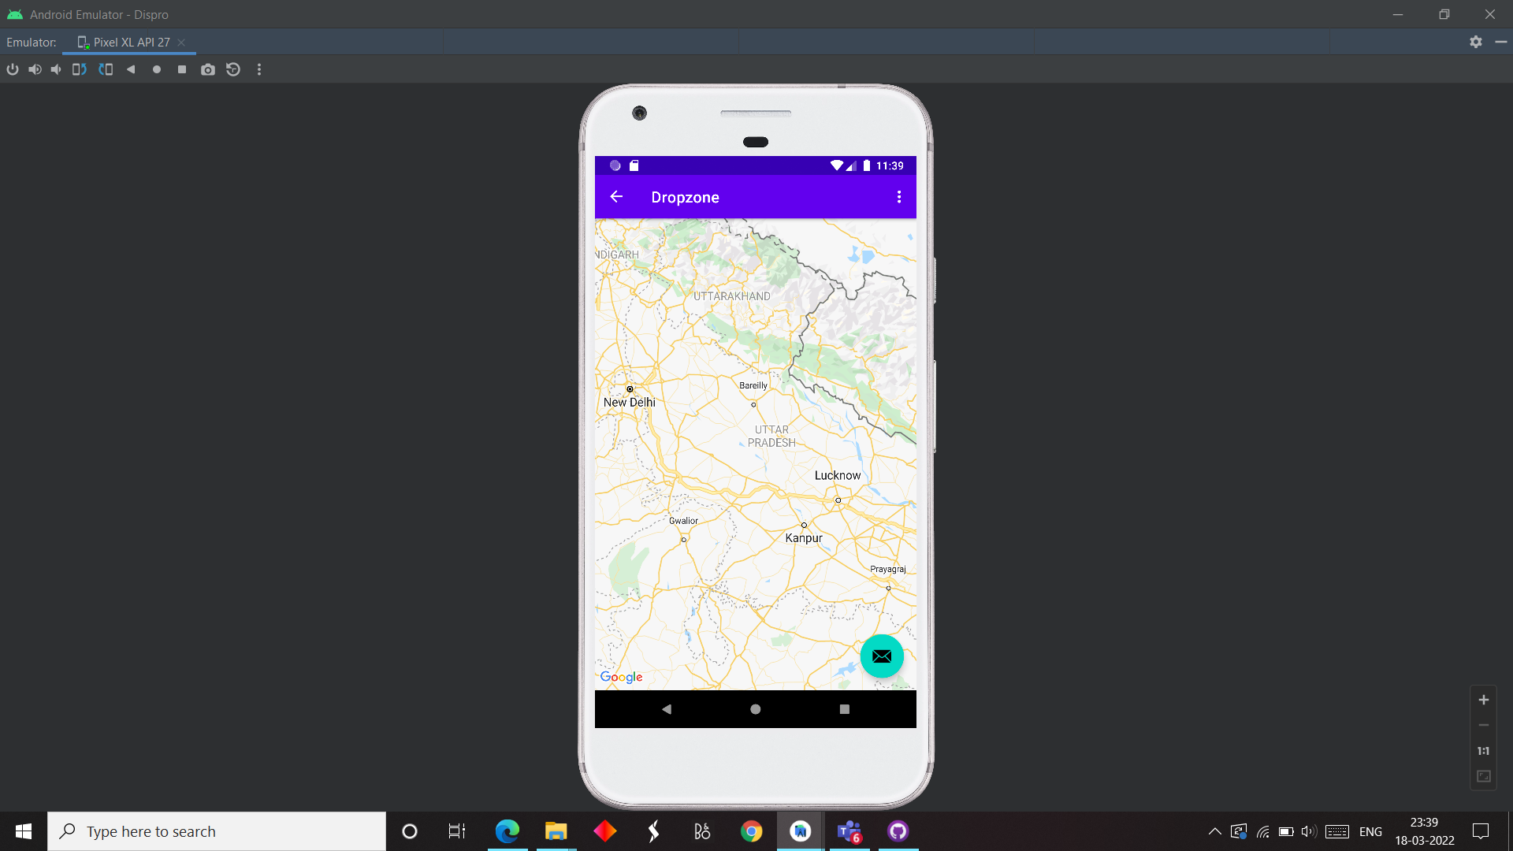
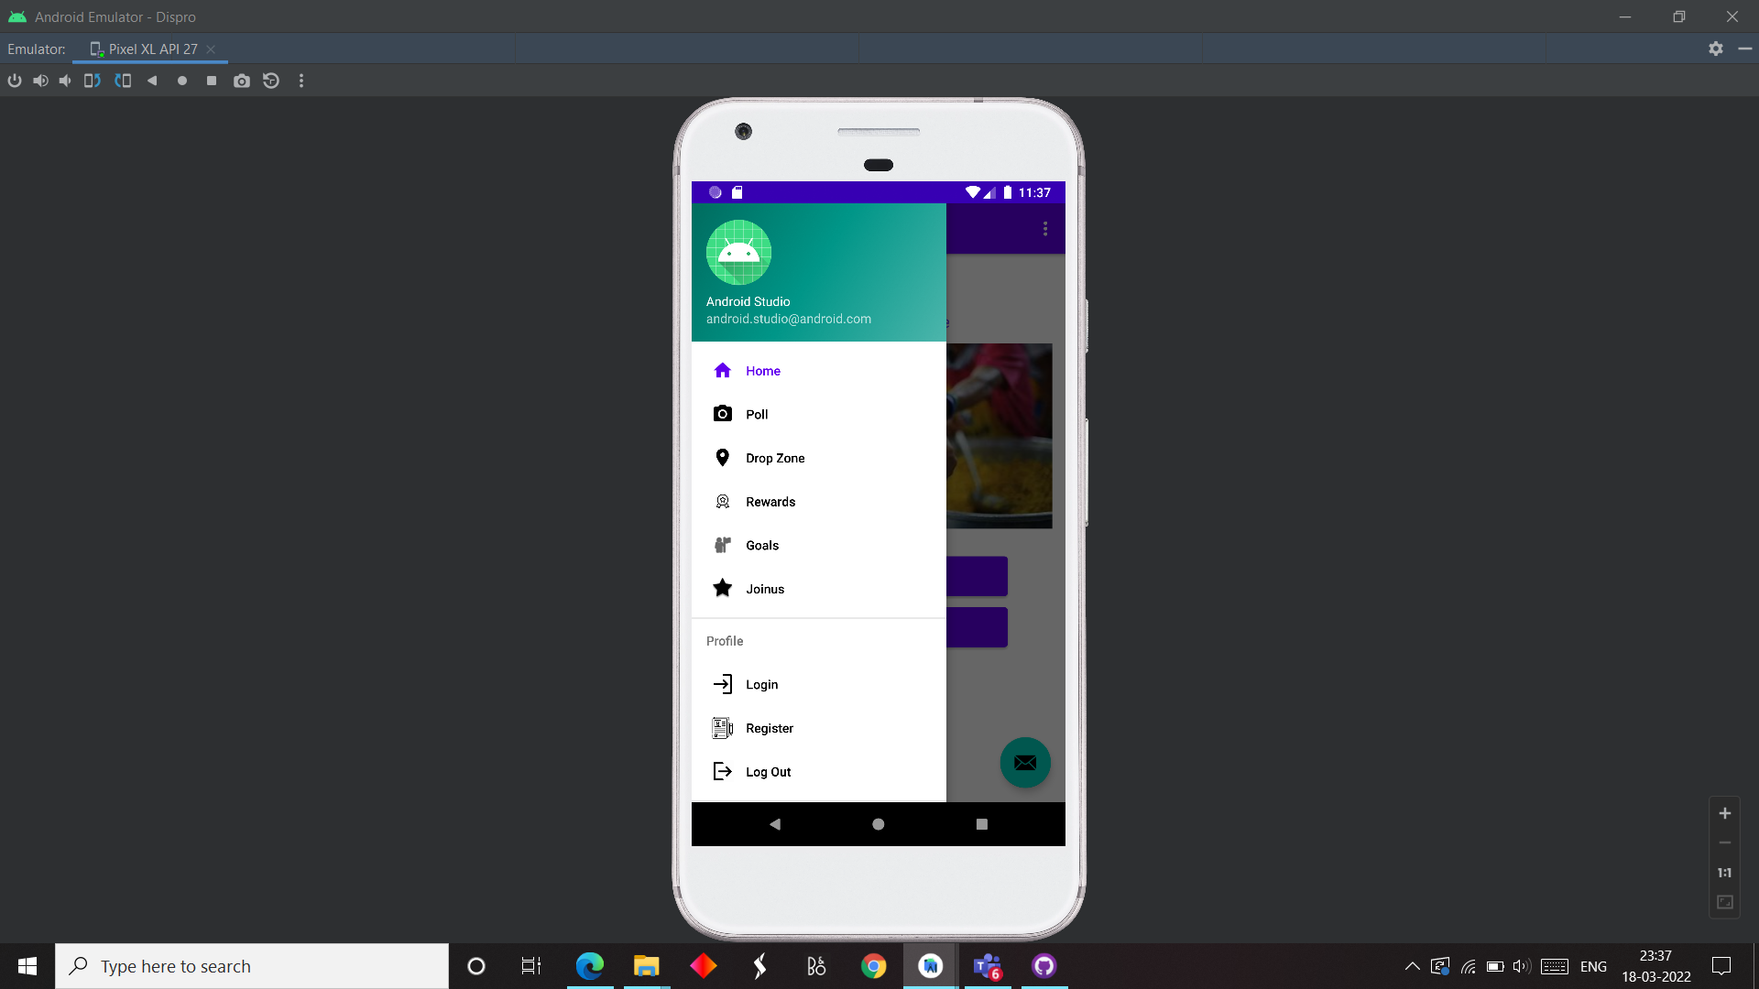
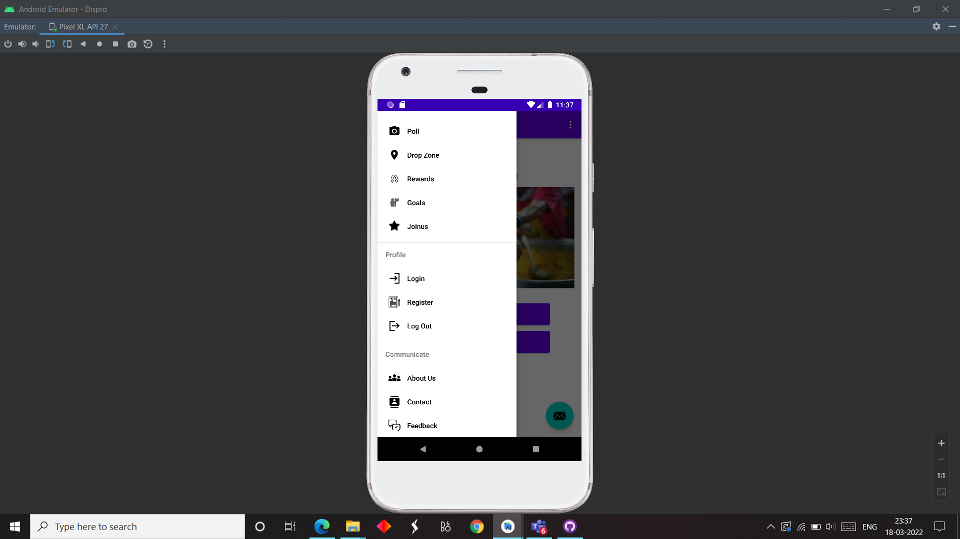
HOW APP WORKS?

Slide 4
APPLICATIONS
ADDITION ( adds/clicks an image)
REVIEW (information about product in image)
RECYCLE (food waste is decomposed)
RECOVER (leftovers or edible food items are recovered)
POLL (clicks an image and reviews it instantly)
DROP ZONE (uses google maps to select/identify locations)
REWARDS (volunteers are rewarded with points)
GOALS (set a area goal to collectively help)

Slide 5
CONCLUSION
The app is based on our daily life situation.
Delivering food and happiness to millions around.
Reaching the needy ones with just few clicks.
If we can think it, we can do it.

Slide 6
THANK YOU

