Slide 1

Project Management Framework
PMF

Slide 2

Agenda
What is Project Management Framework (PMF)?
EITS?
SDLC?
PMF Gates Overview
PMF Swimlane Diagram
SDLC Artefacts
Project Charter
Purpose of Project Charter
Uses of Project Charter
Standard Templates for RBC Artefacts

Slide 3
What is Project Management Framework (PMF)?
The PMF is a common project management methodology created under the Group Executive mandate to enhance project execution capabilities in all disciplines across RBC. A common project management approach was recommended as an important part of the Client First Initiative to help facilitate decision-making and project approvals, enhance accountability, improve operational efficiencies and reduce duplication of work effort. This, in turn, will help us work together to improve the client experience.
The PMF incorporates industry-standard best practices, and was developed as a collaborative effort by many people across the enterprise. It includes standard ‘stage gates,’ processes and document templates, and will replace the multiple approaches and tools currently used.
What is Project Management Framework (PMF)?
A framework to guide the management of initiatives / projects through a stage-gate methodology from idea generation to implementation (benefits realization), such that initiative sponsors, project managers, project teams (whether in the business, functions, operations, and information technology), have a common understanding and approach so that project teams can successfully "get things done" in RBC.

Slide 4
EITS & SDLC?
Enterprise Initiative Tracking System (EITS)
EITS is a Web-based application for creating, tracking and reporting of initiatives from idea creation through to project completion. This tool provides a consolidated view of all initiatives across the enterprise, facilitating a view of the project status and financial reporting at the executive level.
What is Systems Development Life Cycle (SDLC)?
An end-to-end set of processes encompassing the activities, roles, and artefacts required to develop information systems, and which cover investigation, analysis, design, construction, testing, and implementation, and transfer to maintenance.

Slide 5
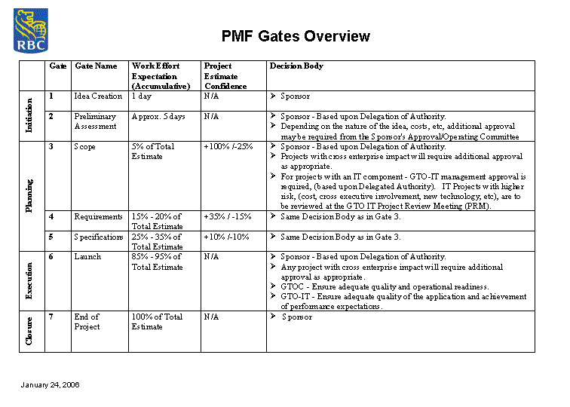
PMF Gates Overview

Slide 6
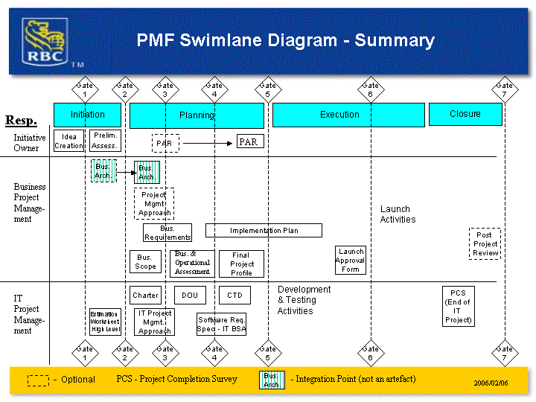
PMF Swimlane Diagram

Slide 7
SDLC ARTEFACTS
Following is a summary of the SDLC Artefacts:
Business Requirements - The Business Requirements Document is produced as part of the PMF process. It provides the features the business expects from the system. Both functional and non-functional requirements are included (PMF artefact).
Software Requirements Plan – The Software Requirements Plan documents planned activities and resources to elicit, analyze, validate, manage and communicate requirements.
Software Requirements Specifications (SRS) - The Software Requirements Specifications (SRS) document provides the specifications for how the system will function to meet the business requirements. The SRS includes functional requirements in the form of Use Cases (or structured English, but not both), GUI Storyboards and Designs, Data Elements, Business Rules, and Traceability of Specifications to requirements. It also includes updated Non-Functional Requirements.
Solution Architecture Description Document - The Solutions Architecture Description Document serves as the container of architecture design decisions throughout the development lifecycle of the project. This document is designed as a communication medium through which the evolving/maturing architecture is captured. It covers Conceptual, Logical and Physical Architectures.

Slide 8
SDLC ARTEFACTS
Solution Architecture Decision - For each key decision made regarding architectural aspect of a project, the Architecture Decision (AD) document records the following:
  Motivation for requiring a decision
  List of alternatives considered
  Rationale and implication of the decision
  Key decision factors, guiding principles etc.
  Who and when involved in the decision making
Proof of Concept Report - The document captures the scope of the Proof of Concept, the alternatives under consideration and their designs, the results as well as their analysis/interpretation.
Security and Control Document - This document is completed by the Solution Architect or Lead TSA/Developer to document the Security features of the project. This includes: logical and physical security, security gaps and recommendations for improving the Security of the project. A Security Control document must be created for each IT System affected.
Master Test Plan or Master Test Plan for Small and Enhancements Projects and Maintenance Releases - The document provides an overview of Testing Process for the Project: Unit, Integration, Functional/System, Performance, UAT, Operational Acceptance (PIV), Disaster Recovery Plan (DRP) and Post Implementation Verification (PIV). This Master Test Plan will outline the strategies, environments, processes and procedures which support all levels of testing involved within the RBC SDLC. Test cases are stored within Mercury Quality Centre (MQC) and execution results of these test cases are documented within the respective test phase execution artefact. Sign-off to results is added as it is obtained. Unit test cases and results are documented within a word or excel document and stored with the project folder as detailed within the SCM Plan.

Slide 9
SDLC ARTEFACTS
Test Execution Signoff for Small and Enhancements Projects and Maintenance Releases – This artefact details the execution and defect results for all test phases within the SDLC. Signoff of results is added after the test is completed and the artefact is reviewed.
Integration Test Execution & Sign Off - This artefact details the execution and defect results for this test run. Confirmation of Entry and Exit criteria are detailed along with the types of tests conducted. Signoff of results is added after the test is completed and the artefact is reviewed.
Test Coverage Report – This artefact details the method(s) used that verifies complete traceability of test scenarios/cases to the system requirement specifications. Signoff of content is added after the artefact has been reviewed by the artefact stakeholders.
Functional/System Test Execution & Signoff - This artefact details the execution and defect results for this test run. Confirmation of Entry and Exit criteria are detailed along with the types of tests conducted. Signoff of results is added after the test is completed and the artefact is reviewed.
Performance Test Execution & Signoff - This artefact details the execution and defect results for this test run. Confirmation of Entry and Exit criteria are detailed along with the types of tests conducted. Signoff of results is added after the test is completed and the artefact is reviewed.
User Acceptance Test Execution & Signoff - This artefact details the execution and defect results for this test run. Confirmation of Entry and Exit criteria are detailed along with the types of tests conducted. Signoff of results is added after the test is completed and the artefact is reviewed.
Disaster Recovery Plan Test Execution & Signoff - This document is done only for projects conducting Disaster Recovery Testing. This artefact details the execution and defect results for this test run. Confirmation of Entry and Exit criteria are detailed along with the types of tests conducted. Signoff of results is added after the test is completed and the artefact is reviewed.

Slide 10
SDLC ARTEFACTS
Technical Design Document – Aggregates design models, which may include (depending on the needs of the project);
  Design Overview and Design Decisions – English descriptions and UML overview models (such as class diagrams and package diagrams) providing a description of the design and of key design decisions which went through a formal alternatives analysis.
  Design Traceability – Use case realizations or design traceability matrix to show how the design implements the specifications.
  Database – Database modelling is performed using entity-relationship diagrams for logical models, and table diagrams for physical model. Tools such as ERWIN provide database modelling functionality.
  Physical deployment - describes how the design components will be deployed in test and production environments.
Design Review Report. Used to document the results of a design review.
Code Review Report. Used to document the results of a code review.
Folio. This is a summary of corporate policies and processes which may have to be updated to reflect implementation of a new system or system changes.
User Manual – The document is a reference document which describes the features of the system the users have to learn about. The manual may be structured based on roles, or on the user profile (e.g. regular users vs. power users).
Training Manual – The document is used to help train new users on how to use the system.
Estimation Worksheet - This document provides the details of how the estimated development effort was derived.

Slide 11
SDLC ARTEFACTS
Online Help – This is online reference and training material for users of the system.
Operating Manual – The document describes how the application has to be handled in production, and is used by the Operations group.
Problem Resolution Procedures – The document describes the application for the Enterprise Help Desk
IT Implementation Plan – This document describes the steps needs to implement the software in the production environment. A backout plan is also included.
Post Implementation Verification Execution & Signoff – A document describing testing to be done immediately after deployment to production to confirm that a the completeness and correctness of the deployment. Signoff is added when testing is completed.
Operations Request for Change – This refers to the information that must be entered into the Production Change Control (such as Peregrine) system to document the changes to the production environment to be performed by the project.
SLA– This document provides the Service Level Agreement between System Operations and the Business Lead.
Application Migration Plan & Checklist - This document provides the Application Support Team with information needed to support the new or changed system.

Slide 12
Project Charter
In project management, a project charter or project definition is a statement of the scope, objectives and participants in a project. It provides a preliminary delineation of roles and responsibilities, outlines the project objectives, identifies the main stakeholders, and defines the authority of the project manager. It serves as a reference of authority for the future of the project. The terms of reference is usually part of the project charter.
The project charter is usually a short document that refers to more detailed documents such as a new offering request or a request for proposal. In Initiative for Policy Dialogue (IPD), this document is known as the project charter. In customer relationship management (CRM), it is known as the project definition report. Both IPD and CRM require this document as part of the project management process.
The project charter establishes the authority assigned to the project manager, especially in a matrix management environment. It is considered industry best practice.

Slide 13
Purpose of Project Charter
The purpose of the project charter is to document:
Reasons for undertaking the project
Objectives and constraints of the project
Directions concerning the solution
Identities of the main stakeholders
In scope and out-of-scope items
High level risk management plan
Communication plan
Target project benefits
High level budget and spending authority

Slide 14
Uses of Project Charter
The three main uses of the project charter:
To authorize the project - using a comparable format, projects can be ranked and authorized by Return on Investment.
Serves as the primary sales document for the project - ranking stakeholders have a 1-2 page summary to distribute, present, and keep handy for fending off other project or operations runs at project resources.
As a focus point throughout the project - for example: project as people walk in to team meetings and use in change control meetings to ensure tight scope management.

Slide 15
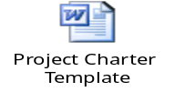
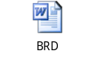
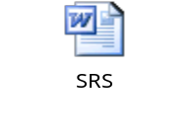
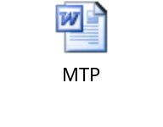
Standard Templates for RBC Artefacts
Project Charter:
BRD:
SRS:
MTP:

Slide 16

Queries?

Slide 17
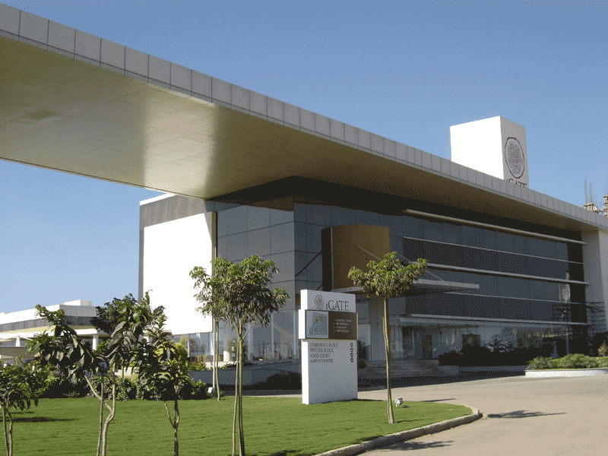

Thank you!

