Slide 1
IBM BOB AI INNOVATION HACKATHON 2026 • AI TRACK SUBMISSION
Threat Intelligence Correlation &
Alert Prioritisation Assistant
Autonomous SOC Platform for Telemetry Deduplication (>73% Noise Drop), RandomForest Scoring (AUC 0.9998), Abuse.ch & STIX 2.1 Enrichment, and Grounded IBM Bob AI Decision Support.
SUBMITTED BY
TEAM ASTRO HACKERS
Team Lead: Kunj Desai | Track: AI Track
CORE STACK
• Python 3.10+ | Streamlit 5-Tab Command UI
• scikit-learn | RandomForest Classifier (120 trees)
• Abuse.ch URLhaus Live Feed | MITRE STIX 2.1
• IBM Bob AI | Grounded Copilot Inference API

Slide 2
BACKGROUND & MOTIVATION
Problem — SOC Telemetry & Alert Fatigue Crisis
SOC analysts face severe telemetry overflow: 244k+ raw daily SIEM alerts overwhelm analysts, burying genuine attack campaigns under 83.5% repetitive noise and causing severe decision bottlenecks.
❌ 244k+ Raw Daily Alerts
Single network segment produces 244,471 raw flow events per day across Zeek & CIC-IDS2018 logs.
❌ 83.5% Telemetry Noise
Over 204,117 raw flows are duplicate 5-tuples or synthetic repetitions, causing extreme alert fatigue.
❌ Unmapped Tactics
Raw SIEM alerts lack automated cross-correlation with formal adversary frameworks like MITRE ATT&CK.
❌ High MTTR & Briefing Gap
Commanders lack concise, evidence-backed BLUF briefs to issue immediate, decisive containment orders.

Slide 3
SYSTEM OVERVIEW & WORKFLOW
Solution — End-to-End Threat Intelligence Platform
1. Telemetry Ingest
244k Raw Events
2. Dedup Engine
83.5% Noise Drop
3. ML Threat Model
RandomForest (0-1)
4. Intel Enrichment
URLhaus + STIX 2.1
5. Campaign Correlate
5-Min Window
6. BLUF Briefing
Priority Formula
7. Command UI
Streamlit + Bob AI
➔
➔
➔
➔
➔
➔
⚡ Telemetry Deduplication • 83.5% Noise Reduction
204,117 duplicate raw flows dropped before ML analysis (244k -> 40k clean flows).
🤖 RandomForest • AUC-ROC = 0.9998
Predicts threat confidence (0–1) with 100% recall (0 missed threats on 8,071 test events).
🌐 Dual Threat Intel Enrichment • Abuse.ch & STIX 2.1
O(1) Abuse.ch URLhaus malicious IP checks + 8 MITRE ATT&CK technique enrichments.
🛡️ Defence BLUF & IBM Bob AI • Priority Score Formula
Auto-generates 4-section briefs (Priority = Conf × Crit × Sev) supported by grounded IBM Bob Q&A.

Slide 4
TECHNICAL ARCHITECTURE
Architecture — Technical Pipeline & Data Flow
COMPONENT PIPELINE ARCHITECTURE
7-STAGE DATA FLOW
• 1. Ingestion
244,471 Zeek + CIC events
• 2. Deduplication
83.5% noise drop -> 40k flows
• 3. ML Scoring
RandomForest confidence (0-1)
• 4. Threat Intel
URLhaus IOC + STIX 2.1 check
• 5. Correlation
5-min window incident cluster
• 6. BLUF Briefs
Priority Score executive brief
• 7. Command UI
Streamlit 5-Tab + IBM Bob AI
• Data Loader & Dedup Engine (pandas / NumPy)
Module: src/engine/data_loader.py | 244k Telemetry Ingest & 5-Tuple Dedup
• ML Threat Classifier (scikit-learn)
Module: src/engine/classifier.py | 12-Feature RandomForest Threat Scoring
• Threat Intelligence Feeds (requests / JSON)
Module: src/threat_intel/ | Abuse.ch URLhaus & MITRE STIX 2.1 Parser
• Correlation Engine (Python stdlib)
Module: src/engine/correlation.py | Source-IP + 5-Min Rolling Window Clustering
• BLUF Briefs & Command UI (Streamlit / Bob API)
Module: src/bluf_generator.py & app.py | Priority Score Formula & 5-Tab Command UI

Slide 5
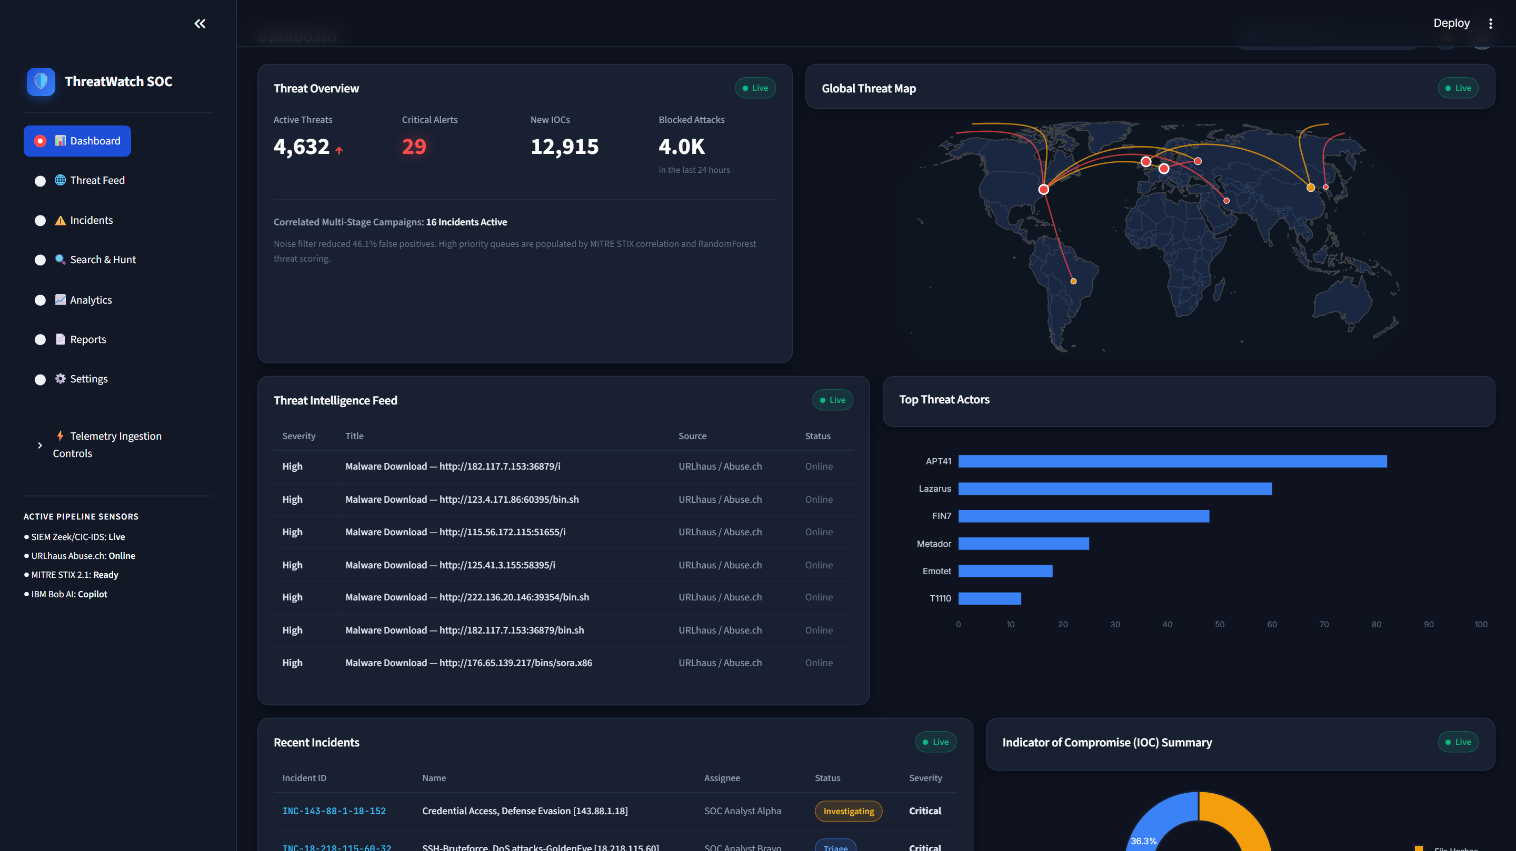
APPLICATION DEMO
Demo / Key Feature — SOC Command Centre
OPERATIONAL WORKFLOW
• 1. Detect Campaign
Surfaces incidents by Priority Score.
• 2. View ML Confidence
RandomForest threat confidence score.
• 3. Enrich Indicators
URLhaus IOC check + MITRE STIX 2.1.
• 4. Correlate Activity
5-min rolling window clustering.
• 5. Auto-Generate BLUF
Structured 4-section executive brief.
• 6. IBM Bob Guidance
Grounded AI Q&A and mitigation plan.

Slide 6
IBM TECHNOLOGY INTEGRATION
IBM Technologies — IBM Bob AI Integration
GROUNDED AI FLOW: Incident Facts (IPs, MITRE IDs, IOCs) ➔ bob_prompts.py ➔ IBM Bob AI API ➔ Grounded Guidance
🤖 Grounded AI Architecture
Prompts inject real pipeline telemetry (IPs, MITRE IDs, IOC tags, ML confidence) via `bob_prompts.py` to prevent hallucination.
💬 Interactive SOC Decision Support
Provides on-demand plain-language incident explanations, dynamic BLUF brief generation, custom mitigation plans, and free Q&A.
🔌 Inference API Implementation
Uses custom `BobClient` class (`src/engine/bob_client.py`) calling IBM Bob OpenAI-compatible endpoint (`POST /v1/chat/completions`).
🛡️ Graceful Offline Fallback
Platform operates 100% offline without an API key — all template BLUF briefs, ML scoring, and MITRE lookups remain functional.

Slide 7
RESULTS & EVALUATION
Results / Impact — Empirical Validation
ACCURACY
99.78%
32,283 Train / 8,071 Test Split
PRECISION
99.58%
18 False Positives out of 3,847
RECALL
100.00%
ZERO missed threats (0 FN)
ROC-AUC
0.9998
Near-perfect discrimination
CONFUSION MATRIX (8,071 TEST EVENTS)
KEY FEATURE IMPORTANCE BREAKDOWN
• 1. dst_port (32.2%)
Attacks target specific ports (4848, 22, 80, 445).
• 2. protocol_enc (15.5%)
Protocol encoding differences (TCP/UDP/ICMP).
• 3. total_packets (13.6%)
Volumetric packet rates capture DDoS bursts.
• 4. packets_fwd (12.9%)
Forward packet rates distinguish scanning.
• 5. total_bytes (6.6%)
Payload size & exfiltration anomalies.
• ✅ Zero Data Leakage
Verified in outputs/ml_validation_report.md.
 | Pred: Benign | Pred: Threat
Actual: Benign | 3,829 (TN) | 18 (FP)
Actual: Threat | 0 (FN) | 4,224 (TP)
⚡ Telemetry Noise Drop: 204,117 duplicate rows removed from 244,471 raw events (83.5% noise reduction) down to 40,354 clean flows.

Slide 8
TEAM & RESPONSIBILITIES
Team — Astro Hackers
IBM BOB AI INNOVATION HACKATHON 2026 • TEAM ASTRO HACKERS
KUNJ DESAI
TEAM LEAD • 24cs015@charusat.edu.in
Lead Architect & AI Pipeline Integrator — System architecture, dataset correlation engine, IBM Bob AI integration, and submission coordination.
KRISH ARDESHANA
TEAM MEMBER • 24cs007@charusat.edu.in
Machine Learning & Intel Lead — RandomForest classifier training, ML validation audit, Abuse.ch URLhaus & MITRE STIX 2.1 threat enrichment.
DEEP CHAUHAN
TEAM MEMBER • 24cs012@charusat.edu.in
Frontend & UI Developer — Streamlit Command Centre 5-tab dashboard, Plotly interactive charts, alert explorer, and UX styling.
NISARG DEDAKIYA
TEAM MEMBER • 24cs014@charusat.edu.in
Data Processing & Engine Engineer — Master events ingestion, 5-tuple deduplication engine, feature matrix derivation, and BLUF generator.

