Slide 1
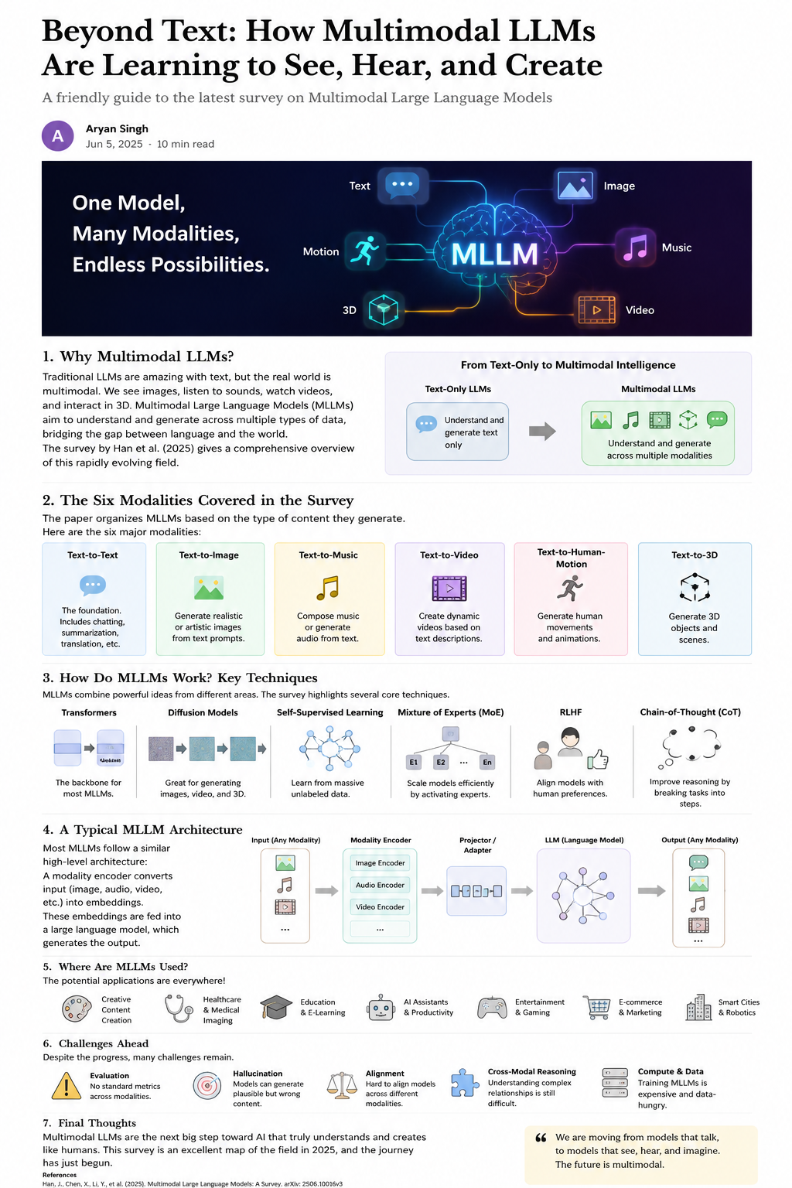
From Chatbots to
World Builders
A short story review of Multimodal Large Language Models
Paper: “Multimodal Large Language Models: A Survey”
Survey paper
Multimodal AI
Foundation models
Notes:
Introduce the topic as a story: AI is moving from text-only chatbots to systems that understand and create across many modalities. Mention that this deck supports the Medium article and GitHub reproduction.

Slide 2
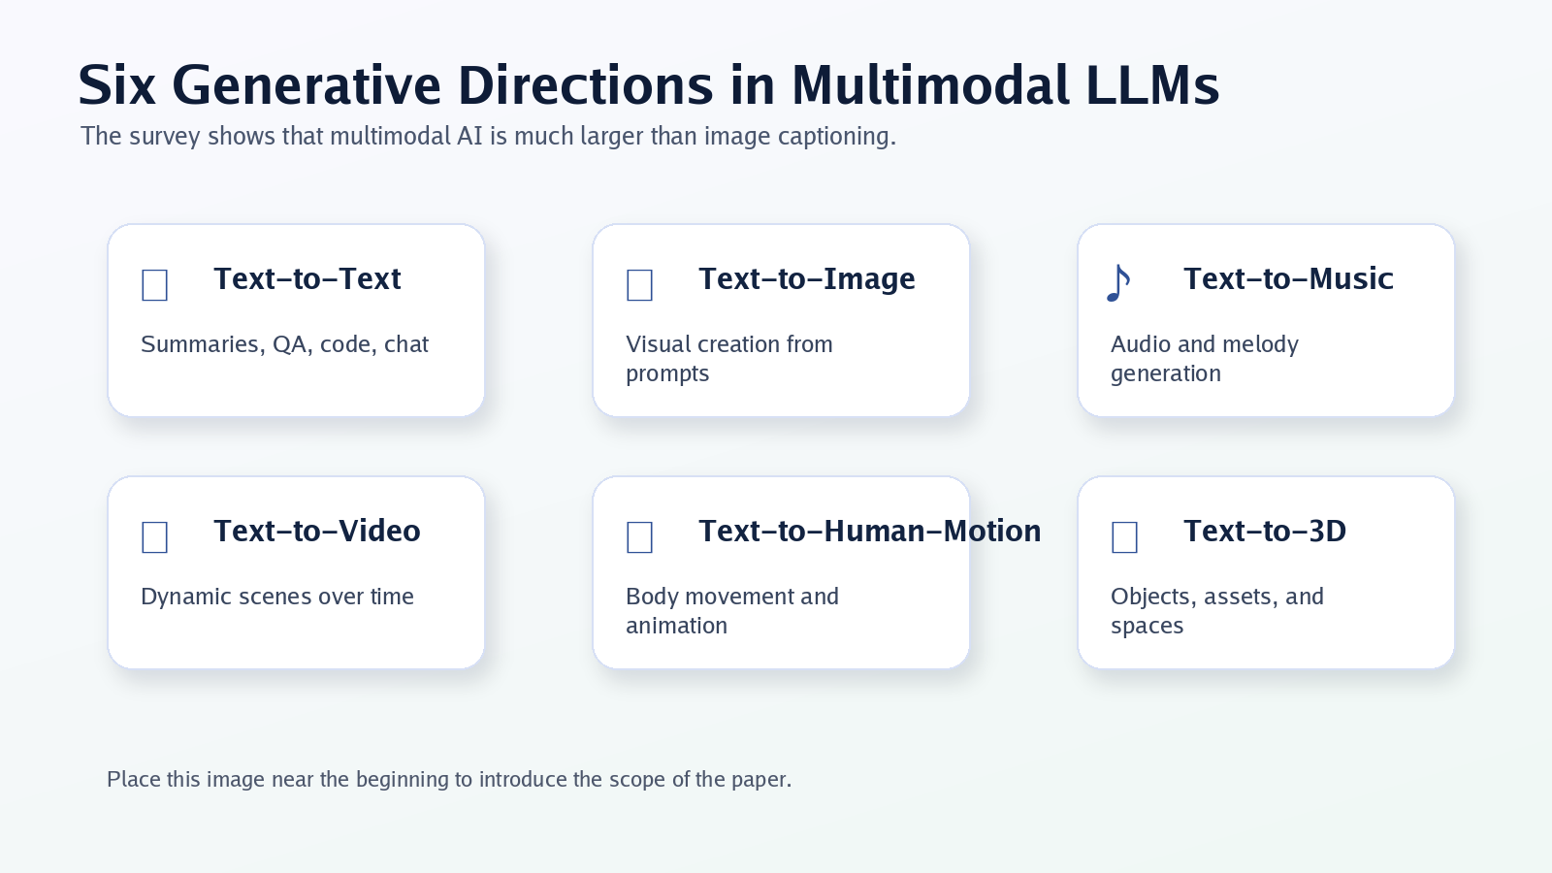
Paper selected for the review
Why this survey fits the short story assignment
Paper
Multimodal Large Language Models: A Survey. arXiv:2506.10016. The latest arXiv version should be used for the assignment because it falls in late 2025.
Why it fits
It is a recent survey on foundation models and LLMs, with a strong focus on non-standard modalities beyond text.
Main value
The paper organizes multimodal generation across text, image, music, video, human motion, and 3D objects.
Use latest arXiv version, not only the original v1 PDF link.
Multimodal LLM Survey Review | 2
Notes:
Explain that this is a survey paper, which is strongly recommended by the assignment. Point out the important detail: use the latest arXiv version rather than only the first version link.

Slide 3
Why multimodal LLMs matter
The real world is not text-only
Traditional LLMs are excellent at reading and writing text, but human understanding uses many signals at the same time: vision, sound, motion, space, and language.
1
See images and scenes
2
Hear music and audio
3
Understand time in videos
4
Create motion and 3D worlds
Multimodal LLM Survey Review | 3
Notes:
Use examples: a student uploads a graph, a doctor sees a scan, a creator describes a scene, a robot sees a room. These need more than text.

Slide 4
What is a Multimodal LLM?
A language model connected to other forms of data
Text-only LLM
Multimodal LLM
Why language matters
Input and output are mainly text: questions, summaries, code, translation, explanations.
Connects language with images, audio, video, motion, and 3D data through specialized encoders and generators.
Natural language becomes the interface for controlling and explaining many types of digital content.
Describe an image
Generate an image from text
Explain a video scene
Create music from a prompt
Generate a 3D object or motion
Multimodal LLM Survey Review | 4
Notes:
Define MLLMs in simple language. Emphasize that text becomes the common interface for many tasks.

Slide 5
Six generative directions in the survey
The paper is broader than image captioning
Multimodal LLM Survey Review | 5
Notes:
Walk through the six modalities: text, image, music, video, human motion, and 3D. Mention that this gives the paper strong coverage of non-standard modalities.

Slide 6
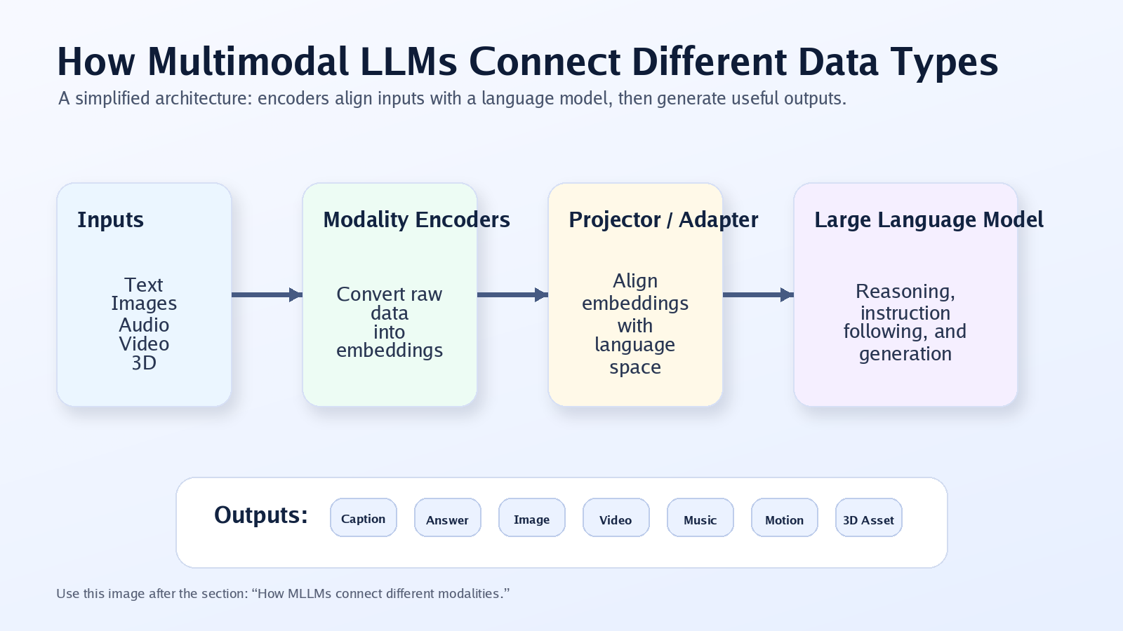
A typical MLLM architecture
Encoders translate different modalities into language-model-friendly representations
Multimodal LLM Survey Review | 6
Notes:
Explain input modalities, modality encoders, projector/adapters, LLM backbone, and output. Keep it high level and avoid math depth.

Slide 7
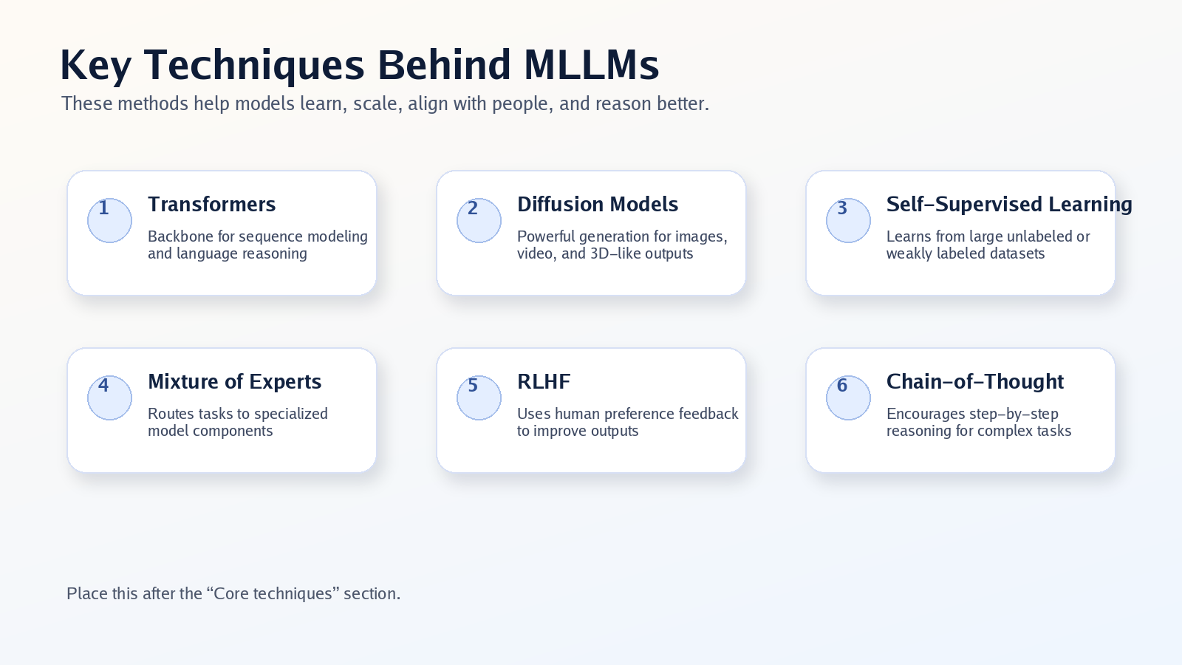
Core techniques behind modern MLLMs
The survey connects many model-building ideas
Multimodal LLM Survey Review | 7
Notes:
Explain each technique briefly: transformers, diffusion models, self-supervised learning, Mixture of Experts, RLHF, and Chain-of-Thought reasoning.

Slide 8
Text-to-image: language becomes a creative brush
From prompt to visual composition
Text-to-image models show how language can control visual generation. The model must understand objects, styles, colors, layout, and relationships.
Prompt understanding
The system maps words like “futuristic classroom” or “sunset city” into visual concepts.
Visual generation
Diffusion-style methods generate realistic or artistic images that match the prompt.
Use cases
Design, marketing, education, prototyping, entertainment, and creative storytelling.
Multimodal LLM Survey Review | 8
Notes:
Use one concrete prompt example, such as generating a futuristic library. Explain that this is popular because the result is visual and easy to understand.

Slide 9
Beyond images: music, video, motion, and 3D
The survey shows multimodal generation is expanding fast
Text-to-music
Generate melodies or audio that match mood, tempo, and description.
Text-to-video
Generate dynamic scenes that require temporal consistency and motion.
Text-to-human-motion
Translate language into body movements for avatars, games, and robotics.
Text-to-3D
Create 3D assets with geometry, texture, and multi-view consistency.
Multimodal LLM Survey Review | 9
Notes:
Explain why these modalities are harder than text and images: time, geometry, motion, and subjective quality.

Slide 10
Architecture trend: from separate tools to unified systems
The future is not one isolated model per task
Earlier systems were often specialized: one model for captioning, one for image generation, one for video, and one for 3D. Newer systems move toward shared language backbones with modality-specific components.
Shared backbone
Modality adapters
Cross-modal transfer
A central LLM handles instruction following and reasoning.
Encoders/projectors connect images, audio, video, and 3D to the LLM.
Learning in one modality can help another modality.
More unified interfaces
More flexible task handling
Better reuse of learned knowledge
Need stronger evaluation and alignment
Multimodal LLM Survey Review | 10
Notes:
Describe this as the shift from individual tools to a multimodal operating system.

Slide 11
Reproduction experiment for GitHub
A small, practical demo inspired by the survey
Because the paper is a survey, the reproduction focuses on a small representative MLLM task: image-to-text understanding using an open-source vision-language model.
Task
Metric
Output
Generate captions for sample images and compare them with expected visual concepts.
Keyword coverage score: how many expected concepts appear in the generated caption.
Tables, charts, and interpretation for the Medium article, slides, and README.
Goal: demonstrate the basic principle behind multimodal learning, not train a huge foundation model from scratch.
Multimodal LLM Survey Review | 11
Notes:
Explain that reproducing all survey models is impossible for a class assignment. A small experiment is acceptable and directly related to multimodal understanding.

Slide 12
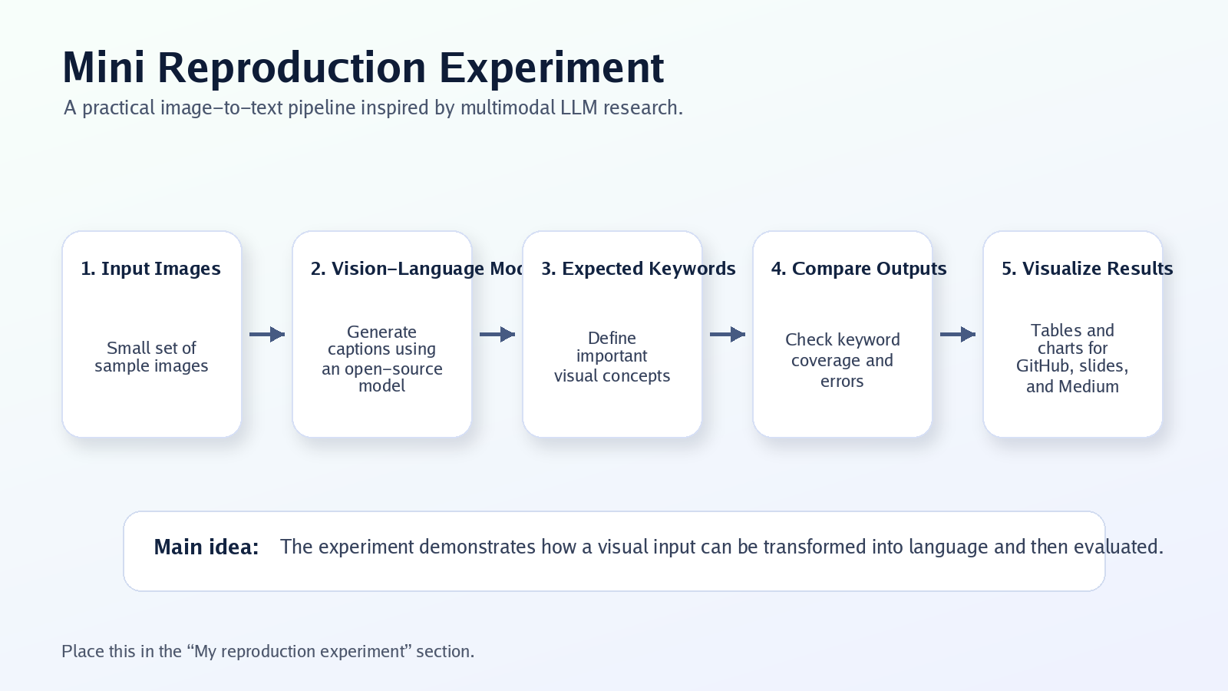
Experiment workflow
From images to captions to simple evaluation
Multimodal LLM Survey Review | 12
Notes:
Walk through each step: sample images, model inference, generated captions, expected keywords, coverage score, and plots.

Slide 13
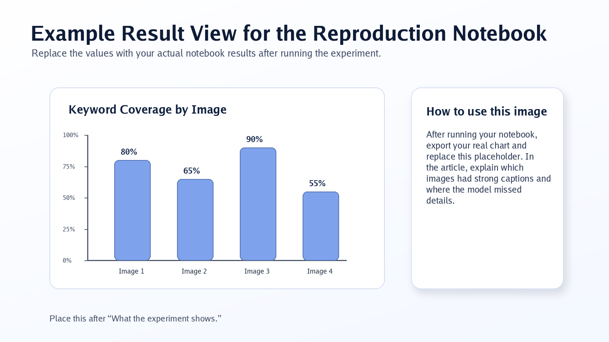
Evaluation: simple, transparent, and explainable
A small metric that makes the demo easy to discuss
Keyword coverage
For each image, define expected concepts such as “dog,” “street,” or “food.” Check whether the generated caption includes those concepts.
Why this metric?
It is easy to understand, easy to reproduce, and enough to demonstrate image-language alignment at a small scale.
Limitations
It does not fully measure reasoning, caption quality, style, or hallucination. It is a classroom-scale proxy metric.
Multimodal LLM Survey Review | 13
Notes:
Be honest about the limitations. This is a demo metric, not a full benchmark.

Slide 14
Expected results and interpretation
What the notebook is designed to show
Simple images usually receive relevant captions.
The model may miss small details or relationships.
Keyword scores make success and failure easy to inspect.
The result illustrates the core MLLM idea: mapping visual information into language.
Replace this placeholder chart with the real chart generated after running the notebook.
Multimodal LLM Survey Review | 14
Notes:
After running the notebook, replace the placeholder chart with your actual results. In the video, briefly explain one successful caption and one limitation.

Slide 15
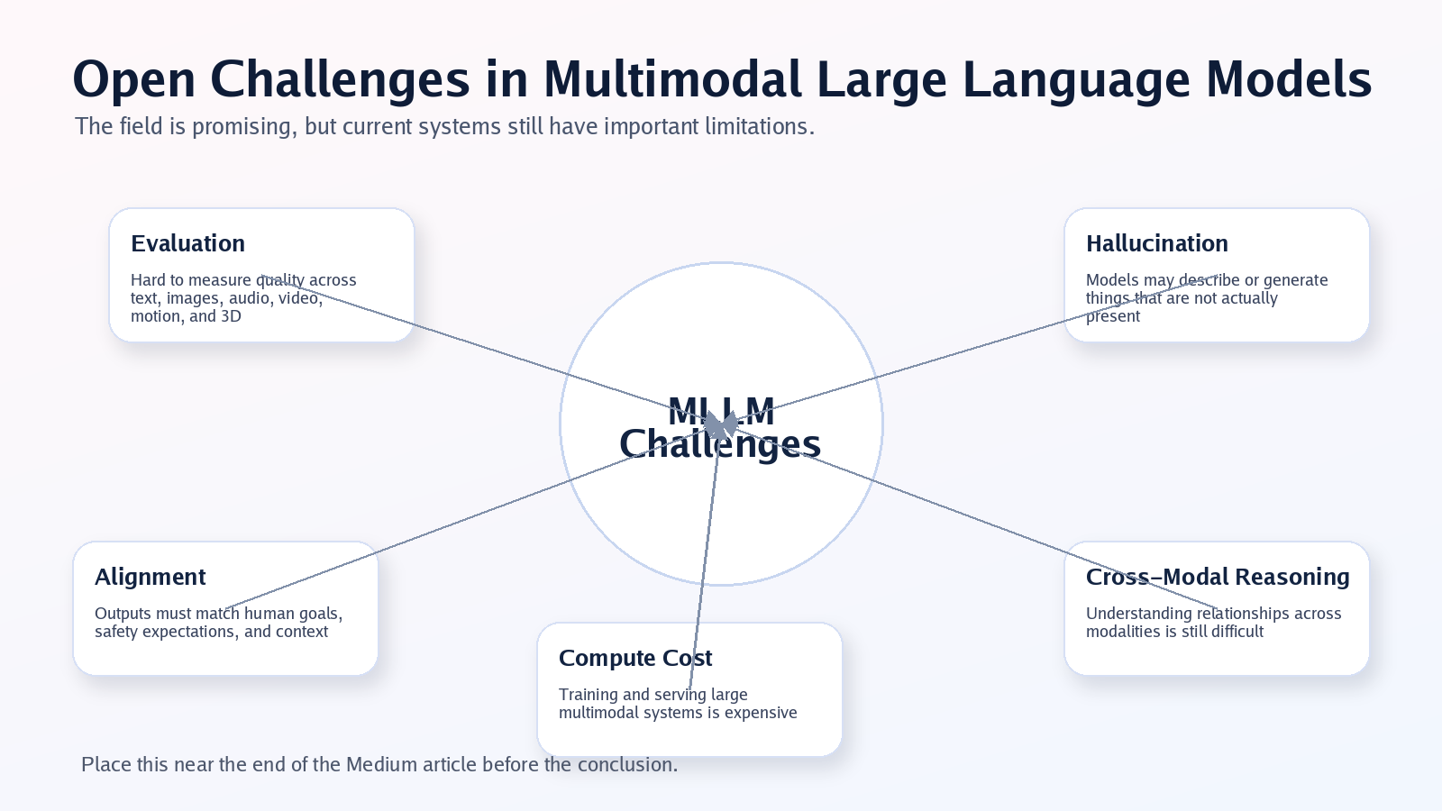
Open challenges in Multimodal LLMs
The paper emphasizes that progress is real, but the field is not solved
Multimodal LLM Survey Review | 15
Notes:
Explain five big challenges: evaluation, hallucination, alignment, cross-modal reasoning, and compute/data cost.

Slide 16
Practical risks and ethical concerns
More powerful generation creates new responsibilities
Misinformation
Safety in high-stakes settings
Realistic generated images, audio, and video can be misused if provenance is unclear.
Errors in healthcare, law, robotics, and security can have serious consequences.
Bias and representation
Hallucinated observations
Multimodal datasets may reflect social, cultural, or geographic bias.
A model may describe objects, actions, or details that are not actually present.
Copyright and ownership
Need for evaluation
Generated media raises questions about training data, attribution, and creator rights.
Reliable multimodal benchmarks and human-centered evaluation remain critical.
Multimodal LLM Survey Review | 16
Notes:
Use this slide to show independent thinking beyond the paper summary.

Slide 17
Future directions
Where multimodal foundation models are likely heading
More unified multimodal architectures
Better benchmarks for reasoning and alignment
Efficient training with modular and expert-based models
Improved safety, provenance, and content authenticity
Applications in education, healthcare, robotics, design, and 3D creation
Multimodal LLM Survey Review | 17
Notes:
Frame the future as moving from models that talk to models that see, hear, imagine, and act.

Slide 18
Final takeaway
Multimodal LLMs are not just better chatbots.
They are becoming interfaces for creating and understanding digital worlds.
Primary reference: Han et al., “Multimodal Large Language Models: A Survey,” arXiv:2506.10016.
Notes:
Close with the main message: we are moving from models that only talk to models that see, hear, reason, and create.

