Slide 1

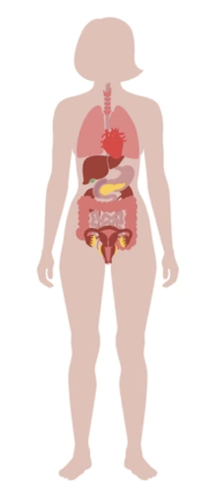

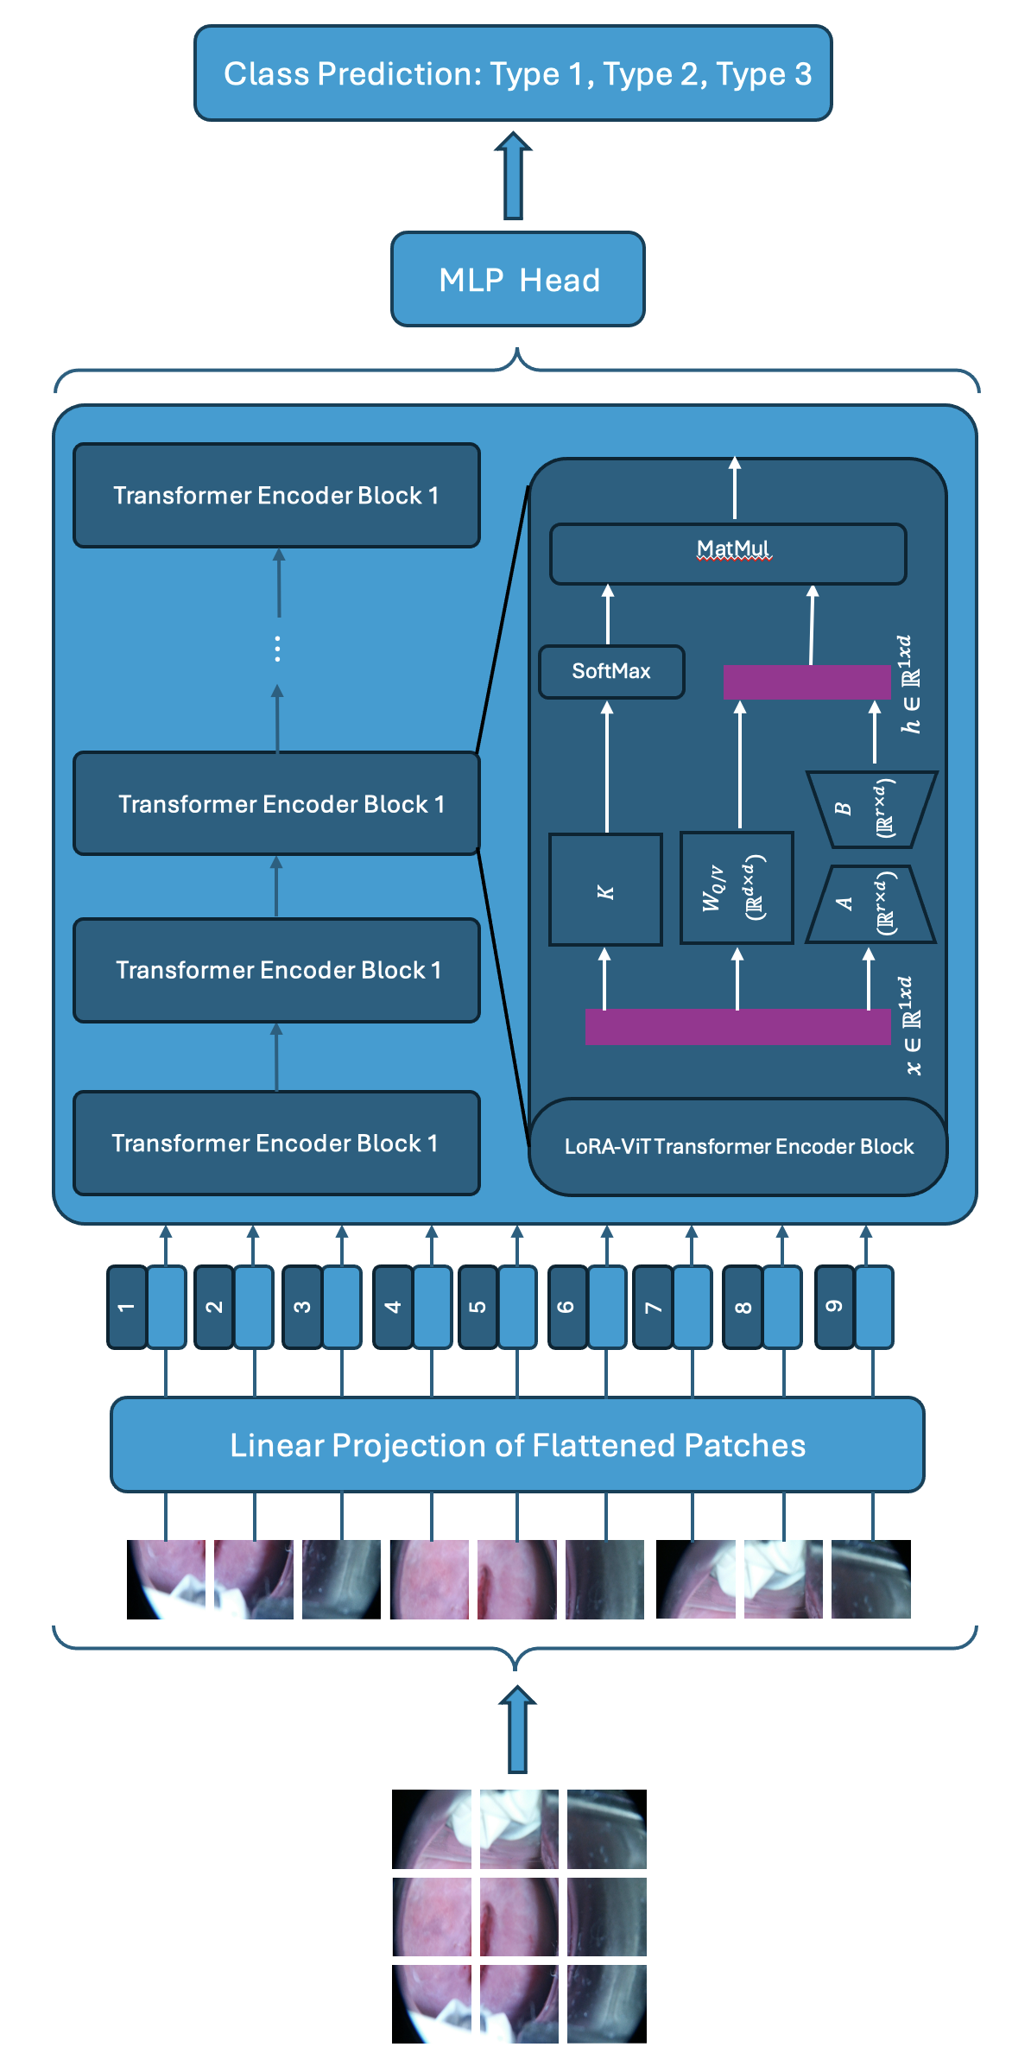
LoRA-ViT architecture
Patient
CAD Report
Data collection: Colposcopy Imaging
Data Processing: Lightweight LoRA-ViT Cervix Type Classifier
Data Results: Computer-aided diagnosis (CAD) Report

