Slide 1
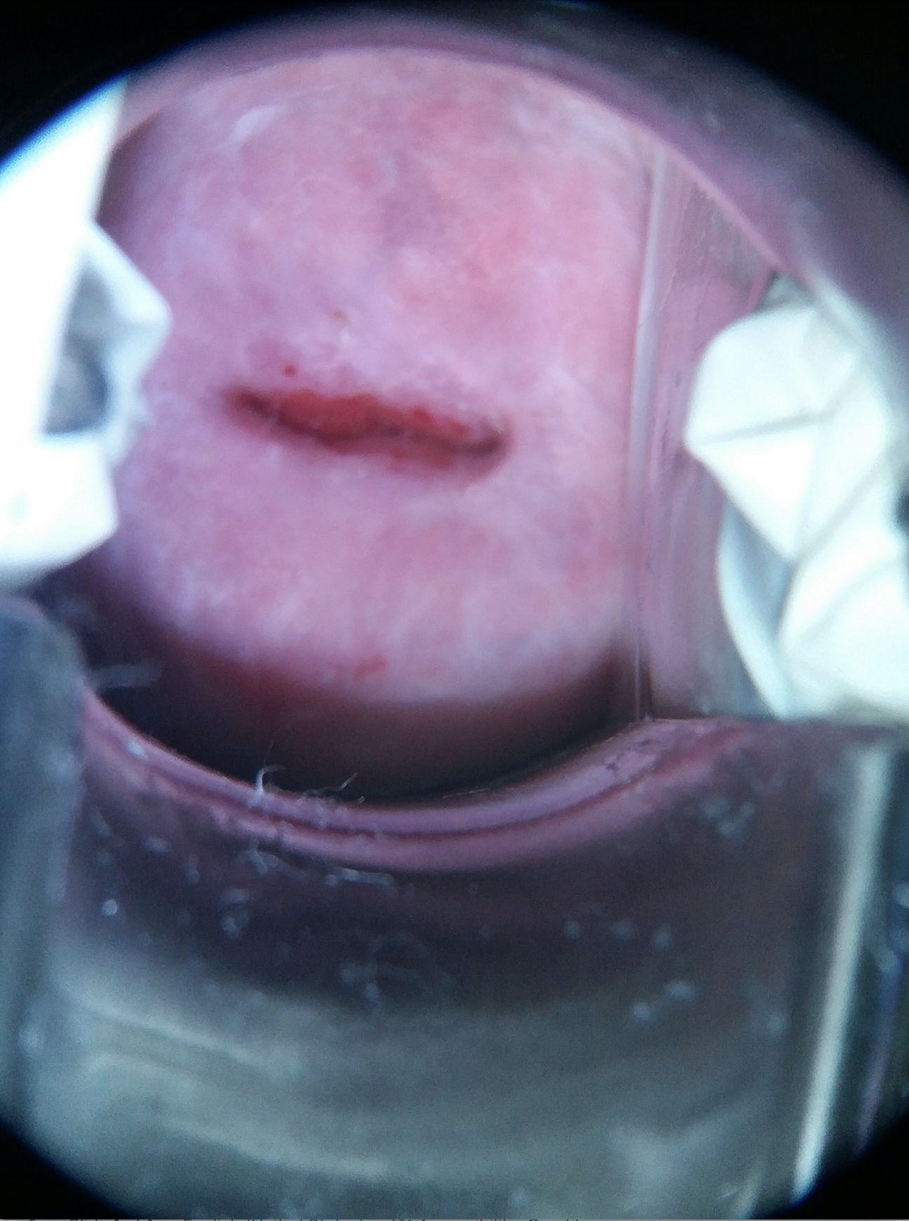
1
2
3
Transformer Block 1
...
Transformer Block 1
Transformer Block 1
Transformer Block 1
4
5
Linear Projection of Flattened Patches
Class Prediction: Type 1, Type 2, Type 3
MLP Head
6
7
8
9

