Slide 1
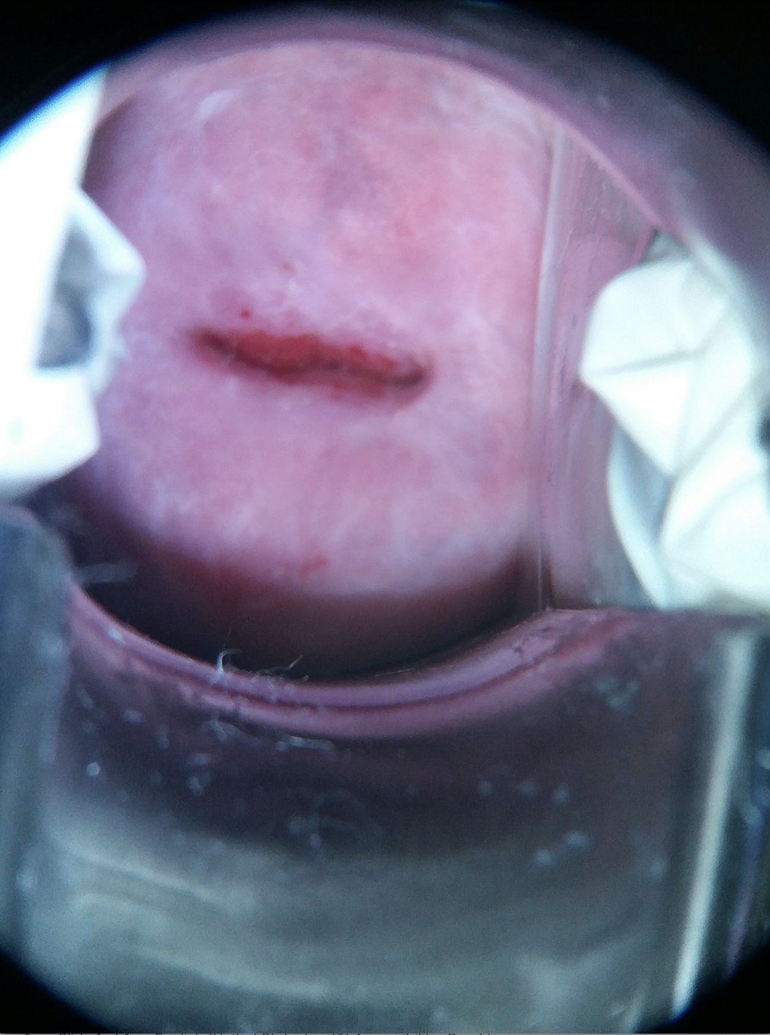






LoRA-ViT architecture
1
2
Transformer Encoder Block 1
...
Transformer Encoder Block 1
Transformer Encoder Block 1
3
Transformer Encoder Block 1
4
5
Linear Projection of Flattened Patches
Class Prediction: Type 1, Type 2, Type 3
MLP Head
6
$$K$$
SoftMax
7
$$W_{Q/V}$$
$${(ℝ}^{d×d})$$
8
MatMul
LoRA-ViT Transformer Encoder Block
9
$$A$$
$${(ℝ}^{r×d})$$
$$B$$
($ℝ^{r×d}$)
$${x∈ℝ}^{1xd}$$
$${h∈ℝ}^{1xd}$$

