Slide 1
Bokeh Effect for Videos
- Rupesh 160050042
- Deep 160100024
- Vinod 160050016

Slide 2
The Process
1
2
3
4
Extracting the Frames
Foreground Extraction
Temporal Smoothing
Emulating Bokeh
Extracting individual frames from a video file
Automated calculation using Grab-cut Algorithm
Ensuring the foreground mask changes gradually with time
Simulating a Lens Blur

Slide 3
Foreground Extraction
For Foreground Extraction, frame-by-frame, Grab Cut algorithm of openCV python library is used.
Initially, we select everything but a bounding rectangle in the frame as background
This is the initial estimate given to the algorithm.
These input pixels are hard-classified as background and remaining pixels have to be classified.
The iterative algorithm proceeds to find an instantiation of the mask.
The algorithm’s goal is to find a min-cut in a graph.
The spatial distance and the intensity difference between 2 pixels are taken as the cost of the edge between them

Slide 4
Temporal Smoothing
Initial mask detection by Grab-cut Algorithm is done separately for each frame. So, the following step is performed to ensure temporal consistency in the mask.
For a 30fps video, we represent the mask as a 3d (num_frame * 640 * 480) binary matrix
To ensure temporal as well as spatial smoothness in the mask:
Convolve the mask matrix with a 3d (10*3*3) all ones filter
This will count for every pixel, the number of neighbours detected as foreground.
For every pixel, if the output is >=60, the pixel is ‘1’ else ‘0’
Thus, out of 90 possible pixels in volume, only if >= 60 neighbours are in the mask originally, then the pixel is considered to be in the foreground of the video.
The mask thus obtained, is much more stable across time, compared to the older mask

Slide 5
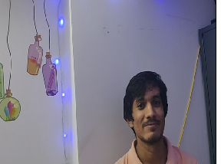
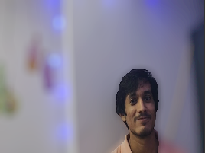
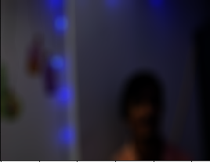
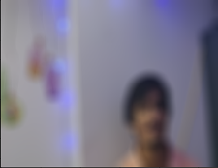
Emulating the Bokeh Effect
Image 1
Perform Gamma-correction (image^3)
Disc-Blur the resultant image
Inverse the Gamma correction (image^(⅓))
Image 2
Directly disc blur the Image
Bokeh Image = Pixel-wise max of (Image 1, Image 2)
Final Image = Foreground + (Bokeh Image * Background Mask)
Original Image
Final Image
Gamma Correction + Disc Blur
Disc Blur

Slide 6
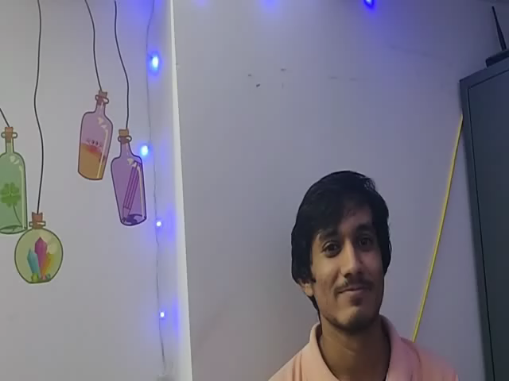

Results (Best)

Slide 7


Some hindrances due to background

Slide 8
Parameters
Rectangle input [GrabCut] | (320,180,200,300)
Iteration Count [GrabCut] | 5
Temporal Smoothing Filter | numpy.ones([10,3,3])
Radius of blur kernel (K) | 32
Gamma (for gamma correction) | 3.0

Slide 9
Conclusion
Pros:
The algorithm for bokeh emulation is simple, fast and efficient
<1min for 5s video of 480p@30fps
High temporal smoothness is observed even though masks vary greatly across frames
Cons:
The algorithm relies greatly on the quality of the foreground mask
The mask is calculated separately for each frame

Slide 10
Thank You

