Slide 1
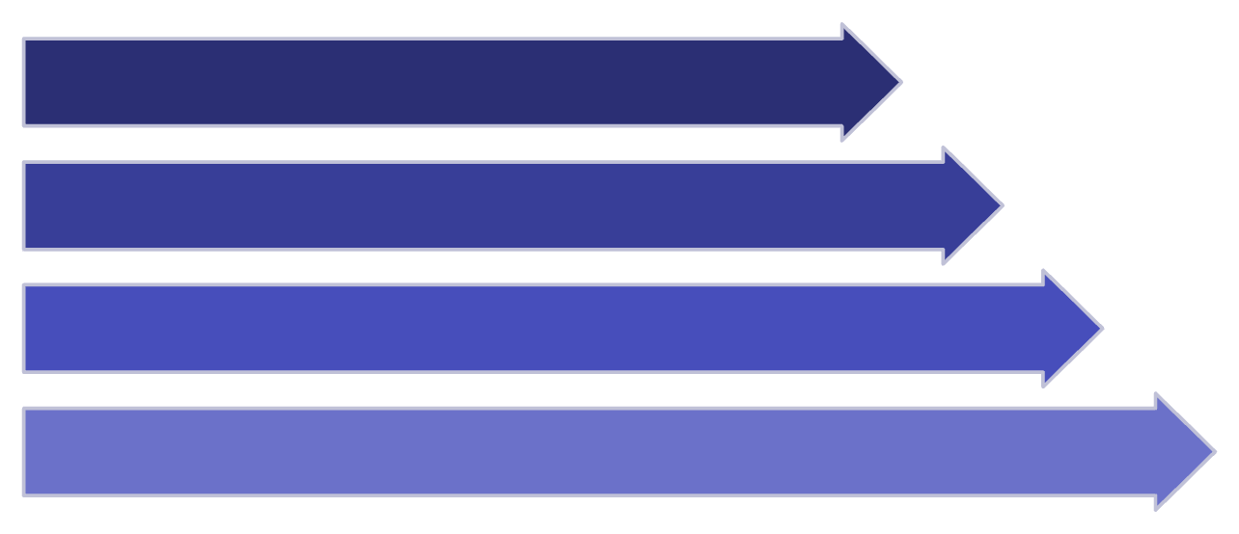
PROJECT REVIEW
VELLORE INSTITUTE OF TECHNOLOGY
Context Stream
Trust-Gated Fast-Weight Updates for TTT-E2E LLMs
Trust Gate
Fast-Weight Update
Serve Output
A Runtime Defense for Language Models That Learn While They Serve
context stream → LLM → fast weights updating
Authors
Manas Maahir R. – 23BAI0051
Jay Krishna Kamlekar – 23BAI0053
Kartheek Yadav – 23BAI0056
PUBLIC RESEARCH REPOSITORY SINCE 2026-08-01 · US FILING DEADLINE ~2027-08-01 · SEE DISCLOSURE.md
Notes:
Good morning. This project is called TrustGate. The one-line version is that a new class of language model has started updating its own weights while it is serving requests, and we think that turns the serving path into a write path into model state. Our work is the defense for that, and just as importantly, the experiment that tests whether the threat is real before we build the defense. I want to flag one thing up front: this repository has been public since the first of August. That was a deliberate decision, and it means the US filing window is now a deadline rather than a safety net.

Slide 2
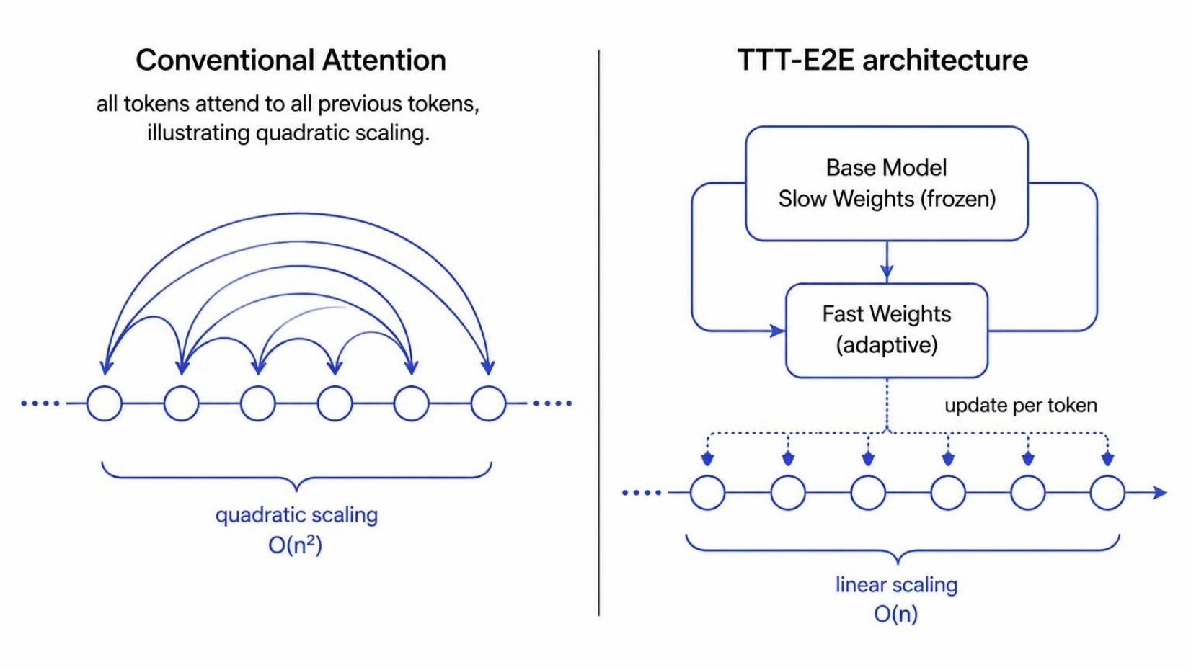
The Challenge: Quadratic Attention Scaling
Full attention complexity: O(n²) for sequence length n
Becomes prohibitively expensive for very long contexts
Need for efficient long-context modeling
TTT-E2E Solution: Test-Time Training
Treats long-context modeling as continual learning during inference
Model updates fast weights using next-token prediction while reading context
Slow/base weights remain fixed and frozen
Fast weights adapt dynamically to current context
Provides near-recurrent computational behavior
Retains long-context modeling capability
PUBLIC RESEARCH REPOSITORY SINCE 2026-08-01 · US FILING DEADLINE ~2027-08-01 · SEE DISCLOSURE.md
Notes:
Some background on what we are defending. Standard attention costs grow with the square of the sequence length, which makes very long contexts expensive. TTT-E2E takes a different route: it treats long context as continual learning. While the model reads your context, it runs an inner training loop and updates a small set of what the authors call fast weights. The base weights stay frozen. The fast weights absorb the context. That is genuinely clever, and it is why the architecture is interesting. It is also the entire reason we are standing here.

Slide 3

The Security Risk: Write Path During Serving
Key Problem
Benign Context Stream
The serving path becomes a write path into model state
A slow, benign-looking input stream can steer successive fast-weight updates
Danger emerges cumulatively, not from one obviously abnormal update
Fast-Weight Updates
Cumulative State Corruption
Degraded or Exploited Behavior
Possible Harms
DEGRADE: later benign inputs receive worse predictions
TRIGGER: a latent association causes attacker-chosen behavior after a trigger
Threat Model Assumptions
Attacker does NOT modify training data
Attacker does NOT modify base weights
Attacker does NOT modify trust-gate code
Attack operates ONLY through the context stream
PUBLIC RESEARCH REPOSITORY SINCE 2026-08-01 · US FILING DEADLINE ~2027-08-01 · SEE DISCLOSURE.md
Notes:
Here is the risk. Because the model learns from the context, the serving path is now a write path into model state. An attacker does not need to touch your training data, your base weights, or our defense code. They only need to supply context, which is the one thing the system is built to accept. And the danger is cumulative. No single update looks abnormal. The harm arrives as a slow drift across many ordinary-looking updates, and it shows up later, on unrelated benign inputs, or as a latent trigger that fires on a phrase the attacker chose.

Slide 4

Closing the Gap: Why Existing Defenses Fall Short
Research Gap
Existing test-time poisoning work targets vision adaptation or input/context channels.
Federated-learning defenses operate on client updates and round-based aggregation
MedBN robustifies batch-normalization statistics (not applicable to TTT-E2E)
No existing approach jointly provides: per-update validation + cumulative drift control + rollback for fast-weight LLM serving
Objectives
Demonstrate whether benign-looking streams can corrupt TTT-E2E fast weights
Intercept every proposed fast-weight update before commitment
Validate updates using a frozen anchor and uncertainty signals
Enforce a bounded cumulative-drift budget
Recover using versioned checkpoints and rollback
Measure attack suppression, clean utility, overhead, and auditability
Key Contributions
Fast-weight-specific runtime threat model
Commit-point update interceptor
Frozen-anchor behavioral consistency gate
Latching cumulative-drift guarantee
O(1) rollback using a versioned ring buffer
JAX/Equinox-compatible, trace-safe implementation
PUBLIC RESEARCH REPOSITORY SINCE 2026-08-01 · US FILING DEADLINE ~2027-08-01 · SEE DISCLOSURE.md
Notes:
We checked whether anyone had already solved this. They have not. Federated learning has excellent defenses, but they assume you are aggregating updates from many clients, and here there is a single stream with nothing to aggregate. Robust test-time adaptation methods like MedBN defend batch-normalization statistics in vision models, which is not what a fast-weight LLM update is. Nothing in the literature does all three of the things we need together: check every update before it commits, bound how far the weights can drift in total, and roll back when that bound is breached.

Slide 5
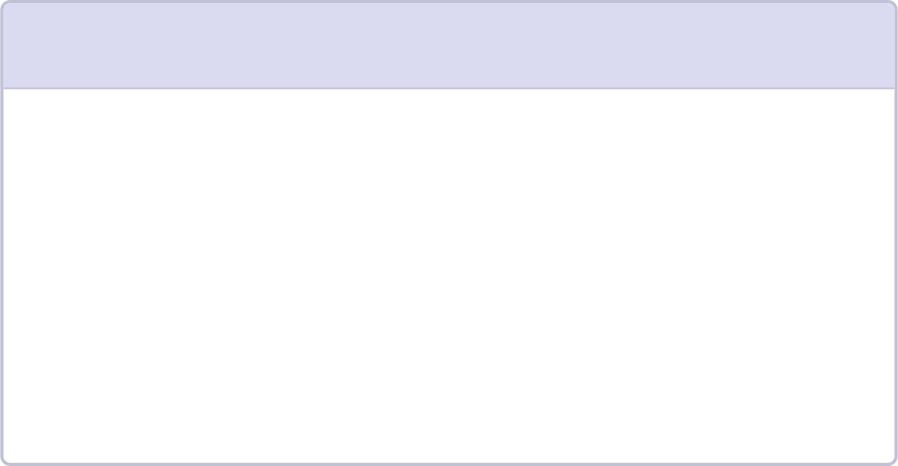
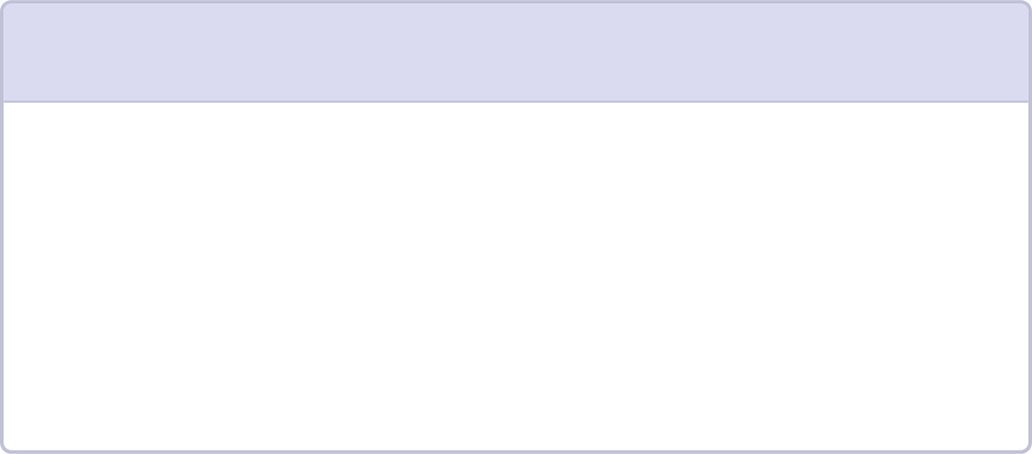
Surveyed 15 Recent Research Articles Across Five Families
1
2
3
Inference-Time Poisoning & Contextual Backdoors
Test-Time Adaptation Attacks & Defenses
Federated-Learning Update Validation & Robust Aggregation
Unit: context/prompt injection
Assumption: attacker controls input stream
Strength: demonstrates real-world attack surface
Limitation: focuses on prompt-level, not weight-level corruption
Unit: test-time update
Assumption: model adapts to distribution shift
Strength: directly relevant to continual learning
Limitation: primarily vision-focused; batch-norm assumptions don't apply to LLMs
Unit: client gradient/update
Assumption: round-based aggregation with multiple clients
Strength: mature defense mechanisms (median, trimmed mean)
Limitation: assumes aggregation; single-stream fast-weight updates have no aggregation
4
5
Offline Model Hardening, Distillation & Adversarial Training
Structural & Feature Poisoning in Graph & Hypergraph Models
Unit: model weights (pre-deployment)
Assumption: defense applied before serving
Strength: no runtime overhead
Limitation: cannot address online fast-weight corruption
Unit: graph edges, node features
Assumption: discrete structural modifications
Limitation: continuous weight updates in LLMs follow different dynamics
Representative Studies:
Contextual backdoors in LLM-driven embodied agents
Test-time poisoning attacks against TTA
Realistic and black-box continual TTA attacks
MedBN, MSGuard, multi-strategy federated defenses
DPAD, AntidoteFL, LDPGuard, FedDRLPD
MIMIC and adversarial self-training
H3NI, momentum-gradient poisoning, graph defenses
PUBLIC RESEARCH REPOSITORY SINCE 2026-08-01 · US FILING DEADLINE ~2027-08-01 · SEE DISCLOSURE.md
Notes:
This is the survey behind that claim: fifteen recent papers across five families. I will not read them all. The pattern worth noticing is the Unit row. Every one of these defends a different unit than we need to. Prompt injection work defends the prompt. Federated work defends a client gradient. Offline hardening defends the weights before deployment. Graph poisoning defends discrete edges. Not one of them defends a continuous fast-weight delta at the moment it commits, on a single stream, during inference.

Slide 6

Comparative Analysis: Where TrustGate Fits
Domain | Unit Defended | Signal | Guarantee | Recovery
Vision TTA | Batch-normalization statistics | Robust median statistic | None (per-update) | None
Federated learning | Client gradients | Robust aggregation (median, trimmed mean) | Byzantine-resilient consensus | None (aggregation-based)
Pre-deployment hardening | Base model weights | Adversarial training, distillation | Improved robustness (empirical) | None (offline)
Long-context LLM continual inference | Fast-weight deltas | Behavioral anchor divergence + uncertainty | Bounded cumulative drift per window | Ring-buffer rollback (O(1))
The missing capability is a state-integrity controller placed at the fast-weight commit point.
This table shows TrustGate uniquely addresses the online, single-stream, continuous-weight-update scenario.
PUBLIC RESEARCH REPOSITORY SINCE 2026-08-01 · US FILING DEADLINE ~2027-08-01 · SEE DISCLOSURE.md
Notes:
This table is the same argument in one view. Read the last row against the others. What is missing across the whole field is a state-integrity controller sitting at the fast-weight commit point, with a stated guarantee and a recovery path. That gap is the contribution we are claiming, and it is a systems claim rather than a detector claim. We are not asserting we can spot poison better than anyone else. We are asserting that the update can be bounded and undone.

Slide 7
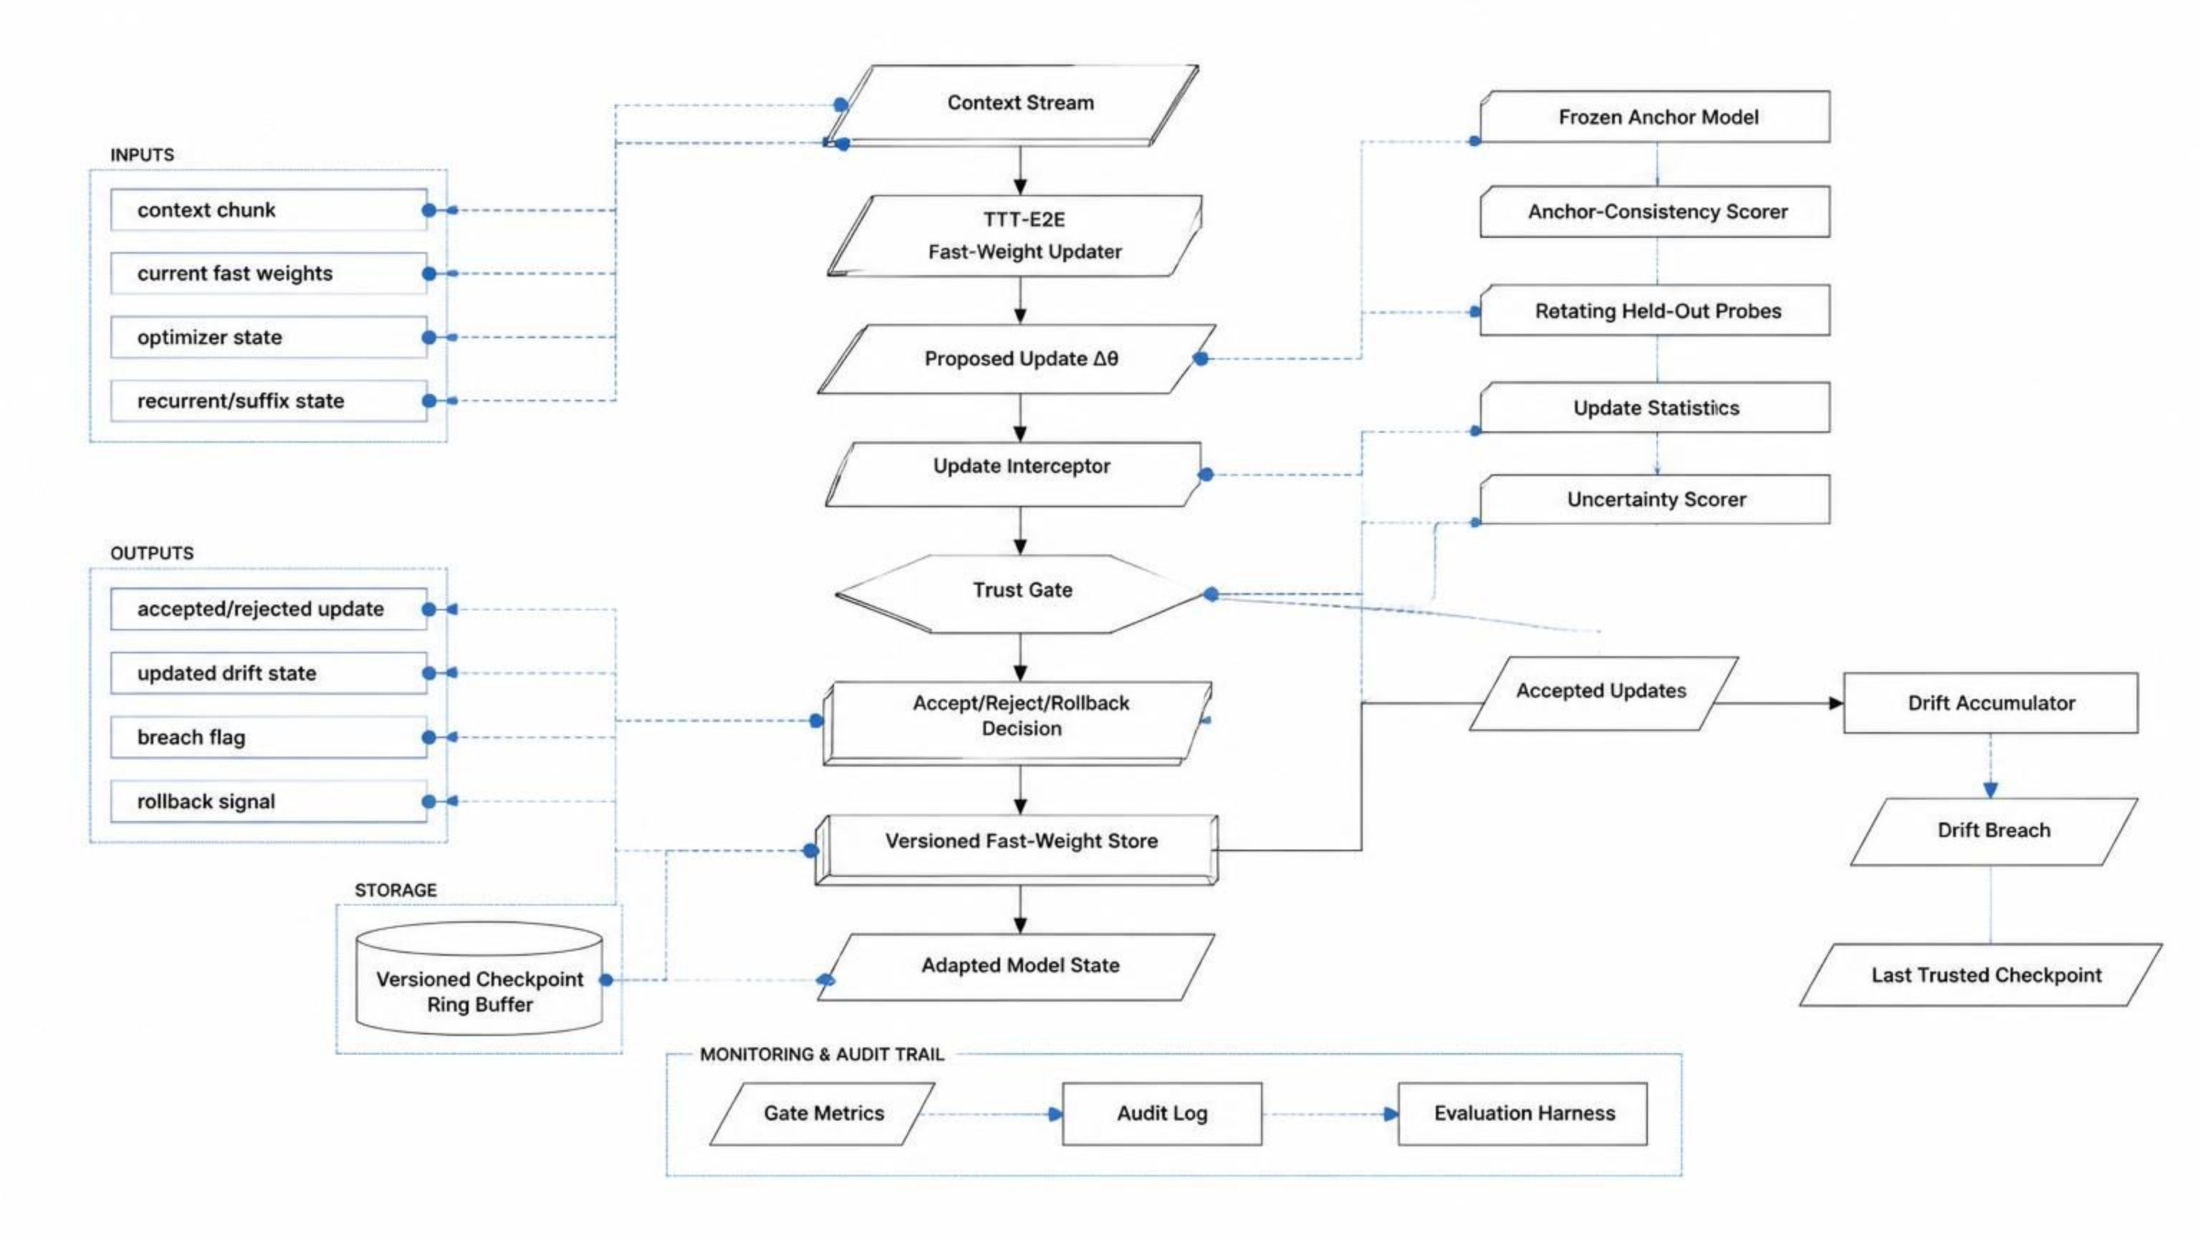
Complete TrustGate Architecture Pipeline
PUBLIC RESEARCH REPOSITORY SINCE 2026-08-01 · US FILING DEADLINE ~2027-08-01 · SEE DISCLOSURE.md
Notes:
This is the full architecture in one picture. Five stages: intercept the proposed update, score it, decide whether to accept it and charge it against a drift budget, keep versioned checkpoints so you can roll back, and log everything for audit. I will walk through each stage, and I will be explicit each time about which parts are built and tested and which parts are still design.

Slide 8
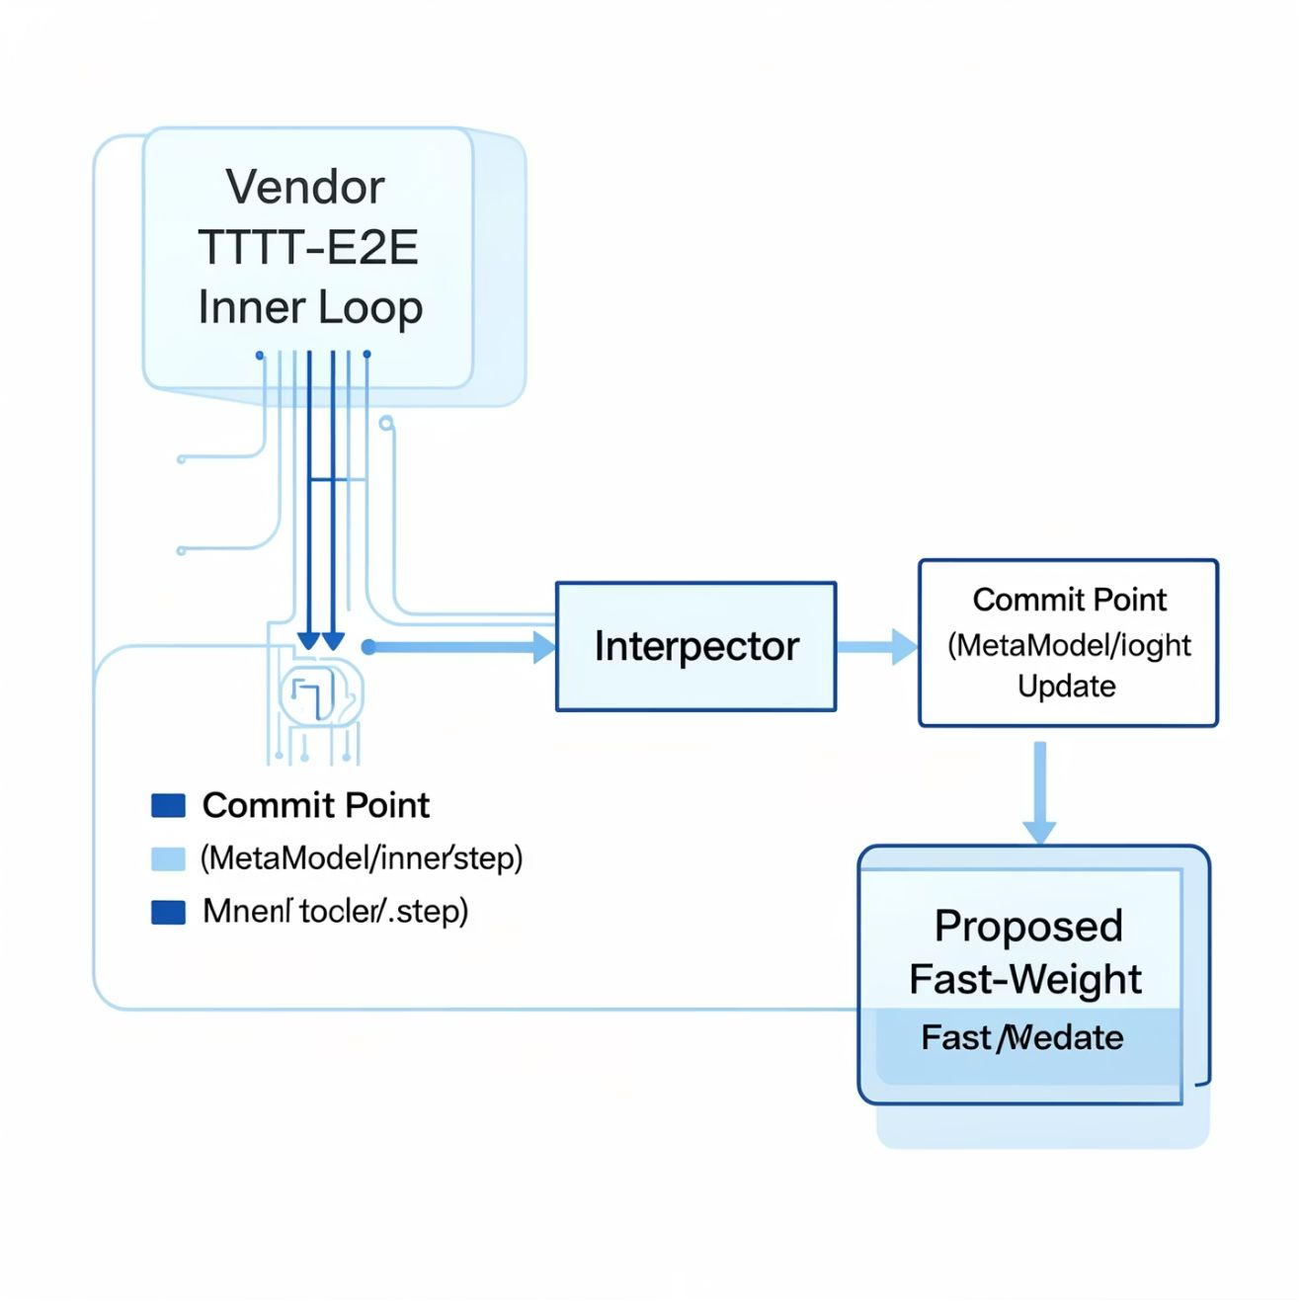
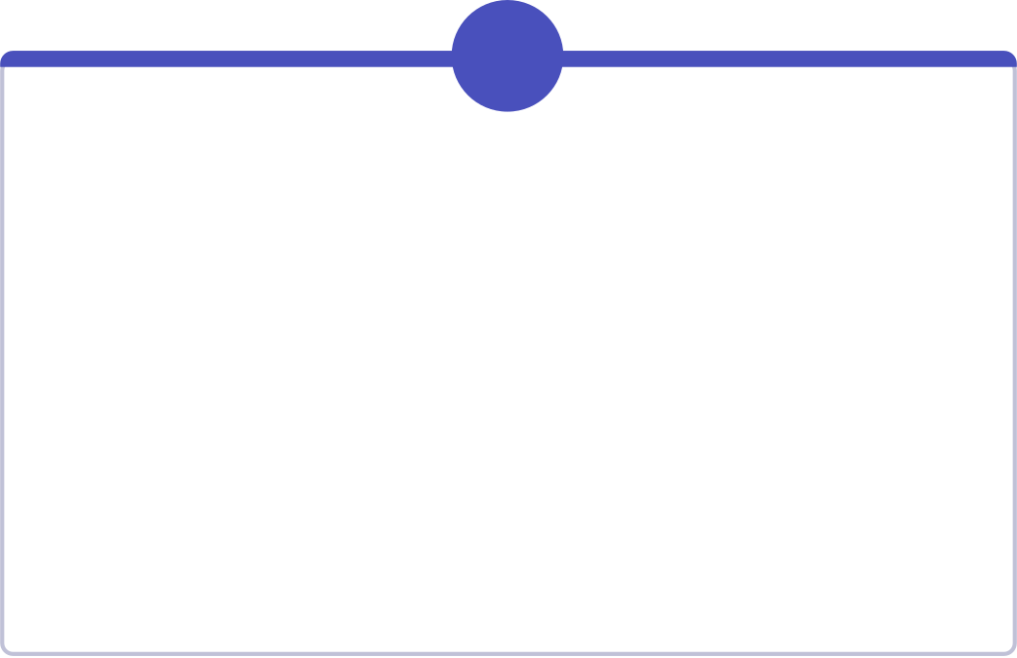
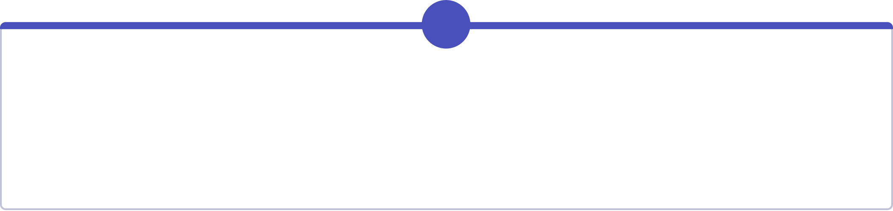

Stage 1: Capturing the Fast-Weight Update
The initial stage of TrustGate focuses on precisely intercepting the proposed fast-weight updates from the vendor's TTT-E2E model before they are committed.
1
2
Inputs
Process
Context chunk x_t
Current fast weights \theta_t
Optimizer state
Recurrent/suffix state
Vendor TTT-E2E inner loop proposes new state
Update delta: \Delta\theta_t = \theta_{(t+1)}^{prop} - \theta_t
Interceptor placed at MetaModel.inner_loop_step
Vendor code is read-only, pinned submodule
Overlay plus a confined, reversible monkeypatch
Vendor discards its scan carry — our overlay threads the fast weights (ADR-006)
3
Outputs
Proposed update \Delta\theta_t
Candidate model state
New suffix/recurrent state
Update metrics
Implementation Files:
src/trustgate/interceptor.py
src/trustgate/vendor_patch.py
src/trustgate/tree_ops.py
Key Design Principle:
The interceptor is non-invasive: vendor code is pinned and read-only. The vendor also discards its adapted state, so the overlay must carry it forward.
PUBLIC RESEARCH REPOSITORY SINCE 2026-08-01 · US FILING DEADLINE ~2027-08-01 · SEE DISCLOSURE.md
Notes:
Stage one, interception. We wrap the exact function where the vendor commits a fast-weight update, compute the delta, and hand it to the gate. The vendor tree is a pinned, read-only submodule; everything we do is an overlay plus a confined, reversible monkeypatch, because that tree ships with no license and we must not edit it. One finding from this stage is worth your attention. The vendor throws the adapted weights away. It computes them inside a scan and never reads the result out. We found that at the desk, before spending anything on hardware, and it changed the design: we now thread that state ourselves.

Slide 9
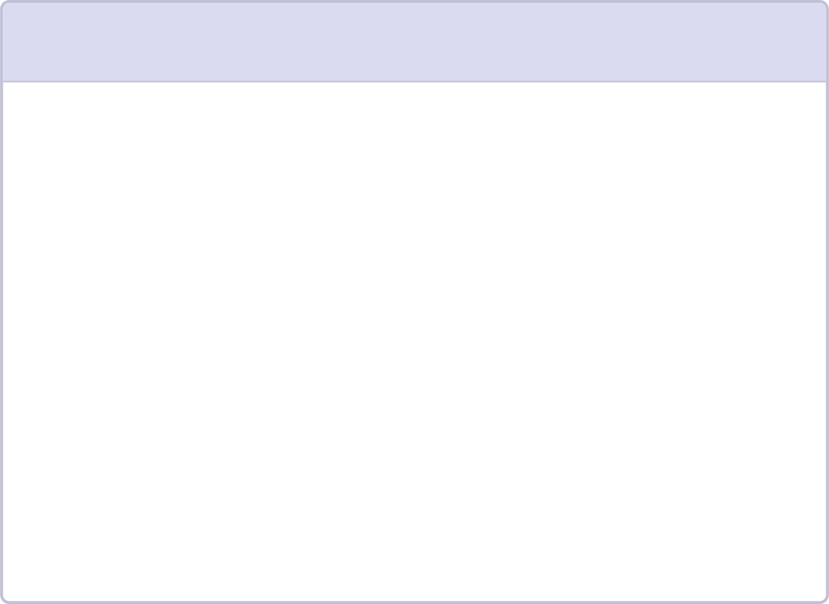


Stage 2: Multi-Signal Validation of Fast-Weight Updates
Three Planned Scoring Signals:
1
2
3
PRIMARY SIGNAL – Option A: Frozen Anchor Behavioral Consistency
SECONDARY SIGNAL – Option B: Gradient-Based Backstop
OFFLINE SIGNAL – Option C: Influence/Gradient Estimation
Frozen anchor model \theta_0 (initialized at deployment)
Small held-out probe set P_t (rotating)
Compare candidate behavior with anchor behavior
Gradient-norm z-score
Loss spike detection
Mini-batch disagreement
Low-cost backstop, but weak against slow low-variance poisoning
Status: Proposed/Phase 2 component
Stronger but too expensive for the online path
Used as a future offline auditor
Status: Proposed/Phase 2 component
Candidate symmetric KL divergence:
A_t = (1 / 2m) \Sigma [KL(p_{candidate} || p_{anchor}) + KL(p_{anchor} || p_{candidate})]
Low divergence suggests consistency; high divergence indicates behavioral displacement
Status: Proposed/Phase 2 component
Inputs to Trust Gate:
\Delta\theta_t (proposed update)
Current fast weights
Anchor parameters \theta_0
Rotating probes P_t
Update statistics
Output:
GateDecision = (verdict, drift_delta, confidence)
Options A, B, and C are proposed/Phase 2 components, not completed implementations.
PUBLIC RESEARCH REPOSITORY SINCE 2026-08-01 · US FILING DEADLINE ~2027-08-01 · SEE DISCLOSURE.md
Notes:
Stage two, scoring. The primary signal compares the candidate model against a frozen anchor taken at deployment, on a small rotating probe set, using a symmetric KL divergence. A cheap gradient-based check acts as a backstop, and a more expensive influence estimate is reserved for offline auditing. I want to be direct about status: all three of these are design, not implementation. They are deliberately not built yet, because if the attack does not work there is no defense worth building, and we would rather not spend the effort first.

Slide 10
Stage 3: Acceptance Policy and Cumulative Drift Control
Decision Policy:
Three Possible Actions:
ACCEPT: commit update and add its drift contribution to the accumulator
REJECT: discard learned weight delta, preserve pre-update weights, continue reading context
ROLLBACK: restore the most recent trusted checkpoint after a breach
Acceptance Condition:
a_t = 1\{A_t \le \tau_A \text{ AND } B_t \le \tau_B \text{ AND } \text{confidence}_t \ge c_{min} \text{ AND } C_t + d_t \le \epsilon\}
Where:
A_t = anchor divergence score
B_t = gradient-based backstop score
confidence_t = confidence in the decision
C_t = current cumulative drift
d_t = drift contribution of this update
\tau_A, \tau_B = thresholds
c_{min} = minimum confidence threshold
\epsilon = cumulative drift budget
Drift Accumulation:
C_{t+1} = C_t + d_t \text{ (if accepted)}
\text{breach}_{t+1} = \text{breach}_t \text{ OR } (C_{t+1} > \epsilon)
Key Properties:
The breach flag latches; the budget resets only at a window boundary or after rollback
The guarantee bounds cumulative accepted drift, not merely the norm of one update
STATUS: accumulator and store are built and unit-tested but NOT yet called by the interceptor — the bound is designed, not enforced (ADR-003)
Inputs:
Outputs:
GateDecision (verdict, drift_delta, confidence)
Drift state (C_t, \text{breach}_t)
Budget \epsilon
Accepted/rejected update flag
Updated drift state (C_{t+1}, \text{breach}_{t+1})
Breach flag
Rollback signal
Implementation:
src/trustgate/drift/accumulator.py
src/trustgate/types.py
PUBLIC RESEARCH REPOSITORY SINCE 2026-08-01 · US FILING DEADLINE ~2027-08-01 · SEE DISCLOSURE.md
Notes:
Stage three is where the actual guarantee lives. An update is accepted only if every condition holds at once, including that the accumulated drift plus this update stays under the budget. Accepted drift adds up, and the breach flag latches, so once it trips it stays tripped until a window boundary or a rollback. That latching is the point. The guarantee is about cumulative drift across a window, not the size of any one update, because the threat is a slow one. Honest status: the accumulator and the store are built and unit-tested, but the interceptor does not call them yet. So the bound is designed, not enforced, and it is blocked by the vendor's fixed scan structure.

Slide 11
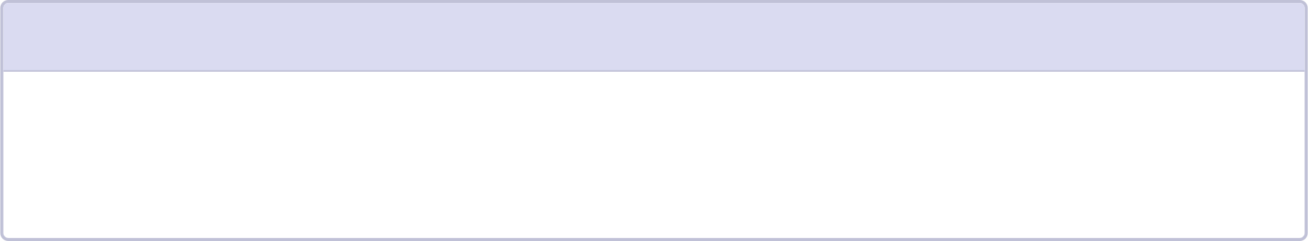
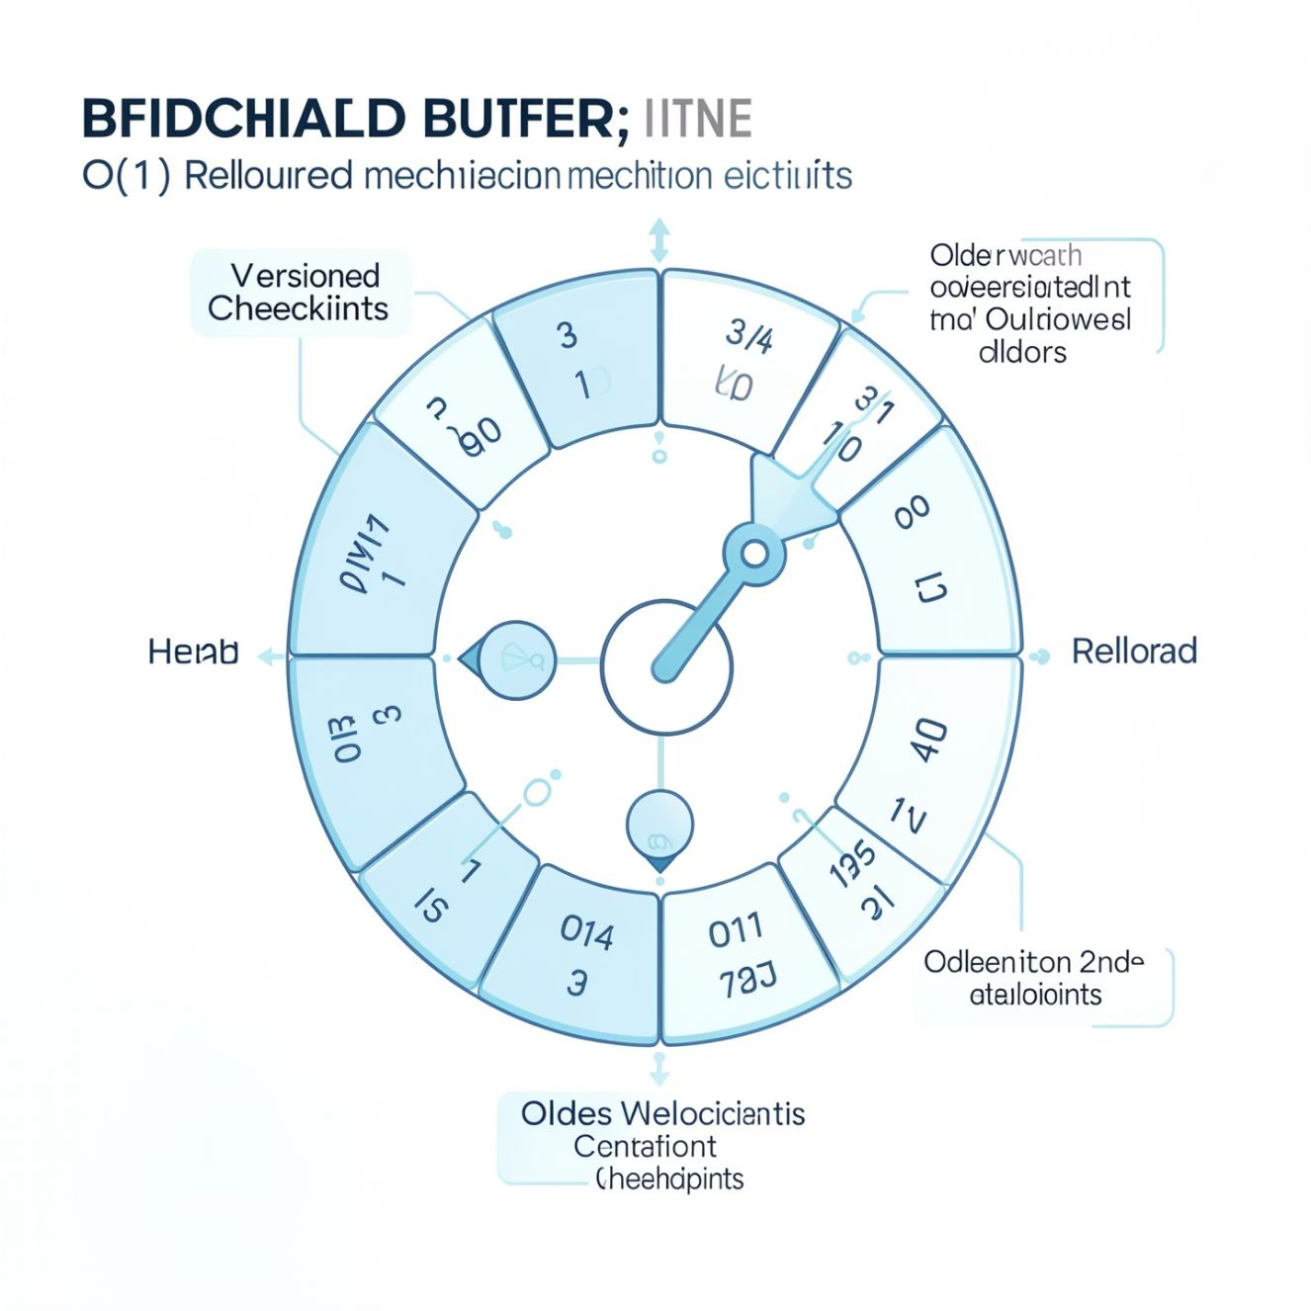
Stage 4: O(1) Rollback via Ring Buffer
Versioned checkpointing ensures that trusted fast-weight states are retained, enabling a computationally constant-time rollback mechanism in case of a breach.
How Versioned Checkpointing Works:
Storage Structure:
Rollback Mechanism:
Trusted fast-weight states are stored in a fixed-depth ring buffer
Each checkpoint has a version/index
The head advances modulo the buffer depth
Rollback reads a checkpoint using traced index arithmetic: index = (head - 1 - steps_back) \pmod k
Rollback is O(1) with respect to the number of preceding updates
JAX pure-function semantics avoid undoing mutations
No explicit state reversal; instead, read the desired checkpoint from the ring
1
2
Inputs:
Outputs:
Trusted fast weights (after acceptance)
Checkpoint depth k
Rollback request (steps_back)
Versioned store (updated ring buffer)
Last trusted fast-weight state
Rollback state after breach
Important Trade-Off:
Rollback is computationally constant time but not free in memory.
Checkpoint memory:
A deeper buffer consumes more HBM and must cover detection latency
Must balance between rollback capability and memory constraints
Design Considerations:
Ring buffer depth k must be chosen to cover the expected detection latency
Deeper buffers provide more rollback history but consume more GPU memory
For billion-parameter models, checkpoint memory can compete with activation memory
Implementation:
src/trustgate/store/versioned.py
PUBLIC RESEARCH REPOSITORY SINCE 2026-08-01 · US FILING DEADLINE ~2027-08-01 · SEE DISCLOSURE.md
Notes:
Stage four, recovery. Trusted states go into a fixed-depth ring buffer, and rollback is index arithmetic, so it costs the same regardless of how many updates have happened since. It is constant time, but it is not free: the buffer sits in GPU memory, and its depth has to cover however long detection takes. For a billion-parameter model that memory competes directly with activations. That trade-off is a real design constraint, not a footnote.

Slide 12
Stage 5: Auditability and Evaluation Framework
Audit Path
Evaluation Path
Metric Collection:
Baseline Reproduction:
JAX scan emits stacked metrics outside the traced path
Python logging is not performed inside the JIT-compiled scan
Metrics include:
  Accepted flag (per update)
  Drift delta (d_t)
  Confidence score
  Update norm (||\Delta\theta_t||)
  Anchor divergence (A_t)
  Gradient-based score (B_t)
Unmodified TTT-E2E model (no TrustGate)
Same seed, token count, chunking, dtype, checkpoint, and evaluation split
Five independent seeds for statistical significance
Attack Evaluation:
Poison versus length-matched benign control
SELECT is the headline; PARAPHRASE and SOFT reported separately
Fluency scored by GPT-2 small — validated by logit equivalence
Difficulty-matched and contiguous arms reported, non-gating
Audit Log:
Pre-Registered Attack Criteria:
AuditLog writes append-only JSON Lines records
Records support reproducibility, incident investigation, and operating-point analysis
Each record contains timestamp, update index, decision, metrics, and state
Cohen's d \ge 0.8; relative benign degradation \ge 10%
Fluency ratio \le 1.5, gated on the MAX across the five seeds
Thresholds CI-pinned to the frozen document — a bar cannot move silently
If any criterion fails: STOP or document a justified revision
Evaluation Metrics:
Corruption metric (attack success)
Trigger attack success rate
Clean regression (benign performance)
Acceptance/rejection rate
Rollback frequency
Gate overhead (latency, memory)
Checkpoint memory consumption
Audit completeness and reproducibility
PUBLIC RESEARCH REPOSITORY SINCE 2026-08-01 · US FILING DEADLINE ~2027-08-01 · SEE DISCLOSURE.md
Notes:
Stage five, evidence. Every decision is logged as append-only JSON lines so a run can be reconstructed afterwards. On the evaluation side, the thing I most want to convey is that we fixed the pass mark before we could see any results. Effect size at least 0.8, benign degradation at least ten percent, and the poison stream's perplexity no more than 1.5 times the control's. All three are required. Those numbers now live in code with a test that reads the frozen document and fails the build if they ever disagree, so the bar cannot move quietly.

Slide 13
Current Implementation Status: Phase 1 CPU Implementation Complete
Implemented and CPU-Tested (197 tests passing) | Pending: model-gated or deliberately deferred
Pytree subtraction, addition, selection, global norm Update interceptor; pass-through and norm-threshold gates Latching drift accumulator; fixed-depth versioned store Fast-weight carry across chunks and sequences (ADR-006) Attack objectives: DEGRADE and TRIGGER, on the victim's own loss Token corpus and crafted-stream builders (ADR-007) Poison/control matching discipline — 13 asserted fields Spike orchestration, verdict report, harness CLI Independent fluency reference model and scorer Corruption metrics, clean regression, audit logging Continuous integration over the CPU suite | Frozen-anchor consistency gate (Phase 2, by design) Rotating probe generation (Phase 2, by design) Uncertainty gate and decision policy (Phase 2, by design) Offline influence auditor (Phase 2, by design) MedBN-analogue robust aggregation baseline Binding the carry overlay to the real vendor model Adversarial stream search (craft_stream) TTT-E2E baseline reproduction — needs GPU and checkpoint Five-seed attack spike and the PROCEED/STOP verdict Wiring the drift accumulator into the interceptor
Project Timeline:
Phase 0.4: desk preparation complete — eval command, pre-registered bar, cost model
Phase 1 (CPU): complete — attack machinery, harness and instrument built and tested
Phase 1 (GPU): blocked on a W&B key and checkpoint · Phase 2: only if the spike says PROCEED
Critical Disclaimer:
No completed model-backed attack or defense result is claimed in the current artifact.
Runnable end to end on CPU and validated. Before any number: a W&B key (the vendor authenticates before eval runs), then checkpoint access. Spend $0 of $325.
PUBLIC RESEARCH REPOSITORY SINCE 2026-08-01 · US FILING DEADLINE ~2027-08-01 · SEE DISCLOSURE.md
Notes:
Where we actually are. The scaffold has grown into a complete CPU implementation: 197 tests, the attack objectives, the stream builders, the matching discipline, the harness, the report, and continuous integration. What is still missing is everything that needs the model itself, plus the Phase 2 gate signals we are deliberately not writing yet. I want to be very clear about the claim: we have produced no measurement. No GPU has been provisioned, no checkpoint fetched, and the spend so far is zero against a written cap of three hundred and twenty-five dollars.

Slide 14
Limitations, Future Directions, and Final Remarks
Limitations:
Technical Constraints:
Core gate signals and model-backed experiments are not yet implemented
Checkpoint and GPU access are required for end-to-end validation
The vendor integration is coupled to a pinned commit and monkeypatch call-site shape
Anchor probe size, rotation schedule, and divergence measure remain open design choices
Extra anchor passes may challenge the approximately 10% overhead target
Checkpoint memory can compete with activation memory for billion-parameter models
Behavioral and Threat Model Limitations:
A behavioral gate can produce false rejects or accepts; the uncertainty signal may miss slow, low-variance poisoning
The threat model assumes the fast-weight update path is exposed to an untrusted stream
The MedBN prior-art comparison still requires a formal line-level review
Perplexity rewards repetition (1.90 vs 19.98 for fluent prose), so the fluency bar cannot catch a repetitive stream — span reuse is reported separately
Repository public by decision (2026-08-01); absolute-novelty jurisdictions forfeit, US filing deadline ~2027-08-01
Future Scope:
Immediate Next Steps:
Procure a Weights & Biases entity, project and API key — the one hard blocker, and a purchase rather than a task
Bind the carry overlay to the real vendor model and implement benign evaluation
Reproduce the 1B DCLM+Books @8K TTT-E2E baseline against the pre-registered bracket
Run the pre-registered five-seed SELECT attack spike and record the PROCEED/STOP verdict
Implement anchor consistency, rotating probes, uncertainty scoring and policy combination — only if the verdict is PROCEED
Wire the drift accumulator and versioned store into the interceptor
Build and tune the MedBN-analogue robust-gradient baseline
Measure ROC/operating points, clean utility, overhead, memory and rollback
Test adaptive attackers, longer streams, and 3B or larger models
Formalize the bounded-drift proof; complete the prior-art and legal review
Final Conclusion:
"TTT-E2E improves long-context modeling by allowing models to learn while serving. The same write path creates a security risk. TrustGate addresses it by validating fast-weight commits, bounding cumulative drift, retaining trusted versions and enabling rollback. The experiment that decides whether the threat is real is now built and validated on CPU; the measurement itself is the next decisive step."
Technical Result Status:
"Phase 1 implementation complete and validated on CPU (197 tests). No model-backed attack or defense result is claimed; no measurement has been taken; spend to date $0 of a $325 cap."
PUBLIC RESEARCH REPOSITORY SINCE 2026-08-01 · US FILING DEADLINE ~2027-08-01 · SEE DISCLOSURE.md
Notes:
Limitations, and I would rather state them than be asked. The core gate signals are unbuilt. The bounded-drift guarantee is designed but not yet wired in. Our vendor integration is pinned to one commit and would break if that moved. And one of our own three pass criteria has a hole we measured: perplexity punishes scrambled text but rewards repetition, so a poison stream that reuses one passage repeatedly would slip past the fluency bar. We report span reuse separately because of that. The next step is not a research question, it is a purchase: a logging key that the vendor's code path requires before evaluation will run at all. Everything downstream of it is written and waiting.

