Slide 1
Reinforcement Learning-Enhanced Chatbot for Natural Language Processing
A Comparative Study of Supervised Learning, PPO, and DPO Approaches
Sanidhaya Sharma
Purdue University Fort Wayne

Slide 2
Project Motivation
Traditional QA models lack adaptability to user feedback Reinforcement Learning (RL) offers potential for dynamic improvement Goal: Develop a QA system that improves through interaction
Research Question: Can RL methods enhance QA model performance beyond supervised learning?

Slide 3
Project Evolution
Phase 1: Base transformer model with character-level tokenization on Shakespeare dataset
Phase 2: Enhanced tokenization (SentencePiece) and expanded literary corpus (6.34M characters)
Phase 3: Implemented RL techniques (PPO and DPO) for model optimization
Phase 4: Comprehensive benchmarking and comparative analysis

Slide 4
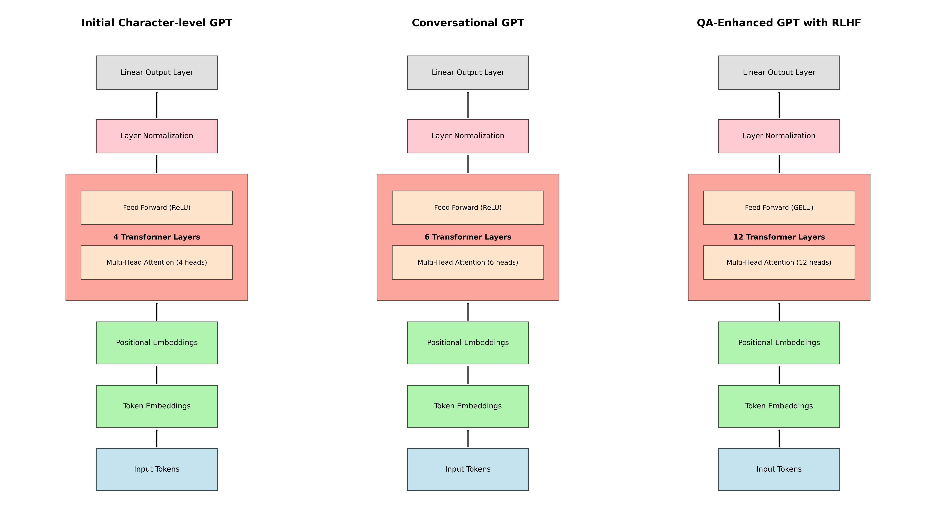

Slide 5
Model Architecture
Components
Specifications
Transformer-based architecture
SentencePiece tokenization
Special conversation tokens
Context window optimization
12 layers, 12 attention heads
512 embedding dimension
25,000 vocabulary size
Special tokens: <USER>, <ASSISTANT> Context window of 512 tokens

Slide 6
Dataset Evolution
Initial Dataset
"tiny_shakespeare" corpus
1.1M characters total
Limited vocabulary and context No structured QA format
Expanded Dataset
Multiple literary works: 6.34M characters
Text included: Pride and Prejudice, Dracula, Frankenstein, etc.
3,000 conversational QA pairs from SQuAD dataset
Structured with special tokens for better context

Slide 7
Reinforcement Learning Approaches
Supervised Learning
Proximal Policy Optimization
Direct Preference Optimization
Cross-entropy loss optimization
Baseline for comparison
Standard teacher- forcing approach
Optimizes policy using reward signals
Prevents large policy updates with clipping
Balances exploration and exploitation
Learns from pairwise preference data
Directly aligns with human preferences
No explicit reward function needed

Slide 8
PPO Implementation
Reference Model: Frozen copy of base model to prevent drift
Reward Model: Trained on human/synthetic feedback
Trajectory Collection: Generate responses and compute rewards
Policy Update: Optimize with clipped surrogate objective
KL Penalty: Maintain proximity to reference policy

Slide 9
DPO Implementation
Preference Data: Pairs of responses with preference labels No Explicit Reward Model: Learns directly from preferences Objective: Maximize likelihood of preferred responses Regularization: KL divergence from reference model Advantage: Simpler training pipeline than PPO

Slide 10
Benchmarking Methodology
Generation Speed
Response Quality
QA Accuracy
Tokens per second
Average generation time
Token count per response
BLEU scores ROUGE-L scores
Comparison to reference answers
Exact match on factual questions
Domain-specific assessment
Consistency evaluation

Slide 11
Sample Questions
Literary Analysis
"What are the main themes in Hamlet?" "Explain the character of Macbeth."
Factual Questions
"Who wrote Pride and Prejudice?"
"How many plays did Shakespeare write?"
General Knowledge
"What is Earth's highest mountain?"
"How long is the Great Wall of China?"
Character Questions
"Describe Elizabeth Bennet's personality."
"What motivates Count Dracula?"

Slide 12
Generation Speed Results
Model | Avg Time (s) | Tokens/sec | Avg Tokens
qa_base | 1.58 | 18.35 | 29.0
qa_ppo | 1.50 | 18.40 | 27.7
qa_dpo | 1.96 | 18.39 | 36.0
All models show similar generation speed (~18 tokens/sec) PPO slightly faster in average time
DPO generates more tokens per response on average

Slide 13
Response Quality Results
Model | Avg BLEU | Avg ROUGE-L
qa_base | 0.0068 | 0.0763
qa_ppo | 0.0059 | 0.0819
qa_dpo | 0.0051 | 0.0462
Low scores across all models indicate challenge in literary QA PPO shows slight improvement in ROUGE-L over baseline DPO underperforms in both metrics

Slide 14
QA Accuracy Results
Model | Accuracy | Correct | Total
qa_base | 20% | 1 | 5
qa_ppo | 20% | 1 | 5
qa_dpo | 20% | 1 | 5
All models achieved identical accuracy (20%)
Only correctly answered: "How long is the Great Wall of China?"
RL methods did not improve factual accuracy in this implementation

Slide 15
Example Outputs
Question: "What are the main themes in Hamlet?"
Base: "How do," said Pierre, Mr. Knightley, for a heightened complexion and has been a delightful evening,...
PPO: "No, don't," said Miss Stoner, and touched his hammer, with a man. Now, look at that strongly, even...
DPO: "But if we must comply with a moment's," said Pierre, blushing and breaking into the...

Slide 16
Challenges & Limitations
Reward Design: Difficulty in creating effective reward signals Data Limitations: Literary corpus may not be ideal for factual QA Model Size: Relatively small model (512 embedding dimension) Hallucination: Models often generate fictional or irrelevant content Computational Constraints: Limited training time and resources

Slide 17
Analysis & Discussion
RL methods did not significantly improve QA performance
Possible reasons:
Reward function design needs refinement
Literary training data vs. factual questions mismatch Model capacity limitations
Generation speed was consistent across all approaches
All models struggled with coherence and factuality

Slide 18
Lessons Learned
RL for NLP requires careful reward engineering
Domain alignment between training and evaluation is crucial Larger models may be needed for complex QA tasks
Tokenization improvements (SentencePiece) were beneficial Expanded dataset improved stylistic range but not factual accuracy

Slide 19
Future Work
Improved Reward Models: Better alignment with human preferences Hybrid Retrieval-Generation: Combine with factual knowledge retrieval Human Feedback Loop: Incorporate real user evaluations
Larger Model Architectures: Scale up for better performance
Domain-Specific Fine-tuning: Target specific QA domains

Slide 20
Conclusion
Successfully implemented and compared three QA approaches RL methods (PPO, DPO) show promise but require refinement
Tokenization and dataset improvements were more impactful than RL
Challenges in QA remain: coherence, factuality, and domain adaptation Future work will focus on better reward design and human feedback

Slide 21
Thank You & Questions
GitHub: github.com/Deep-Learning-CS/NLP_project
Contact: shars11@pfw.edu

