Slide 1
GPU Architecture, Learning to Simulate & Reinforcement Learning
Junyu Yin

Slide 2
GPU Background
Related Work
My Research: Learning to Simulate
RL for Arch Research
Contents

Slide 3
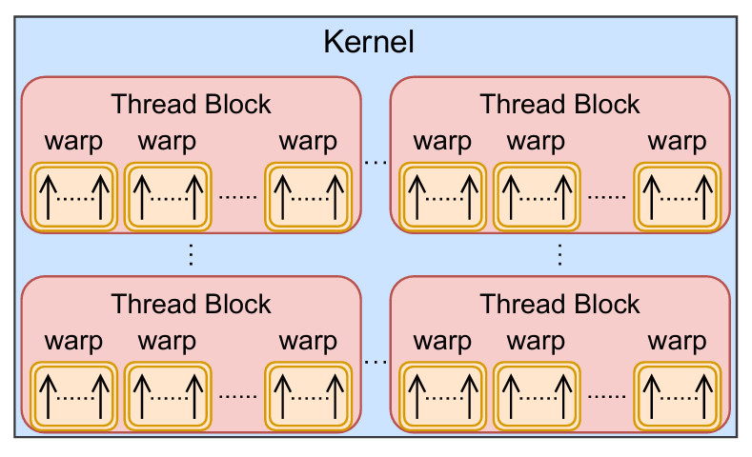
GPU Execution Model
A GPU program or a kernel
A task launched from the host (CPU) side
Organized as a grid of thread blocks runs in parallel
Thread Block (CTA)
A minimal scheduling unit onto Streaming Multiprocessors (SMs)
Threads within the same block can synchronize execution and cooperate via shared memory
Warp
A group of typically 32 threads within a block
All threads in a warp execute the same instruction in lockstep (SIMT)
Warp divergence: threads within the same warp take different execution paths
3

Slide 4
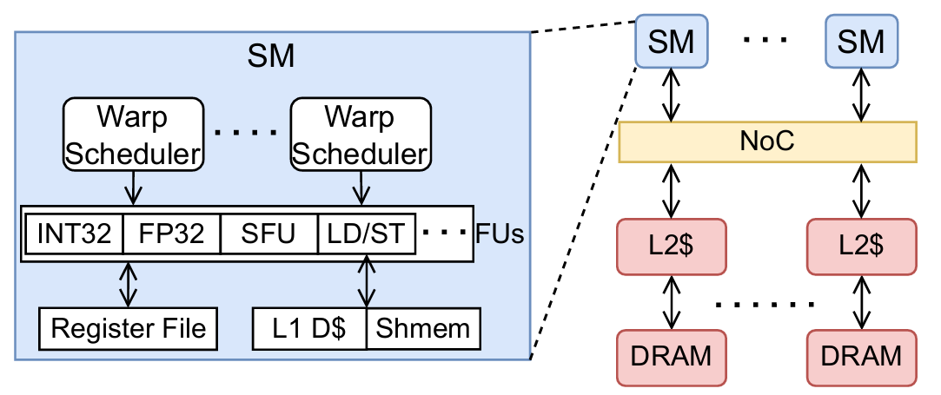
GPU Hardware Model
Streaming Multiprocessors (SMs)
Each GPU contains multiple SMs
An SM executes warps using SIMT model
An SM has many resources: warp schedulers, functional units, register files, L1 memory, ….
Warp Scheduler
Dynamically schedules ready warps to different functional units
There are typically 4 warp schedulers within an SM, and they support multiple scheduling strategies: GTO, LLR, …
L1 Memory
Per-SM private, split into: L1 data cache and shared memory
L2 Cache & Global Memory (DRAM)
L2 Cache: shared across all SMs within a NoC
DRAM: High-capacity, high-latency memory accessible by all threads
It’s a simplified introduction!
4

Slide 5
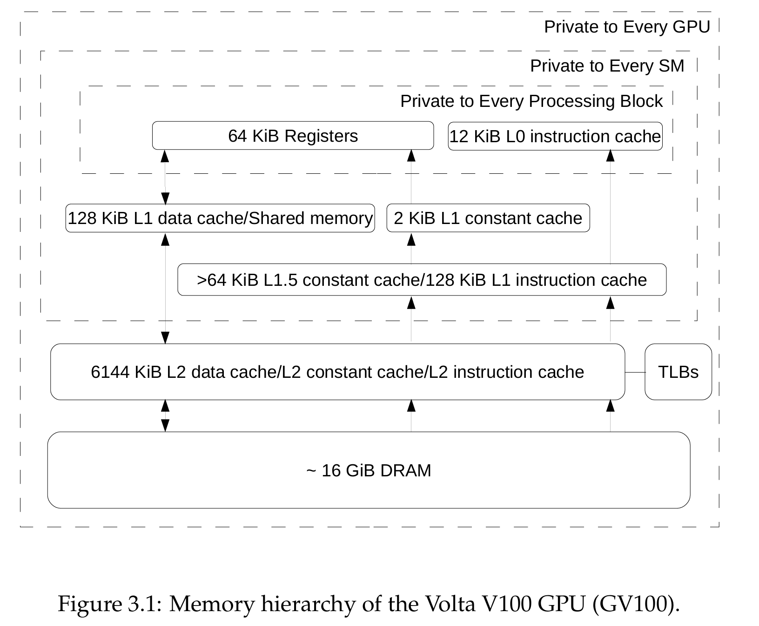

Slide 6
GPU Performance Modeling Challenges
High degree of parallelism
Each SM has thousands of threads, and a GPU can have hundreds of SMs
Synchronization and resource contention across so many threads create complex and unpredictable interactions
Memory behaviors are irregular
In GPUs, a single memory instruction can generate anywhere from 1 up to 32 memory transactions (coalesced vs. scattered, aligned vs. unaligned)
Combined with multi-level memory hierarchy, the overall memory behavior becomes complex and hard to predict
Hardware details are not fully documented
They are kept as top secrets by major companies
6

Slide 7
GPU Background
Related Work
My Research: Learning to Simulate
RL for Arch Research
Contents

Slide 8
Table of GPU Modeling methods
Modeling Methods |  | Running Time | Accuracy | Complexity of Implementation
Cycle-level Simulator | Execution-driven | Long | High | High
 | Trace-driven | Medium | Medium | High
Analytical Modeling |  | Fast | Low to Medium | Medium to High
Ideal GPU Simulator |  | Fast | High | Medium
8

Slide 9
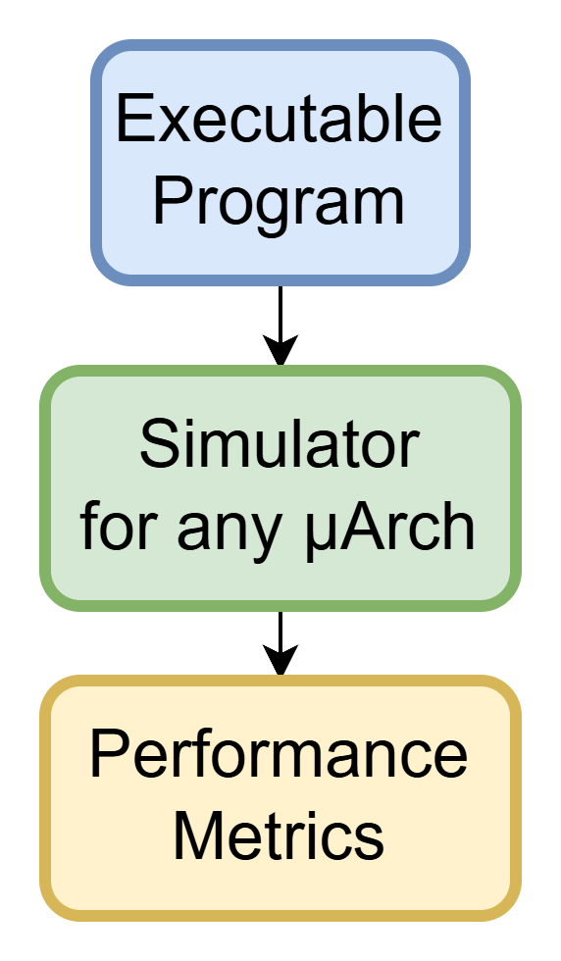
Modeling Approach1: Execution-driven Simulation
What is it?
A technique where the actual instructions of a program are executed in a simulated environment
Characteristics
Dynamic: it models the effects of each instruction by executing them
Accurate: it captures detailed impact of every instruction on the system
Time-consuming: it can take days to years for simulating large programs
Examples: GPGPU-Sim [1], MGPUSim [2]
[1] Bakhoda, Ali, et al. "Analyzing CUDA workloads using a detailed GPU simulator." 2009 IEEE international symposium on performance analysis of systems and software.
[2] Sun, Yifan, et al. "MGPUSim: Enabling multi-GPU performance modeling and optimization." 2019 ACM/IEEE 46th ISCA.
9

Slide 10
Gpgpu-sim
Overview
Open-source, widely used academic GPU simulator
Models NVIDIA-like GPUs at a detailed, cycle-accurate level
Support PTX execution emulation
PTX: a low-level parallel-thread execution virtual machine and ISA
Strengths
High fidelity: captures almost micro-architectural behaviors
Open source: can monitor the whole lifetime of an instruction
Limitations
Extremely slow: simulating a single kernel can take hours or days
It is also an approximation of NVIDIA GPUs
10

Slide 11
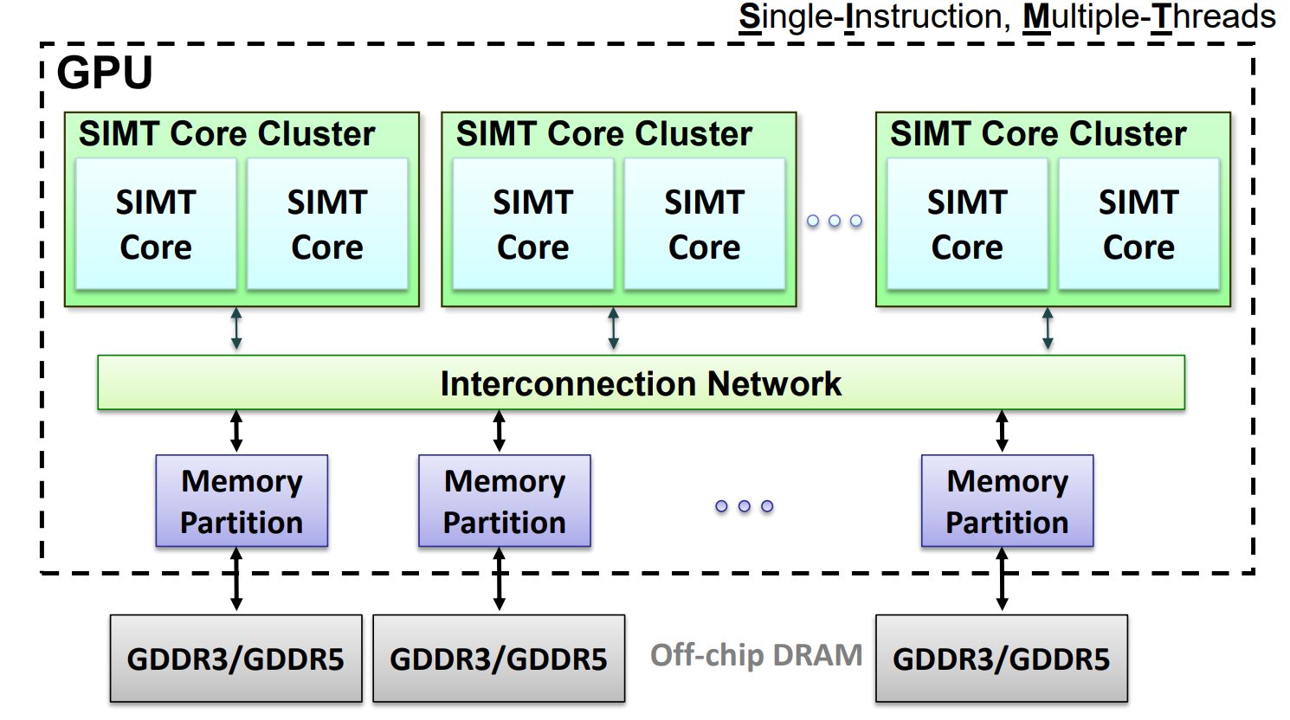

Slide 12
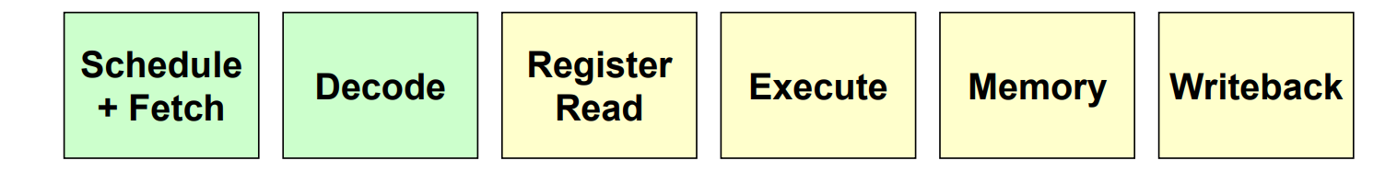
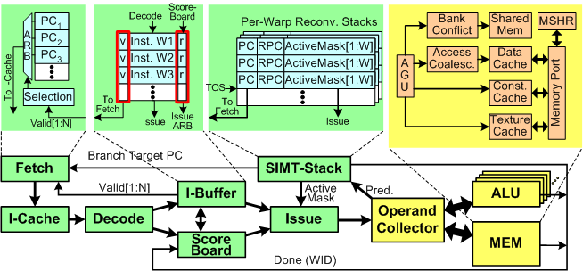
This is a project with ~100k lines of cpp code, so I won’t go into the details here.

Slide 13
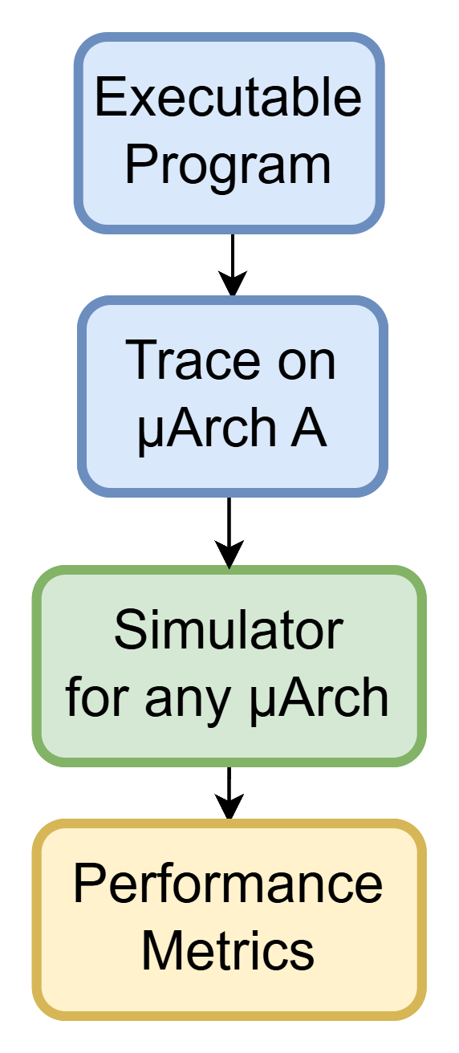
Modeling Approach2: Trace-driven Simulation
What is it?
A technique where a pre-recorded trace from a program’s execution is used as the input for the simulation
A trace can be obtained from another simulator or by instrumenting a program
Trace: a log of executed instructions with additional running information like memory address
Characteristics
Static: the trace is captured once and is fixed during the simulation
Replay-based: it only replays the trace without executing the actual program
Time-efficient: it avoids re-executing each instruction during simulation
Accuracy-limited: it reuses the same trace for different microarchitectures
Examples: Accel-Sim [1]
13
[1] Khairy, Mahmoud, et al. "Accel-Sim: An extensible simulation framework for validated GPU modeling." 2020 ACM/IEEE 47th ISCA.

Slide 14
Accel-sim
Overview
Built on top of GPGPU-Sim to provide SASS trace-driven simulation modes
SASS: native assembly language of NVIDIA GPUs
Strengths
Integrated with CUDA profiling tools NVBit
Maintains cycle-accuracy while improving efficiency
Limitations
Still much slower than real hardware
Remains an approximation of NVIDIA GPUs
14

Slide 15
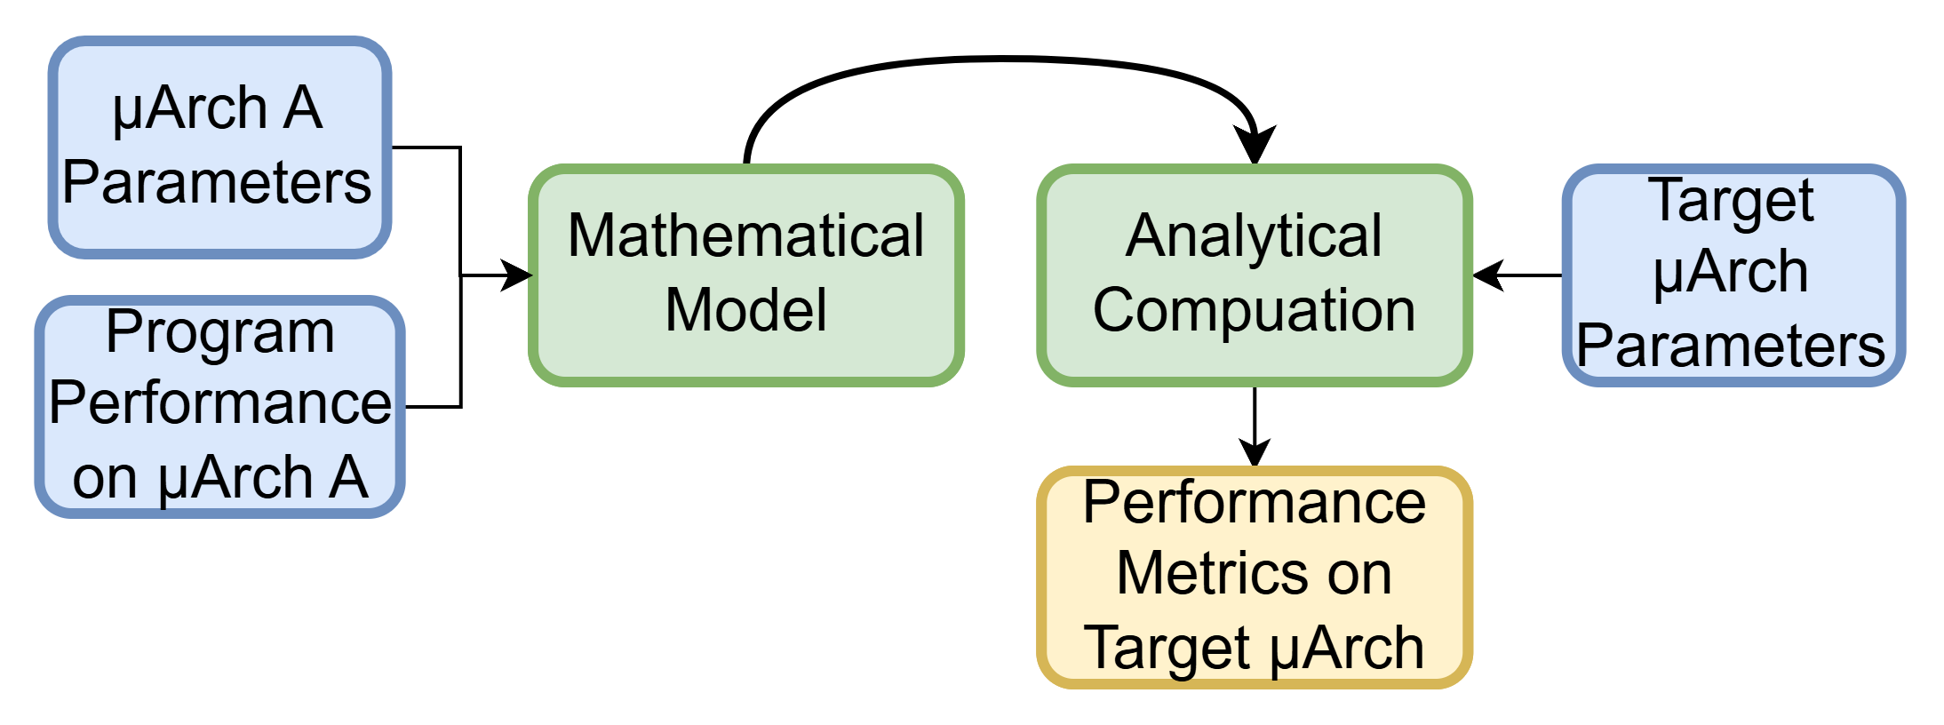
Modeling Approach3: Analytical Modeling
What is it?
A technique that uses mathematical formulas to estimate system performance based on certain assumptions
Characteristics
Abstract: it uses simplified assumptions to model systems
Fast: it is much faster than simulations
Accuracy-limited: heuristic assumptions can be wrong and detailed behaviors are ignored
Examples: GPUMech [1], GCoM [2]
[1] Huang, Jen-Cheng, et al. "GPUMech: GPU performance modeling technique based on interval analysis." 2014 47th Annual IEEE/ACM International Symposium on Microarchitecture.
[2] Lee, Jounghoo, et al. "GCoM: a detailed GPU core model for accurate analytical modeling of modern GPUs." 2022 ACM/IEEE 49th ISCA.
15

Slide 16
GPUMech
Overview
Interval-Analysis Based GPU Performance Modeling
Identifies stall events (memory divergence, control divergence, resource contention) from warp traces
Strengths
Provides CPI stack breakdowns for bottleneck analysis
~97× faster than cycle-accurate simulators
Limitations
Accuracy gap v.s. hardware/simulator
Less flexible for modeling new GPU architectural features
16

Slide 17
2014 MICRO

Slide 18
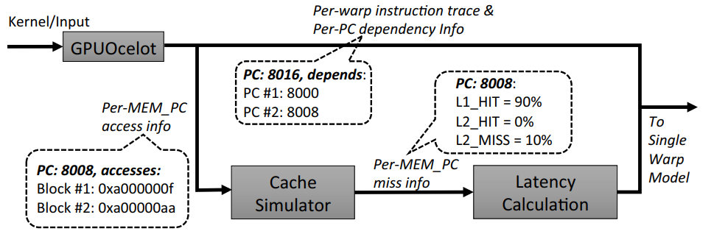
Methodology
Model Workflow
Collect Input
Generate per-warp instruction traces with a functional simulator
A cache simulator reads the memory instructions from the trace of each warp in a round-robin fashion to get the per-memory PC miss rates
Miss rates are calculated across all warps
Get the latency of per PC
Compute PCs: fixed and based on the system configurations
Memory PCs: average memory access time
A memory PC hits L2 (120 cycles) for 90% of the executions and misses L2 (420 cycles) for the rest has the latency 150 = 0.9 × 120 + 0.1 × 420 cycles
For a divergent memory instruction, its miss event depends on the memory request with the longest latency
18

Slide 19
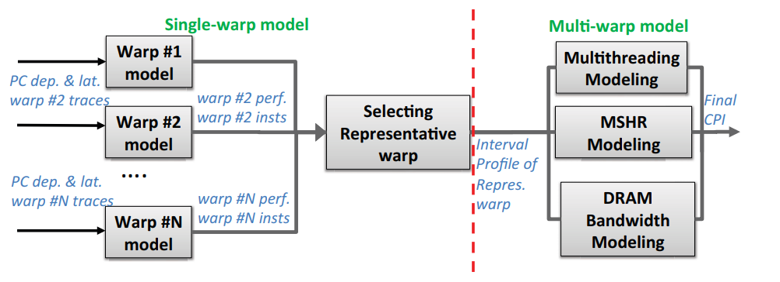
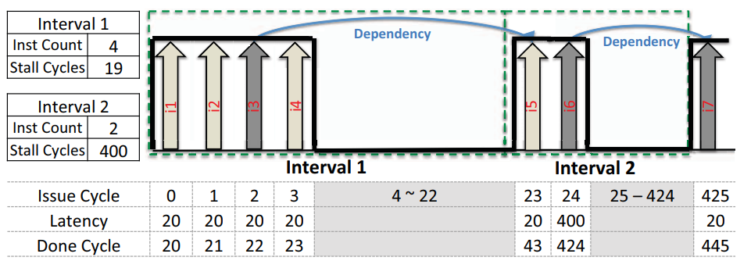
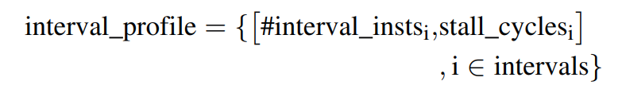
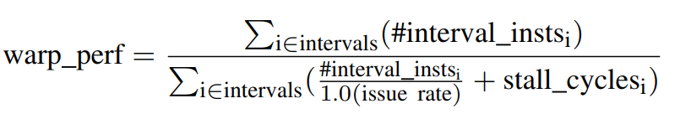
Methodology
Model Workflow
Single-warp model & selecting
Profile each warp with the interval algorithm
Selecting representative warp
Use the k-means algorithm, setting the number of clusters to two
Define per-warp warp performance (IPC)
Define per-warp feature vector
Issue rate: 1 inst / cycle
19

Slide 20
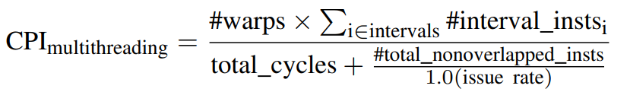
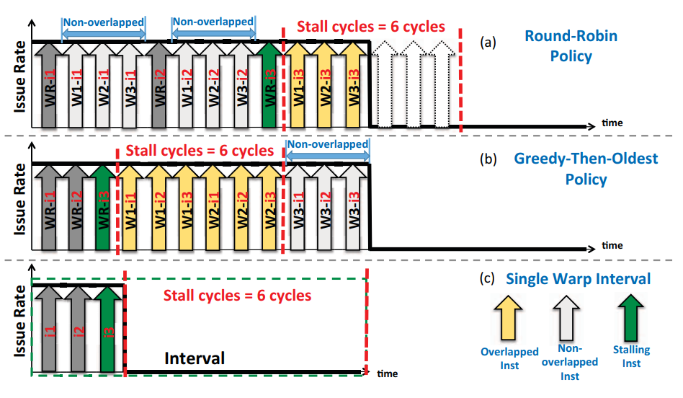
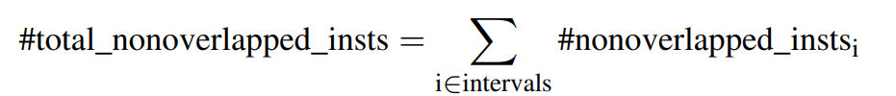
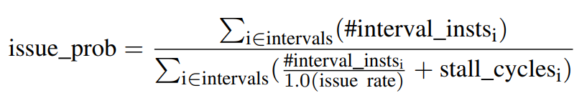
Methodology
Model Workflow
Multi-warp model: 1) Modeling Multithreading
Some instructions do not hide the stall cycles, leading to sub-optimal performance
Call them non-overlapped instructions
Use the interval profile of the representative warp and predict the performance under 2 scheduling policies
issue probability = the probability that
a warp can issue an instruction in a cycle
cycle
20

Slide 21
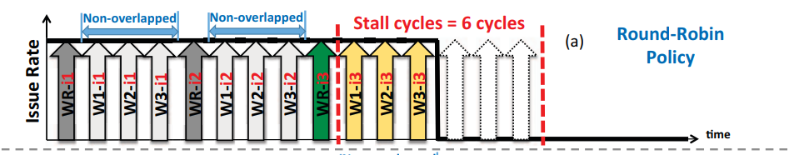
Methodology
Model Workflow
Multi-warp model: 1) Modeling Multithreading
Round-Robin Policy
Assume the non-overlapped instructions are issued within several “waiting slots”
Assume within a waiting slot, every remaining warp is scheduled
21

Slide 22
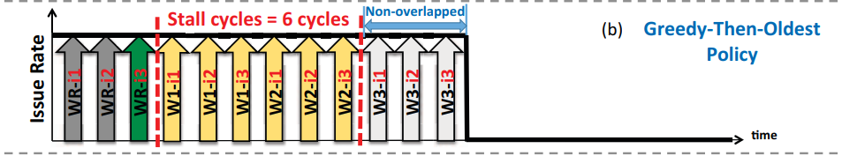
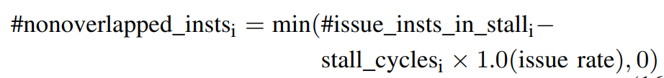
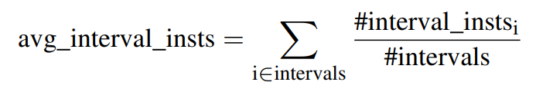
Methodology
Model Workflow
Multi-warp model: 1) Modeling Multithreading
Greedy-Then-Oldest Policy
Assume the non-overlapped instructions are incurred if the number of issued instructions is more than the stall cycles
avg_interval_insts = the number of issued instructions for a remaining warp
#issue warps in stall = the number of warps that issues instructions during the stall cycles
Assume the “oldest” policy equalizes the probability of each warp being scheduled
22

Slide 23
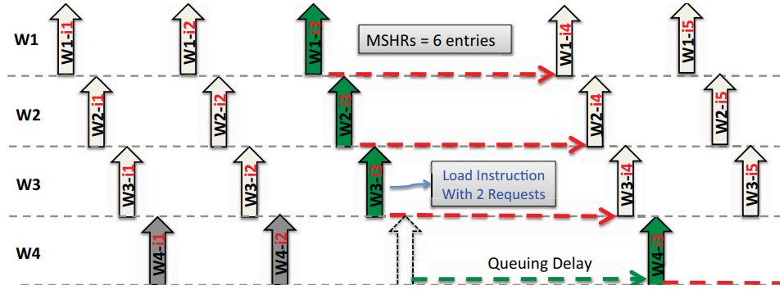
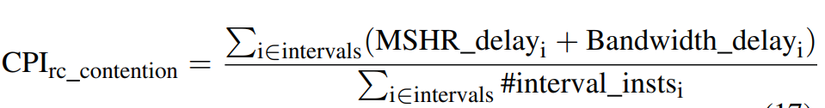
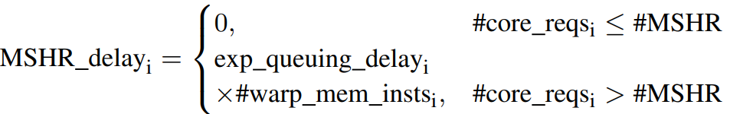
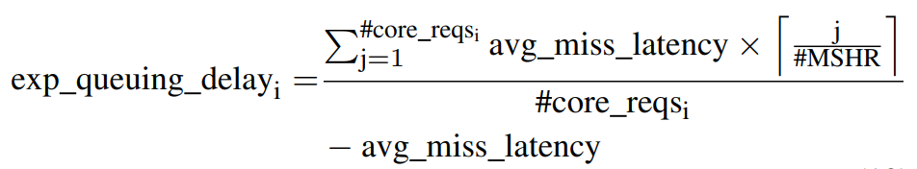
Methodology
Model Workflow
Multi-warp model: 2) Modeling Resource Contention
Only model the queuing cycles of MSHRs and DRAM bandwidth
Modeling MSHRs
the number of concurrent memory requests of a core in interval i
the expected latency of a memory request in interval I
avg miss latency is the average L2/DRAM access latency
23

Slide 24
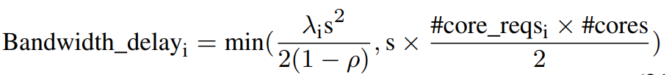

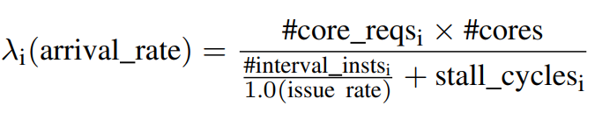
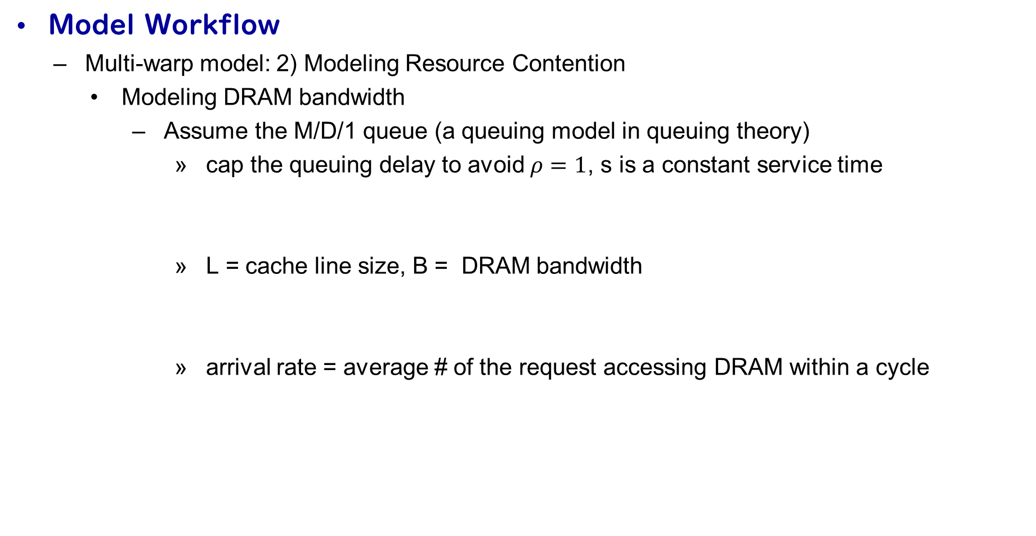
Methodology
Model Workflow
Multi-warp model: 2) Modeling Resource Contention
Modeling DRAM bandwidth
Assume the M/D/1 queue (a queuing model in queuing theory)
cap the queuing delay to avoid $ρ=1$, s is a constant service time
L = cache line size, B = DRAM bandwidth
arrival rate = average # of the request accessing DRAM within a cycle
24

Slide 25
GPU Background
Related Work
My Research: Learning to Simulate
RL for Arch Research
Contents

Slide 26
Challenges & Opportunity
Analytical models are fast but require extensive architecture-specific calibration by designers
Cycle-accurate simulators are prohibitively slow
Can we get an accurate performance model without these problems?
It is the time to leverage the power of deep learning!
26

Slide 27
Overview of My Work
Learning to Simulate: A Trace-Driven Deep Learning Framework for GPU Performance Modeling
Goal: replace slow cycle-accurate GPU simulators with a trace-driven, deep learning framework
Approach: model instruction-level latency using neural network + warp fusion + SM sampling
Output: accurate kernel runtime predictions in cycles
Key Contributions
The first trace-driven, deep learning-based cycle-level GPU performance simulator
Accurate and efficient simulation across architectures
A large-scale, diverse dataset for instruction-level GPU modeling
27

Slide 28
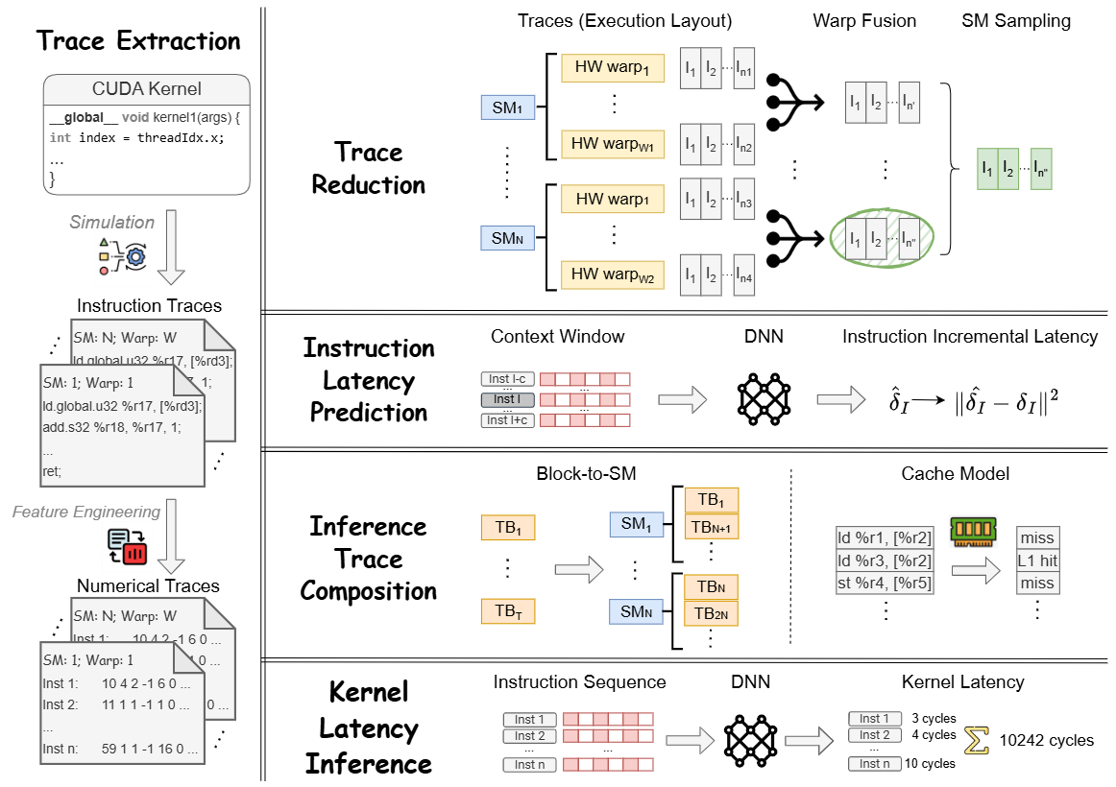

Slide 29
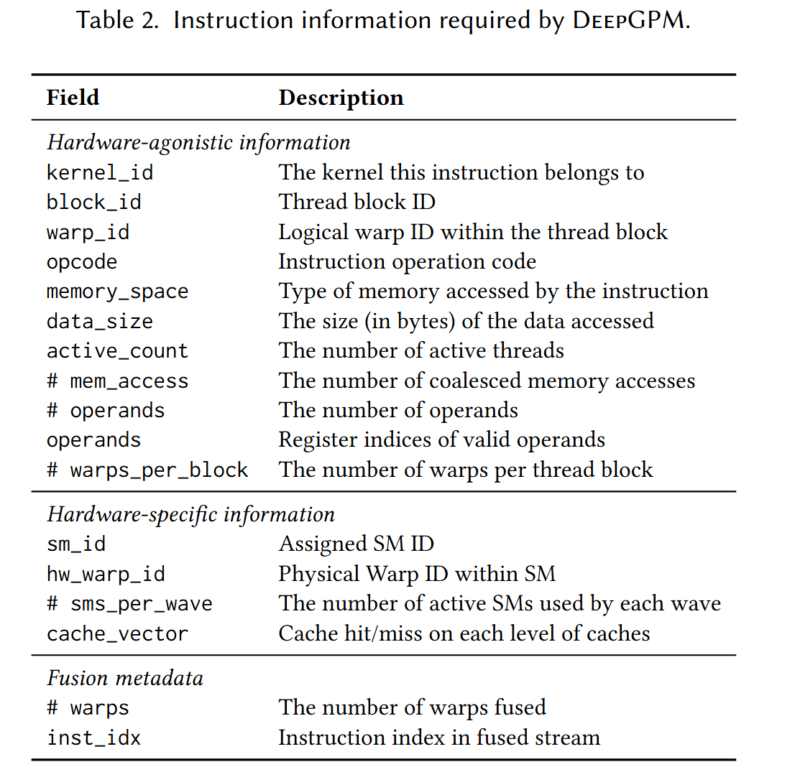
Trace Extraction
Instrumented GPGPU-Sim
Get detailed execution events of every instruction
at every cycle
Collected Information
Hardware-agonistic information
opcode, memory space, active count, operands, …
Hardware-specific information
SM id, cache vector, …
Provides the true latency labels used during
training
Note: ground-truth traces are only required for training; at inference time, the trace can come from other sources
29

Slide 30
Trace Reduction: Challenges with Raw Traces
A GPU kernel typically executes at least millions of instructions
Most warps have similar behaviors
Branch divergence, block-to-SM scheduling, resource contention, … introduce trace heterogeneity
Sequence misalignment between training and inference
We have the exact instruction completion order when training
This order is unavailable at inference time
Key Challenge
How to retain critical execution information while reducing trace size?
Use the same sequence order for training and inference
30

Slide 31
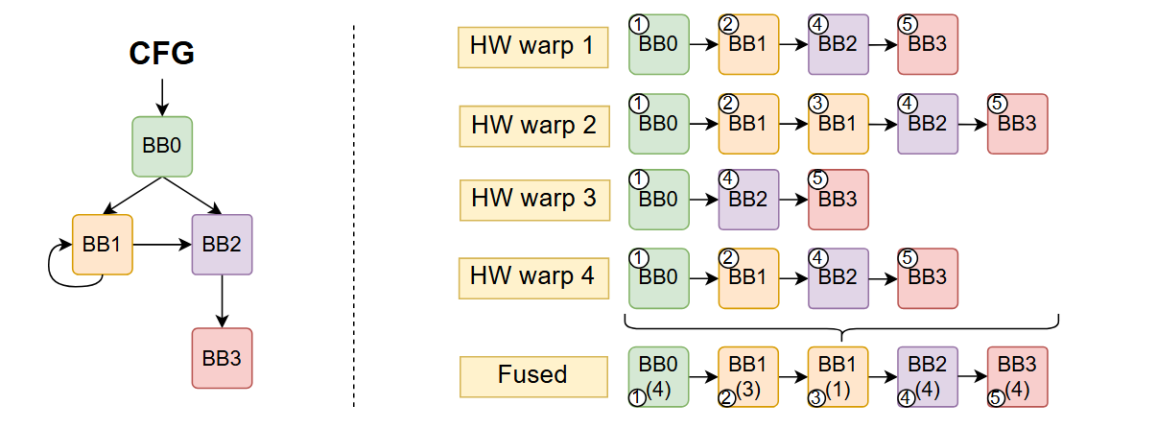
Trace Reduction: Solutions
Warp Fusion for Intra-SM Efficiency
Merge warps at basic-block granularity based on CFG
Preserve divergence blocks but eliminates redundant sequences
Output: a compact instruction sequence for each SM
31

Slide 32
Trace Reduction: Solutions
SM Sampling for Inter-SM Efficiency
Training: select top-k slowest SMs as they dominate kernel latency
Inference: approximate top-k using instruction count heuristic
Output: k instruction sequences for a kernel
32

Slide 33
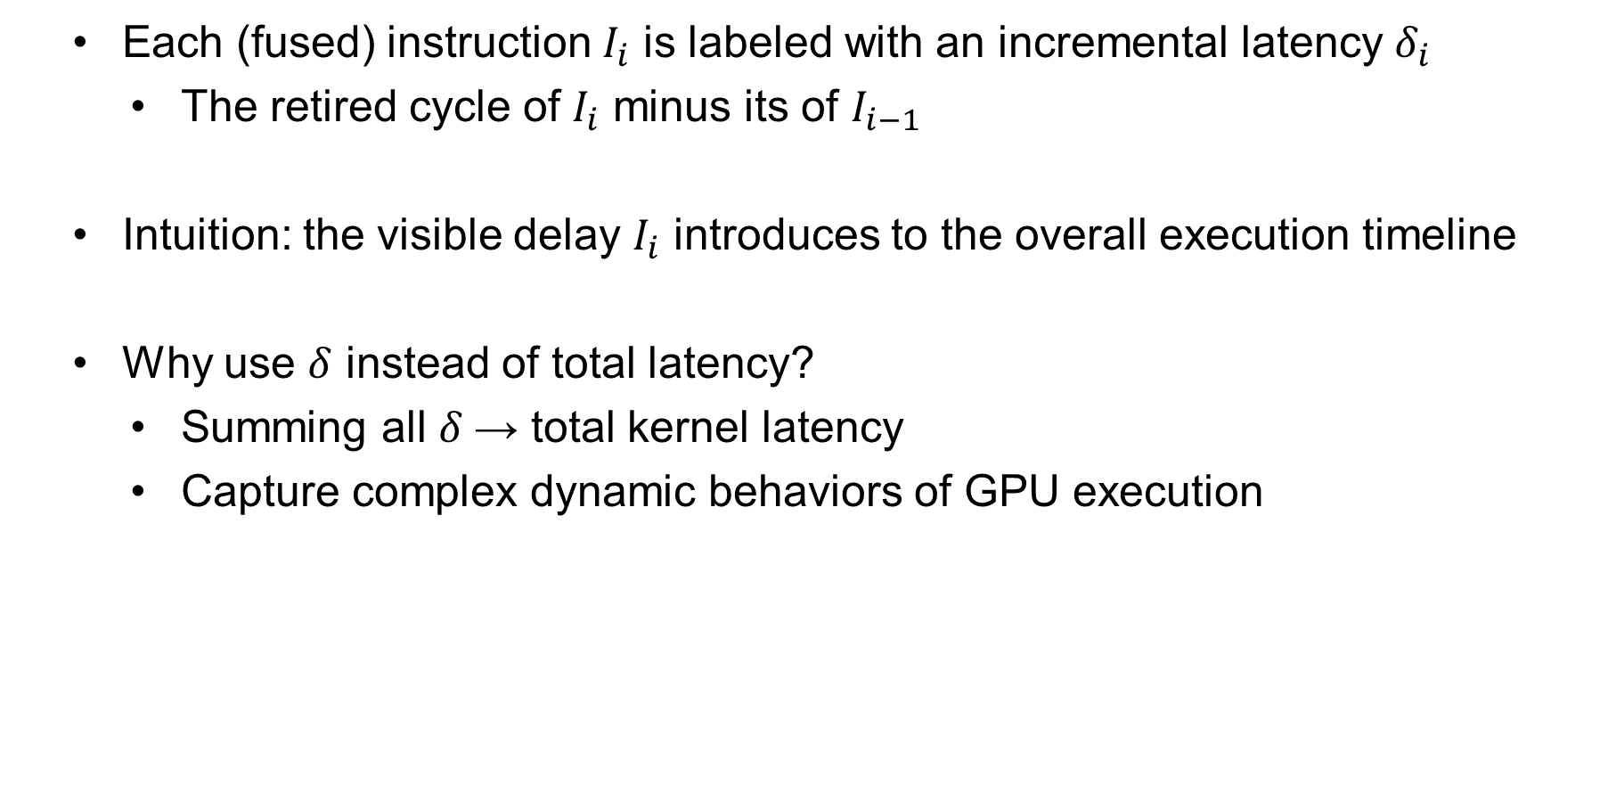
Instruction Latency Prediction: Incremental Latency
Each (fused) instruction $I_{i}$ is labeled with an incremental latency $δ_{i}$
The retired cycle of $I_{i}$ minus its of $I_{i−1}$
Intuition: the visible delay $I_{i}$ introduces to the overall execution timeline
Why use $δ$ instead of total latency?
Summing all $δ$→ total kernel latency
Capture complex dynamic behaviors of GPU execution
33

Slide 34
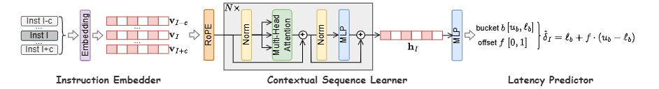
Instruction Latency Prediction: Neural Network Model
Backbone: Transformer Encoder
Why? The latency of an instruction is not only related to itself, but also to the instructions executed before it
Include “future” instructions because, after fusion, an instruction appearing later here may retire earlier in time
Instruction Embedder
Handle categorical features
34

Slide 35
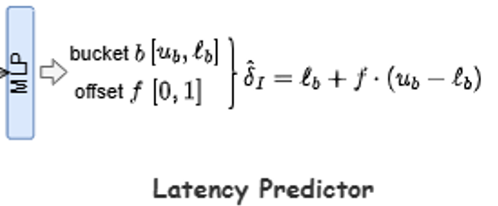
Instruction Latency Prediction: Hybrid Head
The problem with pure regression
Instruction latencies span a very wide range
A small fraction of long-latency instructions dominate overall runtime
Solution: Combining Classification and Regression
Classification: predict which latency “bucket”
Regression: predict an offset within the bucket
Choose the number of bucket to match GPU instruction characteristics
short-latency; medium-latency; long-latency; outlier
ALU operations; L2 cache hits; global memory access; page fault
35

Slide 36
Inference Trace Composition
During training, traces come from instrumented GPGPU-Sim
runtime features (hardware scheduling, cache hits/misses)
During inference, such detailed traces are not available
We must reconstruct essential runtime behaviors (scheduling, memory behaviors) with lightweight models
36

Slide 37
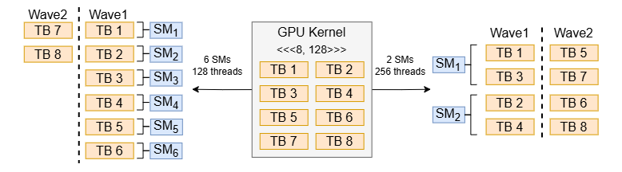
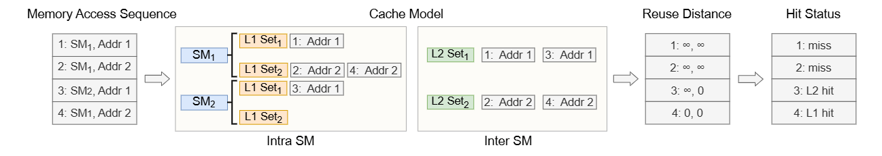
Scheduling & Cache Models
Block-to-SM Scheduling
Sequentially distribute thread blocks to SMs in a round-robin manner
Cache Model (Reuse Distance Based)
Approximate cache behavior using reuse distance analysis
37

Slide 38
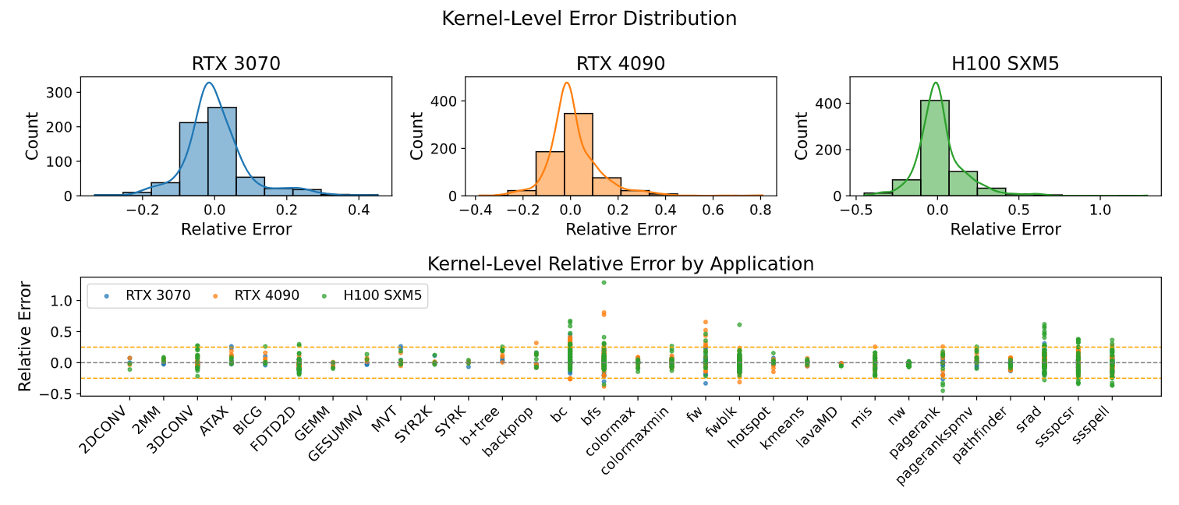
Results: Prediction Accuracy
38

Slide 39
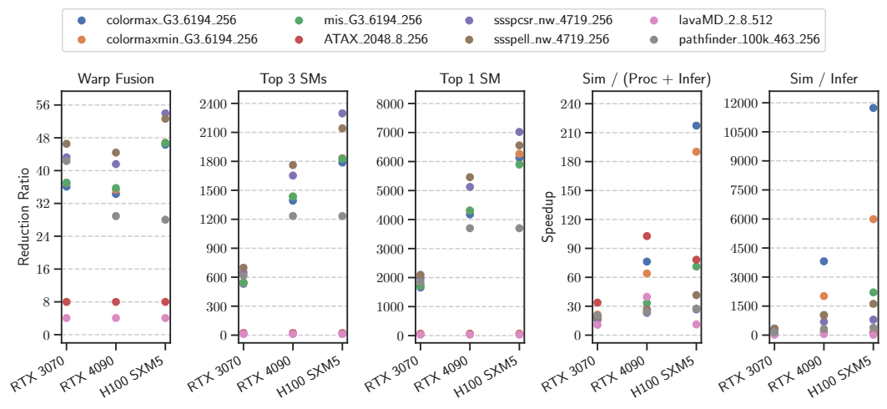
Results: Speedup Over Simulation
39

Slide 40
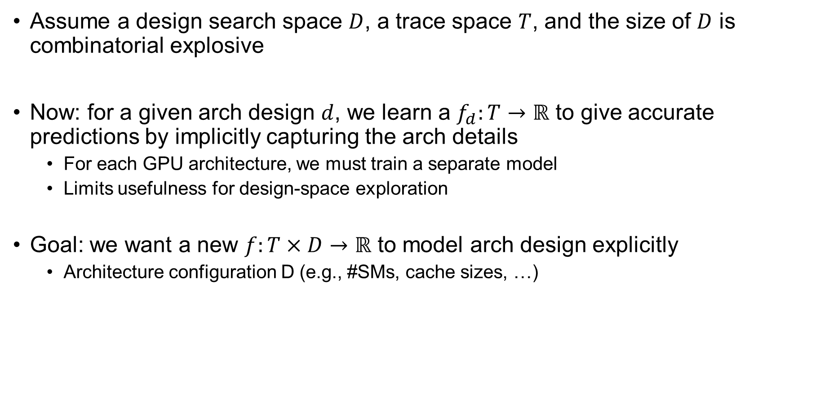
Current Limitation
Assume a design search space $D$, a trace space $T$, and the size of $D$ is combinatorial explosive
Now: for a given arch design $d$, we learn a $f_{d}:T→ℝ$ to give accurate predictions by implicitly capturing the arch details
For each GPU architecture, we must train a separate model
Limits usefulness for design-space exploration
Goal: we want a new $f:T×D→ℝ$ to model arch design explicitly
Architecture configuration D (e.g., #SMs, cache sizes, …)
40

Slide 41
GPU Background
Related Work
My Research: Learning to Simulate
RL for Arch Research
Contents

Slide 42
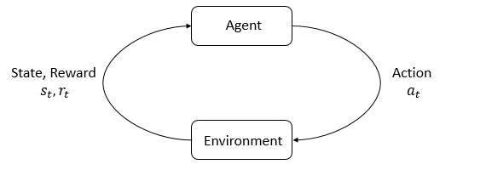
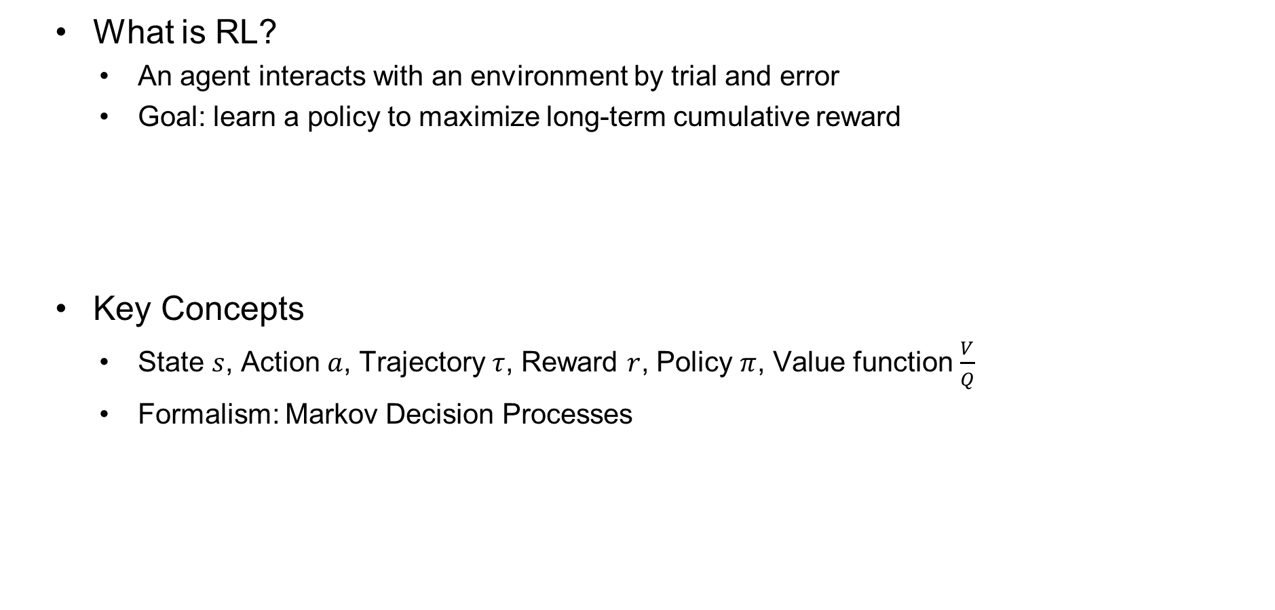
Reinforcement Learning Basics
What is RL?
An agent interacts with an environment by trial and error
Goal: learn a policy to maximize long-term cumulative reward
Key Concepts
State $s$, Action $a$, Trajectory $τ$, Reward $r$, Policy $π$, Value function $\frac{V}{Q}$
Formalism: Markov Decision Processes
42

Slide 43
RL Algorithms Taxonomy
On-Policy Methods
Learn from actions taken by the current policy
“I only trust what I actually tried myself”
Stable, but less sample-efficient
Off-Policy Methods
Learn from data generated by different policies
“I can also learn by watching others or my old self”
sample-efficient at the risk of instability
Model-Free Methods
Learn directly from rewards without modeling the environment
“I don’t need to understand the world, I just react to feedback”
Model-Based Methods
Learn a predictive model of environment
“I build a simulator in my head and practice before acting”
43

Slide 44
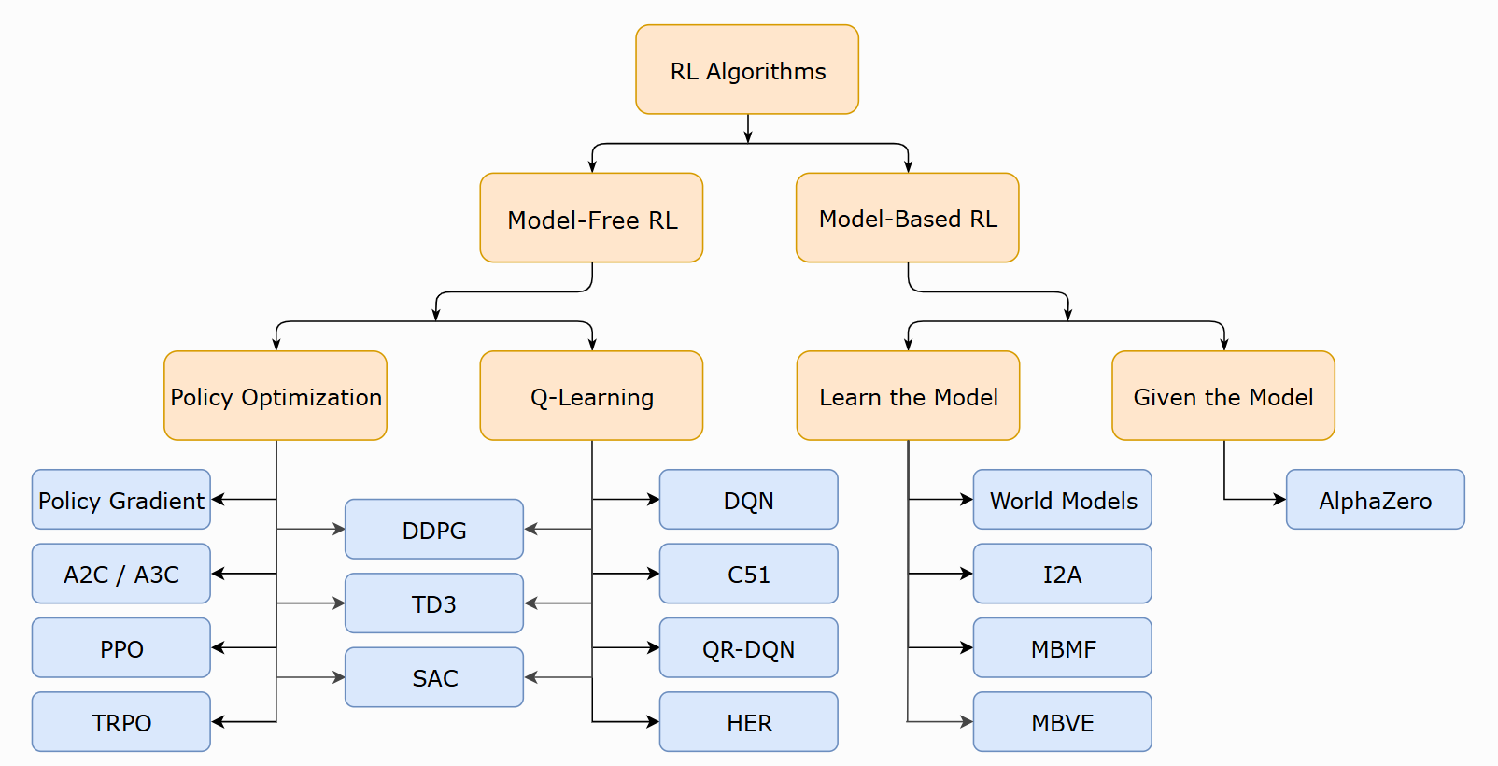

Slide 45
RL for Arch Research
Scheduling and Resource Management
Job scheduling, DAG scheduling (DeepRM, Decima, …)
Cache replacement, bypassing, and prefetching (Pythia, CHROME)
Policy: the scheduler’s decision (which job or task to run next)
Reward: job completion time, throughput, cache hit rate, IPC, …
Design Space Exploration
DRAM controllers (MARL), Network-on-Chip, Chip Floorplanning (Google)
Policy: configuration or placement decision
Reward: performance-per-watt, latency, wirelength, …
45

Slide 46
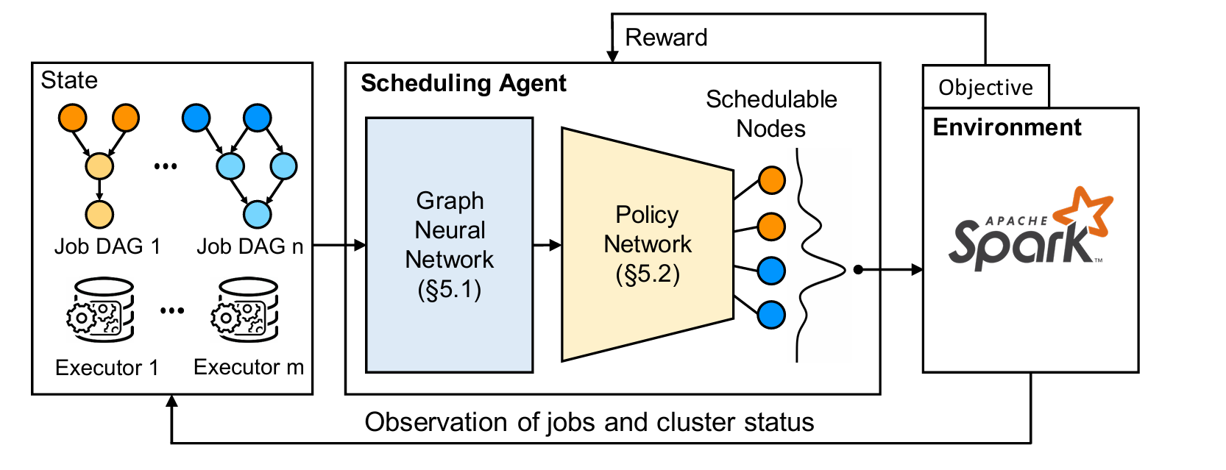
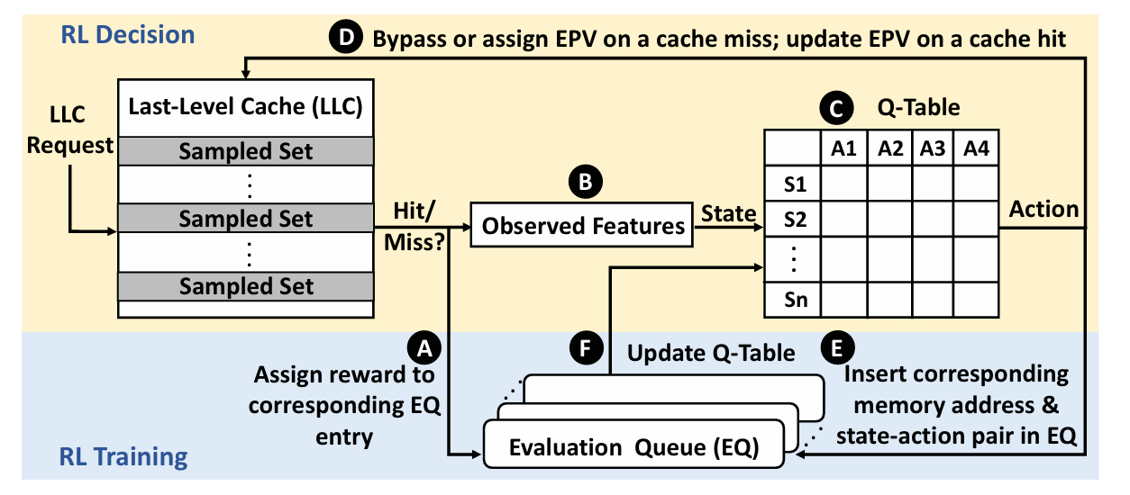

Slide 47
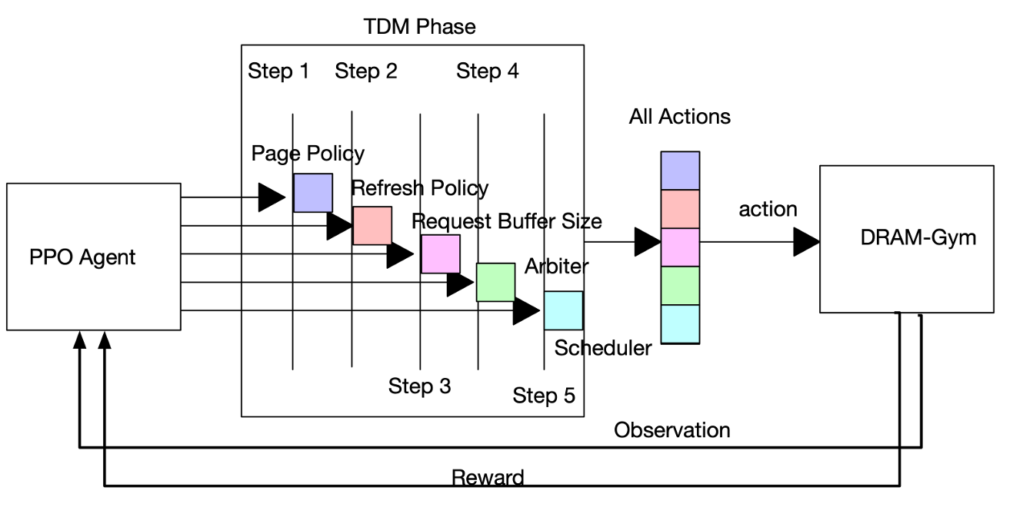
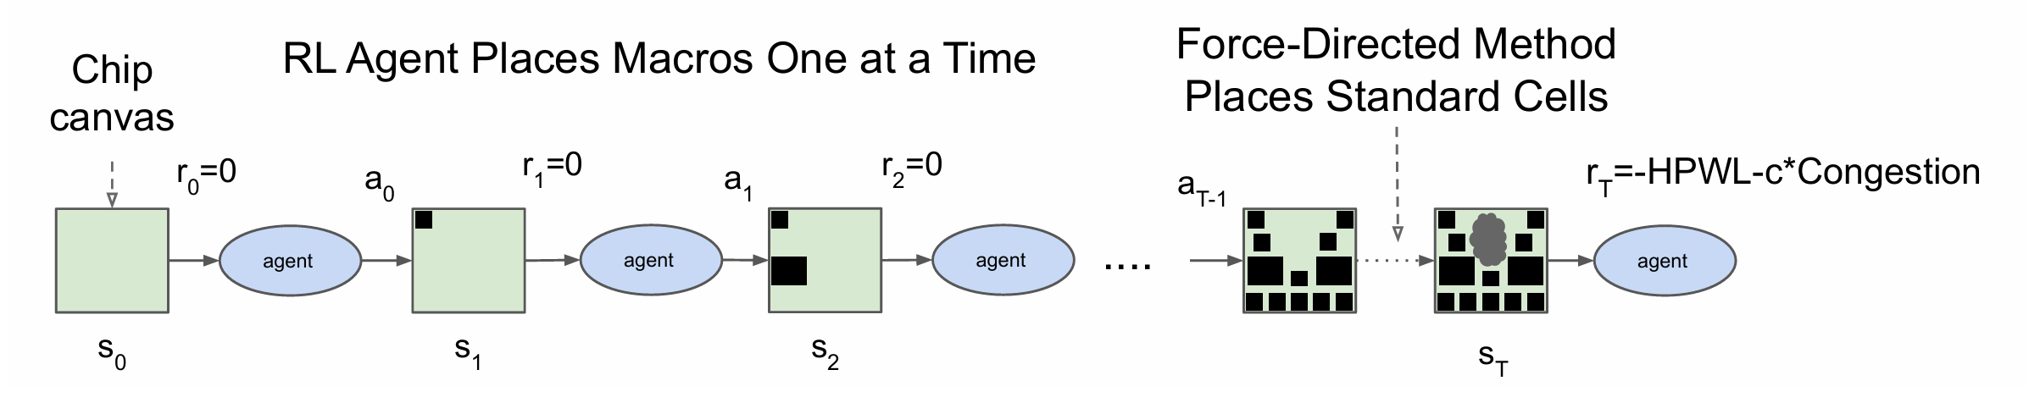

Slide 48
Q & A
Notes:
That’s all. Thanks for the listening.

