Slide 1
Automated Quality Control
Tobias Wolff
AG Reuter

Slide 2
Introduction
Freesurfer QA tools available
  but not enough elaborated
  Problems with version compatibility
Plan: QC pipeline after FS 6.0 processing
Only based on Python 3
Notes:
Based on python in order to avoid version compability

Slide 3
Metrics
On the original image
  WM SNR: orig.mgz
  GM SNR: orig.mgz
Freesurfer processed
  WM SNR: norm.mgz
  GM SNR: norm.mgz
  Contrast to noise ratio: rawavg.mgz
  Number of defects: recon-all log file
  Number of holes: recon-all log file
  Topological fixing time: recon-all log file
  Segmentation outliers: aseg.stats
  Relative Corpus Callosum size: aseg.stats
Notes:
- The norm.mgz image is a highly
processed image, with a skull stripped image and intensity normalisation.
- The signal to noise ratio takes mean/var
The contrast to noise ratio
>>> 100*(W-G)
>>> pct = ---------
>>> 0.5*(W+G)
And then mean/var
-WM GM from freesurfer segmentation

Slide 4
Structure
wm-gm-anat-snr-checker.py
- WM SNR,
- GM SNR
- on norm.mgz and on orig.mgz
cc_size_checker.py
- Relative Corpus Callosum size
holes_topo_checker.py
- Number of holes
- Number of defects
- Topological fixing time
quality-checker.py
contrast-control.py
- Contrast to noise ratio
recon_all_aseg_outlier_checker.py
- Segmentation outliers
- Number of outliers per subject

Slide 5
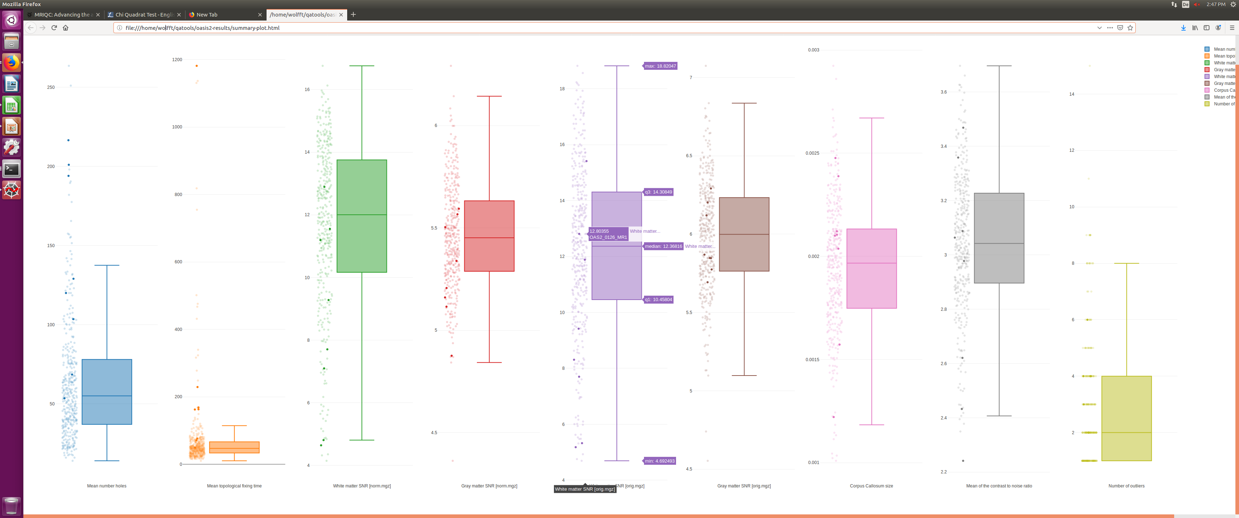
Output
file:///groups/ag-reuter/projects/adni-qc/qc-presentation/oasis2-summary-boxplot.html
Notes:
Dark points are subjects labeled with motion or blurriness

Slide 6
Structure
wm-gm-anat-snr-checker.py
- WM SNR,
- GM SNR
- on norm.mgz and on orig.mgz
cc_size_checker.py
- Relative Corpus Callosum size
holes_topo_checker.py
- Number of holes
- Number of defects
- Topological fixing time
quality-checker.py
contrast-control.py
- Contrast to noise ratio
recon_all_aseg_outlier_checker.py
- Segmentation outliers
- Number of outliers per subject

Slide 7
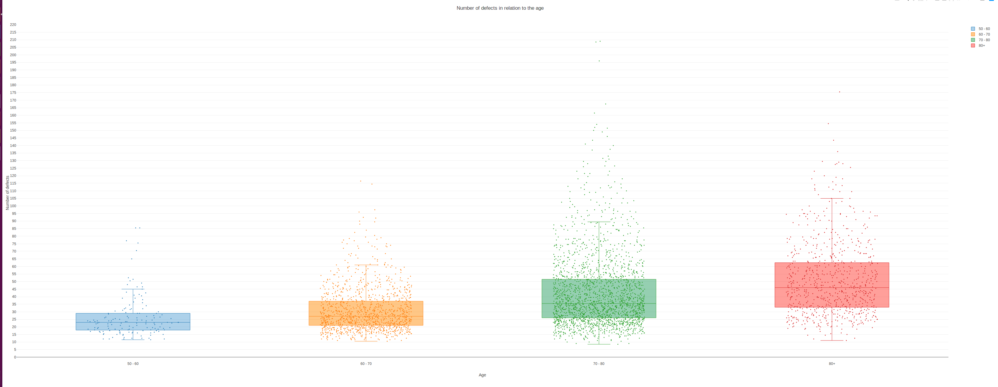
Results: Number defects in orig.nofix
Interactive Plot
file:///groups/ag-reuter/projects/adni-qc/qc-presentation/age-defects-boxplot.html

Slide 8
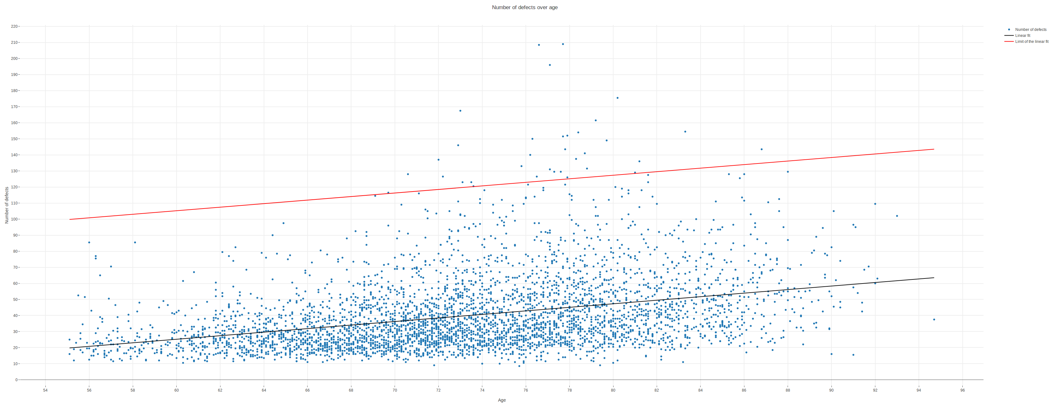
Results: Number defects
Number of defects detected: Arbitrary limit
file:///groups/ag-reuter/projects/adni-qc/qc-presentation/age-defects-scatter-limits.html
Interactive Plot
Open subject

Slide 9
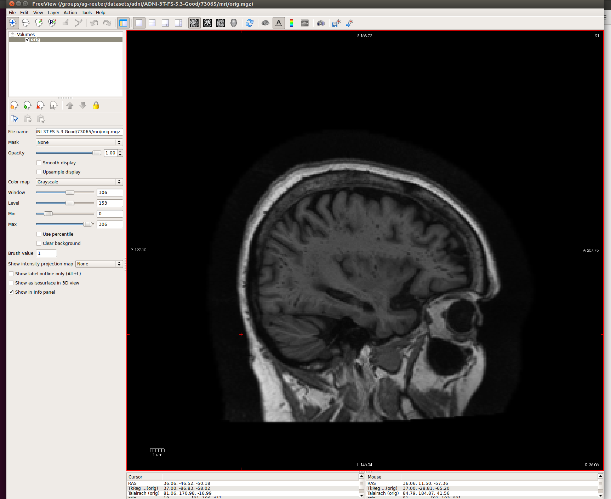
Results: Number defects
freeview /groups/ag-reuter/datasets/adni/ADNI-3T-FS-5.3-Good/73065/mri/orig.mgz
Lots of low intensity pixel in the white matter

Slide 10
Results: Number defects
Number of defects detected: Arbitrary limit
file:///groups/ag-reuter/projects/adni-qc/qc-presentation/age-defects-scatter-limits.html
Interactive Plot
Open subject:

Slide 11
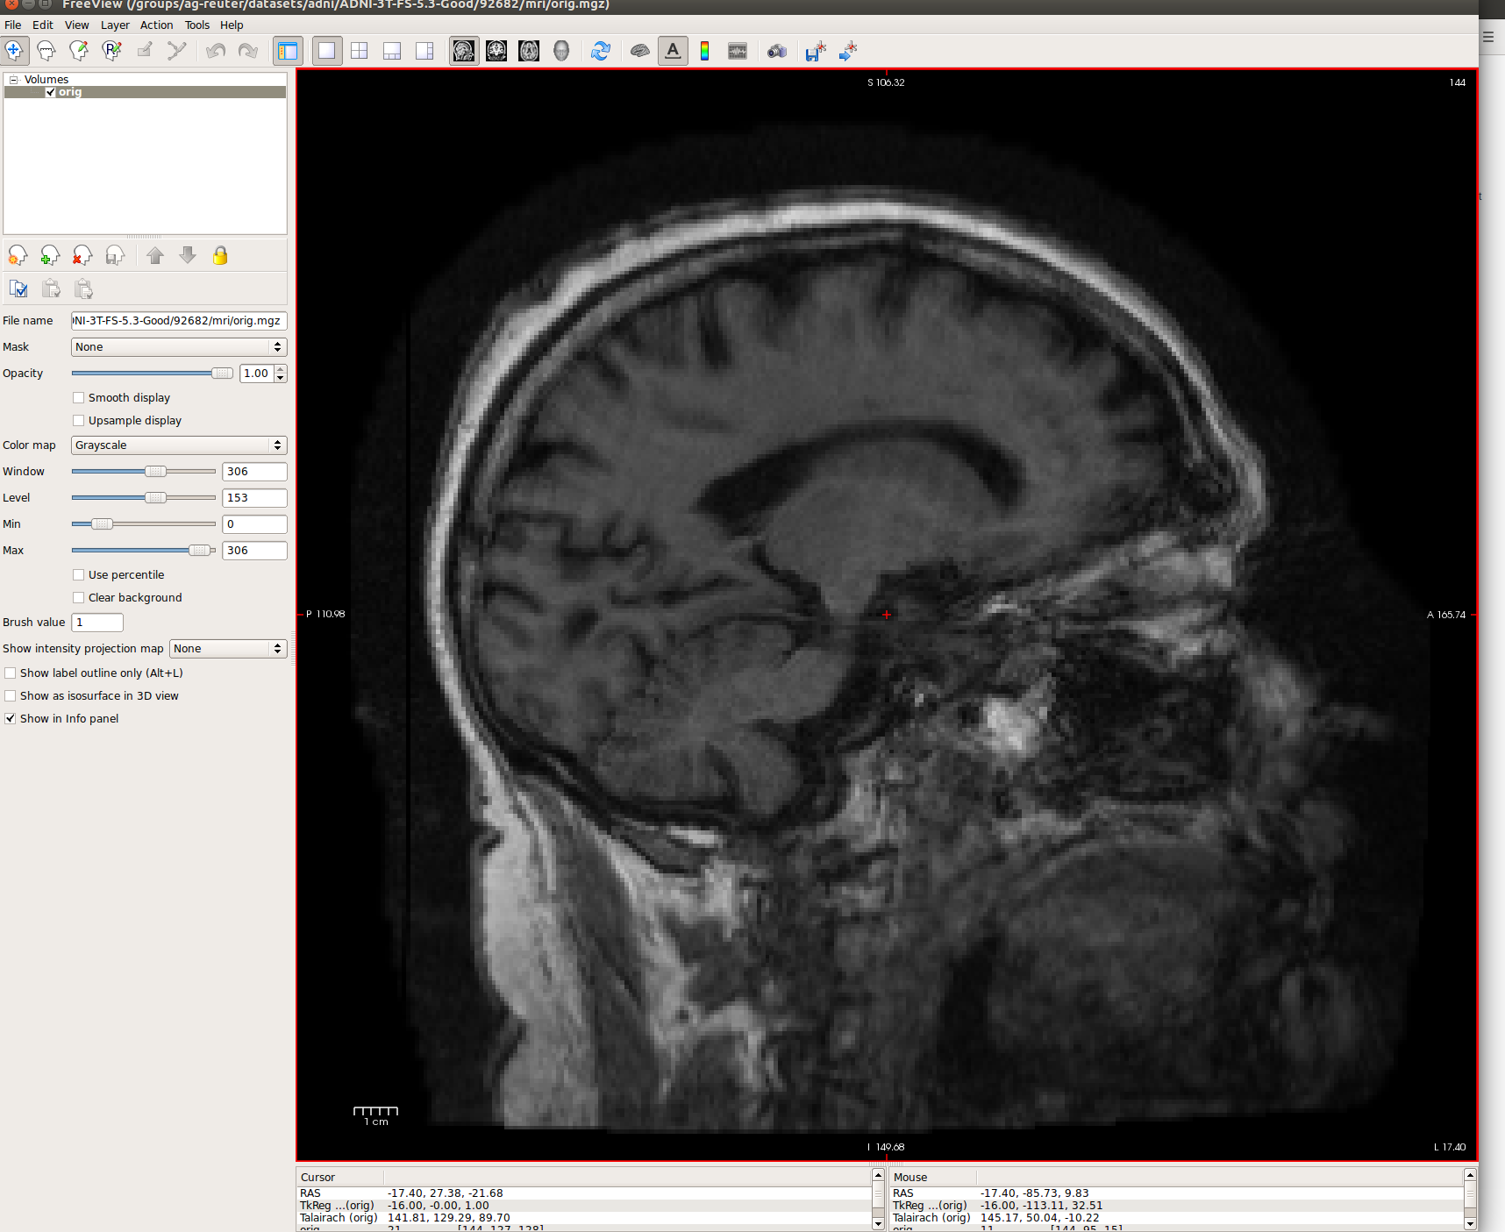
Results: Number defects
freeview /groups/ag-reuter/datasets/adni/ADNI-3T-FS-5.3-Good/92682/mri/orig.mgz
No WM/GM contrast
“Ringing” lines
Full vertical line

Slide 12
Results: Number defects
Number of defects detected: Arbitrary limit
file:///groups/ag-reuter/projects/adni-qc/qc-presentation/age-defects-scatter-limits.html
Interactive Plot
Open subject:

Slide 13
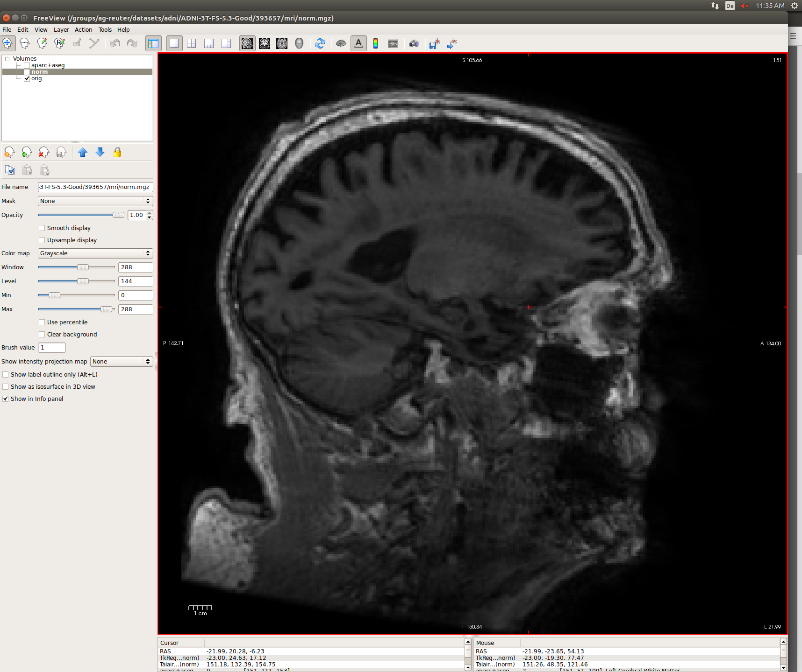
Results: Number defects
freeview /groups/ag-reuter/datasets/adni/ADNI-3T-FS-5.3-Good/393657/mri/orig.mgz
Poor WM/GM Contrast
WM Lesion

Slide 14
Results: Number defects
Number of defects detected: Arbitrary limit
file:///groups/ag-reuter/projects/adni-qc/qc-presentation/age-defects-scatter-limits.html
Interactive Plot
Open subject:

Slide 15
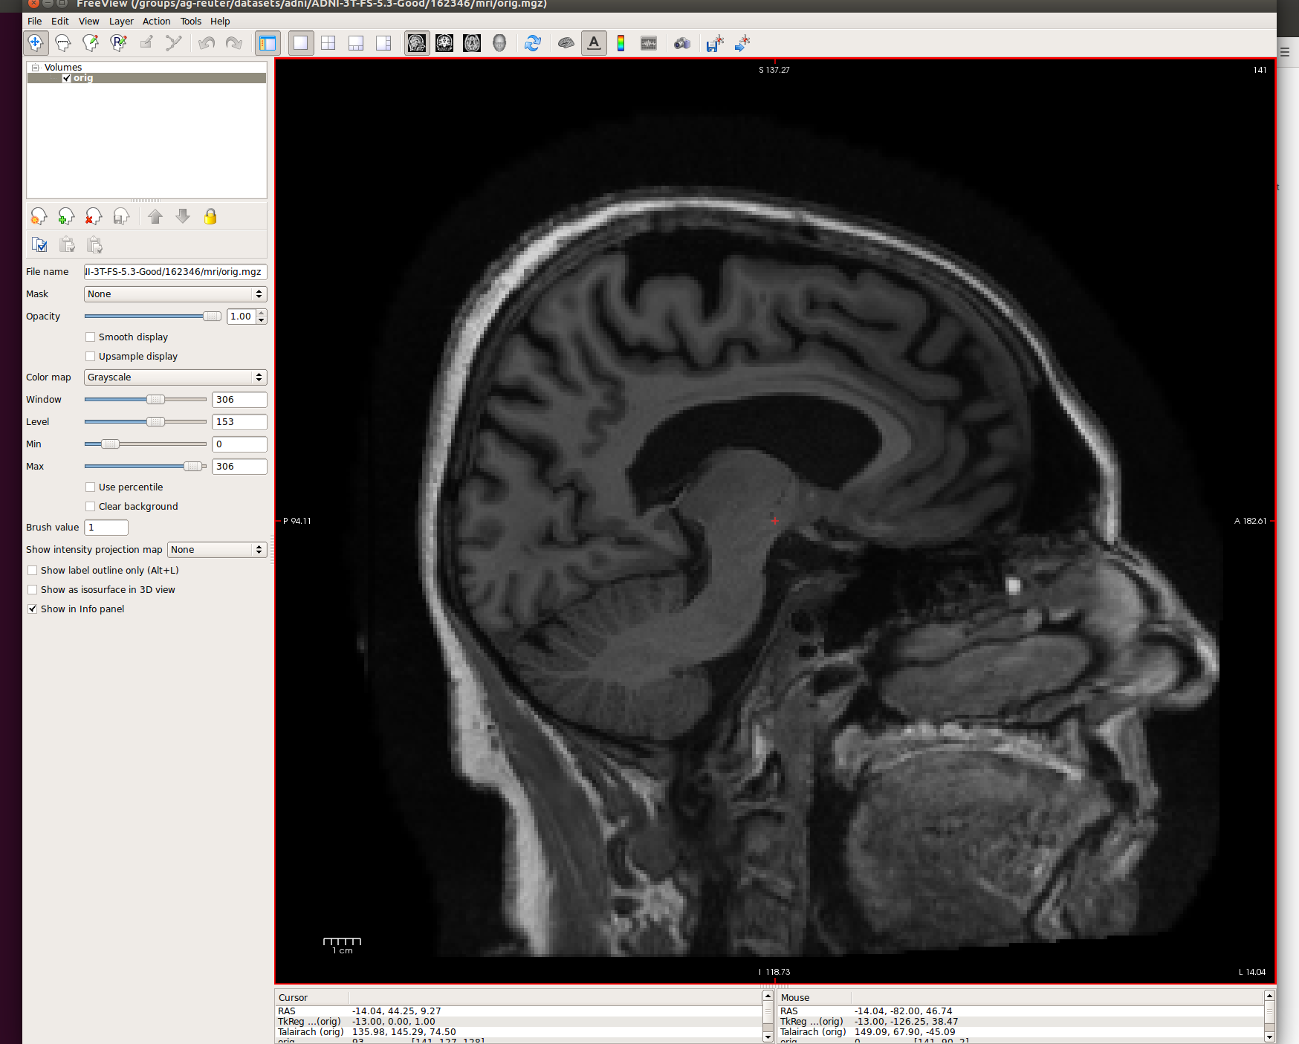
Results: Number defects
freeview /groups/ag-reuter/datasets/adni/ADNI-3T-FS-5.3-Good/162346/mri/orig.mgz
Very good WM/GM contrast
Even the cerebellum very sharp

Slide 16
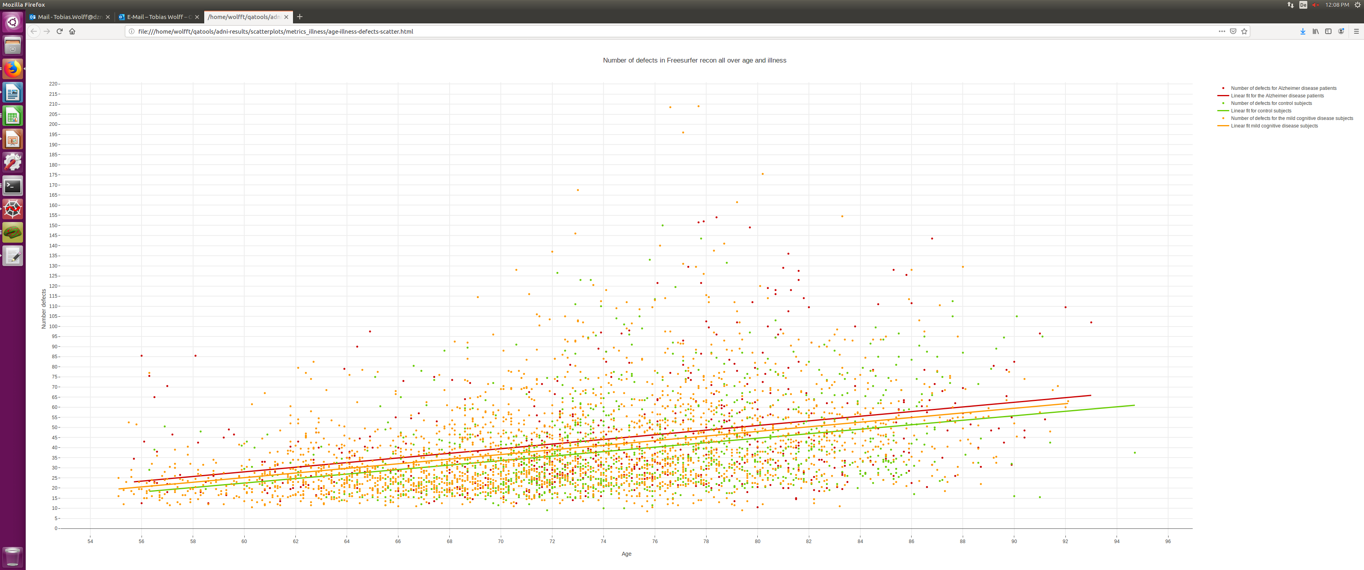
Problems: WM lesion: illness biasing metrics?
Interactive Plot
file:///groups/ag-reuter/projects/adni-qc/qc-presentation/age-illness-defects-scatter.html

Slide 17
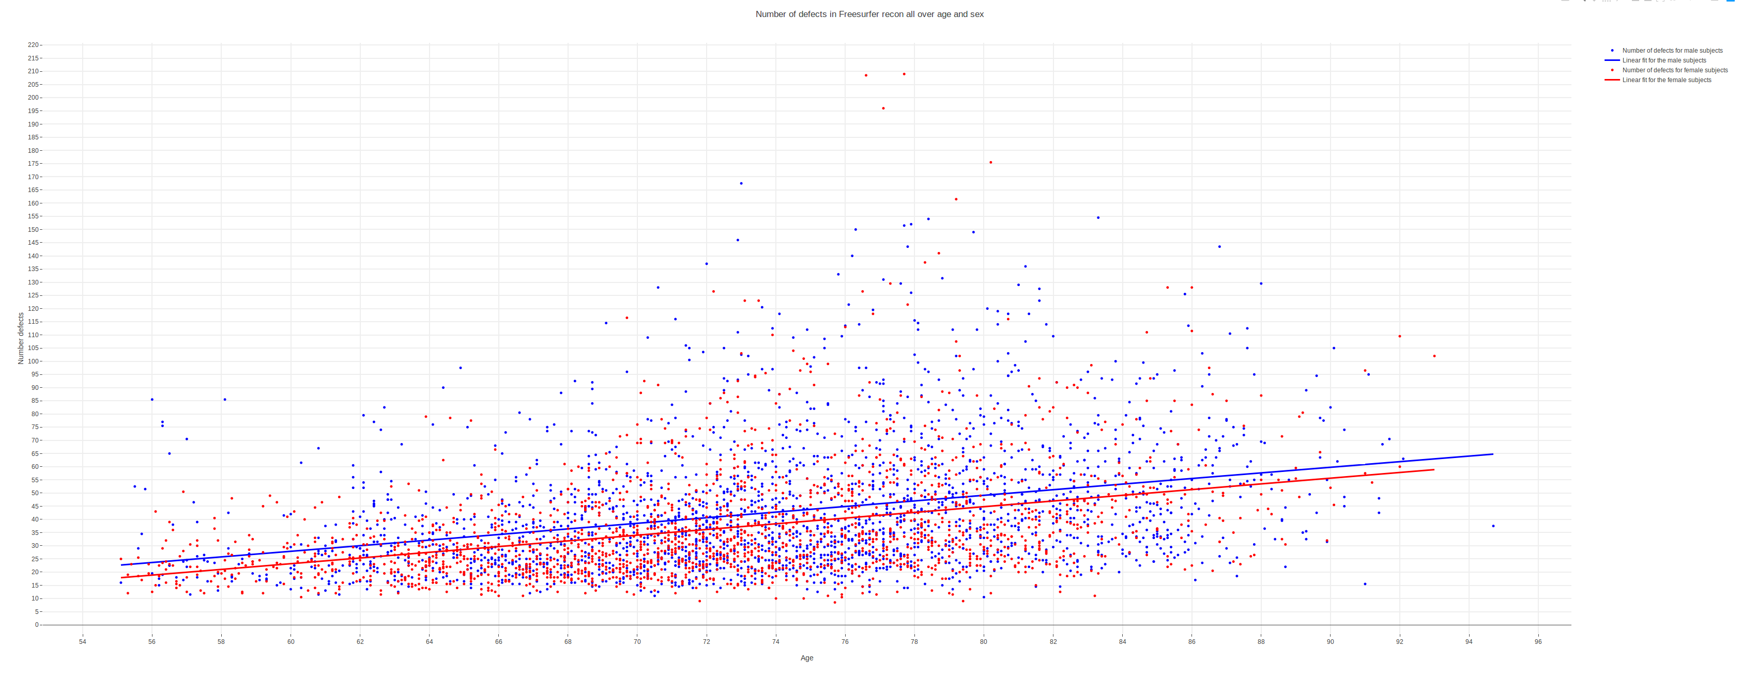
Possible other factors: Sex?
Interactive Plot
file:///groups/ag-reuter/projects/adni-qc/qc-presentation/age-sex-defects-scatter.html

Slide 18
Conclusion
No big difference whether SNR is computed on norm.mgz or orig.mgz
Useful metrics:
  Number of defects/Number of holes/Topological fixing time: Blurriness, motion artifacts
  Contrast to Noise ratio/Gray Matter SNR: Match well with the actual GM/WM contrast

Slide 19
Conclusion
Not very useful for QC:
  WM SNR: Matches more with Hypointensities, rather than bad quality
  Relative Volume of Corpus callosum: Does not match with false segmentation
  Segmentation outliers: outliers segmentation not due to a false segmentation

Slide 20
Discussion: What to do next?
How to define a bad quality?
  Thresholds: Limit the false negative or the false positive
  Thresholds based on standard deviations
Which other metrics useful (MRI QC):
  Foreground-background energy ration
  Goodness of fit of air mask to χ 2 distribution
Shape analysis

