Slide 1
Faster Optimizers
곽대훈

Slide 2
CONTENTS
01. GD
02. Momentum Method
- Momentum
- NAG
03. Adaptive Method
- Adagrad
- RMSprop
- Adam
04. etc.

Slide 3
01 . Gradient Descent

Slide 4
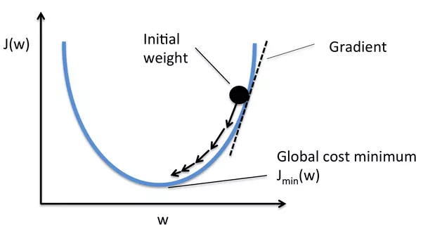
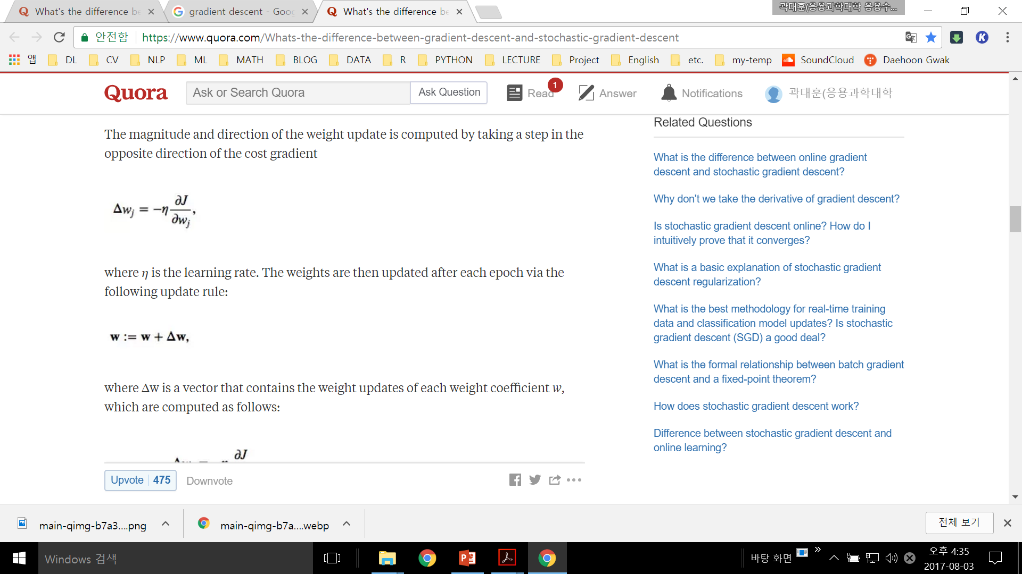
GD
Gradient
Descent
출처: https://www.quora.com/Whats-the-difference-between-gradient-descent-and-stochastic-gradient-descent

Slide 5
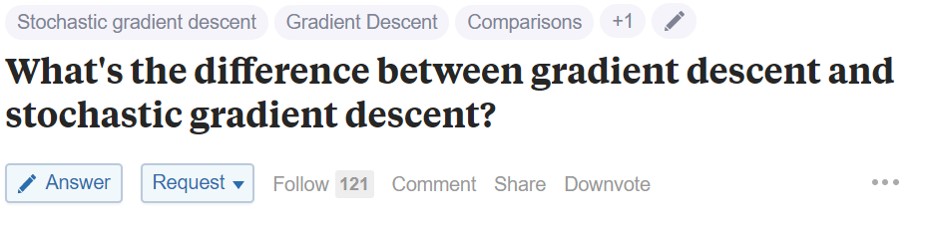
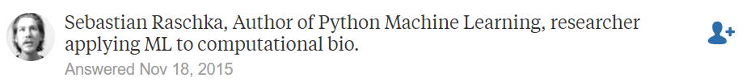
GD
Gradient
Descent
출처: https://www.quora.com/Whats-the-difference-between-gradient-descent-and-stochastic-gradient-descent

Slide 6
GD
Gradient
Descent
GD : (Batch) Gradient Descent
-Whole training set
SGD : Stochastic Gradient Descent
-Here, the term "stochastic" comes from the fact that
the gradient based on a single training sample is
a "stochastic approximation" of the "true" cost gradient.
Mini-Batch GD : Mini-Batch Gradient Descent
-Mini-Batch Gradient Descent (MB-GD) a compromise between batch GD and SGD.
In MB-GD, we update the model based on smaller groups of training samples;
There are tradeoffs: Correctness vs. Speed
출처: https://www.quora.com/Whats-the-difference-between-gradient-descent-and-stochastic-gradient-descent

Slide 7
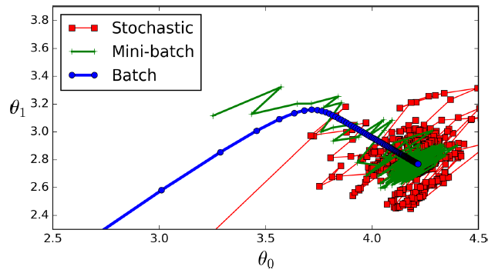
Paths in parameter space
Gradient
Descent
출처: https://github.com/ageron/handson-ml/blob/master/04_training_linear_models.ipynb

Slide 8
02 . Momentum Method

Slide 9
GD
Momentum
Method
Regular Gradient Descent will simply take small regular steps down the slope.
-> Slow
It does not care about what the earlier gradients were.
If the local gradient is tiny, it goes very slowly.
-> Next

Slide 10
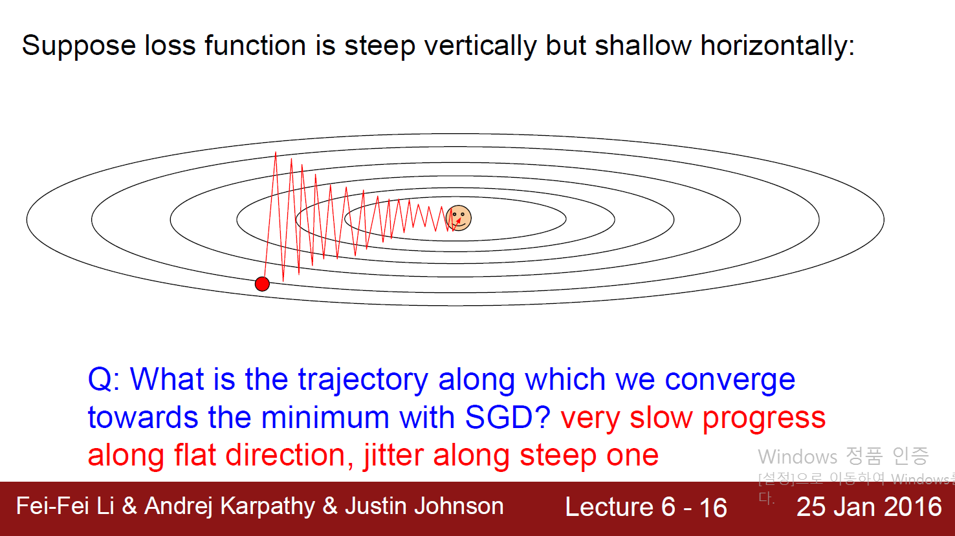

Slide 11
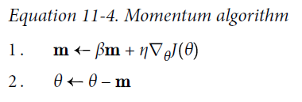
Momentum
Momentum
Method
Imagine a bowling ball rolling down a gentle slope on a smooth surface: it will start
out slowly, but it will quickly pick up momentum until it eventually reaches terminal
velocity (if there is some friction or air resistance).
Eta : learning rate
Beta - like fraction, 0.9, drawback
m – like velocity
gradient – like momentum

Slide 12
Momentum
Momentum
Method
Imagine a bowling ball rolling down a gentle slope on a smooth surface: it will start
out slowly, but it will quickly pick up momentum until it eventually reaches terminal
velocity (if there is some friction or air resistance).
Eta : learning rate
Beta - like fraction, 0.9, drawback
m – like velocity
gradient – like momentum
Terminal velocity -> 1 / (1-beta)
overshoot( friction )

Slide 13
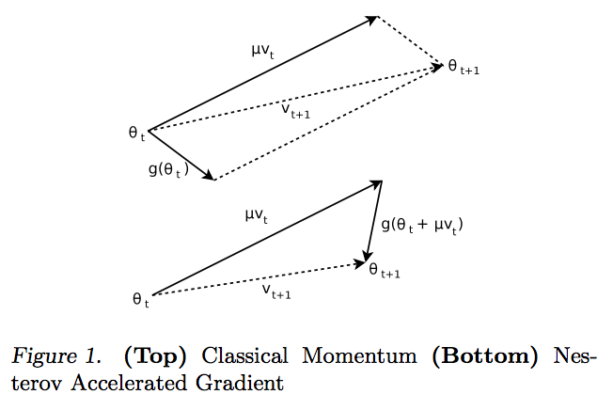
Momentum
Momentum
Method

Slide 14
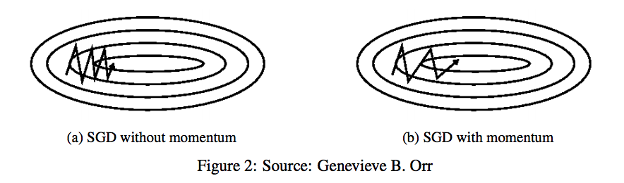
Momentum
Momentum
Method

Slide 15
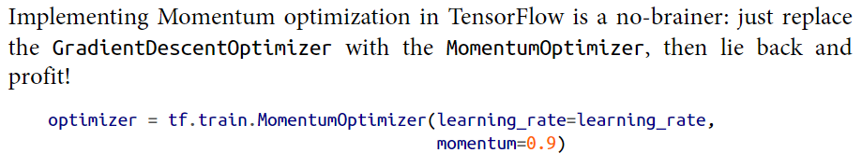
Momentum
Momentum
Method

Slide 16
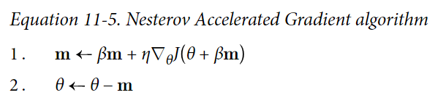
NAG
Momentum
Method
The idea of Nesterov Momentum optimization, or
Nesterov Accelerated Gradient (NAG), is to measure the gradient of the cost function
not at the local position but slightly ahead in the direction of the momentum.

Slide 17
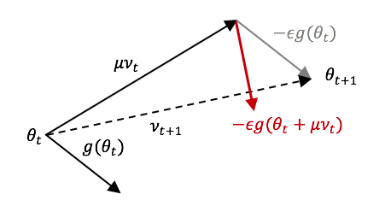
NAG
Momentum
Method

Slide 18
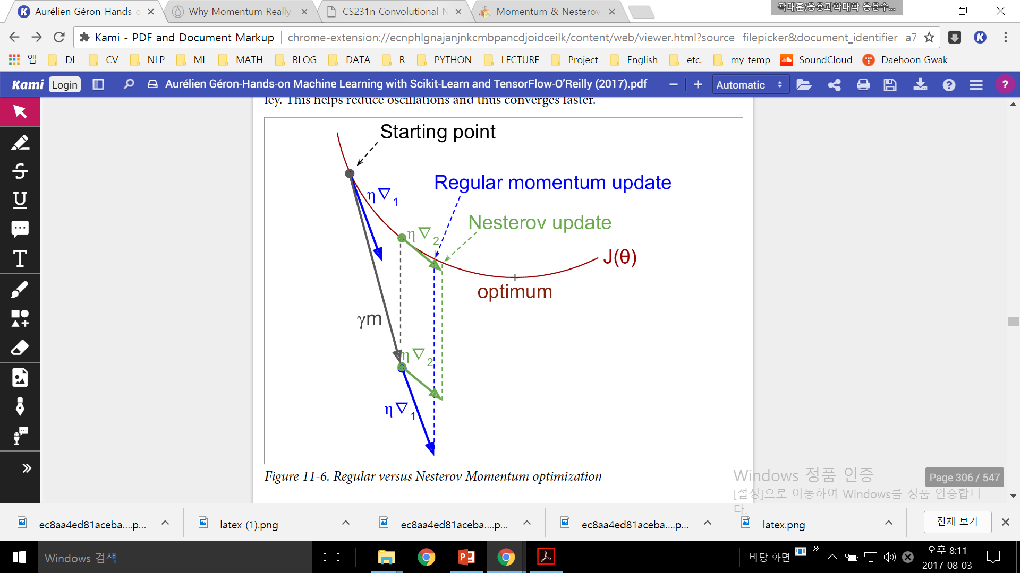
NAG
Momentum
Method
This small tweak works because in general the momentum vector will be pointing in
the right direction (i.e., toward the optimum), so it will be slightly more accurate to
use the gradient measured a bit farther in that direction rather than using the gradi‐
ent at the original position

Slide 19
03 . Adaptive Method

Slide 20
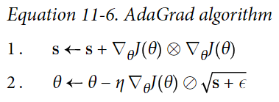
Adagrad
Adaptive
Method
The AdaGrad algorithm achieves this by scaling down the gradient vector along the
steepest dimensions.
In short, this algorithm decays the learning rate,
but it does so faster for steep dimensions than for dimensions with gentler slopes.
This is called an adaptive learning rate.

Slide 21
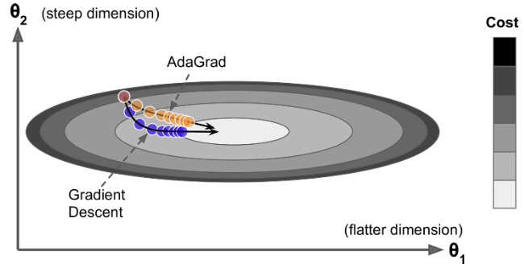
Adagrad
Adaptive
Method
Consider the elongated bowl problem again.
It would be nice if the algorithm could detect this early on
and correct its direction to point a bit more toward the global optimum.

Slide 22
Adagrad
Adaptive
Method
AdaGrad often performs well for simple quadratic problems, but unfortunately it
often stops too early when training neural networks.

Slide 23
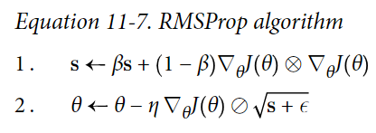
RMSProp
Adaptive
Method
RMSProp algorithm fixes this by accumulating only the gradients
from the most recent iterations (as opposed to all the gradients since the beginning of training).
It does so by using exponential decay in the first step.
beta : 0.9

Slide 24
Adam
Adaptive
Method
Adam, which stands for adaptive moment estimation,
combines the ideas of Momentum optimization and RMSProp:
just like Momentum optimization it keeps track of
an exponentially decaying average of past gradients,
and just like RMSProp it keeps track of
an exponentially decaying average of past squared gradients.

Slide 25
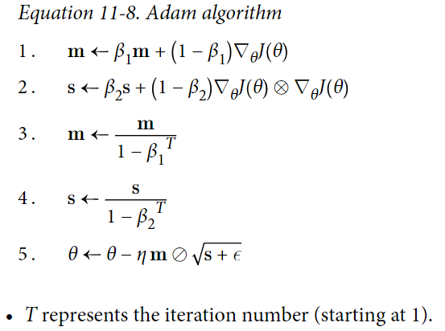
Adam
Adaptive
Method
If you just look at steps 1, 2, and 5,
you will notice Adam’s close similarity to both
Momentum optimization and RMSProp.
The only difference is that step 1 computes
an exponentially decaying average rather than
an exponentially decaying sum, but
these are actually equivalent except for a constant factor
(the decaying average is just
1 – β times the decaying sum).

Slide 26
Adam
Adaptive
Method
Steps 3 and 4 are somewhat of a technical detail:
since m and s are initialized at 0,
they will be biased toward 0 at the beginning of training,
so these two steps will help boost m and s
at the beginning of training.
beta1: 0.9 beta2: 0.999

Slide 27
Book

Slide 28
04 . etc.

Slide 29
etc.
etc.
Which optimizer to use? Adam or SGD + NAG
(http://jaejunyoo.blogspot.com/2017/05/marginal-value-of-adaptive-gradient-methods-in-ML.html)
Adam + NAG (http://cs229.stanford.edu/proj2015/054_report.pdf)
Learning rate schedule with Adaptive methods
NAG implementation tricks (https://tensorflow.blog/2017/03/22/momentum-nesterov-momentum/)
Why momentum Really Works (https://distill.pub/2017/momentum/)

