Slide 1

INSTITUTE OF ADVANCED RESEARCH (IAR)
The University for Innovation | Gandhinagar, Gujarat
SECOND PROGRESS WORK (MID-TERM EXAM) • 13TH OCTOBER 2026 • 20 MARKS
E-COMMERCE CUSTOMER LIFECYCLE &
RFM SEGMENTATION DASHBOARD
Second Phase Technical Report: UML Class & Sequence Models, Data Dictionary & UI Layout Validations
PROJECT SCHOLAR
Candidate Name: Mr. Deep Koshiya
Program: B.Sc. in AI & Data Science
Semester: Semester V (5th Semester)
Academic Year: 2026 – 2027
Course: Project - 1 (CE-502 / PRJ-701)
EVALUATION & DELIVERABLE SCOPE
Milestone: Second Progress Work (Mid-Term)
Evaluation Date: 13th October 2026 (10 AM - 5 PM)
Marks Allotted: 20 Marks (Mid-Term Assessment)
Syllabus Scope: Sections 2.3, 2.4, 3.1, 4.1
Supervision: Assigned Project Supervisor (IAR)

Slide 2
PROGRESSIVE ARCHITECTURE • OVERVIEW
02 / 10
System Architecture & Phase 1 Foundations Recap
1. Phase 1 Foundations (10 Marks)
• Problem Formulation (1.1): Defined retention economics, surging CAC, and OLTP operational gaps.
• Requirement Matrix (1.2): Specified FR-01 through FR-06 and NFR-01 to NFR-03 with hardware specs.
• Tech Stack Layering (1.3): Configured Python 3.9, Pandas 2.3, Scikit-Learn 1.6, and Chart.js.
• DFD Architecture (2.1): Constructed Context Level 0, Level 1 Pipeline, and Level 2 Decomposition DFDs.
2. Phase 2 Deliverables (20 Marks)
• UML Class Diagram (2.3): Domain entity model & pipeline class architecture (TransactionRecord, Refinery, RFM, KMeans).
• UML Sequence Diagram (2.4): 11-step synchronous/asynchronous message dispatch protocol across system lifelines.
• Data Dictionary (3.1): Complete star-schema catalog: FACT_TRANSACTIONS, FACT_REVERSALS, DIM_CUSTOMERS.
• Screen Layouts (4.1): Multi-screen UI layouts with operational input validations (VAL-01 to VAL-04).
3. Technical Value Proposition
• Zero Data Leakage: Strict segregation of reversals ensures return items never pollute positive purchase frequency counts.
• Skew-Resistant Clustering: Log1p scaling neutralizes Pareto monetary power laws for robust K-Means clustering.
• BI Mart Compatibility: Star schema facilitates native query performance in Tableau, Power BI, and SQL engines.
• Instant CRM Activation: Interactive UI enables commercial teams to filter and export high-value at-risk cohorts instantly.
B.Sc. in Artificial Intelligence & Data Science (Sem V) • Institute of Advanced Research • Second Progress Work (13/10/2026)

Slide 3
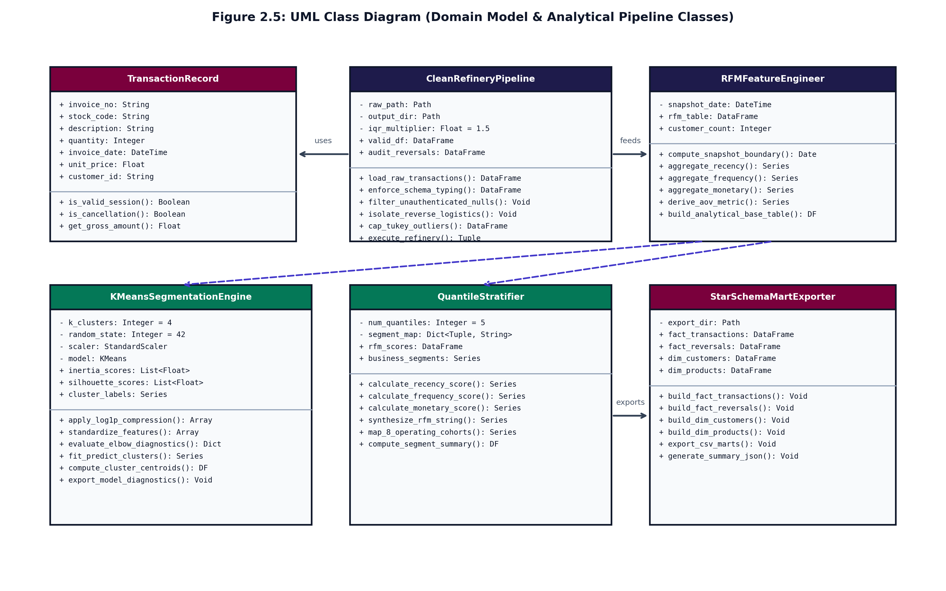
SECTION 2.3 • SYSTEM DESIGN
03 / 10
UML Class Diagram (Domain Model & Object Architecture)
Core Pipeline Classes & Relationships
• TransactionRecord: Domain entity representing single line-item purchases with validation and pricing methods.
• CleanRefineryPipeline: Orchestrates ingestion, typing, guest session filtering, reversal quarantine, and Tukey IQR capping.
• RFMFeatureEngineer: Vectorized engine computing customer Recency (T_obs), Frequency, Spend, and AOV.
• KMeansSegmentationEngine: Encapsulates log1p compression, StandardScaler, K-Means fitting (k=4), and Silhouette diagnostics.
• QuantileStratifier: Assigns 1–5 quantile scores (pd.qcut) and maps accounts to 8 business operational cohorts.
• StarSchemaMartExporter: Generates FACT_TRANSACTIONS, FACT_REVERSALS, DIM_CUSTOMERS, and summary JSON.
Figure 2.5: UML Class Diagram (Domain Model & Pipeline Services)
B.Sc. in Artificial Intelligence & Data Science (Sem V) • Institute of Advanced Research • Second Progress Work (13/10/2026)

Slide 4
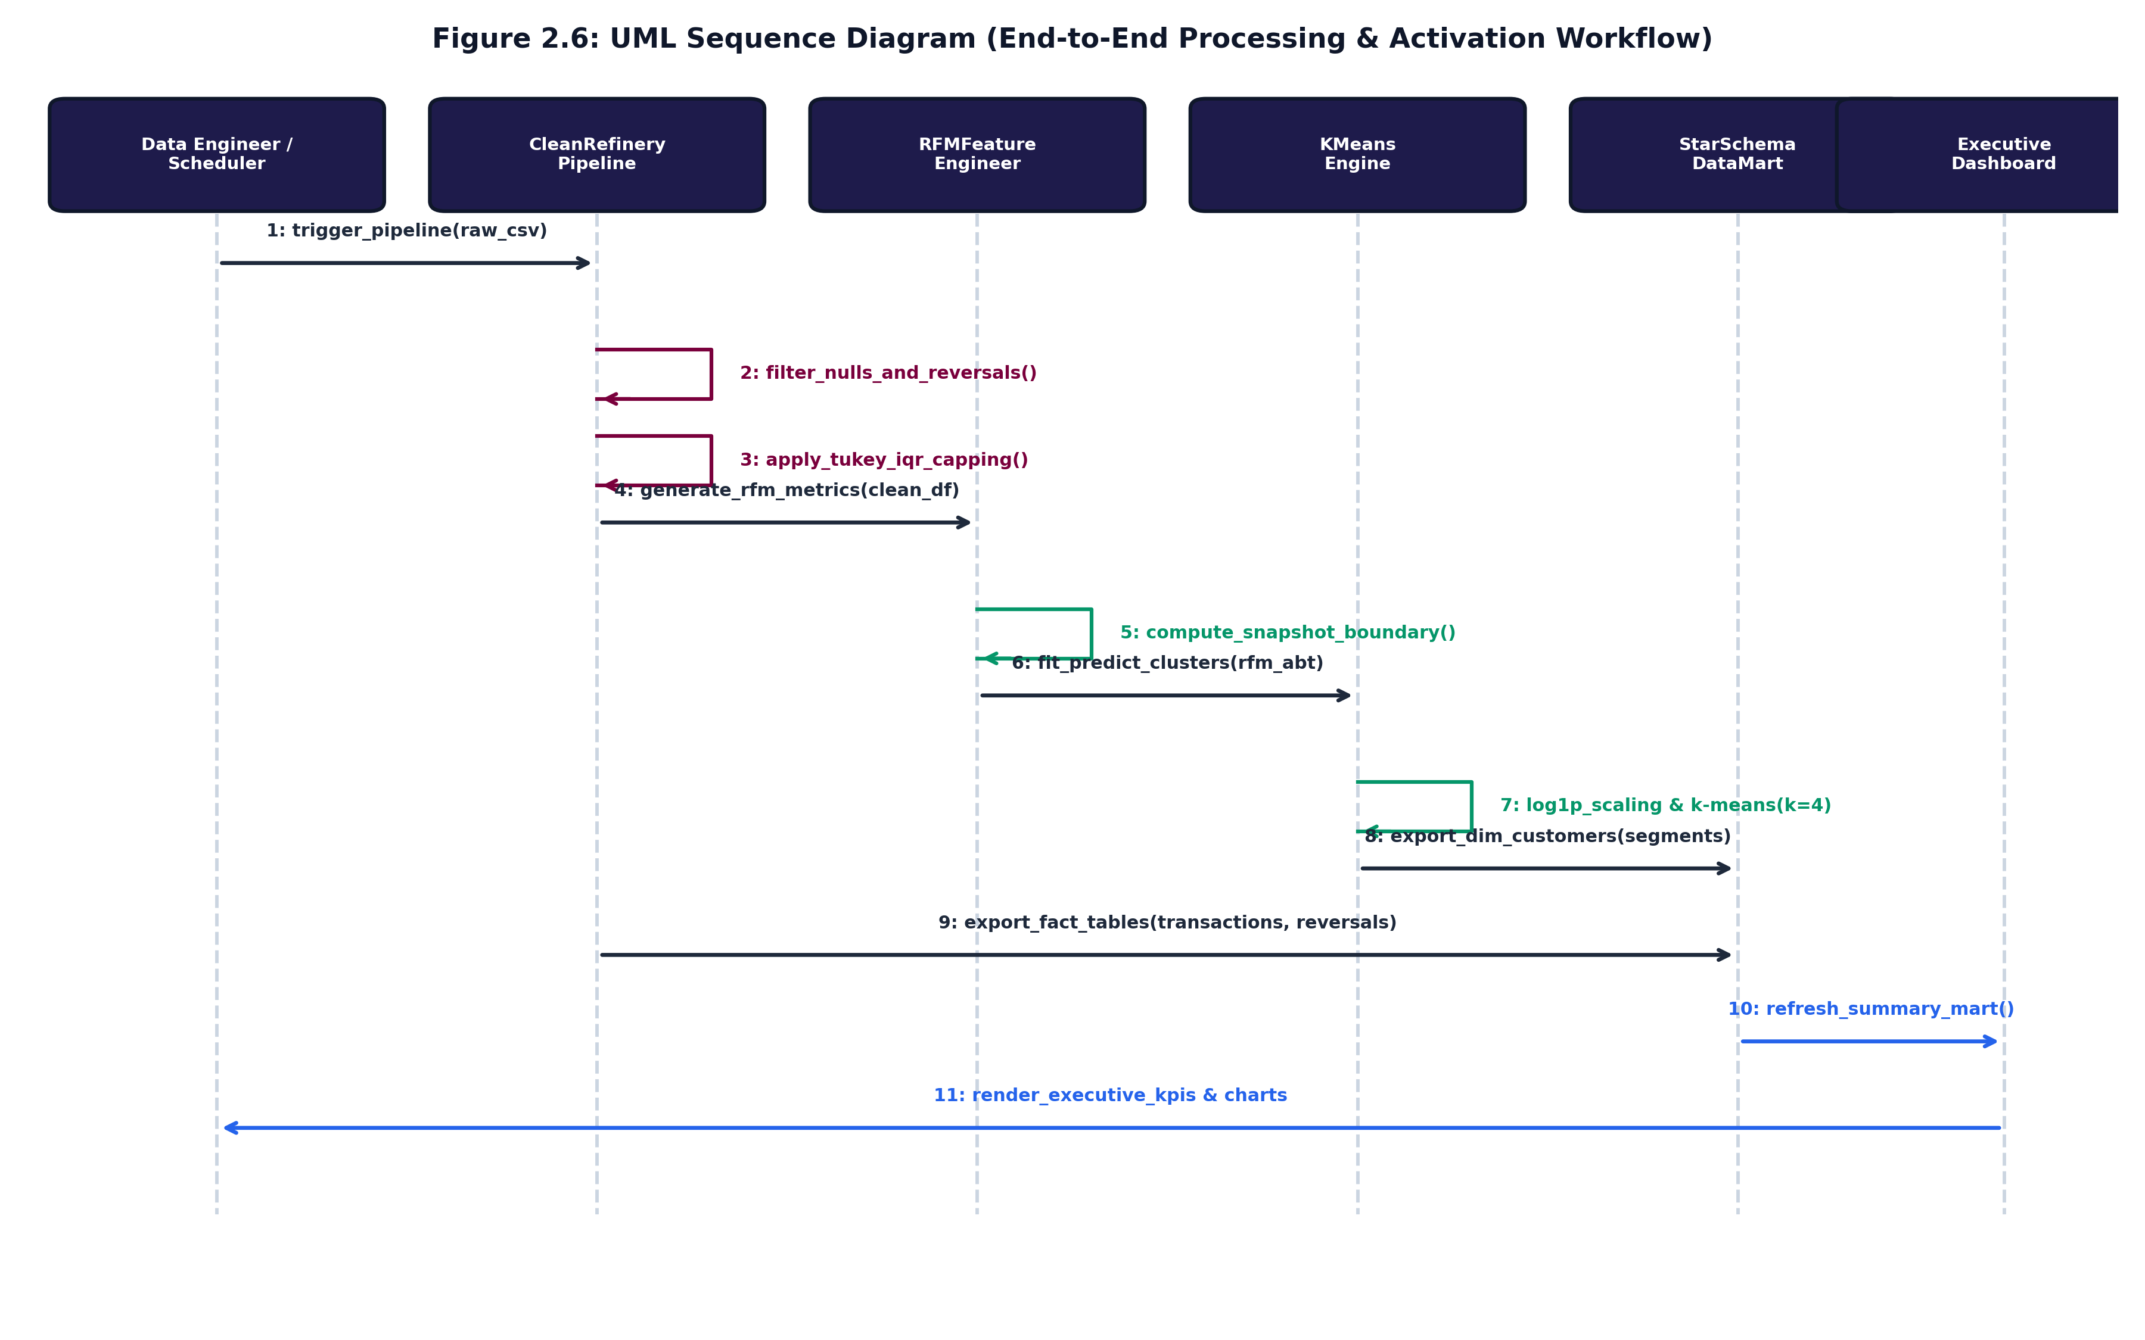
SECTION 2.4 • EXECUTION ARCHITECTURE
04 / 10
UML Sequence Diagram (Pipeline Execution Workflow)
11-Step Message Dispatch Protocol
• Step 1 (Trigger): Data Engineer initiates trigger_pipeline(raw_csv) to commence ingestion.
• Steps 2-3 (Refinery): Self-calls filter unauthenticated sessions, quarantine cancellations, and cap Tukey IQR outliers.
• Steps 4-5 (Feature Extraction): Cleansed records dispatched to RFMFeatureEngineer, deriving snapshot boundary T_obs.
• Steps 6-7 (ML Modeling): RFM Analytical Base Table dispatched to KMeansEngine for log1p scaling and k=4 clustering.
• Steps 8-9 (Data Mart Export): Segments and fact tables persisted to StarSchemaDataMart.
• Steps 10-11 (Activation): Summary JSON exported to ExecutiveDashboard, rendering KPI cards and spatial scatterplots.
Figure 2.6: UML Sequence Diagram (End-to-End Processing & Activation)
B.Sc. in Artificial Intelligence & Data Science (Sem V) • Institute of Advanced Research • Second Progress Work (13/10/2026)

Slide 5
SECTION 3.1 • DATA DICTIONARY
05 / 10
Data Dictionary: Fact Tables (FACT_TRANSACTIONS & FACT_REVERSALS)
Table 3.1: FACT_TRANSACTIONS (Order Fact Mart)
• transaction_id (BIGINT, PK): Surrogate primary key generated monotonically.
• invoice_no (VARCHAR(20)): 6-digit order identifier (e.g. 536365).
• stock_code (VARCHAR(20), FK): Foreign key referencing DIM_PRODUCTS.
• quantity (INTEGER): Item units purchased; strictly Quantity > 0.
• invoice_date (TIMESTAMP, FK): Transaction timestamp referencing DIM_DATE.
• unit_price (DECIMAL(10,2)): Product sale unit price; strictly UnitPrice > 0.
• customer_id (VARCHAR(20), FK): Foreign key referencing DIM_CUSTOMERS.
• gross_amount (DECIMAL(12,2)): Line spend: Quantity * UnitPrice.
Table 3.2: FACT_REVERSALS (Audit Fact Mart)
• reversal_id (BIGINT, PK): Surrogate primary key for return audit records.
• invoice_no (VARCHAR(20)): Cancellation invoice matching regex '^C[0-9]+'.
• stock_code (VARCHAR(20), FK): Foreign key referencing returned product SKU.
• return_quantity (INTEGER): Negative units returned (Quantity < 0).
• reversal_date (TIMESTAMP, FK): Timestamp when cancellation was processed.
• unit_price (DECIMAL(10,2)): Original sale unit price of returned item.
• customer_id (VARCHAR(20), FK): Foreign key referencing customer returning items.
• Operational Integrity: Quarantined in fact_reversals_audit.csv to ensure return events never distort positive spend metrics.
B.Sc. in Artificial Intelligence & Data Science (Sem V) • Institute of Advanced Research • Second Progress Work (13/10/2026)

Slide 6
SECTION 3.1 • DATA DICTIONARY
06 / 10
Data Dictionary: Dimension Tables (DIM_CUSTOMERS & DIM_PRODUCTS)
Table 3.3: DIM_CUSTOMERS (RFM Behavioral Mart)
• customer_key (BIGINT, PK): Surrogate primary key for customer dimension.
• customer_id (VARCHAR(20)): Unique authenticated natural customer ID.
• recency_days (INTEGER): Days elapsed since last order relative to T_obs.
• frequency_orders (INTEGER): Count of distinct checkout trips (unique orders).
• monetary_total (DECIMAL(12,2)): Cumulative net customer spend across all valid orders.
• avg_order_value (DECIMAL(10,2)): Average Order Value: Monetary / Frequency.
• r_score, f_score, m_score (SMALLINT): Deterministic 1 to 5 quantile rank scores (pd.qcut).
• segment_tier (VARCHAR(40)): Mapped business cohort ('Champions', 'At Risk Whales').
Table 3.4 & 3.5: DIM_PRODUCTS & DIM_DATE
DIM_PRODUCTS Catalog Mart:
• product_key (BIGINT, PK): Surrogate primary key for product catalog.
• stock_code (VARCHAR(20)): Unique SKU inventory identifier.
• description (VARCHAR(255)): Cleaned, sanitized item description text.
• unit_price_ref (DECIMAL): Baseline catalog reference price.
DIM_DATE Temporal Mart:
• date_key (INTEGER, PK): YYYYMMDD formatted integer key (e.g. 20261013).
• full_date (DATE): Standard ISO-8601 calendar date.
• day_of_week, month, quarter: Calendar attributes for cohort time-series.
• is_weekend (BOOLEAN): Flag isolating weekend purchasing behavioral shifts.
B.Sc. in Artificial Intelligence & Data Science (Sem V) • Institute of Advanced Research • Second Progress Work (13/10/2026)

Slide 7
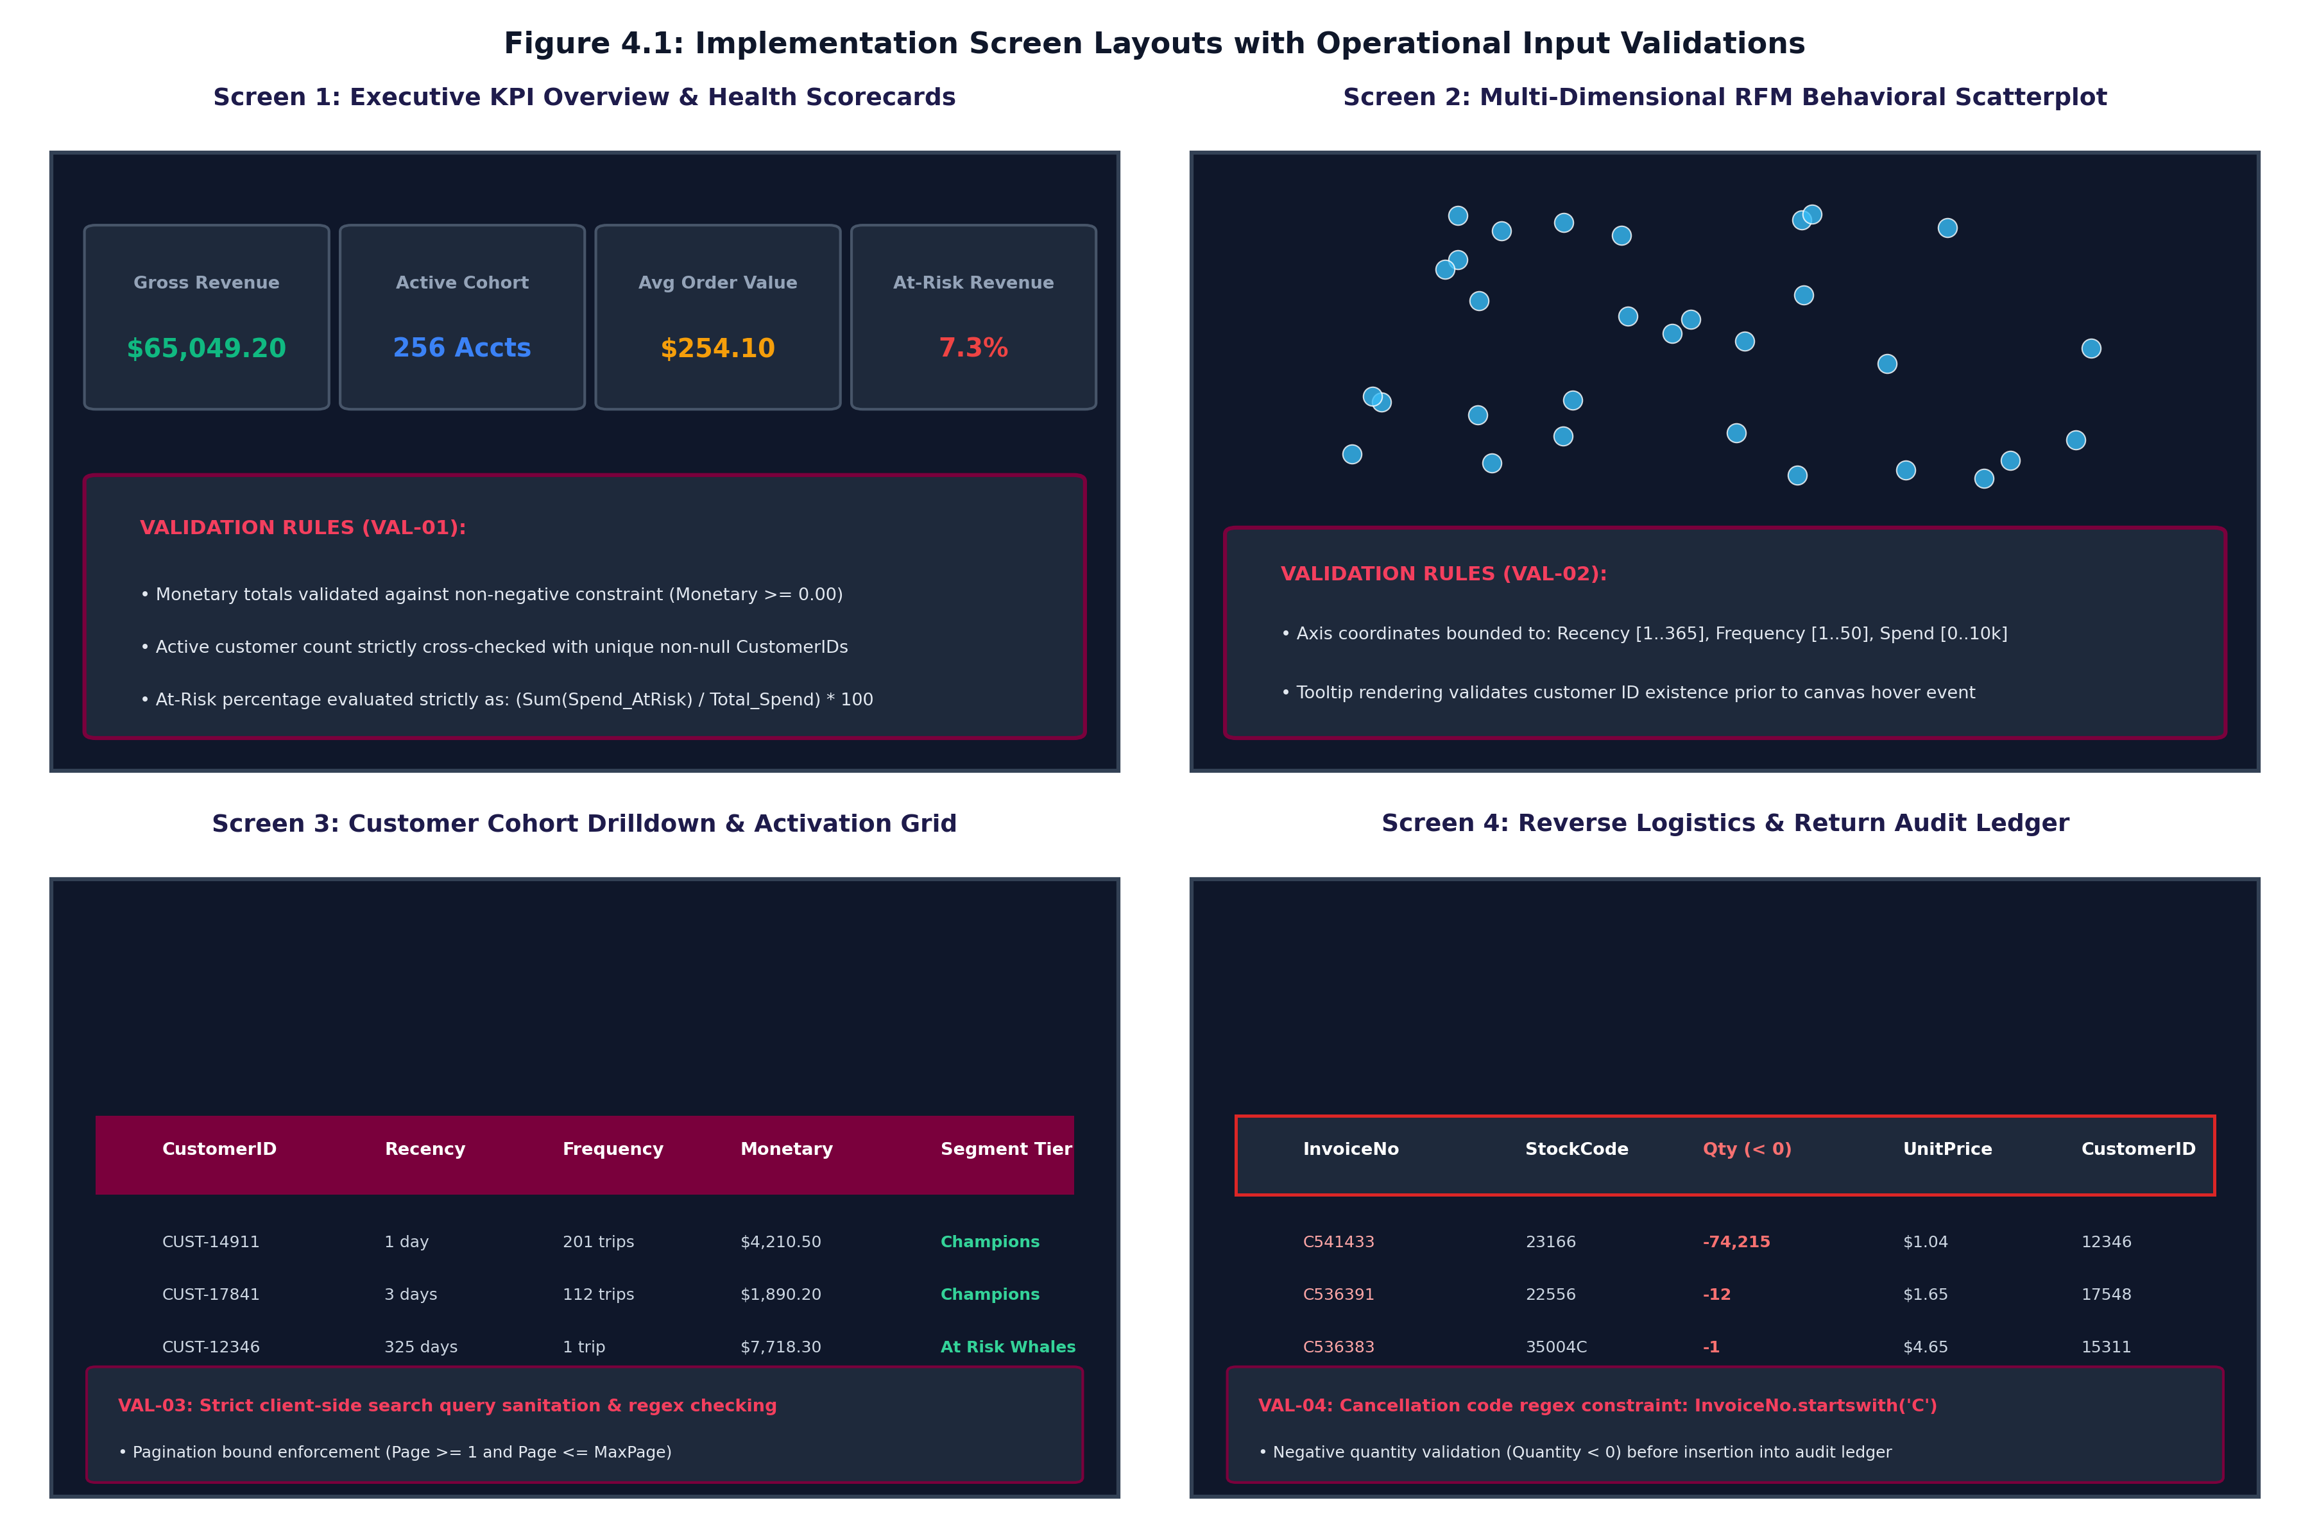
SECTION 4.1 • IMPLEMENTATION
07 / 10
Screen Layouts: Executive BI Dashboard Architecture
4 Synchronized BI Dashboard Views
• Screen 1: Executive KPI Scorecards: High-level summary displaying gross spend ($65,049.20), active customer accounts (256), average order value ($254.10), and at-risk revenue share (7.3%).
• Screen 2: RFM Behavioral Scatterplot: Interactive 2D/3D canvas mapping Recency against Monetary Spend with bubble radii scaled to Frequency.
• Screen 3: Customer Activation Ledger: Filterable data table with instant search, pagination, and targeted CSV audience export controls.
• Screen 4: Reverse Logistics Audit Ledger: Isolated compliance table displaying quarantined cancellations and credit notes.
Figure 4.1: Implementation Screen Layouts (4 Synchronized Views)
B.Sc. in Artificial Intelligence & Data Science (Sem V) • Institute of Advanced Research • Second Progress Work (13/10/2026)

Slide 8
SECTION 4.1 • DATA INTEGRITY
08 / 10
Implementation: Operational Input Validations (VAL-01 to VAL-04)
VAL-01: Scorecard Numerical Integrity Validation
Enforces non-negative monetary constraints (Spend >= 0.00). Active customer counts strictly verify unique authenticated non-null CustomerIDs. At-risk percentages are evaluated as: (Sum(Spend_AtRisk) / Total_Spend) * 100.
VAL-02: Spatial Canvas Coordinate & Boundary Constraints
Interactive scatterplot coordinates enforce strict domain bounds: Recency in [1..365], Frequency in [1..50], Spend in [0..10,000]. Hover tooltips execute null-safety checks before canvas event firing.
VAL-03: Search Query Sanitization & Pagination Bounds
Client-side search input is sanitized against cross-site scripting (XSS) and SQL injection. Table pagination enforces bounded integer intervals (1 <= Page <= MaxPage).
VAL-04: Reverse Logistics Quarantine Constraint
Cancellation transactions strictly enforce regex constraint (InvoiceNo.startswith('C')) and negative quantities (Quantity < 0) before insertion into audit stores.
B.Sc. in Artificial Intelligence & Data Science (Sem V) • Institute of Advanced Research • Second Progress Work (13/10/2026)

Slide 9
MILESTONE TRACKING • CE-502 / PRJ-701
09 / 10
Project Evaluation Schedule & Milestone Status (Mid-Term)
Table 4.1: Comprehensive Project Progress Work Schedule
• [24/09/2026] First Progress Work Evaluation (10 Marks) — COMPLETED & VERIFIED
Curriculum Scope: Sections 1.1, 1.2, 1.3, 2.1, 2.2
• [13/10/2026] Mid-Term Examination (Second Progress) (20 Marks) — DEMONSTRATED (Current Submission)
Curriculum Scope: Sections 2.3, 2.4, 3.1, 4.1
• [27/10/2026] Third Progress Work Evaluation (10 Marks) — Scheduled for Third Milestone
Curriculum Scope: Sections 4.2 (Sample Code), 4.3 (Navigation), 5.1-5.2, 6.1
• [06/11/2026] Report Submission (Spiral Binding) (10 Marks) — Scheduled for Final Submission
Curriculum Scope: Final Signed Spiral Copy & Media
• [18-20/11/2026] Final Examination (SEE) (50 Marks) — Scheduled for Semester Examination
Curriculum Scope: Project Execution Demonstration & Viva Voce
MID-TERM MILESTONE STATUS (13/10/2026): Cumulative completion of 30 Marks (First Progress 10 Marks + Mid-Term 20 Marks). All Class, Sequence, Data Dictionary, and UI Validation specifications fully implemented.
B.Sc. in Artificial Intelligence & Data Science (Sem V) • Institute of Advanced Research • Second Progress Work (13/10/2026)

Slide 10
THANK YOU!
Questions & Technical Discussion
E-COMMERCE CUSTOMER LIFECYCLE & RFM SEGMENTATION DASHBOARD
━━━━━━━━━━━━━━━━━━━━━━━━━━━━━━━━━━━━━━━━━
Candidate: Mr. Deep Koshiya (B.Sc. in AI & Data Science, Semester V)
Institution: Institute of Advanced Research (IAR), Gandhinagar
Assessment Milestone: Second Progress Work / Mid-Term Exam (13/10/2026 • 20 Marks)
Course & Project: Project - 1 (CE-502 / PRJ-701)
GitHub Repository: https://github.com/Deep-k-coder/ecommerce-rfm-analytics
Project Status: Class & Sequence Diagrams, Star Schema Marts & UI Validations Complete

