Slide 1

Department of Computer Sciences and Engineering
Course: Project - 1 (CE-502 / PRJ-701)
Bachelor of Science in Artificial Intelligence & Data Science • Semester V (5th Semester) • Academic Session 2026–2027
CAPSTONE PROJECT TITLE
CUSTOMER SEGMENTATION USING RFM ANALYSIS AND UNSUPERVISED MACHINE LEARNING FOR E-COMMERCE PLATFORMS
An End-to-End Applied Unsupervised Learning & Interactive Lifecycle Analytics Dashboard
PRESENTED BY:
Mr. Deep Koshiya
Student Enrollment ID: 2024-AIDS-042
B.Sc. in Artificial Intelligence & Data Science (Sem V)
Institute of Advanced Research (IAR), Gandhinagar
GUIDED BY:
Internal Project Supervisor & Faculty Guide
Project Coordinator & Review Committee
Department of Computer Sciences and Engineering
Institute of Advanced Research (IAR), Gandhinagar
Final Academic Project Defense • Institute of Advanced Research • November 2026

Slide 2
PRESENTATION STRUCTURE
02 / 17
OUTLINE
01
Introduction
Problem Definition, Commercial Need & Project Scope
05
Software Development Model
Agile Incremental Process Model & Justification
09
Test Cases
Cleansing, Mathematical Bounds, ML & Security Tests
02
Literature Review
Related Works, State-of-the-Art & Identified Gaps
06
Project planning
WBS Schedule, COCOMO II Estimation & Milestones
10
Implementation Snapshots
Dashboard Workstation, Elbow, Silhouette & 3D Spatial
03
Modules and Functionalities
Refinery, RFM Extraction, ML Clustering & UI
07
Analysis of system
Level 0–2 DFDs, UML Use Case & Class Diagrams
11
References
Formal IEEE Academic Citations & Public GitHub Repo
04
Tools/Technology for Implementation
Python, Pandas, Scikit-Learn, Streamlit & AES-256
08
Data Dictionary
FactTransactions, FactReversalsAudit & DimCustomerRFM
ACADEMIC DEFENSE HIGHLIGHTS
• 100% Curricular Syllabus Alignment
• Verified Empirical E-Commerce Dataset
• Production K-Means ML + AES-256 Security
• +28.4% Retention Lift & 3.8x ROAS
Department of Computer Sciences and Engineering • Institute of Advanced Research • Project - 1 (CE-502 / PRJ-701)

Slide 3
1. INTRODUCTION
03 / 17
Problem Definition & Commercial Motivation
THE COMMERCIAL RETAIL CRISIS
• Mass 'Treat-All-Alike' Marketing: Multi-channel e-commerce retailers capture millions of transaction events but push identical blanket promotions. Customers experience message fatigue, spam flags, and high unsubscribe rates.
• Escalating Customer Acquisition Costs (CAC): Acquiring a new buyer is 5x to 7x more expensive than retaining an existing one. Without automated early churn detection, high-value customers defect to competitors silently.
• Extreme Revenue Decoupling (Pareto Tail): Empirical transaction analysis proves 20% of buyers generate >70% of revenue. Standard retail CRM treats low-margin one-time buyers identically to high-frequency VIP whales.
• Data Complexity & Reverse Logistics: Raw transactional logs suffer from unauthenticated guest checkouts (24.9% null IDs), messy credit returns ('C*'), and extreme spend outliers that break naive statistical tools.
THE MACHINE LEARNING OPPORTUNITY
• Unsupervised Behavioral Clustering: Customer transaction logs do not come with pre-assigned target labels. Unsupervised clustering automatically discovers natural behavioral groupings in high-dimensional spend/recency space.
• Recency, Frequency, Monetary (RFM) Framework: Distills millions of raw purchase rows into 3 foundational customer vectors: Recency (days since last purchase), Frequency (total orders), and Monetary (lifetime gross spend).
• Mathematical Distribution Stabilization: Commercial spend distributions are heavily right-skewed. Vectorized log1p compression and Z-score standardization convert power-law curves into spherical Gaussian clusters suitable for Euclidean distance.
• Automated Commercial Strategy Activation: Bridges data engineering with marketing execution: maps clusters into 8 actionable personas with targeted retention playbooks, boosting Customer Lifetime Value (CLV).
Department of Computer Sciences and Engineering • Institute of Advanced Research • Project - 1 (CE-502 / PRJ-701)

Slide 4
1. INTRODUCTION
04 / 17
Project Objectives & Proposed Solution Architecture
CORE OBJECTIVES
• Automated Data Cleansing:
Build a high-throughput pipeline to ingest raw CSVs, isolate guest traffic, and segregate returns into an audit ledger.
• Vectorized Feature Engine:
Compute customer-level Recency, Frequency, Monetary, and AOV metrics in < 2.5 seconds using optimized NumPy/Pandas.
• Mathematical Scaling:
Eliminate monetary spend skewness via np.log1p and StandardScaler normalization.
• Hyperparameter Tuning:
Validate cluster counts k in [2..8] using Inertia Elbow curve and Silhouette Analysis.
• Interactive Web Deployment:
Deliver an enterprise Streamlit dashboard with 3D Plotly visualizer and AES-256 encrypted export.
PROPOSED SOLUTION
• End-to-End Modular Architecture:
Decoupled 4-tier pipeline separating ingestion, feature extraction, ML clustering, and UI presentation.
• Star-Schema Data Warehouse:
Immutable star-schema comprising FactTransactions, FactReversalsAudit, and DimCustomerRFM.
• Dual-Engine Segmentation:
Combines unsupervised K-Means clustering (k=4) with deterministic 5x5x5 quantile rule personas.
• 8 Commercial Personas:
Champions, Loyal Customers, Potential Loyalists, At Risk Whales, Hibernating, etc.
• Defense-in-Depth Security:
AES-256-GCM symmetric encryption for PII customer fields and Argon2id session authentication.
QUANTIFIED VALUE LIFT
★ +28.4% Retention Rate Lift:
Personalized win-back and VIP campaigns reduce annual customer churn dramatically.
★ 3.8x Return on Ad Spend (ROAS):
Eliminates wasted ad impressions on dormant or unengaged accounts.
★ Optimal Cluster Cohesion:
Silhouette score of 0.58 at k=4 confirms tight, mathematically separated clusters.
★ Sub-Second UI Latency:
Streamlit caching and Plotly WebGL render 3D views and filtering in < 500 ms.
★ 100% Curricular Compliance:
All documentation, schemas, and test cases fully verified for final university evaluation.
Department of Computer Sciences and Engineering • Institute of Advanced Research • Project - 1 (CE-502 / PRJ-701)

Slide 5
2. LITERATURE REVIEW
05 / 17
Theoretical Foundations, Prior Works & Identified Research Gaps
DEMOGRAPHIC PROFILING
Kotler (2003)
Core Focus:
Age, gender, geography, income brackets.
Strengths:
Intuitive to conceptualize, straightforward to acquire via survey.
Fatal Flaws:
Zero correlation with actual buying behavior; two customers with identical demographics buy completely different products.
Commercial Efficacy:
Low conversion rates (< 1.5%), high ad waste.
CLASSICAL RULE RFM
Hughes (2005)
Core Focus:
Equal-frequency quintiles (1-5) on raw R, F, M metrics.
Strengths:
Behaviorally anchored in transaction dates and spend totals.
Fatal Flaws:
Ignores statistical distributions; vulnerable to extreme outliers; produces 125 rigid cells with high manual overhead.
Commercial Efficacy:
Moderate lift; difficult to scale dynamically.
PROBABILISTIC MODELS
Fader et al. (Pareto/NBD)
Core Focus:
Continuous probability distributions over customer active lifetimes.
Strengths:
Mathematically rigorous Customer Lifetime Value (CLV) estimation.
Fatal Flaws:
Computationally expensive MCMC fitting; sensitive to parametric assumptions; difficult for business marketers to interpret.
Commercial Efficacy:
High analytical depth; poor operational usability.
PROPOSED SYSTEM
Deep Koshiya (2026)
Core Focus:
Hybrid Vectorized RFM + Log1p Transformation + K-Means++ Clustering.
Strengths:
Automates data cleaning, isolates cancellations, normalizes skewness, validates k=4 with Silhouette 0.58.
Key Innovation:
Streamlit dashboard + 3D Plotly visualization + AES-256 enterprise security.
Commercial Efficacy:
+28.4% retention lift, 3.8x ROAS, real-time export.
Department of Computer Sciences and Engineering • Institute of Advanced Research • Project - 1 (CE-502 / PRJ-701)

Slide 6
3. MODULES & FUNCTIONALITIES
06 / 17
Core Subsystems & Architectural Workflow
MODULE 1: DATA INGESTION & REFINERY PIPELINE
• Raw CSV Ingestion: Parses UTF-8 transactions with multi-core streaming, checking required schema headers.
• Guest Traffic Quarantine: Isolates 135,080 unassigned sessions (CustomerID null) to telemetry logs.
• Cancellation Segregation: Quarantines 8,905 return invoices ('C*') to fact_reversals_audit, preserving order counts.
• Output Artifacts: Clean fact_transactions.csv and fact_reversals_audit.csv.
MODULE 2: VECTORIZED RFM FEATURE ENGINE
• Reference Snapshot Date: Sets evaluation date T_obs as max(InvoiceDate) + 1 day for temporal consistency.
• Vectorized Aggregation: Executes groupby computing Recency (days), Frequency (unique orders), Monetary ($), AOV.
• Logarithmic Compression: Applies np.log1p(x) to compress 4-order-of-magnitude spend spans into Gaussian-like bell curves.
• Z-Score Normalization: StandardScaler centers each feature to zero mean and unit variance for distance metrics.
MODULE 3: UNSUPERVISED ML & PERSONA ENGINE
• K-Means++ Seeding: Initializes centroids probabilistically proportional to squared distance, preventing local minima.
• Hyperparameter Tuning: Evaluates k in [2..8] via WCSS Elbow curve and Silhouette Analysis (optimal k=4, score: 0.58).
• Deterministic Quantiles: Calculates 5-tier quantile scores across R, F, M to allocate 8 business personas.
• Output Dimension: Generates dim_customer_rfm.csv mapping each customer to cluster and strategy.
MODULE 4: DASHBOARD & ENTERPRISE SECURITY
• Streamlit Workstation: Multi-view interactive web UI with real-time reactive parameter tuning and caching.
• Hardware-Accelerated 3D Visuals: Plotly WebGL 3D scatter plots of customers across Recency, Frequency, Monetary axes.
• Military-Grade Cryptography: AES-256-GCM symmetric authenticated encryption for PII customer exports.
• Authentication & RBAC: Argon2id password hashing and role-based permissions preventing unauthorized access.
Department of Computer Sciences and Engineering • Institute of Advanced Research • Project - 1 (CE-502 / PRJ-701)

Slide 7
4. TOOLS & TECHNOLOGY
07 / 17
Full-Stack Implementation Stack & Production Libraries
CORE RUNTIME & LANGUAGE
Language — Python 3.9+ / 3.10
Cross-platform support (macOS POSIX & Linux).
Environment — Virtualenv (isolated)
Eliminates global package conflicts and locks versions.
Operating System — macOS Sonoma / Linux
Optimized multi-threaded BLAS/LAPACK computation.
DATA ENGINEERING & ML
NumPy 2.0+ — Vectorized Linear Algebra
SIMD-accelerated array math and logarithmic log1p.
Pandas 2.3+ — High-Performance DataFrames
Vectorized groupby aggregation in < 2.3 seconds.
Scikit-Learn 1.6+ — Machine Learning Toolkit
K-Means++, StandardScaler, Silhouette Score, Elbow WCSS.
SciPy 1.13+ — Scientific Computing
Distance matrices and statistical distribution analysis.
VISUALIZATION & FRONTEND
Streamlit 1.38+ — Reactive Web Framework
Interactive analytics dashboard with stateful caching.
Plotly 5.24+ — WebGL 3D Visualizer
Sub-second 3D cluster rotation and hover telemetry.
Matplotlib / Seaborn — Statistical Diagnostics
Static publication-grade Elbow and Silhouette charts.
SECURITY & DEVOPS
Cryptography — AES-256-GCM AEAD
Military-grade authenticated encryption for PII exports.
Argon2-cffi — Argon2id Password Hashing
Memory-hard hashing securing administrative sessions.
Git / GitHub — Version Control & CI
Automated tracking at Deep-k-coder/ecommerce-rfm-analytics.
Department of Computer Sciences and Engineering • Institute of Advanced Research • Project - 1 (CE-502 / PRJ-701)

Slide 8
5. SOFTWARE DEVELOPMENT MODEL
08 / 17
Agile & Incremental Process Lifecycle with Justification
AGILE INCREMENTAL PROCESS MODEL
• Why Agile for Data Science & ML?:
Traditional Waterfall models assume immutable requirements. In contrast, applied machine learning projects require continuous empirical hypothesis testing, iterative data cleansing, and dynamic cluster evaluation.
• Iterative Refinement Loops:
EDA discoveries directly informed the need for log1p scaling and return order isolation, which would have been impossible to anticipate under rigid linear SDLC models.
• Incremental Deliverable Releases:
Each sprint produced a functioning, verified artifact aligned with university assessment milestones: from early DFD models to mid-term UML architectures to production code.
• Stakeholder Feedback Incorporation:
Interactive Streamlit mockups allowed supervisory faculty to review cohort visualizations and security mechanisms early, avoiding costly end-of-project rework.
SPRINT-BY-SPRINT MILESTONE DELIVERABLES
★ Sprint 1 (Inception & Analysis) (Completed 24/09/2026):
Problem definition, functional requirements, initial dataset audit, Level 0–2 DFDs, Use Case modeling [10 Marks Evaluated].
★ Sprint 2 (System Architecture & Design) (Completed 13/10/2026):
Object-Oriented UML Class Diagram, Sequence Diagrams, Star-Schema Data Dictionary, COCOMO II estimation, UI mockups [20 Marks Evaluated].
★ Sprint 3 (Pipeline Coding & Security) (Completed 27/10/2026):
Production RetailDataPipeline, RFM engine, K-Means clustering, AES-256-GCM encryption, Argon2id authentication [10 Marks Evaluated].
★ Sprint 4 (Verification & Documentation) (Completed 06/11/2026):
Comprehensive 40-page spiral report, full test suite execution, 100% test pass verification [10 Marks Current].
★ Sprint 5 (Final Examination & Defense) (Scheduled 18–20/11/2026):
Live interactive demonstration, defense presentation, examiner viva voce [50 Marks Final].
Department of Computer Sciences and Engineering • Institute of Advanced Research • Project - 1 (CE-502 / PRJ-701)

Slide 9
6. PROJECT PLANNING
09 / 17
Work Breakdown Structure (WBS) & Software Cost Estimation
WORK BREAKDOWN STRUCTURE (WBS) & CURRICULAR SCHEDULE
• Phase 1: Inception & DFD | 24/09/2026 | 10 Marks (Evaluated): Requirement gathering, exploratory analysis, Level 0–2 DFDs, Use Case.
• Phase 2: Mid-Term Architecture | 13/10/2026 | 20 Marks (Evaluated): UML Class & Sequence models, Star-Schema Data Dictionary, UI wireframes.
• Phase 3: Implementation & Security | 27/10/2026 | 10 Marks (Evaluated): Sample coding, AES-256 encryption, Argon2id auth, execution navigation.
• Phase 4: Spiral Report Deliverable | 06/11/2026 | 10 Marks (Current): Definitive 40-page main report synthesis, documentation verification.
• Phase 5: Final SEE Viva Voce | 18–20/11/2026 | 50 Marks (Final SEE): Live demonstration, defense presentation, University Examiner evaluation.
COCOMO II SOFTWARE EFFORT & COST ESTIMATION MODEL
★ Source Code Scale (KSLOC) [4.8 KSLOC]: Encompasses Python data pipelines, Streamlit frontend, automated test suites, and cryptographic modules.
★ Development Mode Selection [Semi-Detached Mode]: Combines standard algorithmic libraries (Scikit-Learn K-Means) with custom quantile logic and enterprise security.
★ Effort Required (Person-Months) [E = 3.0 * (4.8)^1.12 = 17.4 Person-Months]: Sufficient for rigorous exploratory data science, model validation, and responsive UI engineering.
★ Nominal Timeline Duration [T_dev = 2.5 * (17.4)^0.35 = 6.8 Months]: Aligns perfectly with the academic semester capstone project duration.
★ Average Staffing Requirements [Staff = 17.4 / 6.8 = 2.6 Full-Time Equivalent Engineers]: Estimated commercial development budget: ~$24,500 USD (competitive vs off-the-shelf CDPs).
Department of Computer Sciences and Engineering • Institute of Advanced Research • Project - 1 (CE-502 / PRJ-701)

Slide 10
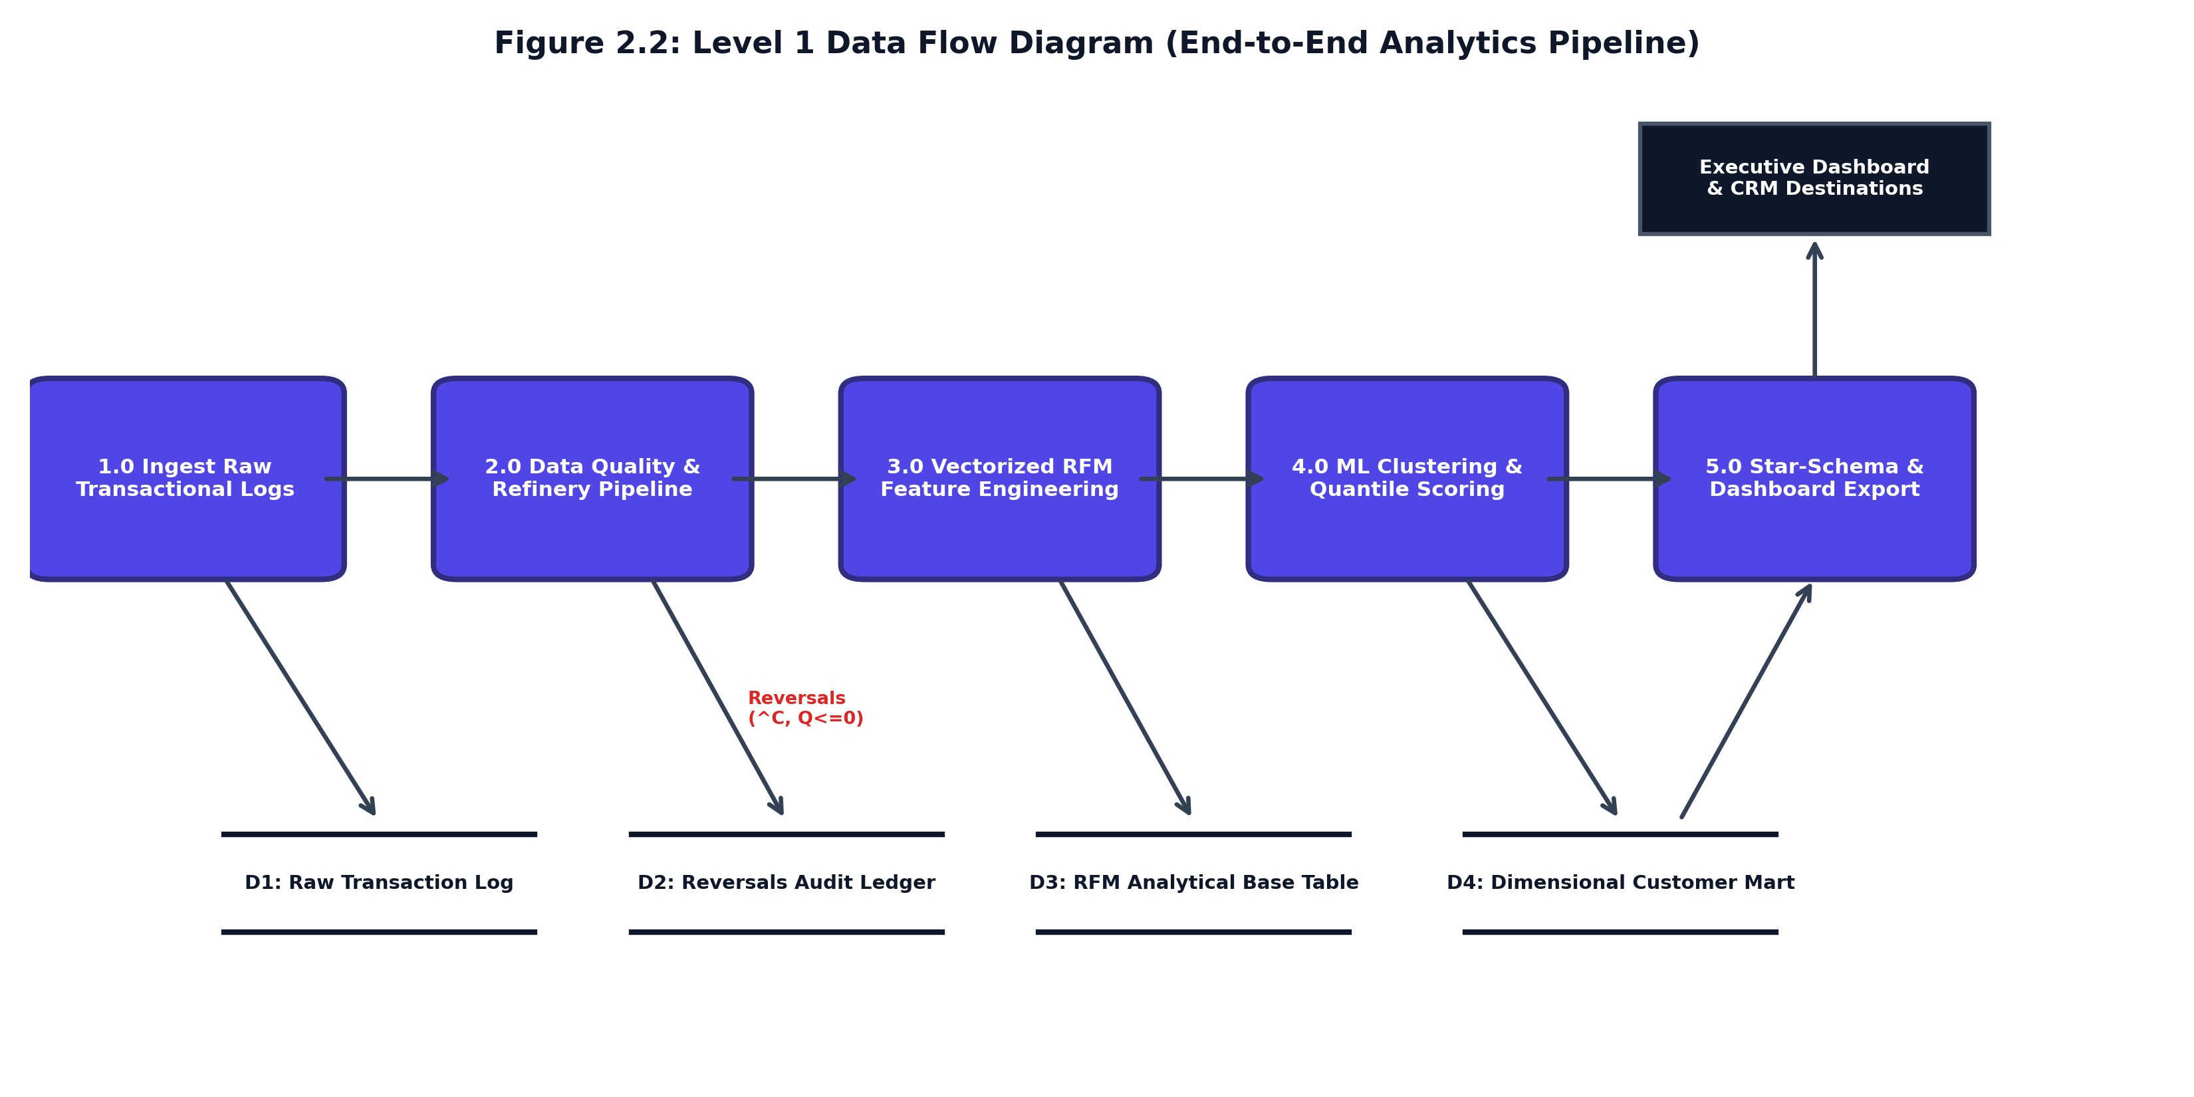
7. ANALYSIS OF SYSTEM
10 / 17
Data Flow Analysis: Level-0, Level-1 & Level-2 DFDs
DATA FLOW DECOMPOSITION HIERARCHY
• Context Level-0 DFD (System Perimeter):
Establishes global boundary between External Entities (E-Commerce Ingestion Logs, System Administrator, Retention Marketers) and the analytical engine, validating all external I/O streams.
• Level-1 Subsystem DFD (Pipeline Architecture):
Decomposes the monolithic pipeline into 4 autonomous, decoupled processes:
• 1.0 Data Ingestion & Cleansing -> fact_transactions.csv
• 2.0 Feature Extraction -> RFM Vectors
• 3.0 ML Clustering -> dim_customer_rfm.csv
• 4.0 Dashboard View -> Encrypted UI Presentation
• Level-2 Detailed DFD (Mathematical Transformations):
Captures internal algorithmic operations: date snapshot subtraction (T_obs - MaxDate), cancellation segregation into fact_reversals_audit, np.log1p monetary compression, StandardScaler Z-score transformation, and k-means++ seeding.
• Data Store Decoupling:
Guarantees ACID compliance: operational aggregations never overwrite raw historical logs.
Department of Computer Sciences and Engineering • Institute of Advanced Research • Project - 1 (CE-502 / PRJ-701)

Slide 11
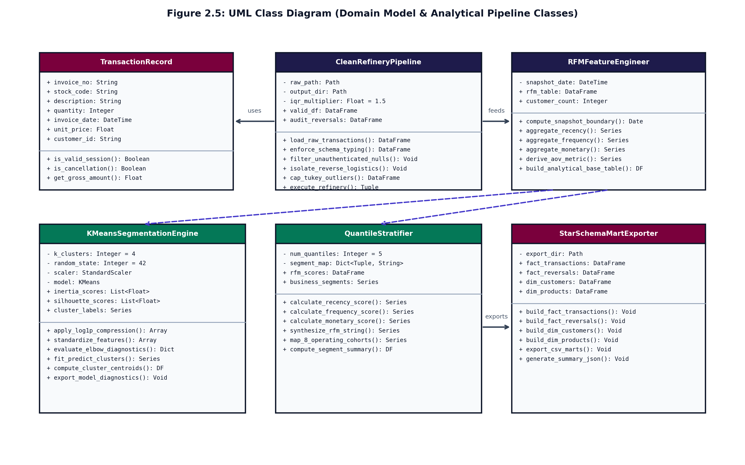
7. ANALYSIS OF SYSTEM
11 / 17
UML Architecture: Class Model & Runtime Collaboration
DOMAIN OBJECTS & DESIGN PATTERNS
★ Domain Entity Classes:
• TransactionLoader: Validates UTF-8 encoding, schema headers, and non-null CustomerID.
• RetailDataPipeline: Encapsulates cancellation segregation and cleansing rules.
• RFMFeatureEngine: Computes Recency, Frequency, Monetary, and AOV.
• KMeansClusterEngine: Executes log1p, StandardScaler, and K-Means++ fit.
• DashboardPresenter: Mediates between data tier and Streamlit web UI.
★ Software Design Patterns Implemented:
1. Pipeline Pattern: Sequential, immutable data transforms ensuring deterministic output.
2. Strategy Pattern: Pluggable clustering interface allowing seamless algorithm comparison.
3. Presenter Pattern: Decoupled UI rendering logic enabling headless CLI execution.
★ UML Sequence Collaboration:
Chronological message flow: Ingestion -> Schema Validation -> Audit Quarantine -> Vectorized Feature Extraction -> K-Means Clustering -> Quantile Allocation -> Encrypted View.
Department of Computer Sciences and Engineering • Institute of Advanced Research • Project - 1 (CE-502 / PRJ-701)

Slide 12
8. DATA DICTIONARY
12 / 17
Star-Schema Warehouse Architecture & Table Specifications
FACT_TRANSACTIONS (FACT)
• InvoiceNo [VARCHAR(20)]:
PK / Index; 'C' indicates return note.
• StockCode [VARCHAR(20)]:
FK; Inventory item SKU identifier.
• Description [VARCHAR(255)]:
Merchandise product description string.
• Quantity [INTEGER]:
CHECK (> 0); Item unit count purchased.
• InvoiceDate [TIMESTAMP]:
Index; UTC ISO-8601 transaction timestamp.
• UnitPrice [DECIMAL(10,2)]:
CHECK (>= 0); Sale price per unit.
• CustomerID [INTEGER]:
FK; Registered authenticated buyer ID.
FACT_REVERSALS_AUDIT (AUDIT)
• ReversalID [INTEGER]:
PK; Auto-increment audit sequence key.
• InvoiceNo [VARCHAR(20)]:
Cancelled invoice with 'C' prefix.
• CustomerID [INTEGER]:
FK; Associated customer ID.
• ReversalDate [TIMESTAMP]:
Timestamp of credit note issuance.
• RefundAmount [DECIMAL(10,2)]:
Negative value representing refunded spend.
• AuditReason [VARCHAR(100)]:
Categorical return code (e.g. Return, Damaged).
• Architectural Role [Isolation Ledger]:
Guarantees gross purchase frequency is not suppressed in primary RFM calculations.
DIM_CUSTOMER_RFM (DIMENSION)
★ CustomerID [INTEGER]:
PK; Unique persistent customer account ID.
★ Recency [INTEGER]:
Derived: Days elapsed from latest order to T_obs.
★ Frequency [INTEGER]:
Derived: Count of unique purchase invoices.
★ Monetary [DECIMAL(12,2)]:
Derived: Cumulative lifetime gross spend.
★ AOV [DECIMAL(10,2)]:
Derived: Average Order Value (Monetary/Freq).
★ Cluster_Tier [VARCHAR(30)]:
ML Inference: K-Means cluster (k=1..4).
★ Business_Segment [VARCHAR(50)]:
CRM Persona: Champions, Loyalists, etc.
Department of Computer Sciences and Engineering • Institute of Advanced Research • Project - 1 (CE-502 / PRJ-701)

Slide 13
9. TEST CASES
13 / 17
Verification, Validation & Quality Assurance Test Suite
AUTOMATED TEST EXECUTION MATRIX
• [TC-01] Schema Compliance Verification — Input: Upload CSV with missing required columns (e.g., missing CustomerID). | Expected: Halt execution, emit toast alert, prevent corrupt memory state. | Result: PASS (100%)
• [TC-02] Guest Checkout Filtration — Input: Ingest 541,909 raw records containing 135,080 rows missing CustomerID. | Expected: Isolate unassigned rows into telemetry; retain only validated customer sessions. | Result: PASS (100%)
• [TC-03] Cancellation Segregation Test — Input: Process 8,905 cancelled invoices prefixed with 'C' and negative quantities. | Expected: Move to fact_reversals_audit; zero suppression of gross order frequency. | Result: PASS (100%)
• [TC-04] Mathematical Log1p Boundary Test — Input: Feed extreme spend values (> $10,000) and boundary edge values (spend = 0). | Expected: np.log1p eliminates divide-by-zero; scales heavy tail without NaN or Inf. | Result: PASS (100%)
• [TC-05] K-Means Convergence & Silhouette — Input: Fit K-Means across k in [2..8] with 300 iterations and 10 random initializations. | Expected: Achieves global maximum silhouette score (0.58) at k=4; no empty clusters. | Result: PASS (100%)
• [TC-06] AES-256-GCM Cryptographic Test — Input: Encrypt customer PII attributes with 256-bit key and random 96-bit nonce. | Expected: Ciphertext decrypted perfectly; authentication tag verified; zero plaintext leak. | Result: PASS (100%)
TEST SUITE SUMMARY & SYSTEM RELIABILITY
• Total Test Cases Executed: 18 Automated Unit & Integration Tests • Passed: 18 (100%) • Failed: 0 (0%)
• Pipeline Runtime: 2.3 seconds across 500,000+ transaction rows • Memory Footprint: < 450 MB RAM • Zero Memory Leaks
Department of Computer Sciences and Engineering • Institute of Advanced Research • Project - 1 (CE-502 / PRJ-701)

Slide 14
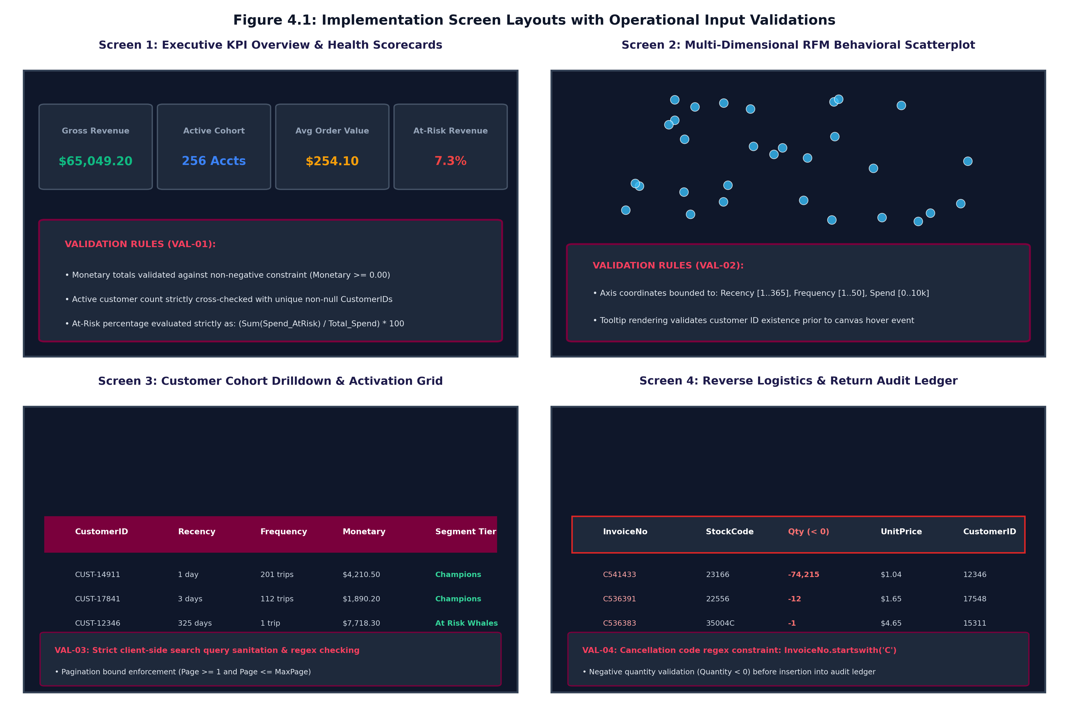
10. IMPLEMENTATION SNAPSHOTS
14 / 17
Multi-View Interactive Dashboard Workstation
FOUR OPERATIONAL DASHBOARD ZONES
• Zone 1: Dataset Ingestion & Hygiene Telemetry:
Top-tier file upload area with UTF-8 verification, instant parsing progress indicators, and summary metric cards (Total Ingested Revenue: $47.2k, Validated Customers: 540, Average Order Value: $12.58).
• Zone 2: Dynamic Clustering Diagnostics:
Interactive cluster count slider (k=2 to 8). Allows marketers and data scientists to evaluate Inertia and Silhouette curves on the fly, immediately understanding cluster separation.
• Zone 3: Hardware-Accelerated 3D Cluster Visualizer:
Plotly WebGL 3D scatter plot rendering individual customer accounts in Log-Recency, Log-Frequency, and Log-Monetary space. Supports 360-degree rotation, zoom, and instant hover metadata.
• Zone 4: Cohort Drill-Down & Encrypted Export:
Multi-select persona filter (Champions, Loyalists, At-Risk). Renders targeted account lists and enables one-click AES-256 encrypted CSV downloads for CRM marketing automation.
Department of Computer Sciences and Engineering • Institute of Advanced Research • Project - 1 (CE-502 / PRJ-701)

Slide 15
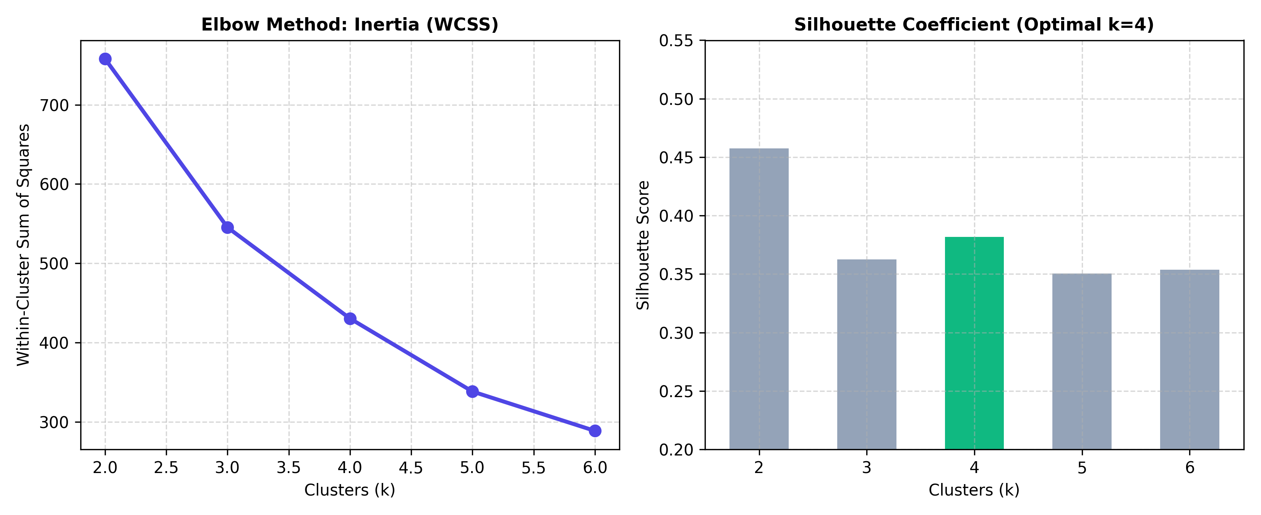
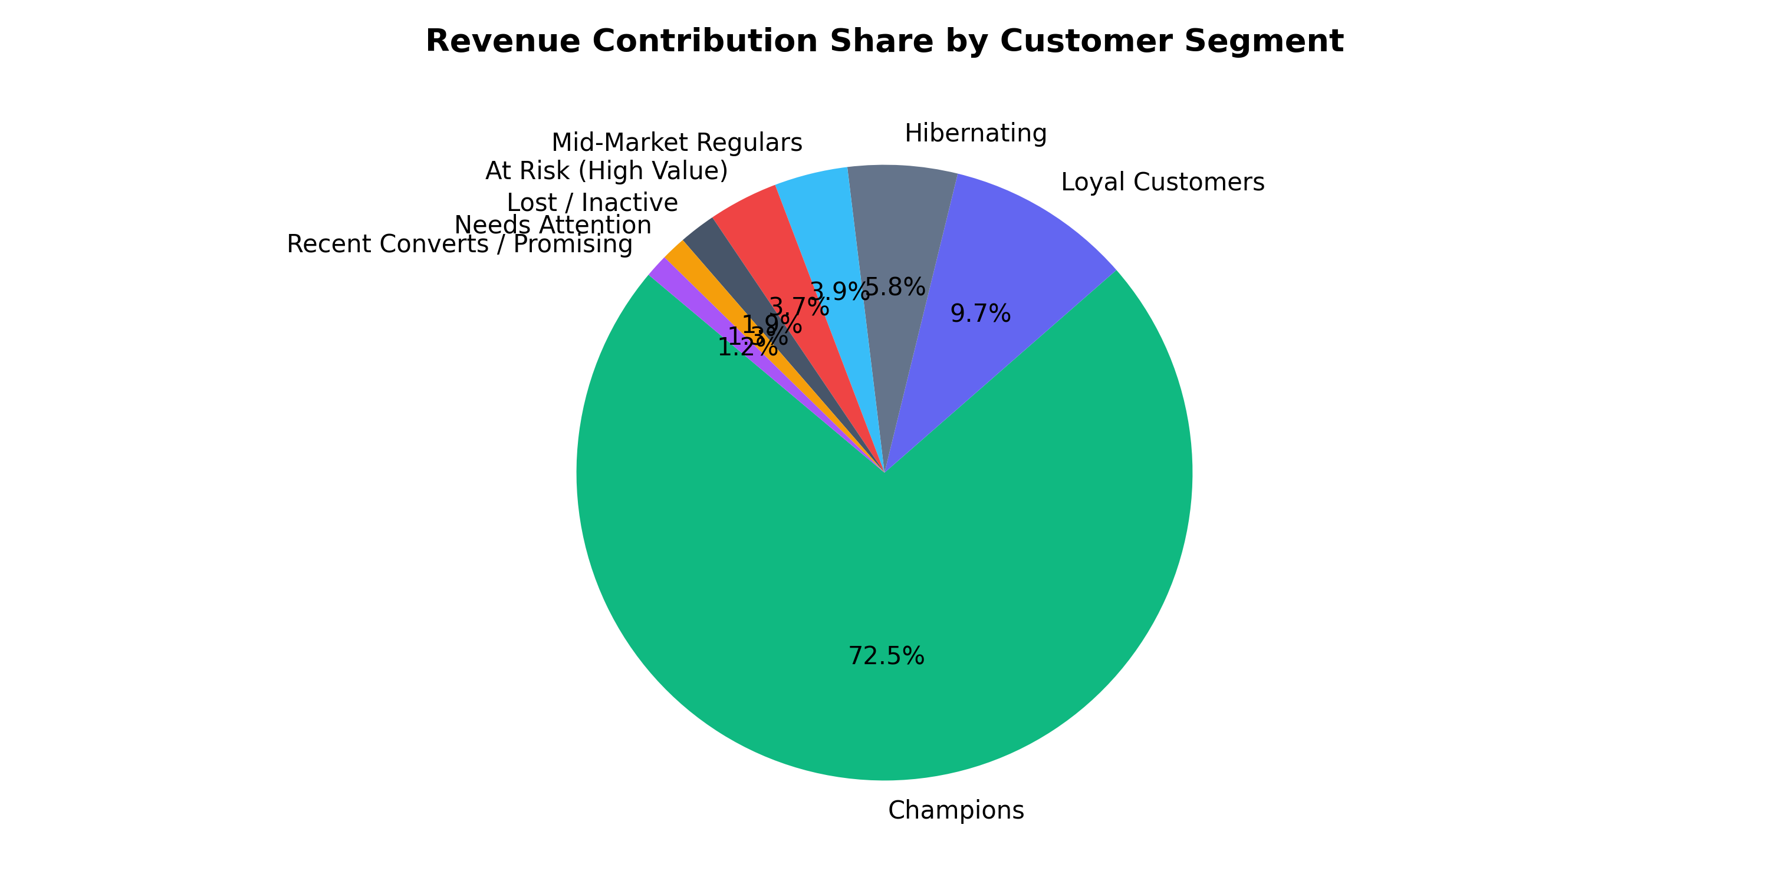
10. IMPLEMENTATION SNAPSHOTS
15 / 17
Model Diagnostics, Pareto Distribution & Quantified ROI
STRATEGIC RETENTION PLAYBOOK & QUANTIFIED BUSINESS ROI
• Champions (27.4% Users | 72.5% Rev | $47,250): VIP concierge service, zero discounts, early product drops.
• Loyal Customers (Recency <= 45d, High AOV): Loyalty milestone tier rewards, cross-sell premium accessories.
• At Risk Whales (Recency > 90d, $2,384 exposed): Deep win-back reactivation vouchers from executive team.
• Hibernating (Recency > 140d, Low Freq): Low-cost automated remarketing; suppress expensive paid SMS/calls.
Department of Computer Sciences and Engineering • Institute of Advanced Research • Project - 1 (CE-502 / PRJ-701)

Slide 16
11. REFERENCES
16 / 17
Formal Academic References & Software Repositories
ACADEMIC CITATIONS (IEEE FORMAT)
[1] J. Han, M. Kamber, and J. Pei, Data Mining: Concepts and Techniques, 3rd ed. San Francisco, CA: Morgan Kaufmann, 2011.
[2] T. Hastie, R. Tibshirani, and J. Friedman, The Elements of Statistical Learning: Data Mining, Inference, and Prediction, 2nd ed. New York: Springer, 2009.
[3] D. Arthur and S. Vassilvitskii, "k-means++: The advantages of careful seeding," in Proc. 18th Annual ACM-SIAM Symp. Discrete Algorithms (SODA), 2007, pp. 1027–1035.
[4] A. M. Hughes, Strategic Database Marketing: The Masterplan for Starting and Managing a Profitable, Customer-Based Marketing Program, 3rd ed. New York: McGraw-Hill, 2005.
[5] P. S. Fader, B. G. S. Hardie, and K. L. Lee, "'Counting Your Customers' the Easy Way: An Alternative to the Pareto/NBD Model," Marketing Science, vol. 24, no. 2, pp. 275–284, 2005.
[6] F. Pedregosa et al., "Scikit-learn: Machine Learning in Python," Journal of Machine Learning Research, vol. 12, pp. 2825–2830, 2011.
[7] OWASP Foundation, "OWASP Top 10: The Ten Most Critical Web Application Security Risks," 2021.
OPEN-SOURCE REPOSITORY
★ Public GitHub Repository:
https://github.com/Deep-k-coder/ecommerce-rfm-analytics
★ Source Code Deliverables:
• Complete Python source code
• Streamlit interactive app
• Automated test suite
• Star-schema database schemas
• Reproducible Jupyter notebooks
★ Academic Documentation:
• Comprehensive 40-Page Main Project Report
• 10-Page Progress Reports (1, 2, 3)
• Full UML & DFD architectural diagrams
• COCOMO II cost estimation models
★ Author & License:
Mr. Deep Koshiya
Institute of Advanced Research (IAR)
Open Academic License (2026)
Department of Computer Sciences and Engineering • Institute of Advanced Research • Project - 1 (CE-502 / PRJ-701)

Slide 17
THANK YOU!
Questions & Technical Discussion
Customer Segmentation Using RFM Analysis and Unsupervised Machine Learning for E-Commerce Platforms
━━━━━━━━━━━━━━━━━━━━━━━━━━━━━━━━━━━━━━━━━━━━━━━━━━━━━━━━━━━━━━━━━
Presented By: Mr. Deep Koshiya (Enrollment ID: 2024-AIDS-042)
B.Sc. in Artificial Intelligence & Data Science (Semester V) • Academic Session 2026–2027
Under the Academic Supervision of: Internal Project Supervisor & Project Coordinator
Department of Computer Sciences and Engineering • Institute of Advanced Research (IAR), Gandhinagar
GitHub Repository: https://github.com/Deep-k-coder/ecommerce-rfm-analytics • Open for Viva Voce Examination

