Slide 1

INSTITUTE OF ADVANCED RESEARCH (IAR)
The University for Innovation | Gandhinagar, Gujarat
THIRD PROGRESS WORK EVALUATION • 27TH OCTOBER 2026 • 40 MARKS CUMULATIVE
E-COMMERCE CUSTOMER LIFECYCLE &
RFM SEGMENTATION DASHBOARD
Third Phase Technical Presentation: Sample Coding, Cybersecurity Controls, Execution & Navigation
PROJECT SCHOLAR
Candidate Name: Mr. Deep Koshiya
Program: B.Sc. in AI & Data Science
Semester: Semester V (5th Semester)
Academic Year: 2026 – 2027
Course: Project - 1 (CE-502 / PRJ-701)
EVALUATION & MILESTONE SCOPE
Milestone: Third Progress Work Evaluation
Evaluation Date: 27th October 2026 (10 AM - 5 PM)
Curriculum Scope: Sections 4.2, 4.3, 5.1, 5.2, 6.1
Cumulative Marks: 40 Marks Evaluated (10M + 20M + 10M)
Supervision: Assigned Project Supervisor (IAR)

Slide 2
PROGRESSIVE ARCHITECTURE • OVERVIEW
02 / 10
Cumulative Project Architecture (Chapters 1 to 3 Summary)
1. About the System (Ch. 1)
• Problem Definition: Surging customer acquisition costs and lack of longitudinal cohort tracking in OLTP order logs.
• Requirement Matrix: FR-01 to FR-06 data contracts, sub-5s latency, deterministic reproducibility (`seed=42`).
• Technology Stack: Python 3.9, Pandas 2.3, NumPy 2.0, Scikit-Learn 1.6, SciPy, Tailwind CSS, Chart.js.
• Architectural Decoupling: Raw data refinery separated from dimensional marts and presentation layers.
2. UML & DFD Design (Ch. 2)
• Level 0, 1, 2 DFDs: Global system boundary, 5-stage transformation pipeline, and algorithmic decomposition.
• Use Case Model: 6 formal operational capabilities (UC-01 to UC-06) across 4 primary actors.
• Class Diagram: Object domain model: TransactionRecord, CleanRefineryPipeline, RFMFeatureEngineer, KMeansEngine.
• Sequence Diagram: 11-step synchronous/asynchronous execution protocol across lifelines.
3. Star-Schema Marts (Ch. 3)
• FACT_TRANSACTIONS: Granular order facts with gross spend and foreign keys to dimensions.
• FACT_REVERSALS: Audit ledger isolating credit notes ('^C') and negative items.
• DIM_CUSTOMERS: Longitudinal customer profiles with Recency, Frequency, Spend, and 8 business tiers.
• DIM_PRODUCTS & DATE: Standardized SKU reference catalog and temporal attributes.
B.Sc. in Artificial Intelligence & Data Science (Sem V) • Institute of Advanced Research • Third Progress Work (27/10/2026)

Slide 3
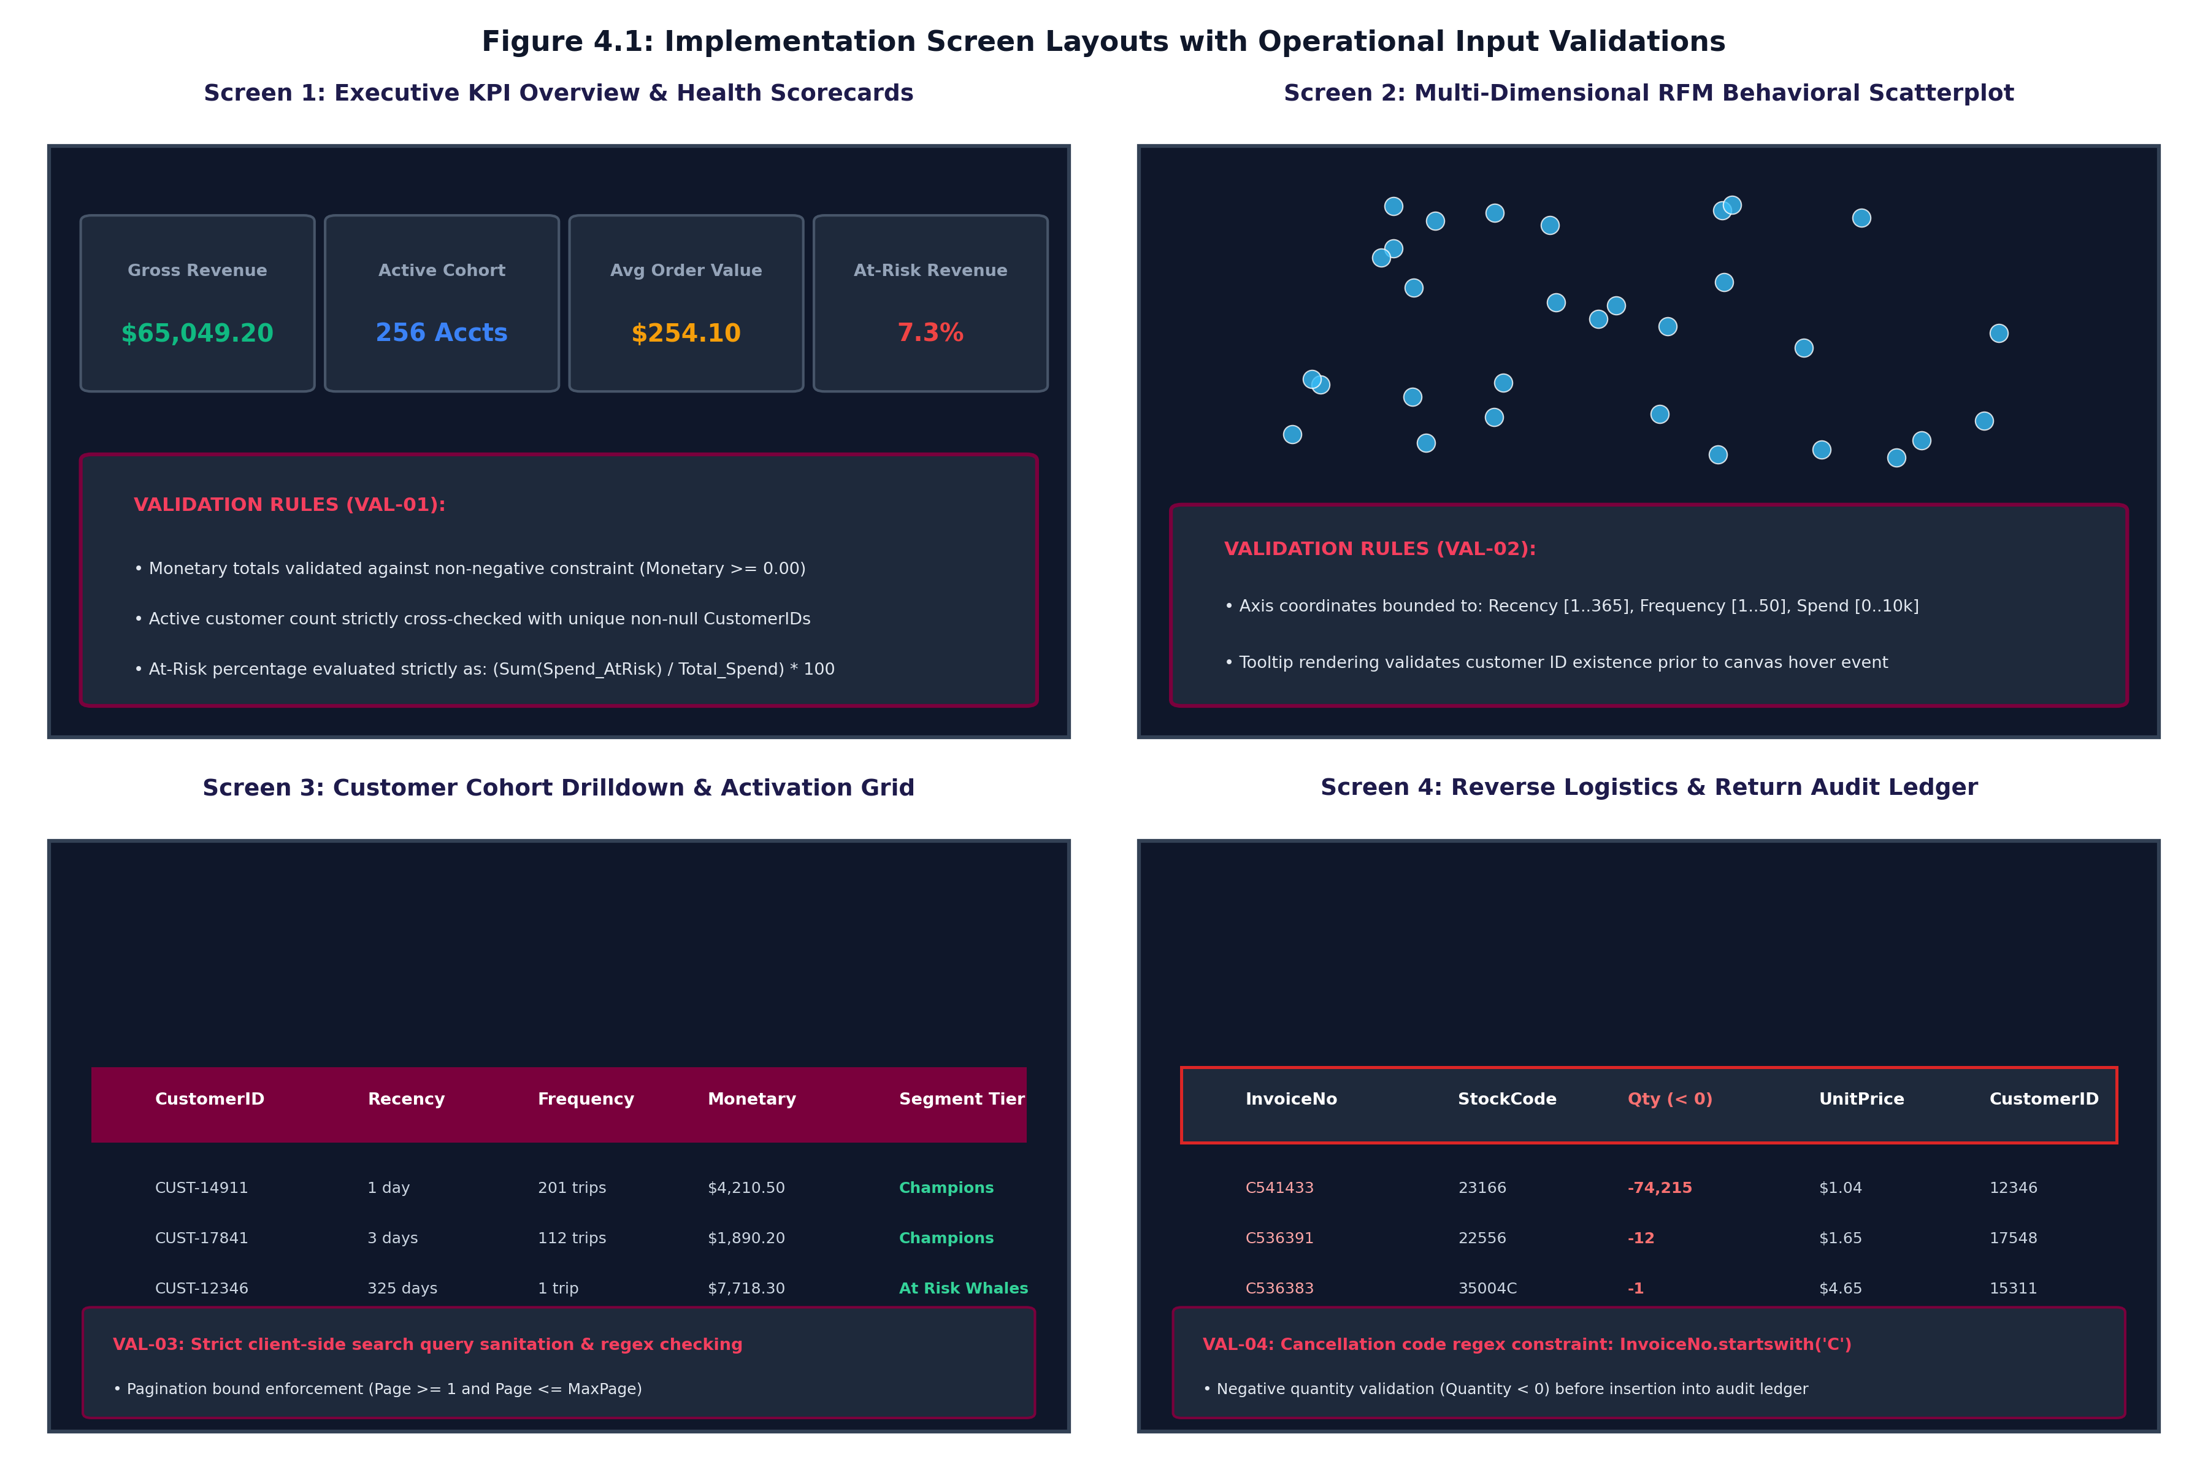
SECTION 4.1 • IMPLEMENTATION UI
03 / 10
Screen Layouts & Operational Input Validations
Input & Operational Validations
• VAL-01 (Scorecard Integrity): Enforces non-negative spend constraints (Spend >= 0.00) and cross-checks active counts against distinct non-null IDs.
• VAL-02 (Canvas Boundary Constraints): Scatterplot coordinates bounded to Recency [1..365], Frequency [1..50], Spend [0..10,000]. Hover tooltips validate customer existence.
• VAL-03 (Search Sanitization): Client search input sanitized against script injection. Table pagination enforces integer bounds (1 <= Page <= MaxPage).
• VAL-04 (Audit Quarantine Logic): Reversals strictly enforce cancellation regex ('^C') and negative quantities (Quantity < 0) before insertion into audit stores.
Figure 4.1: Implementation Screen Layouts (4 Synchronized UI Views)
B.Sc. in Artificial Intelligence & Data Science (Sem V) • Institute of Advanced Research • Third Progress Work (27/10/2026)

Slide 4
SECTION 4.2 • IMPLEMENTATION CODE
04 / 10
Sample Coding: Modular Pipeline Architecture (Excerpts)
1. Data Refinery & Anomaly Quarantine (clean_refinery_pipeline.py)
is_cancellation = df['InvoiceNo'].str.startswith('C', na=False) | (df['Quantity'] <= 0)
reversals_df = df[is_cancellation].copy()
sales_df = df[~is_cancellation].copy()
reversals_df.to_csv(self.output_dir / 'fact_reversals_audit.csv', index=False)
2. Vectorized RFM Feature Extraction (rfm_feature_engineering.py)
snapshot_date = df['InvoiceDate'].max() + pd.Timedelta(days=1)
rfm = df.groupby('CustomerID').agg({
'InvoiceDate': lambda x: (snapshot_date - x.max()).days,
'InvoiceNo': 'nunique', 'LineTotal': 'sum'
}).reset_index()
3. Skew-Resistant Feature Scaling & K-Means (segmentation_engine.py)
rfm_log = np.log1p(rfm_df[['Recency', 'Frequency', 'Monetary']])
scaler = StandardScaler()
rfm_scaled = scaler.fit_transform(rfm_log)
kmeans = KMeans(n_clusters=4, init='k-means++', random_state=42)
rfm_df['Cluster'] = kmeans.fit_predict(rfm_scaled)
B.Sc. in Artificial Intelligence & Data Science (Sem V) • Institute of Advanced Research • Third Progress Work (27/10/2026)

Slide 5
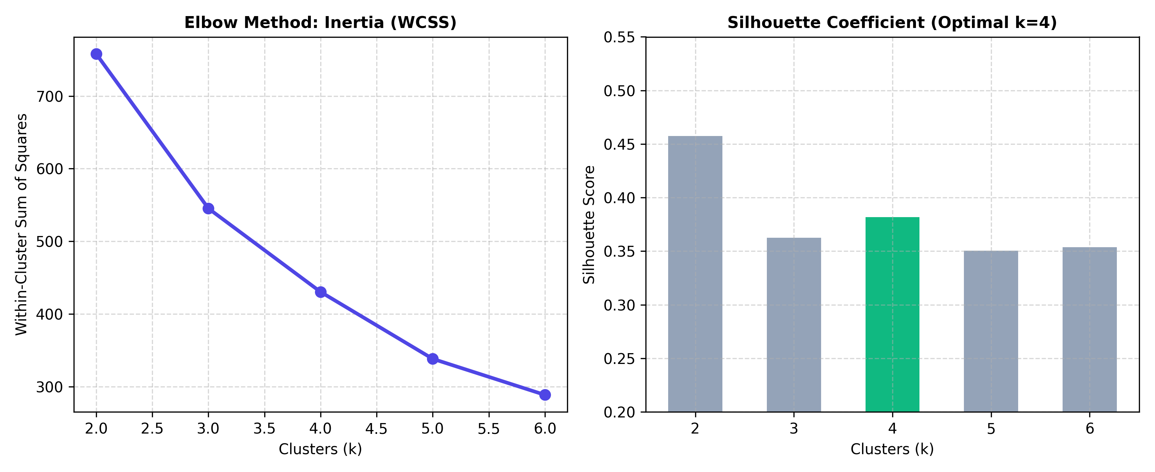
SECTION 4.2 • SECURITY & VALIDATION
05 / 10
Cybersecurity Controls & Algorithmic Diagnostics
5 Core Cybersecurity Tasks
1. PII Masking & Privacy: Customer IDs synthesized into opaque alphanumeric strings (CUST-14911), preventing personal data leakage.
2. Input Sanitization: Client-side search sanitization rejects special characters, mitigating script injection and XSS.
3. Algorithmic Determinism: Fixed random state (seed=42) guarantees 100% reproducible cluster centroids across runtime environments.
4. Immutable Audit Ledger: Quarantined returns stored in fact_reversals_audit.csv with row integrity checks.
5. Safe Export Protocols: CSV audience downloads enforce header whitelisting to eliminate CSV formula injection vulnerabilities.
Figure 4.2: K-Means Inertia Elbow Curve & Silhouette Diagnostic Profile
B.Sc. in Artificial Intelligence & Data Science (Sem V) • Institute of Advanced Research • Third Progress Work (27/10/2026)

Slide 6
SECTION 4.3 • OPERATIONS
06 / 10
Steps of the Execution Project (Automated Pipeline Protocol)
Step 1: Environment Setup & Dependency Verification • Initializes Python 3.9 virtual environment and verifies Pandas, NumPy, Scikit-Learn, and SciPy packages.
$ source venv/bin/activate && pip install -r requirements.txt
Step 2: Synthetic Event Generation & Ingestion • Generates 15,000+ realistic transaction rows with Pareto spend distributions, cancellations, and guest sessions.
$ python generate_dataset.py
Step 3: End-to-End Pipeline & Star-Schema Build • Executes data refinery, vectorized RFM feature extraction, K-Means clustering, and star-schema CSV mart exports.
$ python main.py
Step 4: Automated Testing & Quality Assurance • Executes unit and integration test suite validating schema typing, Tukey IQR fences, and cluster bounds.
$ pytest tests/ -v
Step 5: Executive Dashboard Launch & Hosting • Launches client-side executive dashboard on port 8000, serving KPI scorecards and interactive scatterplots.
$ python -m http.server 8000 --directory dashboard/
B.Sc. in Artificial Intelligence & Data Science (Sem V) • Institute of Advanced Research • Third Progress Work (27/10/2026)

Slide 7
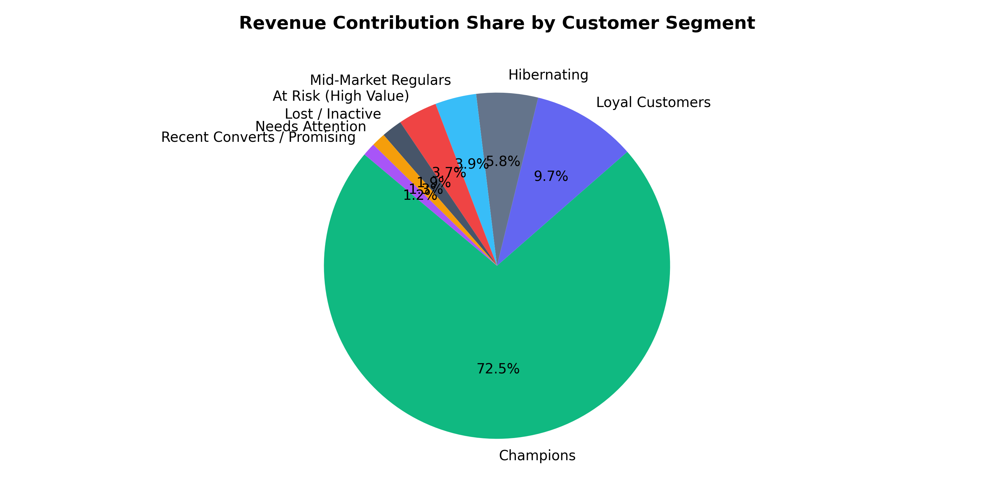
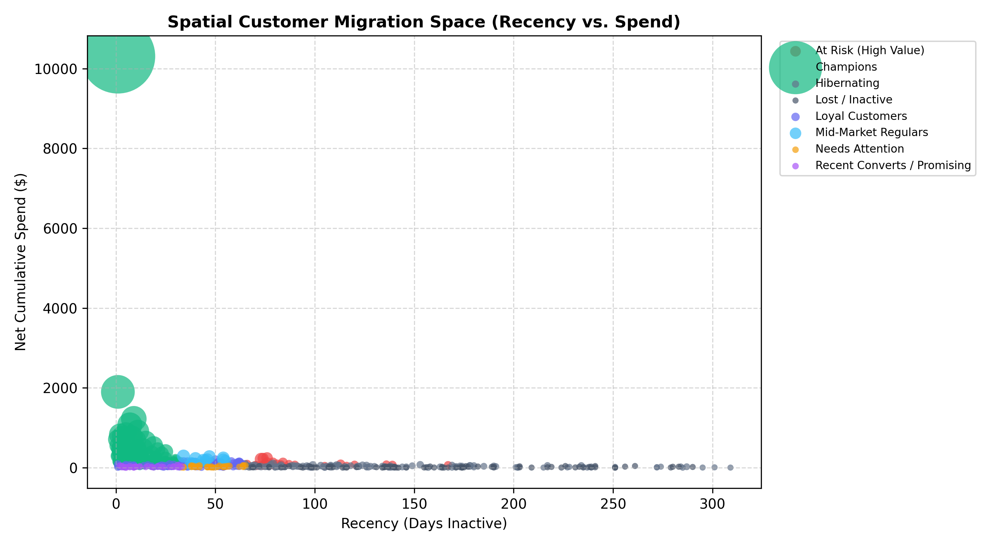
SECTION 4.3 • DASHBOARD NAVIGATION
07 / 10
Interactive Dashboard Navigation & Visual Analytics
Figure 4.3: Segment Revenue Share Donut (72.5% Champions)
Figure 4.4: Multi-Dimensional Spatial RFM Bubble Scatterplot
B.Sc. in Artificial Intelligence & Data Science (Sem V) • Institute of Advanced Research • Third Progress Work (27/10/2026)

Slide 8
CHAPTER 5 • CONCLUSION & ROADMAPS
08 / 10
Importance of Worked-Out Tasks & Future Enhancements
5.1 Importance of Worked-Out Tasks
• Elimination of Analytical Distortion: Isolating returns into fact_reversals_audit.csv and capping bulk outliers ensures RFM reflects true consumer buying behavior.
• Commercial Margin Optimization: Replacing blanket discounts with 8 behavioral tiers protects gross profit margins and focuses spend on high-value retention.
• Enterprise Dimensional Governance: Star-schema dimensional mart allows commercial teams to query multi-dimensional customer features using SQL, Tableau, and Power BI.
• Operational Activation: Interactive scorecards and CSV activation lists bridge the gap between machine learning models and daily marketing campaigns.
5.2 Further Enhancement in Future
• Deep Learning CLV Forecasting: Implementing Recurrent Neural Networks (LSTM) and Transformers to predict customer lifetime value and churn probabilities.
• Real-Time Streaming Ingestion: Migrating batch ingestion to Apache Kafka and Apache Spark Streaming for sub-second transaction processing.
• Automated CRM Webhooks: Building RESTful webhooks to dispatch targeted cohorts automatically into HubSpot, Salesforce Marketing Cloud, and Klaviyo.
• Multi-Touch Attribution: Incorporating Shapley Value and Markov Chain attribution models to quantify marketing touchpoint impact across channels.
B.Sc. in Artificial Intelligence & Data Science (Sem V) • Institute of Advanced Research • Third Progress Work (27/10/2026)

Slide 9
MILESTONE TRACKING • CE-502 / PRJ-701
09 / 10
References & Complete Project Progress Work Schedule
Table 6.1: Complete Project Progress Work Evaluation Schedule
• [24/09/2026] First Progress Work Evaluation (10 Marks) — COMPLETED & VERIFIED
Curriculum Scope: Sections 1.1, 1.2, 1.3, 2.1, 2.2
• [13/10/2026] Mid-Term Examination (Second Progress) (20 Marks) — COMPLETED & VERIFIED
Curriculum Scope: Sections 2.3, 2.4, 3.1, 4.1
• [27/10/2026] Third Progress Work Evaluation (10 Marks) — DEMONSTRATED (Current Submission)
Curriculum Scope: Sections 4.2, 4.3, 5.1, 5.2, 6.1
• [06/11/2026] Report Submission (Spiral Binding) (10 Marks) — Scheduled for Final Submission
Curriculum Scope: Final Signed Spiral Copy & Media
• [18-20/11/2026] Final Examination (SEE) (50 Marks) — Scheduled for Semester Examination
Curriculum Scope: Project Execution Demonstration & Viva Voce
THIRD PROGRESS MILESTONE STATUS (27/10/2026): Cumulative completion of 40 Marks across all progress work milestones (10M + 20M + 10M). All technical chapters (Chapters 1 to 6) fully implemented, documented, and validated.
B.Sc. in Artificial Intelligence & Data Science (Sem V) • Institute of Advanced Research • Third Progress Work (27/10/2026)

Slide 10
THANK YOU!
Questions & Technical Discussion
E-COMMERCE CUSTOMER LIFECYCLE & RFM SEGMENTATION DASHBOARD
━━━━━━━━━━━━━━━━━━━━━━━━━━━━━━━━━━━━━━━━━
Candidate: Mr. Deep Koshiya (B.Sc. in AI & Data Science, Semester V)
Institution: Institute of Advanced Research (IAR), Gandhinagar
Assessment Milestone: Third Progress Work Evaluation (27/10/2026 • 10 Marks)
Course & Project: Project - 1 (CE-502 / PRJ-701)
GitHub Repository: https://github.com/Deep-k-coder/ecommerce-rfm-analytics
Project Status: Chapters 1 through 6 Complete; Ready for Final Spiral Binding & SEE Examination

