Slide 1

INSTITUTE OF ADVANCED RESEARCH (IAR)
The University for Innovation | Gandhinagar, Gujarat
FIRST PROGRESS WORK PRESENTATION • 24TH SEPTEMBER 2026 • 10 MARKS
E-COMMERCE CUSTOMER LIFECYCLE &
RFM SEGMENTATION DASHBOARD
An Applied Machine Learning & Analytics Engineering System for Behavioral Cohort Optimization
PROJECT SCHOLAR
Candidate Name: Mr. Deep Koshiya
Program: B.Sc. in AI & Data Science
Semester: Semester V (5th Semester)
Academic Year: 2026 – 2027
Course: Project - 1 (CE-502 / PRJ-701)
EVALUATION & MILESTONE SCOPE
Milestone: First Progress Work Evaluation
Evaluation Date: 24th September 2026 (10 AM - 5 PM)
Marks Allotted: 10 Marks (Curriculum Deliverable)
Syllabus Scope: Sections 1.1, 1.2, 1.3, 2.1, 2.2
Supervision: Assigned Project Supervisor (IAR)

Slide 2
SECTION 1.1 • ABOUT THE SYSTEM
02 / 10
Problem Definition & Commercial Context
1. Commercial Retention Dilemma
• Surging Acquisition Costs: Digital advertising CAC has increased over 60%, making organic customer retention the primary driver of profitability.
• Homogenous Marketing: Treating all shoppers equally leads to margin-eroding discounts for customers who would have purchased anyway.
• Undetected Churn Risk: Historically high-value accounts slip into dormancy silently without early churn detection triggers.
• Missed Lifetime Value: E-commerce retailers fail to identify and nurture accounts transitioning into Champions.
2. Limitations of OLTP Systems
• Order-Centric Storage: Traditional databases record individual shopping transactions, not longitudinal customer behavioral lifecycles.
• Data Quality Deficits: Event logs contain guest checkouts lacking CustomerID, cancellations, and administrative line-items.
• Distribution Anomalies: Extreme wholesale B2B distributor purchases contaminate standard consumer metrics.
• No Analytical Layer: Decision-makers lack an automated transformation pipeline bridging raw order rows with strategic marketing actions.
3. Targeted Project Solution
• Automated Refinery: Cleanses raw transactions, isolates reversals into an audit ledger, and caps outliers via Tukey IQR fences.
• Vectorized RFM Feature Store: Aggregates transactions into Recency, Frequency, Monetary spend, and Average Order Value (AOV).
• Skew-Resistant ML Clustering: Applies log1p and StandardScaler before K-Means modeling, validated via Silhouette diagnostics.
• Executive BI Dashboard: Interactive web UI with portfolio KPI scorecards, spatial scatterplots, and exportable CRM cohorts.
B.Sc. in Artificial Intelligence & Data Science (Sem V) • Institute of Advanced Research • First Progress Work (24/09/2026)

Slide 3
SECTION 1.2 • PRODUCT SPECIFICATIONS
03 / 10
Requirement Specifications (Functional & Non-Functional)
Functional Requirements Specifications (FR-01 to FR-06)
FR-01: Ingestion & Schema Typing: Ingests raw CSV streams, validates typing (InvoiceDate to datetime64[ns], Quantity/UnitPrice to floats), and sanitizes SKU descriptions.
FR-02: Missing Entity Resolution: Detects and filters guest checkouts missing CustomerID to protect longitudinal cohort integrity.
FR-03: Reverse Logistics Isolation: Routes cancellations ('^C') and credit adjustments to an isolated audit store (fact_reversals_audit.csv) without distorting purchase counts.
FR-04: Tukey IQR Outlier Capping: Applies fences [Q1 - 1.5*IQR, Q3 + 1.5*IQR] on Quantity and Price, neutralizing bulk distributor volume spikes.
FR-05: Vectorized RFM Derivation: Computes Recency days relative to T_obs = max(Date) + 1, Frequency (distinct visits), and cumulative Monetary spend.
FR-06: ML Clustering & Scoring: Standardizes features via log1p and StandardScaler, fits K-Means, and assigns 1–5 quantile scores mapping to 8 business tiers.
Non-Functional Requirements (NFR)
NFR-01 (Latency): Processes 15,000+ orders in <5.0 seconds using vectorized Pandas C-routines.
NFR-02 (Reproducibility): Fixed seed (seed=42) guarantees 100% deterministic clustering across platforms.
NFR-03 (Modularity): Clean star schema data marts (FACT_TRANSACTIONS, DIM_CUSTOMERS).
Table 1.1: System Environment Matrix
Hardware / CPU: Apple Silicon M-Series / Intel Core i5/i7 (8-Core+)
System Memory: 8 GB to 16 GB Unified Memory (Min: 4 GB)
Storage Drive: Solid State Drive (NVMe SSD)
Operating System: macOS Darwin (Unix POSIX) / Linux / Win10+
Runtime & Stack: Python 3.9+, Modern Web Browser, VS Code
B.Sc. in Artificial Intelligence & Data Science (Sem V) • Institute of Advanced Research • First Progress Work (24/09/2026)

Slide 4
SECTION 1.3 • ARCHITECTURE STACK
04 / 10
Tools & Technology Stack (Multi-Layer Architecture)
1. DATA REFINERY & INGESTION LAYER — Python 3.9+ • Pandas (v2.3.3) • NumPy (v2.0.2)
High-throughput tabular ingestion, schema typing, null elimination, reverse logistics isolation, and vectorized Tukey IQR outlier calculations.
2. MACHINE LEARNING & STATISTICAL MODELING — Scikit-Learn (v1.6.1) • SciPy (v1.13.1)
Log1p transformation for Pareto skew compression, StandardScaler normalization, K-Means clustering with k-means++ centroid initialization, and Silhouette score diagnostics.
3. DIMENSIONAL STORAGE & STAR SCHEMA — Analytical Star Schema Data Marts • CSV / Parquet
Decoupled fact and dimension storage (FACT_TRANSACTIONS, FACT_REVERSALS, DIM_CUSTOMERS) designed for BI compatibility with Tableau and Power BI.
4. EXECUTIVE BI DASHBOARD & ACTIVATION — HTML5 • Tailwind CSS • Chart.js 4.x • Git & GitHub
Client-side canvas graphing engine rendering revenue donuts, spatial RFM bubble charts, KPI scorecards, and searchable CRM activation grids.
B.Sc. in Artificial Intelligence & Data Science (Sem V) • Institute of Advanced Research • First Progress Work (24/09/2026)

Slide 5
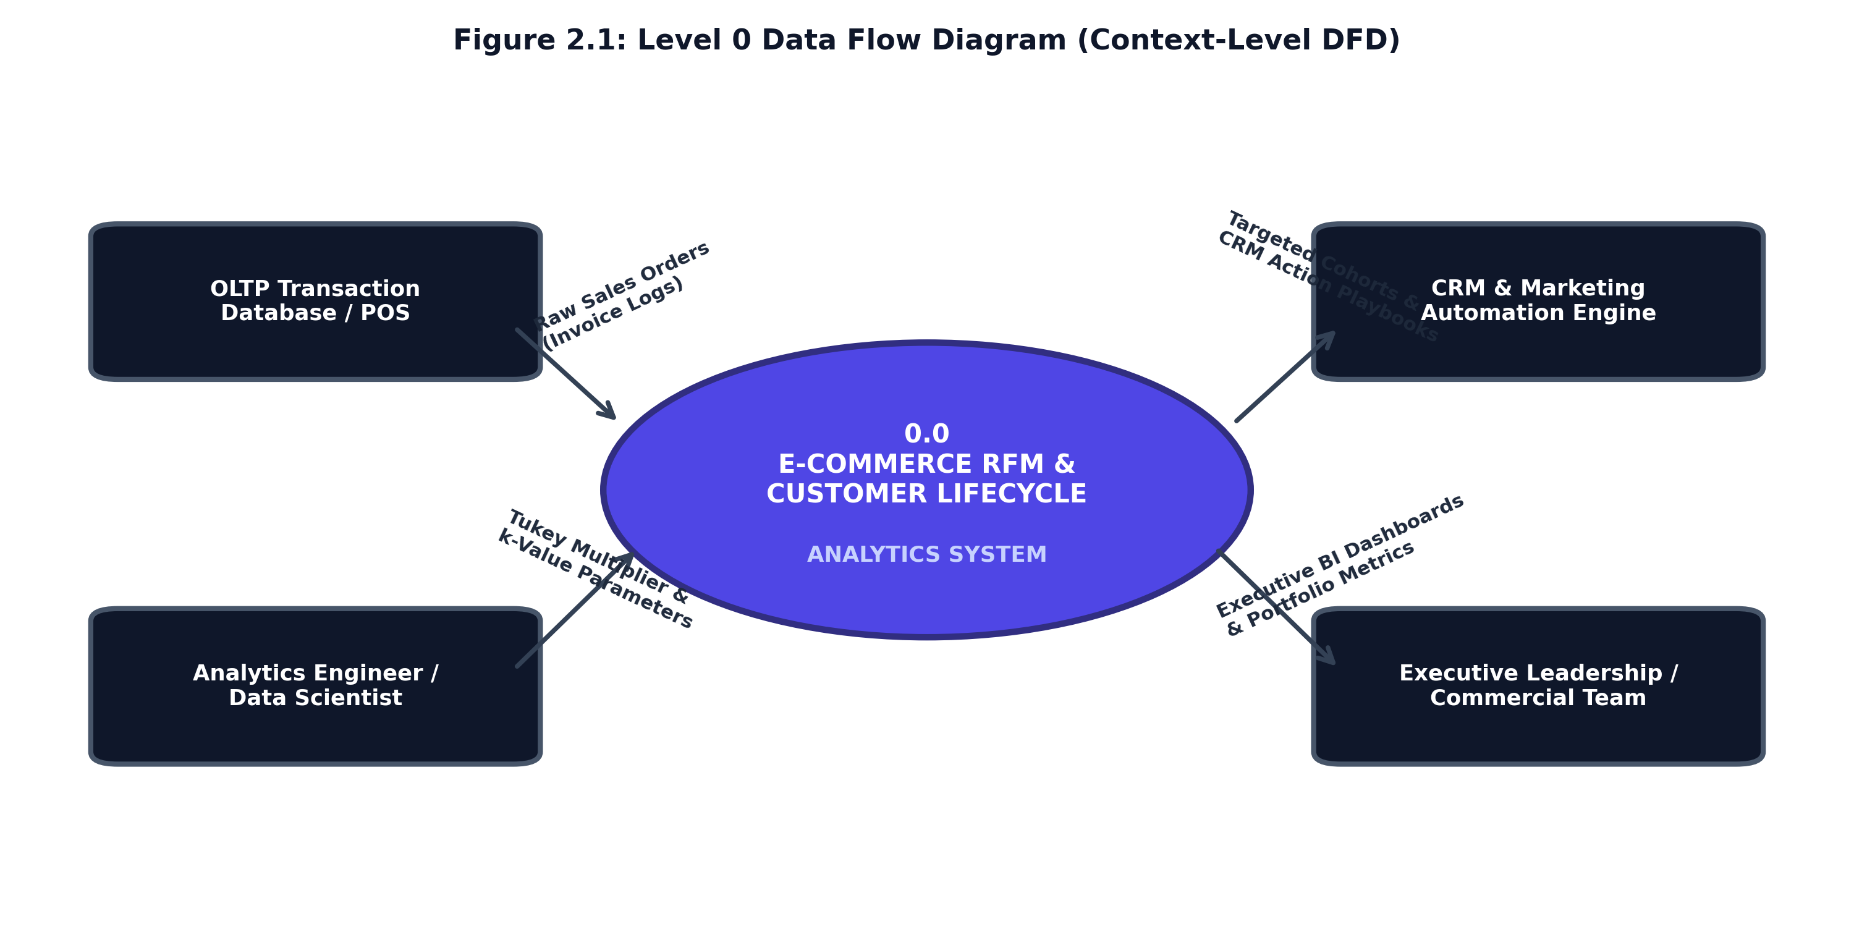
SECTION 2.1 • SYSTEM DESIGN USING DFD
05 / 10
Level 0 Data Flow Diagram (Context Architecture)
Context Boundary & Entity Interfaces
• Process 0.0 (Global Boundary): Represents the complete 'E-Commerce Customer Lifecycle & RFM Analytics System' interacting with 4 primary external entities.
• 1. OLTP Sales Stream: Provides high-frequency transaction logs containing InvoiceNo, StockCode, Quantity, InvoiceDate, UnitPrice, and CustomerID.
• 2. Data Scientist: Supplies IQR outlier tuning multipliers, cluster count hyperparameters (k in [2..6]), and evaluates validation diagnostics.
• 3. CRM Marketing Engine: Consumes segmented customer lists ('Champions', 'At Risk Whales') for programmatic email, SMS, and ad audience targeting.
• 4. Commercial Executives: Receives interactive executive KPI scorecards, segment revenue distribution, and churn risk summaries.
Figure 2.1: Level 0 Context Data Flow Diagram (Macro Boundary)
B.Sc. in Artificial Intelligence & Data Science (Sem V) • Institute of Advanced Research • First Progress Work (24/09/2026)

Slide 6
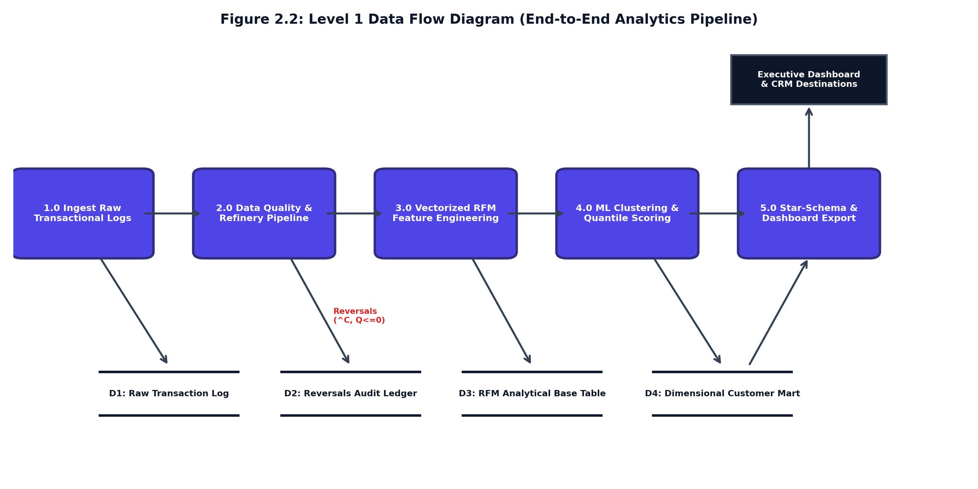
SECTION 2.1 • PIPELINE ARCHITECTURE
06 / 10
Level 1 Data Flow Diagram (End-to-End Analytics Pipeline)
5 Sequential Pipeline Transformations
• Process 1.0 (Ingestion & Schema Typing): Parses raw streams, validates typing, and logs records to D1 (Raw Transaction Log).
• Process 2.0 (Data Quality & Refinery): Drops guest IDs, routes returns to D2 (Reversals Audit Ledger), and applies Tukey IQR fences.
• Process 3.0 (Vectorized RFM Feature Extraction): Computes Recency, Frequency, Spend, and AOV, writing to D3 (RFM Analytical Base Table).
• Process 4.0 (ML Clustering & Quantile Scoring): Executes log1p scaling, StandardScaler, K-Means, and 1–5 scoring into D4 (Segmented Customer Mart).
• Process 5.0 (Star Schema & Dashboard): Publishes BI data marts and powers the interactive executive web dashboard.
Figure 2.2: Level 1 Data Flow Diagram (Pipeline Architecture)
B.Sc. in Artificial Intelligence & Data Science (Sem V) • Institute of Advanced Research • First Progress Work (24/09/2026)

Slide 7
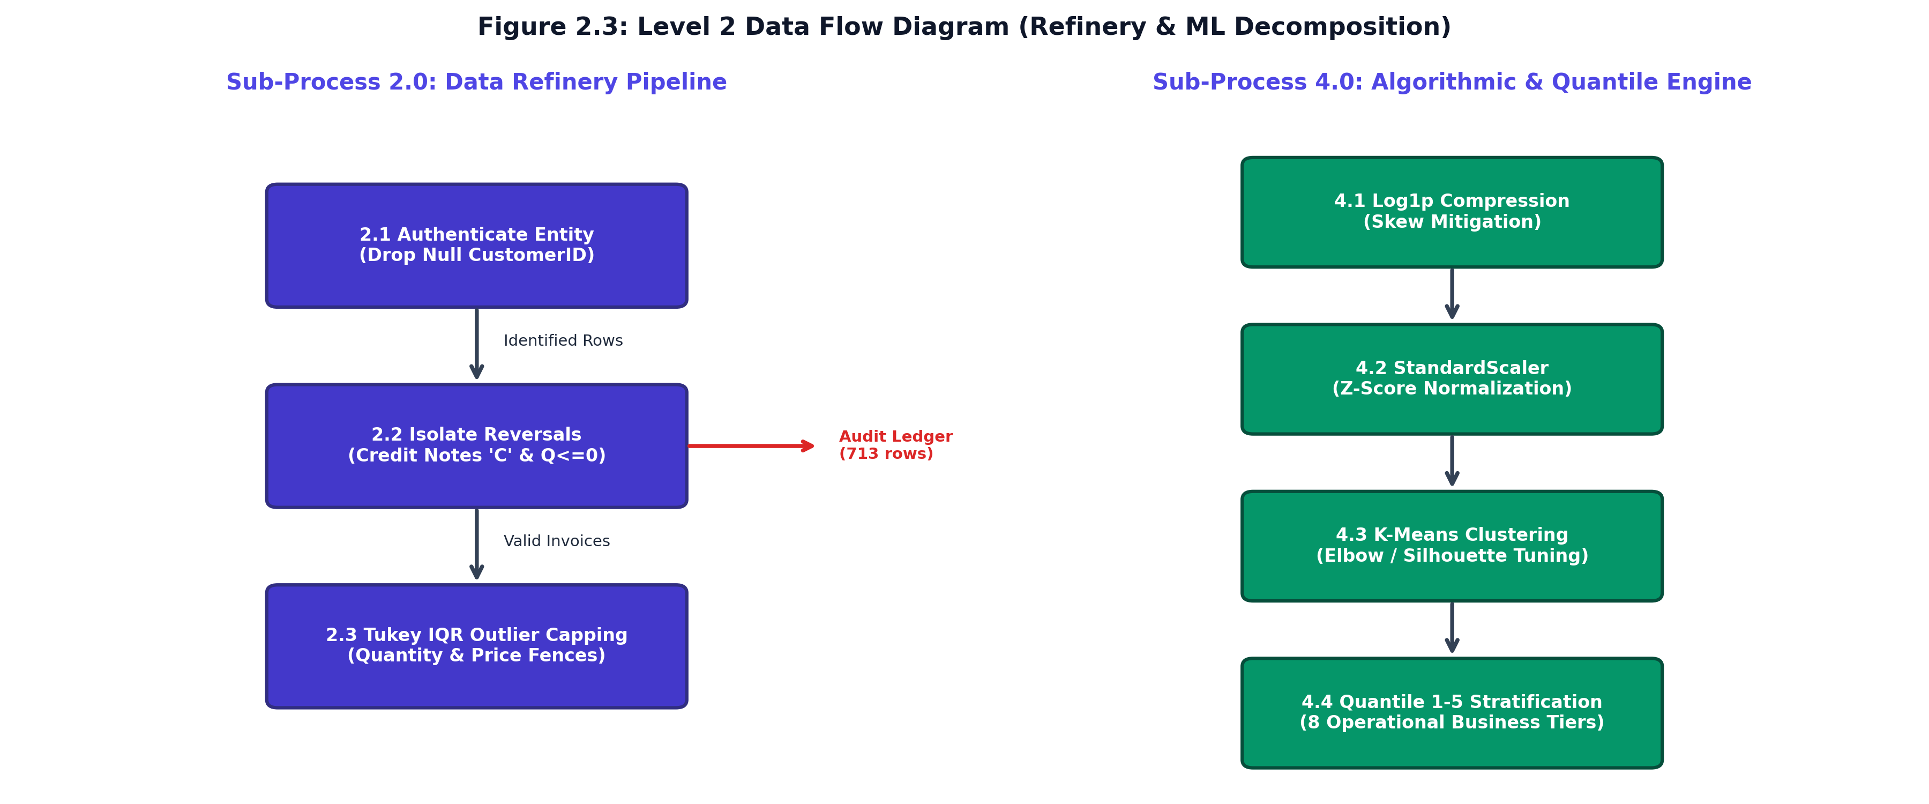
SECTION 2.1 • PROCESS DECOMPOSITION
07 / 10
Level 2 Data Flow Diagram (Refinery & ML Decomposition)
Algorithmic & Mathematical Decomposition
• Sub-Process 2.1 (Null ID Purge): Validates CustomerID existence; drops unauthenticated guest sessions.
• Sub-Process 2.2 (Reversals Filter): Detects cancellation identifiers ('^C' or negative Quantity) and exports to fact_reversals_audit.csv.
• Sub-Process 2.3 (Tukey IQR Capping): Computes [Q1 - 1.5*IQR, Q3 + 1.5*IQR] to eliminate wholesale bulk distributor anomalies.
• Sub-Process 4.1 (Log1p Scaling): Applies z = ln(1 + x) to compress severe right-skewed Pareto customer spending.
• Sub-Process 4.2 (StandardScaler): Transforms features to zero mean and unit variance for distance-based clustering.
• Sub-Process 4.3 (K-Means & Silhouette): Fits K-Means across k in [2..6], diagnosing optimal clusters via Silhouette coefficient.
Figure 2.3: Level 2 Data Flow Diagram (Detailed Decomposition)
B.Sc. in Artificial Intelligence & Data Science (Sem V) • Institute of Advanced Research • First Progress Work (24/09/2026)

Slide 8
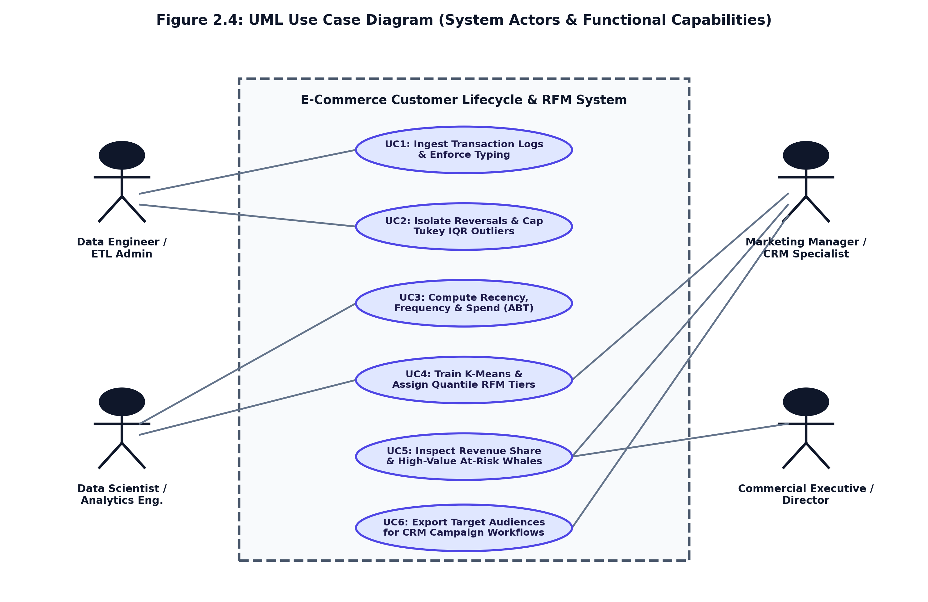
SECTION 2.2 • SYSTEM CAPABILITIES
08 / 10
UML Use Case Diagram & Actor Responsibilities
Table 2.1: Use Case Specification Matrix (UC-01 to UC-06)
UC-01: Ingest Transaction Stream [Data Engineer / Admin]: Ingests raw event logs, enforces schema typing, verifies datatypes.
UC-02: Isolate Reversals & IQR Filter [Data Engineer / Admin]: Purges null IDs, isolates returns (^C), caps Tukey bulk outliers.
UC-03: Compute Vectorized RFM [Analytics Engineer]: Aggregates transactions into customer Recency, Frequency, and Spend.
UC-04: Train & Tune K-Means Model [Data Scientist]: Applies log1p + StandardScaler, evaluates Elbow/Silhouette, fits k=4.
UC-05: Inspect Executive KPI Metrics [Commercial Executive]: Monitors portfolio health ($65k spend), Champions share (72.5%), at-risk capital.
UC-06: Export Targeted CRM Audiences [Marketing Manager]: Filters segments in activation ledger and exports audience lists for campaigns.
Figure 2.4: UML Use Case Diagram (Actors & Capabilities)
B.Sc. in Artificial Intelligence & Data Science (Sem V) • Institute of Advanced Research • First Progress Work (24/09/2026)

Slide 9
MILESTONE TRACKING • CE-502 / PRJ-701
09 / 10
Milestone Evaluation Schedule & Project Roadmap
Formal Assessment Schedule & Deliverable Tracking
• [24/09/2026] First Progress Work Evaluation (10 Marks) — COMPLETED (Current Submission)
Scope: Sections 1.1, 1.2, 1.3, 2.1, 2.2
• [13/10/2026] Mid-Term Examination (Second Progress) (20 Marks) — Scheduled for Next Milestone
Scope: 2.3 (Class Diagram), 2.4 (Sequence Diagrams), 3.1 (Data Dictionary), 4.1 (UI Layouts)
• [27/10/2026] Third Progress Work Evaluation (10 Marks) — Scheduled for Third Milestone
Scope: 4.2 (Sample Coding), 4.3 (Navigation), 5.1-5.2 (Conclusion), 6.1 (References)
• [06/11/2026] Report Submission (Spiral Binding) (10 Marks) — Scheduled for Final Submission
Scope: Final Signed Spiral Copy & Project Media
• [18-20/11/2026] Final Examination (SEE) (50 Marks) — Scheduled for Semester Examination
Scope: Project Execution Demonstration & Viva Voce
MILESTONE STATUS SUMMARY (24/09/2026): All deliverables for the First Progress Work milestone (10 Marks) have been successfully engineered, verified, and compiled into the 10-page report and interactive demonstration dashboard.
B.Sc. in Artificial Intelligence & Data Science (Sem V) • Institute of Advanced Research • First Progress Work (24/09/2026)

Slide 10
THANK YOU!
Questions & Technical Discussion
E-COMMERCE CUSTOMER LIFECYCLE & RFM SEGMENTATION DASHBOARD
━━━━━━━━━━━━━━━━━━━━━━━━━━━━━━━━━━━━━━━━━
Candidate: Mr. Deep Koshiya (B.Sc. in AI & Data Science, Semester V)
Institution: Institute of Advanced Research (IAR), Gandhinagar
Assessment Milestone: First Progress Work (24/09/2026 • 10 Marks)
Course & Project: Project - 1 (CE-502 / PRJ-701)
GitHub Repository: https://github.com/Deep-k-coder/ecommerce-rfm-analytics
Project Status: Refinery Pipeline, RFM Engine, UML/DFD Models & Dashboard Complete

