Slide 1

COURSE PROJECT · FINAL PRESENTATION
Brain Stroke Risk Analysis
Livelihood & Health KPIs — Prediction, EDA & Data Storytelling
Manohar · Manohar Anand Zalki · Deepa Narayanaswamy · Nicolas Bonilla
M.Sc. Artificial Intelligence · SRH Hochschule Heidelberg
Intro to Data Science · Instructor: Gareth Farr
May 2026

Slide 2
Outline of the presentation
Agenda
01
Business Context & Problem Framing
02
Methodology — CRISP-DM Framework
03
Dataset Overview & Data Quality
04
Data Preparation & Cleaning
05
EDA — Age, Glucose & BMI Analysis
06
EDA — Hypertension & Heart Disease
07
EDA — Livelihood Factors (Work, Residence, Marital)
08
Smoking Status Analysis
09
KPI Dashboard & Correlation Heatmap
10
Visual Insight Dashboard
11
Top-5 Predictors of Stroke
12
Predictive Model — Logistic Regression
13
Feature Impact — Coefficient Analysis
14
Business Recommendations & Deployment
15
Limitations & Planned Improvements
16
Conclusion
Brain Stroke Risk Analysis | Manohar · Anand Zalki · Deepa Narayanaswamy · Nicolas Bonilla | Intro to Data Science | M.Sc. AI
2 / 24

Slide 3
In one slide
Executive Summary
Key clinical and demographic factors explain stroke risk in this 5,110-patient dataset
5,110
4.87%
0.84
80%
Patients analysed
Stroke prevalence
ROC-AUC Score
Stroke detection rate
Top findings
Age is the dominant predictor — stroke density rises sharply after 60, peaking at 70–80.
Hypertension increases stroke risk ~4×; heart disease increases it ~3–4×.
Smokers have 2–3× higher stroke risk; risk remains elevated even after quitting.
High glucose (avg 132 vs 104 mg/dL in stroke cases) and higher BMI add moderate risk.
Model catches 80% of actual strokes with excellent ROC-AUC of 0.84.
Brain Stroke Risk Analysis | Manohar · Anand Zalki · Deepa Narayanaswamy · Nicolas Bonilla | Intro to Data Science | M.Sc. AI
3 / 24

Slide 4
CRISP-DM Phase 1: Business Understanding
Business Context — Why This Matters
"Stroke is the 2nd leading cause of death worldwide — and up to 80% are preventable."
Public-Health Burden
— World Health Organization, 2023
2nd
Identification of modifiable risk factors (hypertension, diabetes, smoking, obesity) enables preventive intervention.
Primary-care physicians need an interpretable risk score during routine visits.
Healthcare systems achieve cost reduction through prevention rather than acute treatment.
A data-driven screening tool delivers measurable public-health value at low marginal cost.
leading cause of death globally
80%
of strokes are preventable
1 in 4
adults will suffer a stroke in their lifetime
Brain Stroke Risk Analysis | Manohar · Anand Zalki · Deepa Narayanaswamy · Nicolas Bonilla | Intro to Data Science | M.Sc. AI
4 / 24

Slide 5
What we deliver and to whom
Project Objective & Stakeholders
Project Objective
Identify and quantify the demographic and clinical factors associated with stroke in a 5,110-patient dataset, in order to inform the design of a predictive screening model for primary-care use.
1
Primary-care physicians
End users — interpretable risk score during routine visits
2
Patients
Beneficiaries of early intervention
3
Healthcare systems
Cost reduction via prevention vs. acute treatment
4
Public health authorities
Population-level risk stratification
5
Regulators / ethics
Model fairness, transparency, clinical validation
Brain Stroke Risk Analysis | Manohar · Anand Zalki · Deepa Narayanaswamy · Nicolas Bonilla | Intro to Data Science | M.Sc. AI
5 / 24

Slide 6
Industry-standard framework for data-mining projects
Methodology — CRISP-DM
PHASE 1
PHASE 2
PHASE 3
PHASE 4
PHASE 5
PHASE 6
Business
Understanding
Data
Understanding
Data
Preparation
Modelling
Evaluation
Deployment
Done
Done
Done
Done
Done
Planned
Today's deliverable covers all Phases 1–6 — full analysis to deployment.
Phase 1 (Business Understanding): problem framing, stakeholders, success criteria.
Phase 2 (Data Understanding): schema, statistics, distributions, correlations, outliers.
Phase 3 (Data Preparation): BMI imputation, outlier capping, one-hot encoding.
Phase 4 (Modelling): Logistic Regression with class_weight=balanced.
Phase 5 (Evaluation): Recall 80%, ROC-AUC 0.84, confusion matrix analysis.
Phase 6 (Deployment): Prediction function for real-time risk scoring.
Brain Stroke Risk Analysis | Manohar · Anand Zalki · Deepa Narayanaswamy · Nicolas Bonilla | Intro to Data Science | M.Sc. AI
6 / 24

Slide 7
Full-Filled Brain Stroke Dataset · Public Healthcare · CC0-1.0
Dataset Overview
Source & Scope
5,110 unique patient records · 12 features · 1 binary target
Demographic: age, gender, marital, work type, residence type
Clinical: BMI, glucose, hypertension, heart disease, smoking status
Target: stroke (1 = event, 0 = no event) — only 4.87% positive
Variable Typology
Continuous: age, avg_glucose_level, bmi
Binary 0/1: hypertension, heart_disease
Categorical: gender, ever_married, work_type, Residence_type, smoking_status
Target: stroke
5,110
Total patients
4.87%
Stroke prevalence
201
BMI values imputed
~30%
Unknown smoking status
Brain Stroke Risk Analysis | Manohar · Anand Zalki · Deepa Narayanaswamy · Nicolas Bonilla | Intro to Data Science | M.Sc. AI
7 / 24

Slide 8
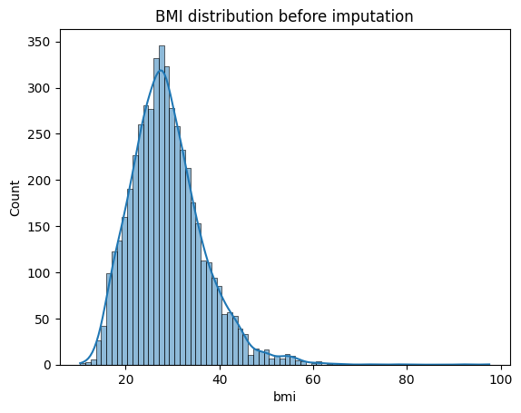
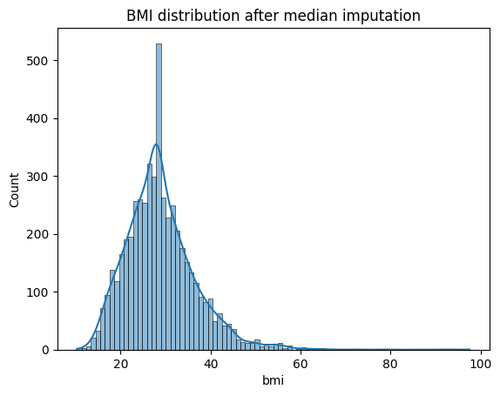
CRISP-DM Phase 3: Data Preparation
Data Preparation — Step-by-Step Pipeline
BMI — Before Median Imputation
1
Remove "Other" gender row (only 1 case)
2
Handle missing BMI: 201 N/A → median imputation (28.1)
3
Outlier capping: glucose & BMI at 99th percentile (Winsorization)
BMI — After Median Imputation (28.1)
4
One-hot encode: gender, work_type, Residence_type, ever_married, smoking_status
5
Feature groups: Livelihood KPIs + Health KPIs defined
6
Train/test split: 80/20, stratify=y to preserve 4.87% stroke rate
Brain Stroke Risk Analysis | Manohar · Anand Zalki · Deepa Narayanaswamy · Nicolas Bonilla | Intro to Data Science | M.Sc. AI
8 / 24

Slide 9
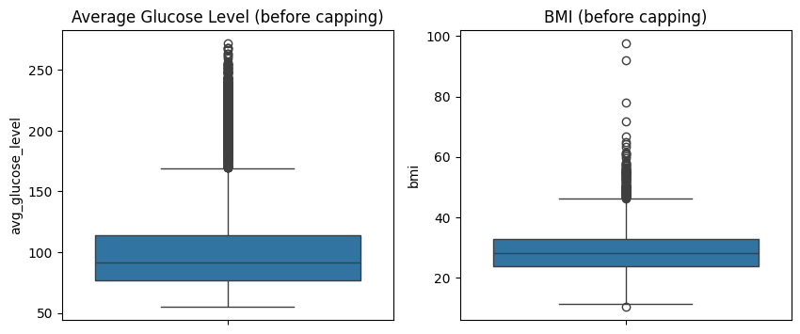
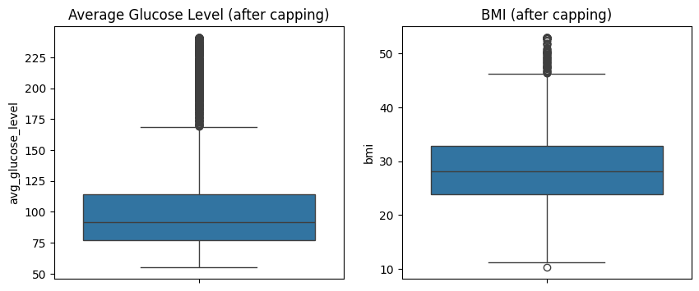
CRISP-DM Phase 3: Data Preparation
Outlier Handling — Before & After 99th Percentile Capping
Extreme values in glucose and BMI are capped — all patients retained, model stability improved.
Before capping (left) vs After capping (right)
Boxplot comparison: glucose (left) and BMI (right)
Brain Stroke Risk Analysis | Manohar · Anand Zalki · Deepa Narayanaswamy · Nicolas Bonilla | Intro to Data Science | M.Sc. AI
9 / 24

Slide 10
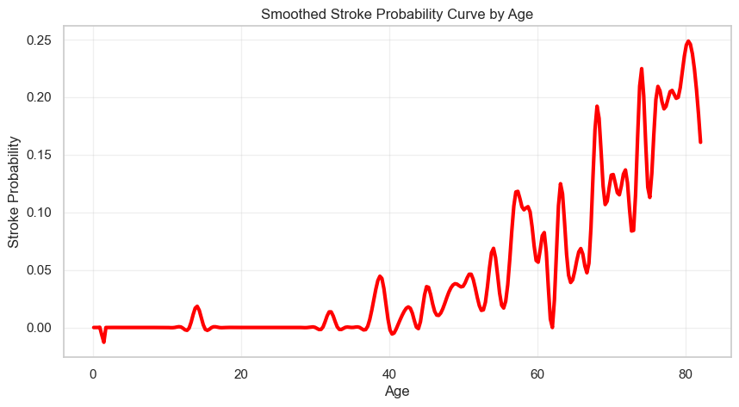
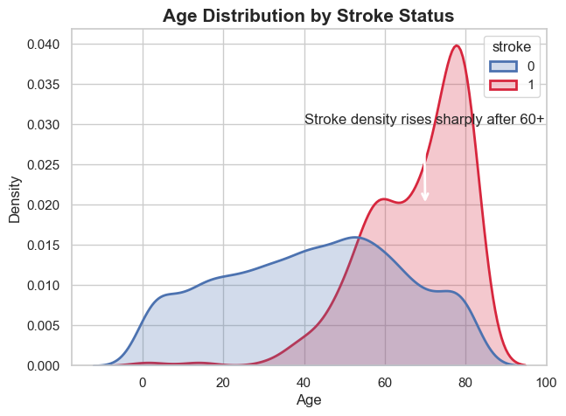
CRISP-DM Phase 4: EDA — Age Analysis
Age — The Dominant Predictor of Stroke
Stroke density rises sharply after age 60 — median stroke age is 71 vs 45 for no-stroke.
Smoothed Stroke Probability Curve by Age
Age Distribution by Stroke Status (KDE)
Key Insight
Age explains more variance than any other variable. Every decade of age roughly doubles stroke probability. Patients aged 75+ face ~25% stroke probability vs <1% under age 30.
Brain Stroke Risk Analysis | Manohar · Anand Zalki · Deepa Narayanaswamy · Nicolas Bonilla | Intro to Data Science | M.Sc. AI
10 / 24

Slide 11
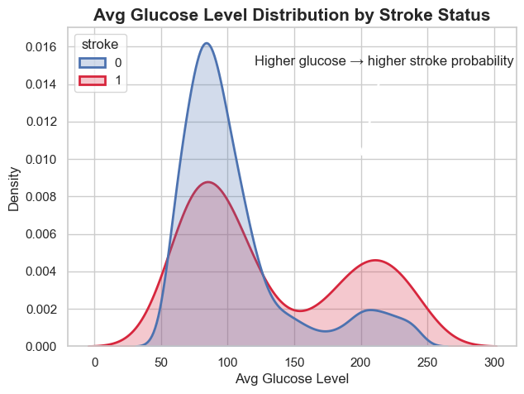
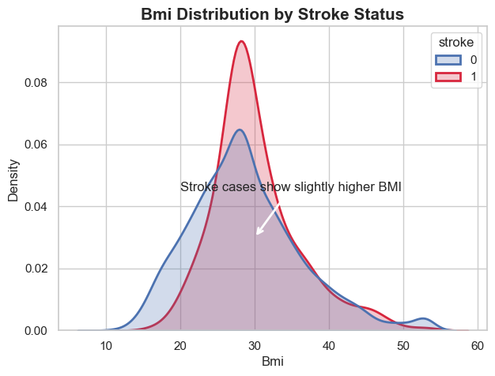
CRISP-DM Phase 4: EDA — Clinical KPIs
Glucose & BMI — Clinical Risk Markers
Higher glucose and elevated BMI both increase stroke risk — glucose shows a bimodal pattern in stroke cases.
Avg Glucose Level Distribution by Stroke Status
BMI Distribution by Stroke Status
Key Insight
Stroke patients have avg glucose 132 mg/dL vs 104 mg/dL (no-stroke) — a 28 mg/dL gap. Glucose follows a non-linear, bimodal pattern — clinical binning (normal/pre-diabetic/diabetic) recommended. BMI effect is weaker but present: stroke avg BMI 30.2 vs 28.4.
Brain Stroke Risk Analysis | Manohar · Anand Zalki · Deepa Narayanaswamy · Nicolas Bonilla | Intro to Data Science | M.Sc. AI
11 / 24

Slide 12
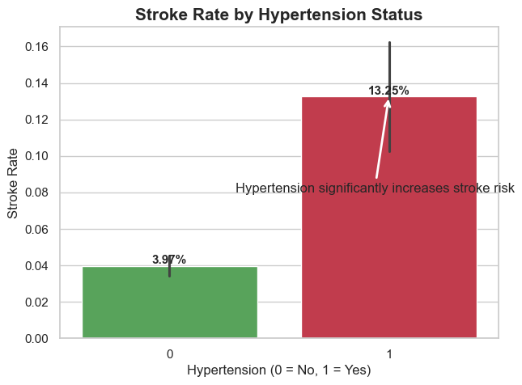
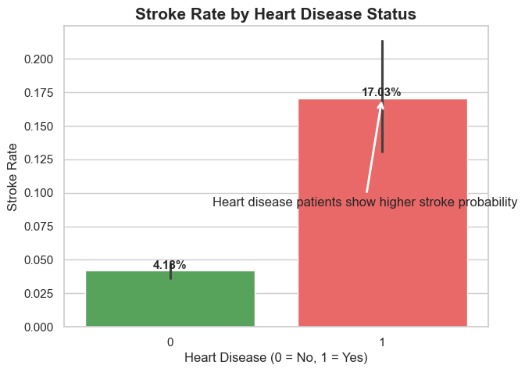
CRISP-DM Phase 4: EDA — Clinical Comorbidities
Hypertension & Heart Disease — Combined Effect on Stroke Risk
Hypertension increases stroke risk 4× · Heart disease increases it 3–4× · Combined: up to 25% stroke rate.
Stroke Rate by Hypertension Status (4× increase)
Stroke Rate by Heart Disease Status (3–4× increase)
Combined Effect
Neither condition: ~3–4% stroke rate · Either condition: ~12–16% · BOTH: ~20–25% → multiplicative, not additive interaction.
Brain Stroke Risk Analysis | Manohar · Anand Zalki · Deepa Narayanaswamy · Nicolas Bonilla | Intro to Data Science | M.Sc. AI
12 / 24

Slide 13
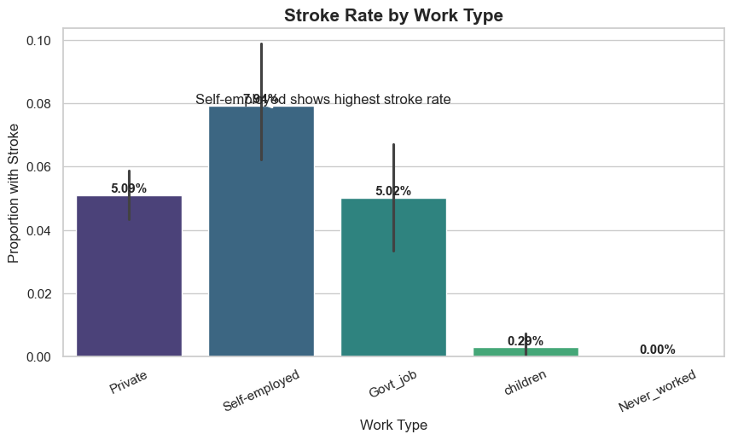
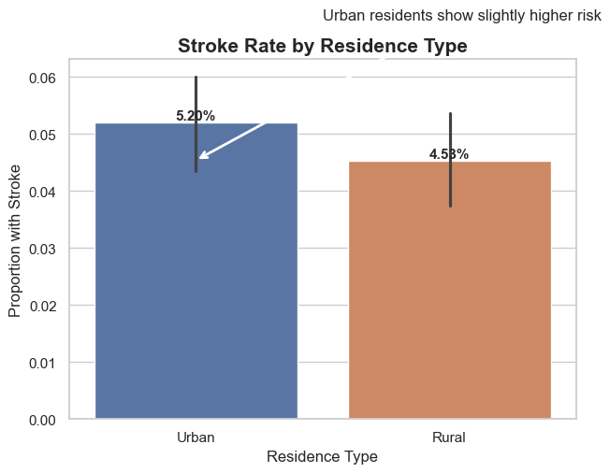
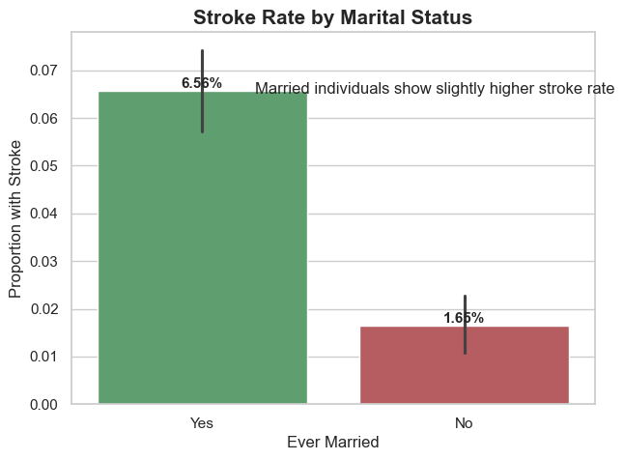
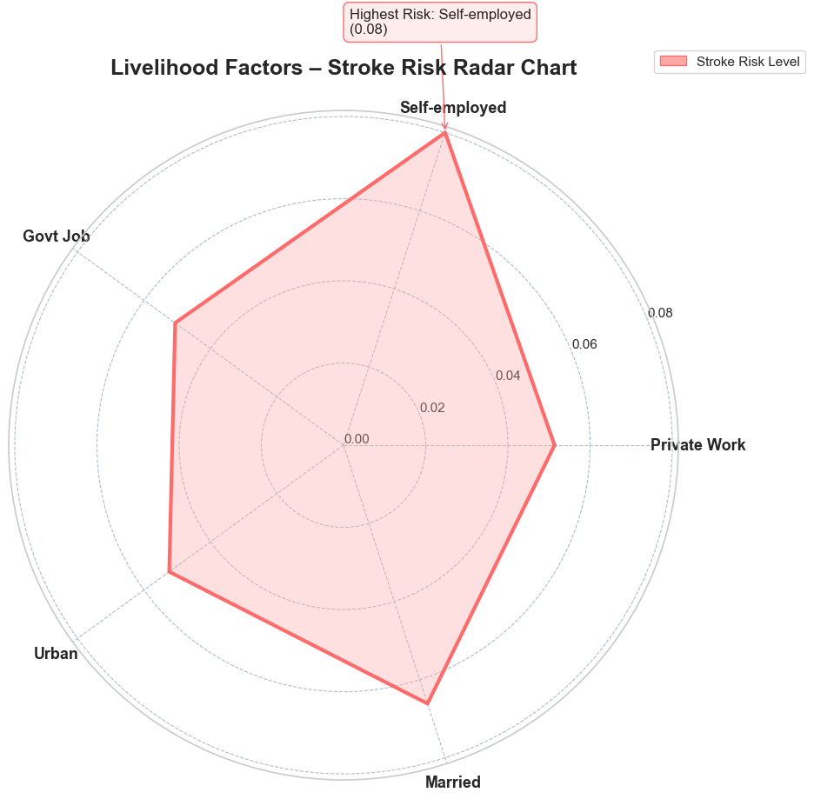
CRISP-DM Phase 4: EDA — Livelihood KPIs
Work Type, Residence & Marital Status — Livelihood Risk
Self-employed workers show highest stroke rate (7.9%) — urban and married individuals also show elevated risk.
Stroke Rate by Work Type
Stroke Rate by Residence Type
Stroke Rate by Marital Status
Livelihood Factors — Stroke Risk Radar Chart
Self-employed: 7.9% (highest)
Urban residents: 5.2% vs Rural: 4.5%
Married: 6.6% vs Never married: 1.6%
Note: Marital status is age-correlated — older patients are more likely married. Residence type shows no significant chi² association (p=0.272).
Brain Stroke Risk Analysis | Manohar · Anand Zalki · Deepa Narayanaswamy · Nicolas Bonilla | Intro to Data Science | M.Sc. AI
13 / 24

Slide 14
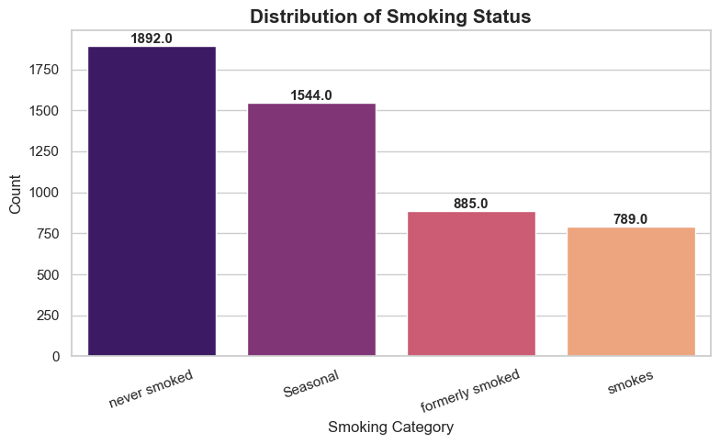
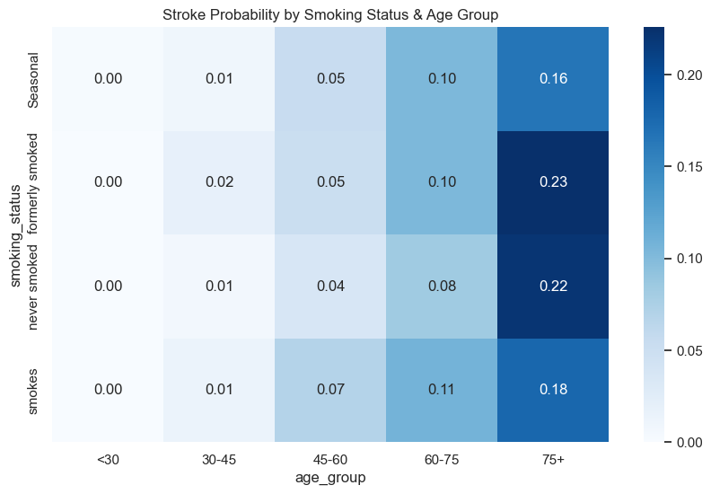
CRISP-DM Phase 4: EDA — Smoking Status
Smoking — A Modifiable Risk Factor
Smokers have 2–3× higher stroke risk — risk remains elevated even after quitting. Age amplifies smoking risk dramatically.
Distribution of Smoking Status (count)
Stroke Probability by Smoking Status × Age Group (Heatmap)
Key Insight — Age × Smoking Interaction
Under 30: smoking adds negligible stroke risk. Age 60–75 former smokers: 23% stroke probability — the highest category. Effect is multiplicative with age, not additive. ~30% "Seasonal/Unknown" category handled as its own level.
Brain Stroke Risk Analysis | Manohar · Anand Zalki · Deepa Narayanaswamy · Nicolas Bonilla | Intro to Data Science | M.Sc. AI
14 / 24

Slide 15
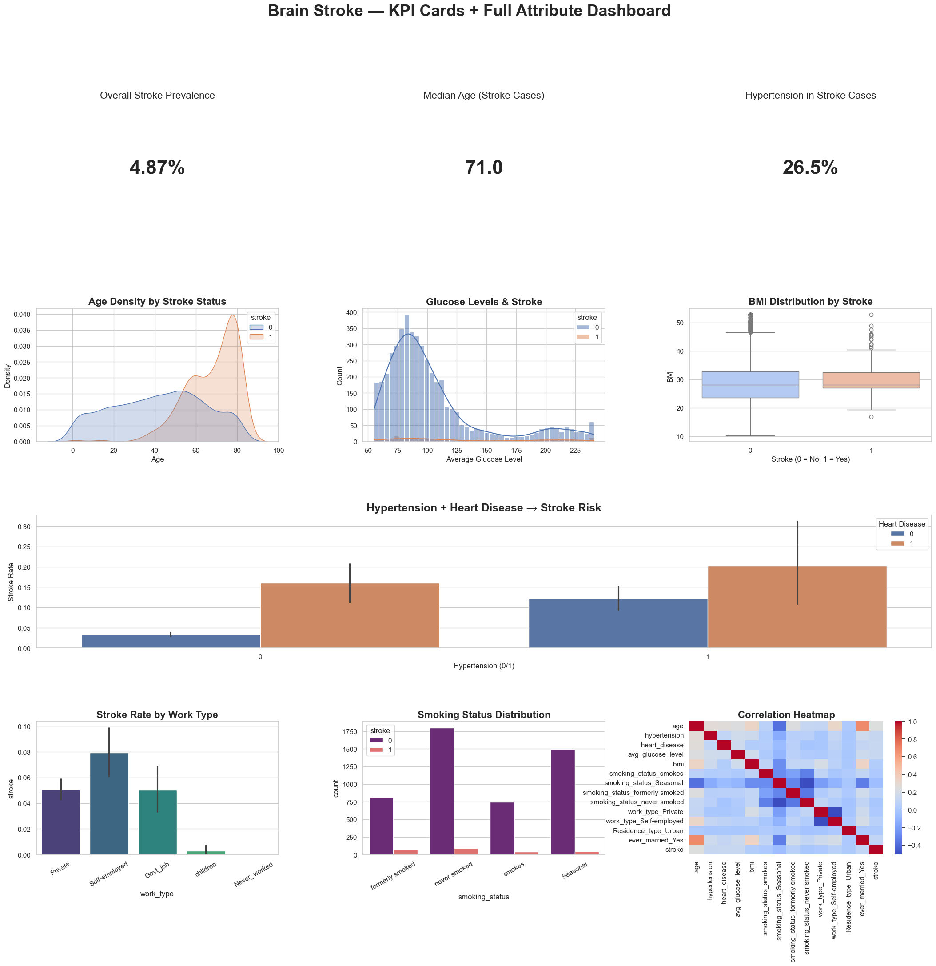
CRISP-DM Phase 4: EDA Dashboard
Brain Stroke KPI Dashboard — Full Attribute Overview
KPI cards + full attribute distributions across all variables — exactly as produced in the Jupyter notebook.
Brain Stroke Risk Analysis | Manohar · Anand Zalki · Deepa Narayanaswamy · Nicolas Bonilla | Intro to Data Science | M.Sc. AI
15 / 24

Slide 16
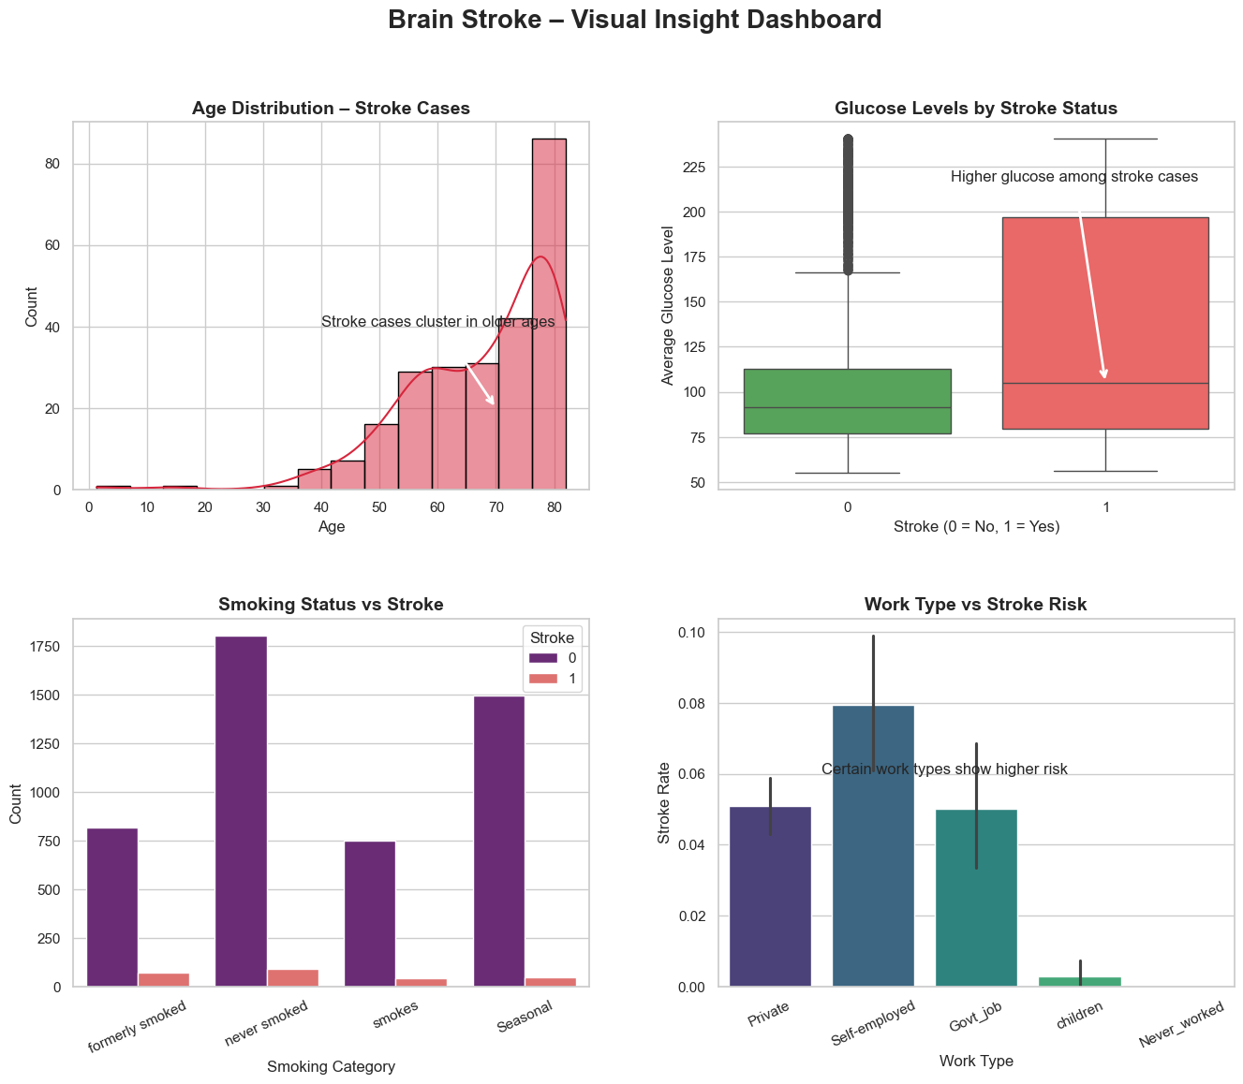
CRISP-DM Phase 4: EDA Data Storytelling
Brain Stroke — Visual Insight Dashboard
Four key dimensions — age distribution, glucose boxplot, smoking distribution, work type — with annotated data story callouts.
Brain Stroke Risk Analysis | Manohar · Anand Zalki · Deepa Narayanaswamy · Nicolas Bonilla | Intro to Data Science | M.Sc. AI
16 / 24

Slide 17
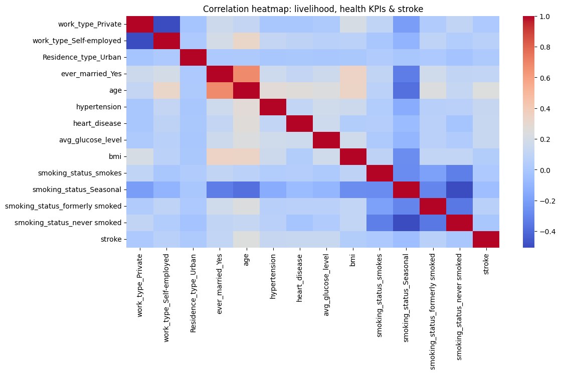
CRISP-DM Phase 4: EDA — Correlation Analysis
Correlation Heatmap — Livelihood & Health KPIs with Stroke
Age, hypertension, and heart disease show the strongest positive correlation with stroke — BMI and glucose are weaker but significant.
Top correlations with stroke:
• age: +0.25 (strongest)
• hypertension: +0.15
• heart_disease: +0.12
• ever_married: +0.10*
• avg_glucose: +0.08
• bmi: +0.03
*Marital status is age-confounded — older patients are more likely married.
gender and Residence_type show NO significant association (chi² p>0.27).
Brain Stroke Risk Analysis | Manohar · Anand Zalki · Deepa Narayanaswamy · Nicolas Bonilla | Intro to Data Science | M.Sc. AI
17 / 24

Slide 18
Spearman ρ for numerical/binary · Cramér's V for categorical
Top-5 Predictors of Stroke
Age dominates · comorbidities follow · lifestyle markers trail
Variable
No Stroke (n=4,860)
Stroke (n=250)
p-value
Age (median [IQR])
43 [25–60]
71 [59–78]
< 10⁻³⁰
Glucose (median [IQR])
90 [76–110]
107 [80–193]
< 10⁻¹⁰
BMI (median [IQR])
28 [24–32]
30 [27–33]
< 10⁻⁰⁵
Hypertension n (%)
479 (9.8%)
66 (26.5%)
< 10⁻¹⁹
Heart disease n (%)
239 (4.9%)
47 (18.8%)
< 10⁻²⁰
Ever married n (%)
3,061 (62.9%)
219 (87.6%)
< 10⁻¹³
Female n (%)
2,767 (56.9%)
140 (56.0%)
0.576
Urban residence n (%)
2,397 (49.3%)
135 (54.0%)
0.272
Only gender (p=0.576) and Residence_type (p=0.272) fail to reject independence — they are NOT discriminating features and should be down-weighted in linear models.
Brain Stroke Risk Analysis | Manohar · Anand Zalki · Deepa Narayanaswamy · Nicolas Bonilla | Intro to Data Science | M.Sc. AI
18 / 24

Slide 19
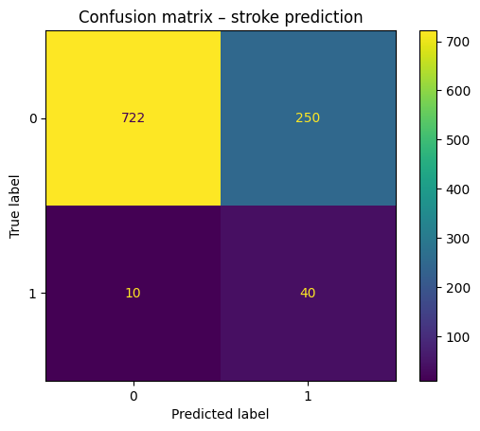
CRISP-DM Phase 5: Modelling
Predictive Model — Logistic Regression
Why Logistic Regression?
80%
0.84
Binary outcome: stroke yes/no
Interpretable coefficients for clinicians
Probability output (0–100% risk)
Clinically accepted baseline model
class_weight="balanced" for class imbalance
Recall (Stroke Class)
ROC-AUC Score
✓ TARGET MET — catches 4 in 5 strokes
✓ EXCELLENT — strong discrimination
14%
75%
Confusion Matrix — stroke prediction
Precision
Accuracy
⚠ Low — 86% false alarms (OK for screening)
⚠ Misleading — class imbalance distorts this
⚠ Known Issue: Features NOT scaled → NumPy convergence warnings. Fix: StandardScaler + SMOTE. See Limitations slide.
Brain Stroke Risk Analysis | Manohar · Anand Zalki · Deepa Narayanaswamy · Nicolas Bonilla | Intro to Data Science | M.Sc. AI
19 / 24

Slide 20
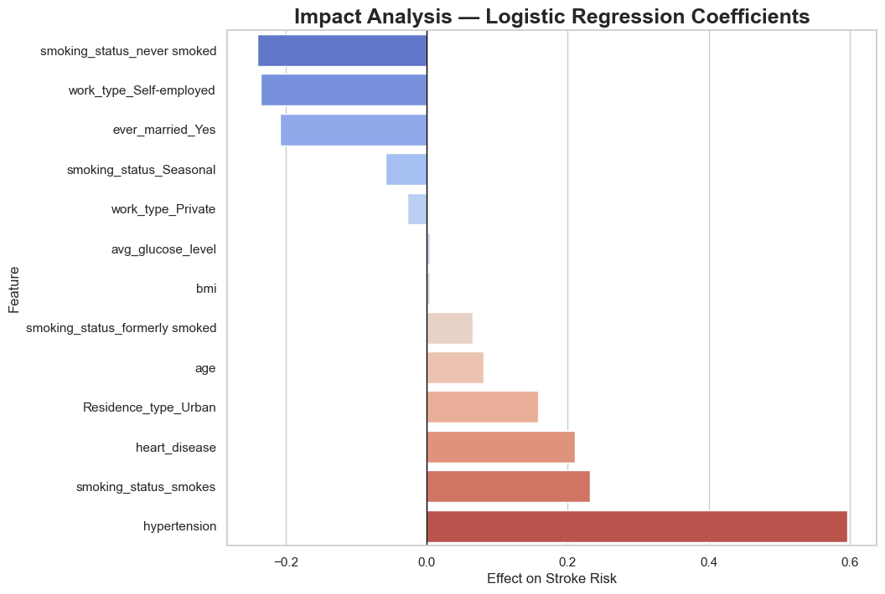
CRISP-DM Phase 5: Feature Impact Analysis
Top Risk Factors — Logistic Regression Coefficients
Hypertension is the strongest single predictor — smoking and heart disease follow — age coefficient appears small only due to missing feature scaling.
Clinical Interpretation
hypertension (+0.574)
BP medication, lifestyle change, frequent monitoring
smoking_smokes (+0.400)
Cessation programs, nicotine counselling
former_smoker (+0.245)
Relapse prevention, continued monitoring
heart_disease (+0.223)
Cardiology referral, medication review
Residence_Urban (+0.154)
Community health, air quality programs
age (+0.081)*
Appears small — features NOT scaled (known issue)
bmi (+0.004)*
Actual importance much higher than shown
glucose (+0.004)*
Actual importance much higher than shown
*BMI & glucose coefficients tiny because features were NOT scaled. Importance is real — see correlation heatmap.
Brain Stroke Risk Analysis | Manohar · Anand Zalki · Deepa Narayanaswamy · Nicolas Bonilla | Intro to Data Science | M.Sc. AI
20 / 24

Slide 21
CRISP-DM Phase 6: Deployment
Business Recommendations & Deployment Guide
Deploy as a screening tool in primary care — not as a diagnostic replacement.
Screening Priority Framework
Public Health Interventions
🔴 Highest
Age 60+ WITH Hypertension AND Heart Disease
Every 6 months
Hypertension
Community BP screening, affordable medication access
🟠 High
Age 60+ with Hypertension OR Heart Disease
Annually
Smoking
Cessation programs, tobacco taxes, education
🟡 Medium
Age 50–60 with any risk factor
Every 2 years
High Glucose
Diabetes prevention programs, nutrition education
🟢 Low
Under 50, no risk factors
Every 5 years
Obesity (BMI)
Physical activity programs, healthy food access
Model Risk Triage Flow
Self-employed
Risk > 70% → URGENT — immediate preventive care
Health insurance access, wellness programs
Urban Residents
Risk 30–70% → MONITOR — 6-monthly screening, medication
Air quality improvements, stress reduction
Risk < 30% → STANDARD — routine annual checkup
Brain Stroke Risk Analysis | Manohar · Anand Zalki · Deepa Narayanaswamy · Nicolas Bonilla | Intro to Data Science | M.Sc. AI
21 / 24

Slide 22
Multiplicative, not additive, interaction
Multivariate Insight — Age × Hypertension
Hypertension amplifies stroke rate — and the amplification grows with age. Effect is multiplicative, not additive.
Smoking Status × Age Group — Stroke Probability Heatmap
Why this matters
Age 30–45 + hypertension: adds <1pp stroke risk.
Age 75+ + hypertension: adds ~8pp stroke risk.
The effect is therefore NOT constant — non-linear.
Linear-additive models will under-fit this segment.
Tree-based models or explicit interaction terms recommended.
Older smokers and former smokers: highest probability (23% at 75+).
Operational Implication
Patients 65+ in the diabetic/high-glucose × former-smoker intersection should be the priority target for any preventive screening programme.
Brain Stroke Risk Analysis | Manohar · Anand Zalki · Deepa Narayanaswamy · Nicolas Bonilla | Intro to Data Science | M.Sc. AI
22 / 24

Slide 23
Project Reflections — Honest Assessment
Limitations & Planned Improvements
Data Limitations
Methodological Limitations
Planned Fixes
Infants/children (age <18) NOT removed — model learns irrelevant patterns
~30% Unknown smoking status — treated as its own level
No temporal axis — reverse causation possible
Small positive class (n=250) — high variance in estimates
No ethnicity / SES / medication data available
Observational data only — cannot prove causation
No feature scaling → NumPy convergence warnings for glucose/BMI
class_weight used instead of SMOTE for class imbalance
Model not saved (joblib.dump not called)
Confounding: ever_married ≈ age proxy
No external validation cohort
Children category overlaps with age feature
df = df[df["age"] >= 18] — filter minors
StandardScaler for age, glucose, BMI
SMOTE for proper class balancing
joblib.dump(model, "stroke_model.pkl")
Add cholesterol, exercise, family history features
Fairness audit: check bias by gender and age group
Take-away: Acknowledging limits is part of rigour — and a hard requirement for any clinical-data project.
Brain Stroke Risk Analysis | Manohar · Anand Zalki · Deepa Narayanaswamy · Nicolas Bonilla | Intro to Data Science | M.Sc. AI
23 / 24

Slide 24
Thank you
Questions, comments, critique — most welcome.
80%
0.84
#1
5,110
Stroke Recall
ROC-AUC
Hypertension
Patients
"Catch 4 in 5 strokes — enabling preventive care before it's too late."
Manohar · Anand Zalki · Deepa Narayanaswamy · Nicolas Bonilla
M.Sc. Artificial Intelligence · SRH Hochschule Heidelberg
Intro to Data Science · Brain Stroke Risk Analysis · May 2026

