Slide 1
IBM University Engagement Project Submission
“Exploring the Power of Agentic AI with IBM Granite and LangFlow”

Slide 2

Project Title – College Admission Agent (RAG-Powered)
Domain of Project – Education
Student Name | Recent Passport Photo | Email ID | Mobile number [WhatsApp]
Deep Dhamecha |  | deep.dhamecha122957@marwadiuniversity.ac.in | 9998075614

Slide 3
Problem Statement -
Problem Statement : College Admission Agent
The Challenge
The college admission process is one of the most critical and stressful experiences for students and their families. Prospective students often struggle to find accurate, up-to-date information about eligibility criteria, application deadlines, fee structures, scholarship opportunities, and admission procedures. This information is typically scattered across multiple web pages, PDF brochures, and institutional portals, making it difficult to get quick, reliable answers.
The Objective
Build an AI-powered College Admission Agent that delivers accurate, personalized, and instant responses to student queries about college admissions. The solution should:
Intelligent Query Resolution – Answer questions about eligibility criteria, deadlines, fees, scholarships, and application procedures using RAG-based retrieval from official admission documents.
Context-Aware Responses – Retrieve relevant context from official college admission data and generate accurate, grounded answers using IBM Granite models.
Semantic Search – Use vector embeddings (ChromaDB + HuggingFace all-MiniLM-L6-v2) to perform semantic search over admission documents for precise information retrieval.
User-Friendly Chat Interface – Provide a modern, glassmorphic React-based chat UI with suggested questions for easy interaction.
IBM watsonx Orchestrate Integration – Enable the agent to be imported as a Custom Skill in IBM watsonx Orchestrate via OpenAPI specification.
Scalable Architecture – Built with FastAPI backend and React frontend, designed for easy deployment and scaling on IBM Cloud.

Slide 4
Technology Used
Tech Stack (Mandatory)
Use any one of the following approaches:
LangFlow + IBM watsonx.ai + Granite Models
IBM Cloud Agentic Lab with IBM Granite Models
Replicate with LangChain + RAG + IBM Granite Models
I used Replicate with LangChain + RAG + IBM Granite Models
Specific Technologies:
Frontend: React, Vite, Vanilla CSS (Glassmorphism & Light Theme)
Backend: Python, FastAPI, Uvicorn
AI/LLM: LangChain, IBM watsonx.ai (Granite ibm/granite-8b-code-instruct)
Vector DB: ChromaDB with HuggingFace Embeddings (all-MiniLM-L6-v2)
API Spec: OpenAPI 3.1.0 for IBM watsonx Orchestrate integration

Slide 5
Proposed Solution -
Proposed Solution: AI-Powered College Admission Agent
The proposed solution is a RAG-powered College Admission Agent built using LangChain, IBM watsonx.ai, and Granite Models to provide accurate, real-time answers to student queries about college admissions. The system addresses challenges in finding reliable admission information through an intelligent, modular architecture.
At its core, the solution uses a Retrieval-Augmented Generation (RAG) pipeline to fetch accurate admission data from official college documents. This data is chunked, embedded using HuggingFace all-MiniLM-L6-v2, and stored in a ChromaDB vector database, enabling the system to retrieve and summarize admission details (eligibility, fees, deadlines, scholarships) using IBM Granite models.
The system architecture consists of:
FastAPI Backend – Serves as the REST API layer, handling query requests and orchestrating the RAG pipeline with IBM watsonx.ai for LLM inference.
RAG Pipeline – Loads admission documents, splits them into chunks (500 chars, 50 overlap), embeds them in ChromaDB, and retrieves top-3 relevant chunks for each query.
IBM Granite LLM – Uses ibm/granite-8b-code-instruct model via watsonx.ai for generating context-grounded answers with greedy decoding.
React Chat Interface – A modern, glassmorphic UI built with Vite that provides an intuitive chat experience with suggested FAQ questions and source snippet display.
The solution includes IBM watsonx Orchestrate integration via a pre-configured OpenAPI specification, allowing the admission agent to be imported as a Custom Skill for enterprise automation.
LangChain orchestrates the retrieval and generation pipeline, while watsonx.ai ensures scalable model deployment and AI governance. Granite models power reasoning, summarization, and accurate answer generation.
Overall, this solution delivers an end-to-end intelligent college admission assistant that helps students get instant, accurate answers about admissions, reducing workload on admission offices and improving the student experience.

Slide 6
LangChain Components Used -
1) Chat Input – React-based chat interface where students type their admission-related queries (eligibility, fees, deadlines, etc.).
2) IBM watsonx AI Agent - Processes user queries using IBM Granite model (ibm/granite-8b-code-instruct) via watsonx.ai to generate accurate, context-aware admission responses.
3) Name of IBM Granite model - ibm/granite-8b-code-instruct → Efficient for real-time admission query resolution with greedy decoding, max 512 new tokens.
4) Chat Output – Displays AI-generated responses including admission details, eligibility criteria, fee breakdowns, and scholarship information along with source snippets.
5) Document Loader (TextLoader) – Loads official college admission data files for processing and embedding into the vector store.
6) RecursiveCharacterTextSplitter – Splits admission documents into 500-character chunks with 50-character overlap for optimal RAG retrieval.
7) ChromaDB Vector Store – Stores and retrieves embedded admission document chunks using HuggingFace all-MiniLM-L6-v2 sentence transformer embeddings for semantic search.
8) RetrievalQA Chain (LangChain) – Orchestrates the end-to-end RAG pipeline combining retriever, prompt template, and LLM for grounded answer generation.

Slide 7
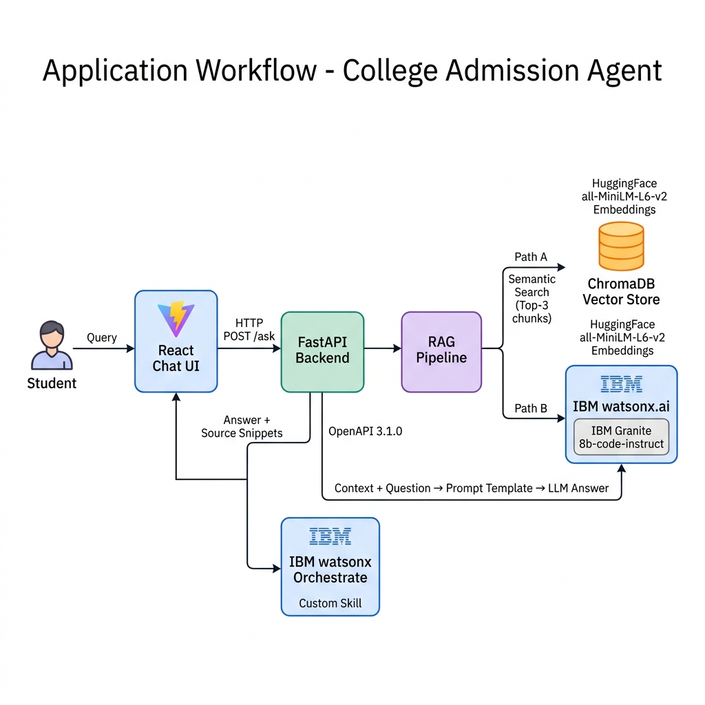
Application Workflow -

Slide 8
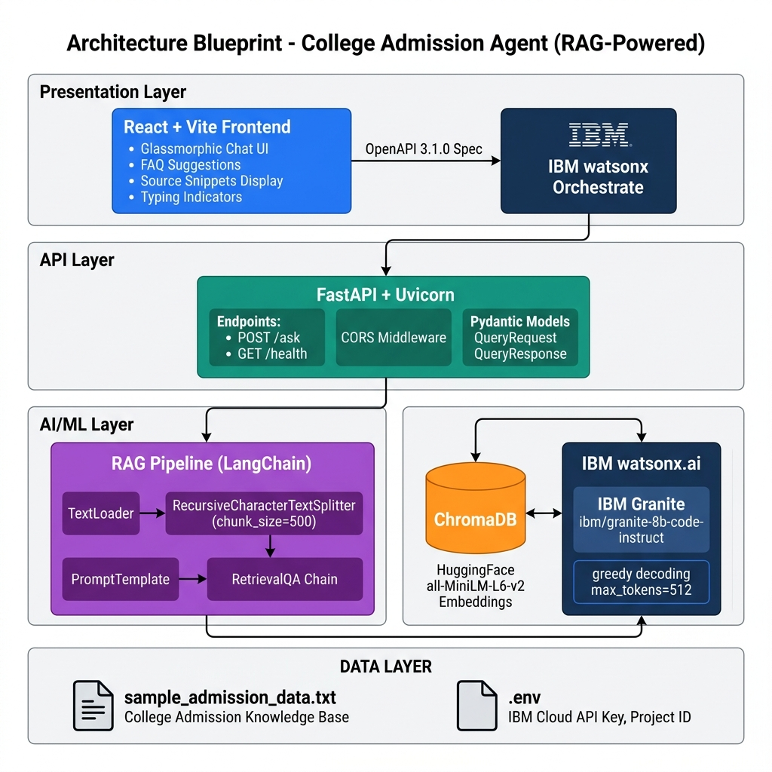
Architecture blueprint

Slide 9
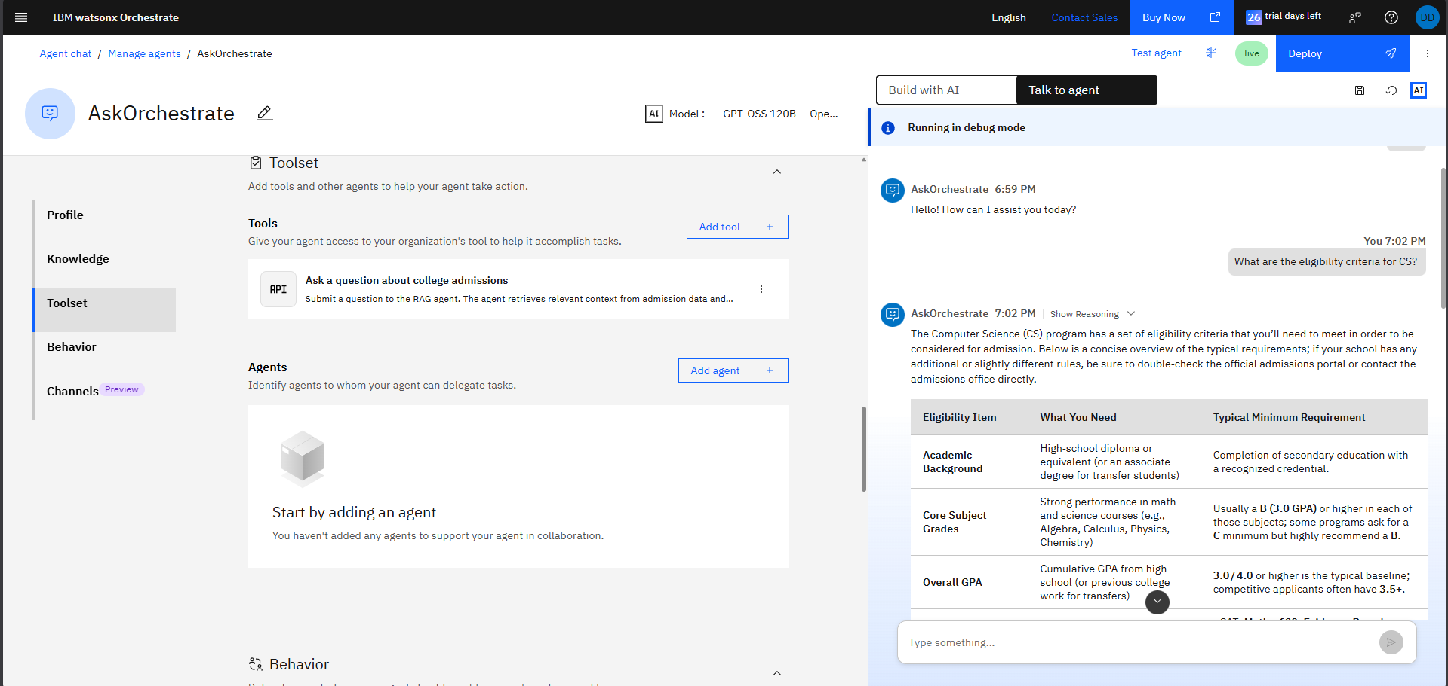
Result

Slide 10
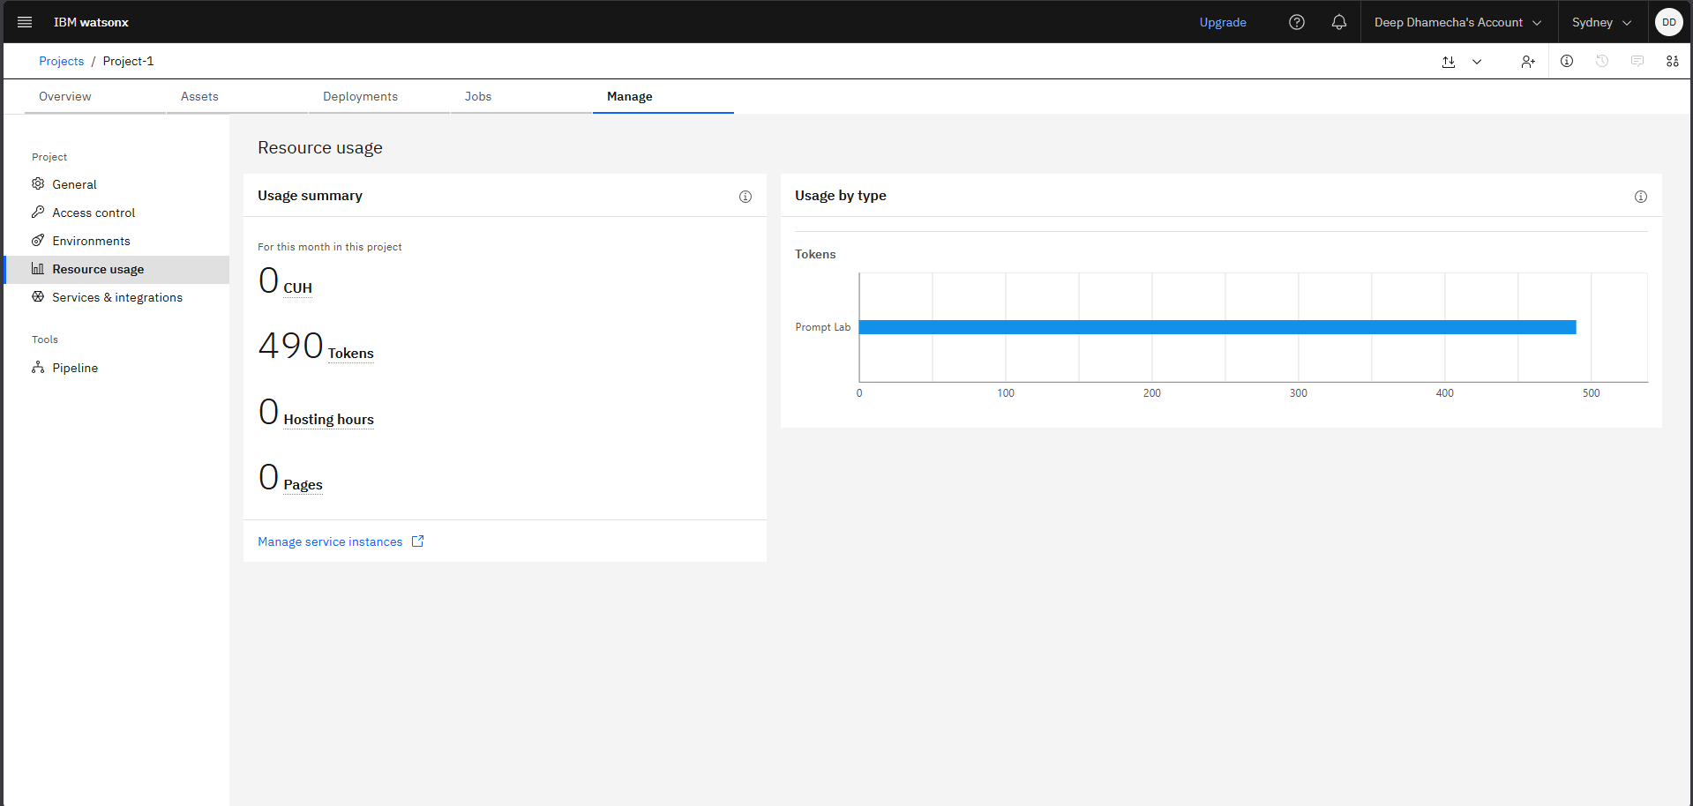
Tokens Used

Slide 11

Role of Agentic AI in the Solution
Role of Agentic AI in College Admission Agent
Agentic AI enables the College Admission Agent to function as an intelligent, autonomous assistant rather than a simple FAQ chatbot. Using IBM watsonx.ai and IBM Granite models, it dynamically retrieves, reasons over, and generates personalized answers to student queries.
The agent operates with a RAG-based reasoning pipeline that autonomously decides which context to retrieve from the vector database based on the student’s question. Rather than returning pre-written answers, it generates fresh, context-grounded responses by combining retrieved document chunks with the Granite model’s reasoning capabilities.
Key aspects of Agentic AI in this solution:
Autonomous Retrieval – The agent independently searches the ChromaDB vector store to find the top-3 most relevant admission document chunks for each query, without manual intervention.
Context-Aware Reasoning – Using the PromptTemplate and LangChain chain, the agent contextualizes its answers based on the specific admission data retrieved, ensuring responses are accurate and institution-specific.
Dynamic Response Generation – Instead of static responses, the Granite model generates natural language answers that adapt to the phrasing and intent of each query.
Transparent Source Attribution – The agent provides source snippets alongside answers, allowing students to verify the information and building trust in the system.
Orchestration Ready – Through OpenAPI integration with IBM watsonx Orchestrate, the agent can be embedded into larger enterprise workflows, acting as an autonomous skill that other agents can invoke.
Overall, Agentic AI makes the system proactive, intelligent, and self-directed, acting like a knowledgeable admission counselor available 24/7 to assist students with their admission journey.

Slide 12
Technology Used
LangChain Framework – For building and orchestrating the RAG pipeline, connecting document loaders, text splitters, vector stores, and LLM into a cohesive retrieval-augmented generation workflow.
IBM Granite Model – ibm/granite-8b-code-instruct – For natural language understanding, context-aware reasoning, and generating accurate admission-related responses with greedy decoding strategy.
IBM Cloud & watsonx.ai – Provides the infrastructure for deploying and accessing IBM Granite models. IBM watsonx.ai enables scalable model inference, embeddings, and AI governance for the admission agent.
RAG (Retrieval-Augmented Generation) – Fetches relevant admission data from the vector store first, then generates intelligent, grounded answers, making the College Admission Agent more trustworthy and accurate.
ChromaDB (Vector Database) – For storing and retrieving embedded admission document chunks using semantic similarity search, enabling precise information retrieval.
HuggingFace Sentence Transformers (all-MiniLM-L6-v2) – For generating high-quality sentence embeddings of admission documents for semantic search.
FastAPI & Uvicorn – High-performance Python web framework for serving the RAG API with automatic OpenAPI documentation.
React + Vite – Modern, fast frontend framework for building the glassmorphic chat interface with real-time interaction capabilities.
IBM watsonx Orchestrate – For importing the admission agent as a Custom Skill via OpenAPI specification, enabling enterprise-grade workflow automation.

Slide 13
Novelty and Uniqueness
The proposed College Admission Agent stands out by combining RAG, IBM Granite AI, and modern web technologies into a single intelligent admission assistance system.
RAG-Based Accuracy – Instead of relying on pre-trained knowledge that may be outdated, the system retrieves real-time data from official admission documents, ensuring trustworthy and up-to-date responses.
IBM Granite-Powered Intelligence – Uses ibm/granite-8b-code-instruct for high-quality reasoning and natural language generation, producing human-like responses grounded in factual data.
Local Semantic Search – Employs HuggingFace all-MiniLM-L6-v2 embeddings with ChromaDB for fast, local semantic search without requiring API calls for embeddings, ensuring speed and privacy.
Transparent Source Attribution – Every response includes source snippets from the original admission documents, building trust and allowing students to verify information.
Glassmorphic Modern UI – Features a premium React-based chat interface with glassmorphism design, suggested questions, typing indicators, and responsive layout for an engaging user experience.
Enterprise Integration Ready – Pre-configured OpenAPI 3.1.0 specification allows instant import into IBM watsonx Orchestrate as a Custom Skill, enabling seamless enterprise workflow automation.
Modular & Extensible Architecture – Clean separation of frontend (React+Vite) and backend (FastAPI+LangChain) makes it easy to swap models, add data sources, or scale the system.
This makes the solution a smart, reliable, and enterprise-ready digital admission counselor, not just a static FAQ page.

Slide 14
Git Hub Link
GitHub Repository URL:
https://github.com/Deep-tech-1314/college-admission-agent
Files uploaded in the repository:
1) openapi.yaml – OpenAPI 3.1.0 specification for IBM watsonx Orchestrate integration
2) README.md – Complete project documentation with setup instructions
3) backend/app.py – FastAPI server with /ask and /health endpoints
4) backend/rag_pipeline.py – RAG pipeline with LangChain, ChromaDB, IBM Granite
5) frontend/src/App.jsx – React chat interface with glassmorphic UI
6) backend/data/sample_admission_data.txt – College admission knowledge base
7) projectpresentation.pptx – Project presentation file
·
·
·

Slide 15
Future Scope
1. Multi-University Support & Comparative Analysis –
The system can be extended to ingest admission data from multiple universities, enabling students to compare eligibility criteria, fee structures, and deadlines across institutions. This would transform the agent into a comprehensive college search and comparison tool powered by RAG.
2. Voice-Enabled & Multilingual Support –
Enhancing the system with speech-to-text input and multilingual capabilities will improve accessibility. Students can interact naturally in their preferred language (Hindi, Spanish, etc.), making the solution more inclusive for diverse populations, especially first-generation college applicants.
3. Personalized Application Tracking & Recommendations –
Integrating user authentication and profile management would allow the agent to track individual application progress, send deadline reminders, and recommend colleges based on the student’s academic profile, preferences, and financial situation using AI-driven matching algorithms.
4. Integration with IBM watsonx Orchestrate for End-to-End Automation –
Leveraging IBM watsonx Orchestrate, the agent can be combined with other enterprise skills (email, calendar, document processing) to automate the entire admission workflow – from answering queries to scheduling campus visits, submitting documents, and processing fee payments.
·
·
·

Slide 16


